Slide 1
Observatory Publications April 2022 Update 2016 -2020
Dennis Crabtree NRC Herzberg Astronomy & Astrophysics

Slide 2
Introduction
This update includes data for 2016 – 2022 publications
Citations updated March 2022
UKIRT data is preliminary
Productivity numbers for multi-telescope facilities divided by the # of telescopes to give productivity per telescope.
ApJ used as the journal used to normalize citations for the “age effect”.
The impact of a paper is the ratio of the number of citations that paper has received to the citation count for the median ApJ paper of the same year
AIPP – Average Impact per Paper; MIPP – Median Impact per Paper

Slide 3
Productivity
The following slide shows telescope productivity for the period 2016 – 2020
Productivity is the number of papers per telescope – multi-telescope facilities such as Keck have their numbers normalized
ALMA’s productivity appears to have levelled off
HST continues to be a paper producing machine!

Slide 4
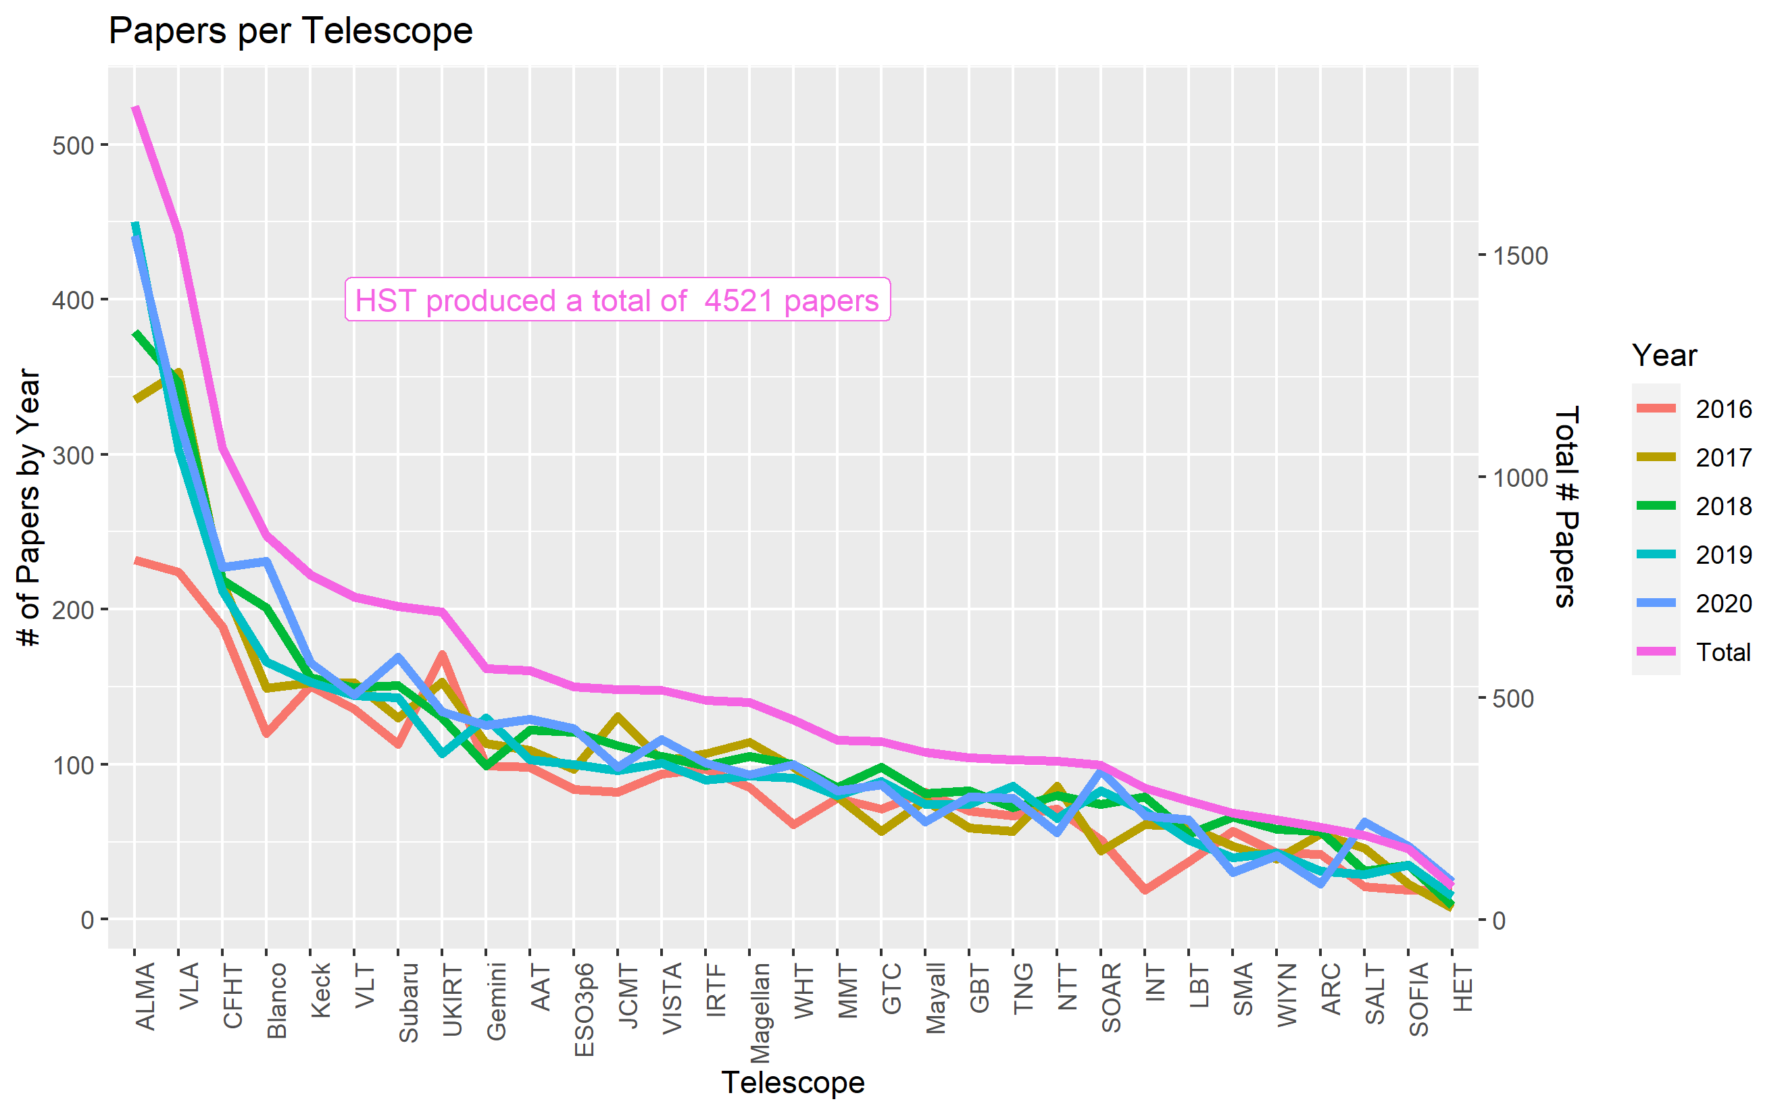

Slide 5
Impact
The following two slides show telescope impact per paper
Recall that impact of a paper is defined as the number of citations to the paper divided by the number of citations received by the median ApJ paper of the same year
The next slide show Average Impact per Paper (AIPP) and Median Impact per Paper (MIPP) for the 5-year period
It also shows the Gini coefficient which is a measure of inequality in the impact distribution
The second following slide is a box and whisker plot. The line is the AIPP while the line inside the box is the MIPP. The ends of the box represent the upper and lower quartile while end of the ‘whiskers’ represent the 0.1 and 0.9 quantiles

Slide 6
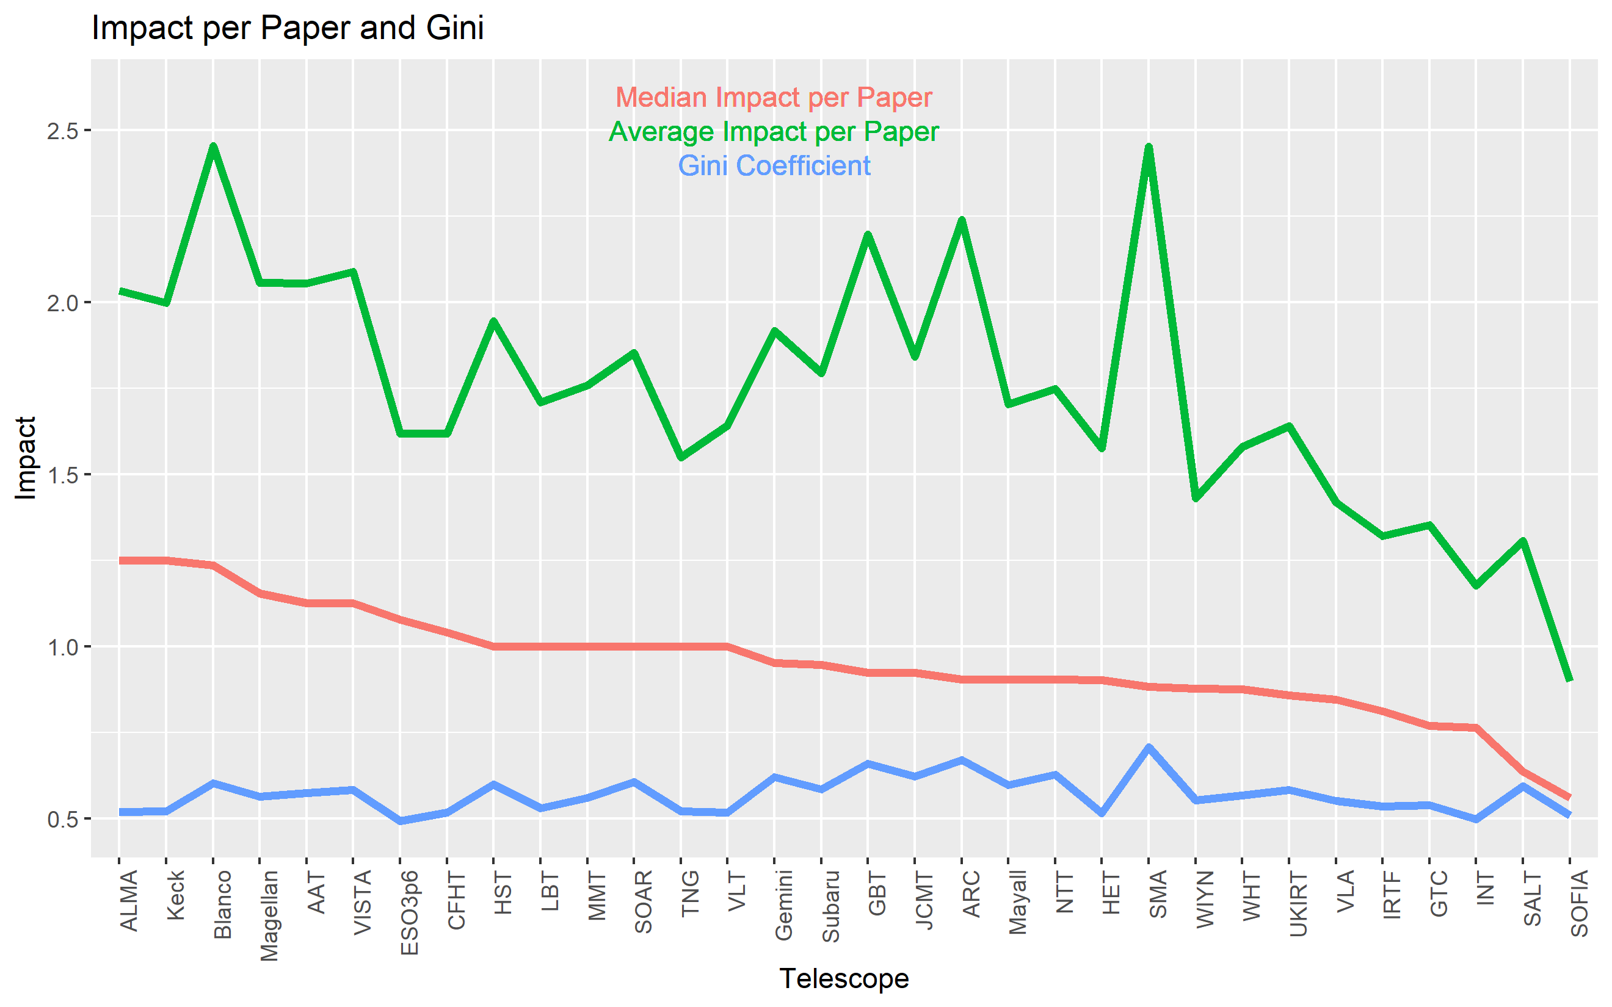

Slide 7
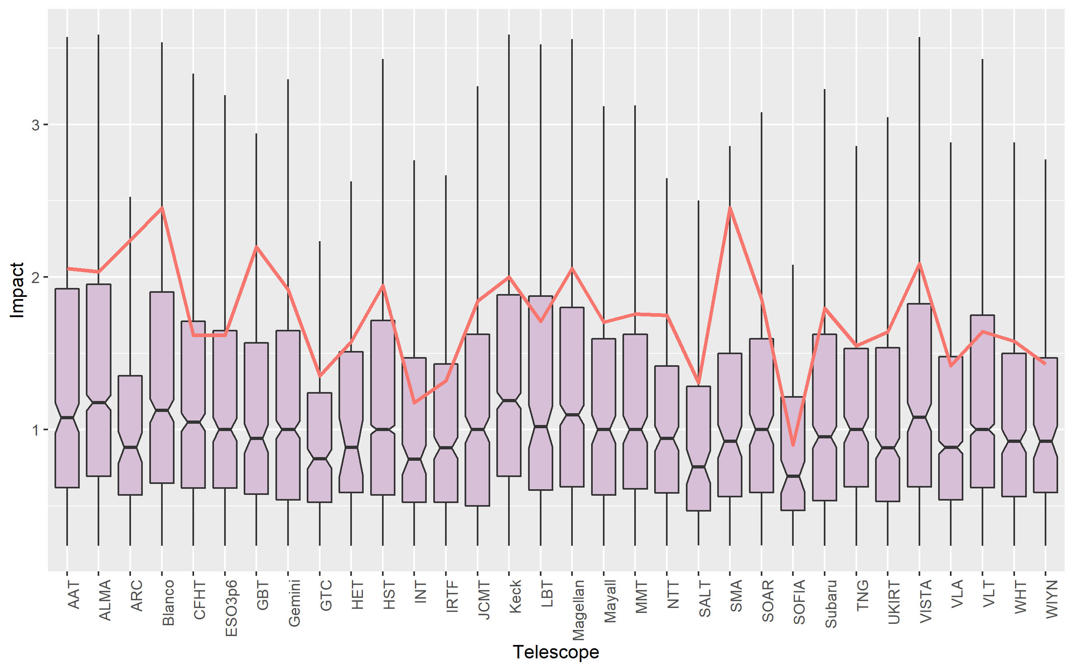

Slide 8
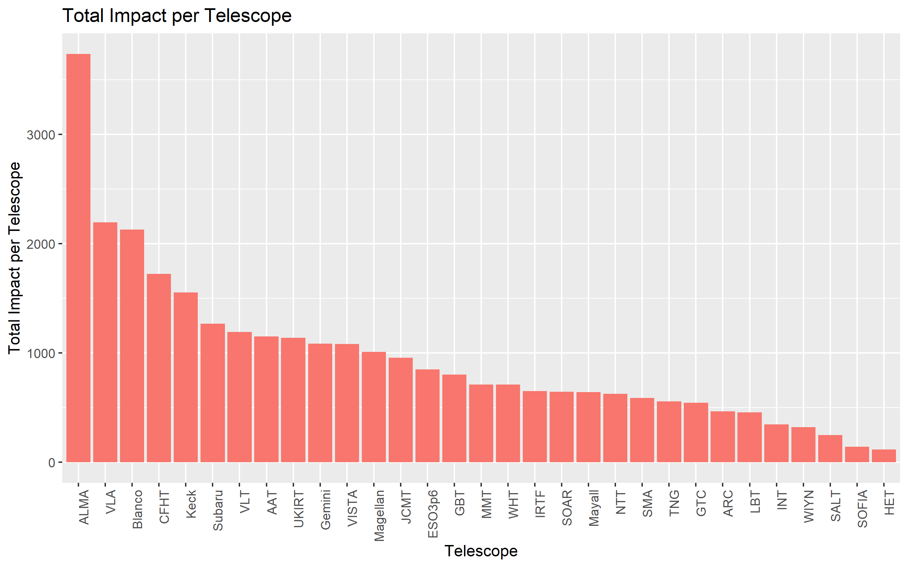

Slide 9
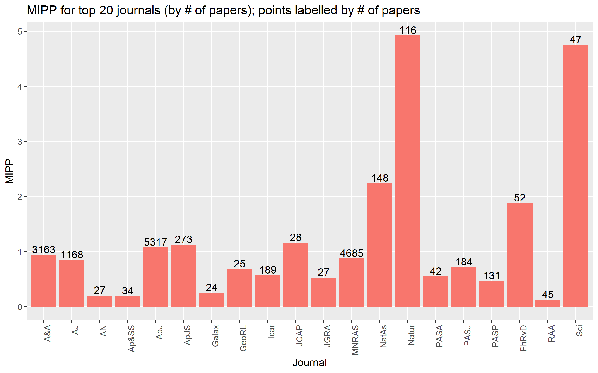

Slide 10
High Impact Papers
Another performance metric is the number or fraction of high impact papers
I define a paper as being high impact if it is in the 90th percentile of the complete distribution of papers
The following plot shows the percentage of a telescope’s papers that are high impact for each telescope

Slide 11
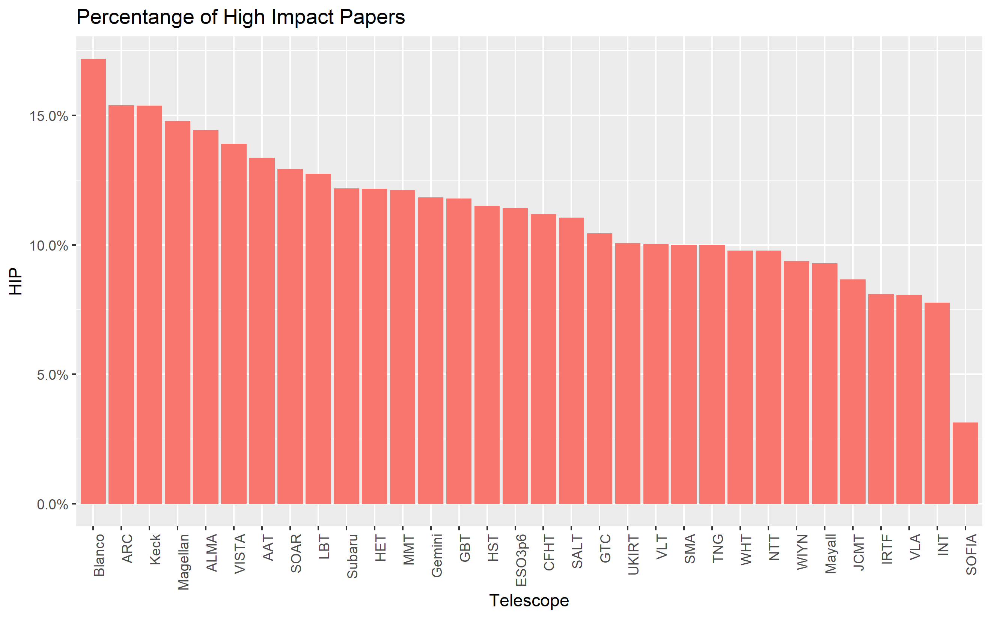

Slide 12
Single Telescope Papers
Single telescope (ST) papers are those that are based on data from a single telescope
The plot on the following page compares ST papers to all papers for each telescope
The purple line is the % of ST papers. The orange line is the ratio of AIPP for ST papers to AIPP for all papers
On average ST papers represent 41% of a telescope’s bibliography and these papers have an impact of 79% that of all papers
The bottom two lines show the % of high impact papers for ST(teal) and all papers (green). In general a smaller fraction of ST papers are high impact

Slide 13
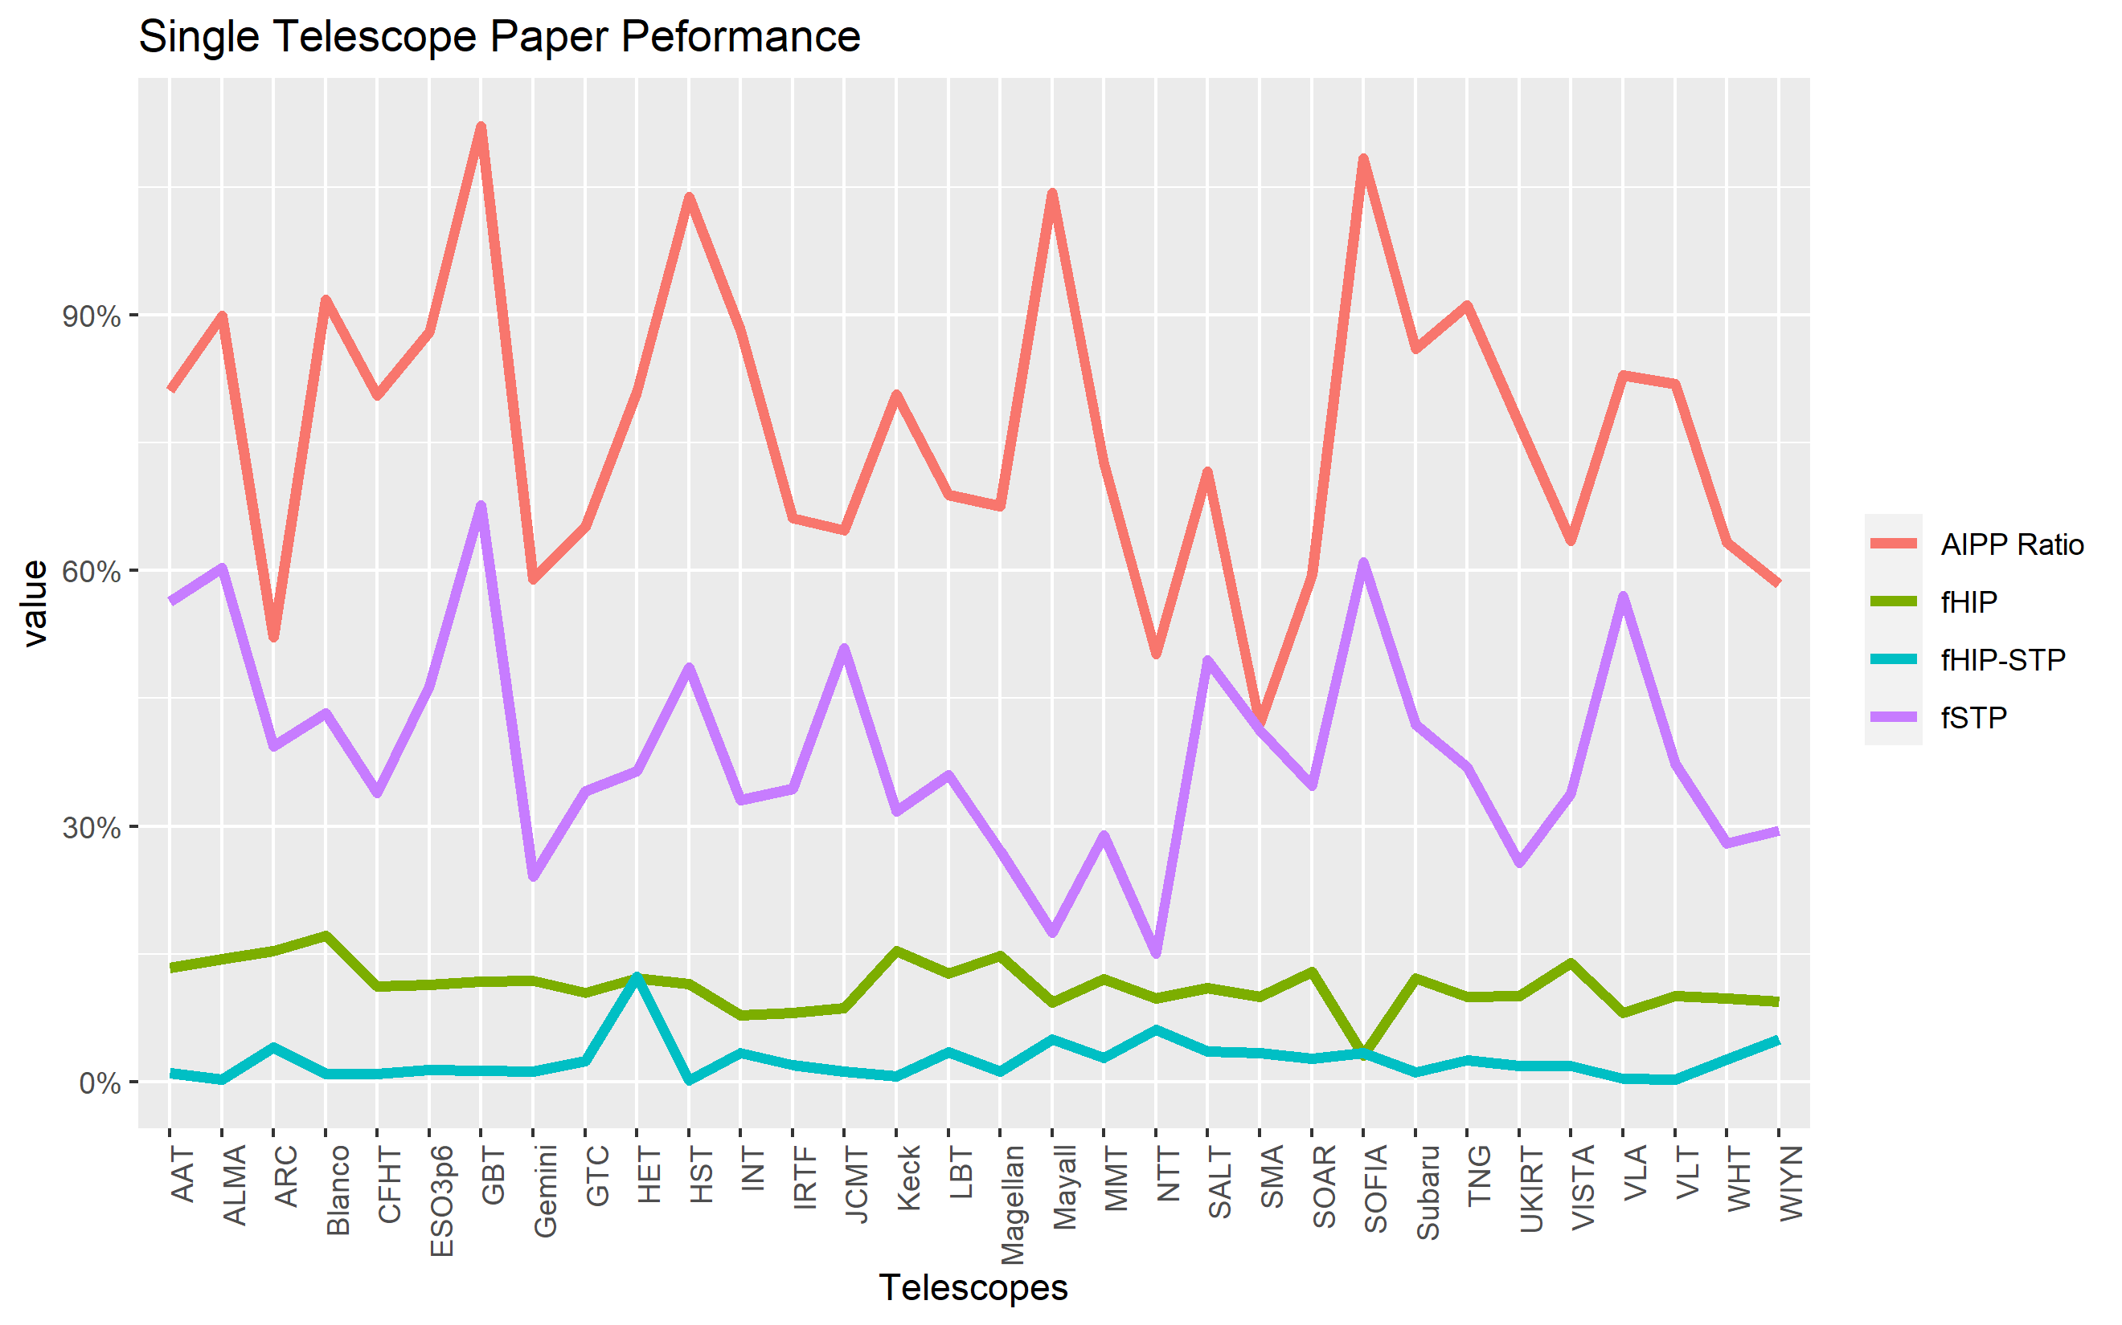

Slide 14
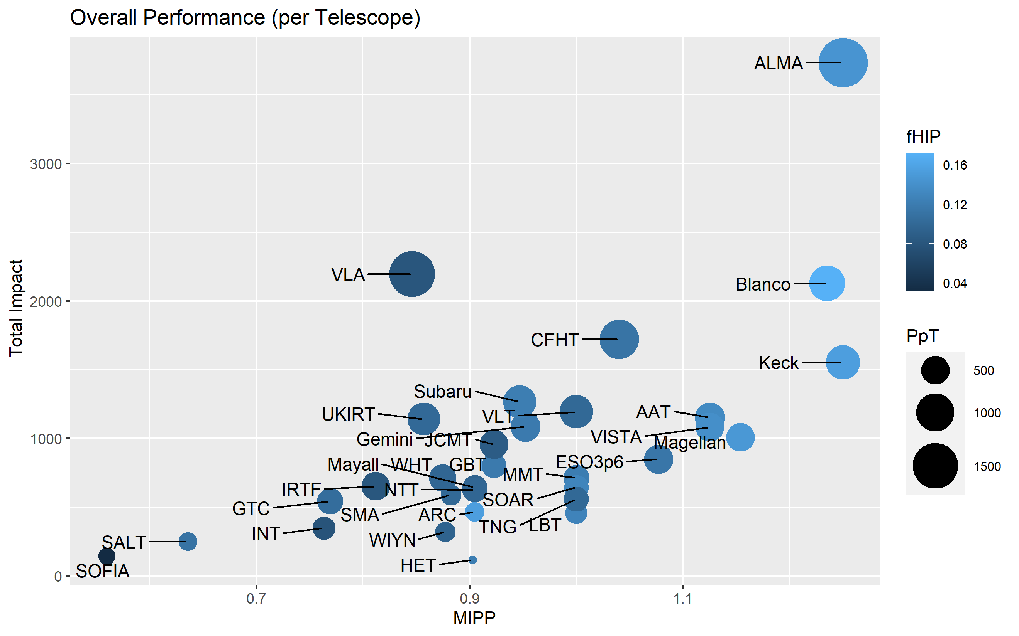

Slide 15
Number of Authors
The next slide displays the # of paper and the ln(AIPP) vs the # of authors
The decline in single author papers continues – there are almost as many papers with 17 authors as single author papers. (For 2013-2017 almost as many papers with 15 authors as single author papers)
The distribution of AIPP is close to log-normal. The ln(AIPP) is shown with the standard error of this variable. The mean impact of a paper increases with the number of authors

Slide 16
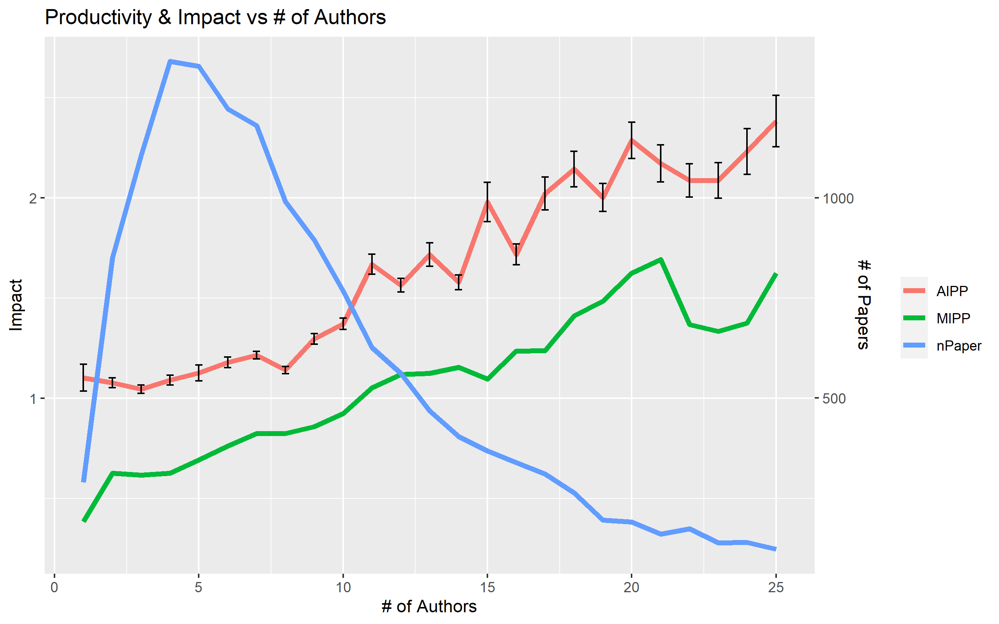

Slide 17
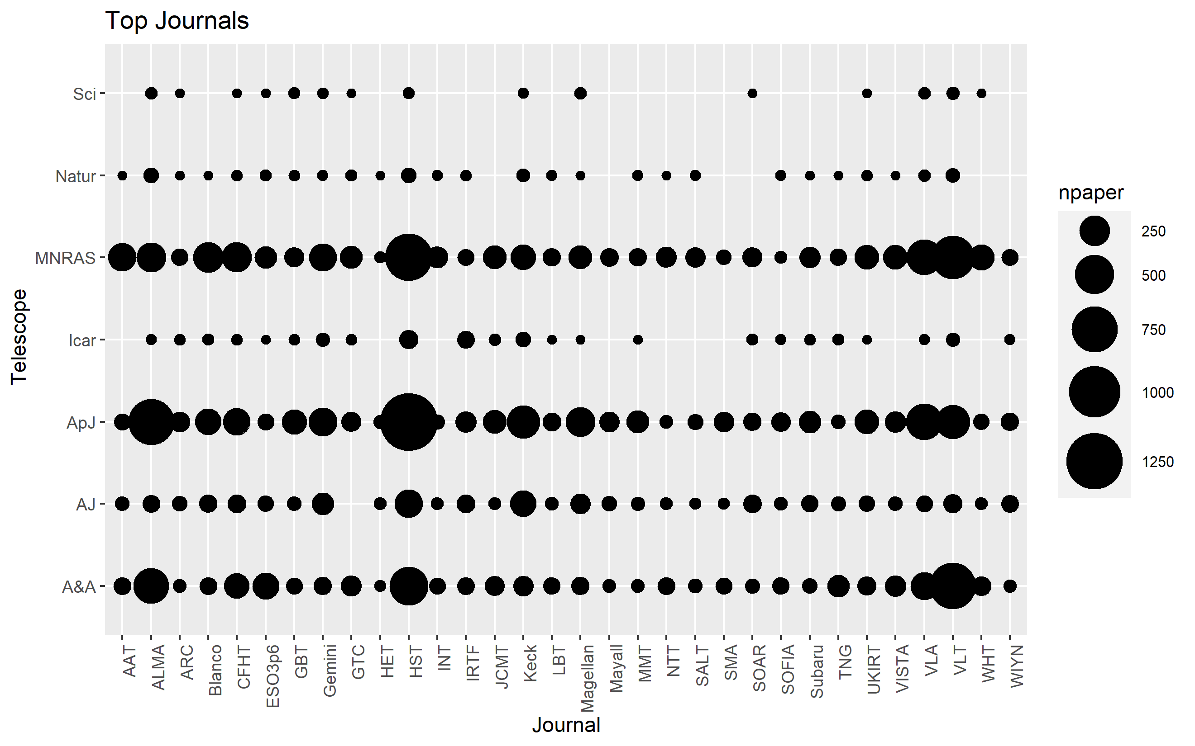

Slide 18
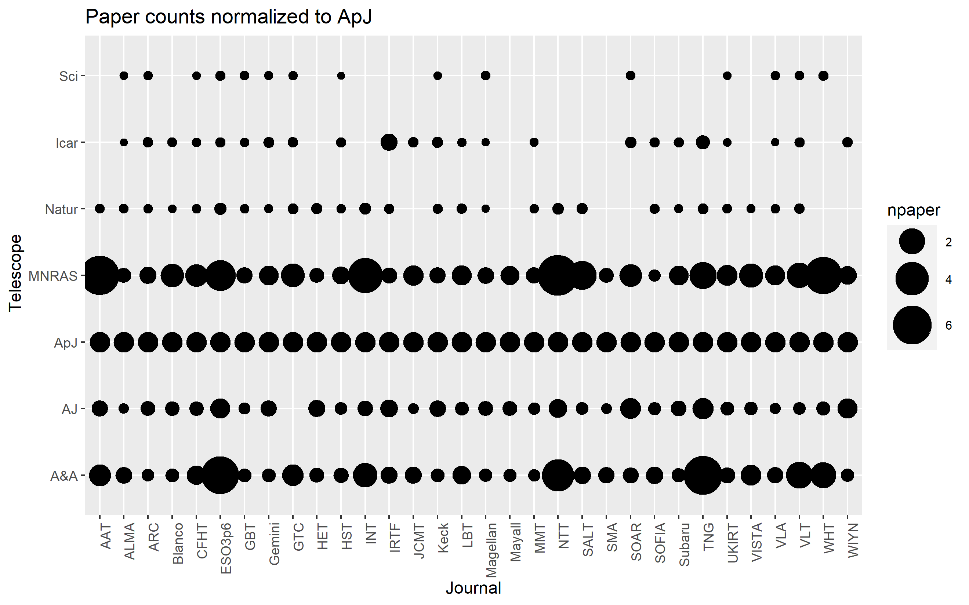

Slide 19
Altmetrics
Defined as non-standard bibliometrics – measures based on things such as social media, online news media, online reference managers and similar
The first plot shows the mean Altmetric score/paper
The second plot shows the mean AS vs journal (top 20)
Note how Science and Nature journals have much higher mean AS
The third plot shows the total AS for each telescope vs the # of Sci/Mat papers
The mean AS for a telescope is basically the # of Sci/Nat paper

Slide 20
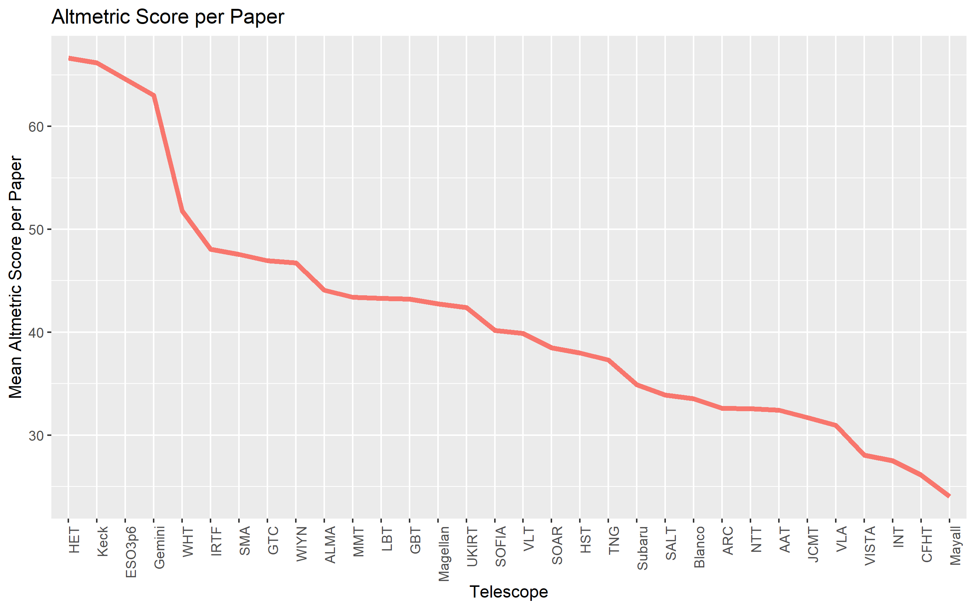

Slide 21
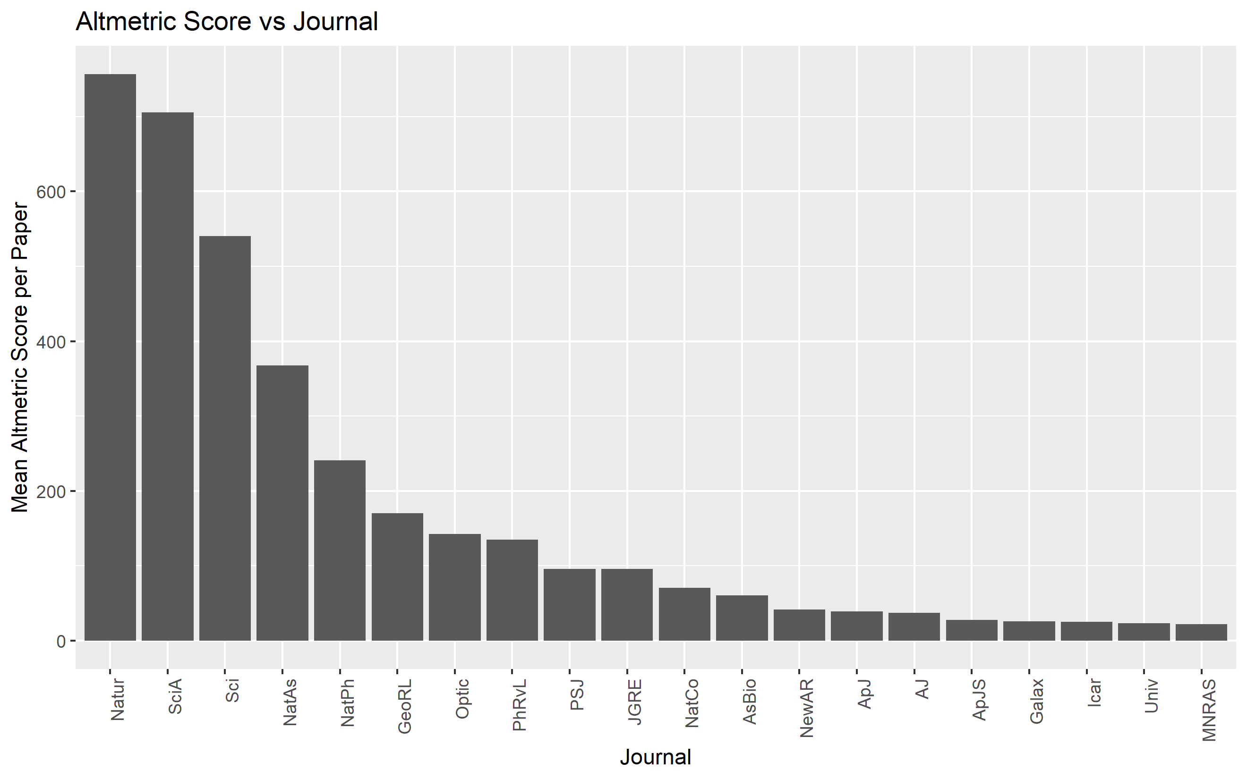

Slide 22
