Slide 1
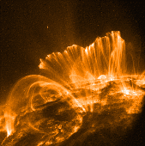
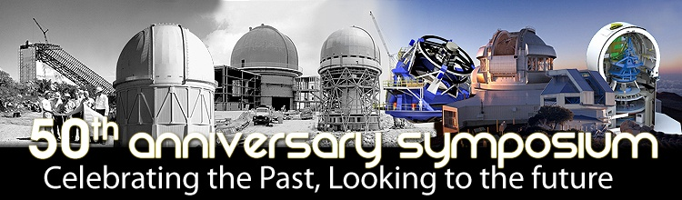
The New Solar Corona
Douglas Rabin
Solar Physics Laboratory
NASA Goddard Space Flight Center

Slide 2

The Sun is new each day. Heraclites
If the Sun had no magnetic field, it would be as dull as most astronomers think it is. R. B. Leighton

Slide 3
Themes
Everything moves, always.
B is the B-all.
We need to see every T simultaneously.
“System science” used to be a catchphrase.
3 >> 1.5 x 2

Slide 4
The Solar Interior is also new …
… but it’s another talk.

Slide 5
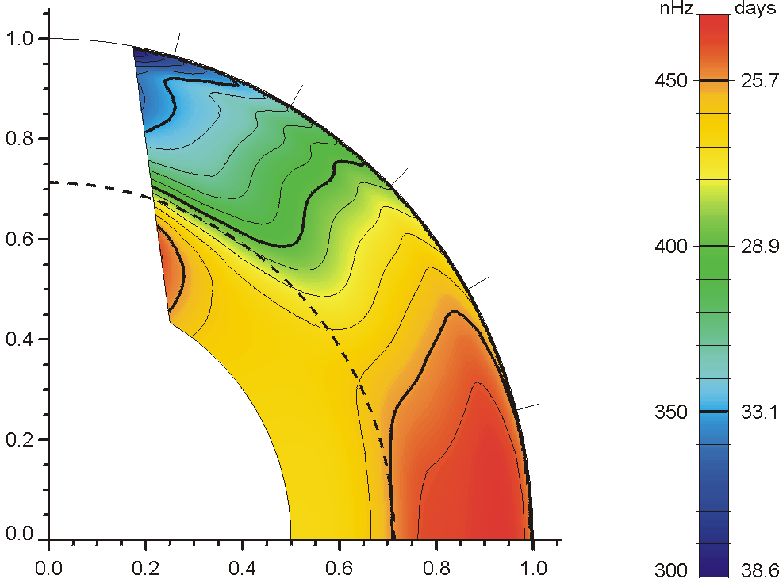
Solar Rotation
Schou et al.: 1998, ApJ 505, 390

Slide 6
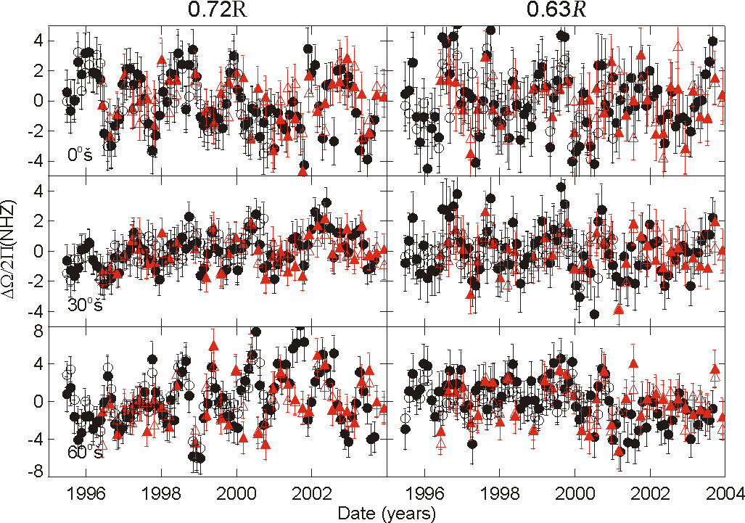
Tachocline Oscillations
Quasiperiodic changes in the rotational shear near the “tachocline” – the interface between differentially and uniformly rotating layers of the Sun.
P≈15-16 months
Variations anti-correlated at 0.72 and 0.63 R
Amplitude ≈ 6 nHz
  significant fraction of the ≈30 nHz difference in Ω with radius across the tachocline)
  Reduced during solar max
● GONG MDI
Howe et al.: 2000, Science 287, 2456

Slide 7
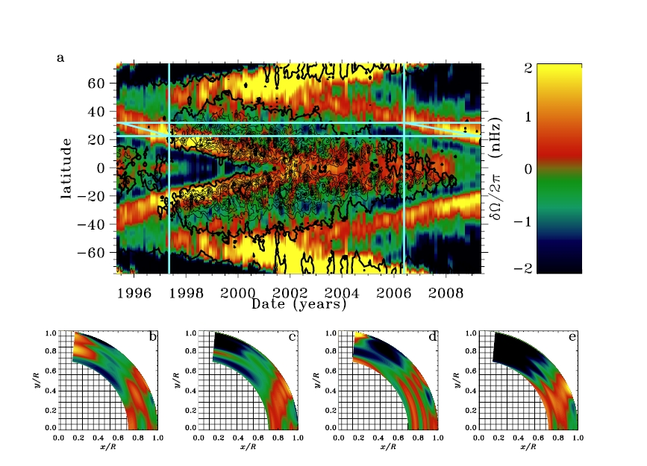
Torsional Oscillations and the Solar Cycle
Slow migration of flow towards equator coincided with extended minimum. Predicted that when flow reached ∼22°, then solar activity would increase. It did.
(R. Howe)

Slide 8
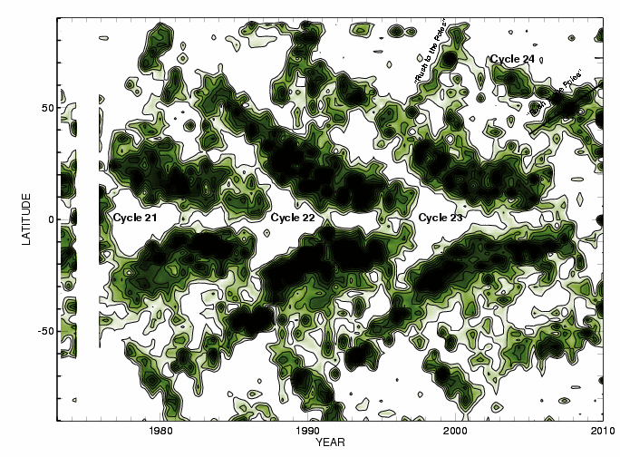
Overlapping Solar Cycles in the Corona
7-Rotation averages of the location of Fe XIV maxima
In the northern hemisphere, the “rush to the poles” has begun at a slower rate than in recent cycles. Observations from the NSO Sacramento Peak Evans Facility.
Altrock 2010
Notes:
8
8

Slide 9
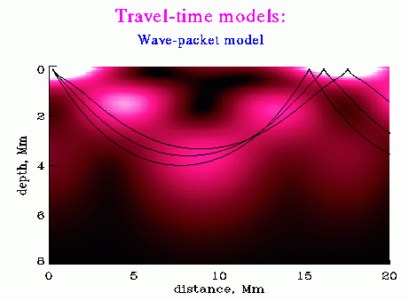
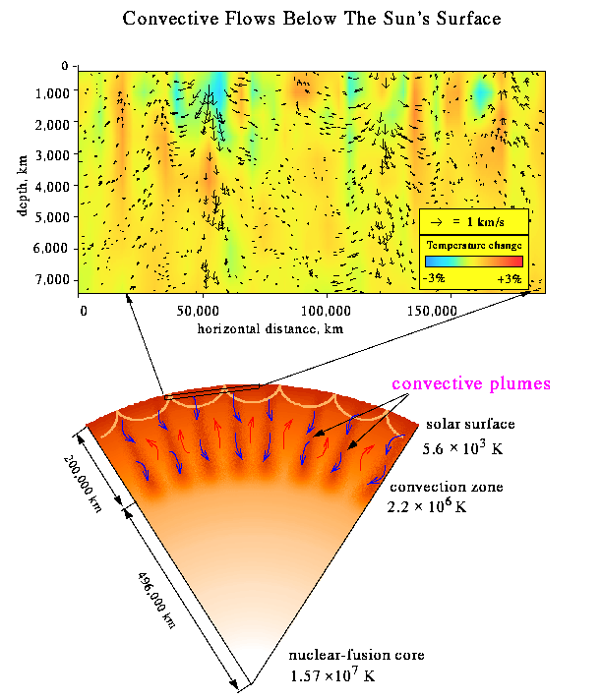
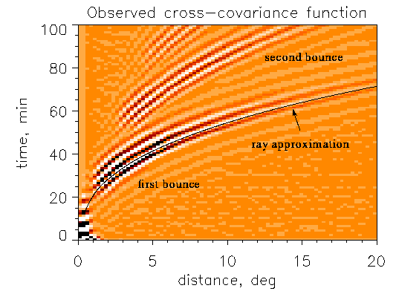
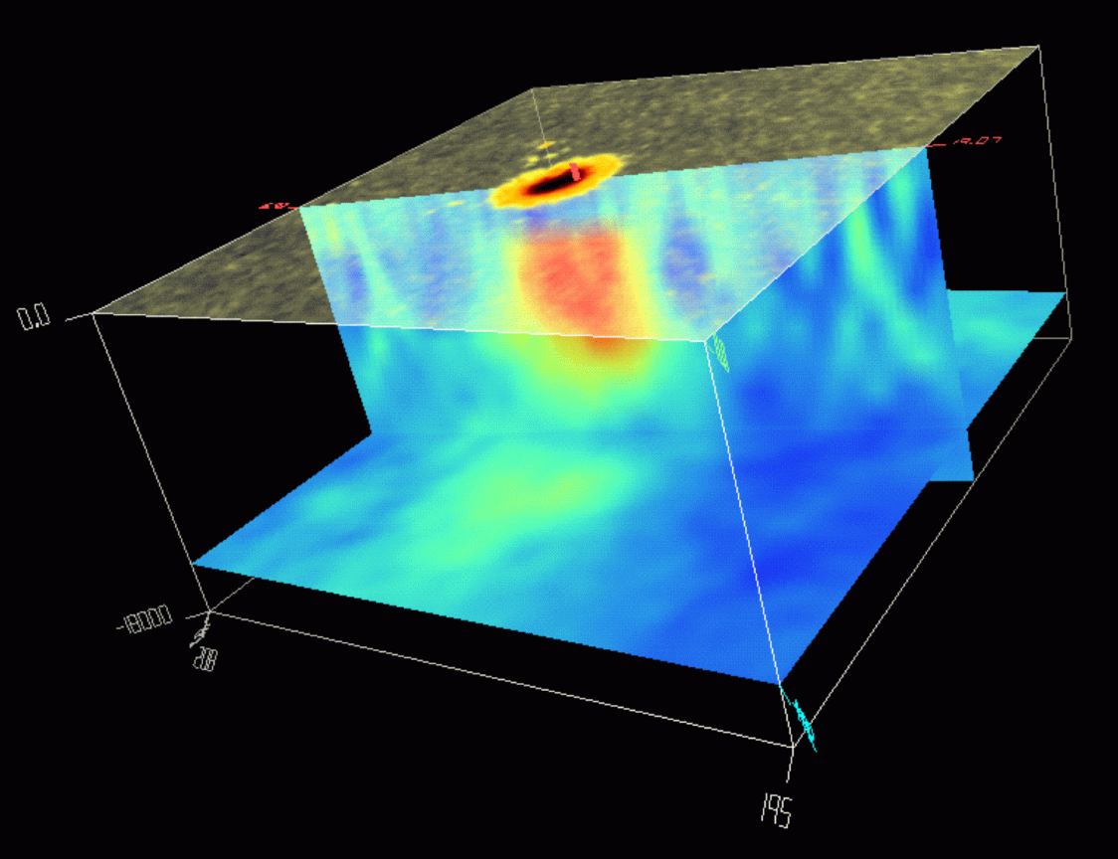
Time-Distance Helioseismology
Technique pioneered at NSO
First images of flows in the convection zone of a star
First images of the subsurface structure of sunspots
Now reaching down to the tachocline

Slide 10

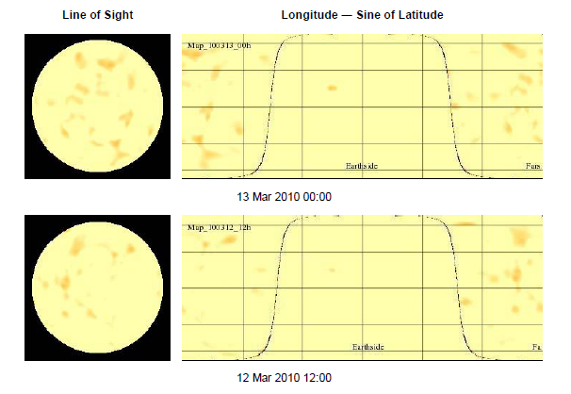
Daily Imaging of the Far Side of the Sun

Slide 11
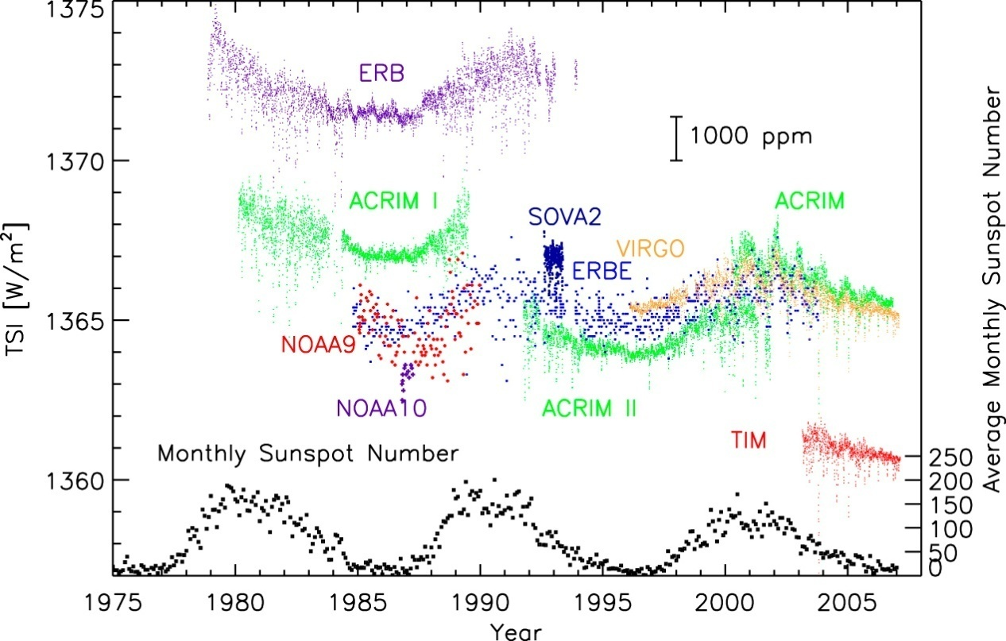
Total Solar Irradiance

Slide 12

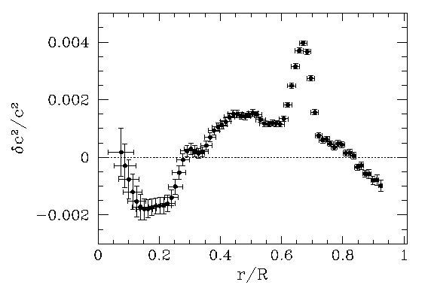
Solar Models and Neutrino Flux
For many decades, the solar neutrino puzzle has been one of the most fundamental problems in astrophysics
Helioseismology played a key role in solving this puzzle by putting ever more stringent constraints on the neutrino flux emitted by nuclear reactions in the core.
Seismic models based on GONG and SOHO data demonstrated that the deficit of the neutrino flux measured on Earth cannot be explained by spherically symmetric “classical” models without neutrino flavor transitions (e.g. Turck-Chieze et al., 2001) .
The neutrino problem was eventually put to rest by the Sudbury Neutrino Observatory (SNO) measurements, which provided strong evidence for solar ν_{e} flavor transitions (Ahmad et al., 2002, Phys. Rev. Let. 89, 011301)

Slide 13
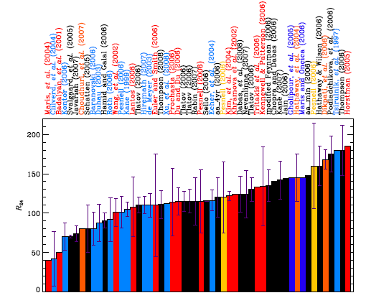

We “predict” the solar cycle.
“A Random Walk Down Sun Street”
Pesnell 2008

Slide 14
We now rejoin our talk in progress.

Slide 15
Magnetic Fields
We need to know everything.

Slide 16
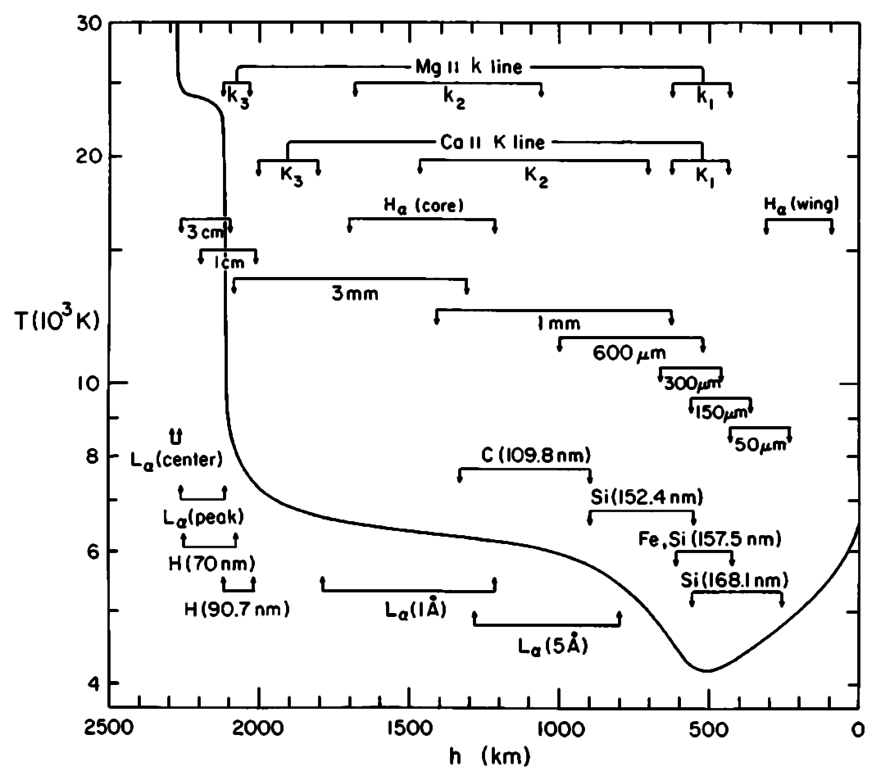
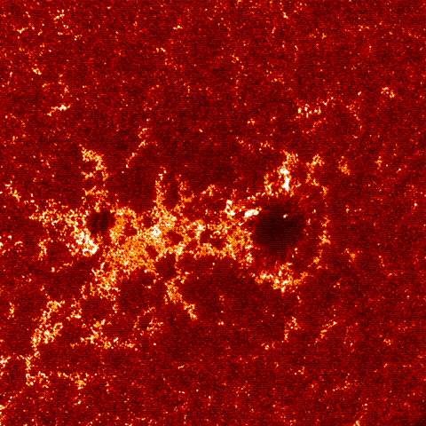
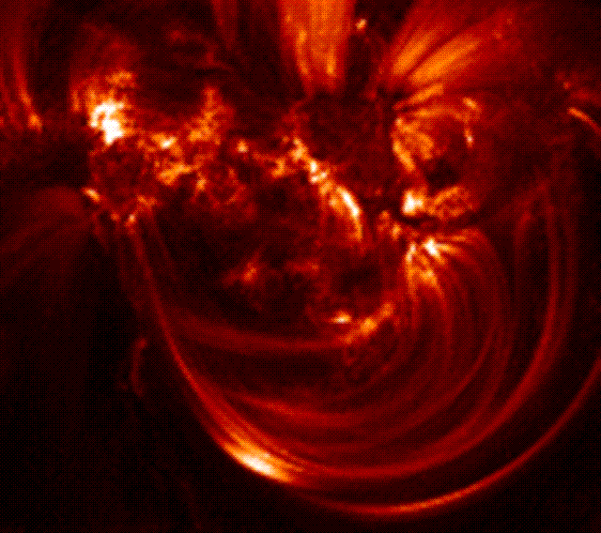
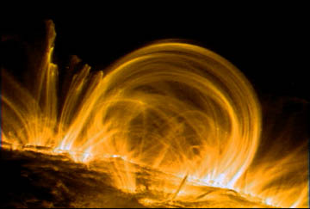
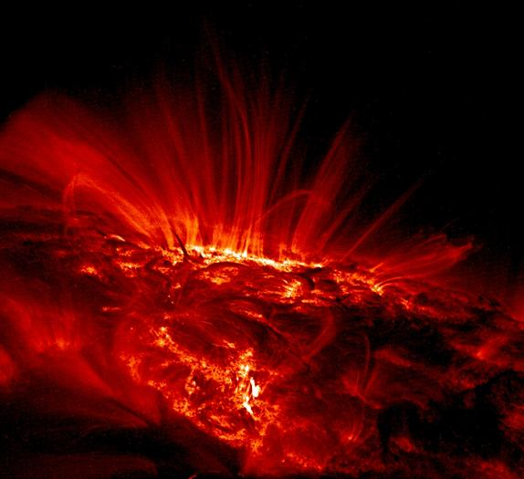
Your Stellar Atmosphere Books are History
One-dimensional, time-independent models (Vernazza, Avrett & Loeser 1981)
TRACE images

Slide 17
Your Stellar Atmosphere Books are History
Actually, we knew it not long after Kitt Peak was founded ̶ but we couldn’t do much about it.

Slide 18
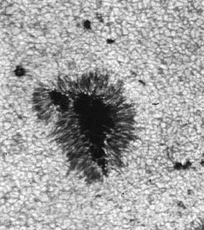
We saw granulation.
Stratoscope I 17 August 1959

Slide 19
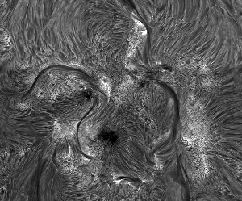
We saw Hα.
AR 10786 Dutch Open Telescope

Slide 20
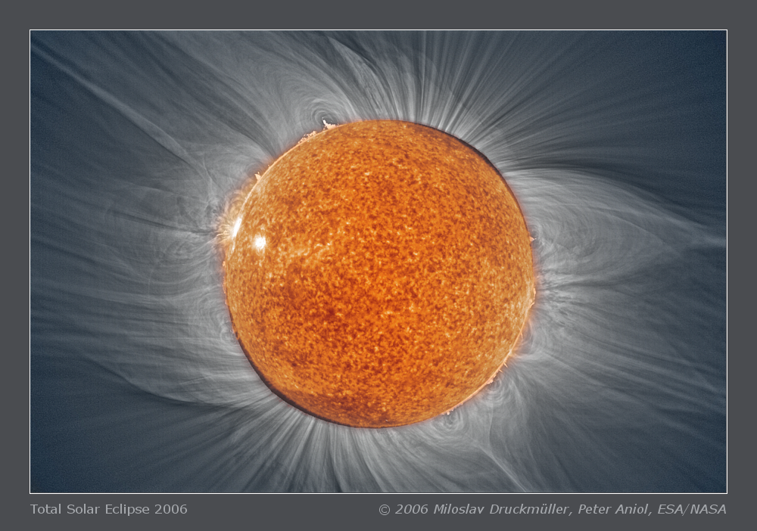
We saw the corona at eclipses.

Slide 21
Your Stellar Atmosphere Books are History
Actually, we knew it not long after Kitt Peak was founded ̶ but we couldn’t do much about it.
Now we can.

Slide 22
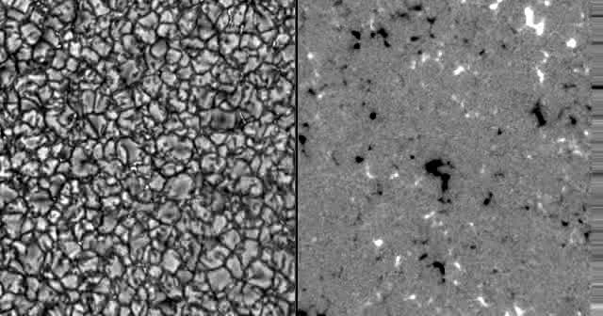
Quiet Sun Magnetic Field Evolution
Broadband continuum
B_{COG}
Courtesy of K. Reardon
NSO Dunn Solar Telescope
IBIS
scaled to +/- 150 G
Δt ~ 45 sec, t=38 min

Slide 23
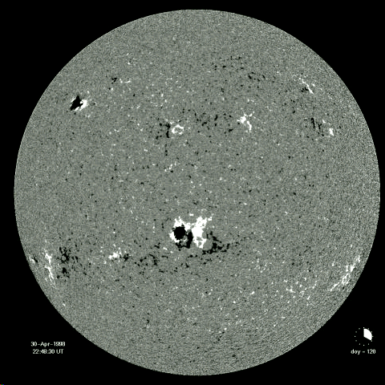
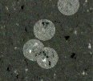
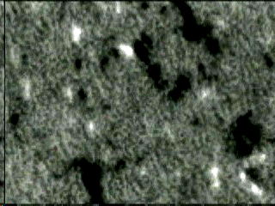
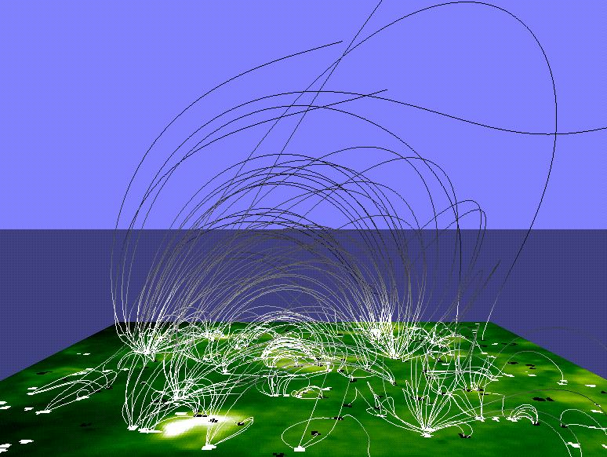
The Sun’s Magnetic Carpet
Constant magnetic flux emergence, frag-mentation and disappearance: T ∼ 40 hours
Energy supply through “braiding” of large-scale coronal field through small-scale flux replacement sufficient to heat corona
Schrijver et al.: 1998, Nature 394, 152

Slide 24
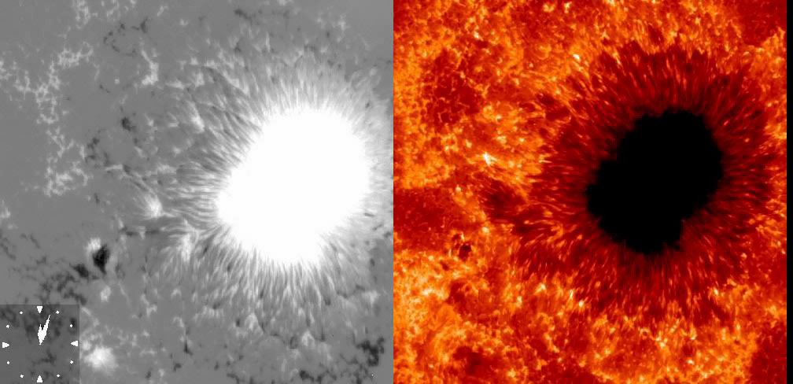
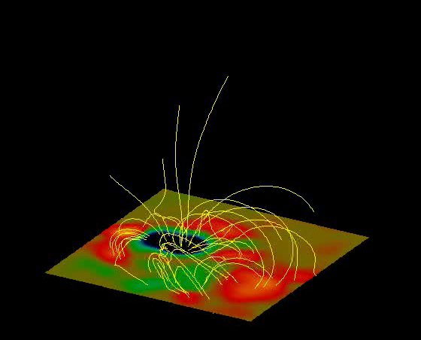
Observing and Modeling B
Nonlinear Force-Free Extrapolation
Hinode Solar Optical Telescope
B (line of sight)
Ca II H
T. Wiegelmann 2009
(a different active region)

Slide 25
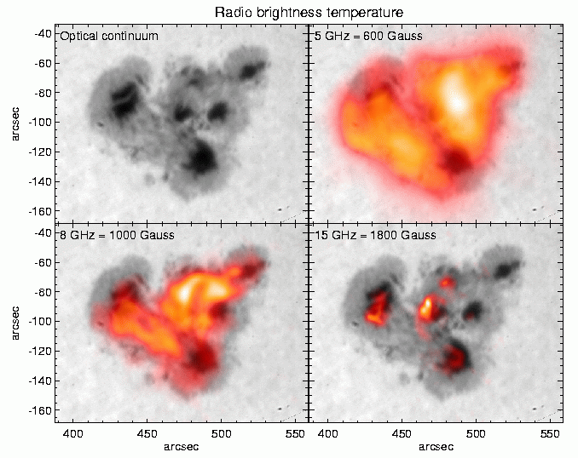
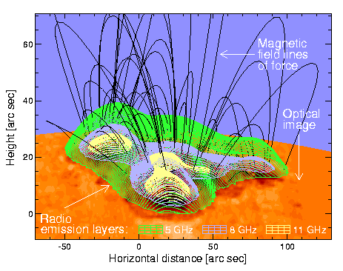
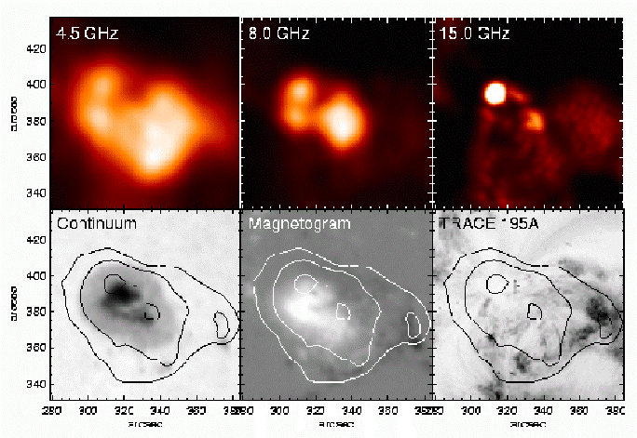
Solar Radio Observations
Electron gyroresonance emission (multiple harmonics)
J. Lee & S. White

Slide 26
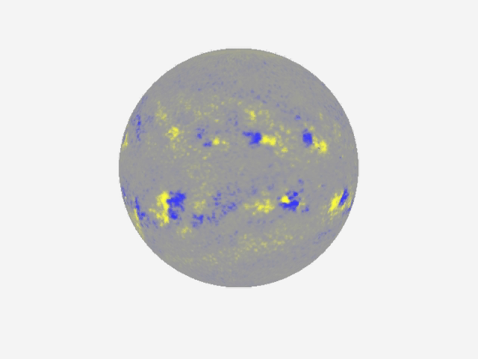
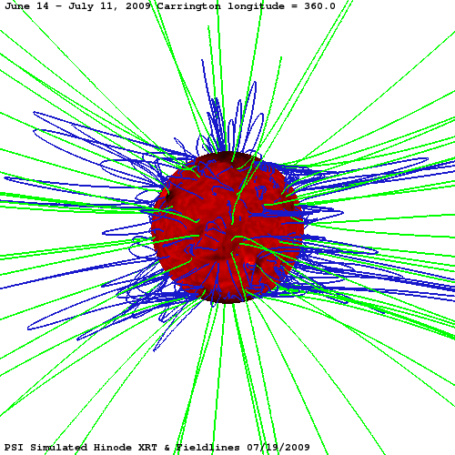
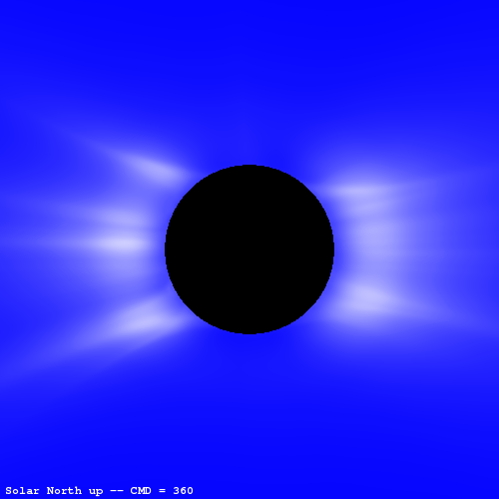
The Global Magnetic Field
MHD simulation
NSO Kitt Peak Magnetograms
Polarized brightness
Mikić et al. 2009

Slide 27
Coronal Heating
What a tangled web it weaves.

Slide 28
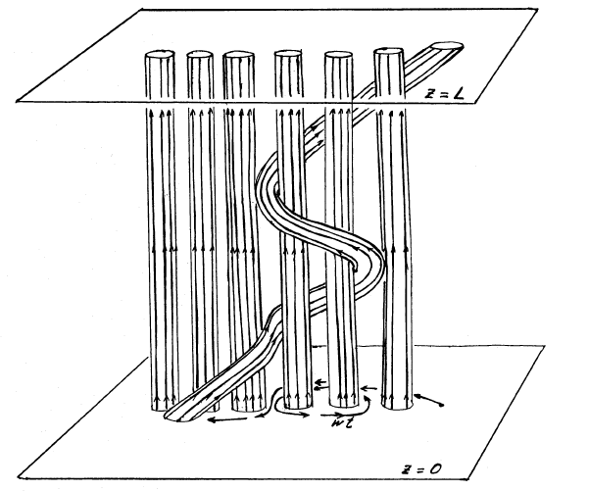
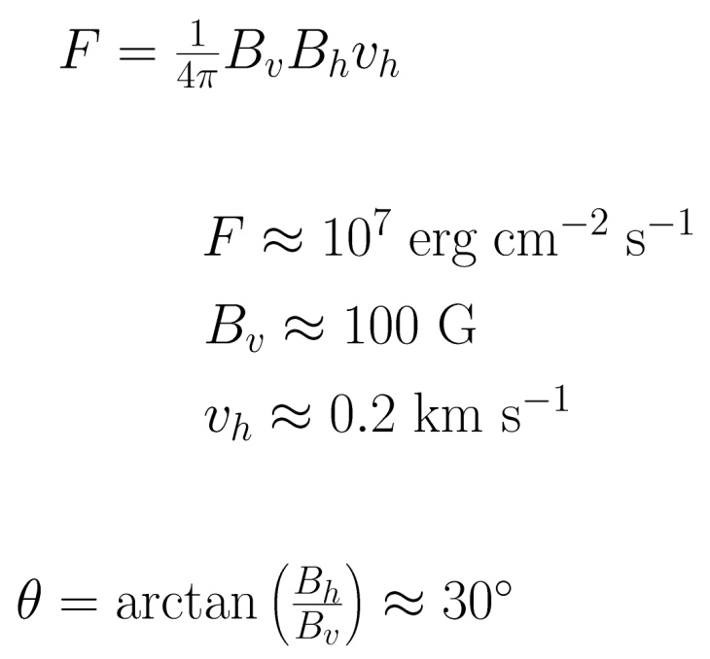
Coronal magnetic fields get tangled.
What happens?
photosphere
corona
photosphere
Parker (1983)
Notes:
Parker first to discuss in detail.
Famous cartoon showing how coronal field tangled by random footpoint motions.
Recently, Priest et al looked at from slightly different perspection.
Corona tectonics.
De Moortel will discuss.

Slide 29
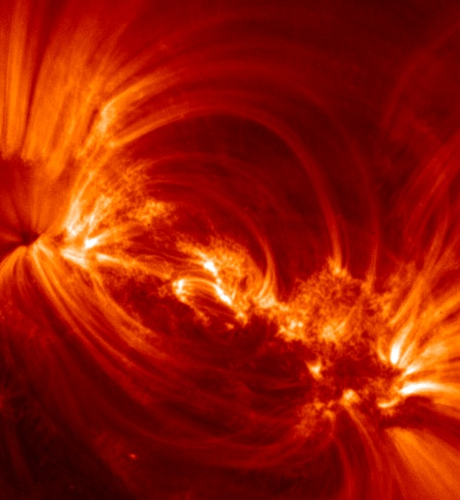
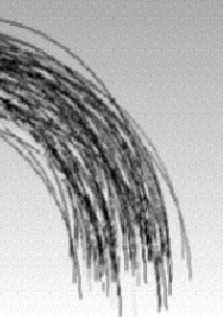
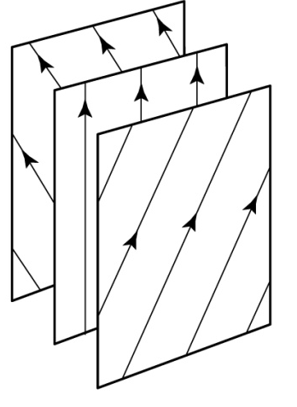
Pursuing Parker’s Idea
current sheet
Photospheric magnetic field is highly fragmented.
Coronal loops are bundles of sub-resolution flux strands that become tangled by turbulent photospheric convection.
Current sheets exist at the interfaces between misaligned strands.
Reconnection at these interfaces causes “nanoflares.”
Notes:
intertwined

Slide 30
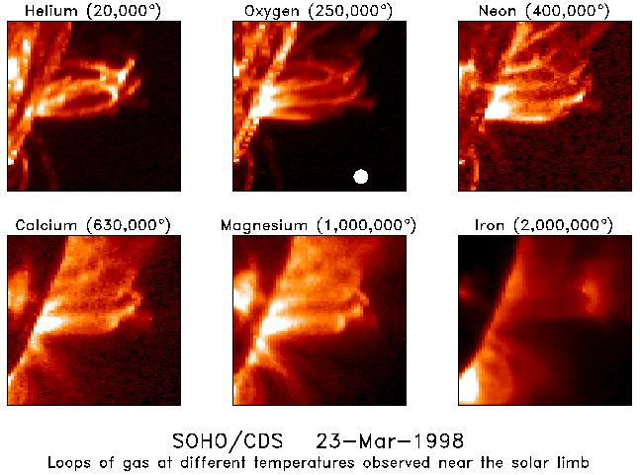
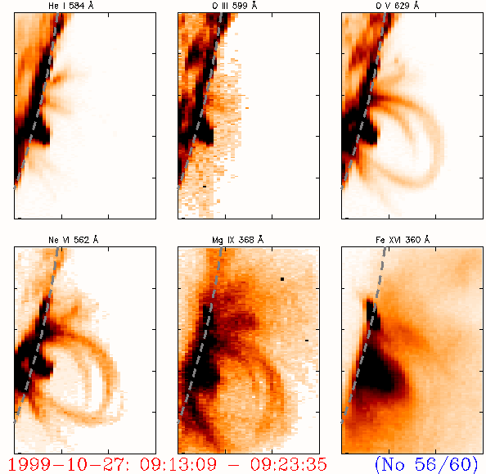
Coronal Loop Temperatures
Loops with very different temperatures co-exists within an active region, sometimes very close to each other, but not really co-spatial, i.e. they occupy different volumes
Fludra et al.: 1997, Solar Phys. 175, 487

Slide 31
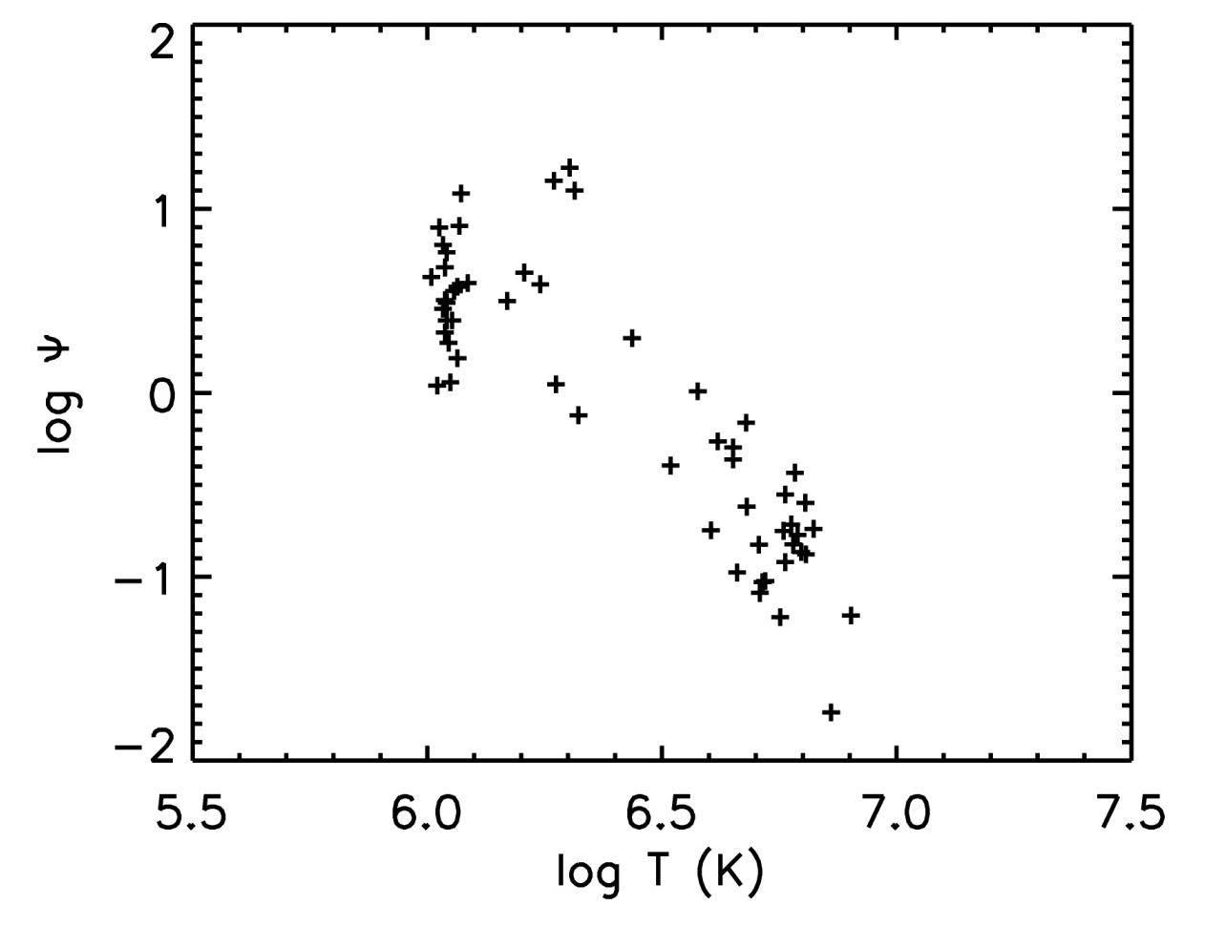
Most coronal loops are overdense.
TRACE
Yohkoh/SXT
Compared to what? – compared to the quasi-static loop models of Rosner, Tucker & Vaiana 1978.
Ψ = n / n_{eq}
Klimchuk (2006)

Slide 32
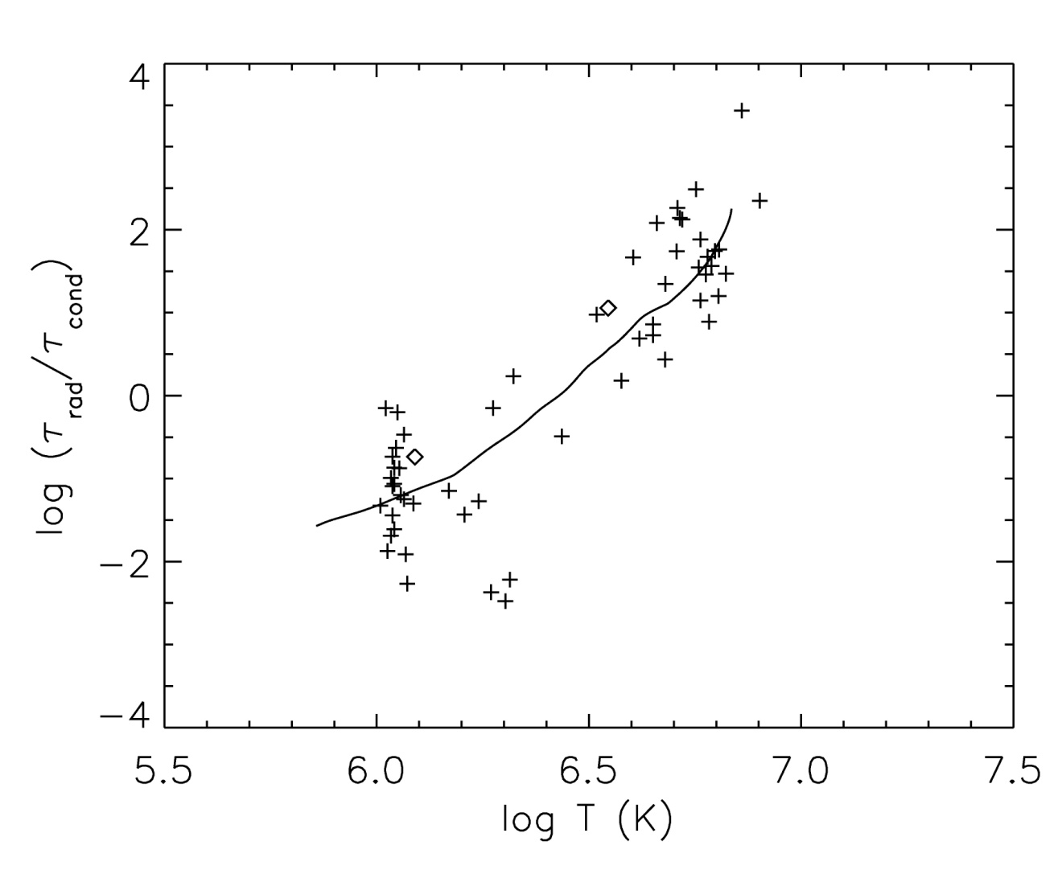
Most loops are heating or cooling.
Thermal cond.
dominates
Cooling track
static
equil.
Radiation
dominates
TRACE
Yohkoh
τ_{rad}/τ_{cond} = T⁴ / (nL)²
Klimchuk (2006)

Slide 33
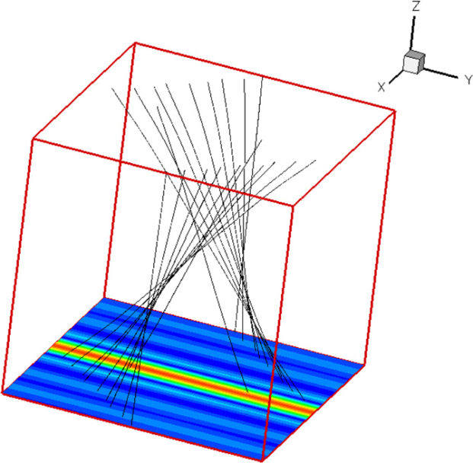
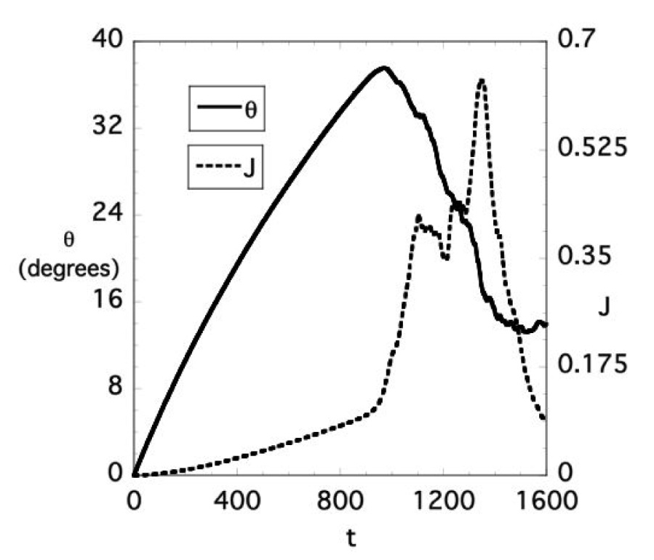
Must current sheets reconnect?
An essentially 3D instability
Current sheet equilibrium is destabilized by a two-dimensional resistive instability (the primary instability).
Resistive disturbance grows until it saturates nonlinearly to form a two-dimensional secondary equilibrium.
Two-dimensional equilibrium is itself destabilized by a three-dimensional ideal instability (the secondary instability).
Three-dimensional disturbance grows to large amplitude and transitions to turbulence with enhanced energy dissipation.
Explosive energy release occurs when
shear angle reaches ~40 degrees (“Parker angle”).
Dahlburg, Klimchuk, & Antiochos (2003, 2005, 2009)

Slide 34
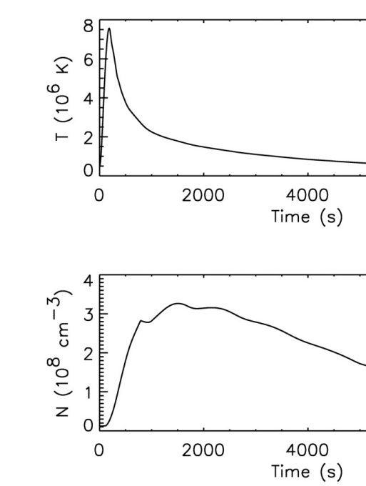
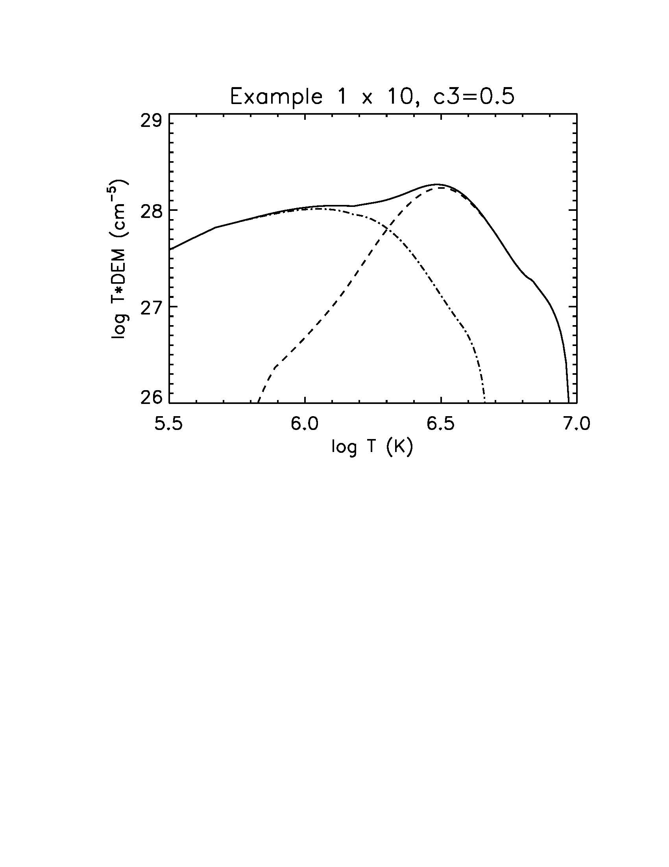
Consequences of the Nanoflare Model
Nanoflare model predicts small quantities of super-hot plasma
Recently detect by several instruments
Long-duration nanoflare storm
Corona
Faint super-hot
emission
Transition
Region
(footpoint)
Individual events are short-lived and low-density.
Klimchuk (2010)
Notes:
CORONAS-F (Zhitnik et al. 2006), RHESSI (McTiernan 2008),
XRT (Siarkowski et al. 2008; Reale et al. 2008); EIS (Patsourakos & K 2008)

Slide 35
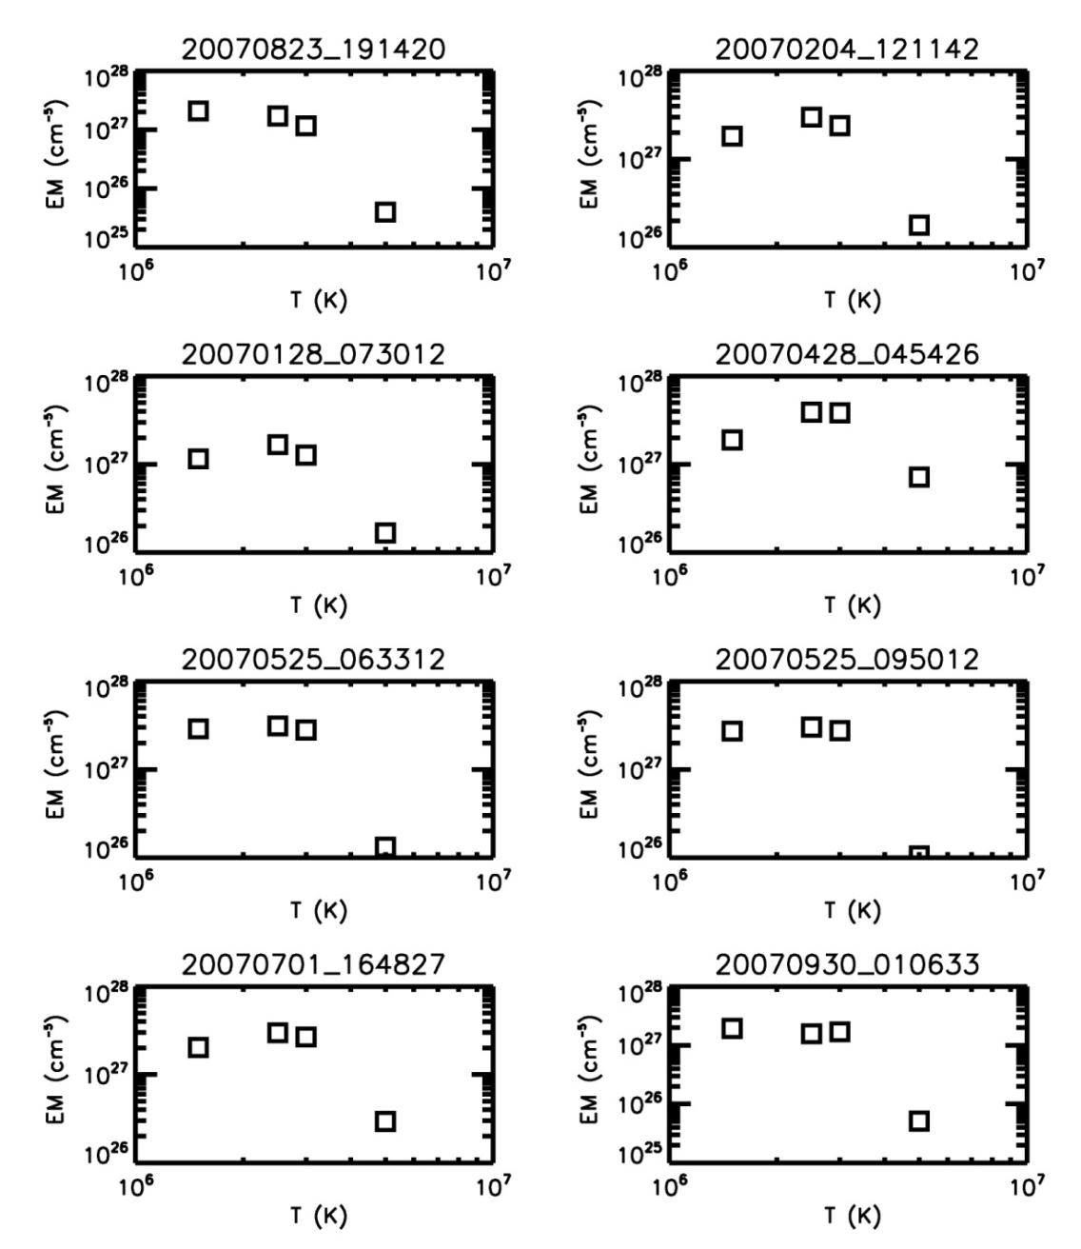
Very-Hot Plasma Detected by Hinode/EIS
Different
active regions
Fe XII, Fe XV,
Ni XVII, Fe XVII
EM = ∫ N_{e}² dh
Patsourakos & Klimchuk 2008

Slide 36
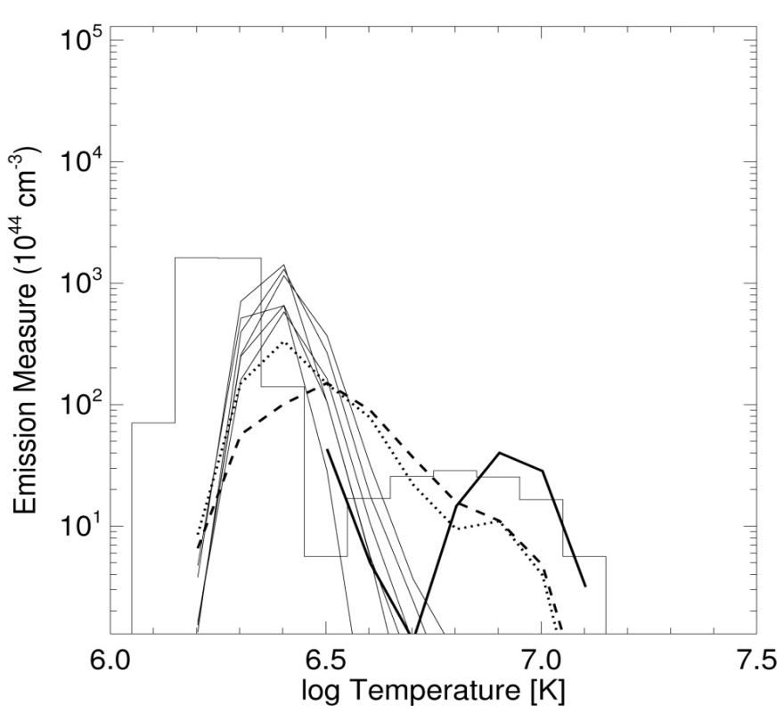

Super-Hot Plasma Detected by Hinode/XRT
Reale et al. 2009
Schmelz et al. 2009
Notes:
Hard ratio – blue
Soft ratio - green

Slide 37


Observations of Explosive Events
Discovered with HRTS sounding rocket (Brueckner et al. 1983)
  Short-lived (60 s), small-scale (1500 km), high velocity (±150 km/s)
Significance: believed to represent the high-energy tail of a spectrum of network events that occur on scale unobservable with current techniques
SUMER raster-scan in Si IV 1393Å
Bi-directional plasma jets ejected from small sites
Structure of jets evolves in a manner predicted by theoretical models of magnetic reconnection
  Strongly suggests that magnetic reconnection is the fundamental process for accelerating plasma on the Sun
Innes et al.: 1997: Nature 386, 811

Slide 38

Heating the corona is both too easy and too hard.
Coronal heating confusogram (Oughton, Cranmer)

Slide 39





Evidence for Ion Cyclotron Wave Heating
In coronal holes, heavy ions (e.g., O⁺⁵) both flow faster and are heated hundreds of times more strongly than protons and electrons, and have anisotropic temperatures.
Kohl et al.: 1998, ApJ 501, L127
Cranmer et al.: 1999, ApJ 511, 481
Alfven wave’s oscillating
E and B fields
ion’s Larmor motion around radial B-field

Slide 40



High-Frequency Waves in the Low Corona
(or, Some Things You Can Do in 6 Minutes)
Resonant transmission of fast magneto-acoustic body waves
Observations from EUNIS 2006
Jess et al. 2008, ApJ 682

Slide 41
Eruptive Events in 3D

Slide 42

The Sun as seen with
SOHO (MDI/EIT/LASCO), TRACE, and RHESSI

Slide 43


The Extended Corona and Solar Wind
SOHO/LASCO Large Angle and Spectroscopic Coronagraph
Observe the corona from 2 - 32 Rs in white light with overlapping fields of view

Slide 44



EIT (Moreton) Waves
Speeds: 200 - 600 km/s
Deflected by AR
Stop at CH boundaries
Usually associated with CMEs
Several hundred observed
May be fast-mode Alfvén shock (Uchida 1968, 1973)
Coronal seismology

Slide 45

Panoramic View from STEREO
90º
360 Rs
65º
260 Rs
24º
96 Rs
4º
15 Rs

Slide 46

COR2, HI-1 and HI-2: February 9, 2007
Running Differences and Median Filtering

Slide 47


3D Structure of CMEs
Polarization analysis of single-view LASCO images has resulted in the first 3D reconstructions of CMEs.
The scattering point’s distance from the plane-of-the-sky is determined by the ratio of the polarized-to-unpolarized electron scattered emission.
From the brightness ratio the 3D structure, position and velocity could be computed for several CMEs
The data suggest that halo-CMEs are expanding arcades of multiple loops from the Sun
3D reconstruction
Moran & Davila 2004
polarized brightness

Slide 48


STEREO: Coronal Stereoscopy
4 yr.
3 yr.
Ahead @ +22°/year
2 yr.
1 yr.
Sun
Earth
1yr.
Behind @ -22°/year
2yr.
4 yr.
3 yr.
Geocentric Solar Ecliptic Coordinates
Fixed Earth-Sun Line (Ecliptic Plane Projection)
(a) Solar-rotation stereosocopy
(b) Two-spacecraft stereoscopy
Parallax measurement
as a function of time (>1 day)
-requires quasi-stationary loops
-Parallax measurements
simultaneously from 2 spacecraft
images at different positions

Slide 49
Coronal Stereoscopy from COR1
Kramar & Davila 2010

Slide 50
Coronal Stereoscopy from COR1
Kramar & Davila 2010

Slide 51
Coronal Stereoscopy from COR1
Kramar & Davila 2010

Slide 52
Coronal Stereoscopy from COR1
Kramar & Davila 2010

Slide 53
Coronal Stereoscopy from COR1
Kramar & Davila 2010

Slide 54
Coronal Stereoscopy from COR1
Kramar & Davila 2010

Slide 55
Coronal Stereoscopy from COR1
Kramar & Davila 2010

Slide 56
Coronal Stereoscopy from COR1
Kramar & Davila 2010

Slide 57
Coronal Stereoscopy from COR1
Kramar & Davila 2010

Slide 58
Coronal Stereoscopy from COR1
Kramar & Davila 2010

Slide 59
Coronal Stereoscopy from COR1
Kramar & Davila 2010

Slide 60
Magnetic Topology and Reconnection

Slide 61




Reconnection cartoons circa 1960
Gold, T., and Hoyle, F., Mon. Not. R. astron. Soc, 120, 89 (1961)
Sweet, P. A., "The neutral point theory of solar flares," in Electromagnetic Phenomena in Cosmical Physics, IAU Symp. 6, p. 123 (1958).
Tether cutting – Moore and Roumeliotis 1992
Sturrock, P. A., "A model for the high-energy phase of solar flares," Nature 211, 695 (1966).

Slide 62


Reconnection cartoons +40 yr
Cartoon Professional Edition*
Cartoon Student Edition
Freedman, R.A., and Kaufmann, W. J., III, Universe, 8th edition, W.H. Freeman, 2008.
McKenzie, D. E., "Signatures of reconnection in eruptive flares," Yohkoh 10th anniversary meeting, COSPAR Colloquia Series, p. 155 (2002).
* Costs extra

Slide 63


Magnetic Breakout: Interacting Flux Systems
Topological Confinement
Magnetic Breakout
Dipolar region in a background bipole: core field flux (green) can reconnect if sheared but can’t erupt.
Quadrupolar region in a background bipole: core field flux can erupt because high-level reconnection can release confining flux.
Energy theorems: Aly 1991, Sturrock 1991
Antiochos 1998

Slide 64


New field: Topological Zoology
Separator
Positive null points, potential and non-potential
Null
Longcope 2005
Spine
There are many more degrees of freedom available to instability and reconnection in 3D than in 2D: 3 >> 1.5 x 2
Sweet redux: four interacting flux domains

Slide 65


Breakout: MHD Models

Slide 66

MHD simulation:
Eruption of a kink-unstable flux rope
Török & Kliem 2005

Slide 67



Of course, it’s more complicated than that.
L: Martin et al. 1992
R: Swedish Solar Telescope
(Lin et al. 2005)
Prominences have helicity (dextral or sinistral)
Prominences have legs or “barbs” that terminate in parasitic or cancelling small-scale magnetic flux.
Such cancellation is often associated with prominence eruption, but not in a simple way (Kilper 2010).
Eruption
initiation
Small-scale flux
cancellation
SOHO/MDI Magnetogram
with MLSO H-alpha overlay

Slide 68

STEREO: More Than a Gimmick
Ahead
Behind
On 6 June 2007, a quiescent polar crown prominence erupted over the northwest limb, and was observed at 304 Å by both STEREO spacecraft.
The angular separation was 11°.6.
By triangulating small filamentary features in the prominence, the time-dependent 3D structure can be derived.

Slide 69

As seen from STEREO-Behind
So what?
W. Thompson 2010

Slide 70

As Seen from Directly Above the CME
The prominence structure is more compact when seen from above, i.e. a vertical sheet.
The prominence spine rotates counter-clockwise as it erupts.
The northern end of the prominence disappears before the eruption is complete.
That’s what!
W. Thompson 2010

Slide 71
Solar Flares
Another topic unto itself …
… just a taste

Slide 72

We used to think Hα flares were complicated.
TRACE

Slide 73

RHESSI Gamma-ray Imaging
2003 October 28
X-ray sources
Energy: 200 – 300 keV
Origin: accelerated electrons
Gamma-ray sources
Energy: 2.2 MeV
Origin: accelerated ions
X-ray to gamma-ray offset
14" and 17" ± 5"
Cause of offset
Unknown
Ions and electrons accelerated in different loops?
Propagation effects?
Separation by charge?
TRACE 195 Å image
Hurford et al. 2006, ApJ., 644, L93

Slide 74

Bulk Electron Acceleration High in the Corona
We do not understand how the Sun energizes a large fraction of the electrons in a bulk volume.
Milligan et al. 2010

Slide 75




Flare forecasts from subsurface helicity
Helicity measurements
Superposed epoch analysis
Active regions with both strong subsurface vorticity (twisting motions) and high surface magnetic field are likely to produce energetic flares.
The kinetic helicity density changes rapidly before a flare occurs, starting as many as three days in advance of the flare.
The predictive capability is twice that of current methods and likely can be improved.
Reinard, Henthorn, Komm & Hill 2010

Slide 76
Looking to the Future

Slide 77
The Future is Bright
ATST (Advanced Technology Solar Telescope)
SOLIS (Synoptic Long-Term Investigations of the Sun)
GONG (Global Oscillations Network Group)
Other ground-based telescopes and networks
SDO
Solar Irradiance
Solar Orbiter and Solar Probe Plus
IRIS and other Explorers
Virtual Solar Observatory

Slide 78

Heliophysics Great Observatory
_{Wind}
_{Voyager}
_{RHESSI}
_{SOHO}
_{STEREO}
_{TRACE}
_{Geotail}
_{ACE}
_{THEMIS}
_{TIMED}
_{FAST}
_{Cluster}
_{Polar}
_{SDO}
_{ACRIMSAT}
_{SORCE}
_{IRIS}
_{Glory}
_{Picard}
_{Hinode}
_{MMS}

Slide 79

Solar Dynamics Observatory
“All the Sun, All the Time”
Mission Science Objectives
SDO’s goal is to understand, driving towards a predictive capability, the solar variations that influence life on Earth and humanity’s technological systems by determining
•How the Sun’s magnetic field is generated and structured
•How this stored magnetic energy is converted and released into the heliosphere and geospace in the form of solar wind, energetic particles, and variations in the solar irradiance.
Science Investigations
Helioseismic and Magnetic Imager (HMI)
PI Institution: Stanford University
Images the Sun’s helioseismic, longitudinal and vector magnetic fields to understand the Sun’s interior and magnetic activity
EUV Variability Experiment (EVE)
PI Institution: University of Colorado
Measures the solar extreme ultraviolet (EUV) spectral irradiance to understand variations on the timescales which influence Earth’s climate and near-Earth space
Atmospheric Imaging Assembly (AIA)
PI Institution: Lockheed Martin Solar Astrophysics Laboratory
Images the solar atmosphere in multiple wavelengths to link changes to surface & interior changes
Mission Specs:
Launched 11 February 2010
Inclined Geosynchronous Orbit
Continuous 150 Mbps Ka-Band downlink
Dedicated ground station

Slide 80


Solar Probe Plus (2018)
A simulated view of the Sun and inner heliosphere from above, illustrating the trajectory of Solar Probe+ during its multiple near-Sun passes inside 30 R_{S}. The spacecraft will cross coronal structures that are associated with coronal streamers, and the solar wind [McComas et al 2008].

Slide 81

Coronal Tomography from Solar Probe
COROTATION
TOMOGRAPHY
COROTATION

Slide 82

The Advanced Technology Solar Telescope
Steve Keil, Director
National Solar Observatory

Slide 83
Comparison with other Telescopes
Areal Resolution
10000
DST
THEMIS
NSST
1000
McMP
GREGOR, NST
Resolved Area (km^2)
Predicted Magnetic Fibril sizes
ATST
100
0
50
100
150
200
250
300
350
400
450
Aperture (cm)

Slide 84
Comparison with other Telescopes
Fixed B, Fixed Size
(assumes same sensitivity)
100
DST
THEMIS
NSST
Relative Time
10
McMP
GREGOR, NST
e.g. Moving Magnetic Flux Tube
ATST
1
0
50
100
150
200
250
300
350
400
450
Aperture (cm)

Slide 85



ATST and Magnetoconvection
Theory and Modeling have gone beyond our ability to test observationally.
1.1”
Numerical simulation of magneto-convection (F. Cattaneo )
As viewed with a diffraction limited 4-m telescope
As viewed with a diffraction limited 1-m telescope
Major Question ATST will Address
How are the highly intermittent magnetic fields observed at the solar surface generated by dynamo processes and how are they dissipated?
What magnetic configurations and evolutionary paths lead to flares and coronal mass ejections?
What mechanisms are responsible for variations in the spectral and total irradiance of the Sun?

Slide 86

Magnetoconvection Simulation
F. Cattaneo

Slide 87

ATST and the Infrared
Exploit the Zeeman effect in the forbidden coronal emission line Fe XIII 1074.7 nm.
Contour map (based on 20 pixels) of the measured coronal magnetic field strength using Fe XIII overplotted on the EIT Fe XV image. The thick contour corresponds to 4 G, with additional contours corresponding to flux densities of 2, 0, and -2 G. Tick marks indicate the spatial scale in units of arcseconds.
Lin, Kuhn & Coulter 2004

Slide 88

ATST and the Infrared (2)
Coronal Multichannel Polarimeter (CoMP) at NSO Sac Peak
Map of inferred values of coronal parameters. (a) The intensity of the Fe XIII 1074.7 nm emission line; (b) The LOS velocity; (c) The intensity with superimposed vectors showing the plane-of-sky direction of the magnetic field; (d) The LOS component of the coronal magnetic field.
Tomczyk et al. 2008

Slide 89


ATST and the Infrared (3)
COmosphere Dynamics: p-mode excitation of photospheric gas seen in correlated Doppler shifts and line excitation of CO first overtone rovib lines.
T. Schad and M. Penn

Slide 90

ATST and the Infrared (4)
Coronal Waves
Line of site (parallel to the solar limb) velocity fluctuations measured in Fe XIII 1074.7 nm. Wave are clearly seen propagating upward in the corona.
Phase speed were measured between 500 and 3500 km/sec, indicating the presence of Alfven waves as well as other fast MHD waves. Accurate measurements of the vector magnetic field are needed to confirm.
1.40 R
1.03 R

Slide 91

The Telescope
Telescope Mount Assembly
  Main Telescope
    Primary
    Secondary
    Heat Stop
    Polarimetry Unit
    Feed Optics
  Nasmyth Instrument and Rotator
    Best location for coronal instruments
  Coude Lab
    Large flexible area for instrumentation
    Easy implementation of MCAO

Slide 92


It’s Already There!
ATST on Haleakala, Maui

Slide 93
Thanks!
Dick Altrock
Spiro Antiochos
Brian Dennis
Bernhard Fleck
Dale Gary
Mark Giampapa
Joe Gurman
Frank Hill
Mike Kaiser
Steve Keil
Gary Kilper
Jim Klimchuk
John Leibacher
Dana Longcope
Ryan Milligan
Leon Ofman
Bill Thompson
Tongjiang Wang
Special thanks to the Symposium organizers and Jane Price.

Slide 94
Acronyms and Abbreviations
ATST Advanced Technology Solar Telescope
EIS Extreme ultraviolet Imaging Spectrograph
EUNIS Extreme Ultraviolet Normal Incidence Spectrograph
GONG Global Oscillations Network Group
IBIS Interferometric Bidimensional Spectrometer
LASCO Large Angle and Spectroscopic Coronagraph
LWS Living With a Star
RHESSI Ramaty High Energy Solar Spectroscopic Imager
SDO Solar Dynamics Observatory
SOHO Solar and Heliospheric ObservatorY
SOLIS Solar Optical Long-Term Investigations of the Sun
SORCE Solar Radiation and Climate Experiment
STEREO Solar Terrestrial Relations Observatory
TRACE Transition Region and Coronal Explorer
VSM Vector Spectromagnetograph
VSO Virtual Solar Observatory
XRT X-Ray Telescope

