Slide 1
The high utility of z ~ 2 – 20 supernovae
ELT science in light of JWST
Jeff Cooke
Swinburne University

Slide 2
Supernovae
Types
Supernovae classification scheme
no hydrogen (type I) hydrogen (type II)
Ia – white dwarf(s)
IIP – plateau decay
greater
loss of
outer
layers
and/or
mass
loss
rate
IIL – linear decay
greater
progenitor
mass
Ib – shows helium
Ic – no helium
IIn – narrow lines
SLSN-I
SLSN-II
PISN pulsational
PISN
e.g., Gal-Yam+ 07, Elias Rosa+ 09, Elias Rosa+ 10, Smith+ 11, Gal-Yam 12

Slide 3
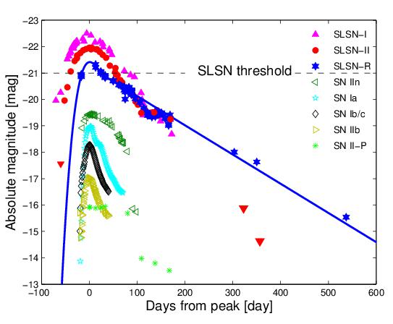
Supernovae
Light curves
Superluminous
supernovae (SLSNe)
Brighter than M = -21
Type Ia supernovae
Core-collapse
supernovae (CCSNe)
IIn, Ib/c, IIB, IIP, IIL, etc.
Gal-Yam+ 12

Slide 4
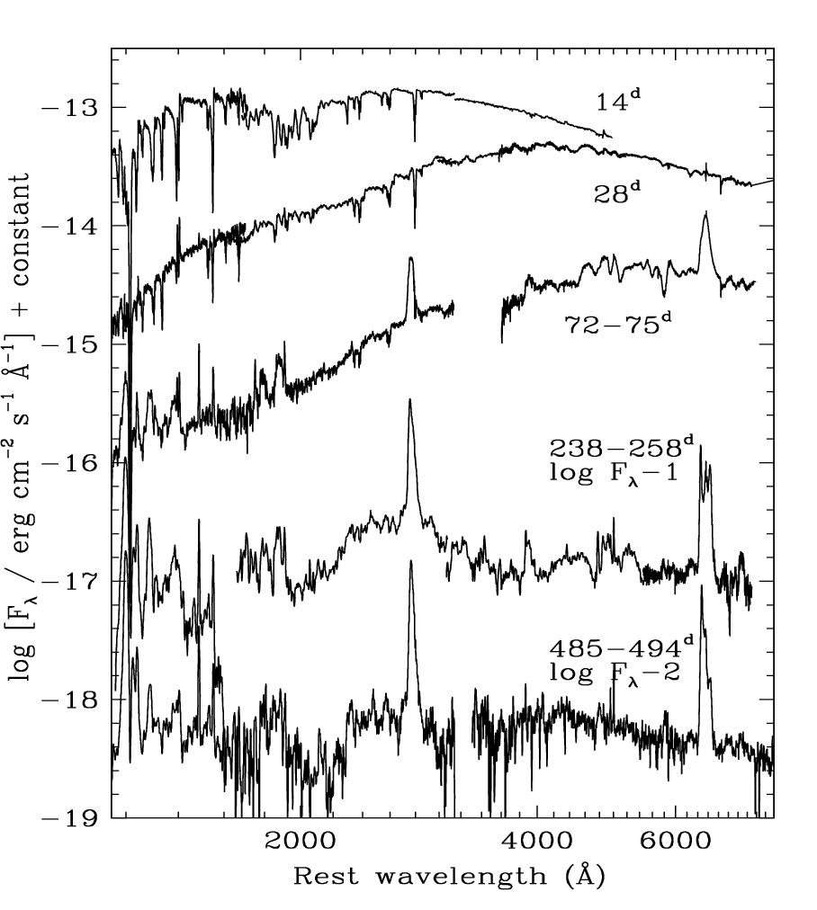
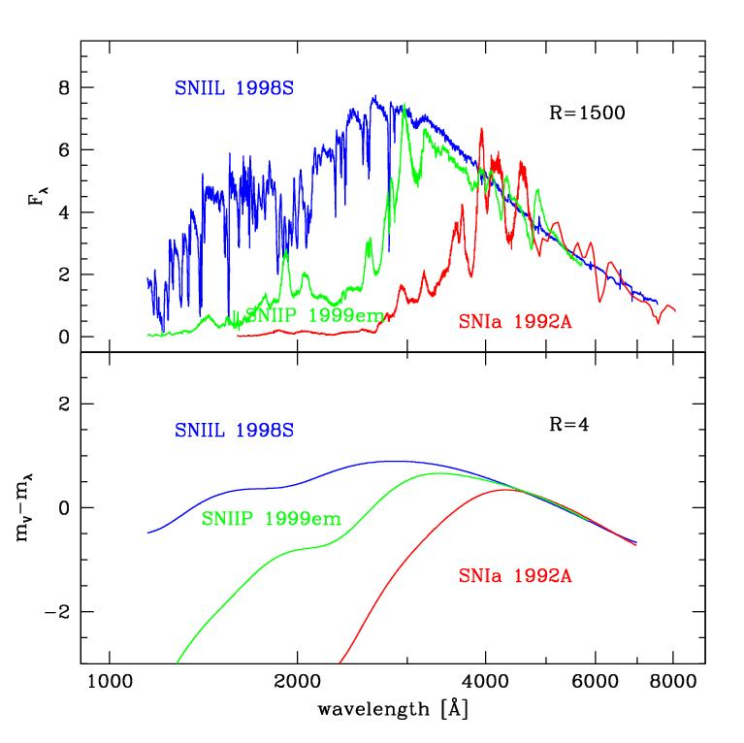
Supernovae
SNIIn 1995N
Detectability at high redshift (z > 2)
Most CCSNe are UV-luminous
detectable above z ~ 2
Type Ias → little UV due to line-blanketing
Riess+ 04
Fransson+ 02

Slide 5
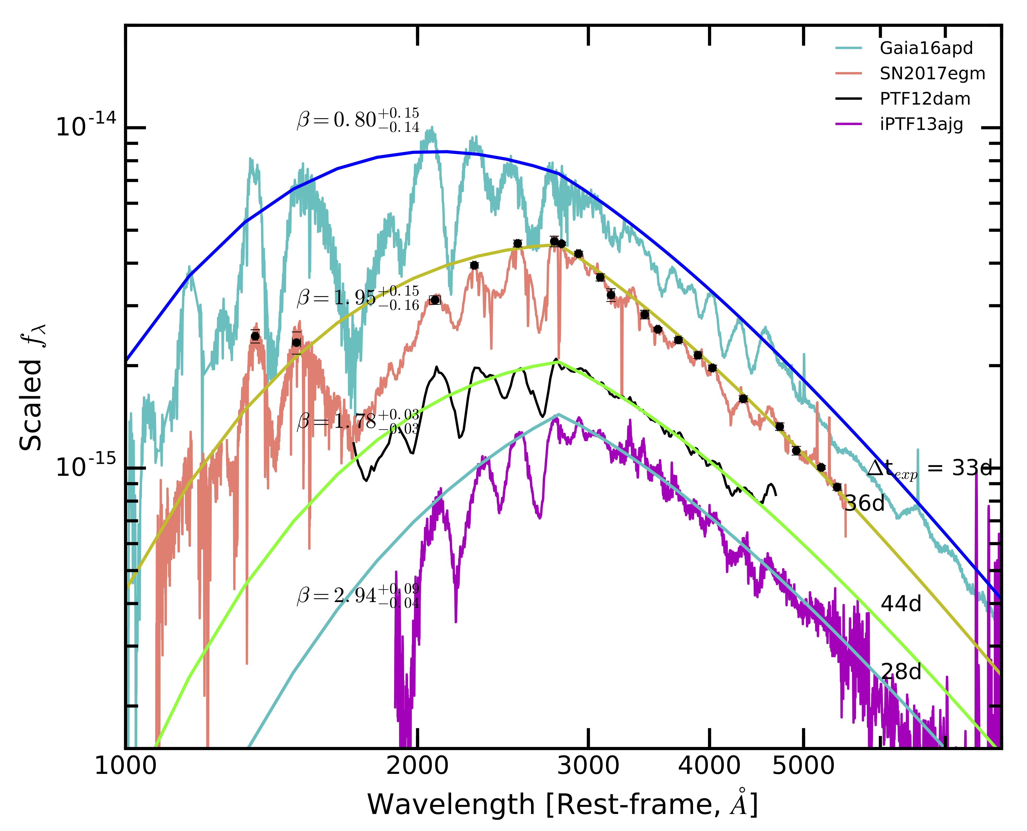
Supernovae
Superluminous
supernovae (SLSNe)
UV is information rich
Necessary for models
to help understand
their extreme
explosion mechanisms, their environments and
their progenitors
Yan+ 18

Slide 6
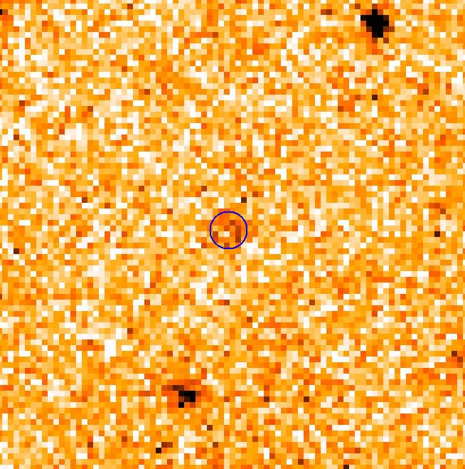
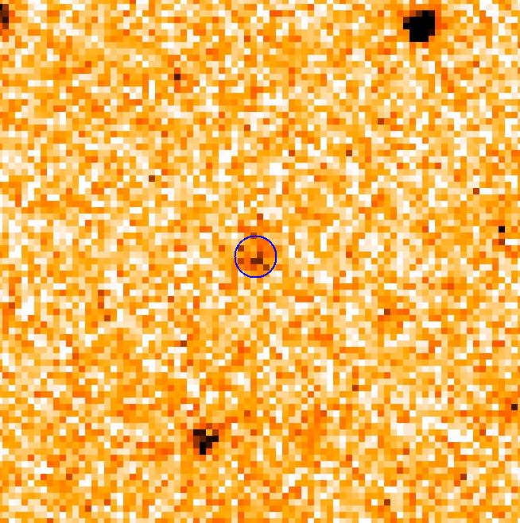
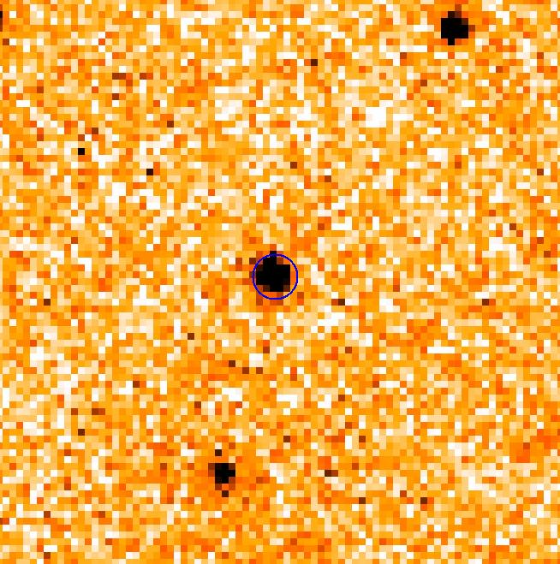
Supernovae
Superluminous
supernovae (SLSNe)
Brighter than M = -21
SLSNe-I are found nearly
exclusively in
low-mass,
low metallicity,
dwarf galaxies
SLSNe are much brighter than their hosts
~15 arcsec

Slide 7
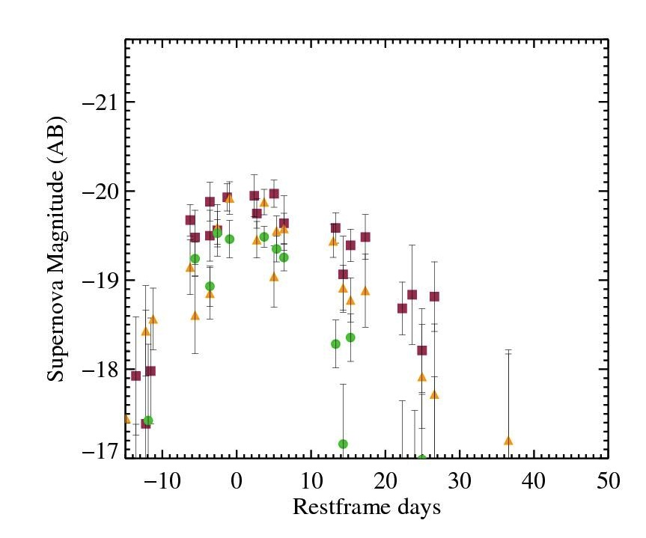
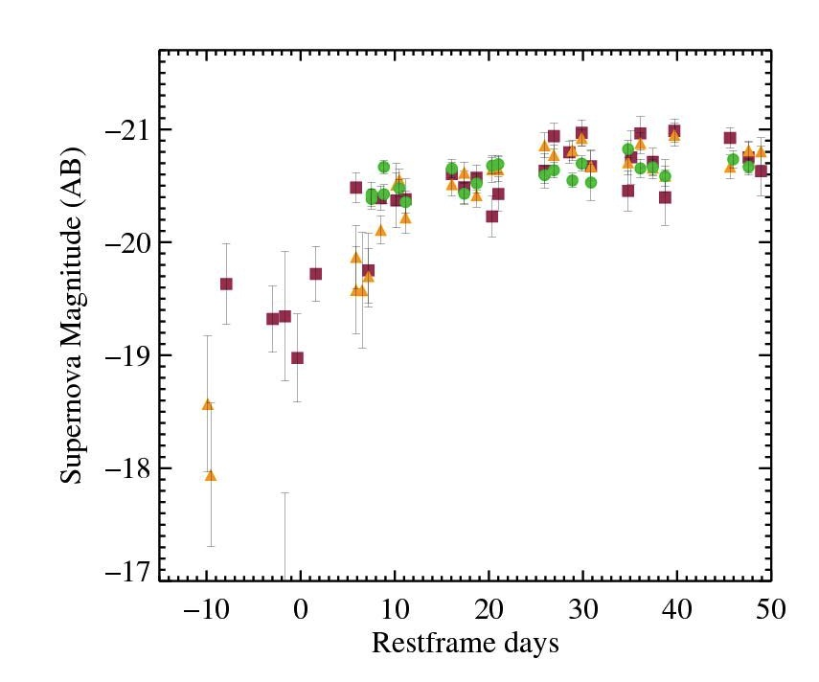
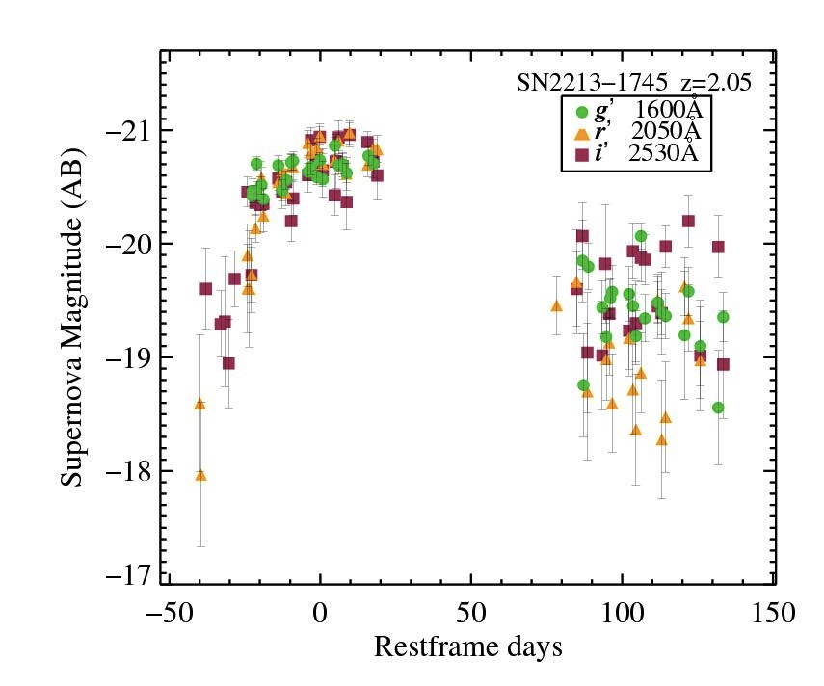
Supernovae
Light curves
Time dilation
High-z supernovae
evolve over years
Classically
scheduled follow up
at high-z
(no need for ToOs)

Slide 8
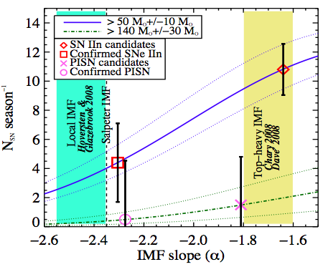
Utility
Some high-z supernova science
High-mass end of the IMF
Bright background beacons to probe
host ISM, CGM, and intervening IGM
Cosmic reionisation – emit LyC photons,
provide probes into host leakage
Pair-instability supernova detection
Deaths of population-III stars
Early cosmic chemical evolution
Early Universe star formation rates
Extreme explosion mechanisms
physics and circumstellar environment
Berger+ 12

Slide 9
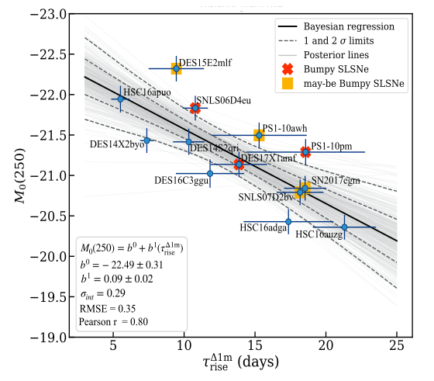
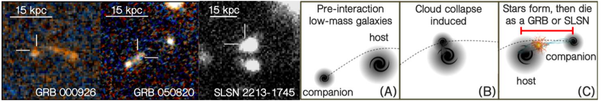
Utility
Some high-z supernova science
Locate high-redshift proto-galaxies
and/or dwarf galaxies
Massive star formation environments,
metallicity, galaxy interactions
Cosmology – potential use as a z ~ 0 – 20
standardizable candle
Measure cloud collapse and progenitor
lifetime via galaxy interactions

Slide 10
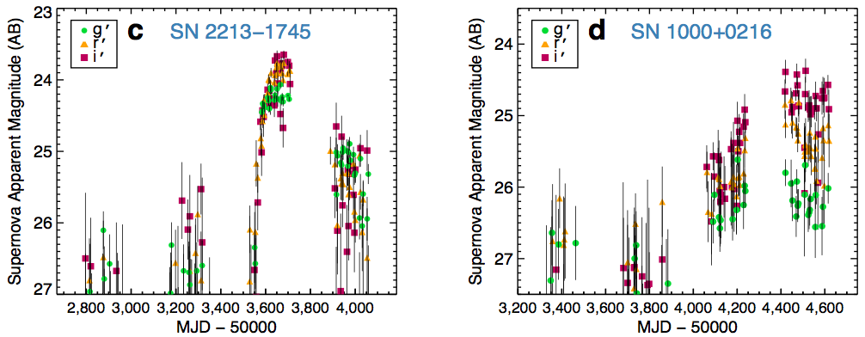
Transient challenges
Rare, unpredictable, and well … transient
Detection – Need deep, wide-field imaging over several square degrees
Cadence of about once a month during 6-month visibility for 4+ years
4 years of data
Here,~20 epochs/yr
Cooke+ 12

Slide 11
Transient challenges
Detection
Deep, wide-field imaging over several square degrees
Rates for SLSN higher at high-z, higher than from cosmic SF alone
CCSNe can peak as bright as M ~ -20
SLSNe can peak as bright as M ~ -22.5
Imaging requirements for M ~ -21 events
Ground-based optical Roman/JWST
redshift z ~ 2 3 4 5 6 7 10 15 20
depth m ~ 24.8 25.6 26.1 26.4 26.7 27.0 27.5 28.1 28.5
Per epoch. Includes 1 mag deeper to get rise and fade
Ground-based optical: CFHTLS Deep (5yr), DES → m ~ 27.5 yr, m ~ 26 per epoch
HSC SHIZUCA (4yr) → m ~28.0 yr, m ~ 26.5 per epoch
Roman deep fields aim to reach m ~ 28-29, shallower per epoch
JWST tiled wide-fields (e.g., COSMOS-Web) deeper

Slide 12
Transient challenges
All supernovae are classified in the rest-frame optical
Supernovae at z > 4 are observed only in their restframe UV
Their identifying optical features and light curves are beyond the near-IR and largely out of the mid-IR for the highest redshifts
Need for ELTs and JWST
There is a (desperate) need for a UV classification scheme
Requires deep optical, near-IR and mid-IR spectroscopy
Deep, high spatial resolution IFU data are needed for redshifts, supernova location in their host galaxies, host galaxy properties, local environment properties, evidence for interactions, etc.
ELT – JSWT complementarity
Classification: ELTs - restframe-UV, JWST - restframe-optical IFU spectra of z ~ 2-7 supernovae + hosts
Supernova discovery and study: to z ~ 15 → ELTs, z ~ 20+ → JSWT

Slide 13
ELT and JWST science
Some of the ELT and JWST science discussed at this meeting
Stellar populations, globular clusters, ultra-faint/dwarf galaxies, low-surface brightness source, stellar streams, etc., in and beyond the Local Group
Transients: Gravitational wave sources, all the supernova science here, including their hosts (probing dwarf hosts and galaxies with very recent star bursts, etc.)
Ly-a and H-a emitters, Ly-a blobs, etc., narrowband searches, companions, groups, interactions, for spatial structure and IFU study
High redshift source contamination (very deep optical imaging)
Gravitationally lensed sources
Galaxies at the faint-end of the luminosity function
Identifying massive structures at low and high redshift
Cosmic reionization: Lyman Continuum galaxy identification and mapping,
combining reionization with future 21 cm surveys (i.e., Square Kilometre Array)

Slide 14

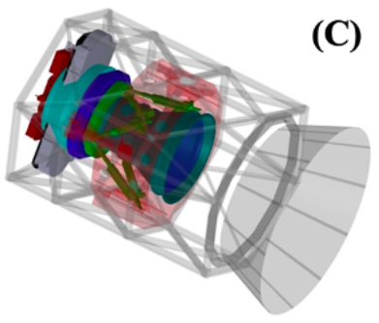
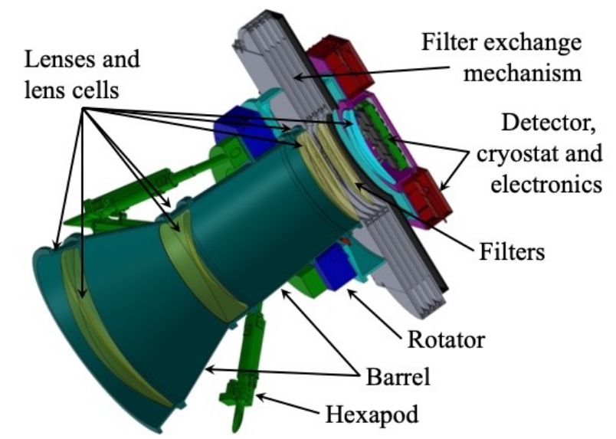
Keck Wide-Field Imager
The most powerful wide-field optical imager for decades
Groundbreaking depths, unparalleled UV sensitivity
Able to reach m ~ 29-30 – Head-to-head with Roman (mag/s)
Fills large gap in capability for the foreseeable future
0.145” per pixel resolution, < 15 s readout
Broadband and HSC narrowband filters, ~10 s filter change
Extremely deep u-band, sensitive to the near-UV
Same night instrument multiplexing with deployable secondary
Real-time data reduction pipeline and analysis (2-3 minutes)
5 sigma depths, KWFI: 0.8” FWHM seeing, 3 days from New Moon

Slide 15
Summary
Supernovae have taught us a lot about the Universe and physics within it
They have high utility across multiple areas of research
Detection: z > 2 - 20 supernovae require deep, dedicated multi-year wide-field surveys
Roman, Rubin, HSC (but PFS), need KWFI to fill current/future blue/deep gap
ELT and JSWT need: Urgency for UV classification scheme
Keck/ELTs and JWST needed for z ~ 2–4 confirmation, study, and classification
ELTs and JWST for z ~ 2–20 confirmation and study, SN environment, host properties
Lots of science
ELT/JWST spectra to understand explosion physics, environment and progenitors
Probe the early Universe, host ISM/CGM/IGM, and locate faint high-z galaxies
Measure the IMF, cosmic SFR, chemical evolution
Detect pair-instability supernovae and the deaths of Population III stars
Reionisation: supernova LyC and sightlines into their host galaxies
Direct observational measure of cloud collapse timescale and progenitor lifetime
Use as cosmological probes

Slide 17
Detection facilities and surveys
Euclid Several ~10 deg² Deep Fields to m ~ 27-28
Can detect SLSNe to z ~ 10
Roman Several ~10 deg² Deep Fields to m ~ 28-29
Can detect SLSNe to z ~ 13
JWST surveys Possible < 1 deg² deep survey field(s) to m ~ 29-30
Can detect SLSNe to z ~ 20
CFHT Several ~1 deg² Deep Fields to m ~ 27, including u-band
DECam Several ~3 deg² Deep Fields to m ~ 27, poor u-band
Can detect SLSNe to z ~ 4
Subaru ~Two ~2 deg² Deep Fields to m ~ 28, no u-band
Can detect SLSNe to z ~ 6
KWFI Cover Roman Deep Fields to m ~ 29, including u-band
Can detect SLSNe to z ~ 7

Slide 18
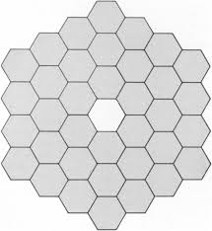
Detection facilities and surveys
CFHT DECam Subaru Rubin Keck
8.6 m² 9.2 m² 53 m² 35 m² 76 m²
Current wide-field (> 0.5 deg) optical imagers on 4m+ class telescopes
CFHT Megacam CTIO DECam Subaru HSC Rubin Observatory
3.6m – 1 deg 4.0m – 2.2 deg 8.2m – 1.5 deg 6.5m – 3.5 deg
20 yr-old 11 yr-old 10 yr-old
Maunakea optics shared with LSST until 2034
Spectroscopic Prime Focus
Explorer (MSE) Spectrograph (PFS)
Future wide-field imagers on 4m+ class telescopes (ground or space for decades)
None Keck Wide-Field Imager
10.0m – 1.0 deg

