Slide 1
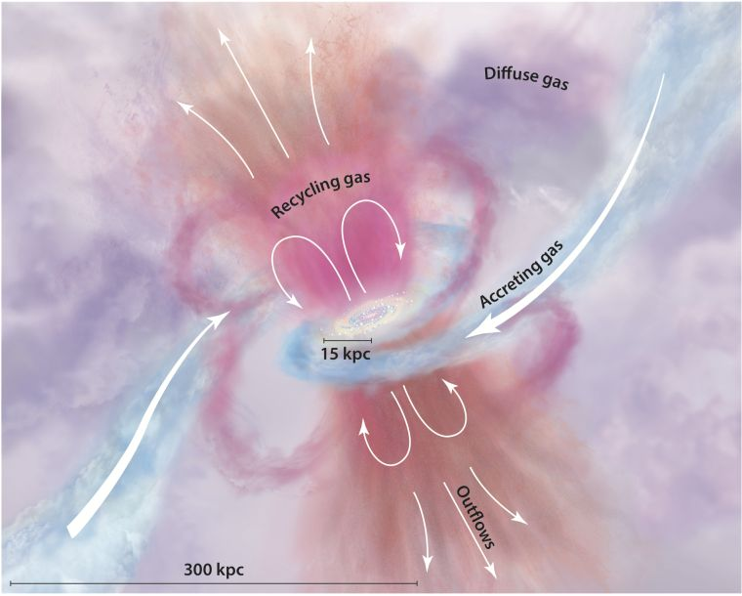
Outflows in JWST Galaxies at z = 3 − 9: Implications of More Frequent and Spherical Galactic Fountains
Yi Xu (University of Tokyo)
In collaboration with M. Ouchi,
K. Nakajima, Y. Harikane, Y. Isobe, Y. Ono, H. Umeda, Y. Zhang
Tumlinson+17

Slide 2
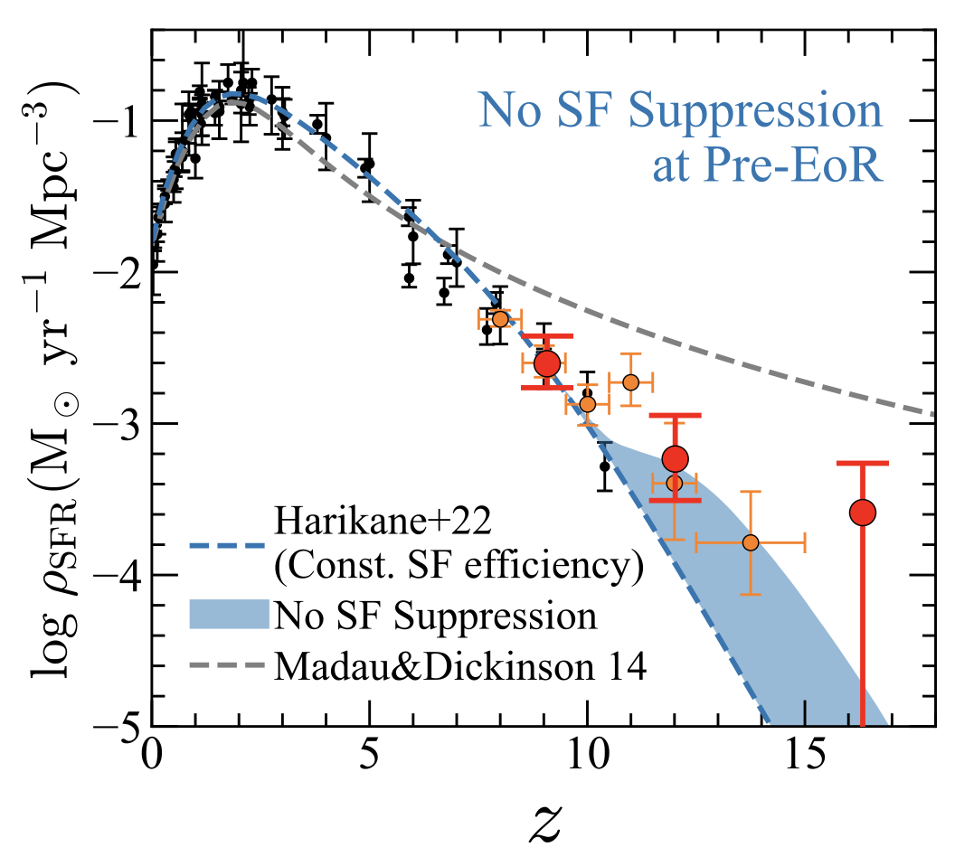
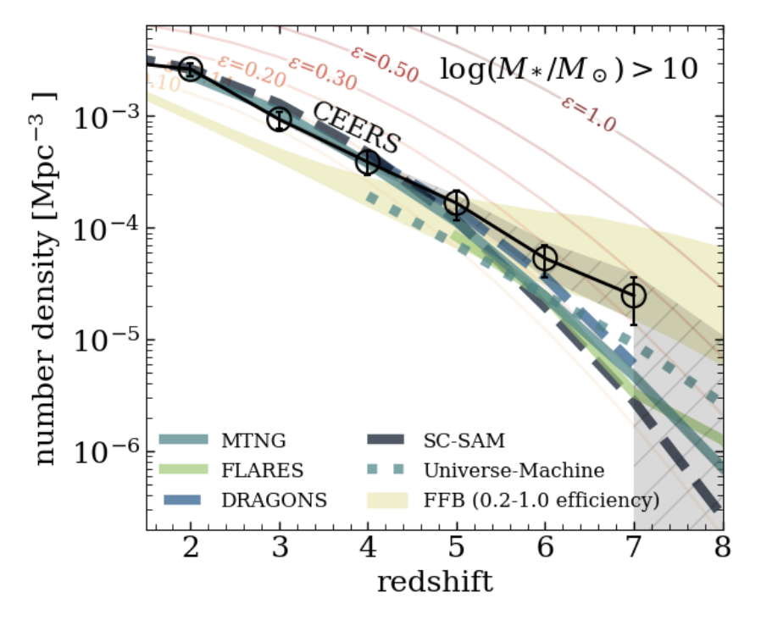
Introduction: background of early massive galaxies
Can we check the feedback efficiency by observing outflows?
Explained by feedback-free model?
Harikane+23a
Chworowsky+23

Slide 3
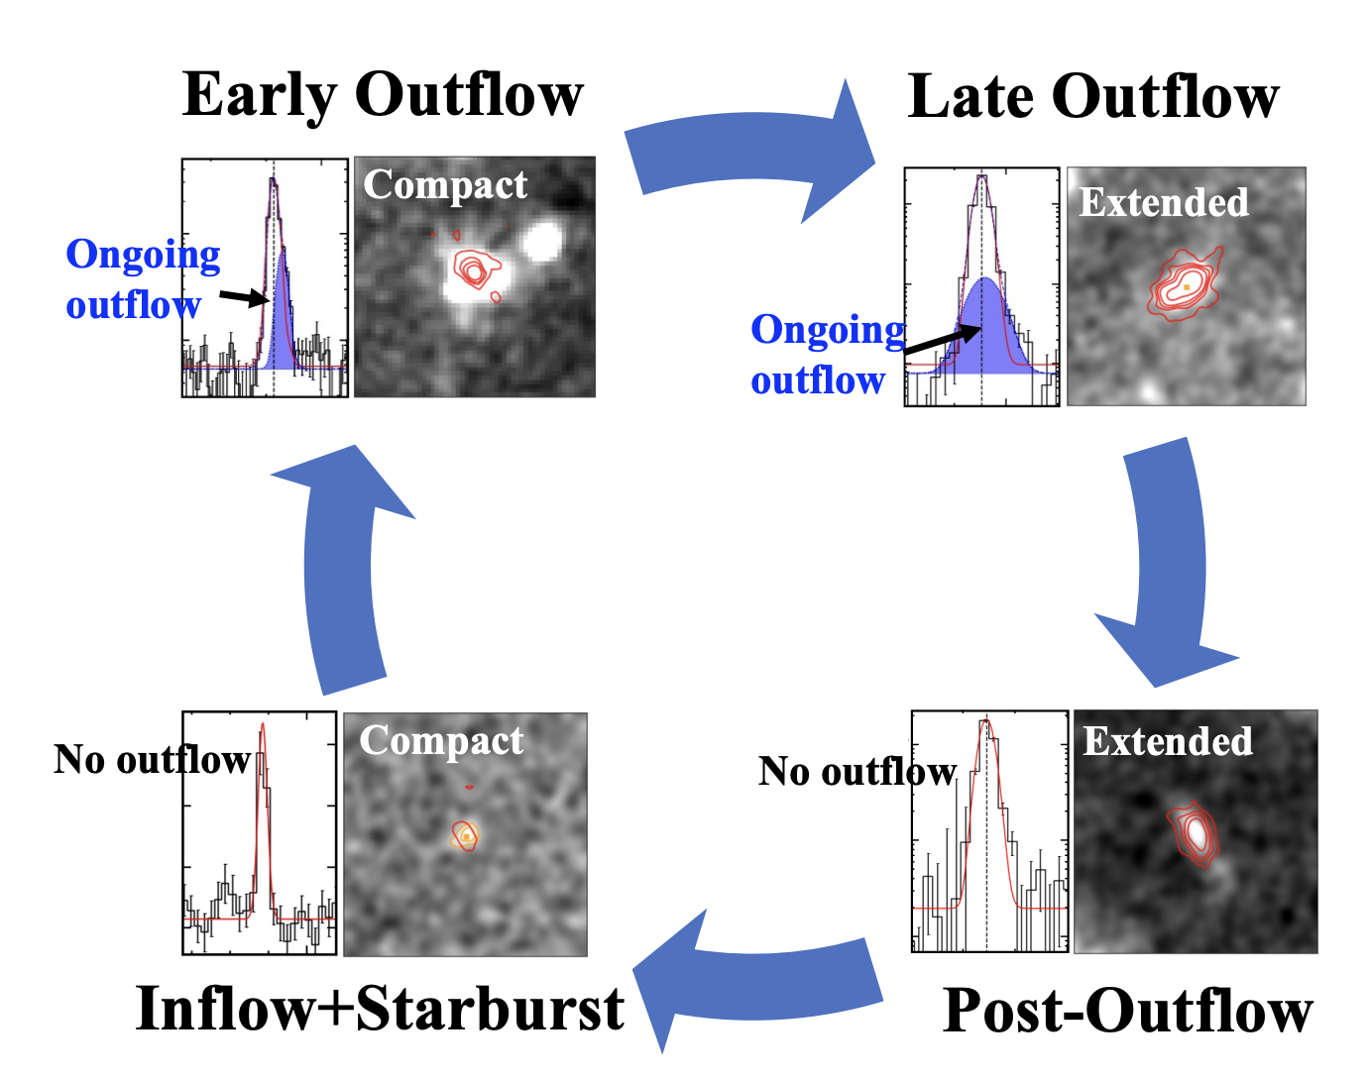
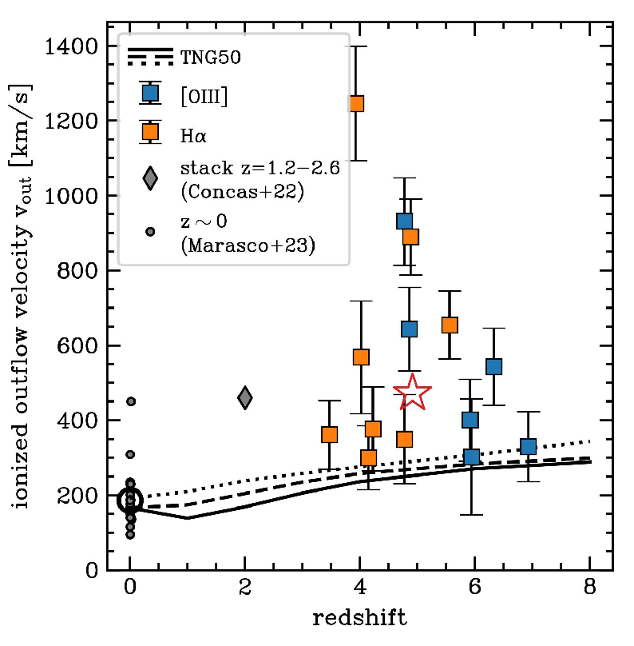
Introduction: outflow at high z in the era of JWST
Objectives of our study:
identify outflows in galaxies w/ and w/o AGNs
statistically constrain feedback efficiency
quantitatively discuss outflow geometry and duty cycle
Y. Zhang, …, YX, et al. 2023, arXiv:2306.07940
Data: NIRCam + NIRSpec from ERO,GLASS,CEERS
Carniani et al. 2023
Data: NIRSpec from JADES

Slide 4
Galaxy Sample
130 galaxies at z~3-9 with H⍺ or [OIII]λ5007 detections
CEERS,ERO
GLASS, JADES
FRESCO

Slide 5
Galaxy Sample
Include 12 Type-1 AGN selected by broad H⍺ line (Harikane+23b, Maiolino+23c)

Slide 6
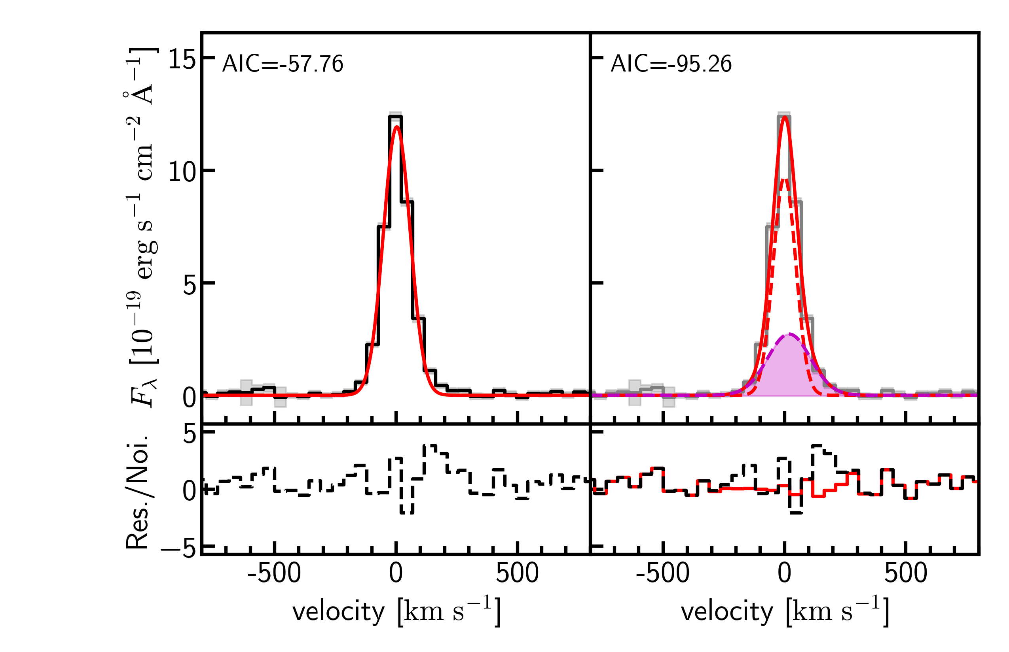
Identification of outflow
Significant difference of AIC
outflow

Slide 7
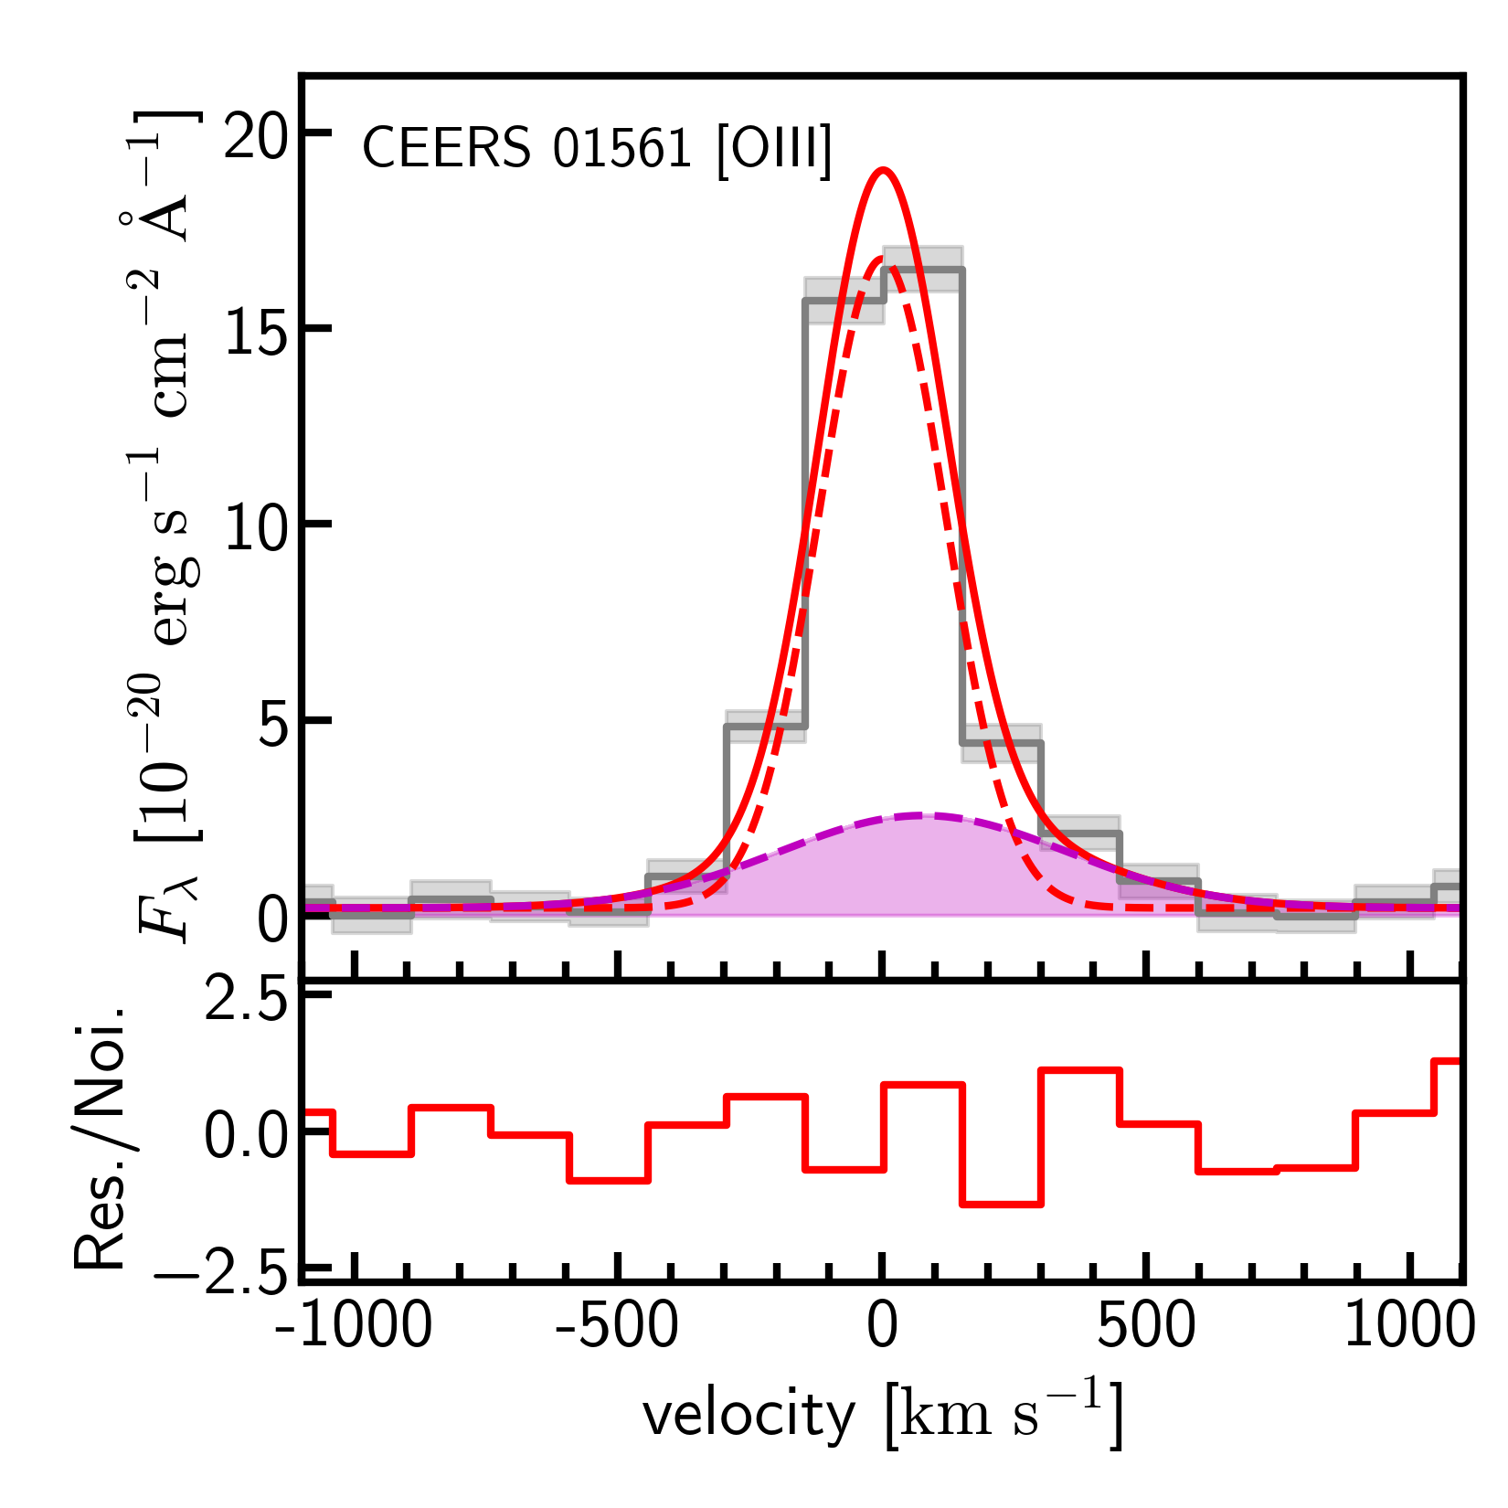
Outflows in star forming galaxies
Broad wings in [OIII] and/or H⍺

Slide 8
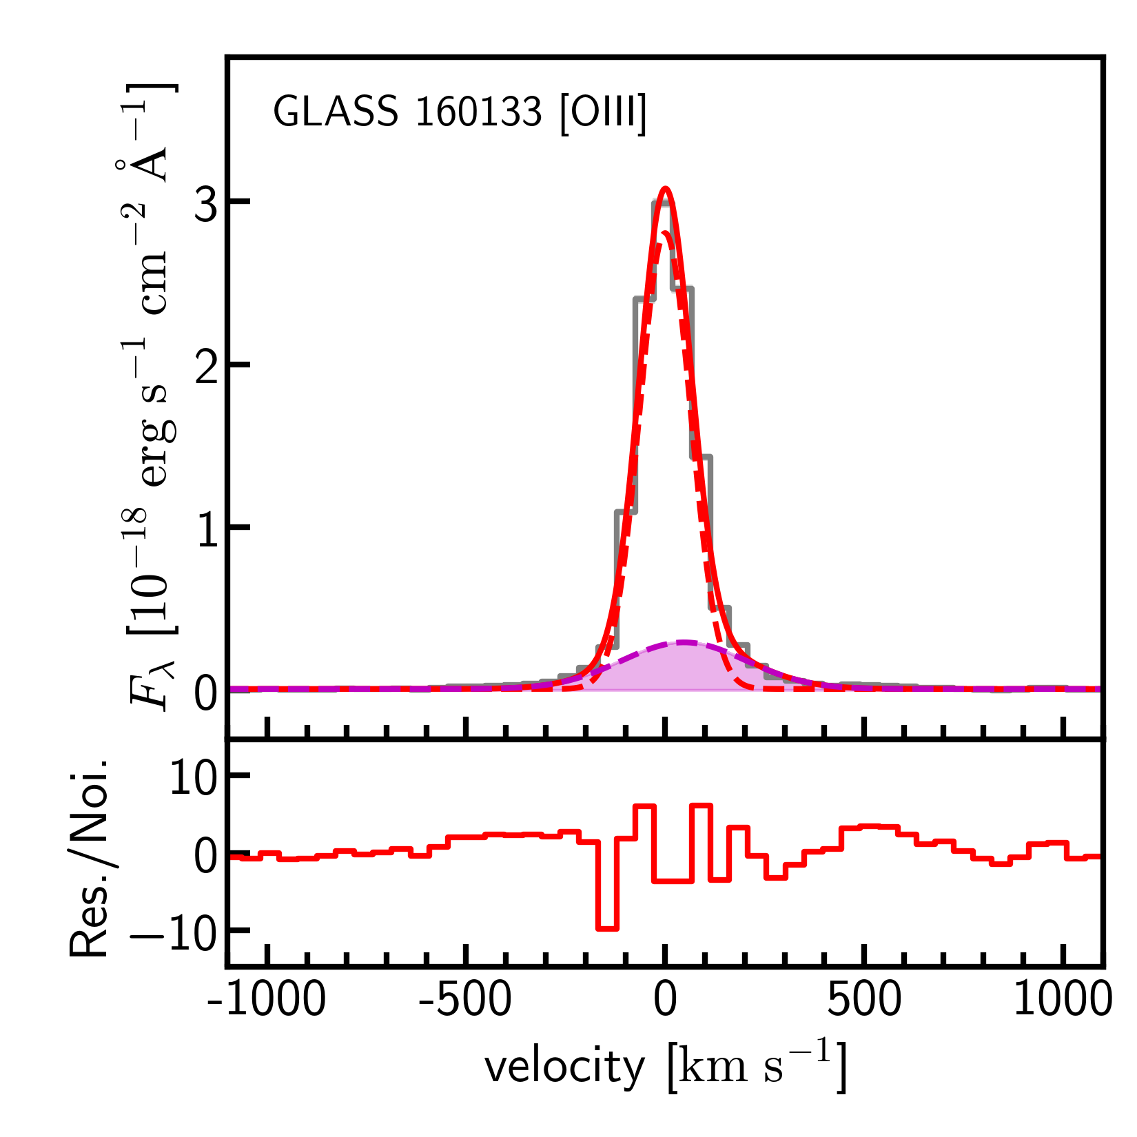
Outflows in Type-1 AGN
outflow
BLR
confirmed with forbidden line

Slide 9
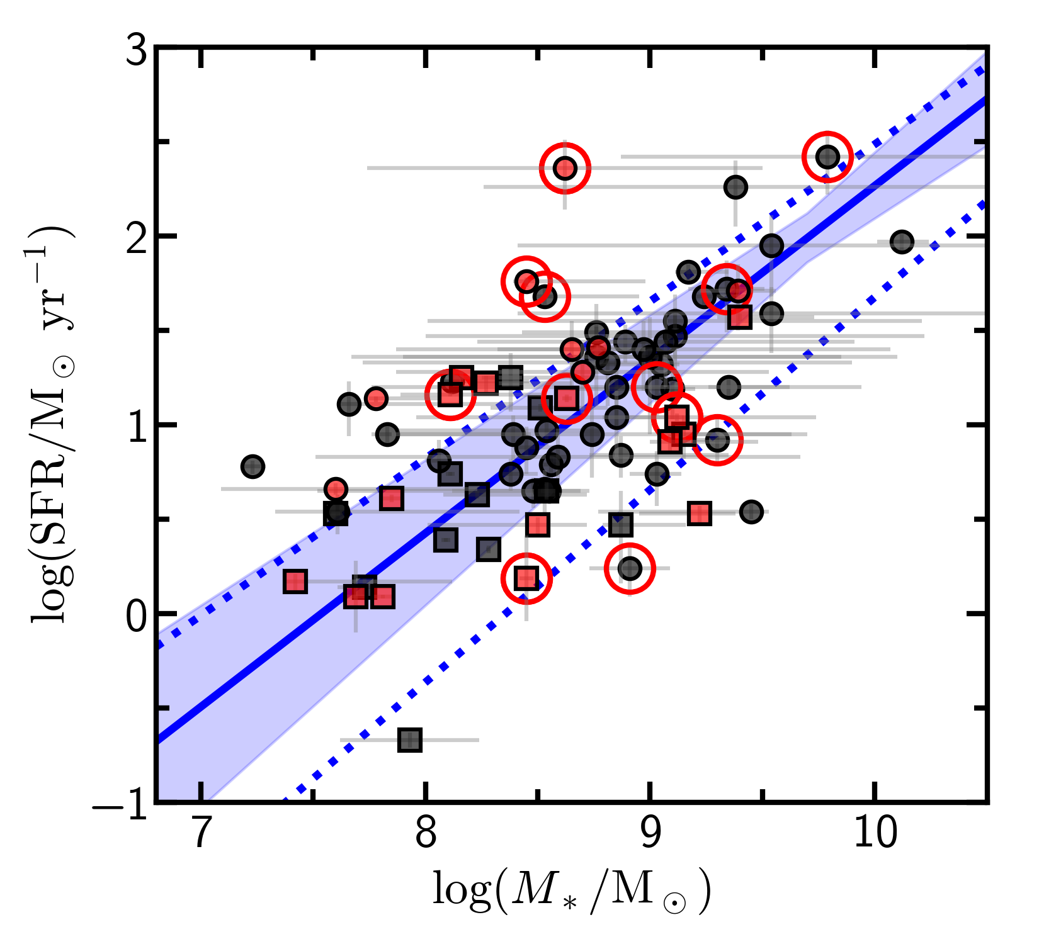
Detection rate
118 (=130-12) star forming galaxies => 26 w/ outflows
12 Type-1 AGN => 4 w/ outflows
Evenly scattered around the SFMS
Ubiquitous outflow?

Slide 10
Implications for outflow geometry and duty cycle
incidence rate = covering fraction
outflow fraction
Bursty SF and outflow
conical outflow
Pandya+21

Slide 11
Implications for outflow geometry and duty cycle
incidence rate = covering fraction
outflow fraction
30%
20%@z=0

Slide 12
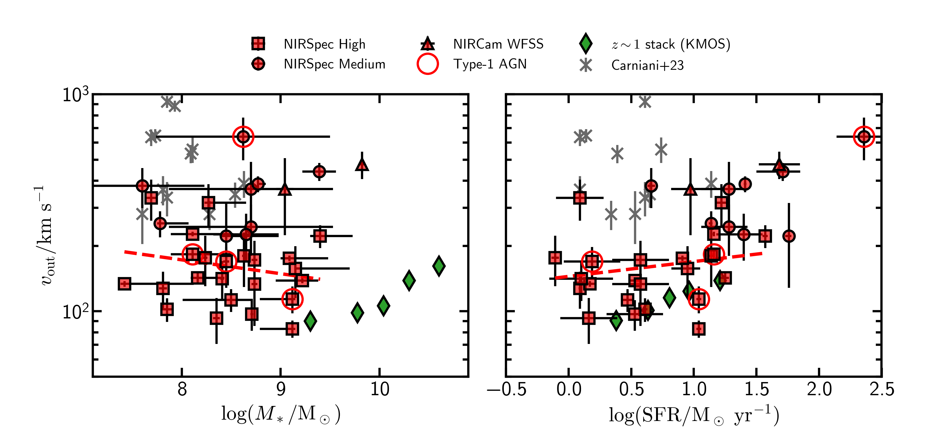
Outflow velocity
faster or comparable with low-z results
v_{out} in AGNs are not particularly large
Notes:
feedback:
motivation and goal is unclear
introduction

Slide 13
Implications of galactic fountains
Recycling
Tumlinson+17

Slide 14
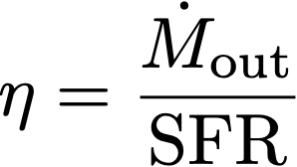
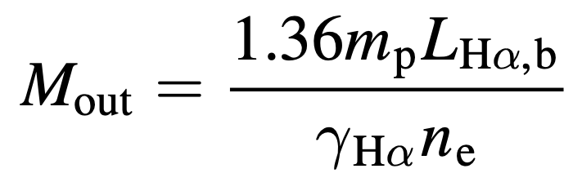
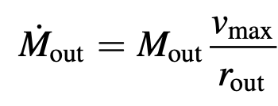
Feedback efficiency: mass-loading factor
z~6 EAGLE
z~6 FIRE-1
Mass outflow rate:
(e.g., Newman+12)
z~1 FIRE-2
z~1 FIRE-1
η ~ 0.1 – 1, comparable to those of z~1 galaxies
Feedback efficiency is lower than simulation predictions for high z
Future prospective: one-to-one comparison with mock observations from simulations
Notes:
things to improve
difficult to understand the figure
annotate the simulations (arrows)
show only (z~6) models and z~0 for reference

Slide 15
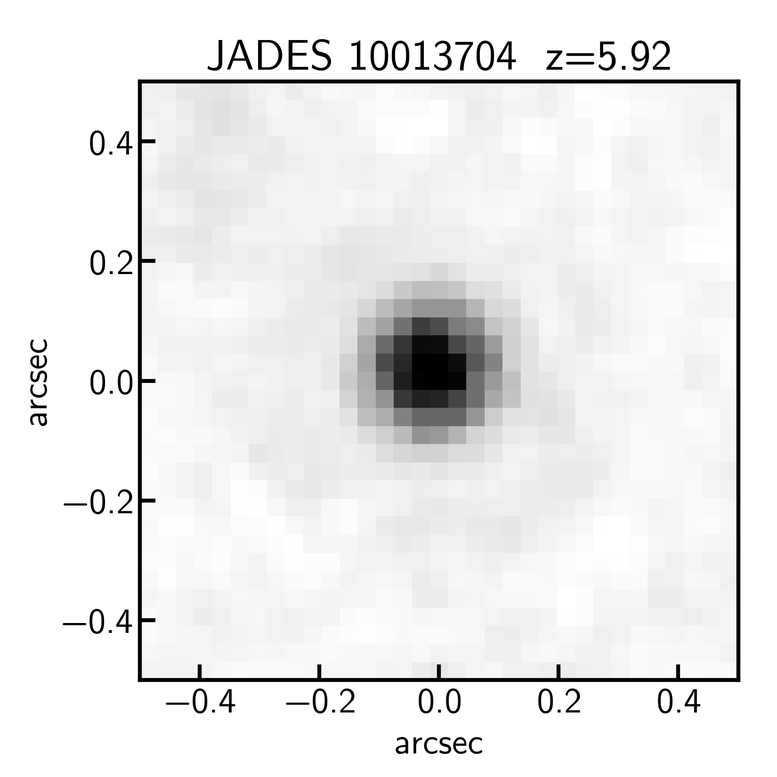
Stellar driven or AGN driven?
Resolve the launching site of outflows => mission with ELTs

Slide 16
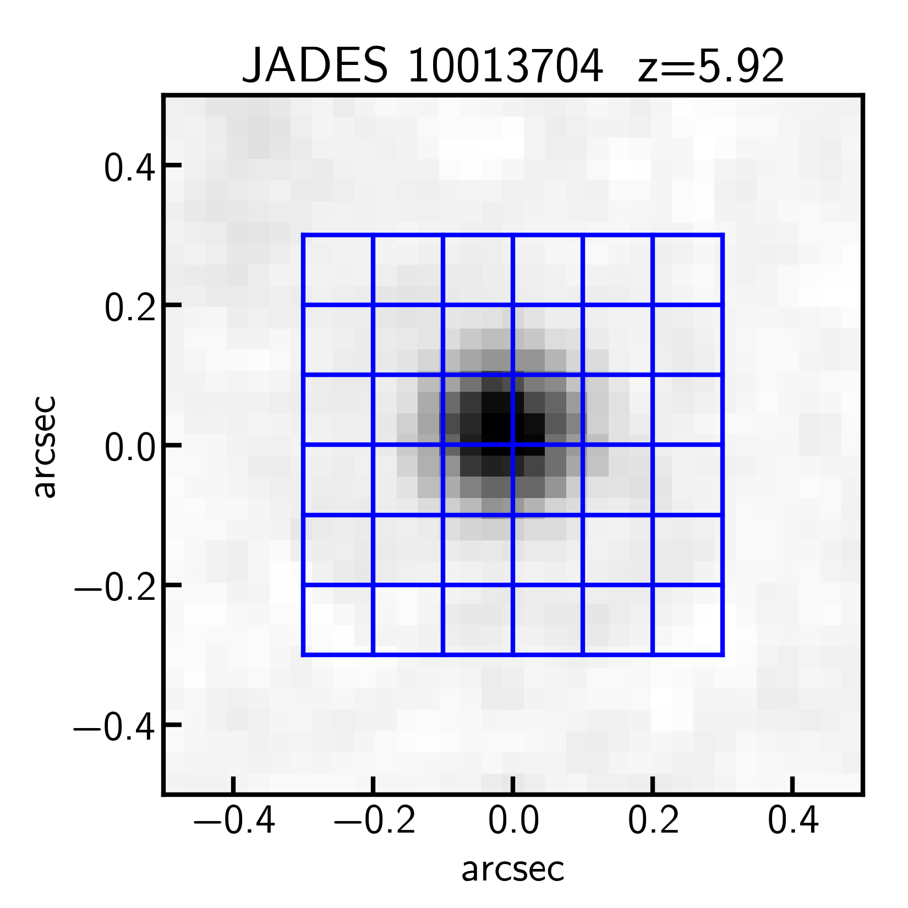
Stellar driven or AGN driven?
Resolve the launching site of outflows => mission with ELTs
NIRSpec IFU
pixel scale~0.’’1
HARMONI
pixel scale~4 mas
(similar for GMT, TMT)

Slide 17
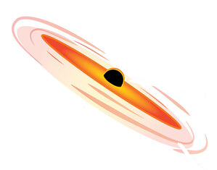
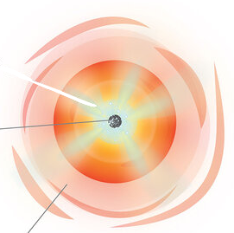
Stellar driven or AGN driven?
Edge-on
Face-on
Image Credit: Sophia Dagnello, NRAO/AUI/NSF

Slide 18
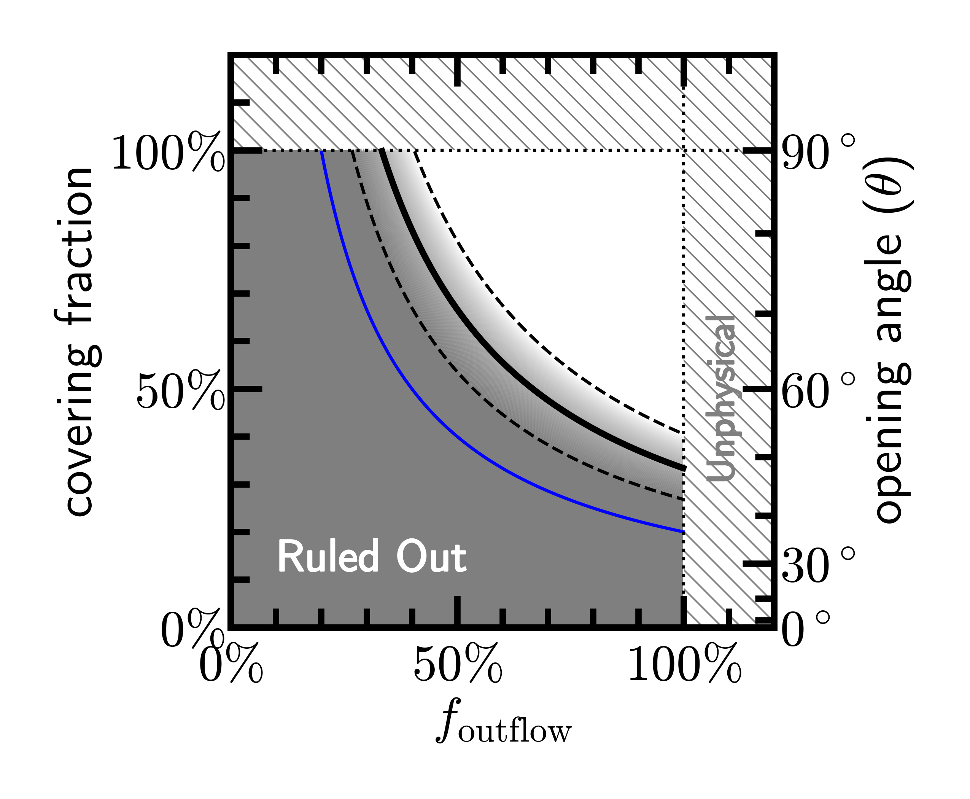
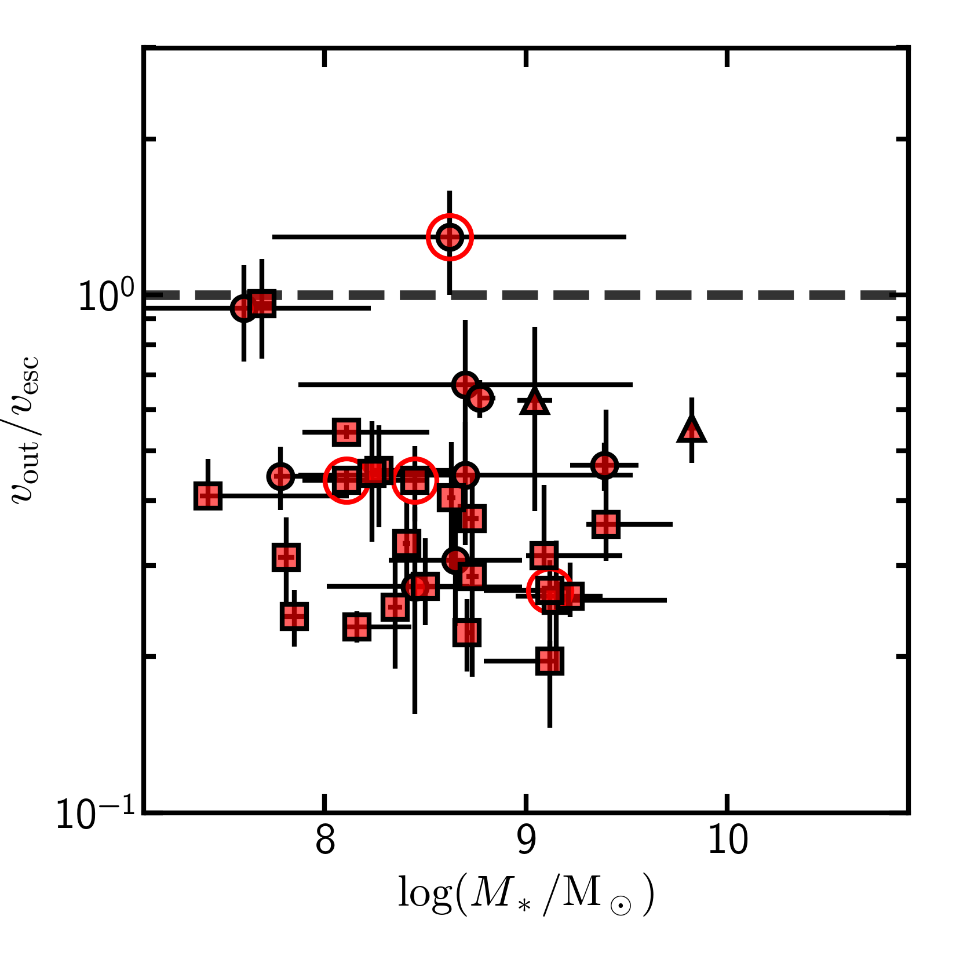
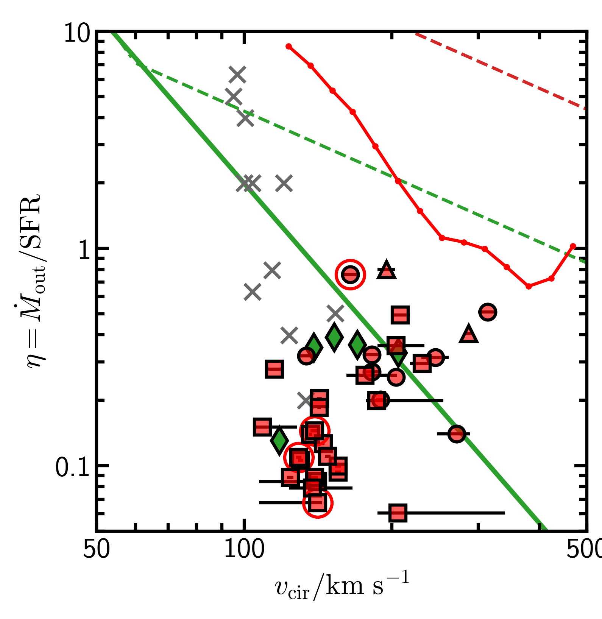
Take home message (arXiv:2310.06614)
High-z outflows are more likely frequent and spherical galactic fountains

Slide 20
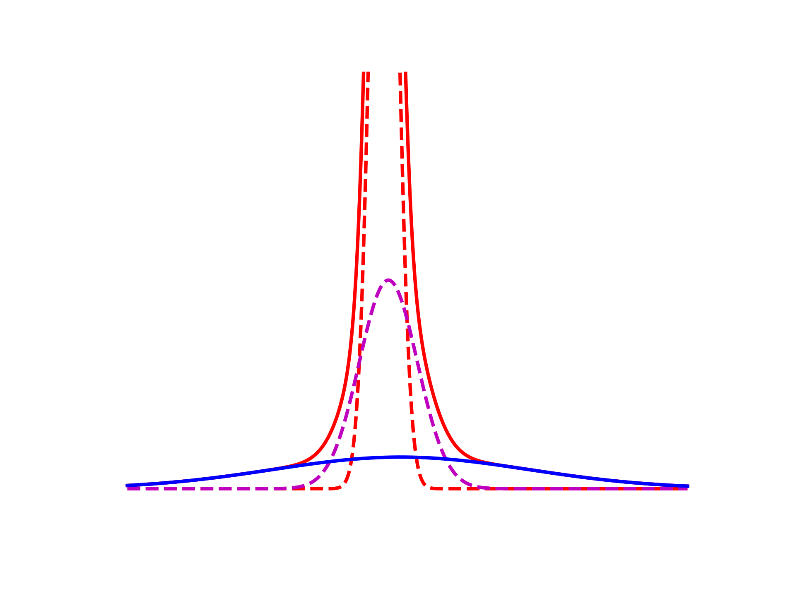
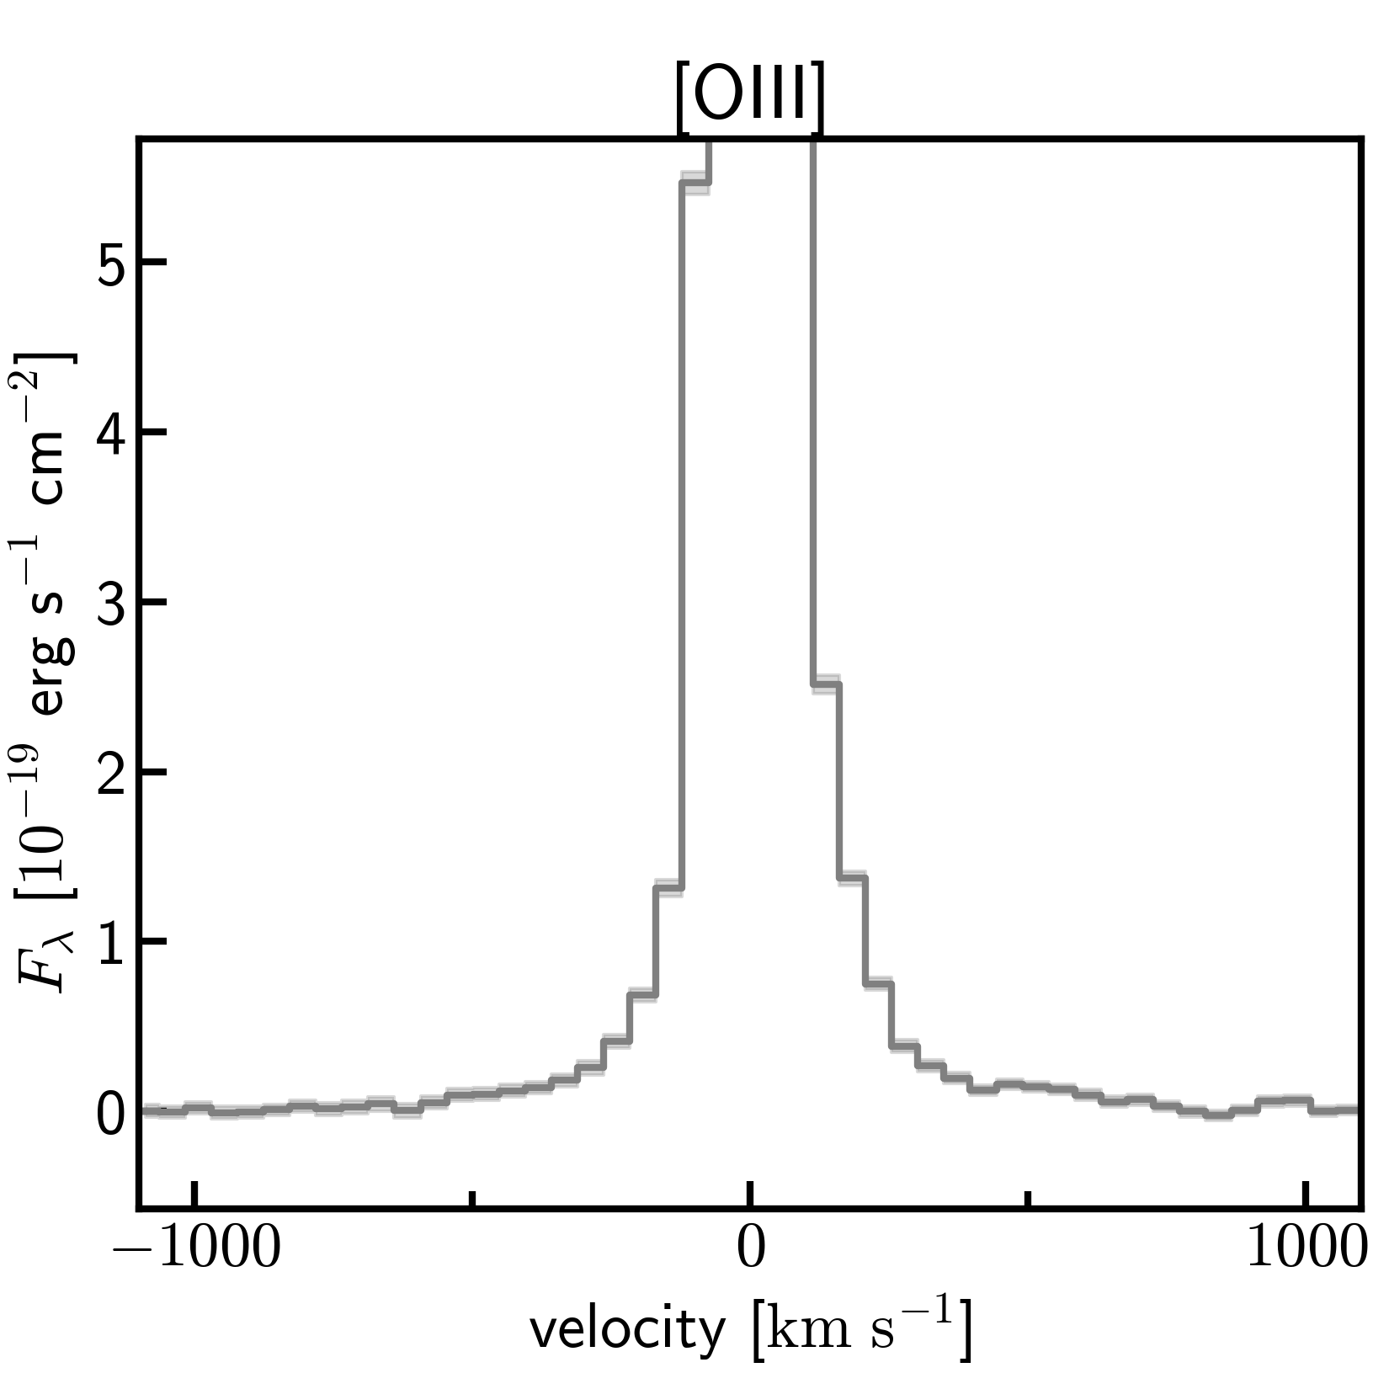
Outflows in Type-1 AGN
outflow
BLR
Notes:
hard to see

Slide 21
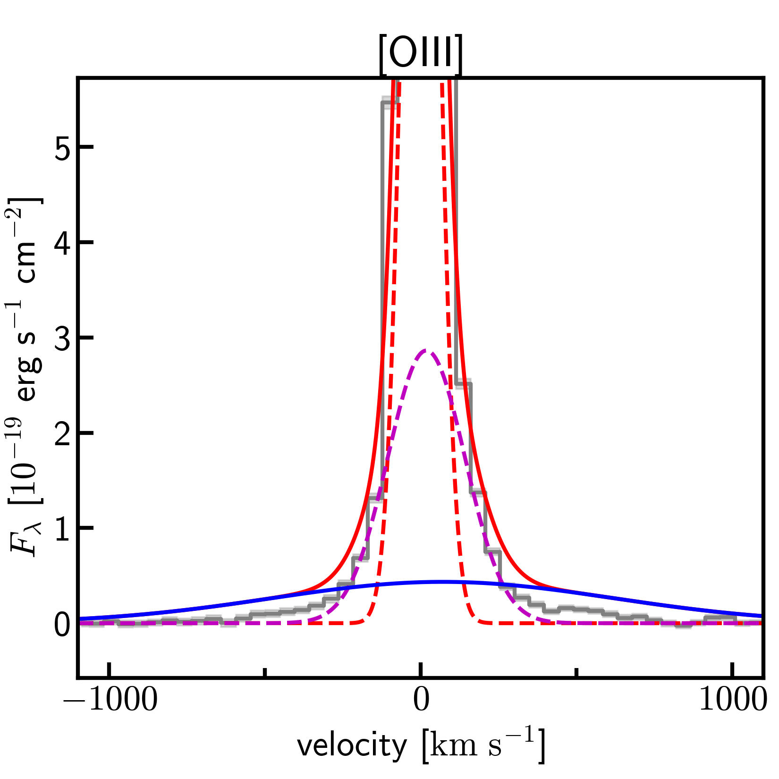
Outflows in Type-1 AGN
Significant difference of AIC
outflow
outflow
BLR
Notes:
hard to see the outflow component (color?)

Slide 22
Comparison with simulations
z~6
z~1
z~0
Feedback efficiency is lower than simulation predictions for high z

Slide 23
FIRE-1
FIRE-2

Slide 24
Outflow velocity
larger sample needed to test the correlation at each redshift
(NIRSpec High and SF galaxy only)

Slide 25
Mass outflow rate
Broad emission line => mass of outflow gas
v_{max}
Ionized gas
/
dynamical timescale:
r_{out}/v_{max}
r_{out}: spatial extend of
ionized outflow gas
＝
Mass outflow rate (see also e.g., Newman+12)

Slide 26
Outflow at z~8.5

Slide 27
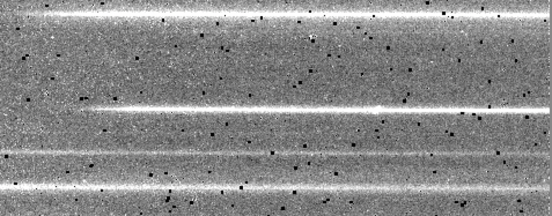
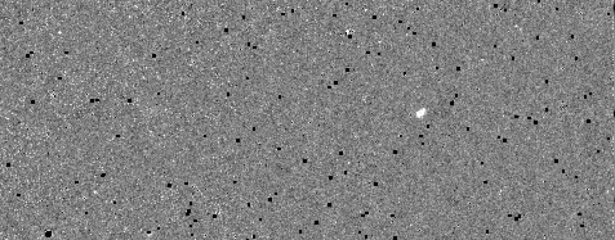
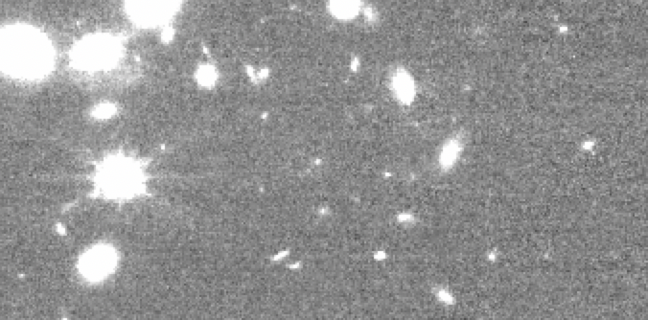
NIRCam/WFSS Data Reduction
Raw data
② subtract cont.
using median filtering
(Kashino+22)
① Assign WCS, flat fielding
using JWST pipeline
Detect with SExtractor
④ Search for emission line pair
([OIII]λ4959,5007) on the same dispersed location
NIRCam
image
③ calculate the location
of dispersed spec.
14 [OIII] emitter at z~6-8

Slide 28
NIRCam/WFSS Data Reduction

