Slide 1

Using KCWI to Explore Galactic Feedback in a Reionization-era Spectral Analog J1044+0353
Presenter: Zixuan Peng
Advisor: Prof. Crystal L. Martin
Image Credit: Yuan Li
1 kpc

Slide 2
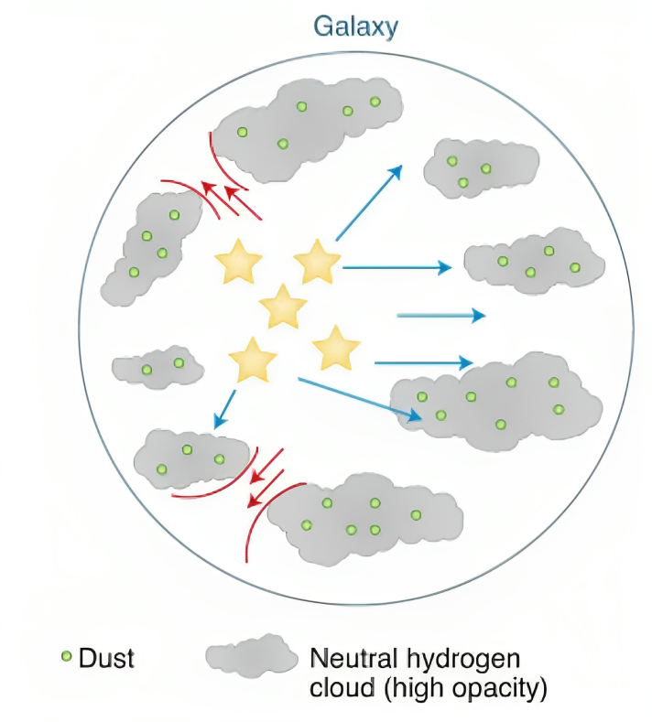
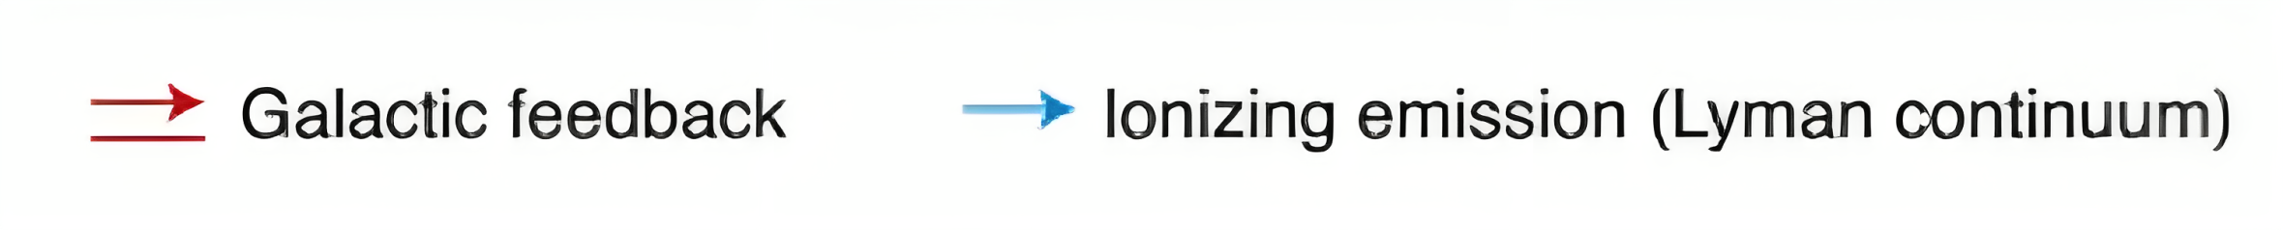
Motivation: LyC Escape & Galactic Winds
“Holes” in HI
LyC Escape Picture: galactic winds/feedback (red arrows) play a critical role in generating pathways, holes in the HI reservoir, for LyC escape.
Supernova Timing Problem: the lifetimes of massive stars producing substantial LyC radiation (blue arrows) are short compared to the lifetimes of most progenitors of core-collapse supernovae.
Alavi (2020)

Slide 3
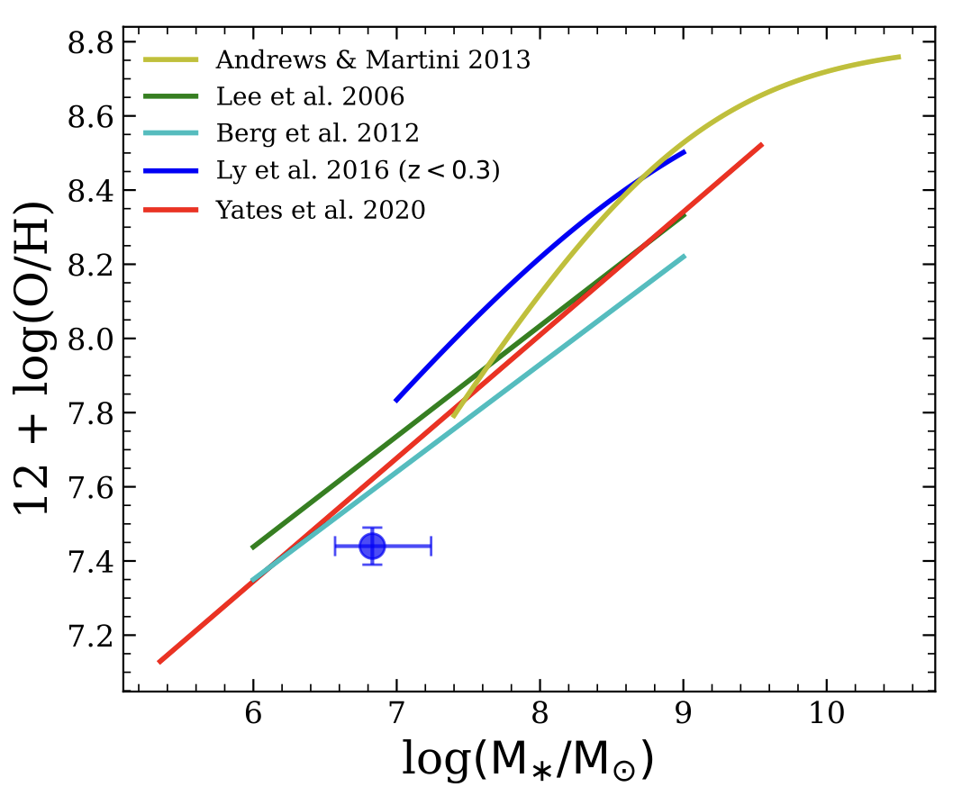
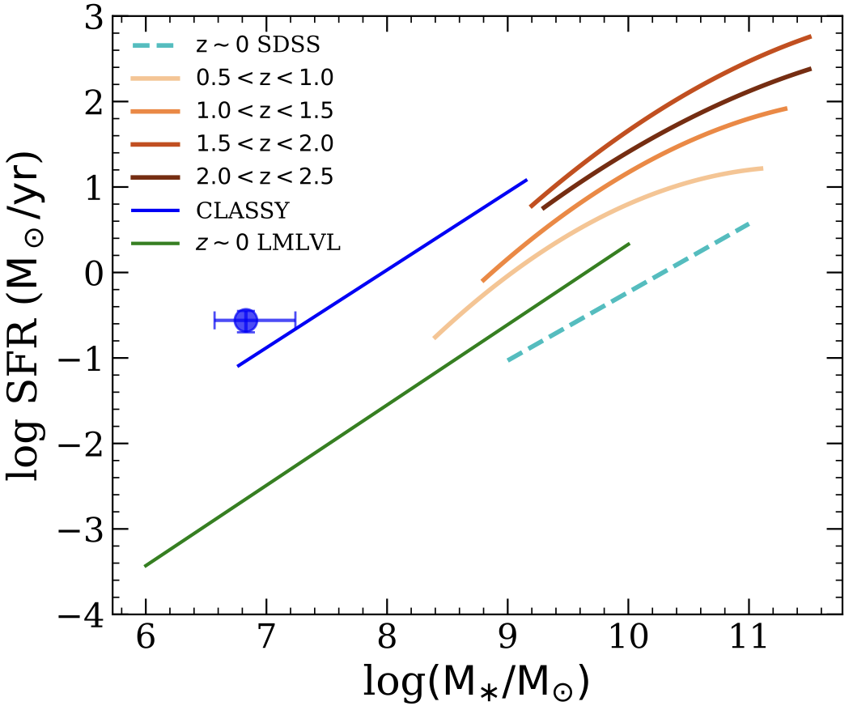




Target: J1044+0353 (z = 0.013)
Selection Criteria:
35 / 27000 dwarf galaxies (fainter than $M_{r}=−18$) from the NASA-Sloan Atlas with EW [OIII] > 1000 $Å$
71 / 27000 dwarf galaxies are listed as He II emitters (Shirazi & Brinchmann 2012)
log SFR ($M_{⊙}$ ${yr}^{−1}$): -0.56
0.06 $Z_{⨀}$
Metallicity Dilution!
SFR Enhancement!
log($M$/$M_{⊙}$): = 6.83
Induced radial inflow of low-metallicity gas (by mergers or interactions; see talks by Danielle Berg and Danial Langeroodi)?
Notes:
Three slicer pointings outline the footprint of the KCWI mosaic cube. We configured KCWI with the small slicer, the BL grating, and a camera angle that produced a central wavelength
of 4600 angstrom.

Slide 4
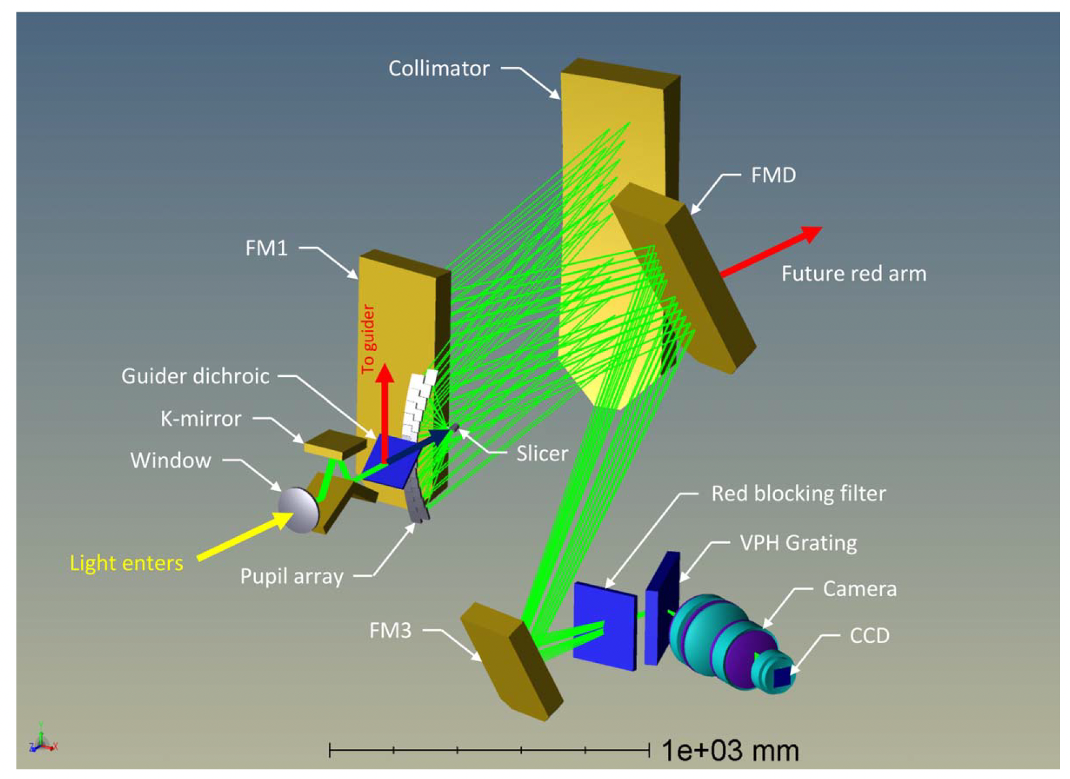


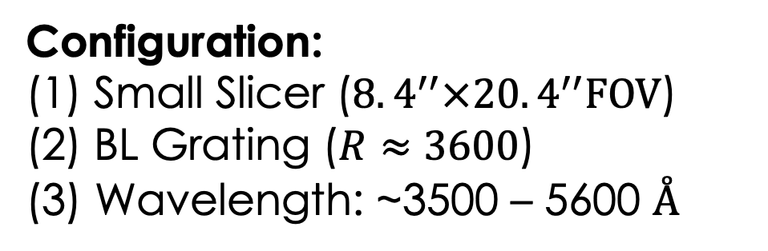
Target: J1044+0353
KCWI Optical Layout
SB
$${16.8}^{′′}$$
1 kpc
$$20.4^{′′}$$
Configuration:
Small Slicer ($8.4^{′′}×20.4^{′′}FOV$)
BL Grating ($R≈3600$)
(3) Wavelength: ~3500 – 5600 $Å$
Notes:
`Three slicer pointings outline the footprint of the KCWI mosaic cube. We configured KCWI with the small slicer, the BL grating, and a camera angle that produced a central wavelength
of 4600 angstrom.

Slide 5
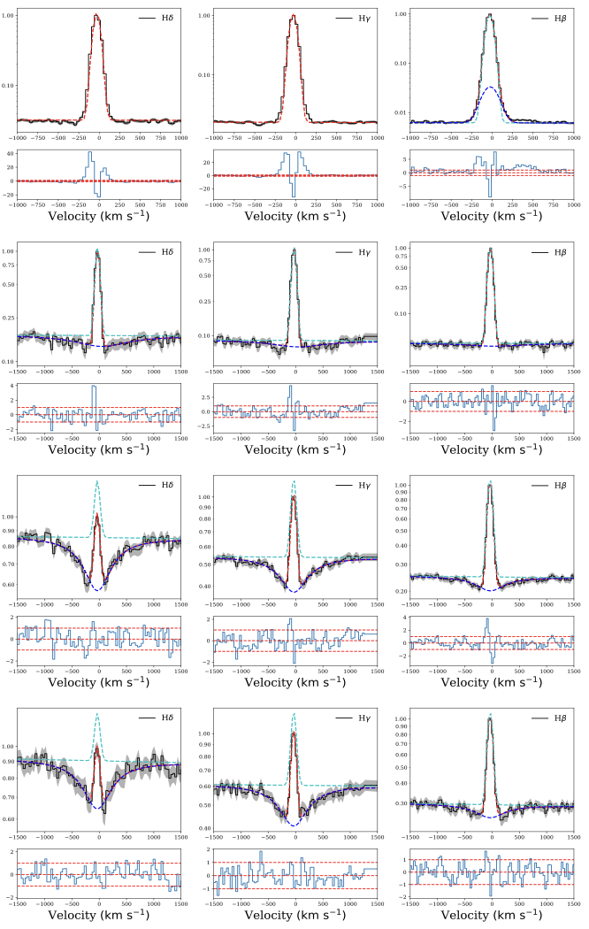
Target: J1044+0353
Color composite image constructed from the DECalS g, r, z-images
Peng, Martin, et al. (2023)
PSB
NEN
SB
FEN
MEN
Background galaxy at z = 0.275
$t_{PSB} \sim 15−20$Myr; $t_{SB} \sim 3−5$Myr (fitting from BEAGLE)
Notes:
Based on the irregular morphology of this galaxy, we wonder what triggers the propagation of star-formation and what physical mechanisms, like inflows and outflows, play a more dominant role in this galaxy.

Slide 6
Global Gas Kinematics ([OIII] 5007)
A strong velocity gradient $\sim 30$ ${\text{km} \text{s}}^{−1}{kpc}^{−1}$(parallel to minor axis)
High $v_{p}$ regions correspond to the high FWHM regions, but why?
Prolate Galaxy Ratator? (see Jeyhan Kartaltepe’s talk)
Peng, Martin, et al. (2023)

Slide 7
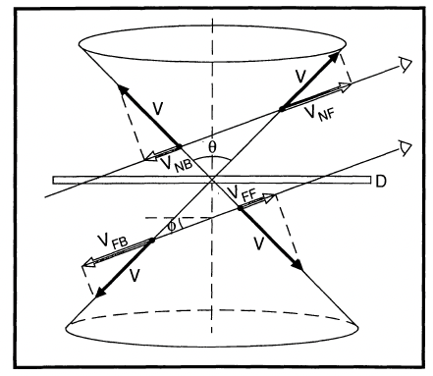


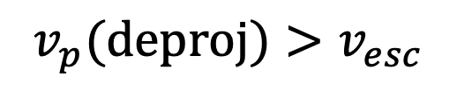
Variations in Line Profiles
E3
E2
E1
$$i$$
$$v_{p}(deproj)>v_{esc}$$
Escaping!
Heckman et al. (1990)
$$v_{p}$$

Slide 8
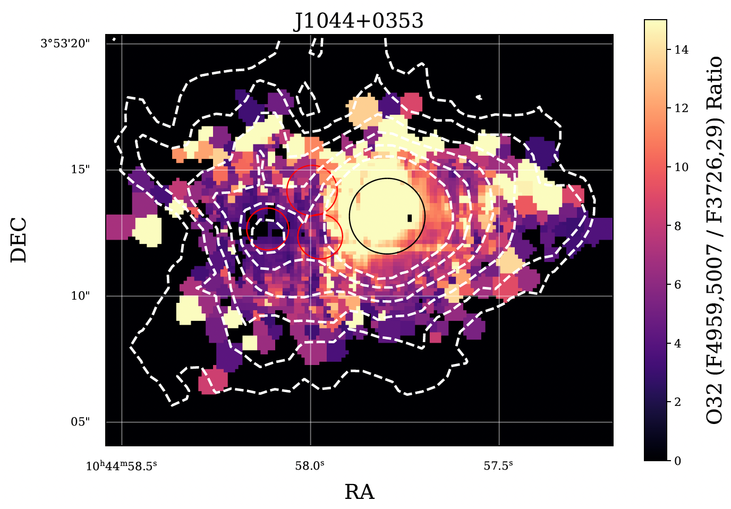

Anisotropic Lyman Continuum Escape
Optically Thin Channel
Ionization Cone (Density Bounded Region)
$$O32≳18$$
Case A Regions
[OIII] Contours
Peng, Martin, et al. (2023)
Galactic Outflow Bicone
Martin, Peng, and Li (submitted to ApJ)

Slide 9
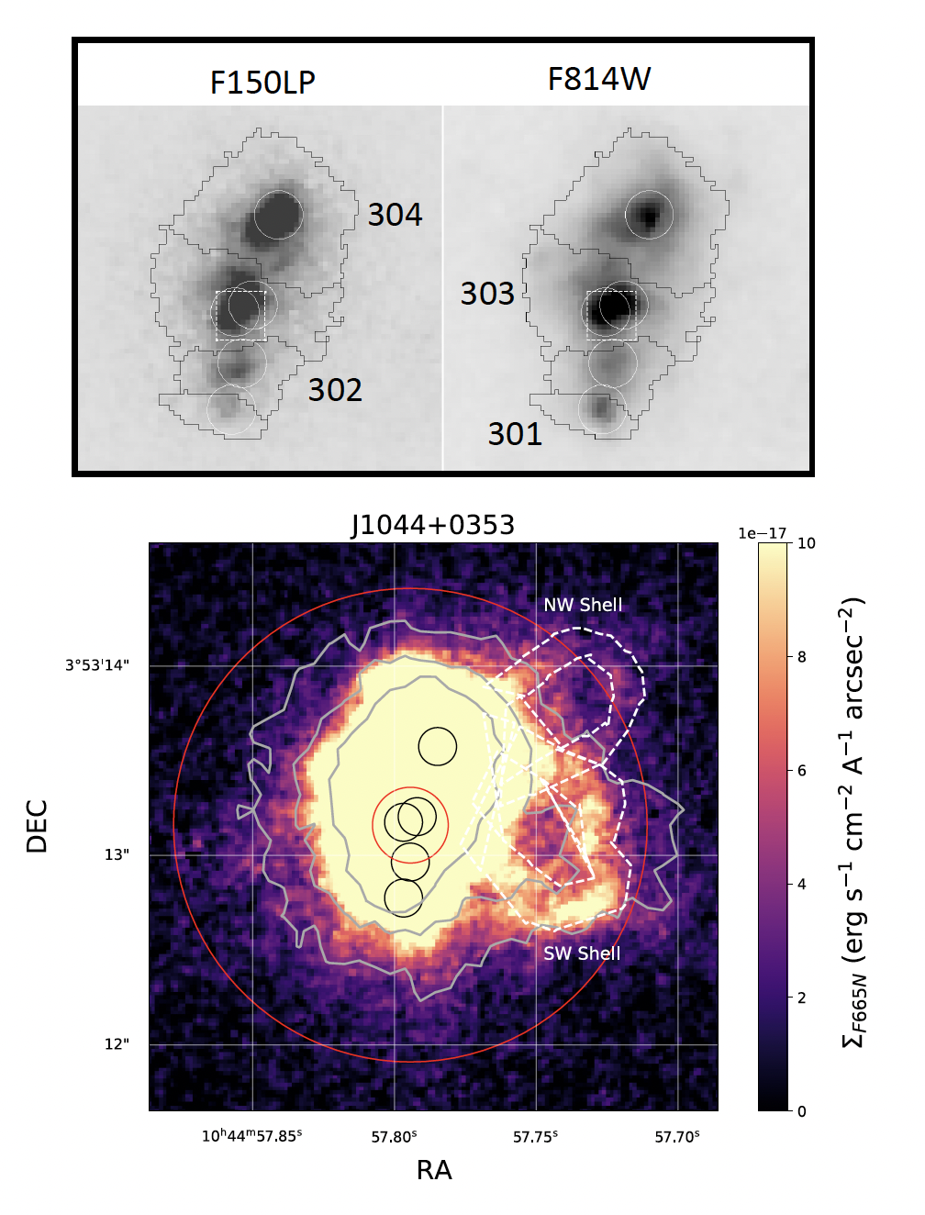
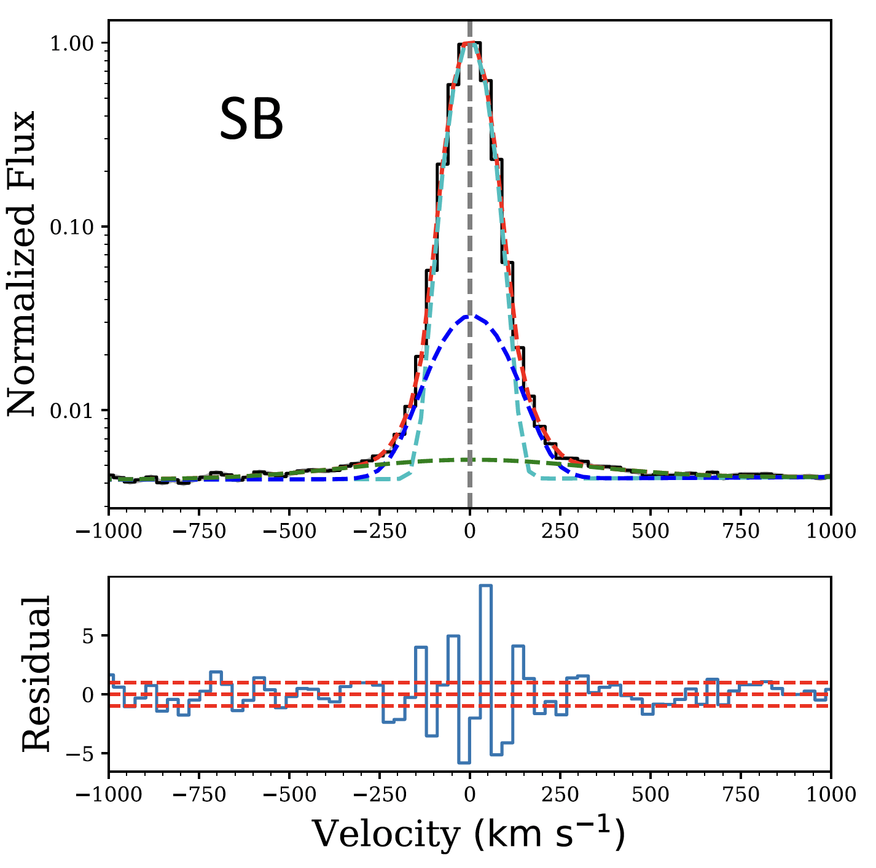
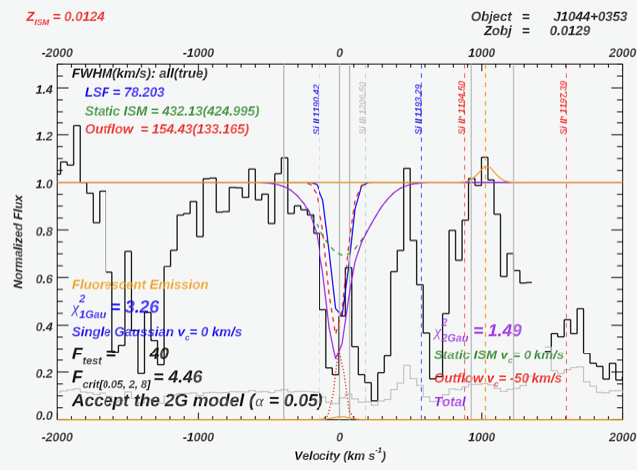
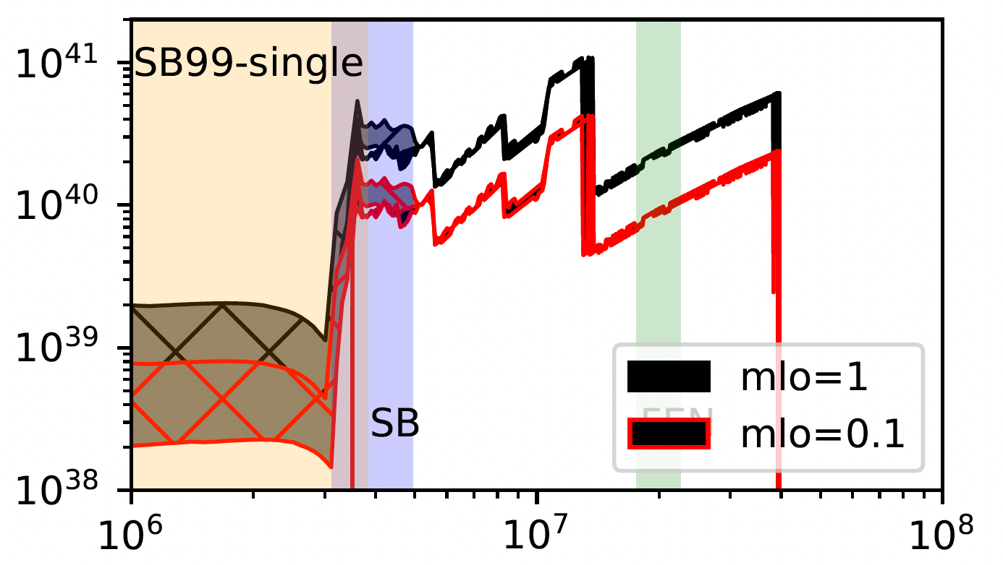
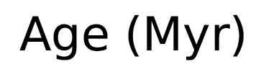



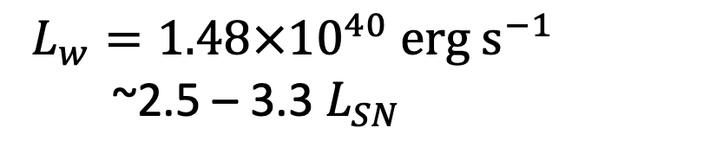

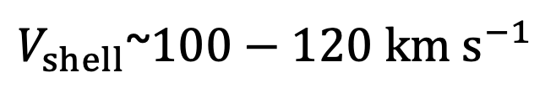




Superbubble Breakthrough
SB Segmentation
Weaver et al. (1977) Bubble Model:
$$R_{shell}$$
$V_{shell}$~$100−120$ $km s^{−1}$
$$t_{exp}$$
$V_{shell}∝$ $R_{shell}$/ $t_{exp}$
$$R_{shell}$$
Xu et al. (2022) CLASSY III
[OIII] 4959
$$L_{w}=1.48×{10}^{40} erg s^{−1}$$
~2.5 – 3.3${ L}_{SN}$
SB
$$V_{shell}$$
narrow
$L_{w}$ $∝R_{shell}^{2}V_{shell}^{3}n_{amb}$
broad
$$n_{amb}$$
very-broad
SNe only meet power requirement if volume filling medium has a low density, i.e. there is a hot phase in the ISM
$V_{shell}$ consistent with broad component in [OIII] and outflow component in UV absorption line
Martin, Peng, and Li (submitted to ApJ)

Slide 10

Superbubble Breakthrough
SB Segmentation
Weaver et al. (1977) Bubble Model:
$$R_{shell}$$
$V_{shell}$~$100−120$ $km s^{−1}$
$$t_{exp}$$
$V_{shell}∝$ $R_{shell}$/ $t_{exp}$
Xu et al. (2022) CLASSY III
[OIII] 4959
narrow
SB
broad
very-broad
$V_{shell}$ consistent with broad component in [OIII] and outflow component in UV absorption line
Martin, Peng, and Li (submitted to ApJ)

Slide 11
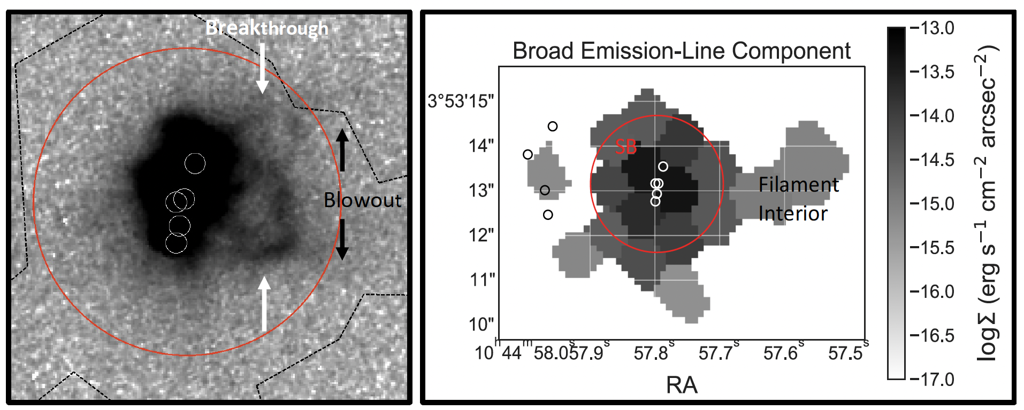
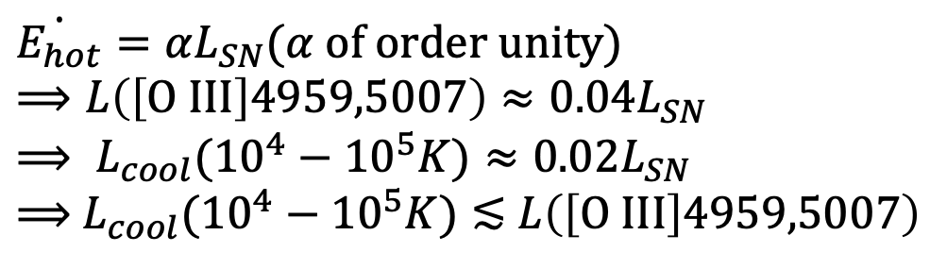
Superbubble Blowout
FWHM (narrow) ~ 95 km s⁻¹
(ISM gas)
NW Shell
FWHM (broad) ~ 210 km s⁻¹
(Supershell)
FWHM (very broad) ~ 700 km s⁻¹
(Direct Radiative Cooling of
Hot wind?)
SW Shell
Filament
Interior
(Blowout)
$\dot{E_{hot}}=αL_{SN}$($α$ of order unity)
$$⟹L\left(\left[O III\right]4959,5007\right)≈0.04L_{SN}$$
$$⟹ L_{cool}({10}^{4}−{10}^{5}K)≈0.02L_{SN}$$
$⟹$ $L_{cool}({10}^{4}−{10}^{5}K)≲$ $L\left(\left[O III\right]4959,5007\right)$
Thompson et al. (2016)
Direct Radiative Cooling of Hot wind✖️
Turbulent Radiative Mixing Layer✔️
Martin, Peng, and Li (submitted to ApJ)

Slide 12
Superbubble Blowout
NW Shell
FWHM (broad) ~ 210 km s⁻¹
(Supershell)
FWHM (very broad) ~
700 km s⁻¹ (?)
SW Shell
Filament
Interior
(Blowout)
Very-broad component originates from
(1) Direct Radiative Cooling of Hot wind✖️
(2) Turbulent Radiative Mixing Layer✔️
Peng, Martin, Fielding et al. (in prep.)
Martin, Peng, and Li (submitted to ApJ)

Slide 13
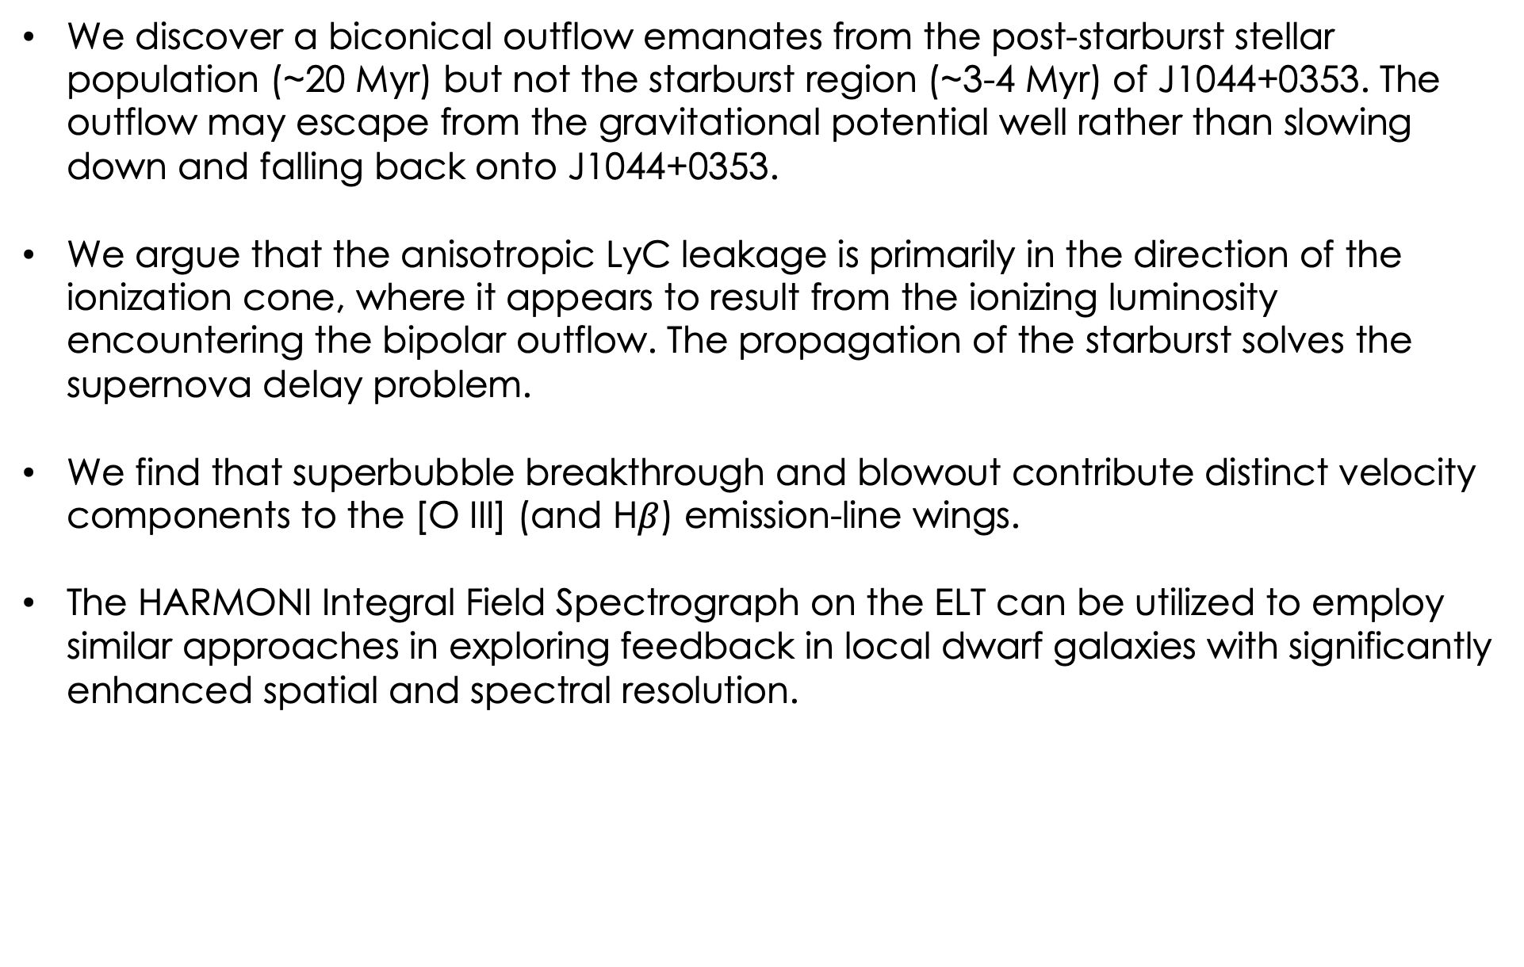
Summary & Outlook
We discover a biconical outflow emanates from the post-starburst stellar population (~20 Myr) but not the starburst region (~3-4 Myr) of J1044+0353. The outflow may escape from the gravitational potential well rather than slowing down and falling back onto J1044+0353.
We argue that the anisotropic LyC leakage is primarily in the direction of the ionization cone, where it appears to result from the ionizing luminosity encountering the bipolar outflow. The propagation of the starburst solves the supernova delay problem.
We find that superbubble breakthrough and blowout contribute distinct velocity components to the [O III] (and H$β$) emission-line wings.
The HARMONI Integral Field Spectrograph on the ELT can be utilized to employ similar approaches in exploring feedback in local dwarf galaxies with significantly enhanced spatial and spectral resolution.

Slide 14
Extra Slides

Slide 15
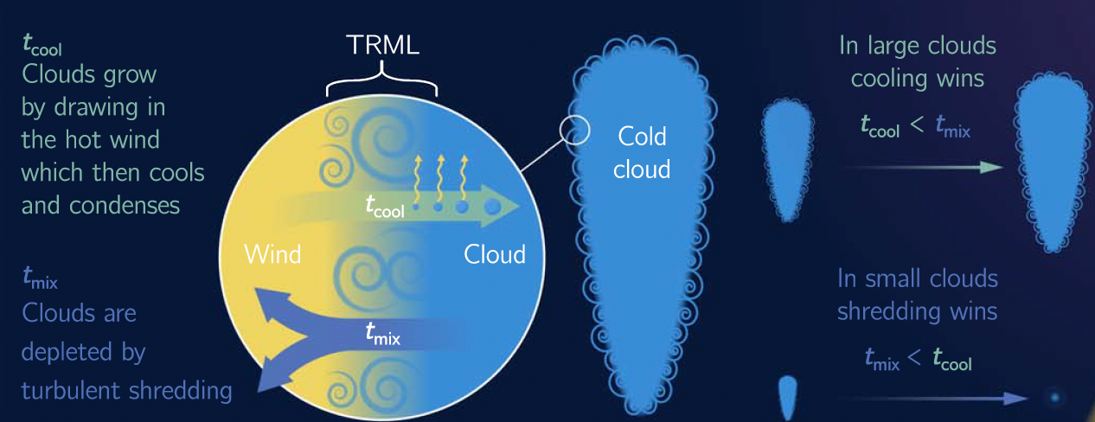
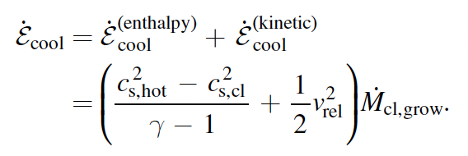
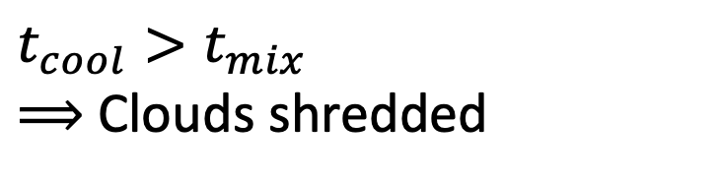
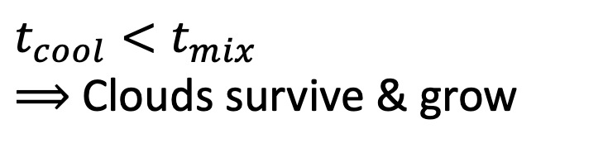
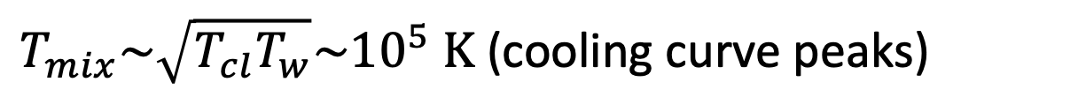
Turbulent Radiative Mixing Layer
Fielding & Bryan (2022)
$$t_{cool}<t_{mix}$$
$⟹$ Clouds survive & grow
$$t_{cool}>t_{mix}$$
$⟹$ Clouds shredded
Peng, Martin, Fielding et al.
(in prep.)
$T_{mix}\sim \sqrt{T_{cl}T_{w}}\sim {10}^{5} K$ (cooling curve peaks)

Slide 16
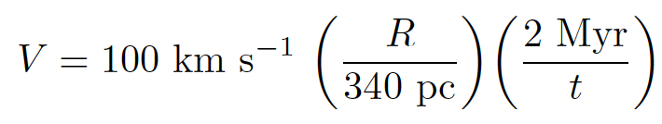
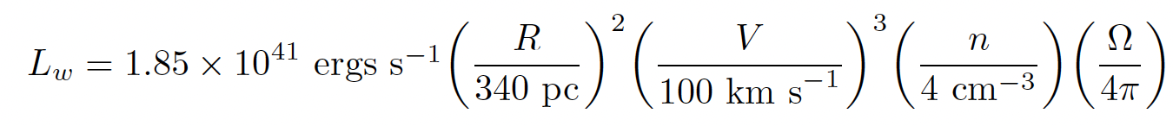
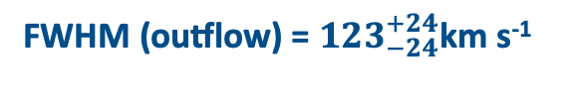
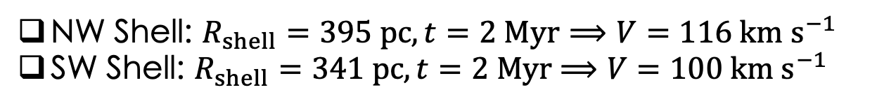


Superbubble Breakthrough
Weaver et al. (1977) Bubble Model:
NW Shell: $R_{shell}=395 pc, t=2 Myr⟹V=116 km s^{−1}$
SW Shell: $R_{shell}=341 pc,t=2 Myr$ $⟹V=100 km s^{−1}$
Xu et al. (2022) CLASSY III
[OIII] 4959
SB
NW Shell: $Ω=0.5 sr⟹L_{w}=1.48×{10}^{40} erg s^{−1}\sim 2.5{ L}_{SN}$
SW Shell: $Ω=1.3 sr⟹L_{w}=1.92×{10}^{40} erg s^{−1}$ $\sim 3.3{ L}_{SN}$
SNe only meet power requirement if volume filling medium has a low density, i.e. there is a hot phase in the ISM
FWHM (broad) ~ 210 km s⁻¹
$v_{c}$ (outflow) = ${−52}_{−12}^{+12}$km s⁻¹
FWHM (outflow) = ${123}_{−24}^{+24}$km s⁻¹
Martin, Peng, and Li (submitted to ApJ)

Slide 17
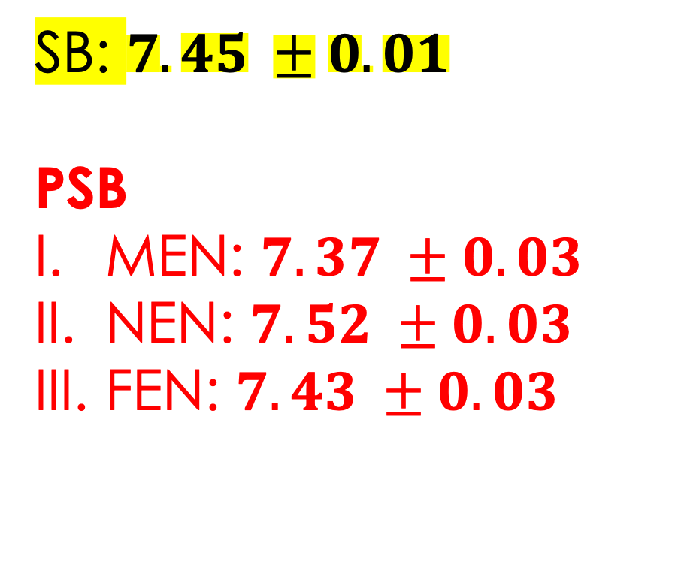
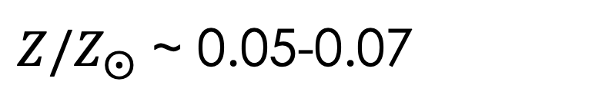
Gas-Phase Metallicity (12 + log(O/H))
We used the direct method (i.e., using the line ratio between [OIII] $λ4363$ and [OIII] $λλ4959,5007$) to determine the gas-phase metallicity of each stellar population.
SB: $7.45 ±0.01$
PSB
MEN: $7.37 ±0.03$
NEN: $7.52 ±0.03$
FEN: $7.43 ±0.03$
PSB
$Z/Z_{⨀}$ ~ 0.05-0.07
Notes:
The PSB stellar complexes show relatively similar metallicity values as the SB region, which might indicate the ISM matter there are not efficiently mixed with supernova ejecta. There are also nonnegligible variation in metallicity within the PSB region, which might indicate whether merger-like interaction can induce accretion of metal-poor gas.

Slide 18
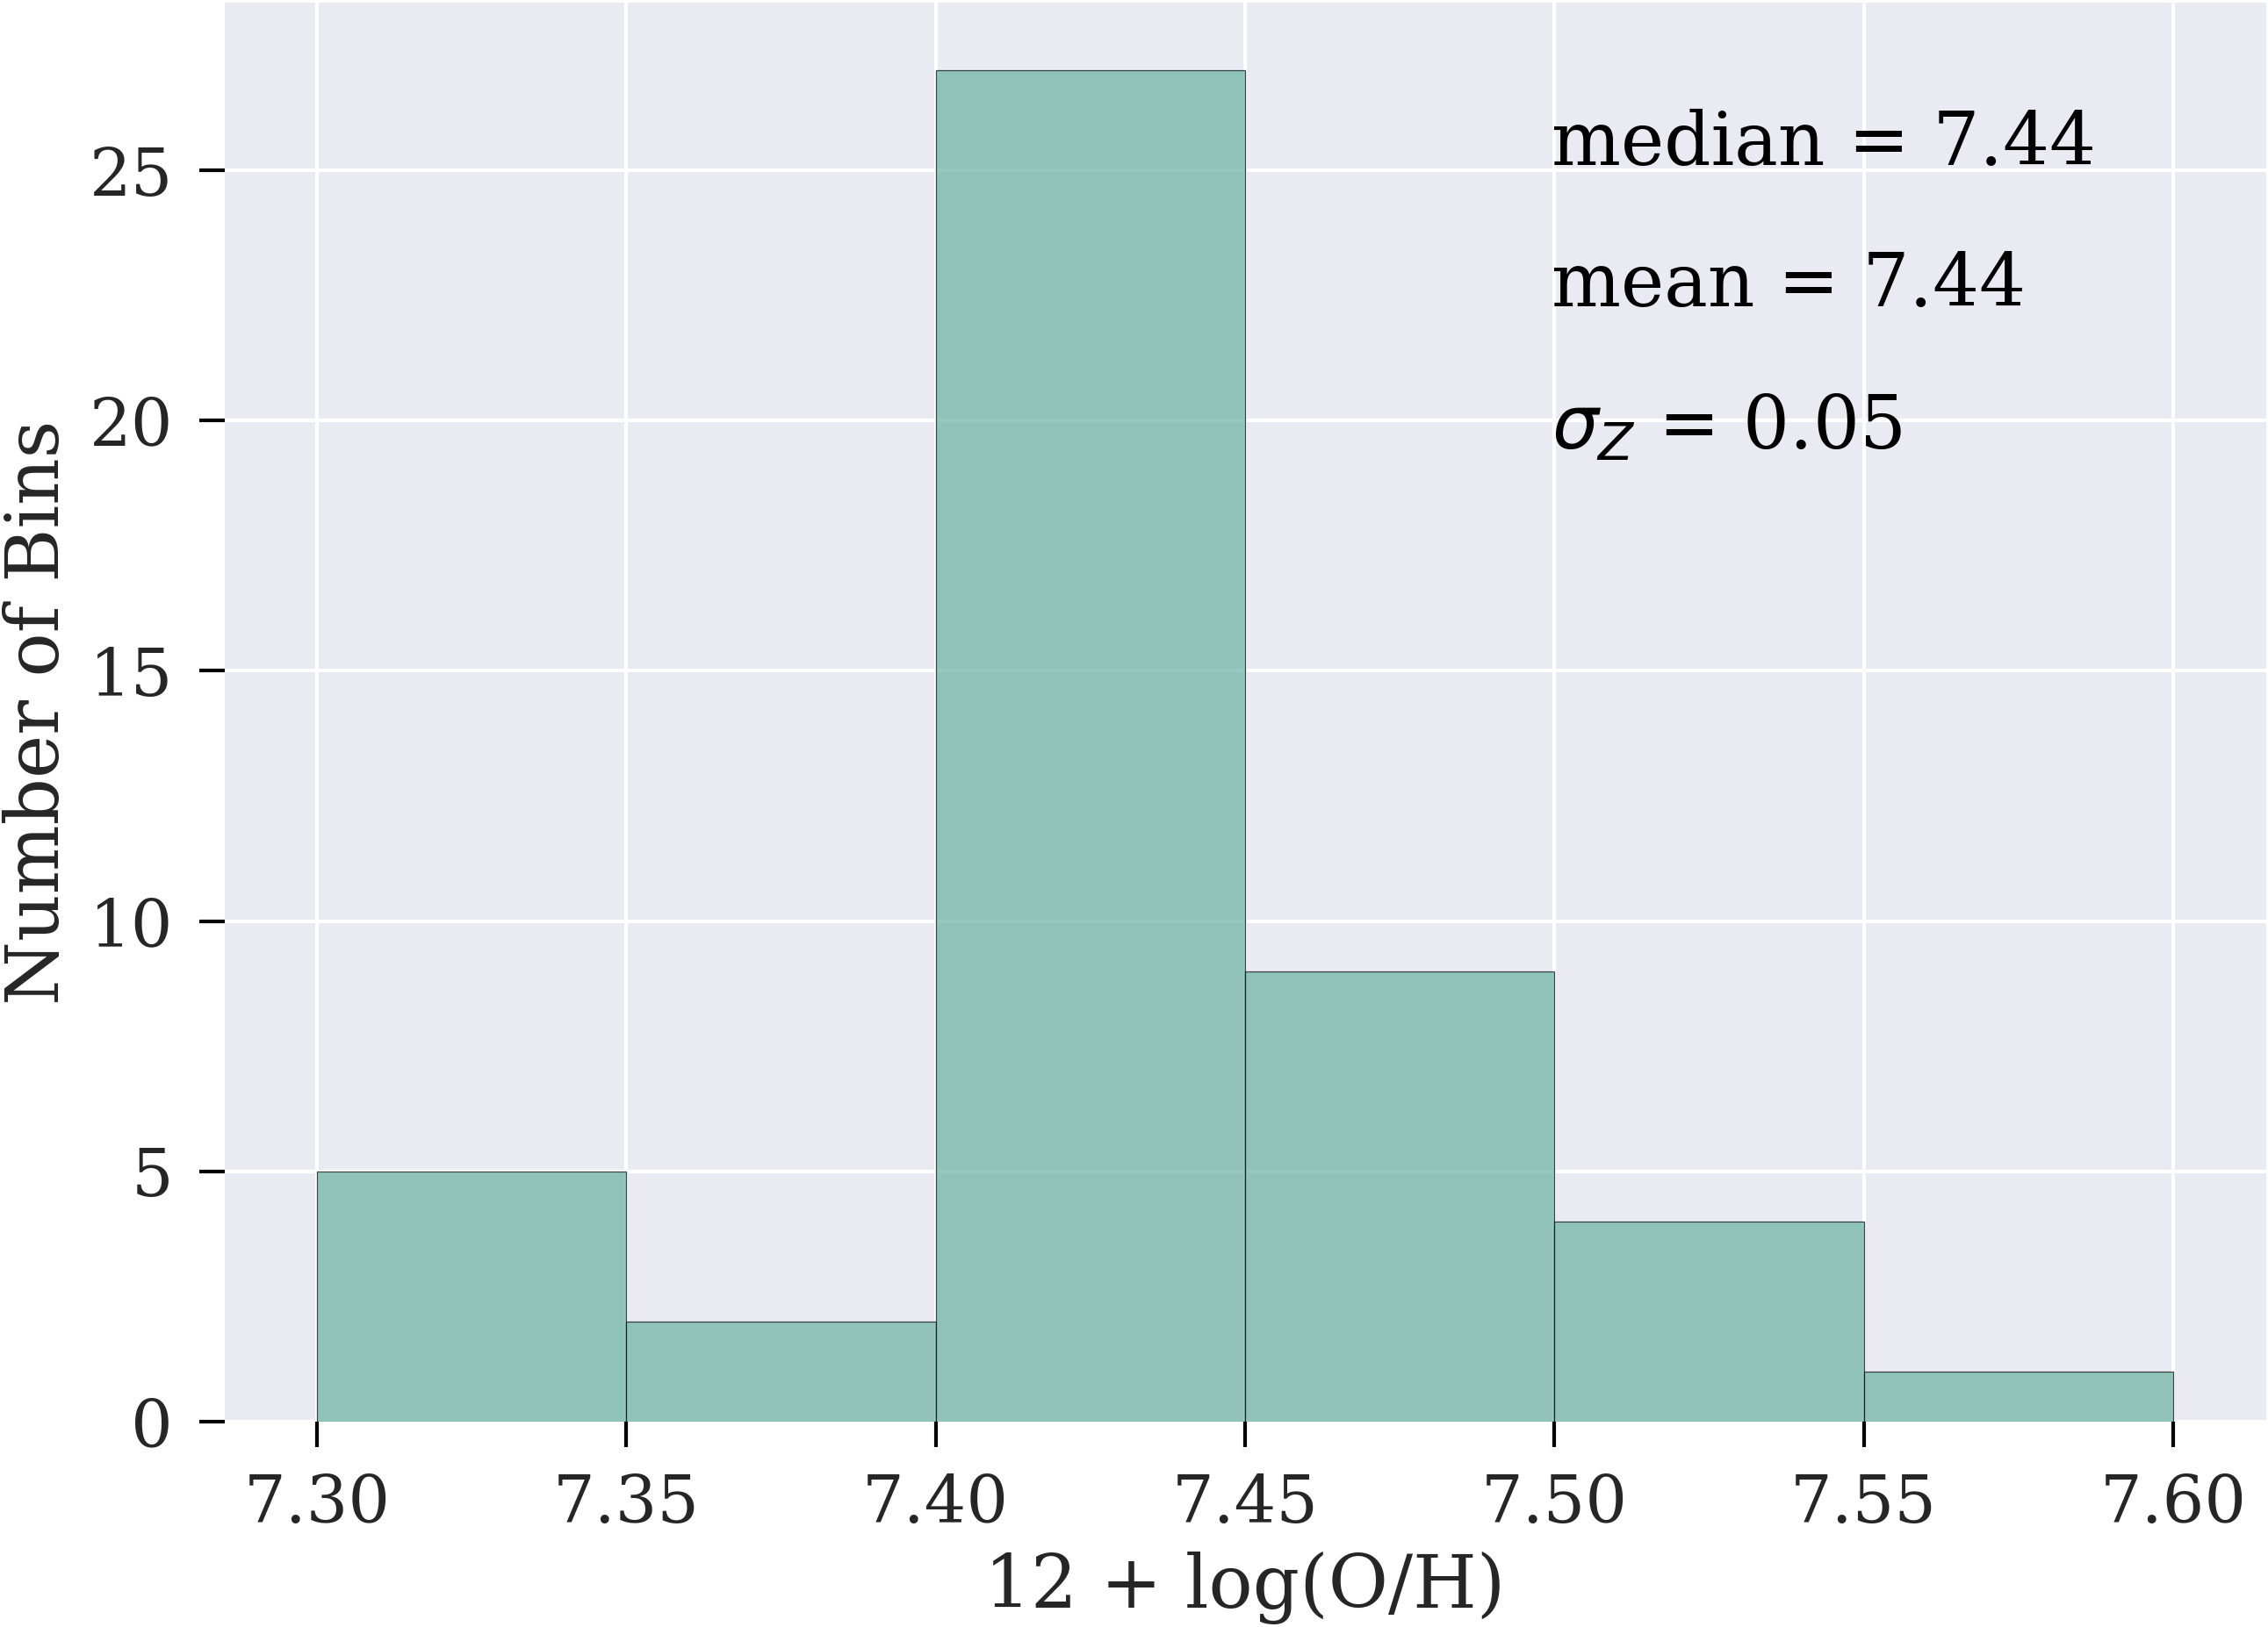
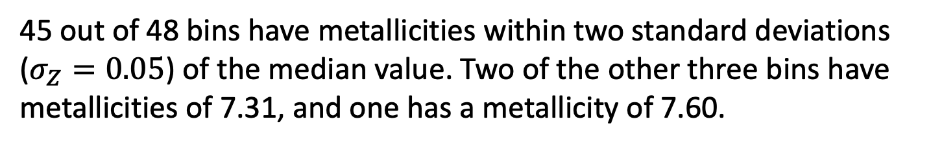
Metallicity Map
IQR = 0.04
Its relatively large scatter of metallicities within the PSB suggests an induced inflow of low-metallicity gas, potentially caused by mergers or interactions.
The existence of spatial variations among these outlier regions, with a resolution element size of approximately 250 pc, cannot be disregarded, particularly in the post-starburst region where two of these outliers are located within this area.
45 out of 48 bins have metallicities within two standard deviations ($σ_{Z}=0.05$) of the median value. Two of the other three bins have metallicities of 7.31, and one has a metallicity of 7.60.

Slide 19
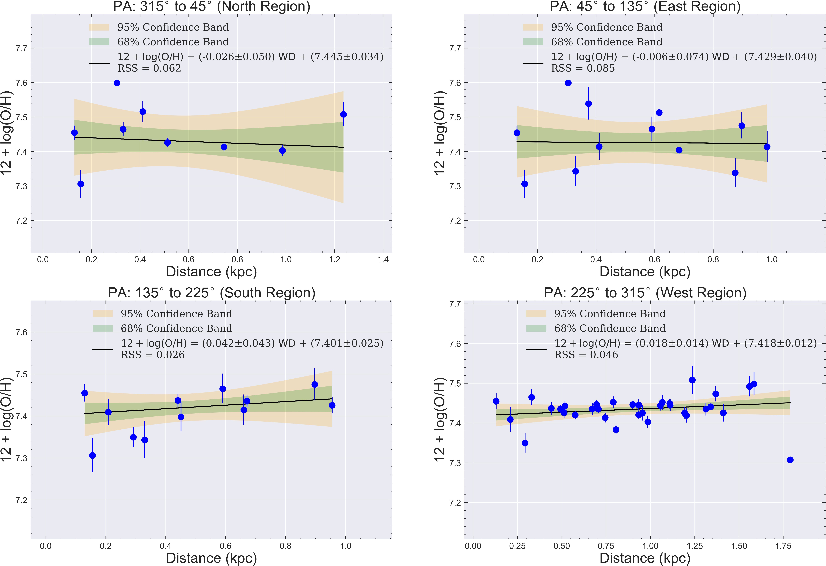
Metallicity Gradient

Slide 20
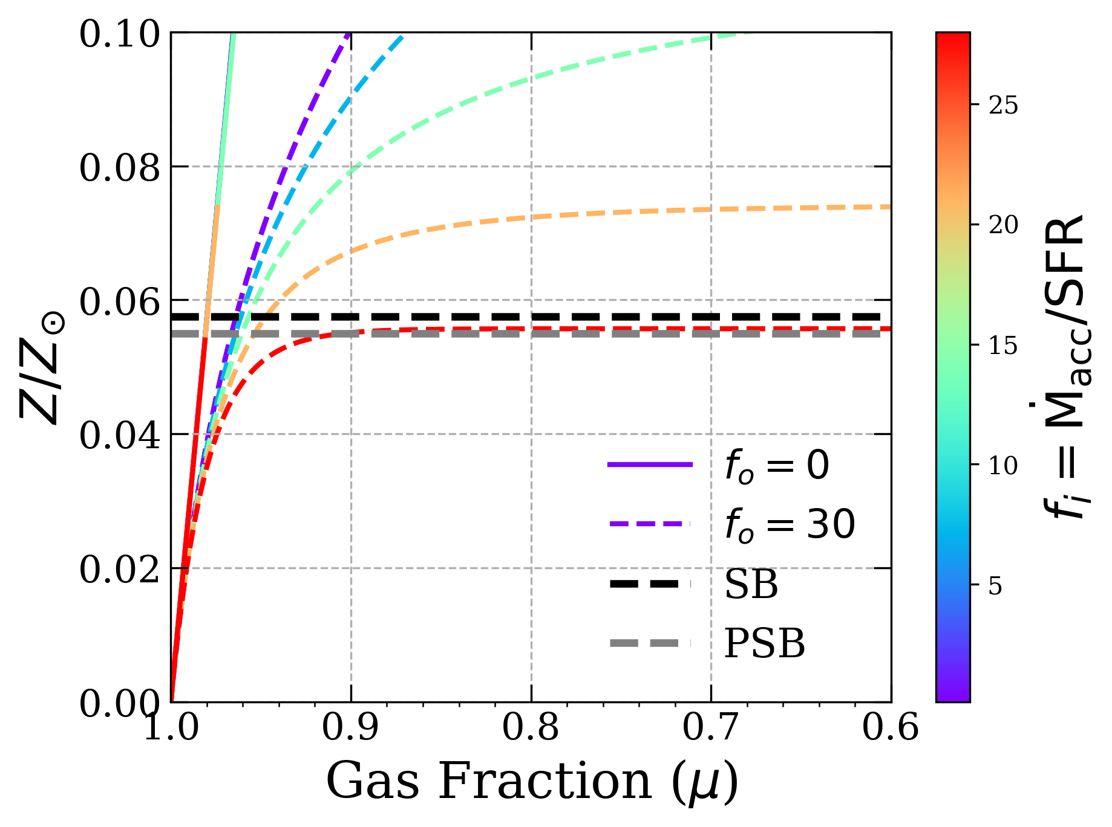
Chemical Evolution Model
Homogeneous Model
Metal-Enriched Wind (non-homogeneous)
SB
PSB
SB
PSB
$μ_{SB}≳0.98 ;{0.7≲μ}_{EN}≲0.85$ (From Kennicutt-Schmidt Law)
Peng, Martin, et al. (2023)

Slide 21
Line Fitting
SB
FEN
MEN
NEN

Slide 22
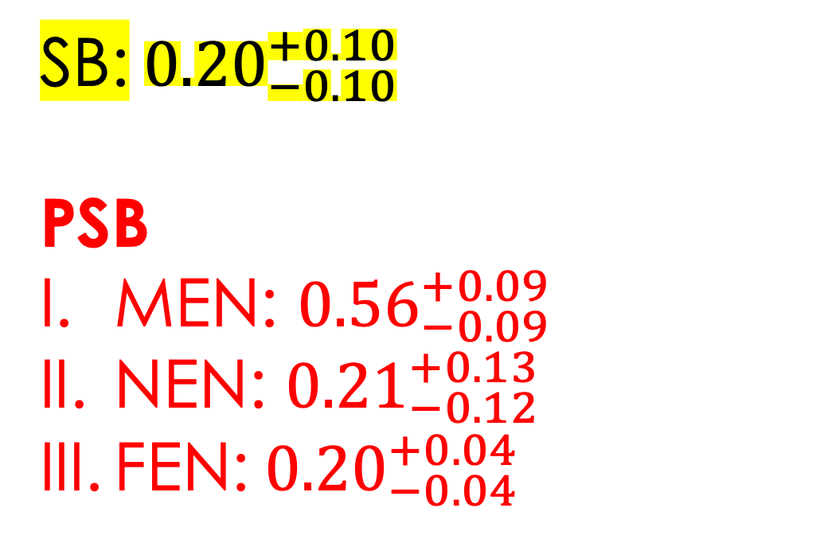
Extinction ($A_{V}$)
SB:${0.20}_{−0.10}^{+0.10}$
PSB
MEN: ${0.56}_{−0.09}^{+0.09}$
NEN: ${0.21}_{−0.12}^{+0.13}$
FEN:${0.20}_{−0.04}^{+0.04}$
PSB

Slide 23
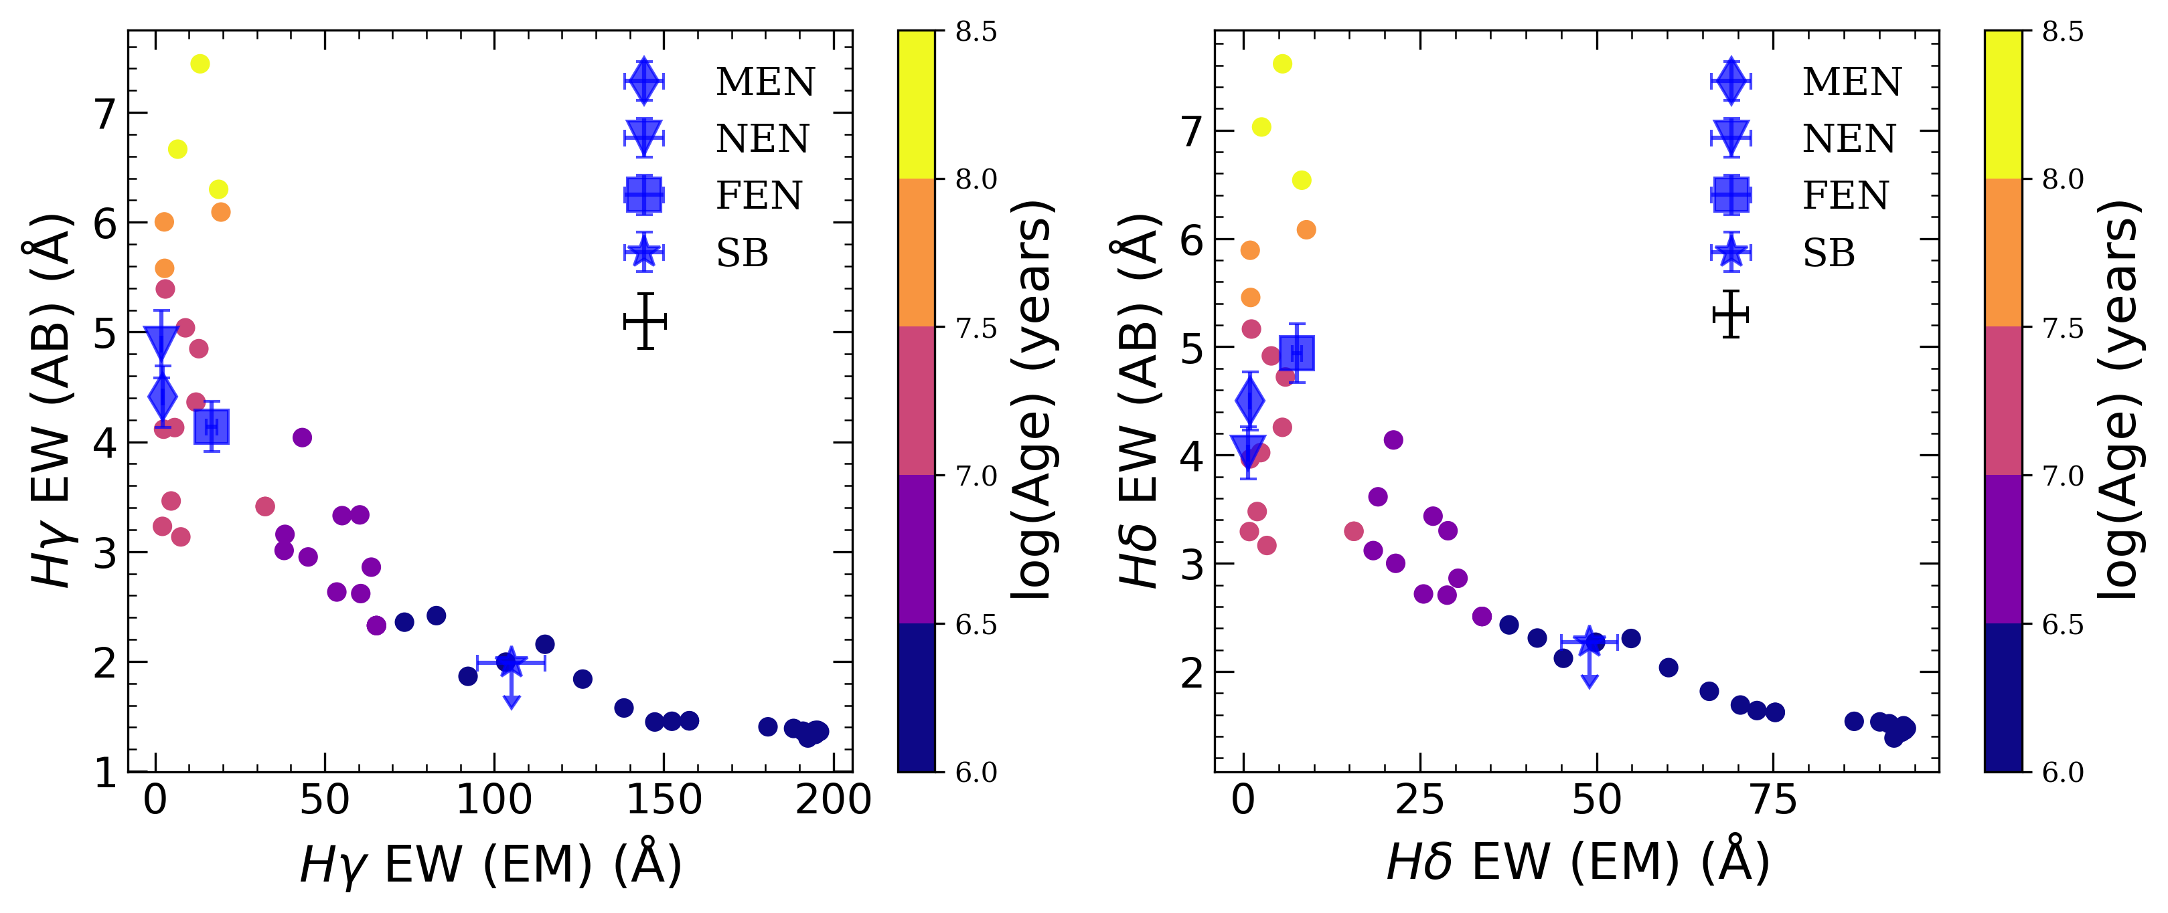
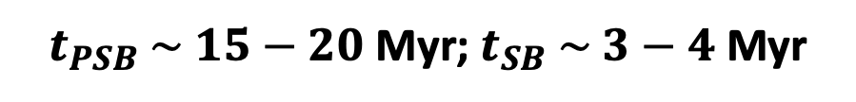
Stellar Population Age (SED Model)
We used BEAGLE to build mock galaxy spectra at different ages and measure equivalent widths (EWs) for both emission and absorption portions of the Balmer line profiles.
$t_{PSB} \sim 15−20$Myr; $t_{SB} \sim 3−4$Myr

Slide 24
Overview
Why this topic? Why this target?
Results
  KCWI Observations & Stellar Population Ages
  Global Gas Kinematics
  Chemical Inhomogeneities and Evolution
Summary & Future works

Slide 25
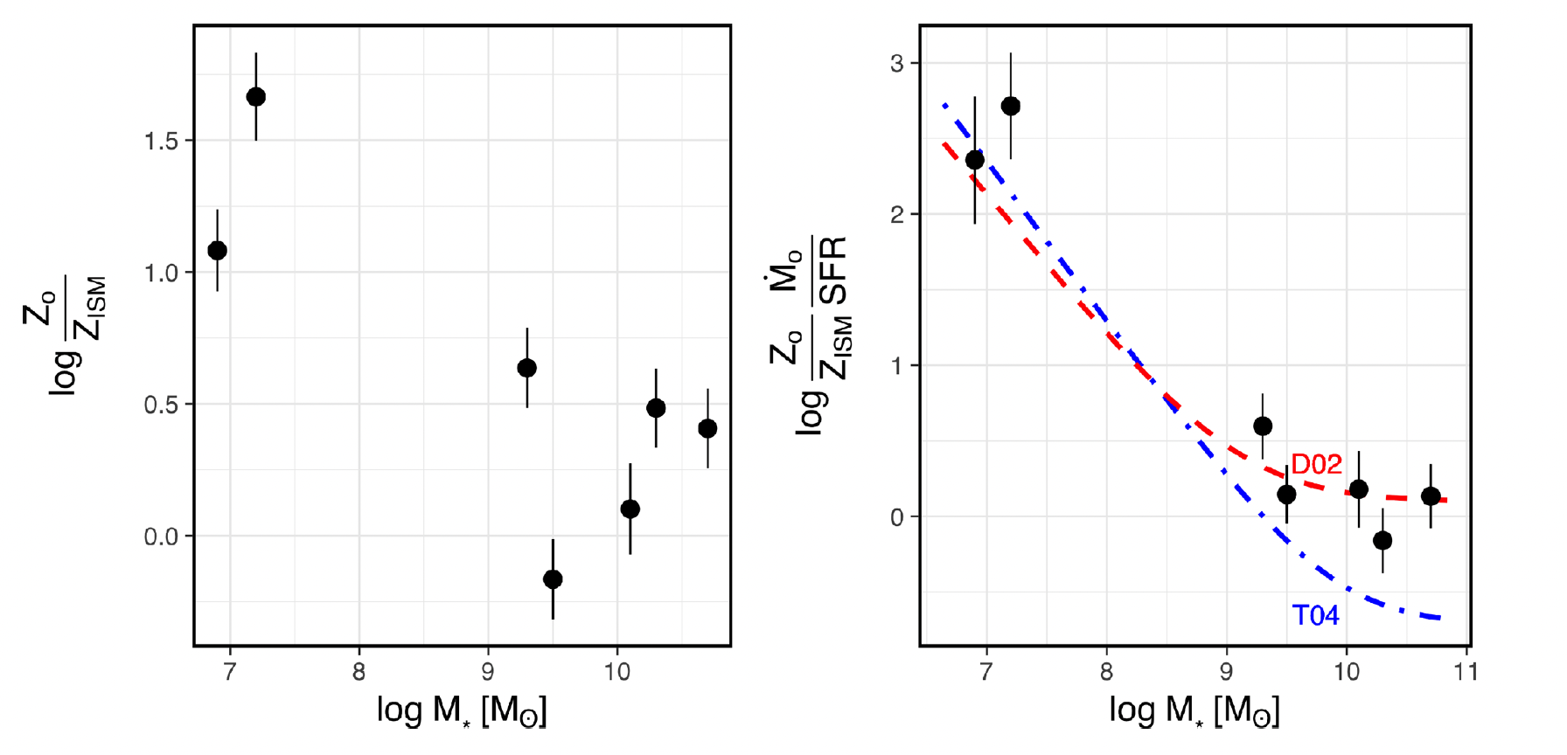
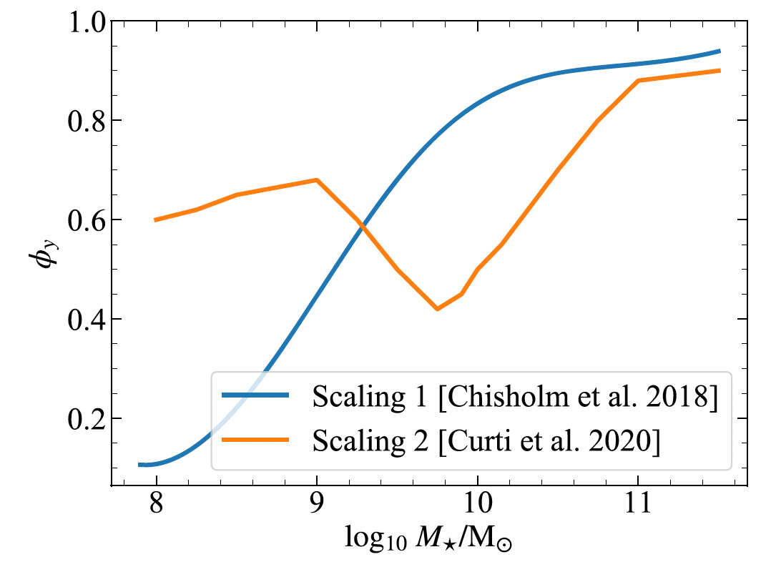
Motivation: Metallicity & Galactic Winds
Instantaneous recycling approximation that supernova ejecta would uniformly and immediately mix with the ISM matter might be wrong in dwarf galaxies!
Fully Mixing between ISM & SN Ejecta
Chisholm et al. (2018)
Sharda et al. (2021)

Slide 26
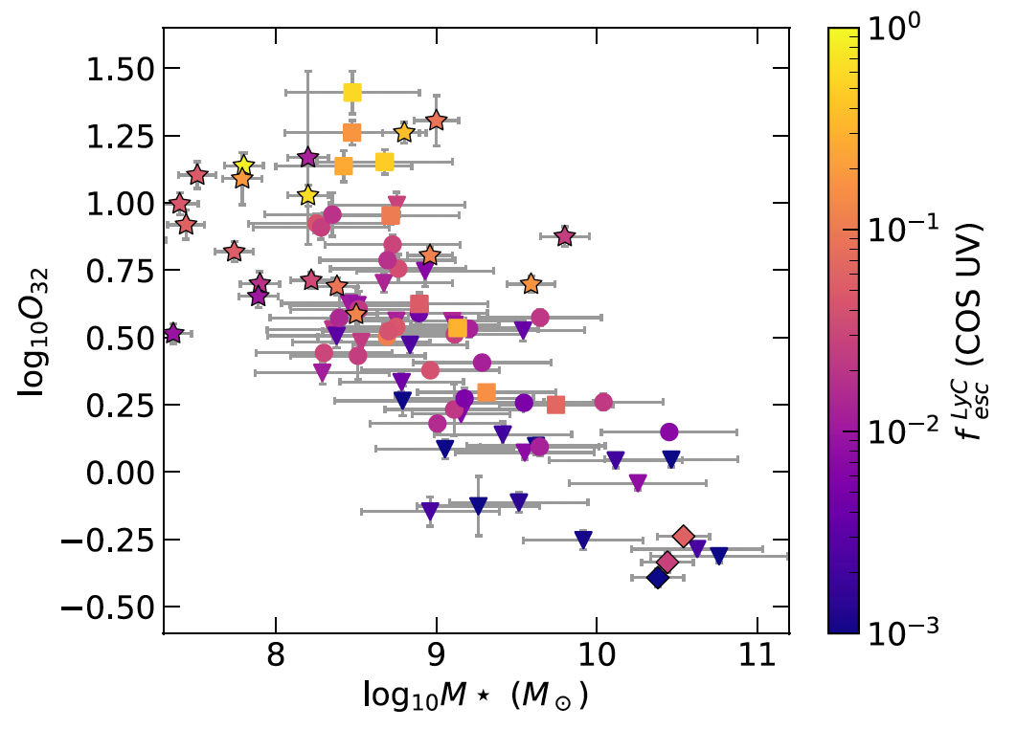
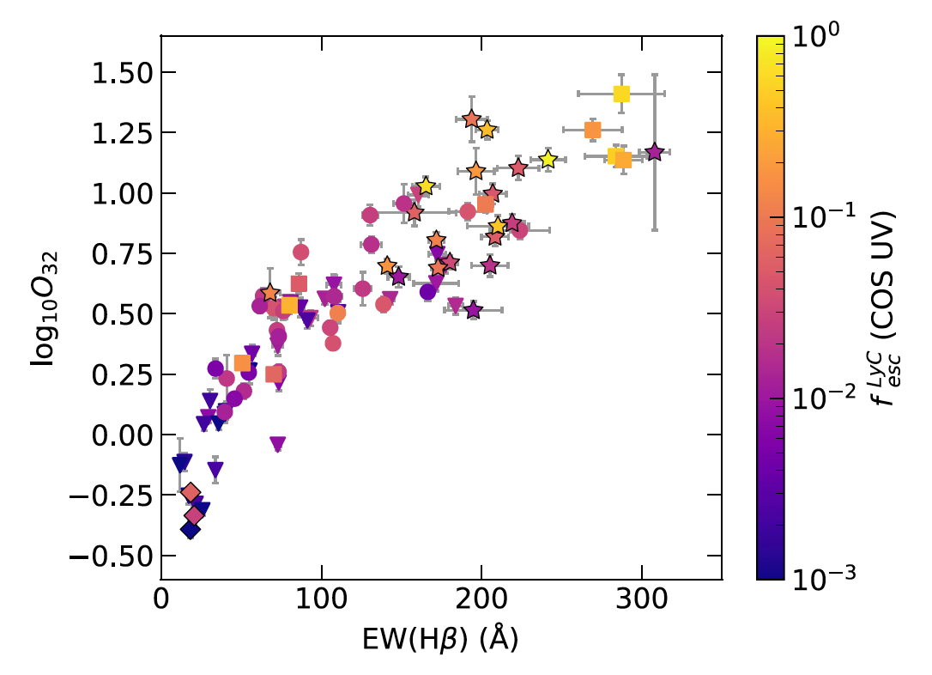
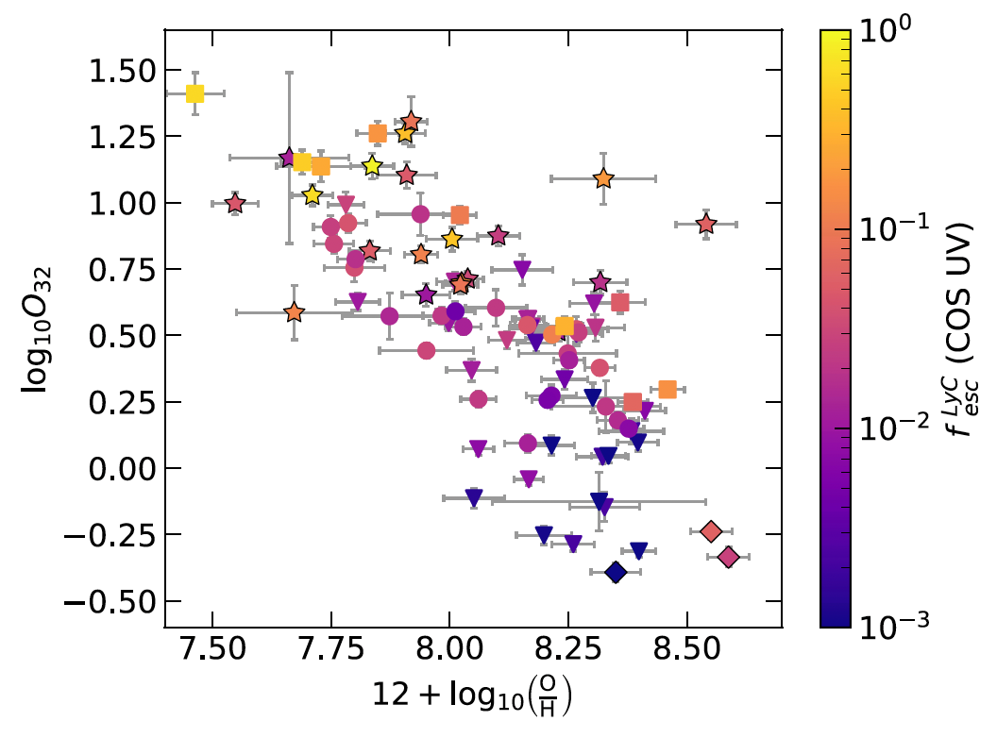
Motivation: LyC Escape & Physical Properties
(1) Highly ionized
(2) Young
(3) Metal-poor
(4) Dwarf Galaxies → High LyC Escape Fraction!!!
More Ionized Nebulae
More Ionized Nebulae
More Ionized Nebulae
Less Massive
Younger Stellar Populations
More Metal Poor
Flury et al. (2022)

Slide 27
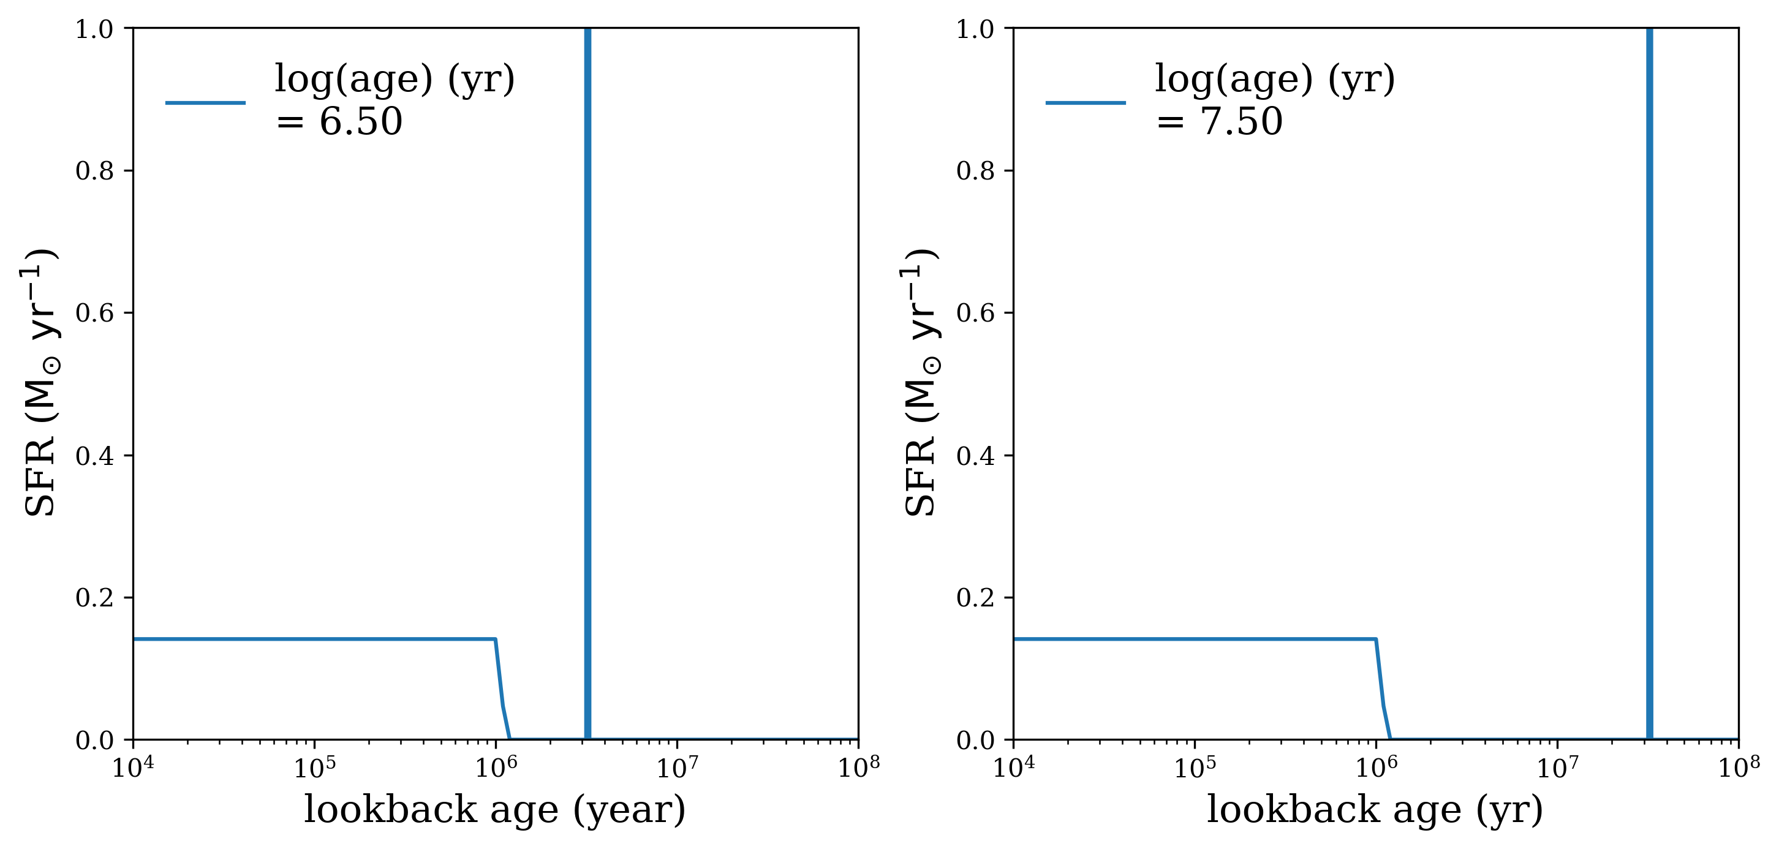
SED Modeling (BEAGLE): Stellar Population Age
We proposed a composite SFH model, including a recent burst in addition
to the first burst occurring at the ignition of the star formation.

Slide 28
High-Ionization Regions & Optically Thin Regions
Martin, Peng, Li, (in preparation)
These Optically thin regions (or the high-ionization regions), corresponding to the holes in the HI distribution, might shed light on the escape direction of ionizing photons.

Slide 29
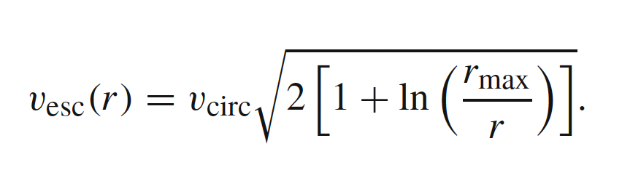

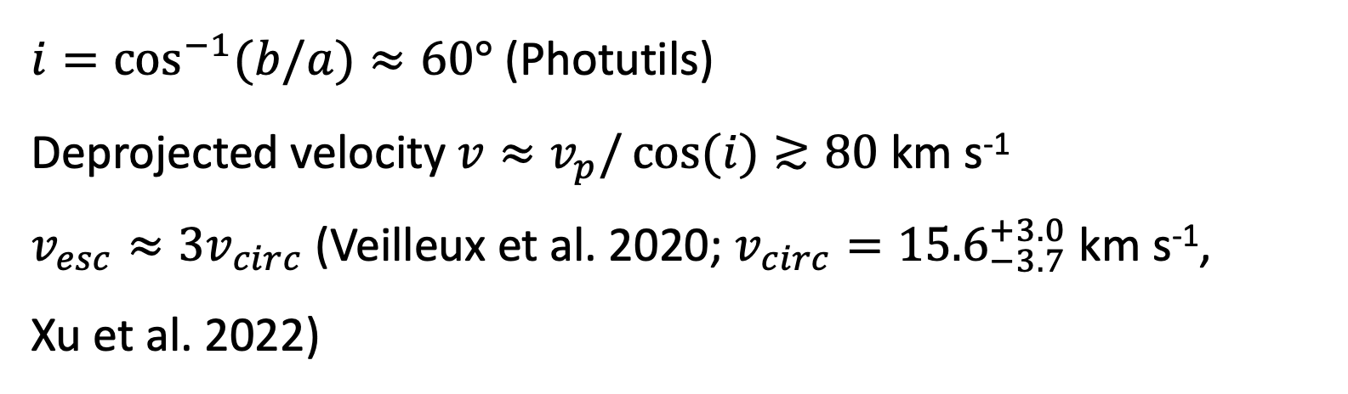
Escape Velocity Validation
$i=\cos^{−1}{(b/a)≈60°}$ (Photutils)
Deprojected velocity $v≈v_{p}/\cos{(i)}≳80$ km s⁻¹
$v_{esc}≈3v_{circ}$(Veilleux et al. 2020; $v_{circ}={15.6}_{−3.7}^{+3.0}$ km s⁻¹,
Xu et al. 2022)
Assume singular isothermal sphere that truncates at a radius $r_{max}$,
For $\frac{r_{max}}{r}=10−100$, $\frac{v_{esc}}{v_{circ}}=2.6−3.3.$

Slide 30
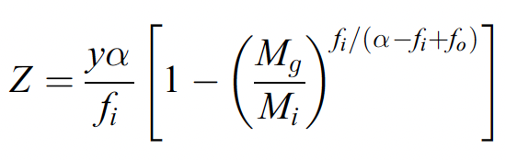
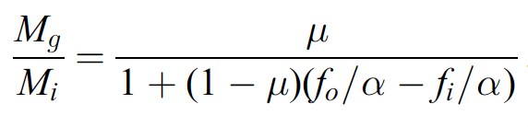
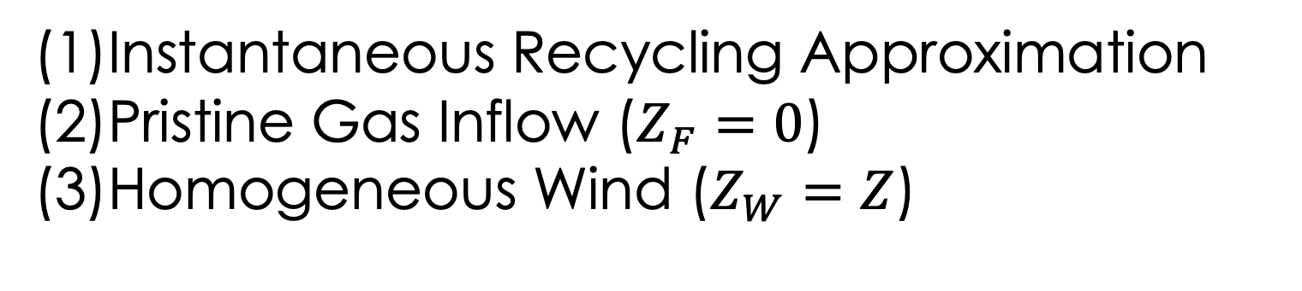
Chemical Evolution Model
Simple Chemical Evolution Model (Erb 2008):
SB
PSB
Instantaneous Recycling Approximation
(2)Pristine Gas Inflow ($Z_{F}=0$)
(3)Homogeneous Wind ($Z_{W}=Z$)
$μ_{SB}≳0.98 ;{0.7≲μ}_{PSB}≲0.85$ (From Kennicutt-Schmidt Law)
Peng, Martin, et al. (2023)

Slide 31


Chemical Evolution Model
Metal-Enriched Wind (non-homogeneous)
$$Z_{W}=Z+ ξ\frac{y}{max⁡(f_{o},R)}$$
$ξ=0:$ fully mix with ISM
$ξ=1:$ all metals lost in galactic wind
SB
PSB
(Sharda et al. 2021)
$ξ≈0.4$($\sim {10}^{8} M_{⨀}$) (Sharda et al. 2021)
$μ_{SB}≳0.98 ;{0.7≲μ}_{EN}≲0.85$ (From Kennicutt-Schmidt Law)
Peng, Martin, et al. (2023)

