Slide 1
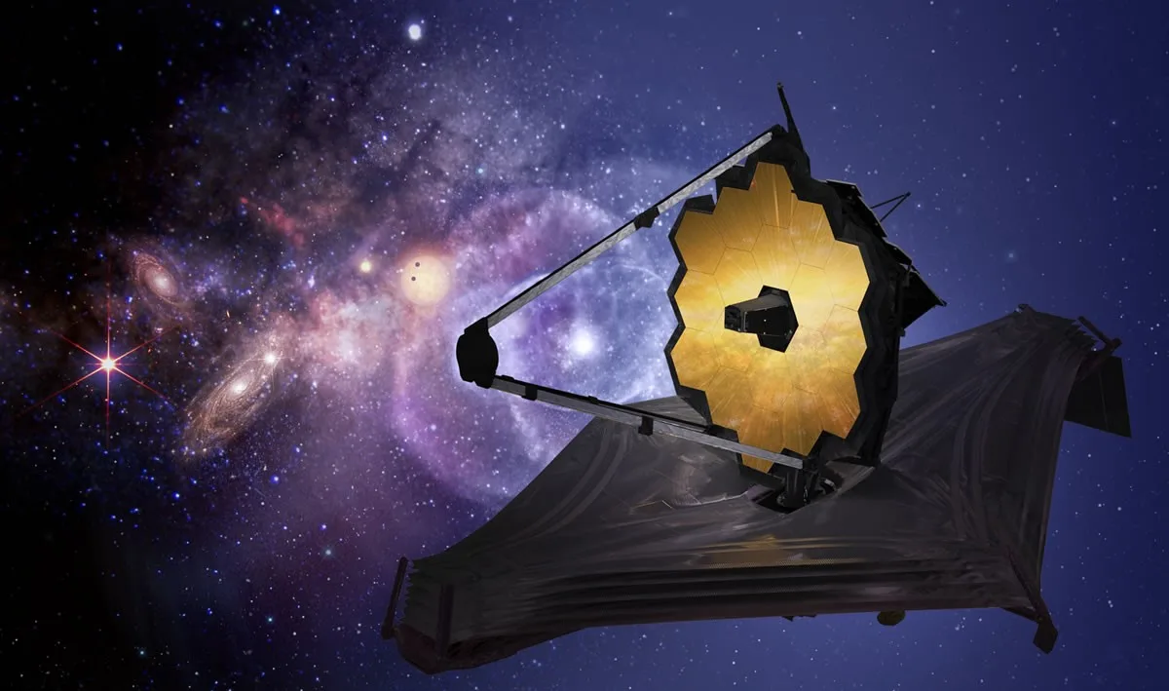
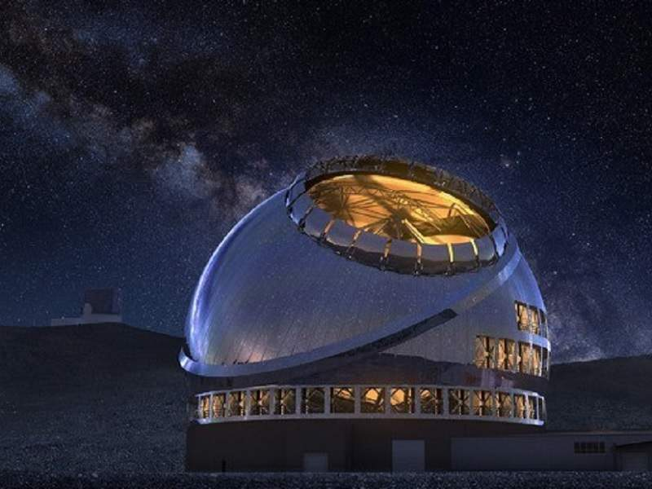
Constraining Cosmic Reionization Parameters with Lyα Damping Wing Absorptions of Galaxies at z=7-12 Towards the JWST x ELTs Era [Based on Umeda et al. 2023; arXiv:2306.00487]
Hiroya Umeda
(UTokyo/ICRR; Ph.D. 1st year)
Collaborators: M. Ouchi, K. Nakajima, Y. Harikane, Y. Isobe,
Y. Ono, Y. Xu, Y. Zhang
credit: Jingchuan Yu, Beijing Planetarium
Notes:
Hi. I’m Hiroya Umeda, a 1st year Ph.D. student from the University of Tokyo. Today, I would like to talk about the new result on cosmic reionization using rich JWST data.

Slide 2
What is Cosmic Reionization?
Cosmic-Scale Phase Change of IGM
Fully Ionized by z~5-6 (for Hydrogen)
~Big Questions~
Ionizing Sources (Dwarf/Massive/AGN/GCs?)
Time-Evolution (History)
Spatial Distribution (Ionized Bubble Topology)
Redshift
The Dark Age
Today
Big
Bang
Cosmic Reionization
First Stars?
Current Galaxies

Slide 3
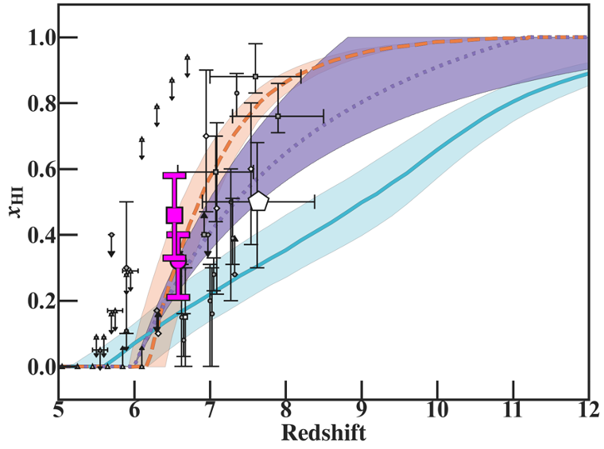
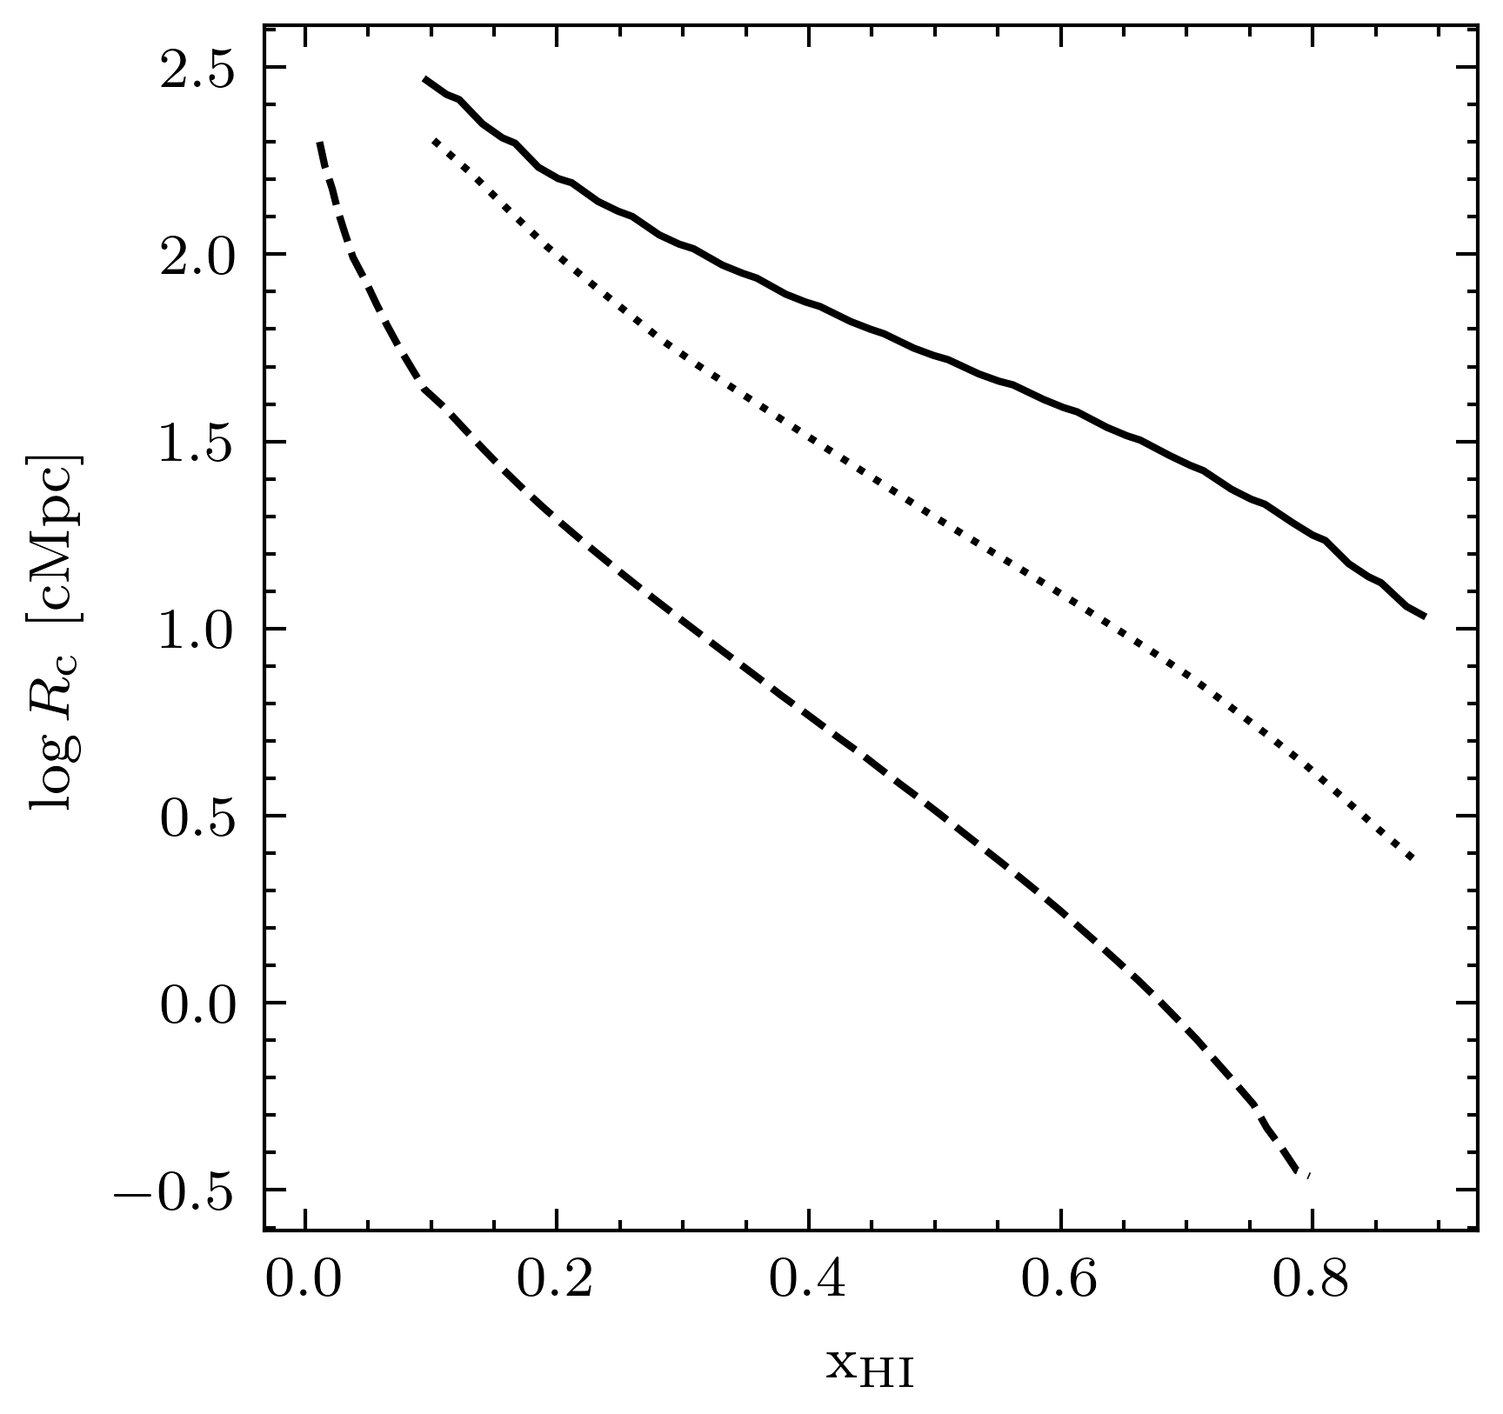
Conquest for Key Parameters of Cosmic Reionization
1. Neutral Fraction
x_{HI}=n_{HI}/n_{H}
2. Ionized Bubble Radius
R_{b}
1-x_{HI}
Black:
Ionized
Bright Gal.
(Naidu+20)
UV Luminosity Function (LF)
w/ const. fesc (Ishigaki+18)
White:
Neutral
z>8 ?
Bubble Size
Evolution?
Faint Gal.
(Finkelstein+19)
Bubble Size
Observations
1-<x_{HI}>
Credit: S. Gambit
Neutral Fraction
Notes:
To understand how cosmic reionization proceeded, we have been focusing on the several key parameters. One is a neutral fraction xHI, which is a fraction between neutral hydrogen density over the whole hydrogen density. This figure shows the redshift evolution of xHI. There are multiple predictions on how xHI evolve depending on the ionization sources. There were multiple observational constraints on xHI at z<8, but lack of information beyond z=8 inhibited complete understanding of cosmic reionization history. Another key parameter is ionized bubble radius around galaxy. As shown in this gif image, in inside-out scenario, neutral IGM, shown in white, is gradually photoionized from the center by galaxies, which leads to expansion of ionized region, shown in black. The typical size of bubble size at different neutral fraction also depends on the sources, but there had been no constraints.

Slide 4
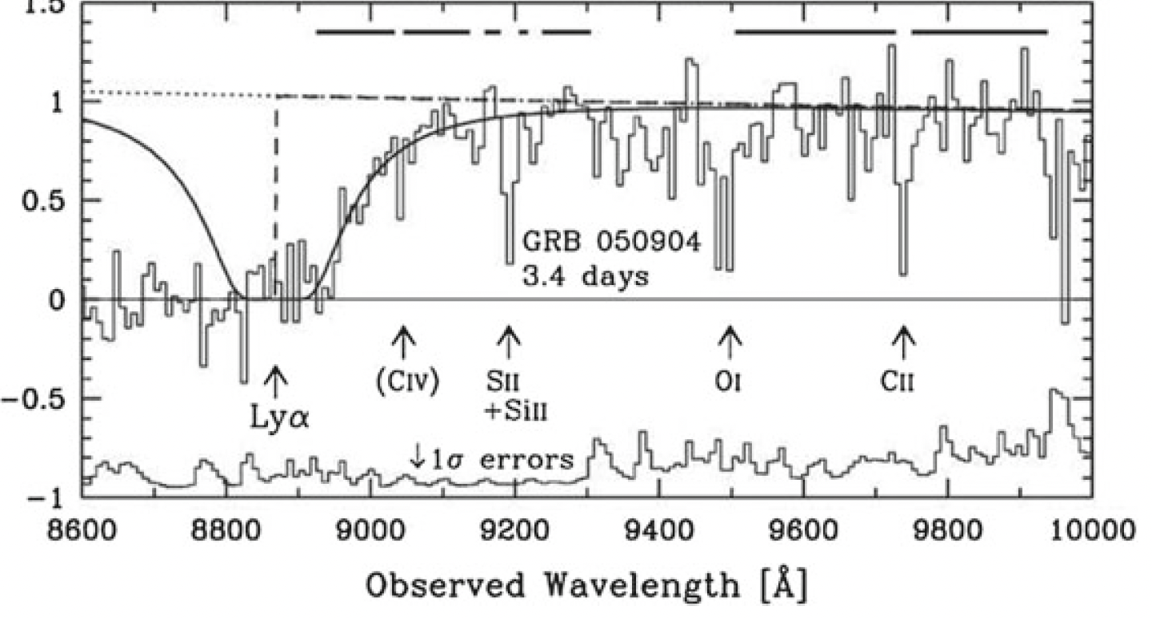
Lyα Damping Wing (DW) Absorption
IGM Absorption (Damping Wing Absorption)
DW Absorption: Redward Absorption (Uncertainty Principle)
Benefit: Less Sensitive to x_{HI}→Probe Neutral Universe
High Lyα Transmission→Large Bubble
Requirement for Measurement:
1. UV Continuum Detection 2. Spectroscopic Redshift
Gamma Ray Burst (GRB)
@ z~5.9
(Totani+14)
GRB UV Continuum (M_{UV}=-27)
Very Bright Sources (Quasar & GRB)
detection limited @ z>7
Any Alternative Sources?
Lyα
Notes:
How are and can we infer these key cosmic reionization parameters? Here’s an example. This is an UV spectra of gamma ray burst at z=6 with clear continuum detection, complete absorption beyond Lya, and also redward absorption as known as damping wing absorption by uncertainty principle. While bluer side of Lya is intensely suppressed for neutral universe, the damping wing absorption depends mildly to xHI and thus a good probe to infer xHI at higher redshift. Also, high Lya transmission can traces large ionized bubble because the transmission depends on the size of highly transmissive ionized region that photon redshift before encountering neutral gas. To do damping wing analysis, we need UV continuum detection as well spectroscopic redshift confirmation to measure absorption profile. However, detection of extremely bright sources such as gamma ray burst and quasars are limited at higher redshift, which had inhibited our investigation of cosmic reionization beyond z=8. Are there any other alternatives?

Slide 5
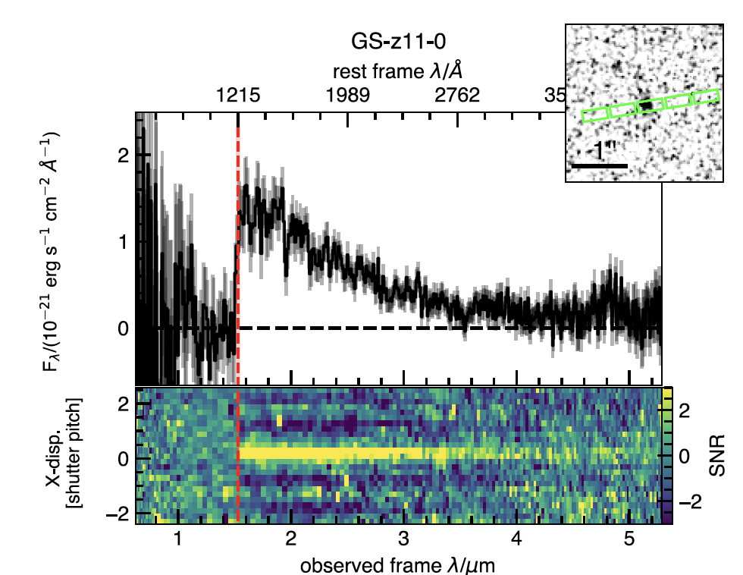
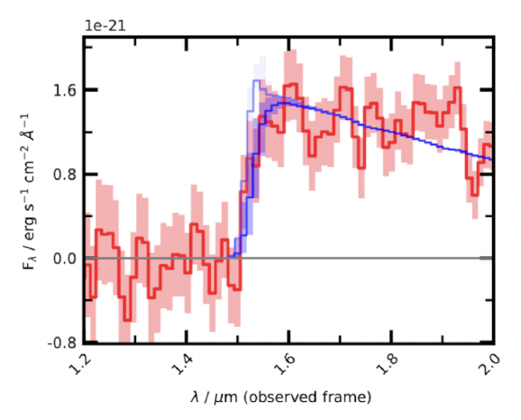
Deep JWST Galaxy Observation
JWST NIRSpec/PRISM (R~100) Observation
Sensitivity(S/N=10 for 1 ks): ~0.1 μJy→Galaxy Continuum
Damping Wing Feature at z~10? (Curtis-Lake+22)
But no emission line for precise redshift determination
Observation
model
w/ DW Absorption
JADES (Curtis-Lake+22)
Notes:
The start of James Webb observation has changed the situation dramatically. JWST NIRSpec/PRISM observation has very high sensitivity that for 1000 exposure time, we can detect 0.1 micro Jansky continuum at signal-to-noise ratio of 10. For this, we can now detect UV bright galaxy continuum at z>7 with deep JWST observation. The left panel is a spectra of redshift 10 Lyman break galaxy obtained in JADES program. The UV continuum is clearly detected. Curtis-Lake et al. conducted damping wing measurement as shown in the right figure, and suggested the existence of damping wing by neutral IGM at z=11. Their analysis, however, lacks precise information on systemic redshift, which require emission line detection.

Slide 6
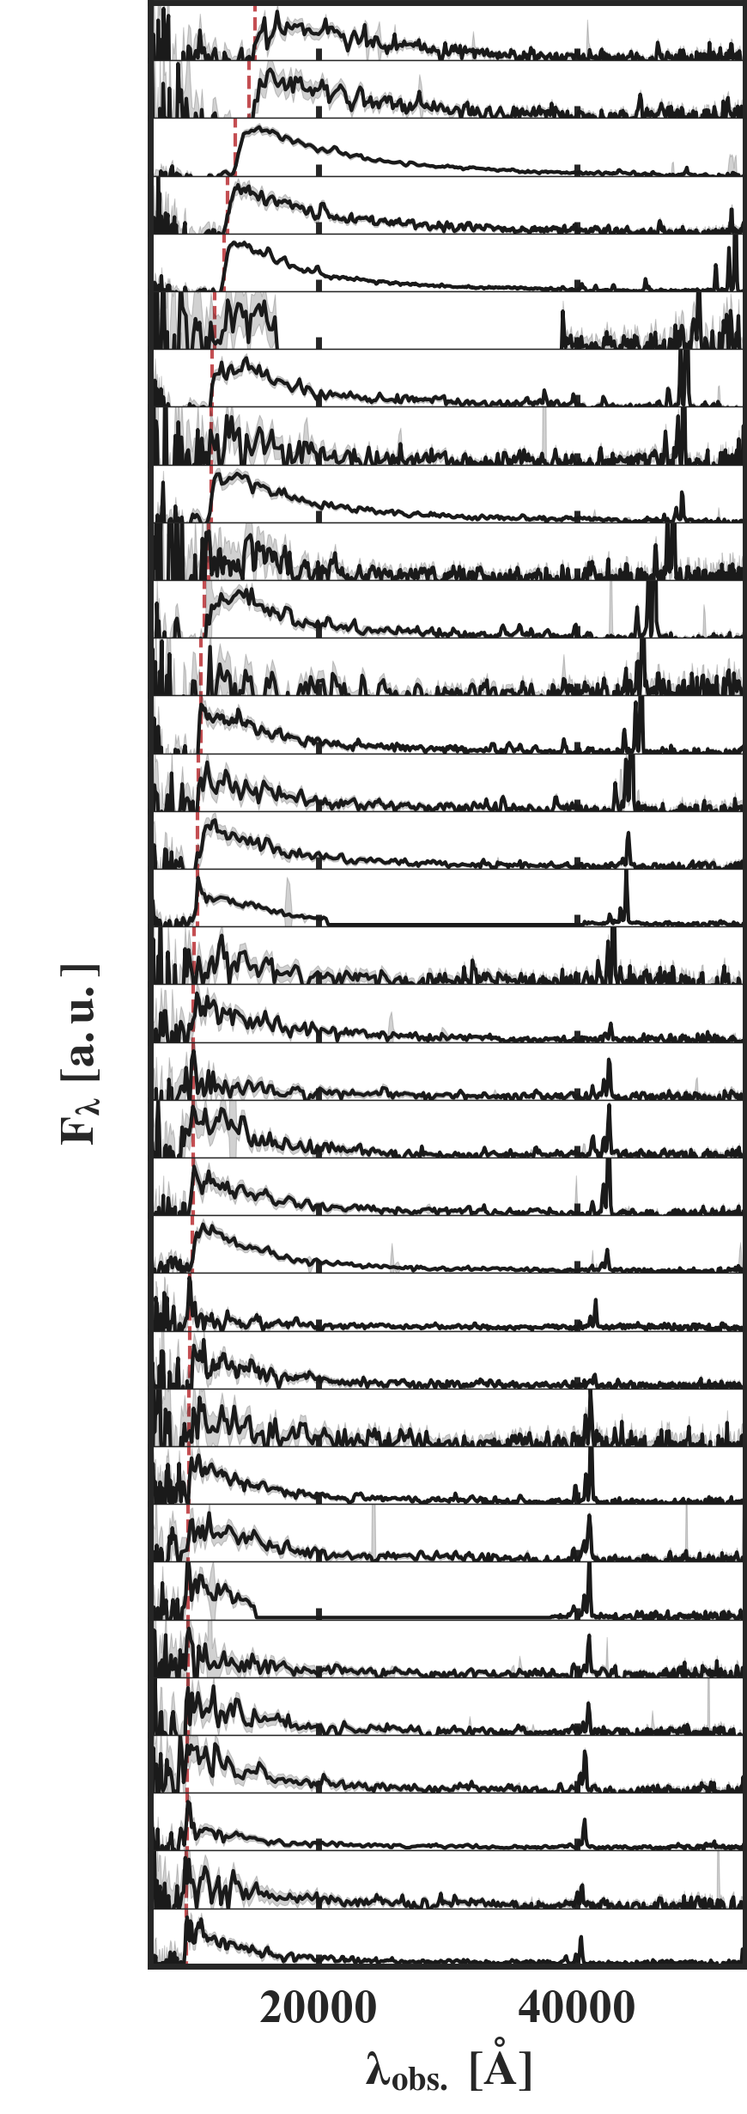
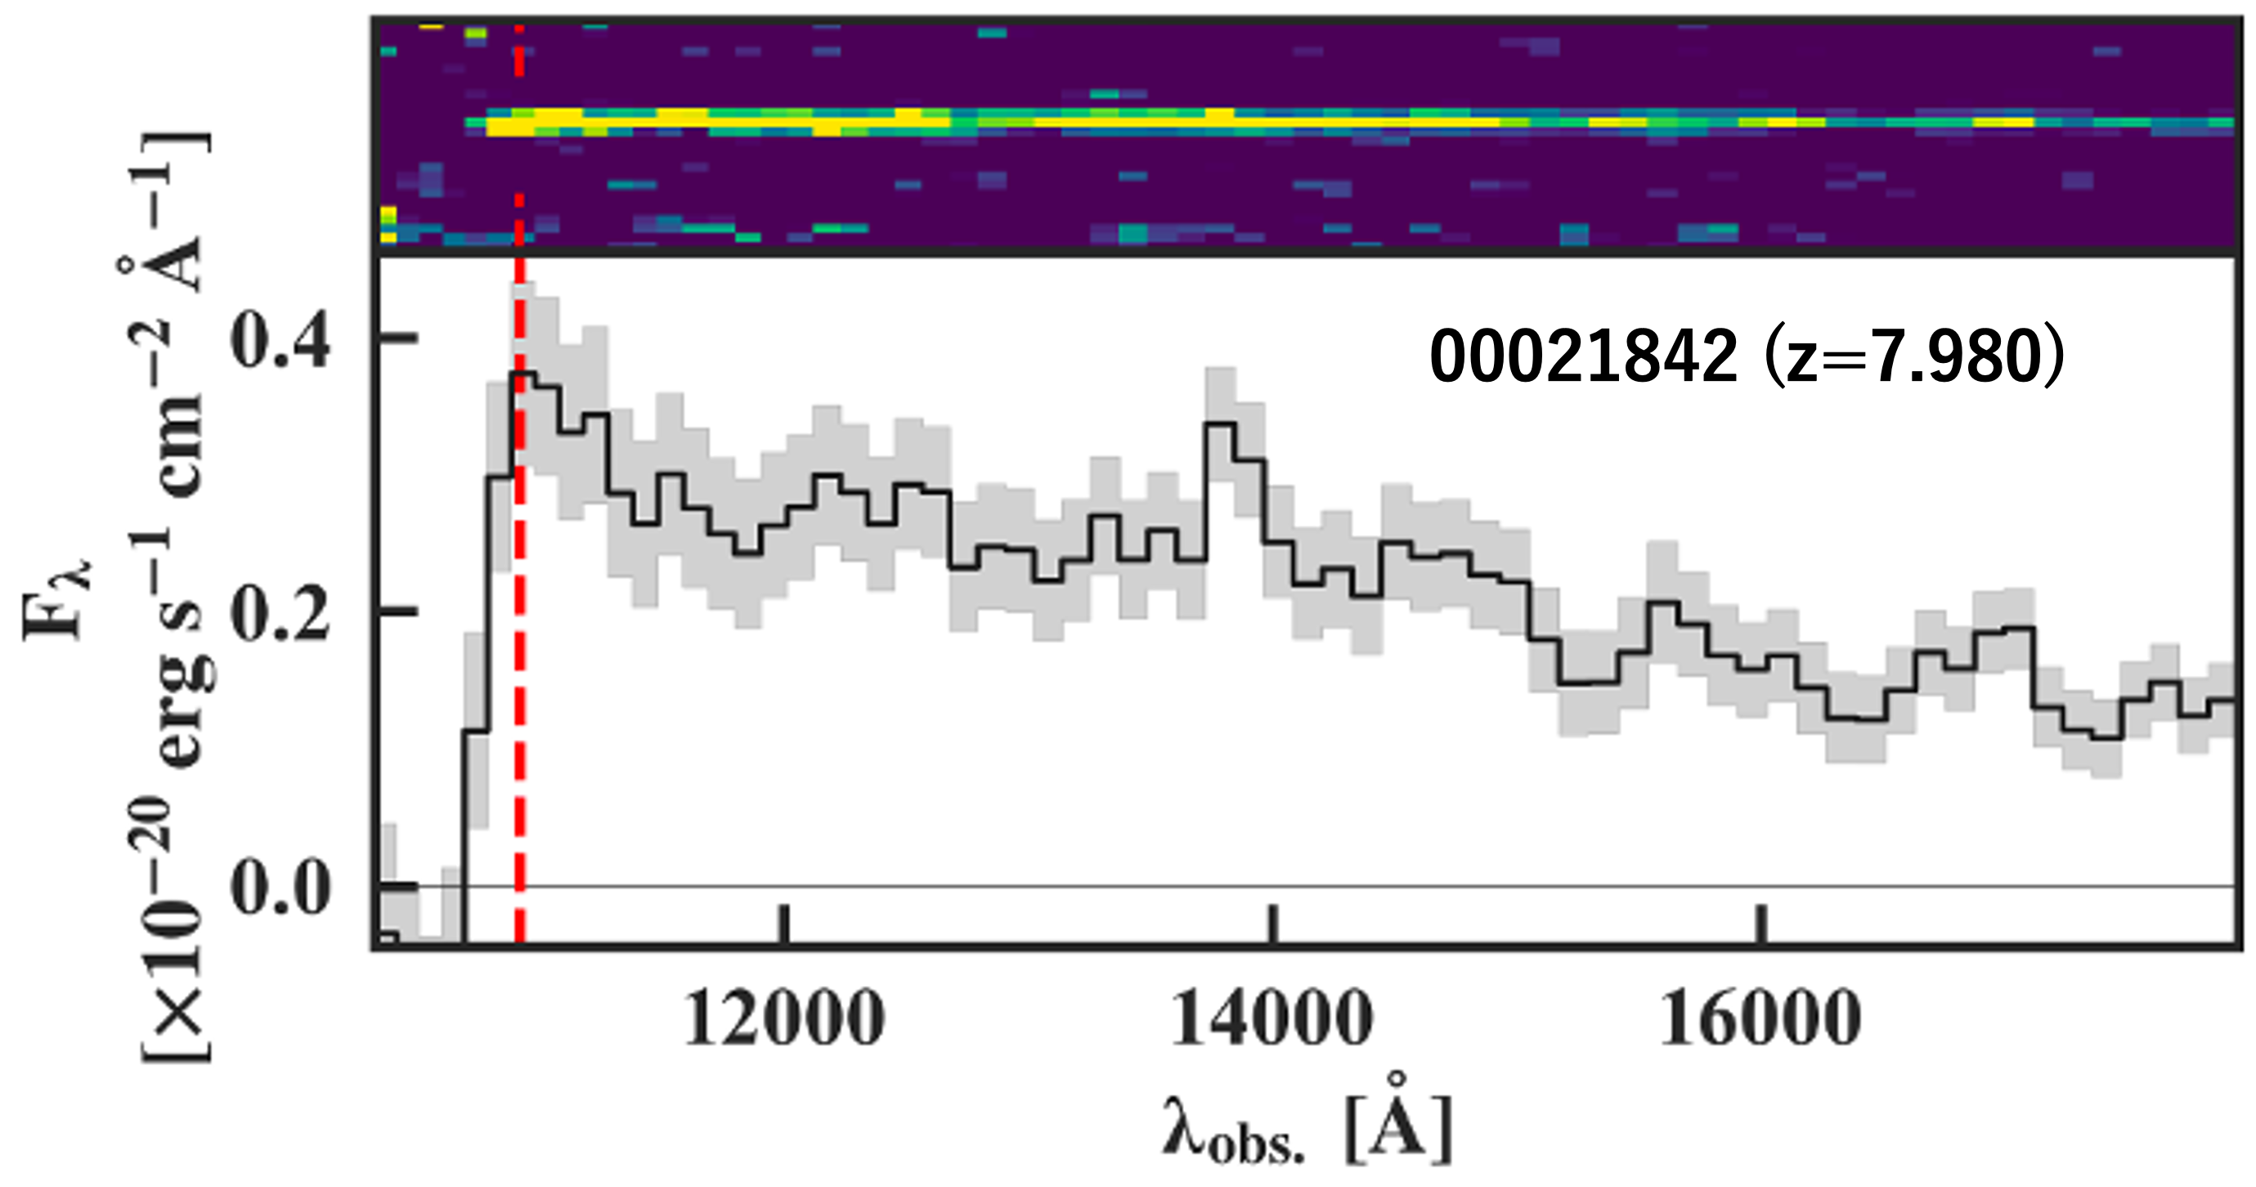
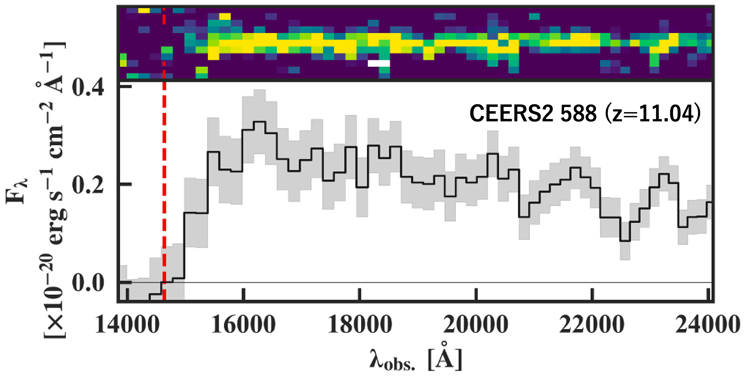
Bright Galaxy Dataset
Emission Line
Lyman Break
26 UV-Bright (M_{UV}<-18.5) Galaxies from 7<z<12
*Thanks to CEERS, DDT2750, GO1430, JADES collab.
spec-z confirmed from emission line
(Nakajima+23, Harikane+23, Bunker+23)
Lyα
Lyα
4.2σ Offset
→High Transmission
→Large Ionized Bubble?
Strong damped Lyα?
Notes:
In our work, we decided to gather UV bright prism spectra from open access data of multiple survey. We selected galaxy spectra with systemic redshift confirmation from the emission line. Our final galaxy sample consist of 26 galaxies from redshift 7 to 11.4 with UV magnitude all brighter than -18.5. Here are the spectra of our galaxy sample from low to high redshift from bottom to the top, and we see Lyman break and the rest-frame optical emission line. With UV continuum detection and systemic redshift confirmation, we can directly compare the offset of Lyman break. For example, this galaxy at redshift 8 shows the offset to bluer side of systemic redshift with 4.2 sigma significance, indicating high Lya transmission and the existence of large, ionized bubble. On the other hand, for redshift 11 sources, we see very strong damping wing feature..

Slide 7
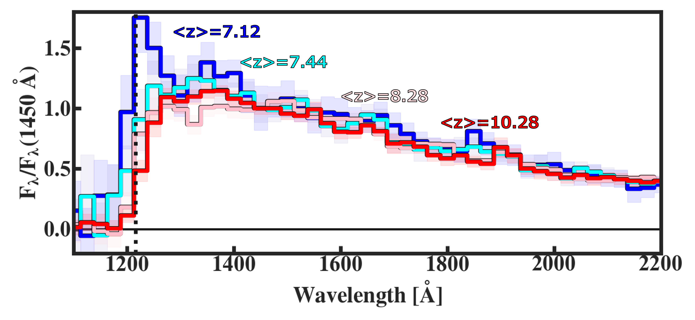
Stacked Spectra & Softening Break
Stacked by 4 redshift bins
→Softening Break at Rest-frame 1216 Å
→Higher Absorption as Higher <x_{HI}>
Lyα
Notes:
To see the trend of the spectrum shape more clearly, we stacked spectra by four redshift bins as shown in the bottom figure. All stacked spectra are shifted to the rest-frame and bluer to redder color corresponds to the stacked spectra of low to high redshift bins. If we focus on the change at spectrum shape near rest-frame Lya, we can see clear trend of softening break feature from low to high redshift, suggesting the increase in neutral fraction of IGM towards higher redshift.

Slide 8
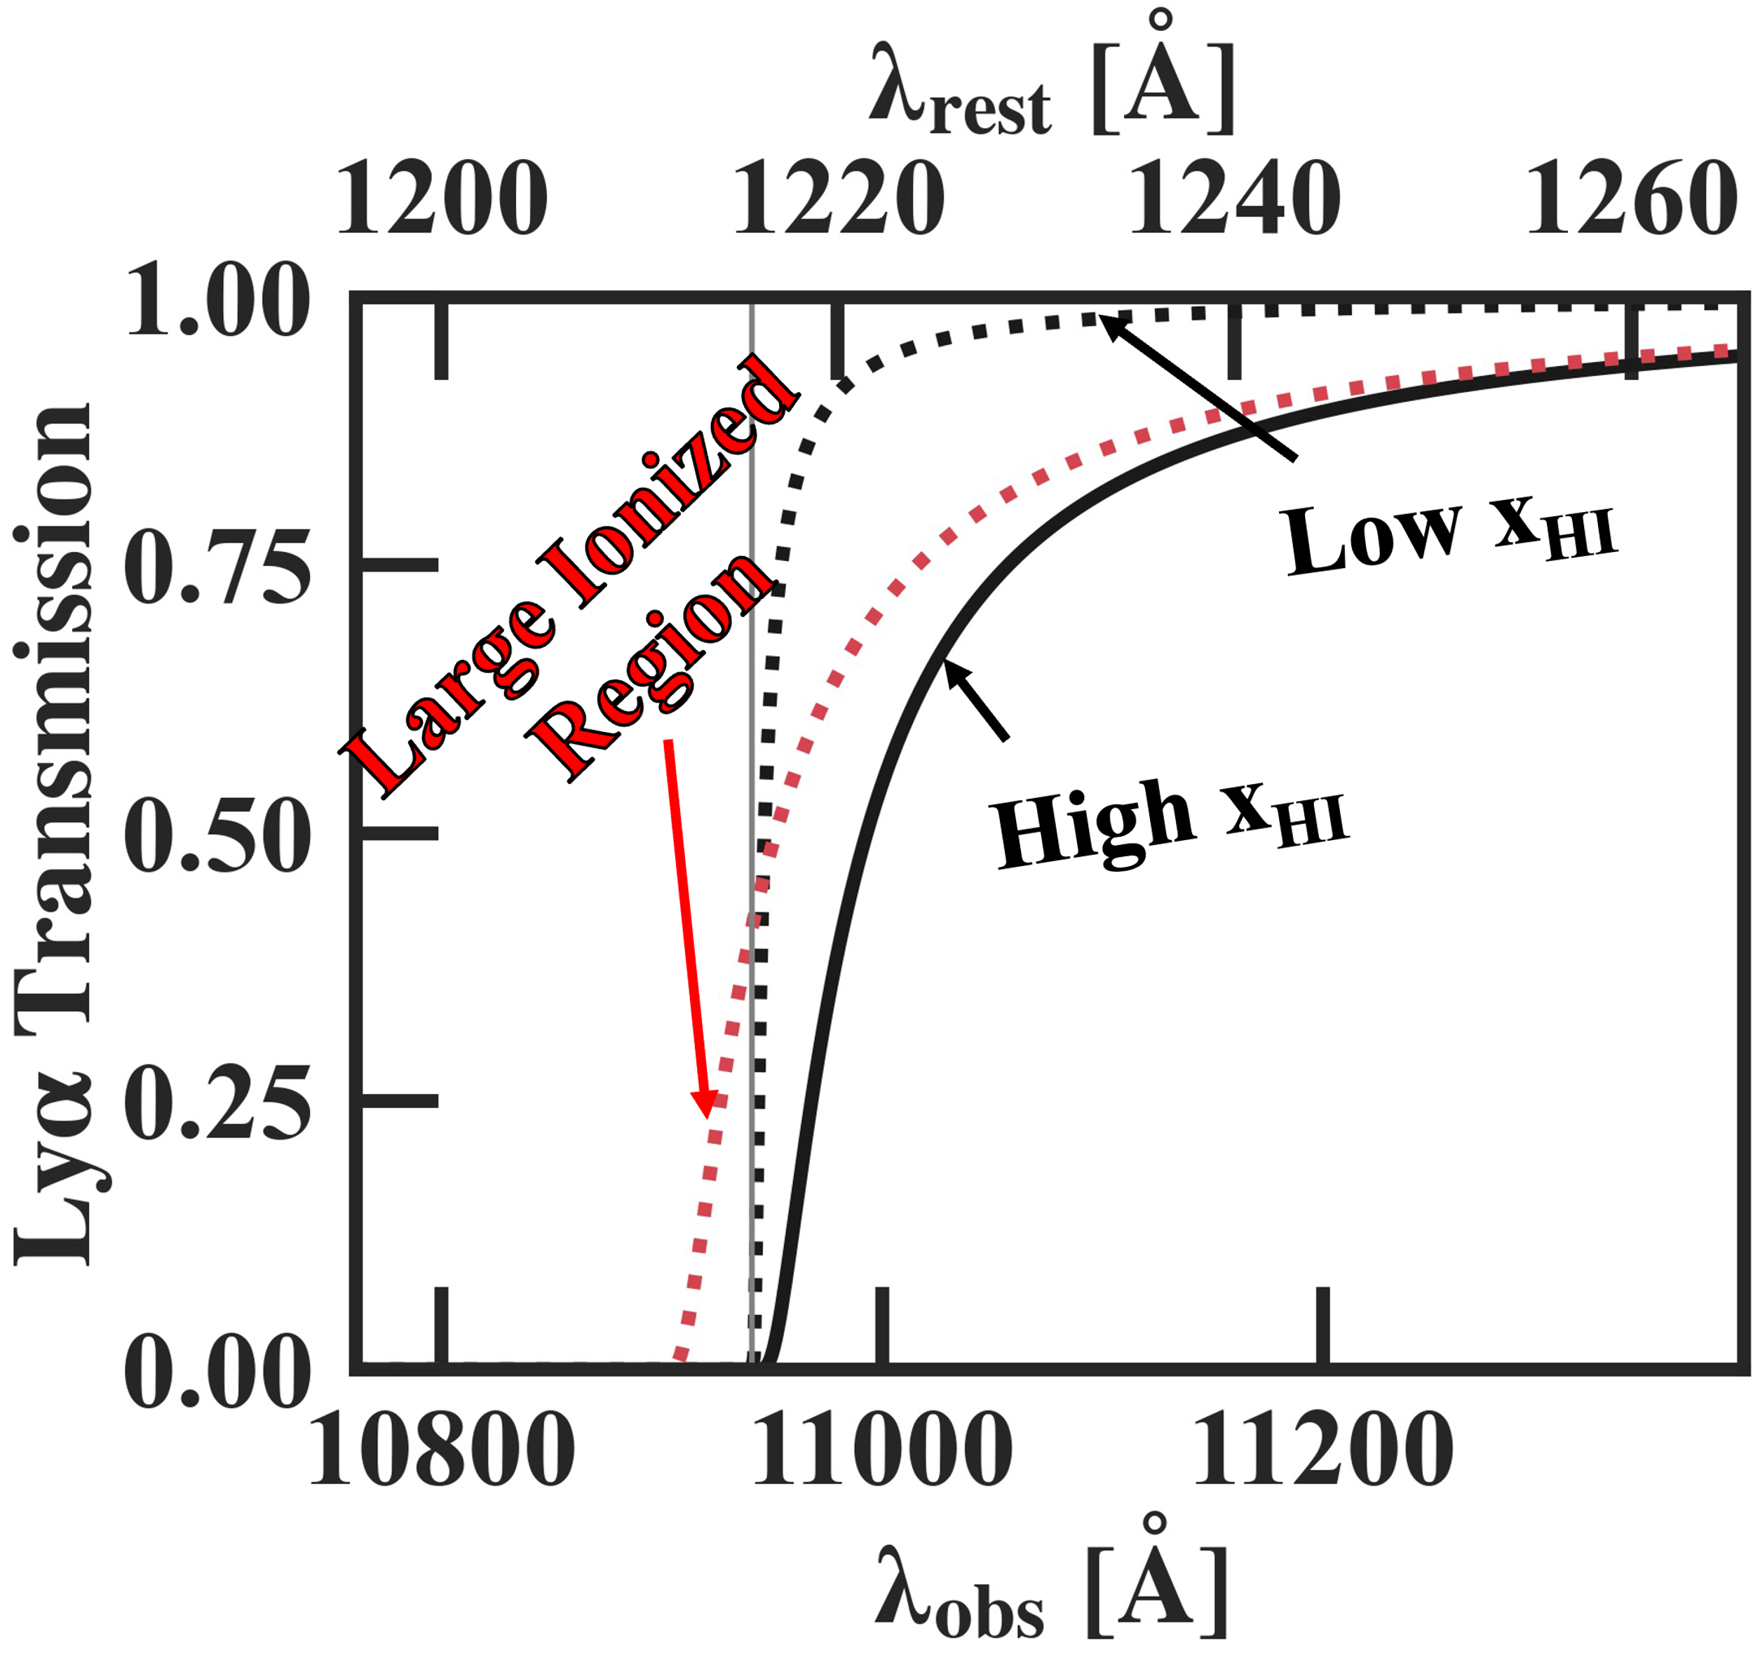
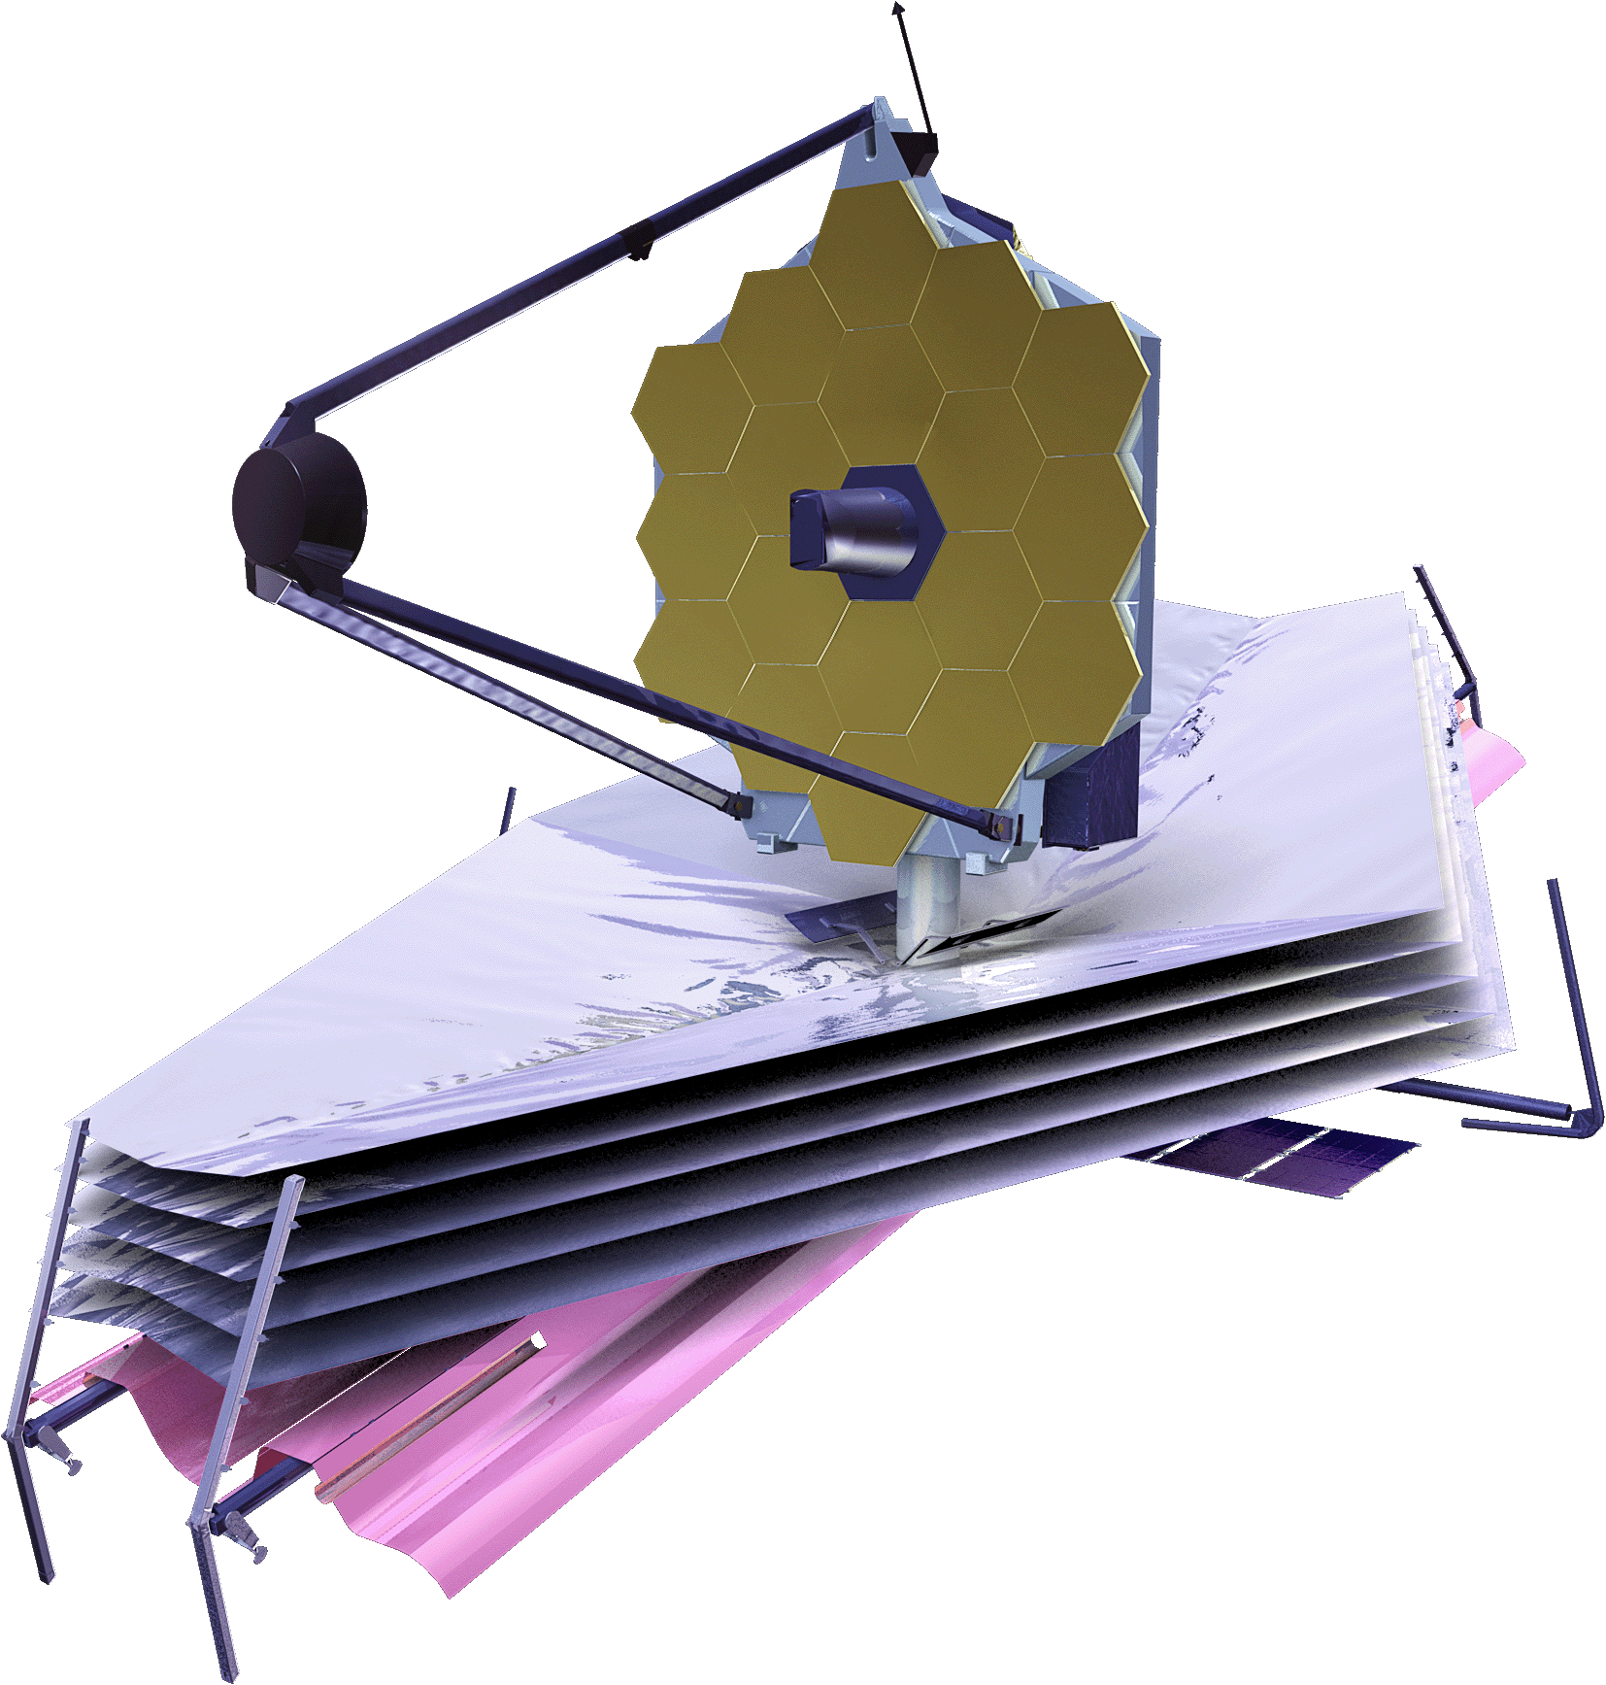
Lyα DW Absorption Measurement
Analytic Model (Miralda-Escude+98; Totani+14)
x_{HI}: Absorption Strength (Averaged; Homogeneous)
R_{b}: Velocity Offset (Enhance Lyα Escape)
Intrinsic Spectra: Used Prospector
Model Illustration
Neutral
Galaxy
Rb
Ionized
z=0
z~5
0<xHI<=1
(Averaged;
Constant)
z>7
Notes:
We extend our analysis to quantitatively evaluate the xHI and bubble size evolution by measuring Lya absorption. We assume analytic damping wing absorption profile given by Miralda-Escude et al. We show the model illustration at the bottom. We assume galaxy resides in center of fully ionized bubble with radius Rb. IGM state is inhomogeneous in reality, but we approximate it with average xHI value between the edge of bubble to z=5. We show example Lya transmission for different parameter values at different wavelength at z=9. As shown in the figure, xHI governs the strength of the absorption, whereas Rb governs velocity offset with large Rb enhancing Lya escape on the blue side of the systemic redshift.

Slide 9
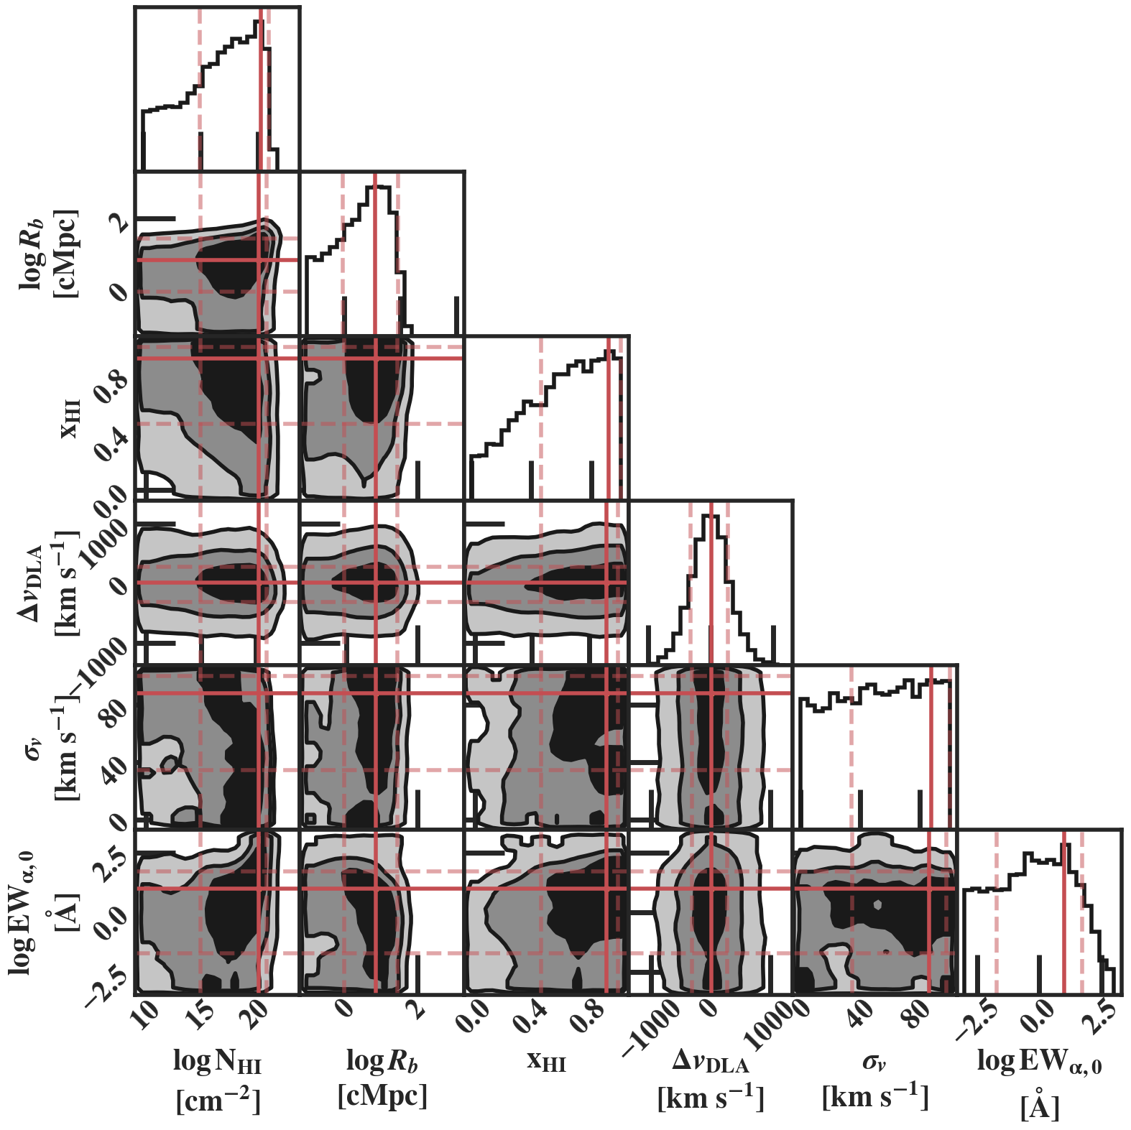
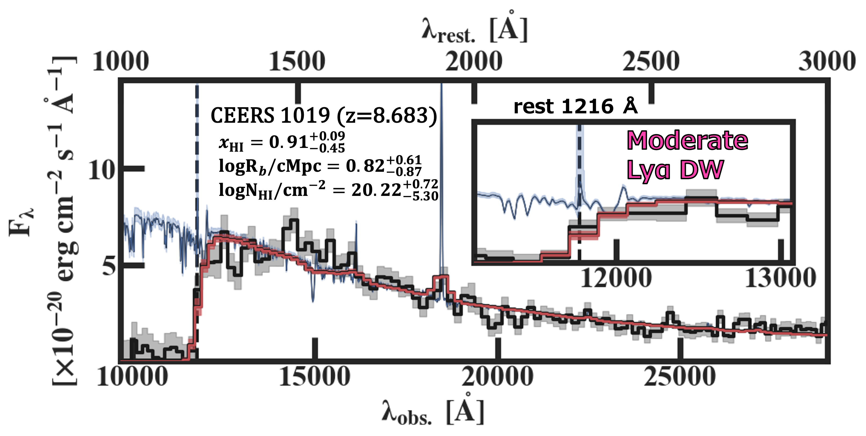
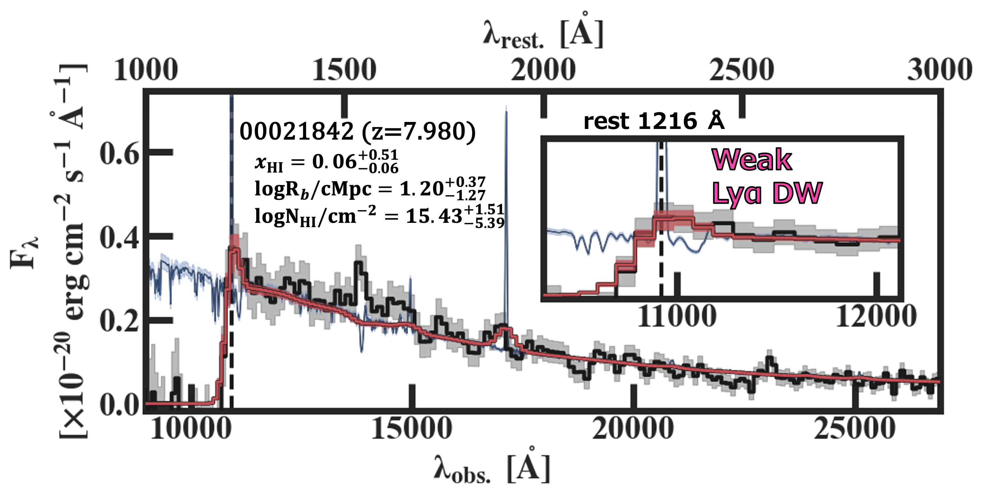
Fitted Spectra (Example)
Parameter Estimation
(ex. For CEERS_1019)
Intrinsic Spectrum
Obs.
Best-fit
Model (w/ absorption)
Notes:
This is an example of the fitted galaxy spectra for one of the galaxies at z=8.6. The black lines is a observed spectra. The red line is the best-fit model after IGM absorption and the blue spectrum is the intrinsic galaxy spectrum without any absorption. The best-fit and observed spectra seems to match well overall and even near rest-frame Lya as shown in the inset panel. Here we shown another example with stronger and weaker absorption feature and they look good as well. With the fitting, we get parameter estimation as shown in this figure for multiple parameter we implemented. Next thing we must consider is that whether the estimated parameters are realistic. Especially, we need to be careful on additional parameter that changes spectrum feature around Lya drastically.

Slide 10
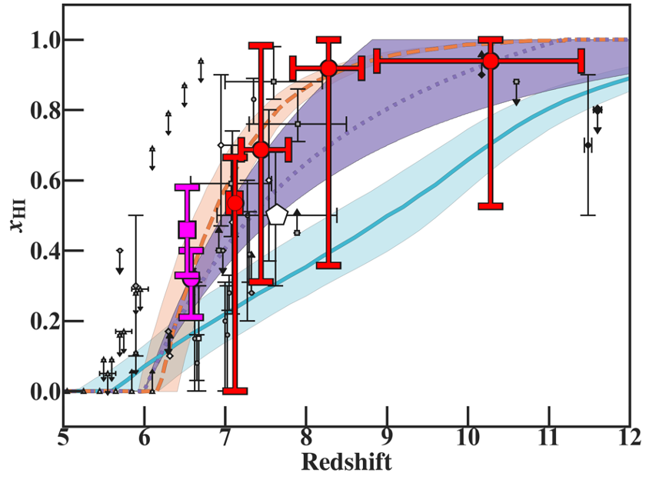
x_{HI} Evolution
✅ Smooth Connection between z=6-12
✅ Consistent w/ CMB, UV LF evolution
UV LF Evolution w/ const. fesc
(Ishigaki+18)
Bright Gal. Dominant (Naidu+20)
Our Work
(Binned)
Subaru HSC
z~6-7 Lyα Emitters
(Umeda 23)
Faint Gal.
Dominant (Finkelstein+19)
Cosmic Microwave
Background (Planck+20)
Notes:
Finally, we show are binned xHI estimate for four redshift bin in the bottom figure in red. The pink is a xHI estimate from statistical properties of z=6-7 Lya emitter identified by Subaru Hyper Suprime Cam. Although the error bar is still quite large, we can clearly see the smooth and monotonic increase in xHI toward high redshift between z=6 to 12. Also, our measurement is consistent with xHI inferred from electron scattering of cosmic microwave background. Moreover, our measurement is consistent with various xHI evolution prediction including that inferred from UV luminosity function evolution with constant escape fraction shown in purple line and shades.

Slide 11
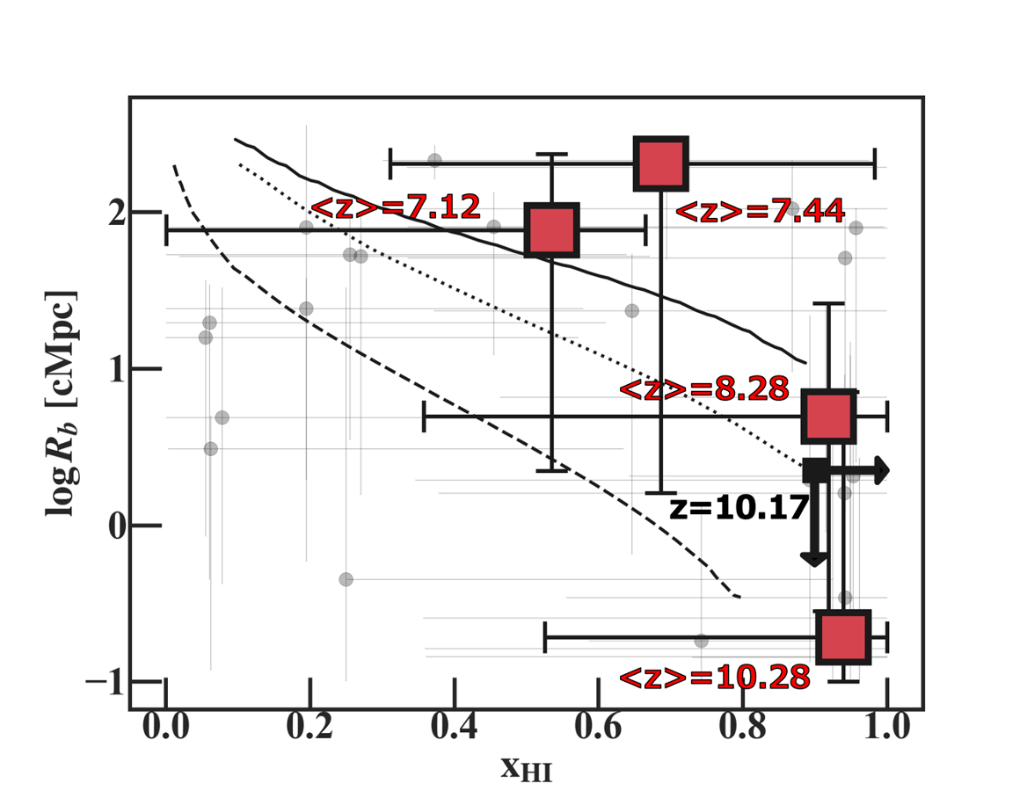
Bubble Size Relation
⚠️ Systematically Larger than Cosmic Average
✅ Consistent w/ Around Bright Galaxy (Merged Region; Lu+23)
Bright Gal. (M_{UV}<-20) (Lu+23)
JWST Opening Up New Windows for Reionization Study
Still, Challenges Remains:
PRISM (R~30 @ 1-2 um) for UV cont. detection
→Degeneracy Remains due to low spec. resolution
(Lyα Contribution/Absoprtion Velocity Offset, etc…)
Bubble Size
Cosmic Average
(Furlanetto&Oh05)
See also
Endsley+21, Chen+23
Neutral Fraction
Notes:
Next, we investigate xHI and bubble size relation. We once again plot our binnd result in the red. Our Rb measurements are systematically larger than the cosmic average relation suggested from the analytic relation, shown in dashed line. We puzzled at first, but when we compare the bubble size relation around bright galaxies by recent numerical simulation by Lu et al., we find our estimates are roughly consistent with their relations. The enhanced bubble size near bright galaxies is due to the underlying galaxy over density and merge of neighbor ionized region. Anyway, it is very exciting that we can quantitatively analyze the ionized bubble size using galaxy observation before 21cm observation by next generation radio interferometers.

Slide 12
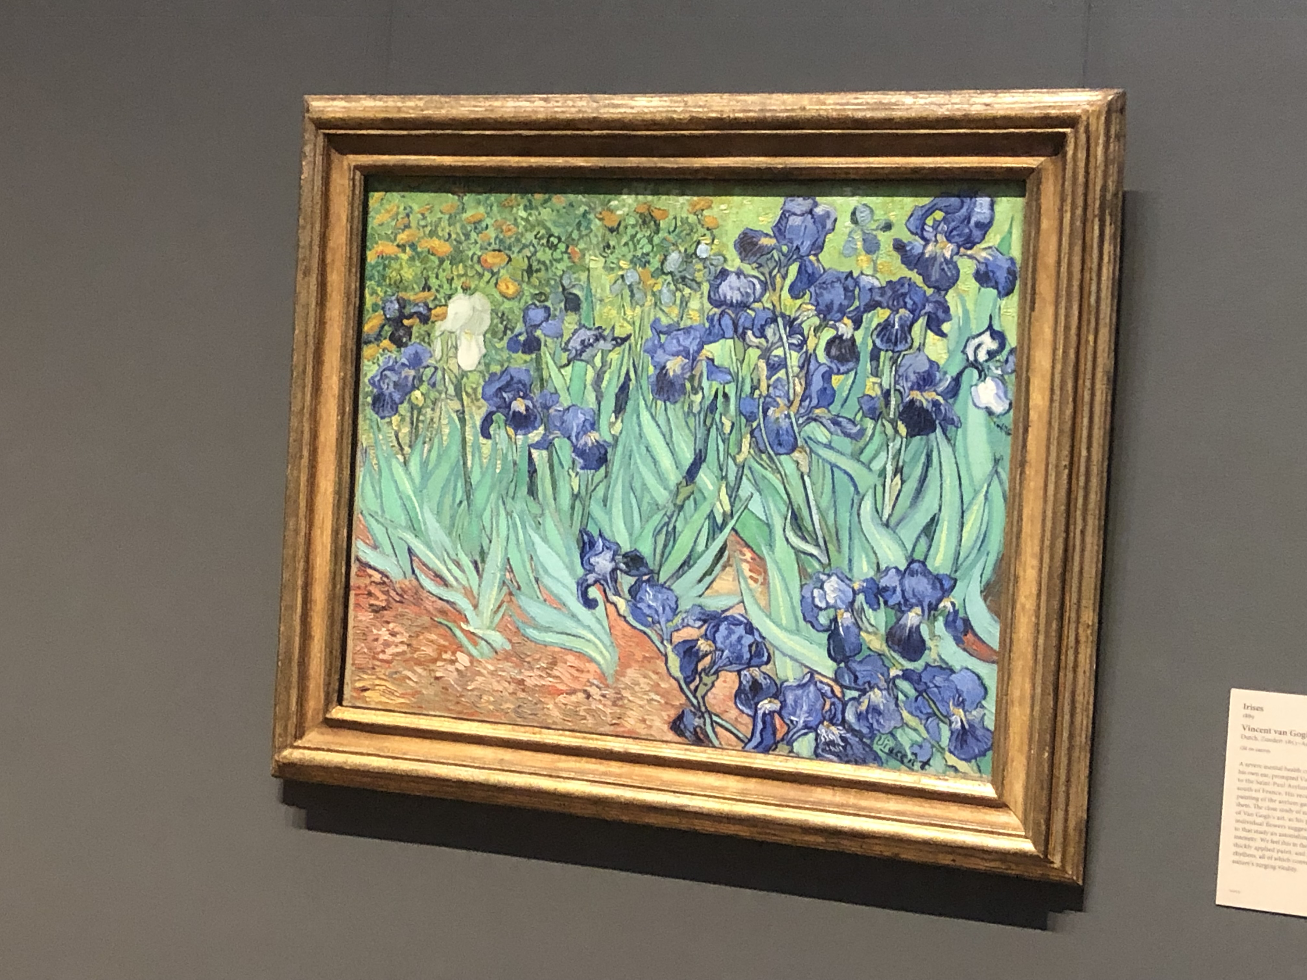
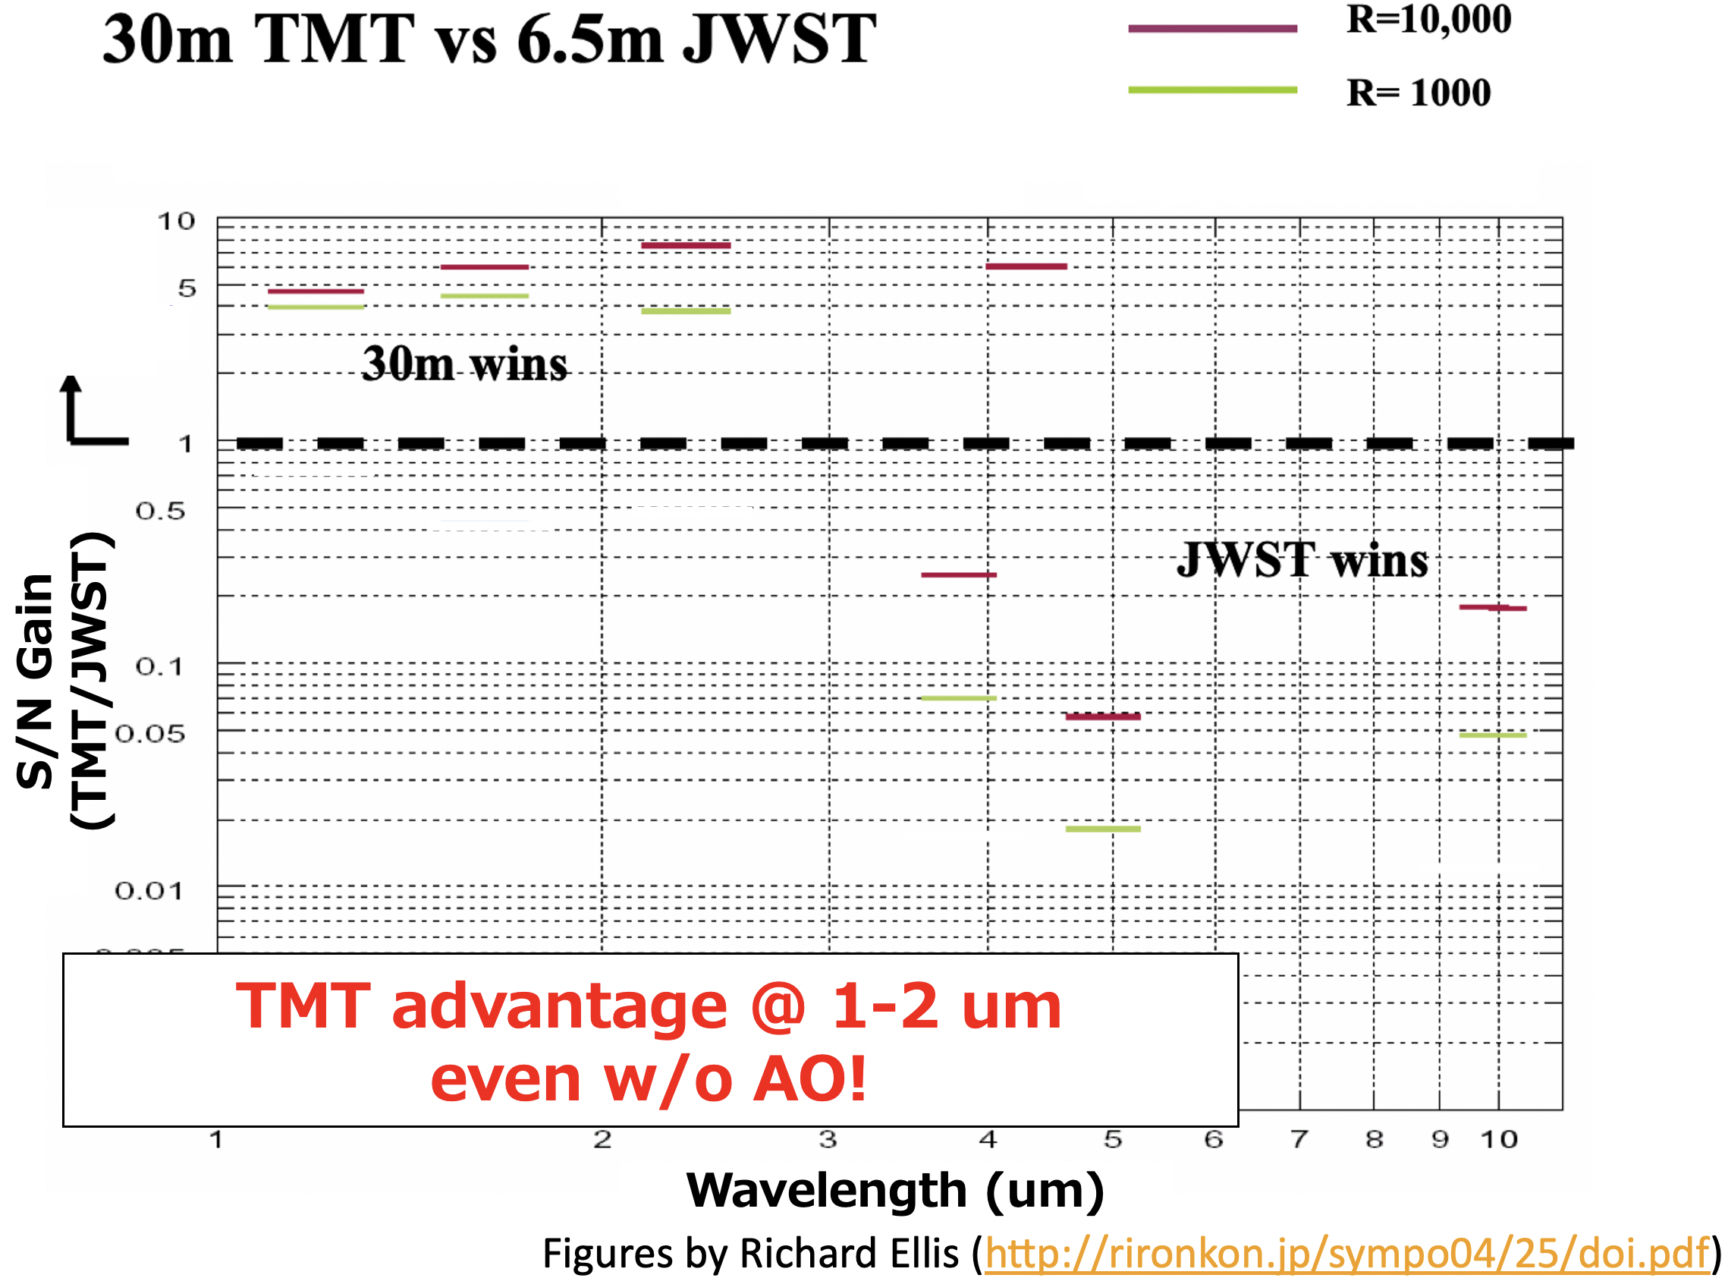
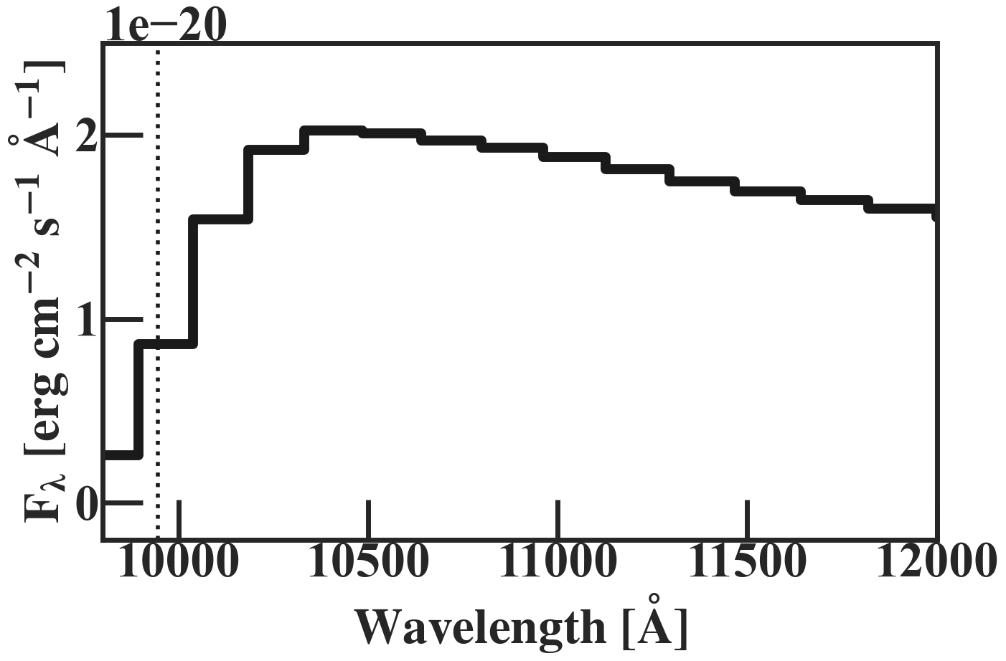
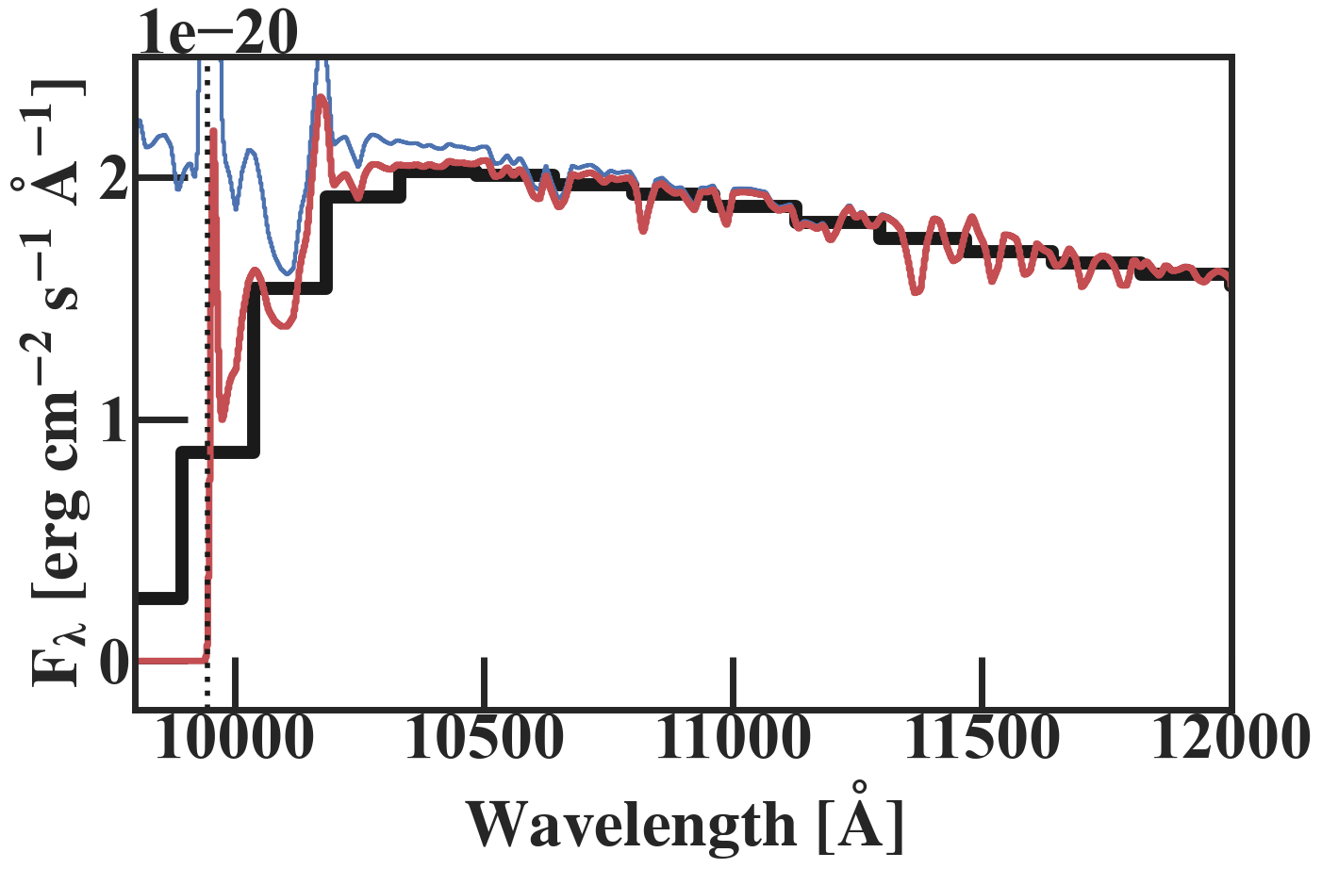
For the Epoch of JWST x ELTs
@Getty Center
High Sensitivity + Spectral Resolution (R~1000) @ ~1 um
→suits DW analysis for z~7-9 (ex. TMT/IRIS)
→Lyα DW Profile Fitting w/ ELTs?
ex. TMT
JWST/PRISM
Resolved Spectra
(w/ ELTs)

Slide 13
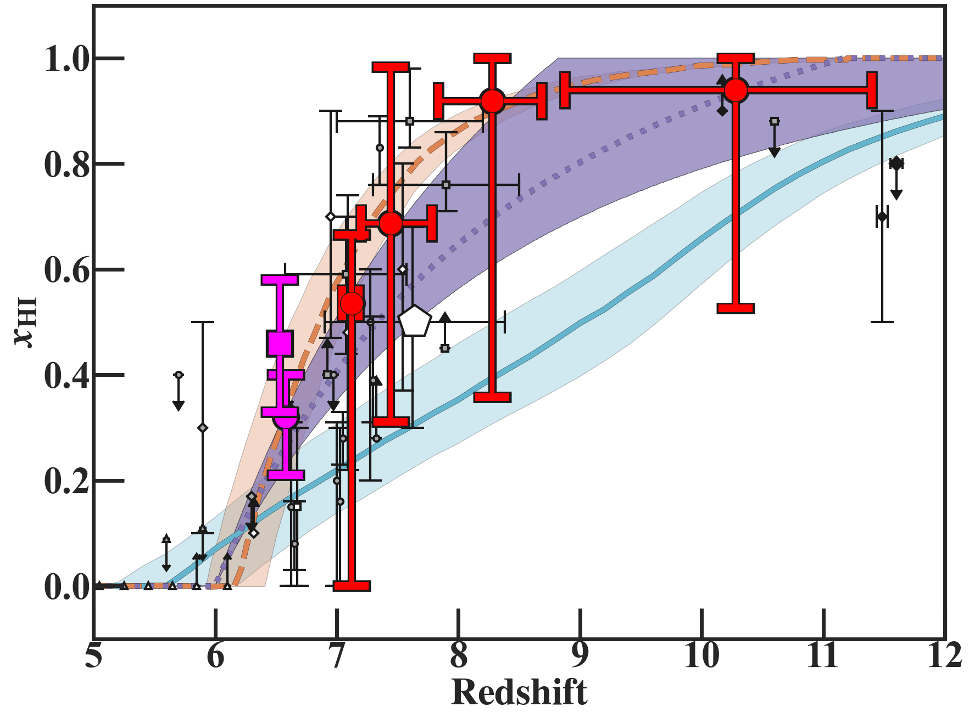
Summary
Galaxy Lyα DW to probe
Cosmic Reionization @ z>7
z=7-12 UV-Bright Galaxy
26 spectra w/ spec-z confirmation
stacking suggest x_{HI} evolution
DW Measurement
Constrain x_{HI} & R_{b}
x_{HI} constraint consistent w/ CMB & UV LF evolution
Bubble size relation consistent w/ that around bright galaxy
ELTs for High Sensitivity/Spec. Resolution!
Notes:
Here’s my take home messages. In our work, we used galaxy Lya damping wing absorption to probe cosmic reionization at z>7. From public JWST data, we collected a total of 26 UV bright galaxies ranging from redshift 7 to 12. Stacking the galaxy spectra by redshift bin shows clear trend of softening break feature at rest-frame 1216 Å, indicating increase in IGM neutral fraction toward high redshift. We also measured absorption profile to quantitatively evaluate xHI and Rb. Our xHI estimate is smoothly connected with z<7 result and consistent with other observational constraints. We also investigate bubble size relation and find that our measurement is consistent with the predicted relation around bright galaxies by recent numerical simulations.

