Slide 1
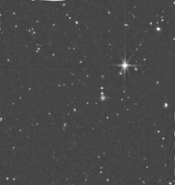
First look at the MIRI 7.7um sources in COSMOS-Web
Santosh Harish (Postdoc, RIT)
Jeyhan Kartaltepe, Caitlin Casey, Daizhong Liu & the COSMOS-Web team
ELT Science in Light of JWST
December 14, 2023

Slide 2
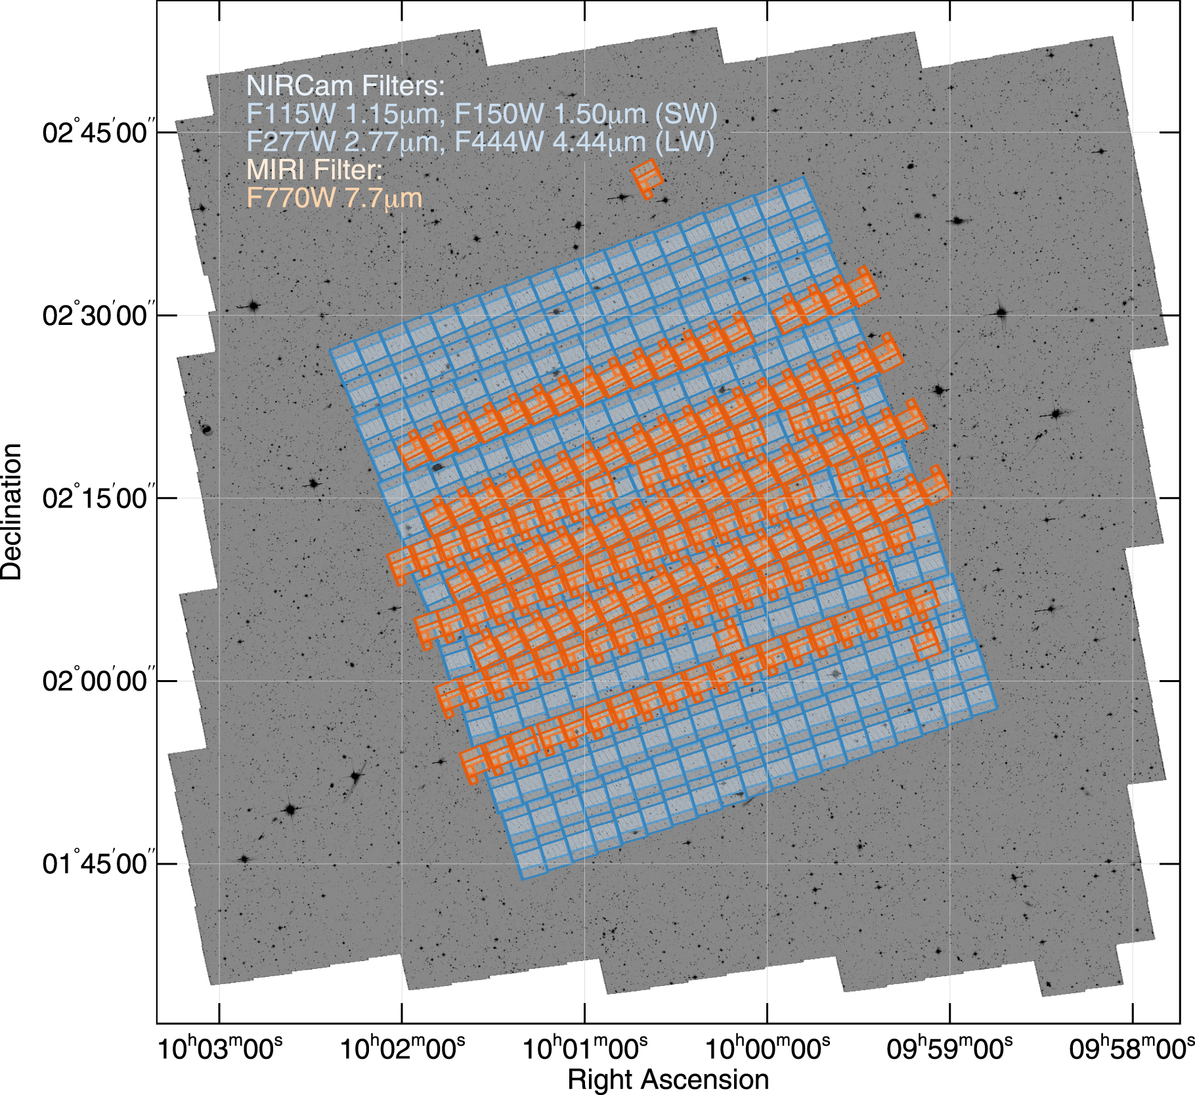
COSMOS-Web survey
225-hour treasury program in JWST Cycle 1
One large contiguous coverage in NIRCam + parallel non-contiguous coverage in MIRI
0.54 deg² NIRCam
(F115W, F150W, F277W, F444W)
0.19 deg² MIRI (F770W)
Casey+2023

Slide 3
COSMOS-Web survey
Observations so far..
Jan 2023: 6 visits

Slide 4
COSMOS-Web survey
Observations so far..
Jan 2023: 6 visits
Apr 2023: 76 visits
(4 skipped)

Slide 5
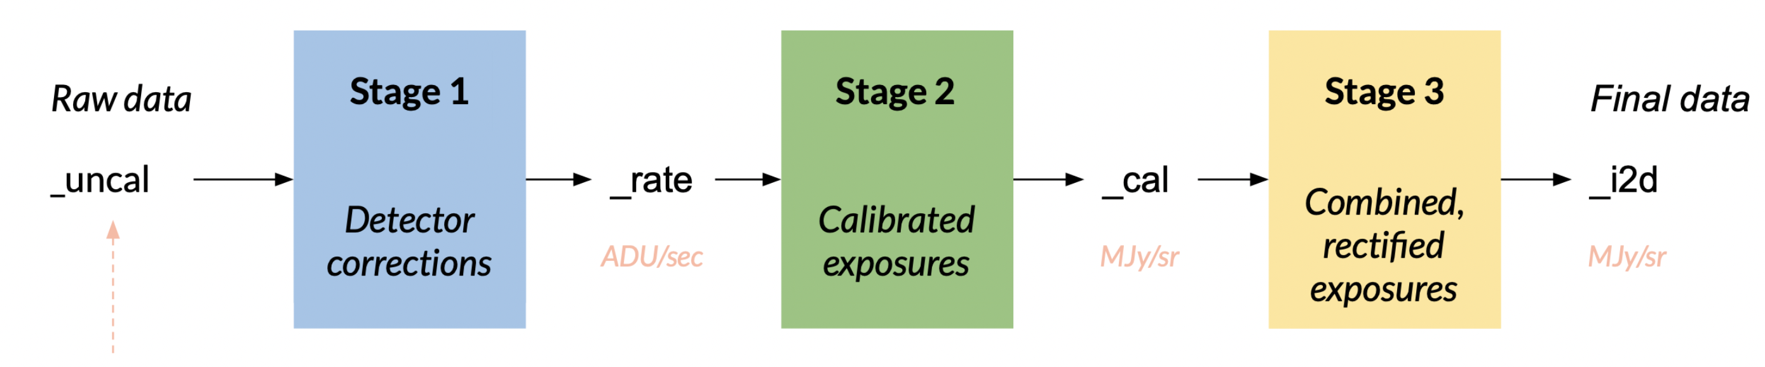
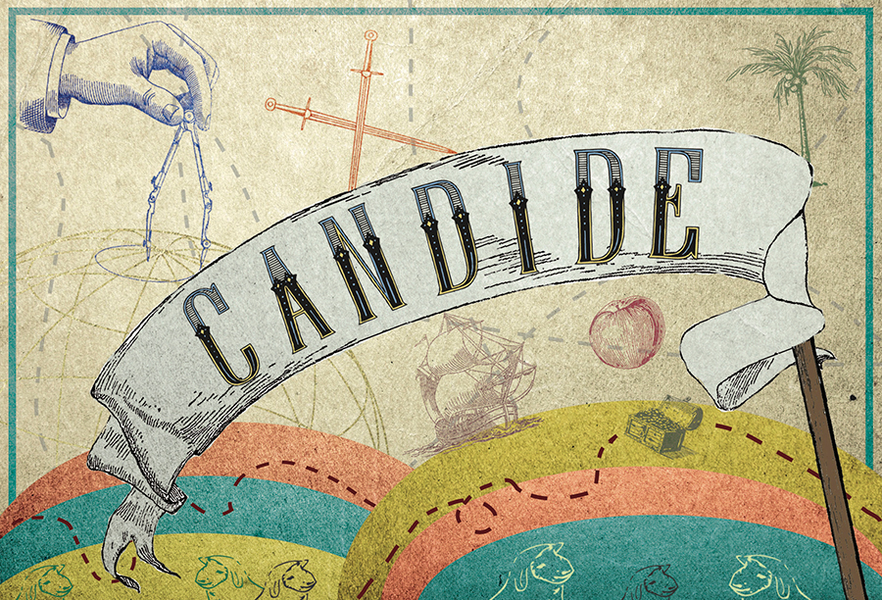
COSMOS-Web: MIRI reduction
JWST Science Calibration Pipeline (STScI)
Canin+2021
Jan+Apr 2023
JWST Pipeline: v1.12.1
CRDS: jwst_1130.pmap

Slide 6
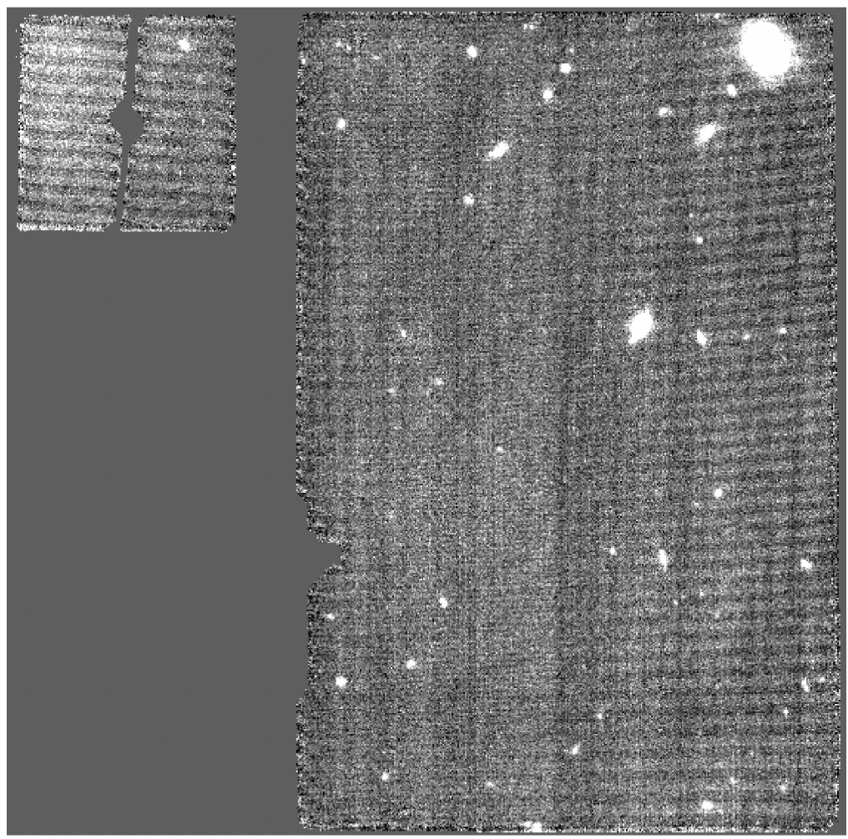
COSMOS-Web: MIRI reduction
Image-for-image subtraction†
  MIRI imaging is impacted by a strong (instrumental) background feature
  Per exposure, this feature is removed by constructing a master background that is derived using source-emission-masked resampled images (stage 3) of other exposures/visits, and subtracting the master background from that exposure by re-running stage 2 & 3 calibrations.
  Before subtraction
† https://github.com/1054/Crab.Toolkit.JWST/blob/main/docs/reprocessing_MIRI_with_ImageForImageBackgroundSubtraction.md

Slide 7
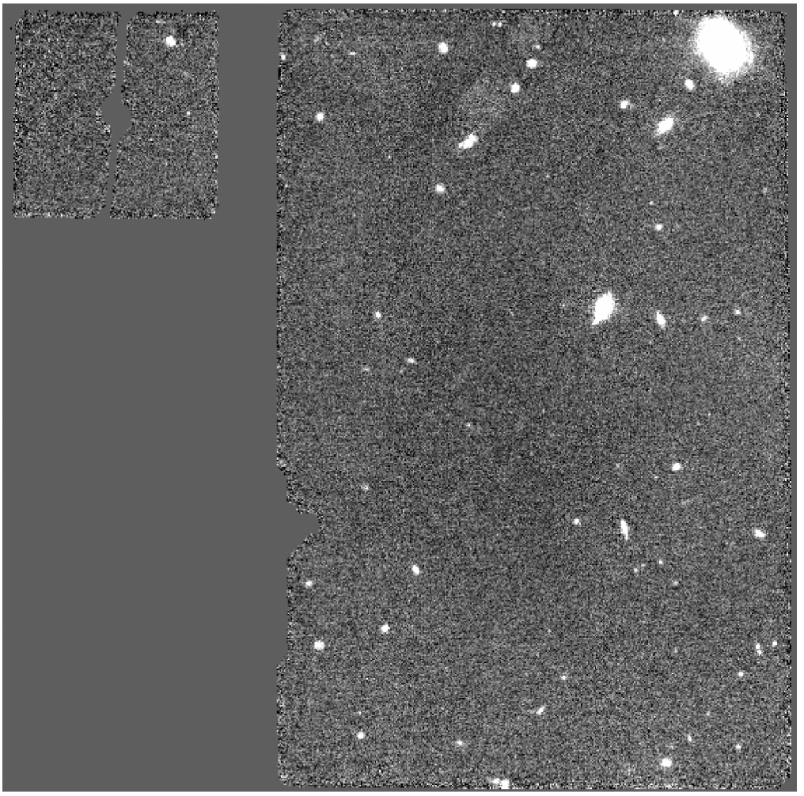
COSMOS-Web: MIRI reduction
Image-for-image subtraction†
  MIRI imaging is impacted by a strong (instrumental) background feature
  Per exposure, this feature is removed by constructing a master background that is derived using source-emission-masked resampled images (stage 3) of other exposures/visits, and subtracting the master background from that exposure by re-running stage 2 & 3 calibrations.
  After subtraction
† https://github.com/1054/Crab.Toolkit.JWST/blob/main/docs/reprocessing_MIRI_with_ImageForImageBackgroundSubtraction.md

Slide 8
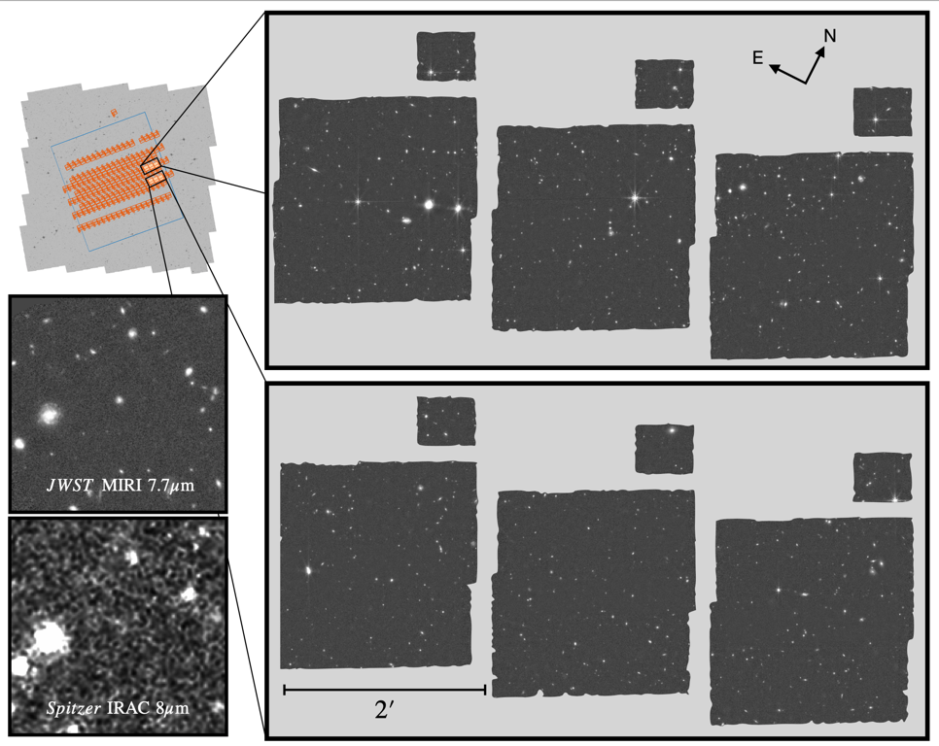
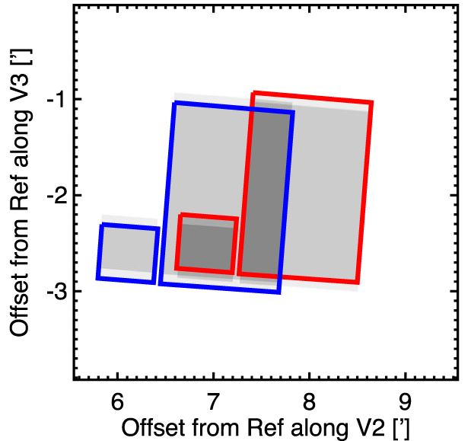
COSMOS-Web: MIRI reduction
Jan 2023 observations
Casey+2023

Slide 9
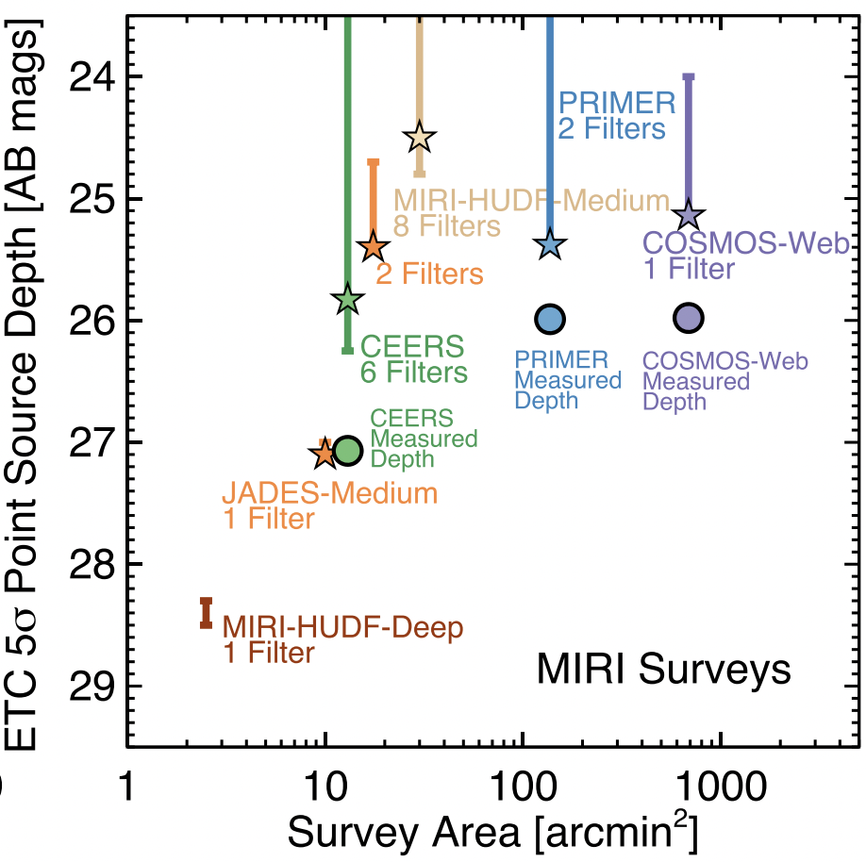
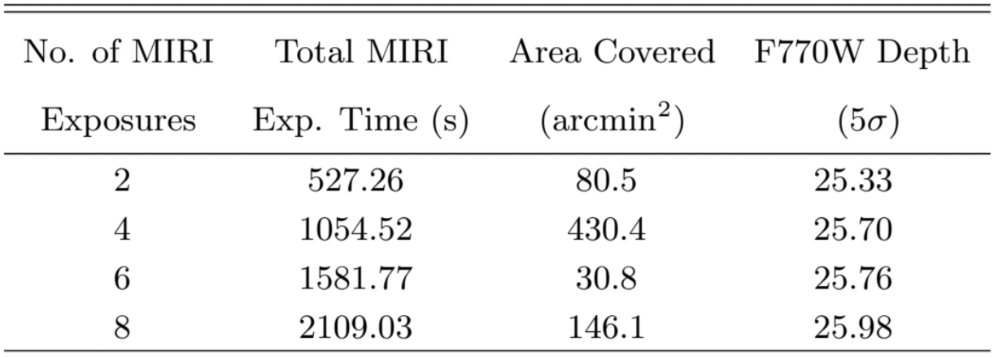
COSMOS-Web: MIRI reduction
Jan 2023 observations
Casey+2023

Slide 10
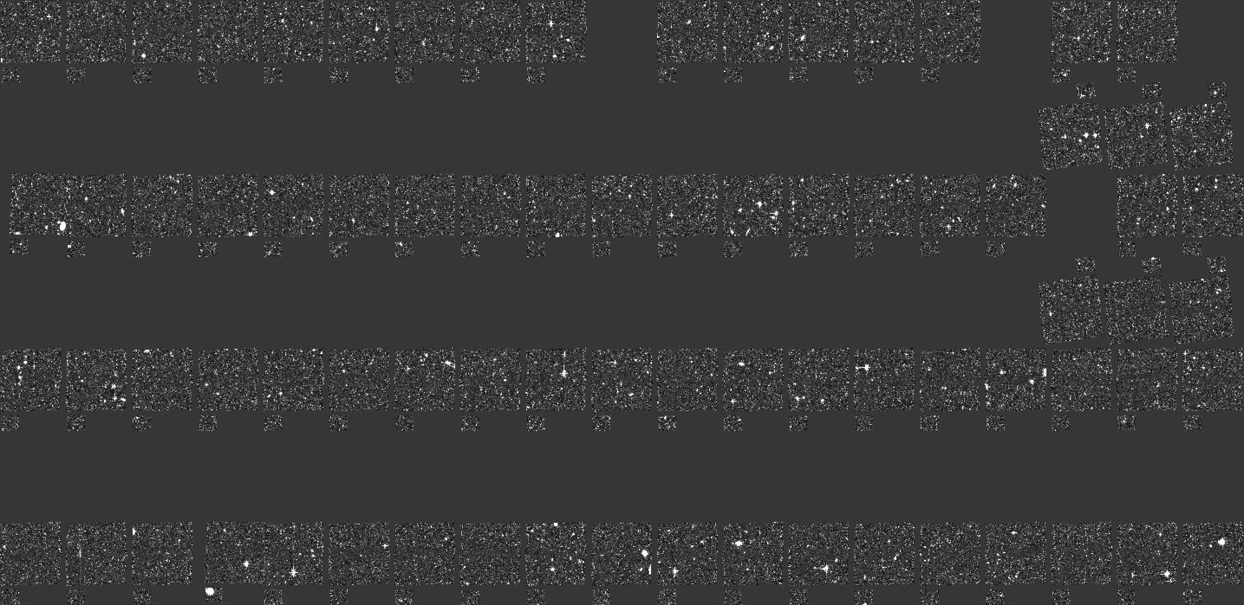
COSMOS-Web: MIRI reduction
Jan+April 2023 observations
Coverage ∼ 0.1 deg²
Median depth (5𝝈) ∼ 25.72 mag

Slide 11
COSMOS-Web: MIRI reduction
Jan+April 2023 observations
Coverage ∼ 0.1 deg²
Median depth (5𝝈) ∼ 25.72 25.83 mag

Slide 12
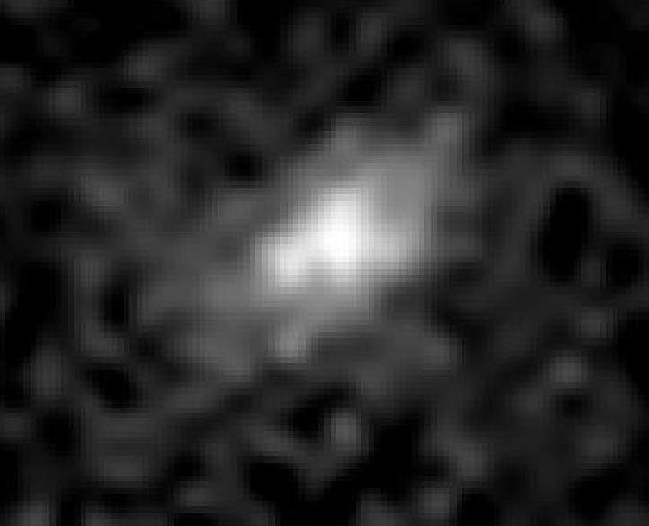
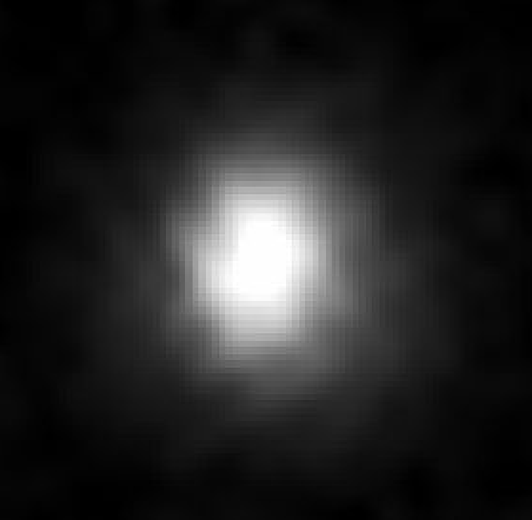
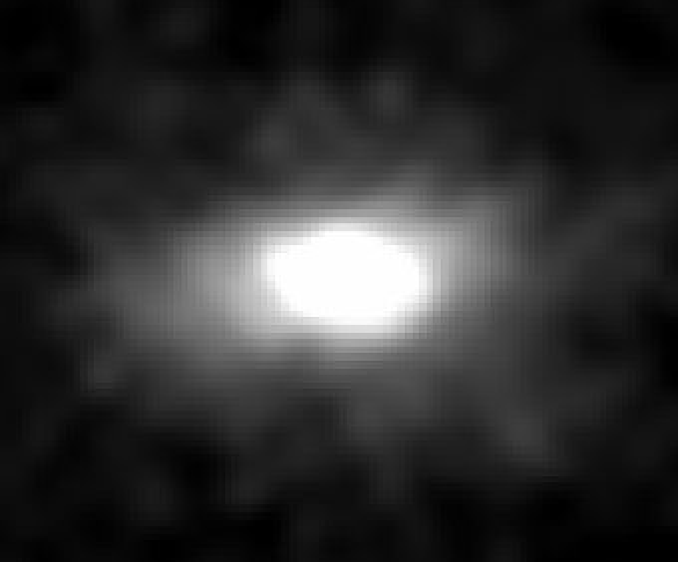
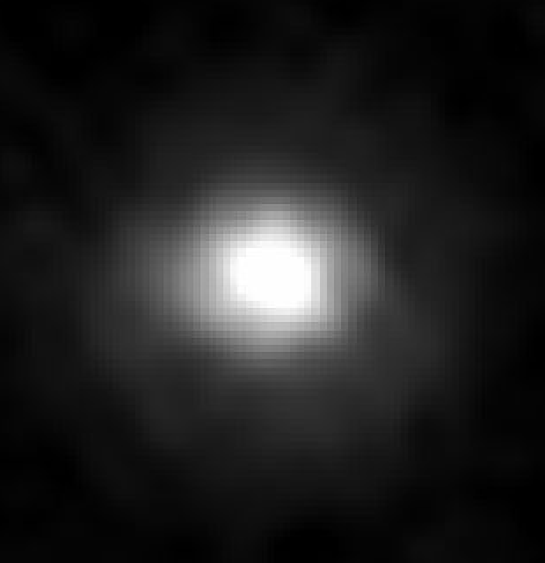
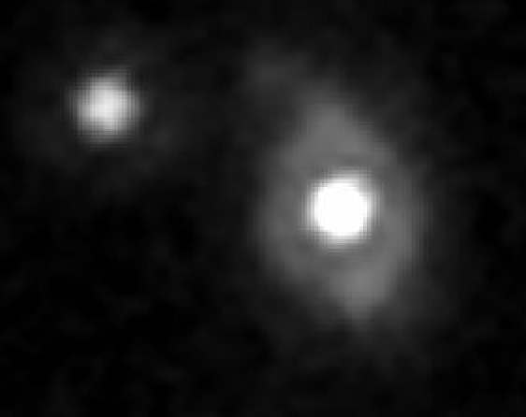
COSMOS-Web: MIRI
IRAC CH4

Slide 13
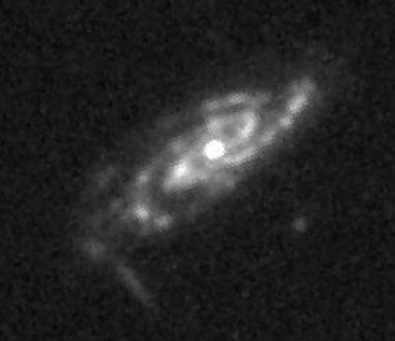
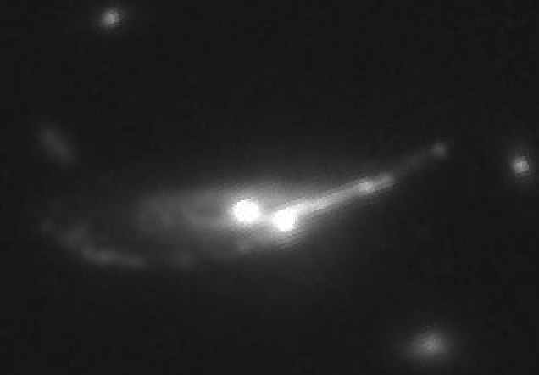
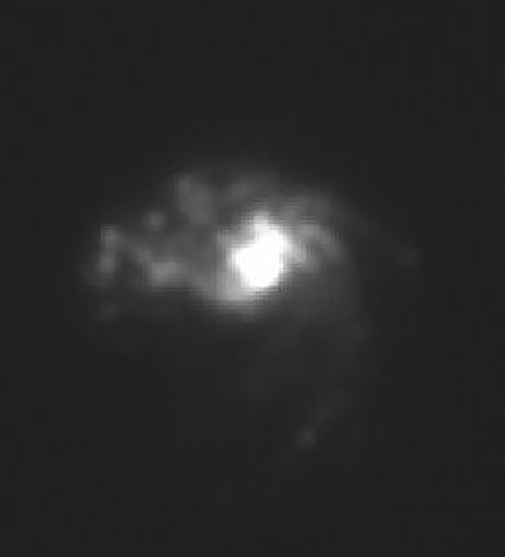
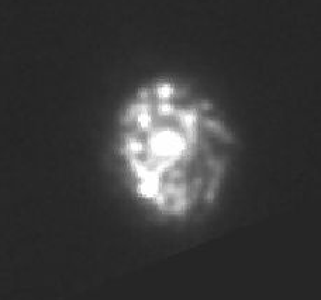
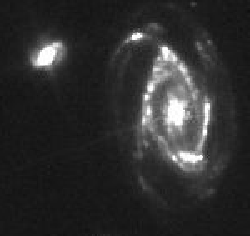
COSMOS-Web: MIRI
IRAC CH4
MIRI 770W

Slide 14
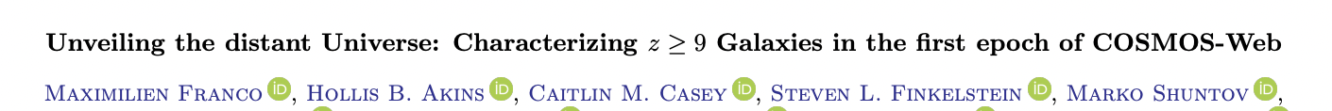
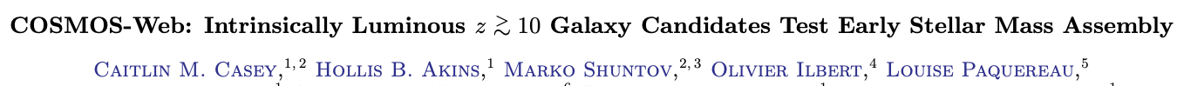
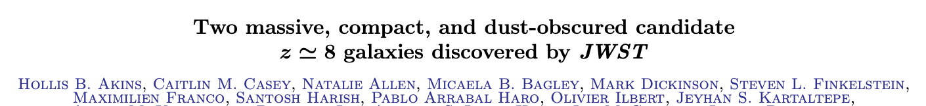
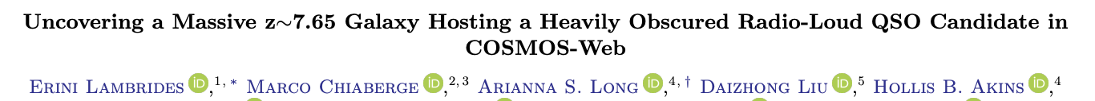
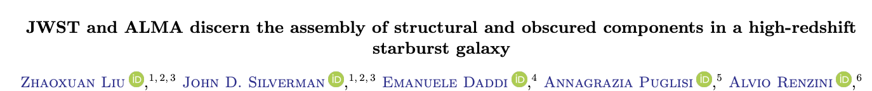
EoR candidates
Dust-obscured galaxies
Dust-obscured RL AGN
𝑧∼2 starburst galaxy

Slide 15
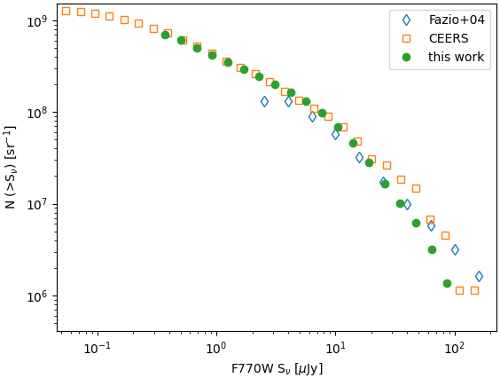
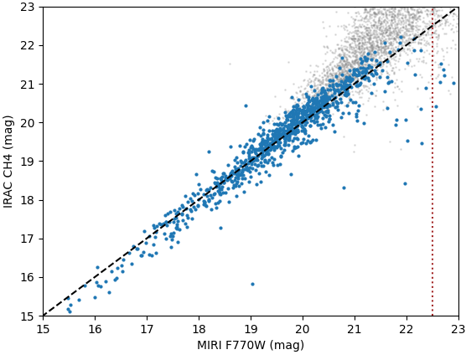
COSMOS-Web: MIRI
Preliminary
Harish+(in prep.)
>15,000 sources (>5𝜎)

Slide 16
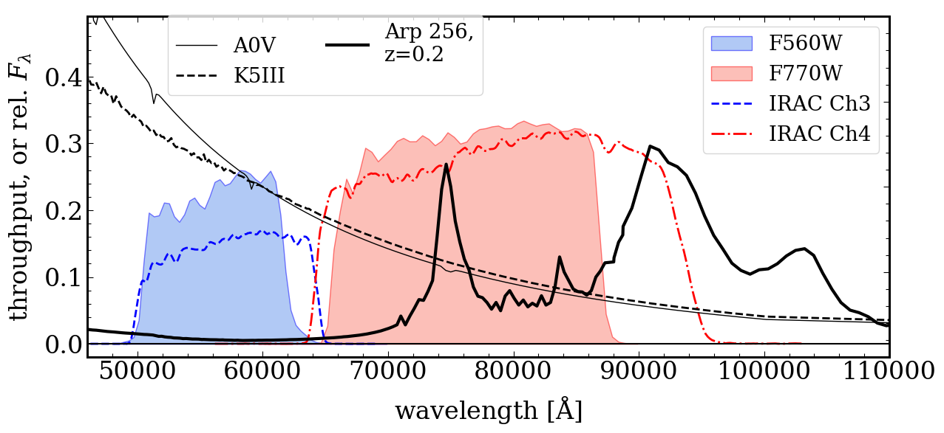
COSMOS-Web: MIRI
Preliminary
Harish+(in prep.)
∼20,000 sources (>5𝜎)
Yang+2023

Slide 17
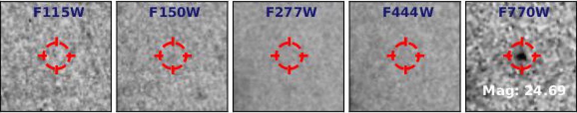
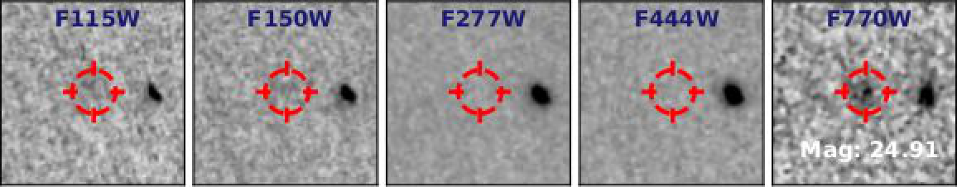
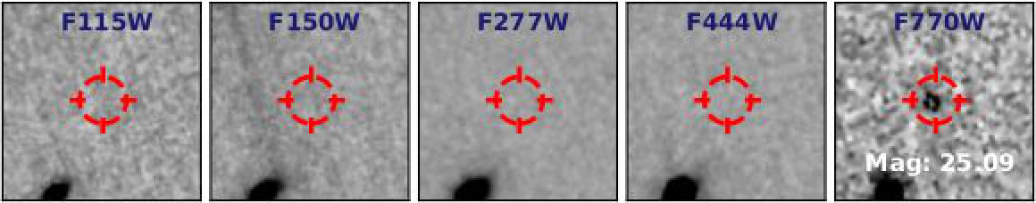
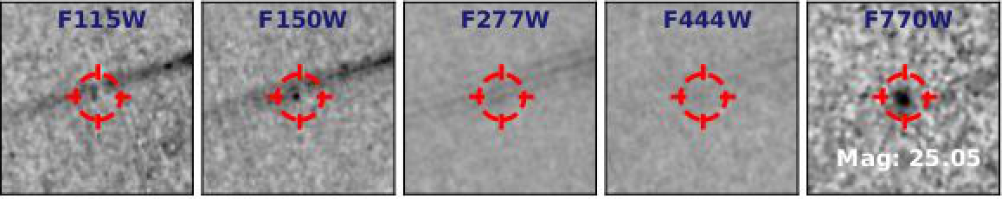
COSMOS-Web: MIRI-only candidates
Preliminary
Harish+(in prep.)

Slide 18
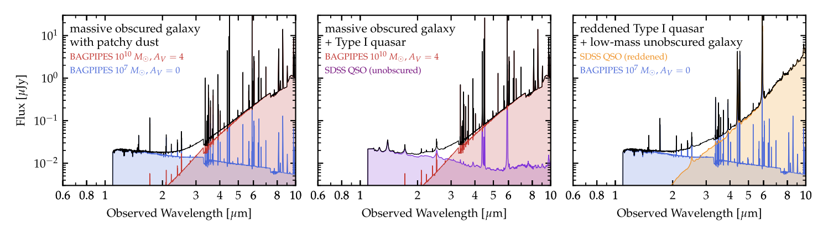
COSMOS-Web: MIRI-only candidates
Preliminary
Harish+(in prep.)

Slide 19
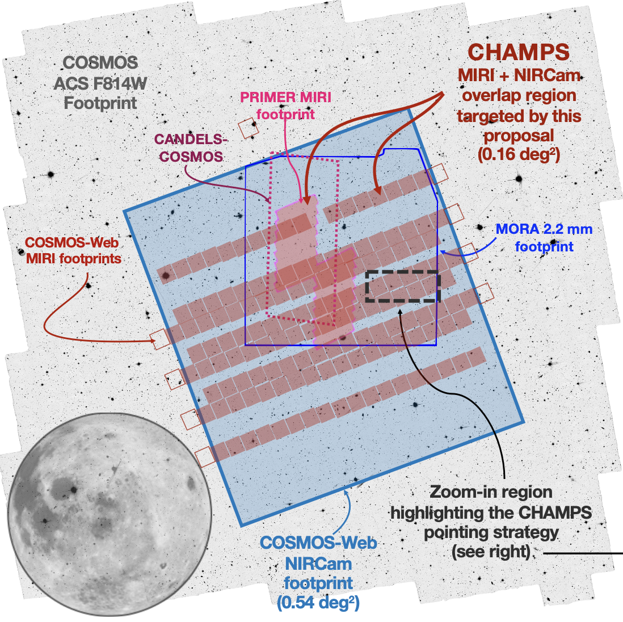
COSMOS-Web: MIRI-only candidates
Preliminary
Harish+(in prep.)

Slide 20
Extreme Emission Line Galaxies at z > 6
Extreme Emission Line Galaxies (EELGs) in the local Universe are found to be typical of high-z galaxies that we are finding in past programs with Spitzer IRAC excess and now with JWST
Using F277W and F444W to identify z ∼ 3 – 5 and z ∼ 7 – 9 [OIII] emitters that are ‘extreme’ even in the high-z Universe with COSMOS-Web
Sample selection:
  Apply photo-z cut
  Ensure < 3𝜎 detection bluewards of Lyman Limit
  SED fitting with CIGALE
Use [OIII] EW measurements as a selection criteria for EELGs
Courtesy: Ali Ahmad Khostovan (RIT)

Slide 21
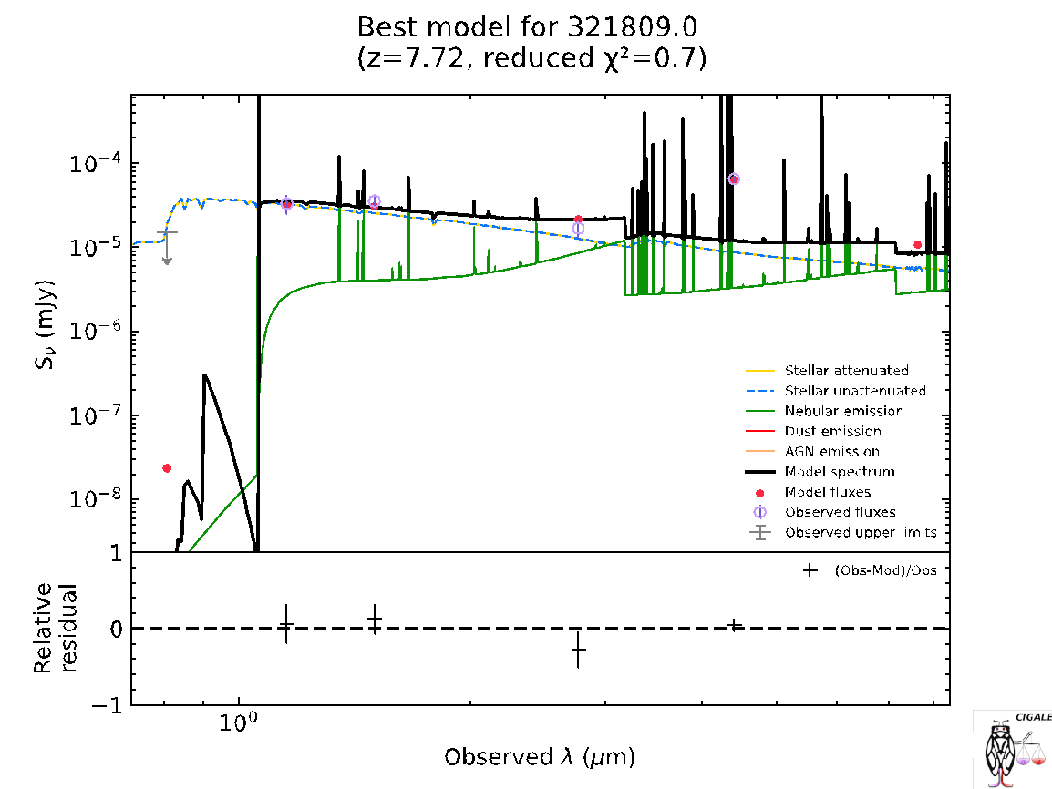

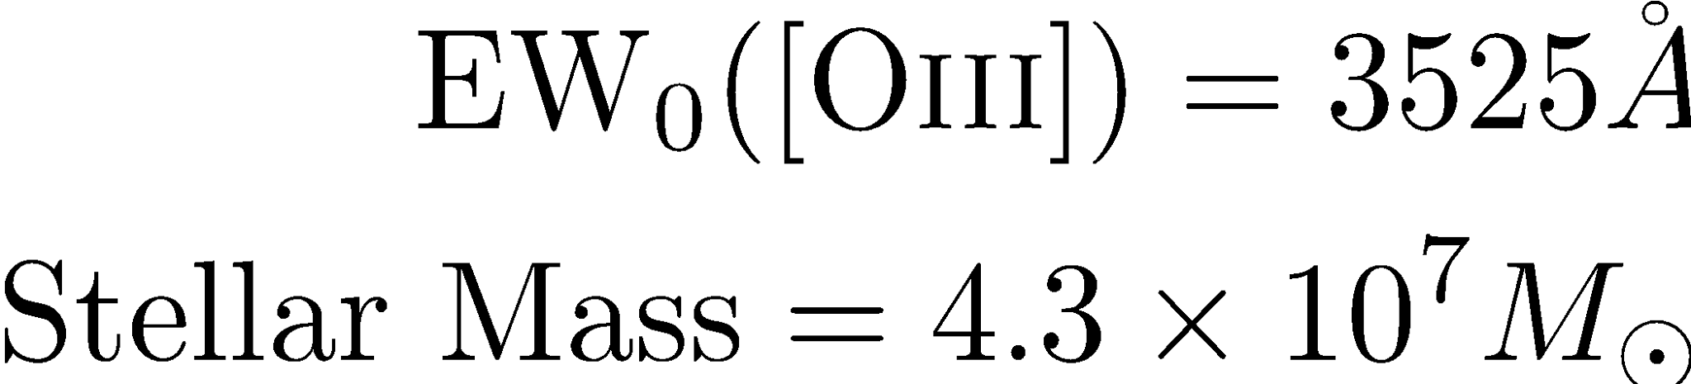
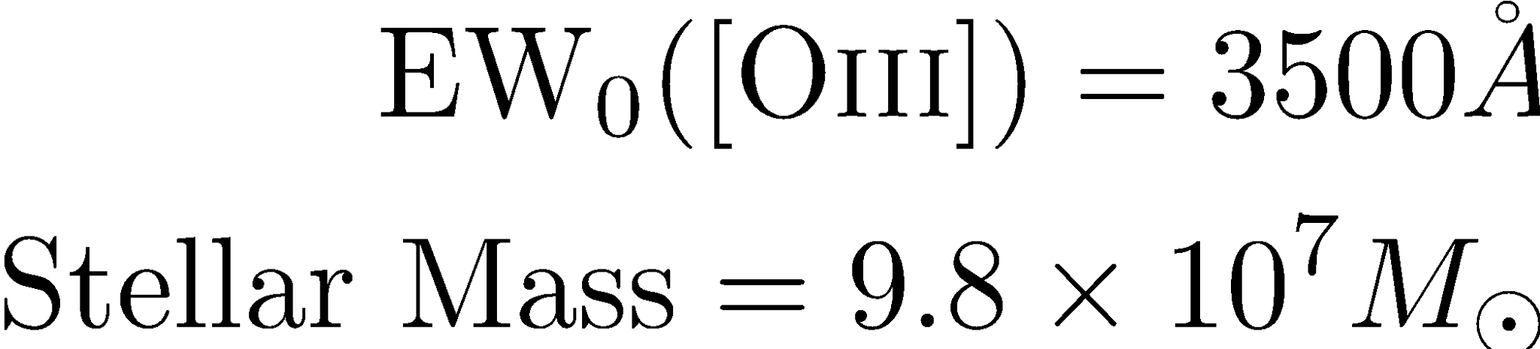
Extreme Emission Line Galaxies at z > 6
Preliminary
Courtesy: Ali Ahmad Khostovan (RIT)

Slide 22
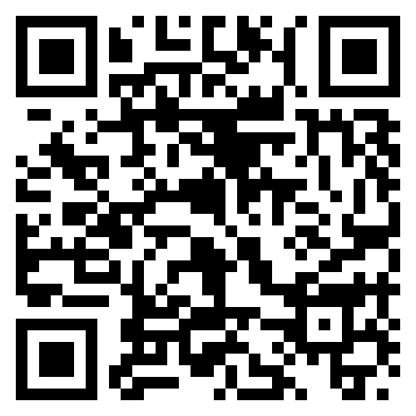
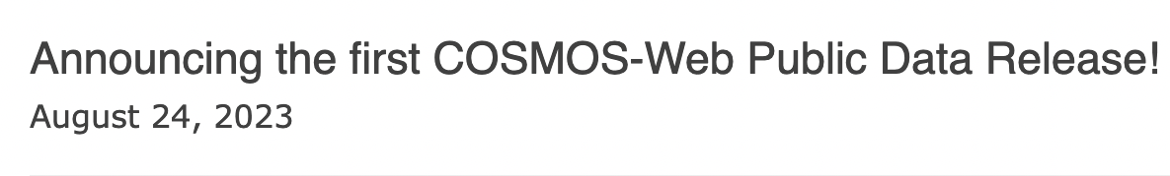
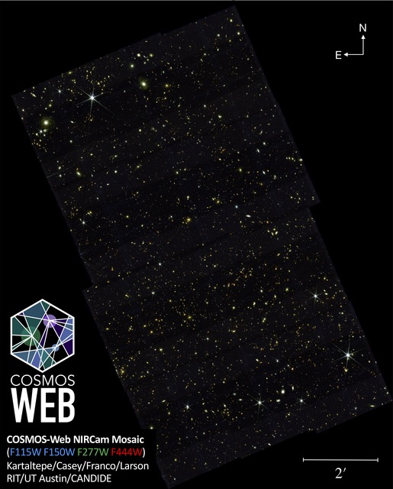
IRAC CH4
Questions?
MIRI F770W

