Slide 1
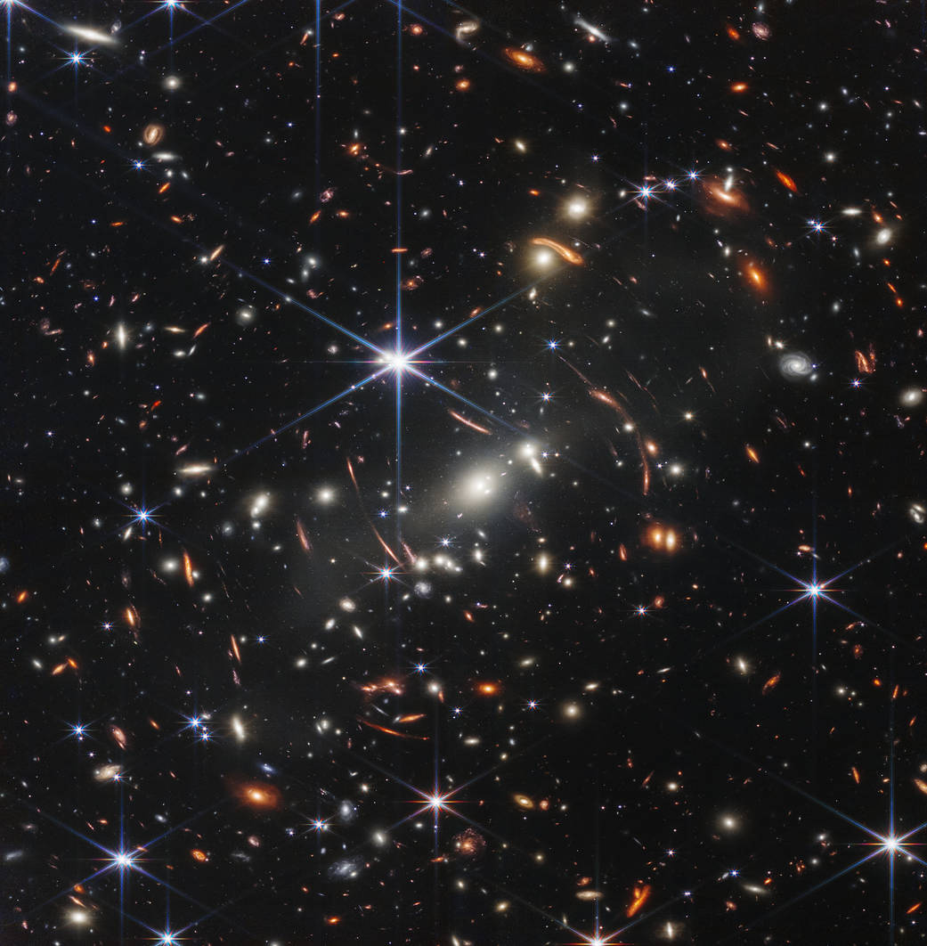

High-Redshift Galaxy Formation with ELTs in the Era of JWST Discovery
Alice Shapley
Image credit: NASA, ESA, CSA, and STScI
Notes:
Thank the organizers.
Given the events of the past year and a half, my talk is going to be a bit more about JWST discovery than anything else, but I hope that what I’ll say will really get us thinking about the ways in which ELTs will truly excel in the next decade.

Slide 2
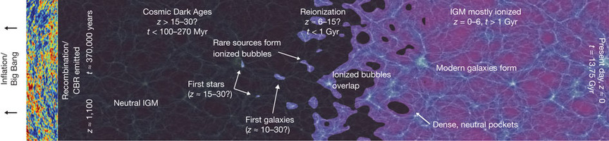
Big Questions
Robertson et al. 2010
When did the first stars and black holes emerge and what are their properties and co-evolution?
What is the nature of cosmic reionization?

Slide 3
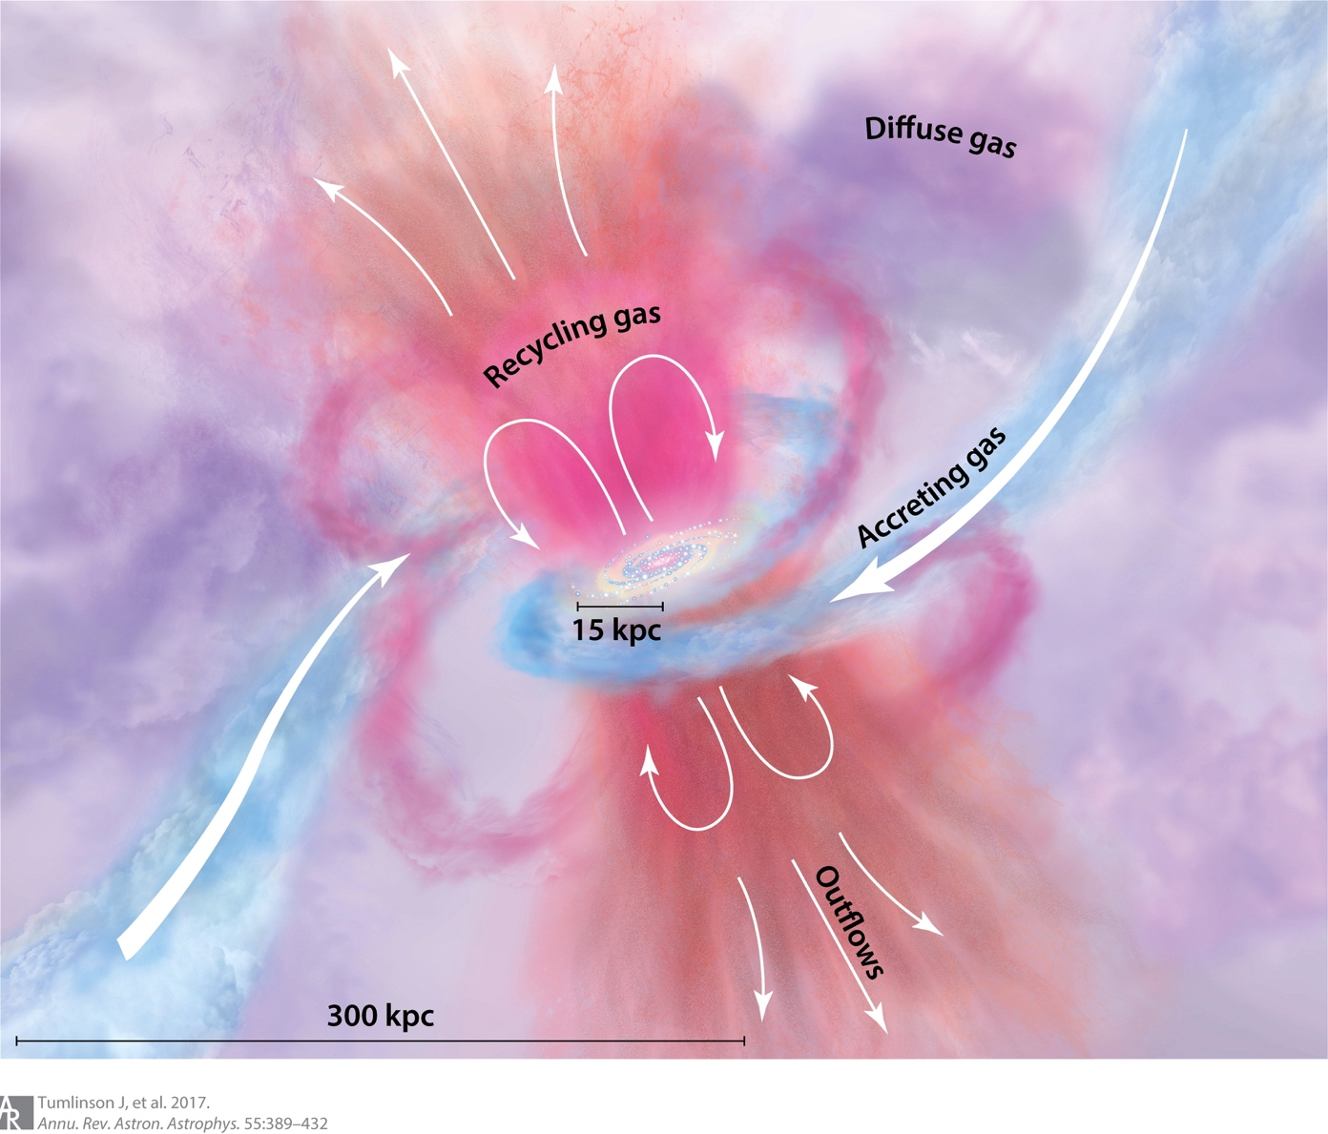
Big Questions
How do baryons cycle through galaxies?
How are galaxies assembled?

Slide 4
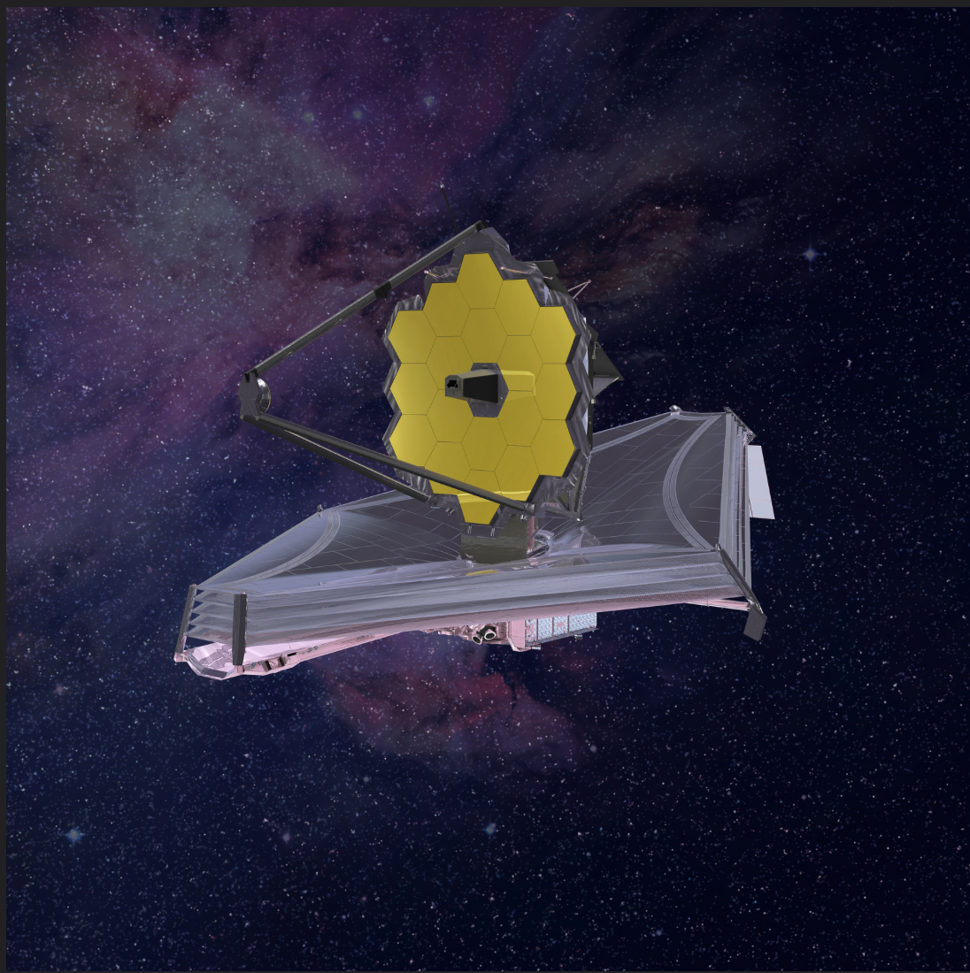
The JWST Revolution
Image credit: NASA’s JWST
Over the past 1.5 years, JWST has transformed our knowledge of galaxies in the distant universe all the way back to Cosmic Dawn.
Notes:
Hundreds of galaxy formation papers using JWST data thus far. I’d like to highlight some of the notable results, which we’ll hear more about from other speakers.

Slide 5
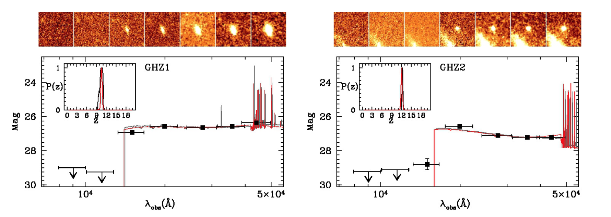
Distant Galaxy Candidates and the UV LF
Castellano et al. 2022
z_{phot}=10.6t
z_{phot}=12.3t
Two bright (m<27.5 AB, M<-21 AB), z>10 candidates in JWST ERS (GLASS) NIRCam imaging were an order of magnitude more numerous than predicted.
(See also Naidu et al. 2022)
Notes:
There have been many notable “surprises” in early JWST results. One of the very first science results back in summer 2022 had to do with the evolution of the rest-frame UV luminosity function of galaxies, which is related to the evolution of the SFR density in the universe.
After “predicted”: Prediction based on various galaxy formation simulations.

Slide 6
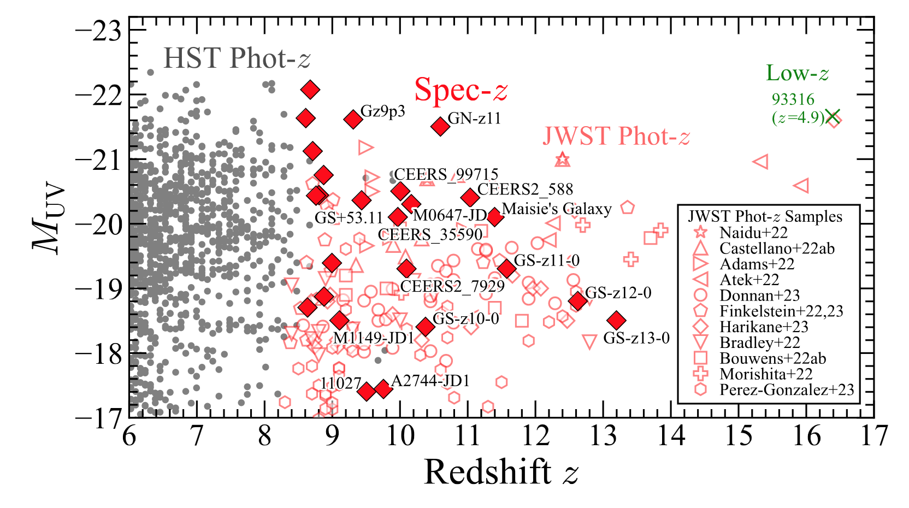
Distant Galaxy Candidates and the UV LF
Harikane et al. 2023
Better statistics based on first year of data.
Notes:
Based on more extensive photometry from both ERS and Cycle 1 programs, we can see the regime in redshift and luminosity space uncovered by JWST/NIRcam. It’s very clear in redshift space where HST peters out, and JWST takes over. Plus you can see where galaxies have been spectroscopically confirmed (or not).

Slide 7
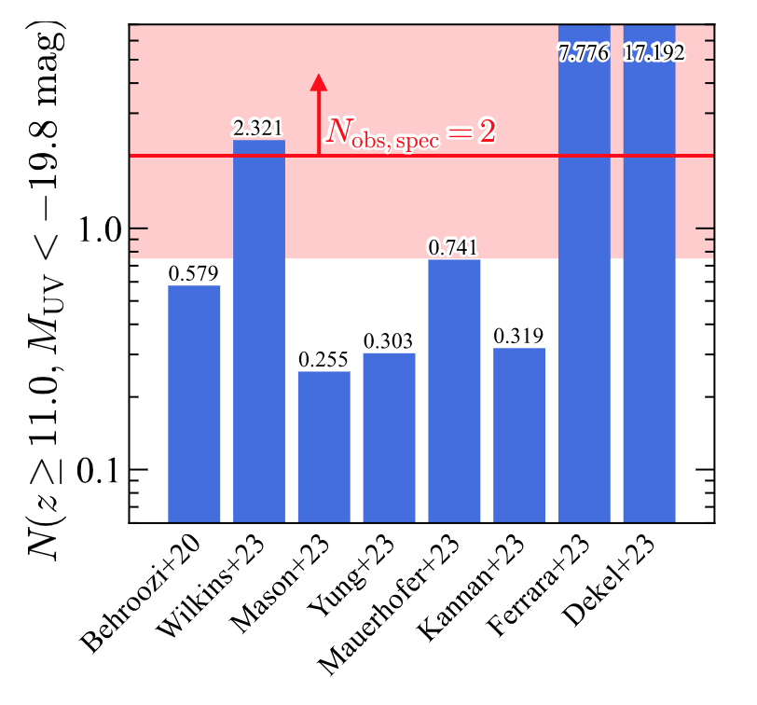
Distant Galaxy Candidates and the UV LF
Harikane et al. 2023
Better statistics based on first year of data: still tension with most models at the bright end.
Notes:
SKIP.

Slide 8
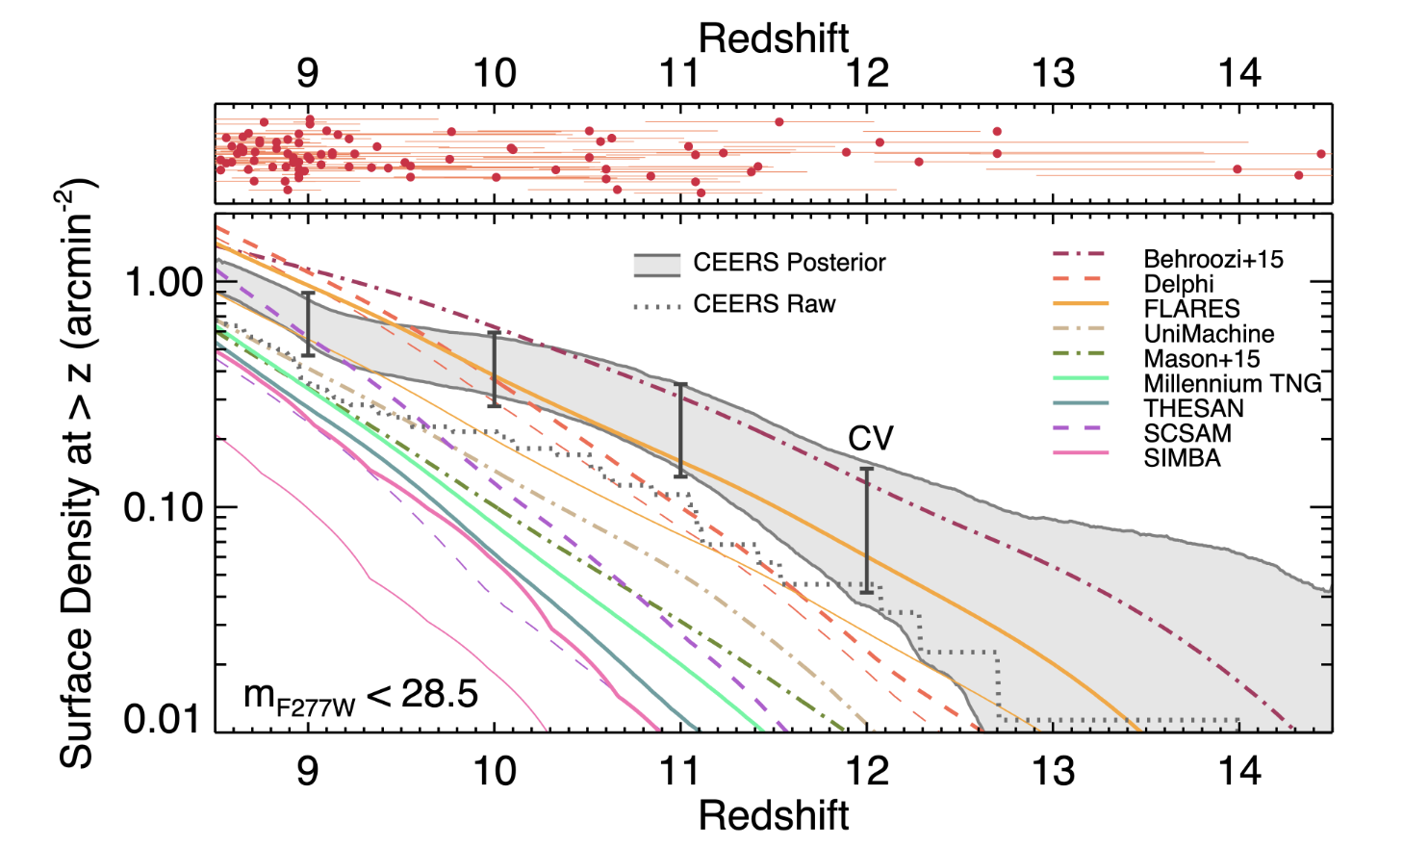
Distant Galaxy Candidates and the UV LF
Finkelstein et al. 2023
Better statistics based on first year of data: still tension with most models at the bright end.
Notes:
Look at dispersion among different model predictions, based on different physics incorporated / approach. UVLF is not a powerful tool for cosmology (nor stellar masses).
“Posterior” is completeness corrected counts.

Slide 9
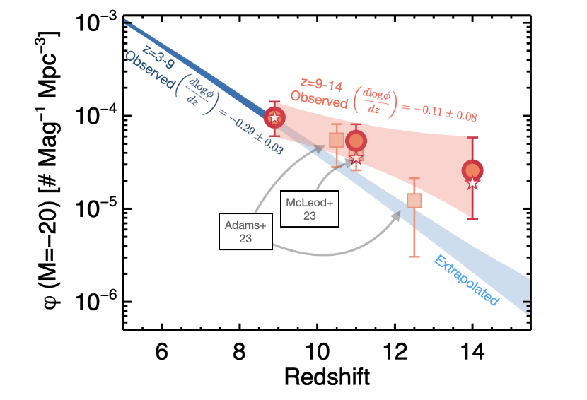
Distant Galaxy Candidates and the UV LF
Finkelstein et al. 2023
Better statistics based on first year of data: evolution different from lower-z extrapolation (see also COSMOS-Web results).
Notes:
This plot shows the evolution of the number density of bright (M=-20) galaxies, indicating a shallower evolution beyond z~9 than below it. Suggests an optimistic forecast for JWST for detecting luminous galaxies beyond z~12.

Slide 10
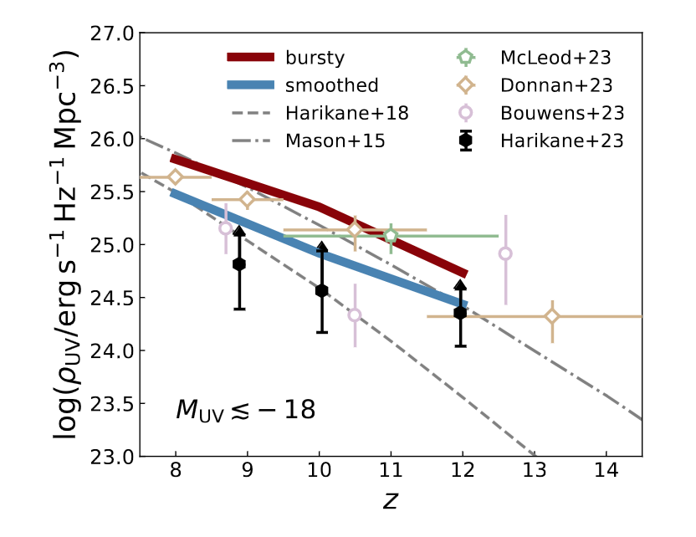
Distant Galaxy Candidates and the UV LF
Sun et al. 2023
Models with bursty star-formation histories (red line) can reproduce the evolution of the UV luminosity density at z>10 (e.g., FIRE-2 simulations).

Slide 11
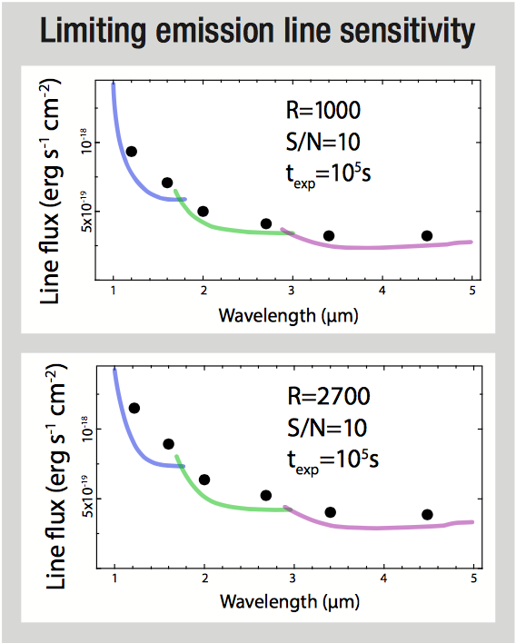
The JWST Spectroscopic Revolution
JWST/NIRSpec
Image credit: NASA’s JWST
Over the past 1.5 years, JWST has transformed our knowledge of the distant universe
Notes:
We’ll hear more from Caitlin about photometric samples, and from Jeyhan about morphologies. I’d like to focus on spectroscopy.
NIRSpec on the right. Also very notable spectroscopic results with NIRCam grism (e.g., FRESCO). What I’d like to talk about are chemistry, black holes, some extraordinary individual examples, and, if time, the extension of Balmer line measurements back to Cosmic Dawn.

Slide 12
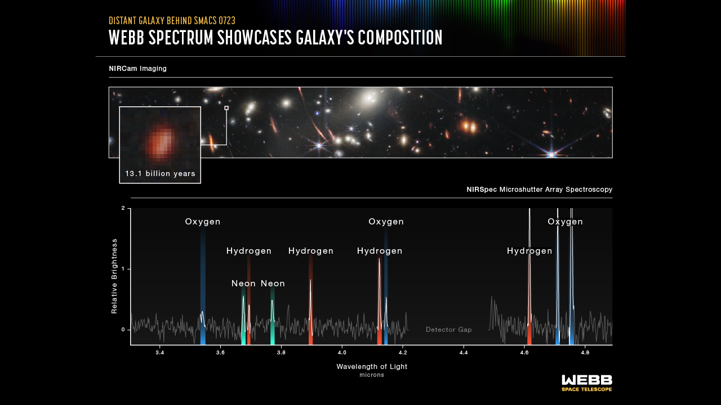
Promise from ERO Spectroscopy
Credit: NASA, ESA, CSA, STScI;
Notes:
So let’s start off with chemistry:
What do you remember being most excited about from JWST last summer? Very luminous or massive galaxy candidates? A possible galaxy at z~16? For me it was this spectrum of a galaxy at z=8.5, taken as part of the early release observations.
This shows the NIRSpec spectrum of a galaxy at z=8.5, which corresponds to a lookback time of over 13 billion years. You can see features from hydrogen, oxygen, and neon. This is a rest-optical spectrum. But rather than looking at redshift 0 or even redshift 2, we are looking at redshift greater than 8.
I’d also like to call your attention to the wavelength range covered by NIRSpec. It’s illustrative to perform a comparison of NIRSpec’s capabilities relative to what we could do with the MOSFIRE instrument on Keck….

Slide 13
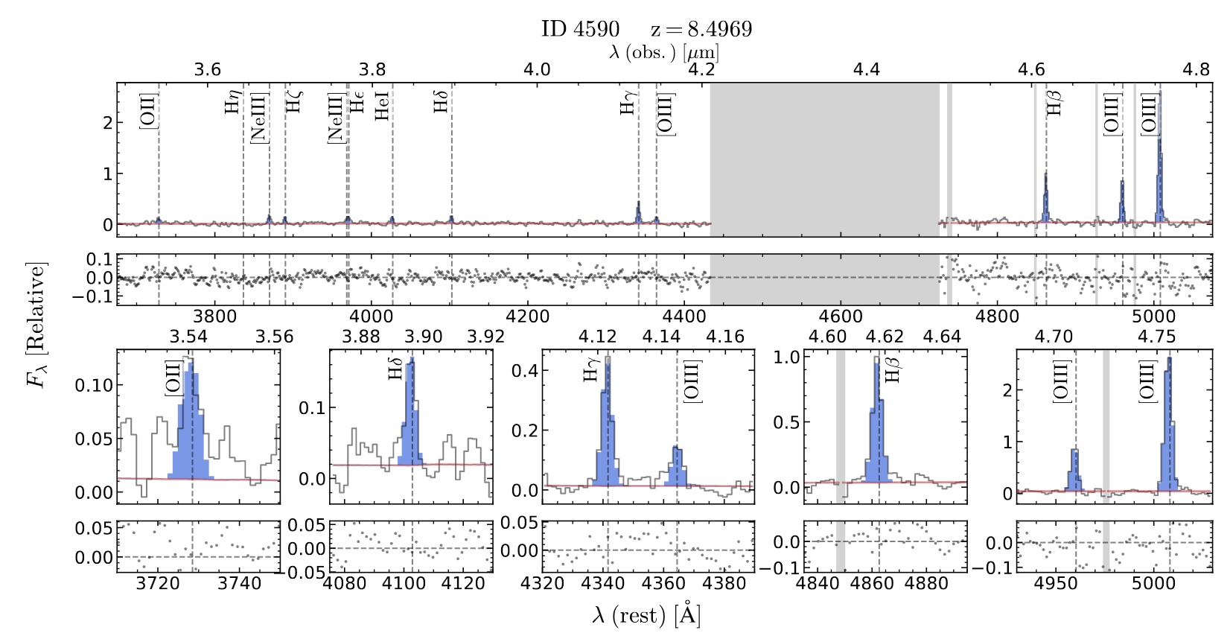
Promise from ERO Spectroscopy
ERO Spectrum: Detection of [OIII]4363 auroral line at z=8.5 enabling direct metallicity estimate (12+log(O/H)=6.99), few % solar.
(Curti et al. 2023a; See also Schaerer et al. 2022, Trump et al. 2023; Arellano-Cordova et al. 20233, others)
Notes:
One of several papers about this object.
This shows the NIRSpec spectrum of a galaxy at z=8.5, which corresponds to a lookback time of over 13 billion years. You can see features from hydrogen, oxygen, and neon. This is a rest-optical spectrum. But rather than looking at redshift 0 or even redshift 2, we are looking at redshift greater than 8.

Slide 14
Direct Metallicities at High Redshift
Auroral line now detected at z=9.4 (Laseter et al. 2023)
16 CEERS targets
9 JWST literature targets
21 ground-based targets
46 auroral-line emitters at z=1.4-8.7 (2-60% Z_{sun})
(Sanders et al. 2023d; See also Laseter et al. 2023 )
Notes:
Ryan Sanders assembled a sample of auroral line measurements from CEERS and other sources.
Here are the CEERS 4363 measurements. In addition, Ryan assembled…9, 21, for a total sample of 46 auroral-line emitters at z=1.4-8.7.

Slide 15
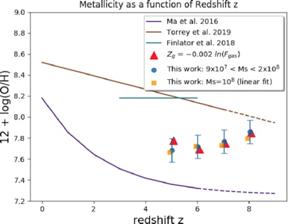
MZR Evolution at z>3
Drastically different predictions for mass-metallicity relation (MZR) evolution at z>3 in different hydrodynamical simulations.
NIRSpec observations will be able to distinguish among them.
Require robust metallicity calibrations. Larger samples.
(Langan et al. 2020)
Notes:
Initial attempts to measure MZR at z>=4 with NIRSpec.

Slide 16
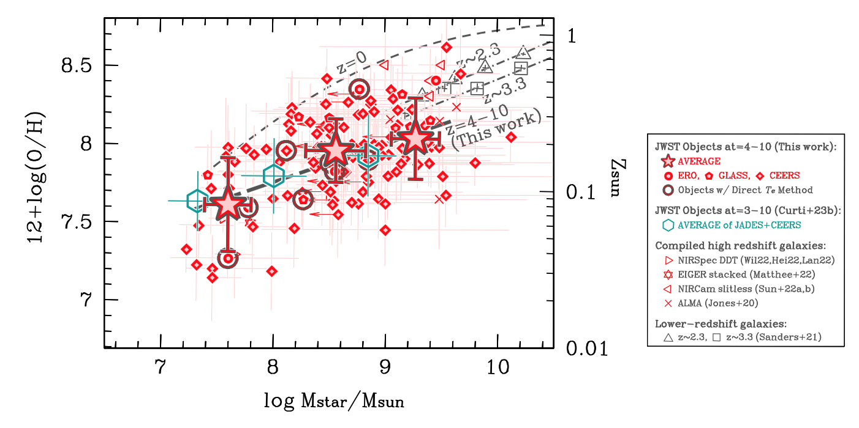
MZR Evolution at z>3
(Nakajima et al. 2023)
Weak MZR evolution consistent with some simulations, not others.
Require feedback that doesn’t remove too many metals.
Notes:
Initial attempts to measure MZR at z>=4 with NIRSpec.

Slide 17
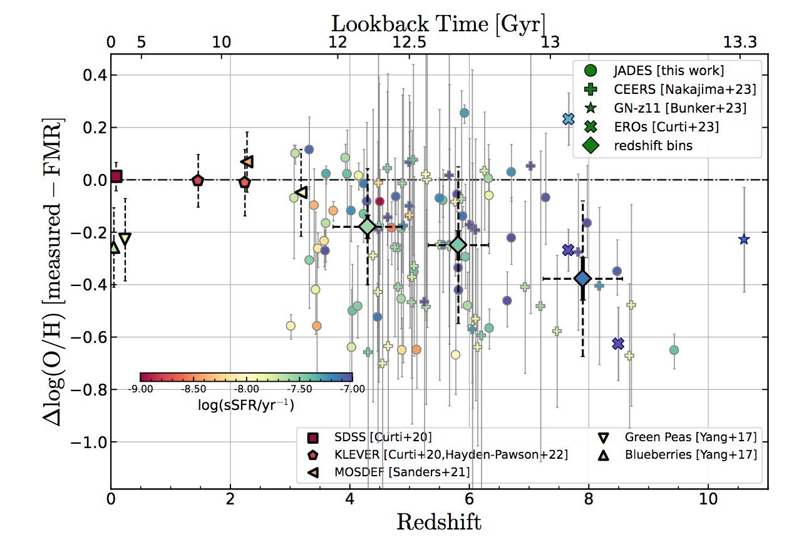
FMR Evolution at z>3
(Curti et al. 2023b)
FMR=Fundamental Metallicity Relation (M*, Z, SFR)
Notes:
Initial attempts to measure FMR at z>=4 with NIRSpec, suggest an evolution towards lower Z at fixed M and SFR beyond z~4. z<3 equilibrium among gas inflow, SF, outflow not in place.

Slide 18
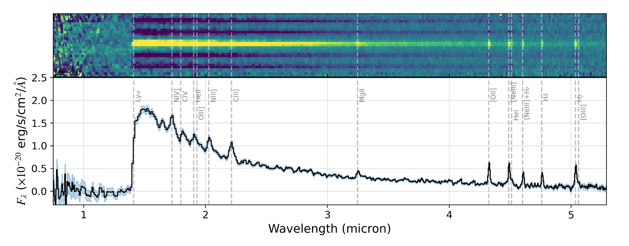
A Thing of Sheer Beauty: GN-z11
(Bunker et al. 2023)
JADES Spectrum: GN-z11 at z=10.6, M_{UV}=-21.5, most luminous z>10 candidate in GOODS-N.
Star formation (e.g., Senchyna et al. 2023)? AGN (e.g., Maiolino et al. 2023)?
Notes:
Now we’re going to talk about three demonstrations of NIRSpec’s exceptional sensitivity: Regardless, the detection of a large number of rest-UV and optical emission lines is nothing short of spectacular. The challenge here is placing GN-z11, the brightest z>10 galaxy in GOODS-N, into context.

Slide 19
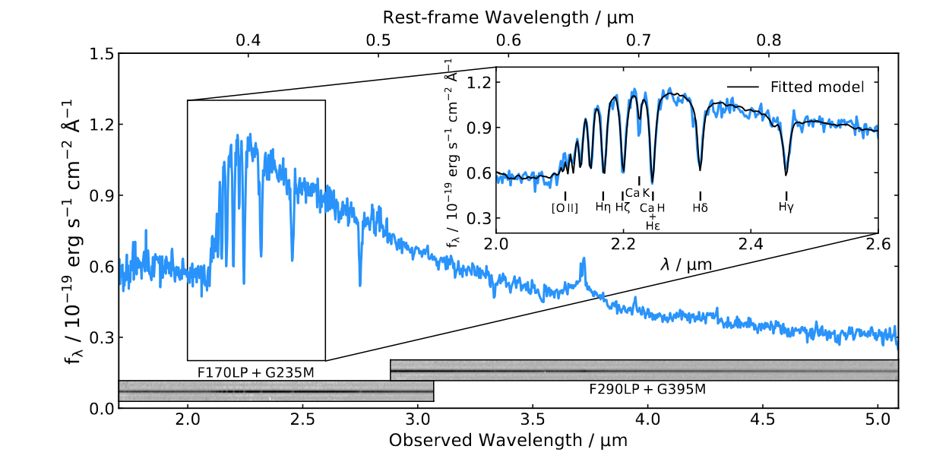
Another Thing of Sheer Beauty
(Carnall et al. 2023)
Massive, quiescent galaxy at z=4.659, star formation quenched at z>6.
Progenitor of cores of most massive local elliptical galaxies.
Notes:
Is it a model, or data?

Slide 20
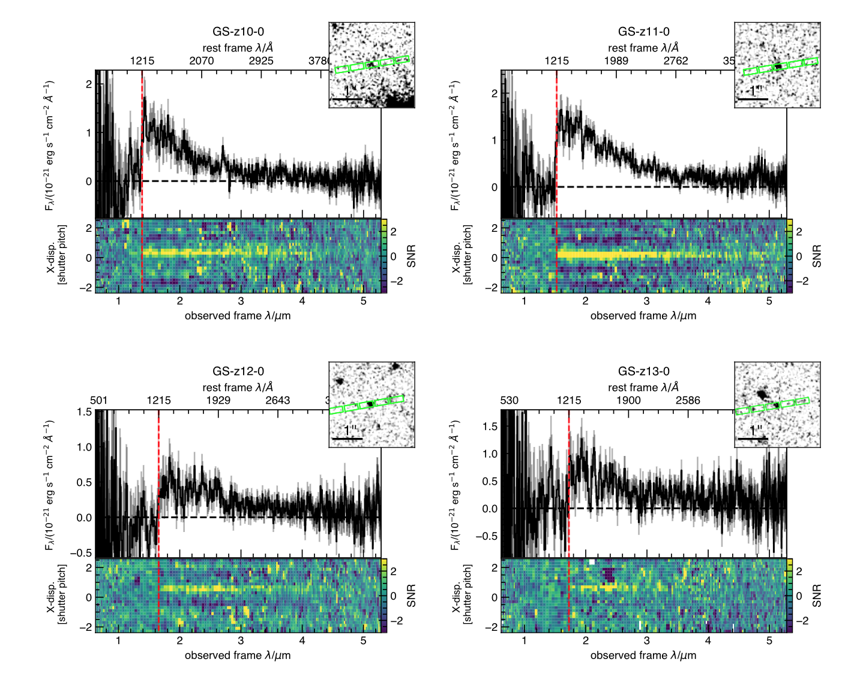
Advancing the Redshift Frontier
z=10.38
m=28.9
z=11.58
m=28.4
(Curtis-Lake et al. 2023)
z=12.63
m=29.6
z=13.20
m=29.2
NIRSpec R~100 prism spectra used to determine redshifts for 4 galaxies at z>10.4.
Redshifts primarily based on Lyα break.
Notes:
Magnitudes 28-29 AB, exposure times range from 9.3 hours (z=13.20) to 28 hours (z=11.58) using NIRSpec prism (R~100).

Slide 21
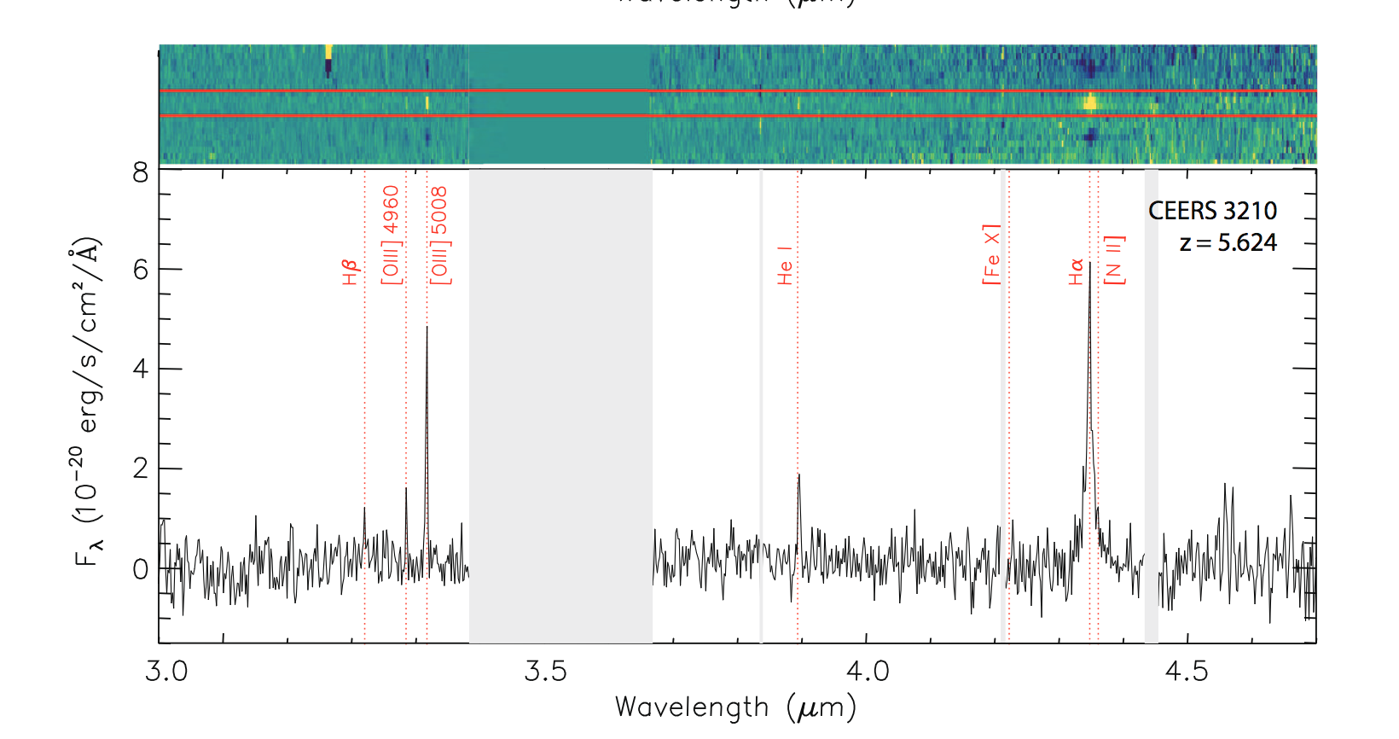
Early Growth of SMBHs
(Kocevski et al. 2023)
CEERS: One of the z~8 “universe breaking” candidates from Labbe+2023 is actually an AGN at z=5.62.
(See also Greene et al. 2023; Matthee et al. 2023; Kokorev et al. 2023; Goulding et al. 2023)
Notes:
The detection of Balmer lines beyond z~3 has enabled a wide range of forefront science with JWST. In particular, AGNs have been revealed beyond z~4 in a new way.

Slide 22
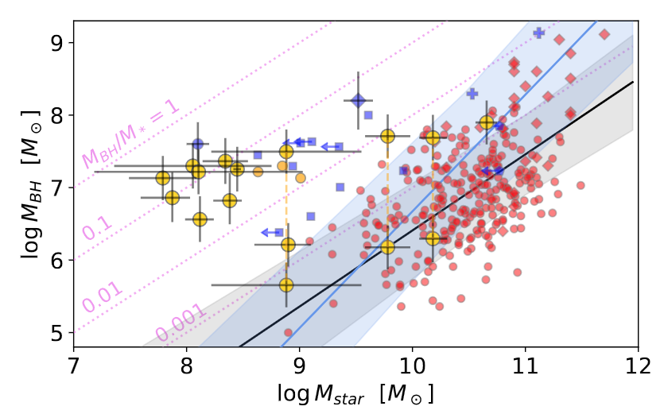
Early Growth of SMBHs
z=4-11
(Maiolino et al. 2023b)
Evolution in M_{BH} vs. M* relation.
Implications for SMBH seeds and/or Eddington ratios.
Notes:
Based on 12 new AGNs plus GN-z11 from JADES sample

Slide 23
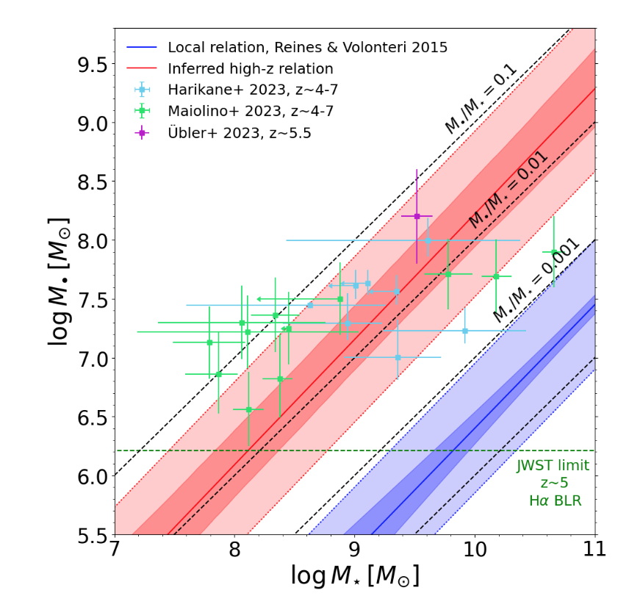
Early Growth of SMBHs
(Pacucci et al. 2023b)
Evolution in M_{BH} vs. M* relation.
Implications for SMBH seeds and/or Eddington ratios.

Slide 24
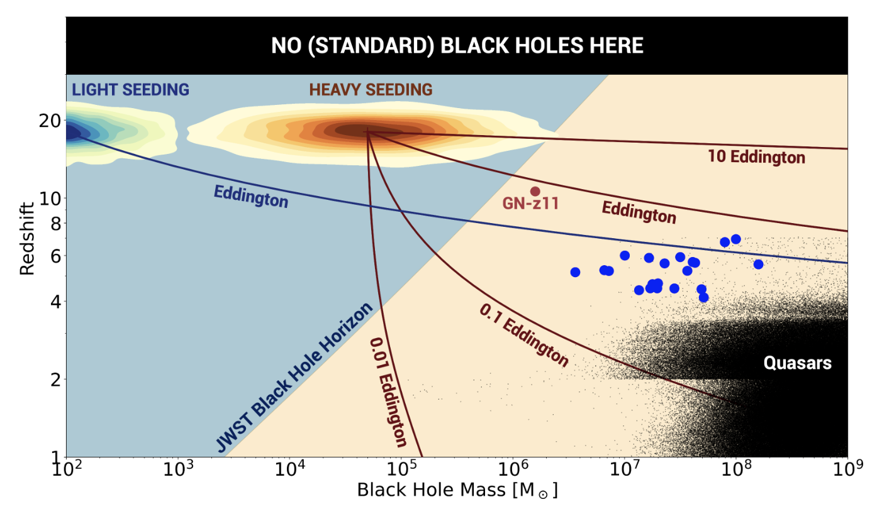
Early Growth of SMBHs
(Pacucci et al. 2023b)
Evolution in M_{BH} vs. M* relation.
Implications for SMBH seeds and/or Eddington ratios.

Slide 25
NIRSpec/CEERS “low-z” sample: Boring old Hα
Hα is the “gold standard” for estimating SFR, but inaccessible from the ground above z~2.7.
With NIRSpec, it is measured out to z~7.
(Shapley et al. 2023a)
Notes:
In order to characterize the average properties of the sample….
Gets around the lack of detections of lines like [NII] and [NeIII] in the majority of our sample.

Slide 26
NIRSpec/CEERS “low-z” sample: Boring old Hα
SFR vs. M* where SFR is based on Hα emission at z=2.7-6.5 for the first time.
z=2.7-4.0 and 4.0-5.0 samples consistent with Main Sequence (Speagle+2014), while z=5.0-6.5 sample has elevated sSFR.
Must use a subsolar metallicity conversion from Hα to SFR at z≥3.
(Shapley et al. 2023a)
Notes:
So one of the most basic things to do is look at the relationship between SFR and M* -- with SFR is based on Ha emission.
The main point I want to make here is that if you’re trying to infer SFRs from these galaxies, you must use a subsolar metallicity calibration to go from Ha luminosity to SFR.
10^-41.67 *not* 10^-41.37, conversion for Z_*=0.001.

Slide 27
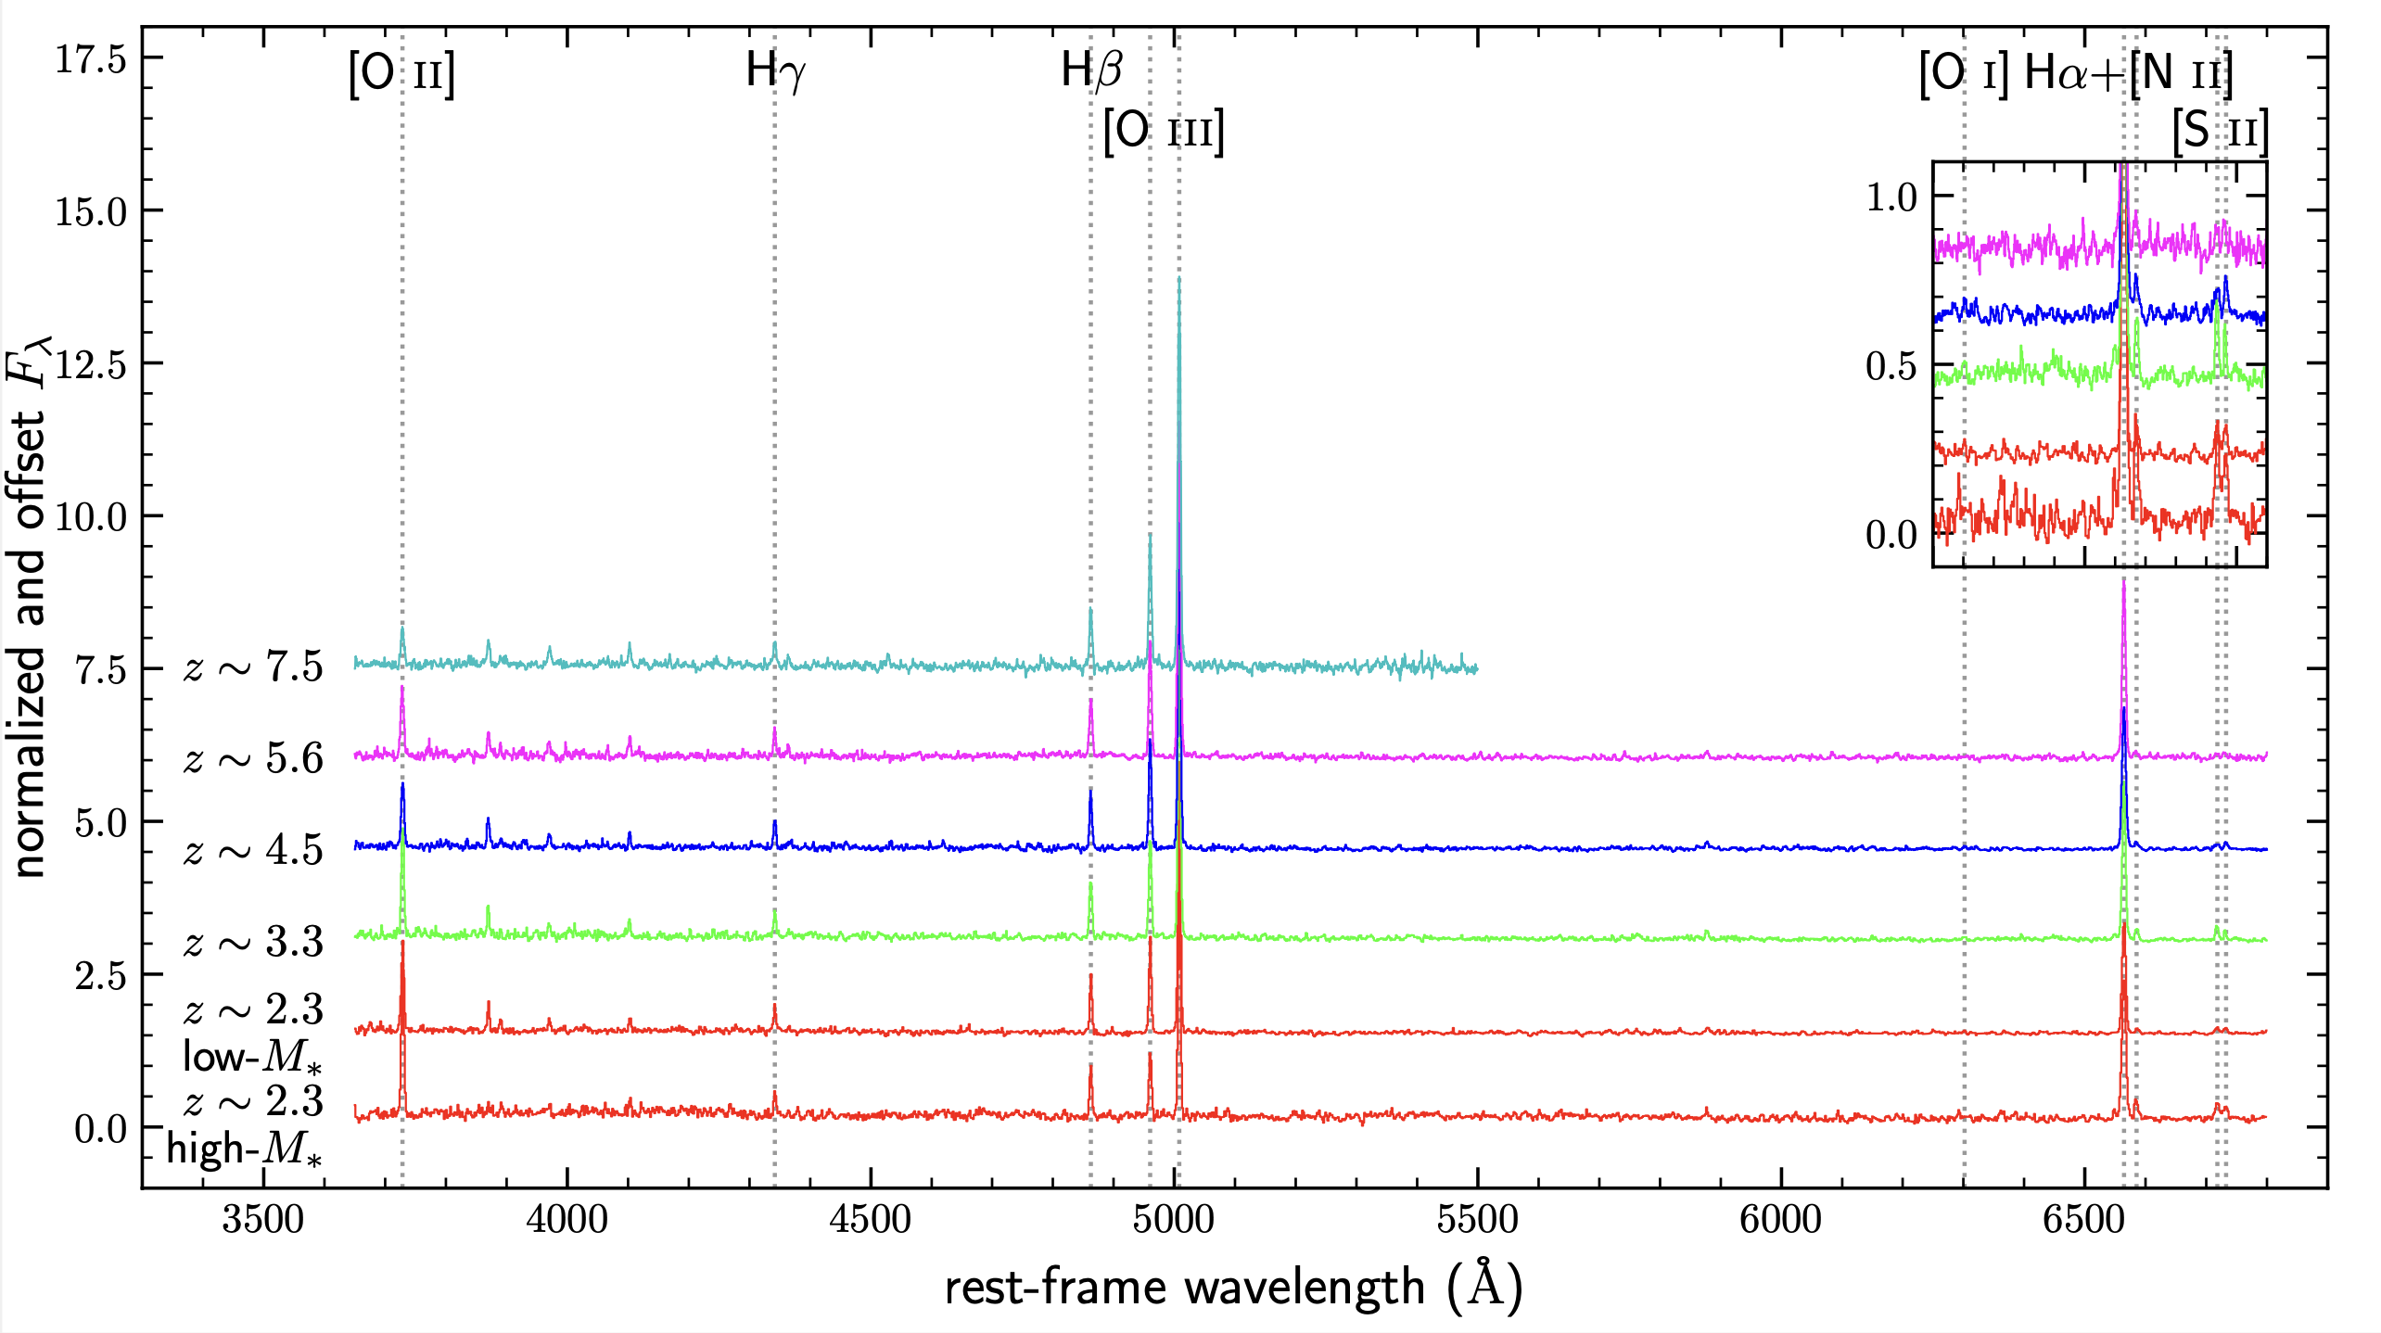
NIRSpec/CEERS “low-z” sample: stacked spectra
(Sanders et al. 2023c)
Notes:
In order to characterize the average properties of the sample….
Gets around the lack of detections of lines like [NII] and [NeIII] in the majority of our sample.

Slide 28
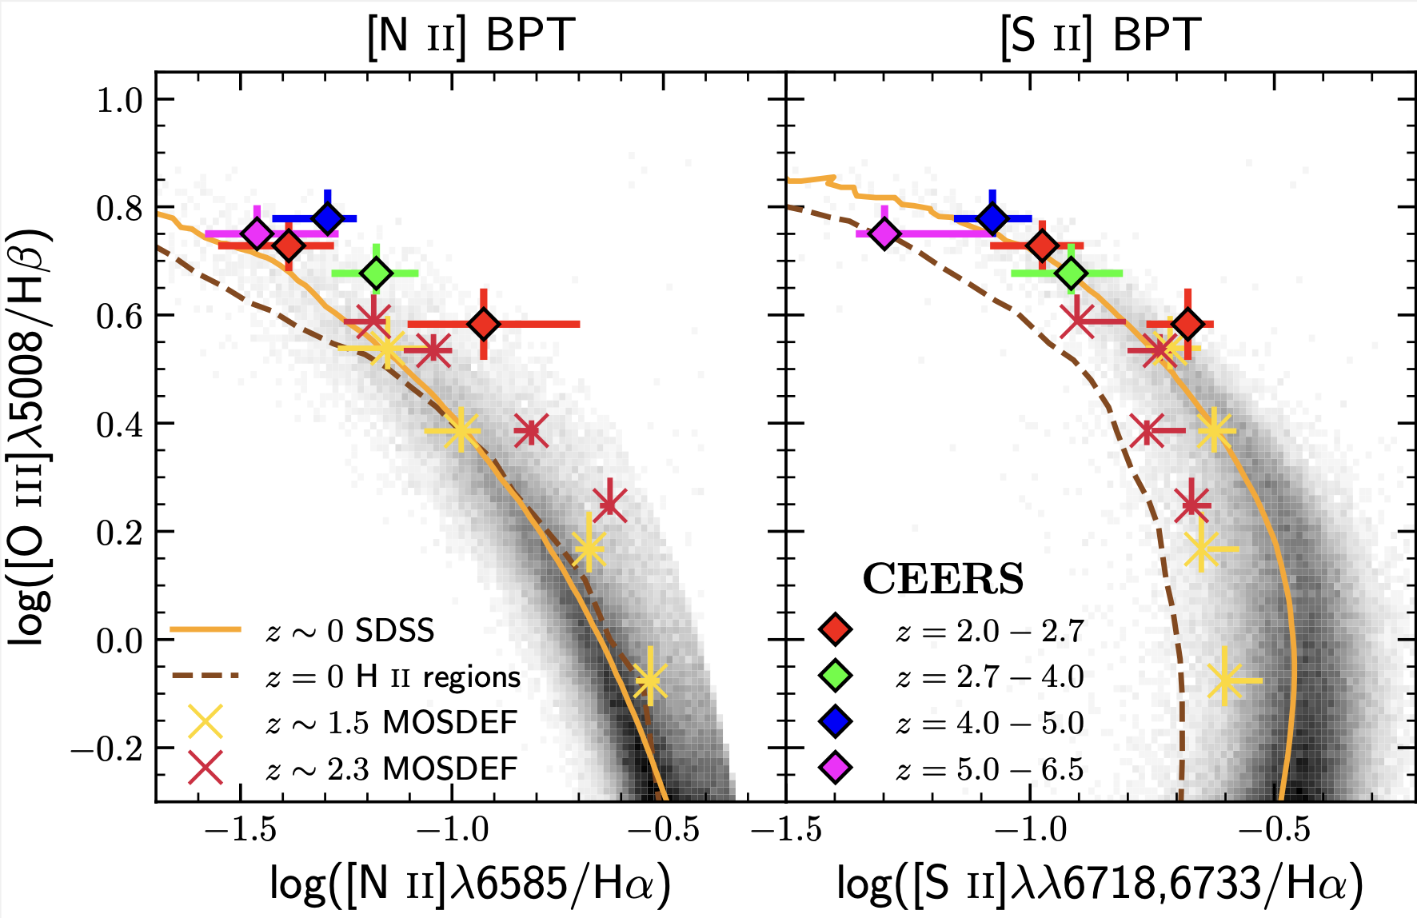

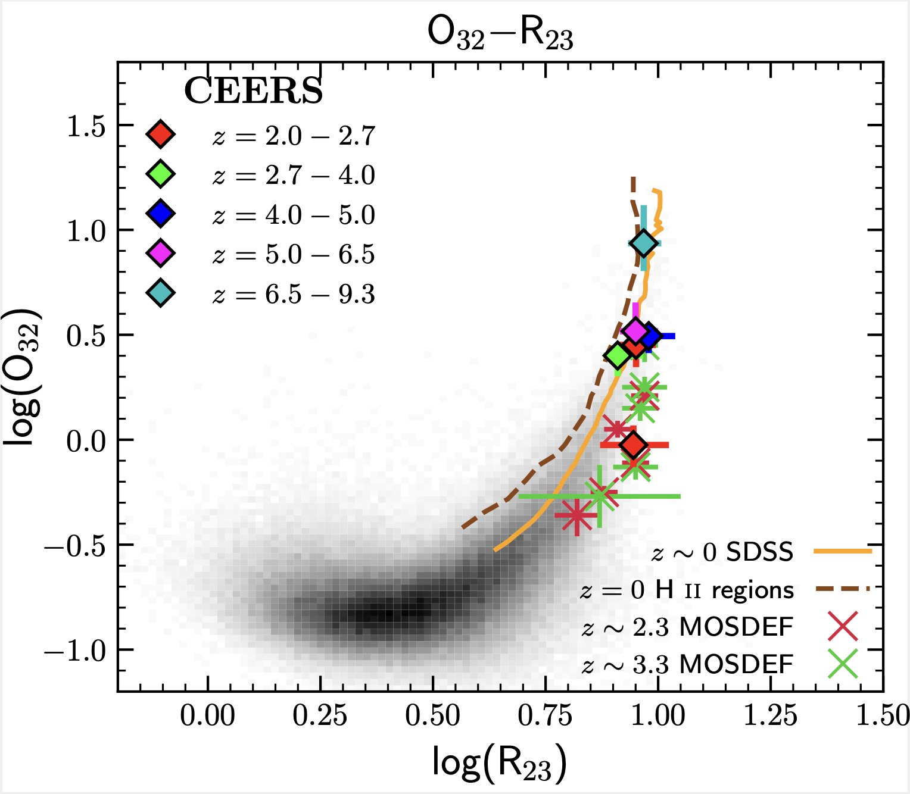
Excitation & Ionization Conditions
No evidence for strong evolution of ISM ionization conditions between z=2 and z=6.5 (9?)
(Sanders et al. 2023c; See also Cameron et al. 2023)
Notes:
We can summarize the average relations like this:
Apparently, there is no significant evolution in the rest-optical emission-line sequences between z~2 and 6.5 (and maybe z~9), which may hint that such conditions are already in place deep in the epoch of reionization, remain roughly constant for the first few Gyr, and then evolve between z~2 and z~0. Evocative of O/Fe vs. Fe/H.
So what does this mean about translating emission-line ratios to metallicities?

Slide 29
From the Ground to NIRSpec
Notes:
Clearly, there is amazing promise here. Thus far, though, we have been in more of a mode of “demonstration” science, and reporting individual spectacular objects. I’d argue that at some point we will need to transition into more of a survey mode, and assemble statistical, uniformly selected samples from JWST photometry, for follow-up spectroscopy. Only with such samples will we be able to distinguish among various models for early galaxy formation within the first 2 billion years of cosmic time.
Now I’d like to try to quantify the improvement of JWST relative to previous observations.

Slide 30
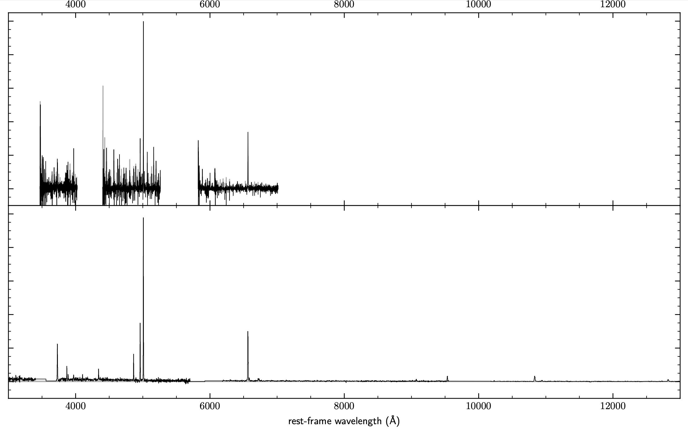
Keck/MOSFIRE: 2 hours per filter
10-meter ground-based
star-forming galaxy at z=2.29
JWST/NIRSpec: 50 minutes per grating
6.5-meter space telescope
Notes:
We found 7 MOSDEF galaxies with good spectra that were on the CEERS masks. One is at z=2.29, CEERS ID=3788. S/N in H-band is ~several times higher. No sky.

Slide 31
Keck/MOSFIRE: 2 hours per filter
10-meter ground-based
JWST/NIRSpec: 50 minutes per grating
6.5-meter space telescope

Slide 32
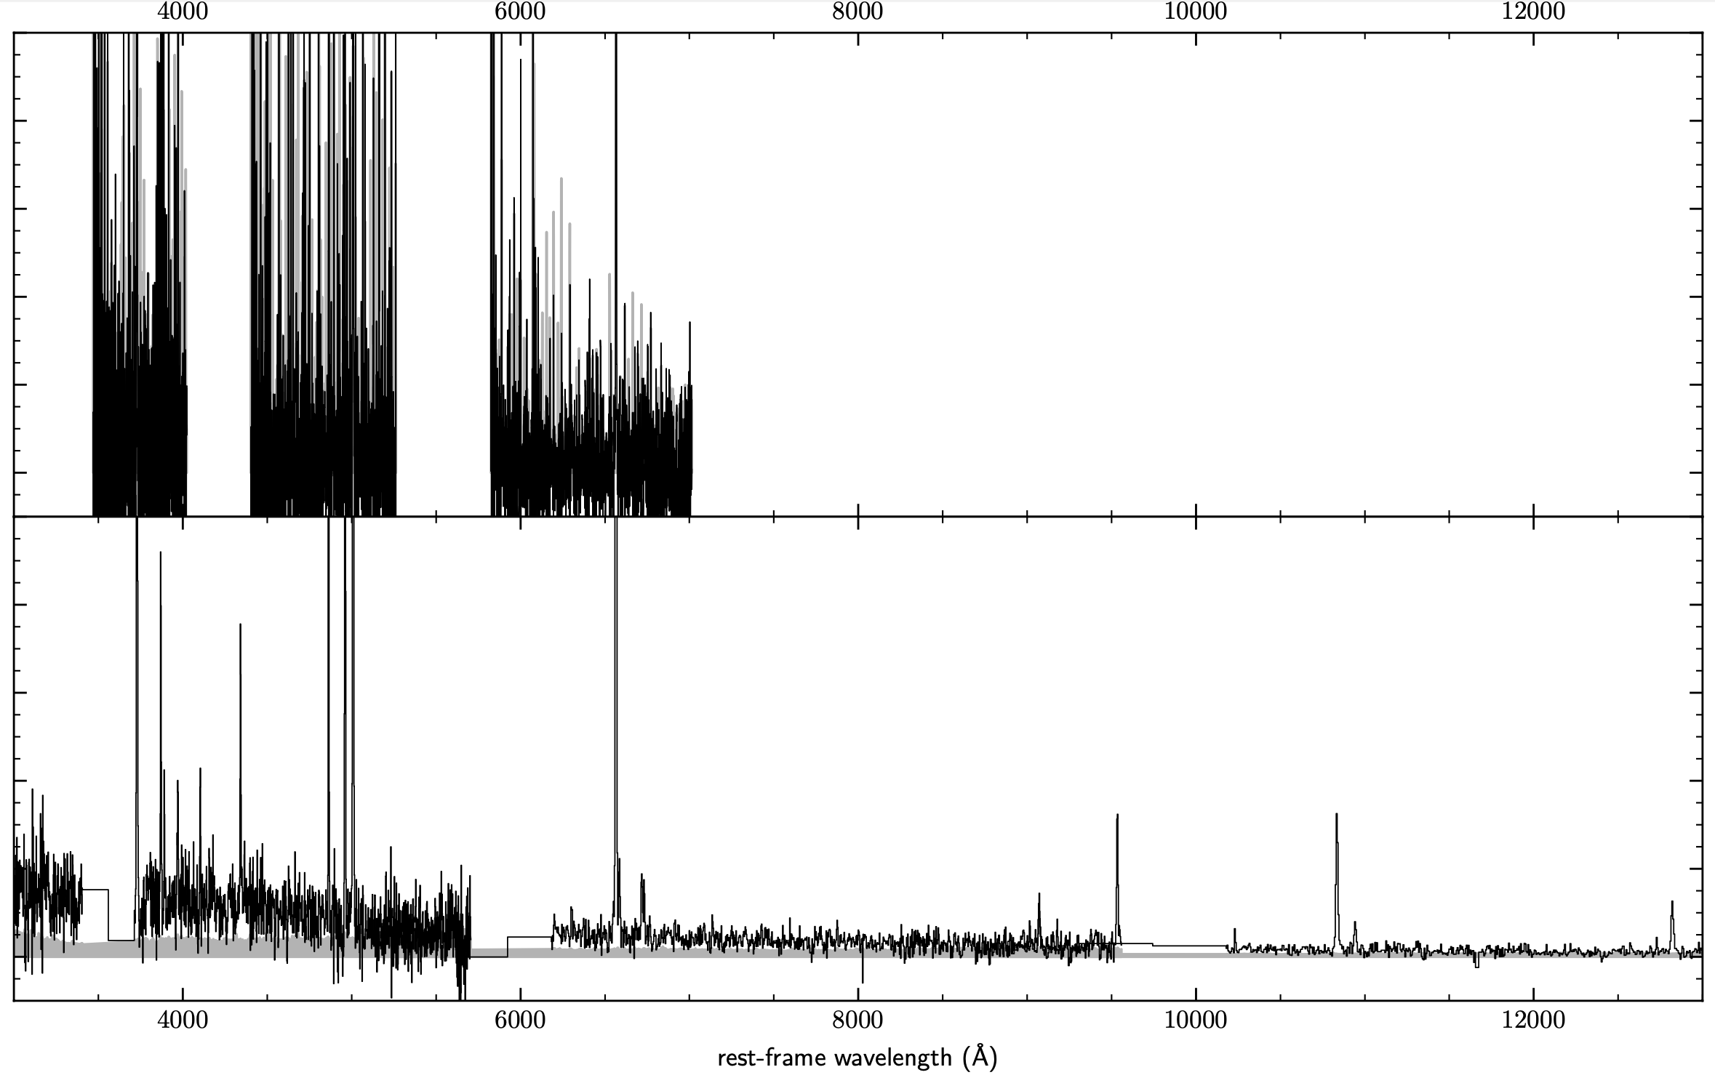
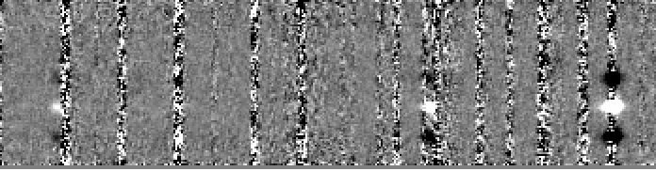
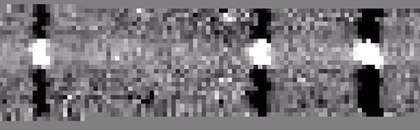
Keck/MOSFIRE: 2 hours per filter
10-meter ground-based
JWST/NIRSpec: 50 minutes per grating
6.5-meter space telescope
Credit: Ryan Sanders

Slide 33
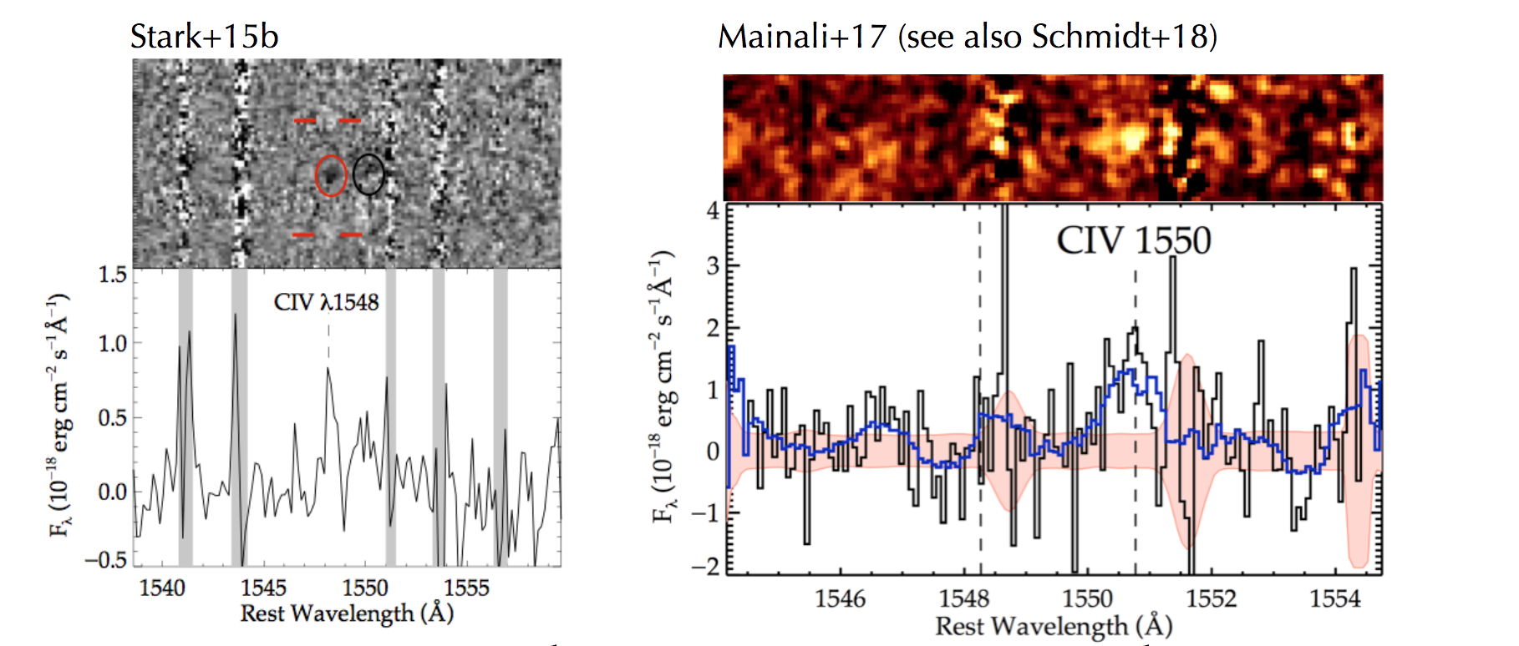
Untangling Astrophysics at z>6
Pre-JWST: two z>6 low-mass lensed galaxies (m~25-26 AB) with detected CIV emission (Keck/MOSFIRE; Magellan/FIRE).

Slide 34
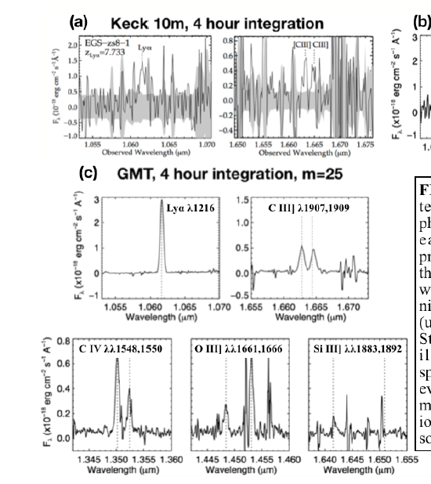
Untangling Astrophysics at z>6
Simulation of GMT/SuperFIRE (similar for GMTIFS)
(Papovich et al. 2019)

Slide 35
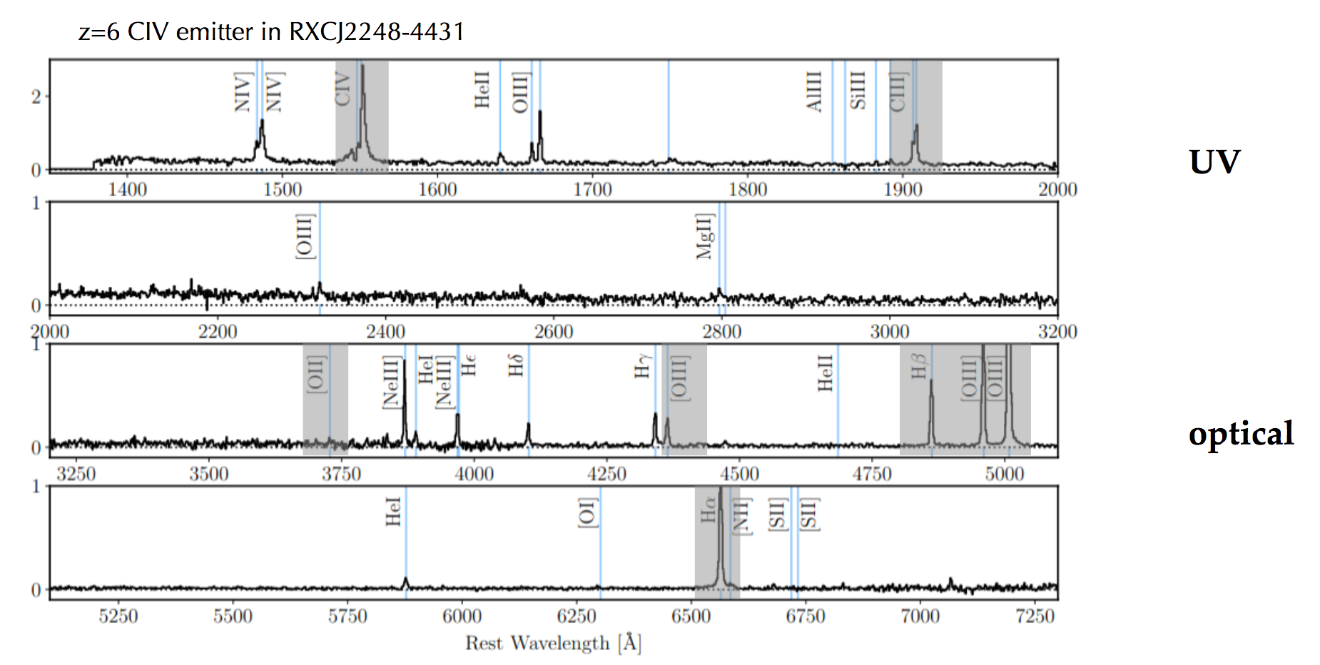
Untangling Astrophysics at z>6
(Topping et al., in prep)
(Curtis-Lake et al. 2023)
Pre-JWST: two z>6 low-mass lensed galaxies (m~25-26 AB) with detected CIV emission.
Post-JWST: rich suite of exquisitely detected rest-UV and optical features enabling detailed analysis of massive stars and ISM.
Notes:
1.8 hours in G140M, 0.4 hours in G235M and G395M.
High ionization emission lines (CIV, He II, NIV], NIV] detections indicating N/O enhancement, Very high electron density (>10^5 cm^-3) in ionized gas.
Rest-optical spectra also indicate extreme ionization conditions, low metallicity

Slide 36
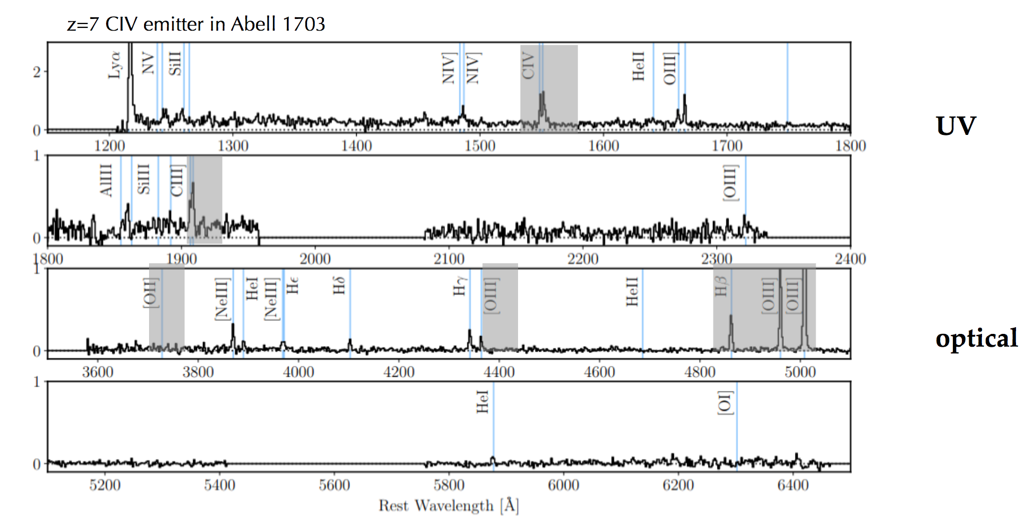
Untangling Astrophysics at z>6
(Topping et al., in prep)
Pre-JWST: two z>6 low-mass lensed galaxies (m~25-26 AB) with detected CIV emission.
Post-JWST: rich suite of exquisitely detected rest-UV and optical features enabling detailed analysis of massive stars and ISM.
Notes:
1.8 hours in G140M, 0.4 hours in G235M and G395M (only z~6 galaxy has G235M).
High ionization emission lines (CIV, He II, NIV], NIV] detections indicating N/O enhancement, Very high electron density (>10^5 cm^-3) in ionized gas.
Rest-optical spectra also indicate extreme ionization conditions, low metallicity

Slide 37
But What about ELTs? Outstanding Key Science Cases
Reionizaion: Direct constraints on leakage of ionizing radiation from star-forming galaxies at high redshift (ELT optical spectroscopy: WFOS, GMACS).
Reionization: Tracing the progress of Reionization with Lyα (ELT near-IR spectroscopy at ~1 μm: MOSAIC, IRIS (IRMS), GMACS).
Galaxy assembly: High-resolution imaging and IFU spectroscopic maps of galaxies at high redshift (ELT diffraction-limited near-IR imaging and spectroscopic maps: IRIS, GMTIFS, HARMONI).

Slide 38
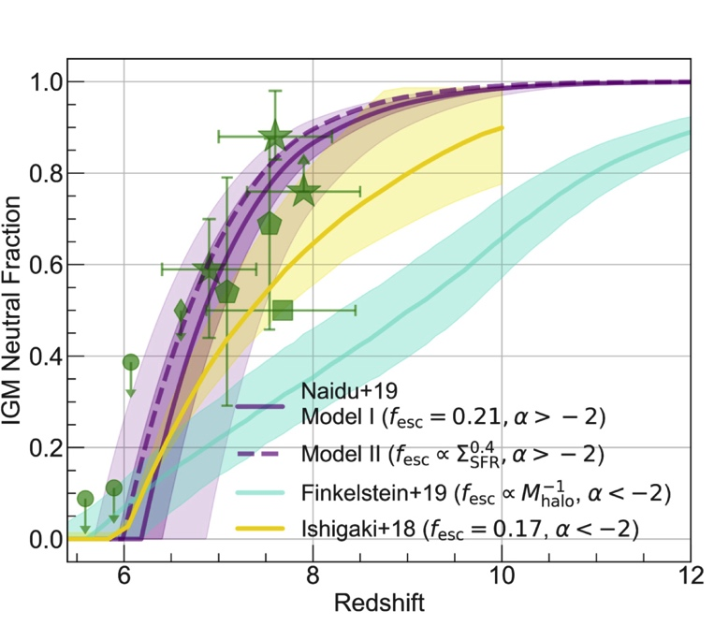
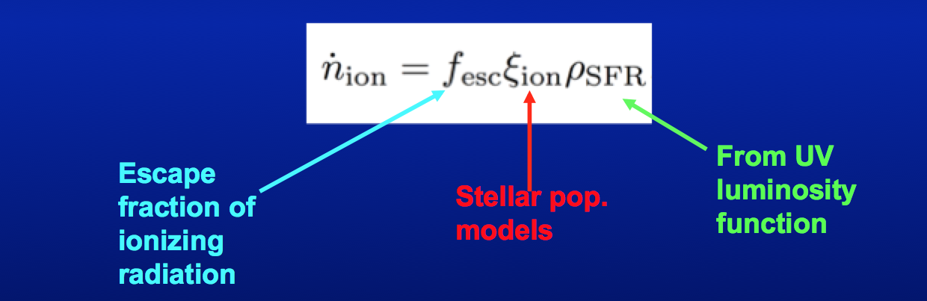
What is the timeline of reionization?
Slow (democratic) vs. rapid (oligarchical) reionization.
Ionizing photon production rate expressed as:
The nature of reionization timeline determined by how f_{esc}(LyC) depends on galaxy properties.
(Naidu et al. 2020)
Notes:
Cannot be measured directly during the epoch of reionization, so we do this at lower redshift. Today, “lower redshift” means z~3, roughly the highest redshift at which we can perform direct LyC measurements.

Slide 39
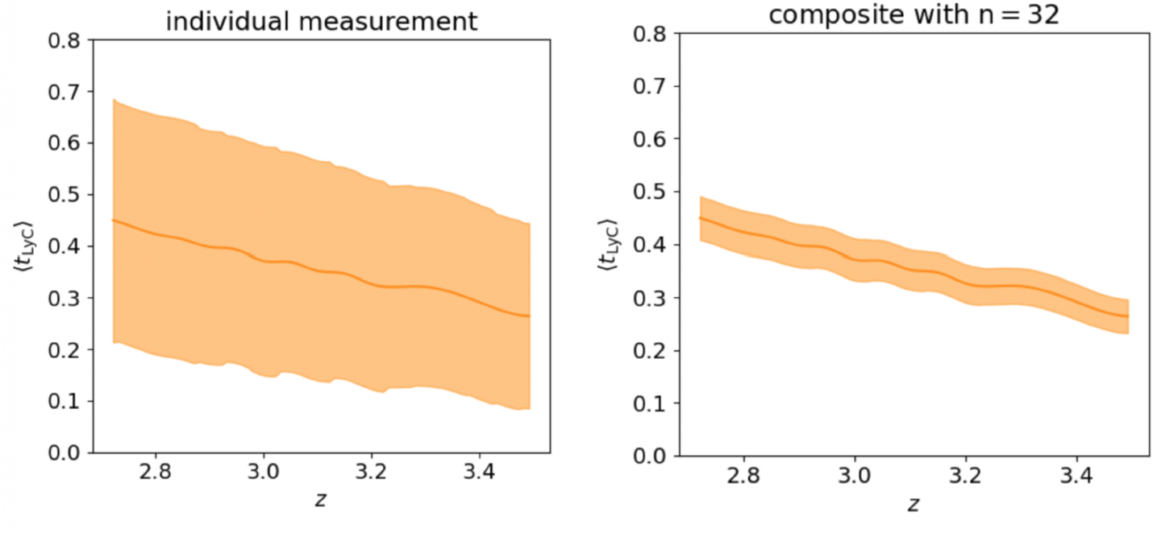
Benefits of stacking
(Pahl et al. 2023)
One of the leading systematic uncertainties in inferring f_{esc} at z~3 is in the correction for IGM opaciy.
Notes:
With samples of >=30 galaxies t_IGM uncertainty <10%.

Slide 40
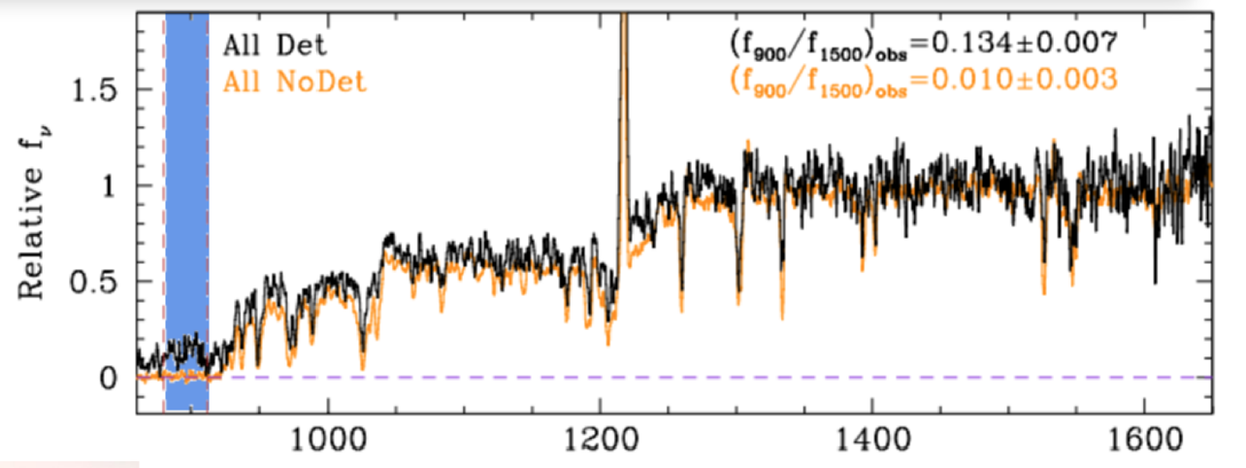
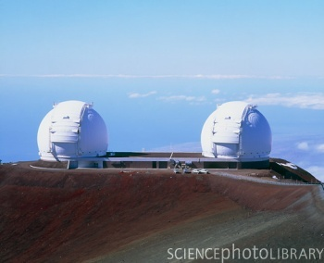
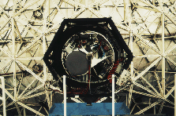
Keck Lyman Continuum Spectroscopic (KLCS) Survey
KLCS: a deep Keck/LRIS survey of 124 star-forming galaxies at z~3.
8-hour LRIS spectra covering the LyC region.
(Steidel et al. 2018)
(Credit: P. Shopbell)

Slide 41
Keck Lyman Continuum Spectroscopic (KLCS) Survey
KLCS: a deep Keck/LRIS survey of 124 star-forming galaxies at z~3.
8-hour LRIS spectra covering the LyC region.
(Steidel et al. 2018)
After contamination removal (4 galaxies), 13/120 galaxies had significant LyC detections.
<f_{esc}>=0.06±0.01
ε_{LyC}~5.5×10²⁴ erg/s/Hz/Mpc³
Higher f_{esc} found at higher Lyα EW and lower UV luminosity.

Slide 42
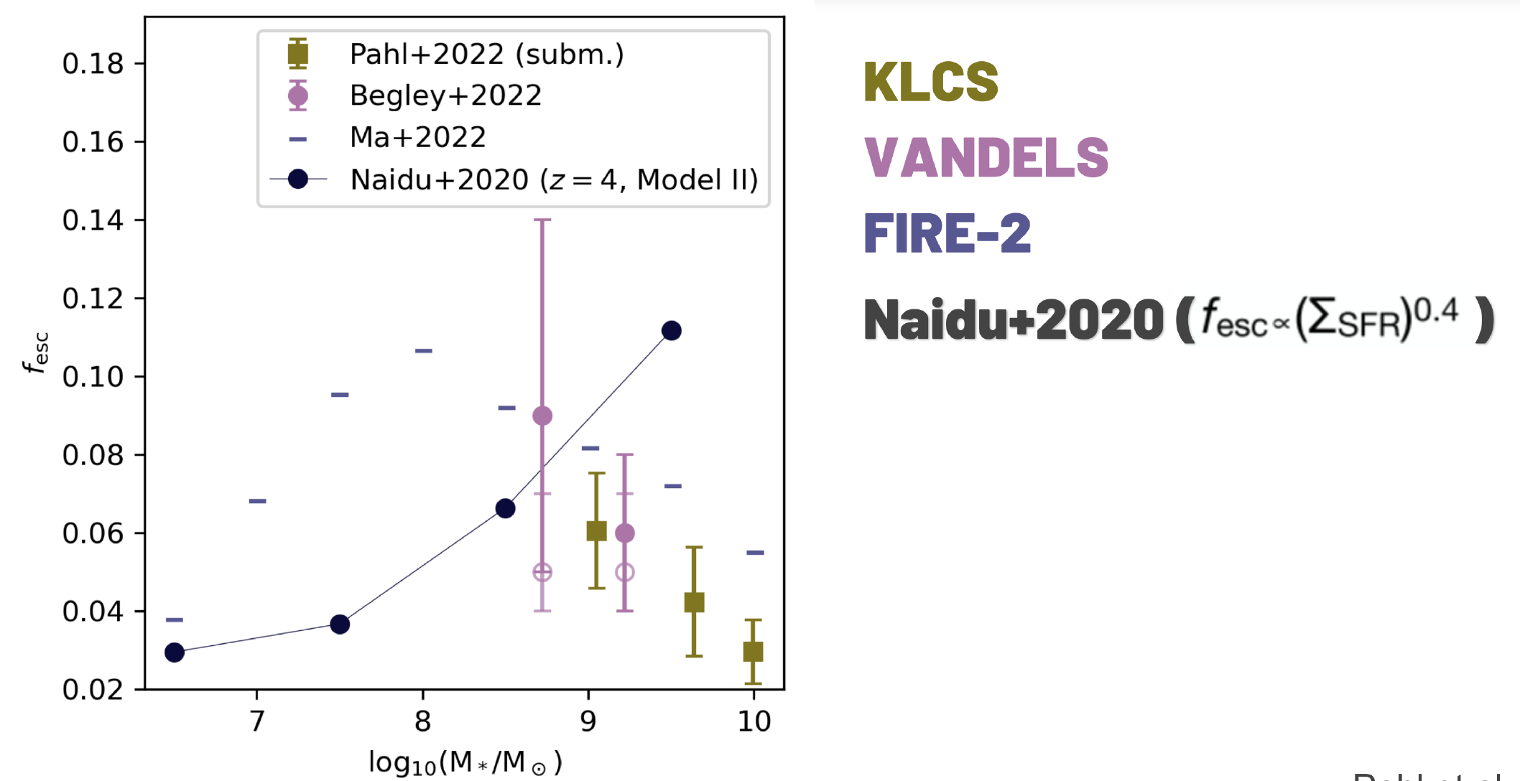
f_esc vs. M*
Positive trend between f_{esc} and M* is a feature of the “oligarchical” model (Naidu et al. 2020) and unconfirmed by our analysis.
(Pahl et al. 2023)

Slide 43
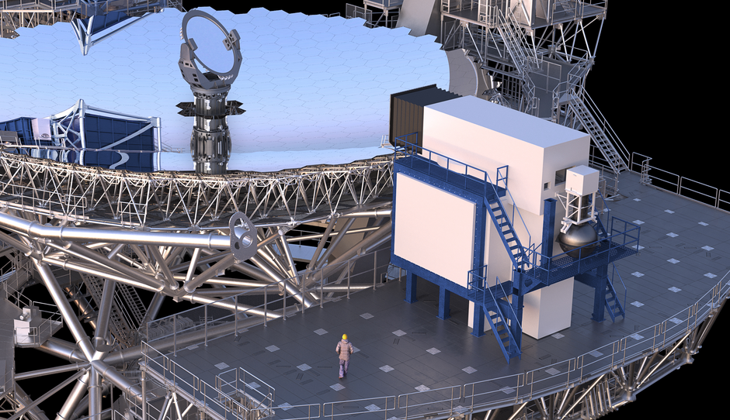
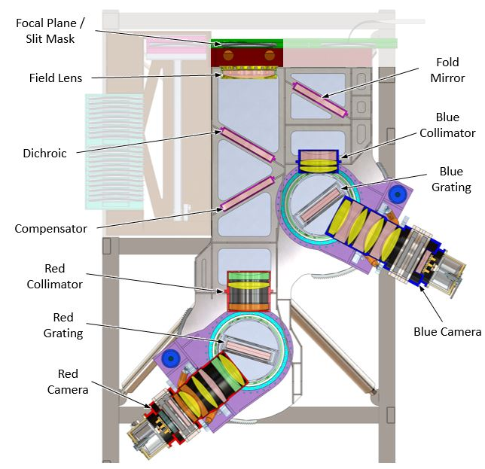
ELT Lyman Continuum Spectroscopic Survey
TMT/WFOS, GMT/GMACS are sensitive below 4000 Å (ELT MOSAIC not blue enough).
Assemble 1000 L* galaxies with comparable observations in LyC region.
Measure LyC for faint galaxies that may be responsible for reionization.
Determine scaling of LyC with galaxy properties.
Obtain higher spectral resolution Lyα profiles (essential LyC proxy).
Definitive z~3 LyC survey.
WFOS
https://www.tmt.org/page/wfos
https://instrumentation.tamu.edu/instruments/gmacs/
GMACS
(See also Rigby et al. 2019)

Slide 44
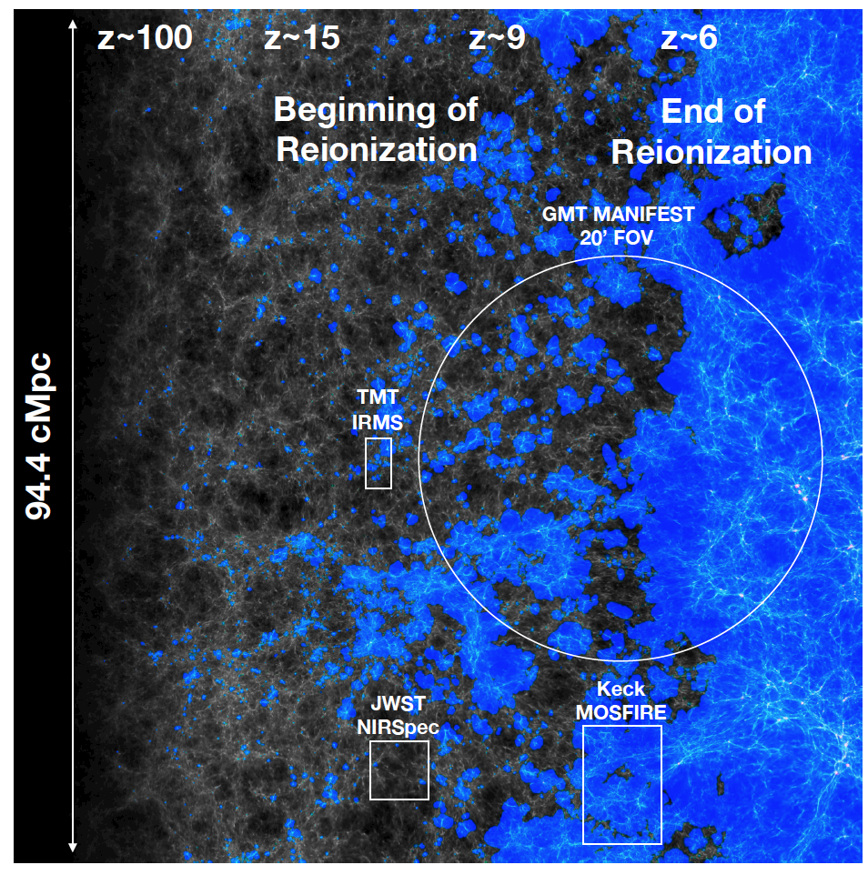
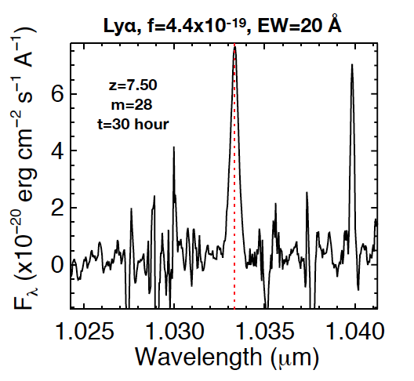
ELTs Unveiling Reionization with Lyα
GMACS, MOSAIC (IRMS) will measure Lya fluxes down to ~10⁻¹⁹ cgs.
Both increased sensitivity at ~1 μm (z~6-8) relative to NIRSpec and larger surveying area.
Trace and map IGM neutral fraction vs. time.
Constrain models of reionization.
(Finkelstein et al. 2019)
Notes:
Cannot be measured directly during the epoch of reionization, so we do this at lower redshift. Today, “lower redshift” means z~3, roughly the highest redshift at which we can perform direct LyC measurements.

Slide 45
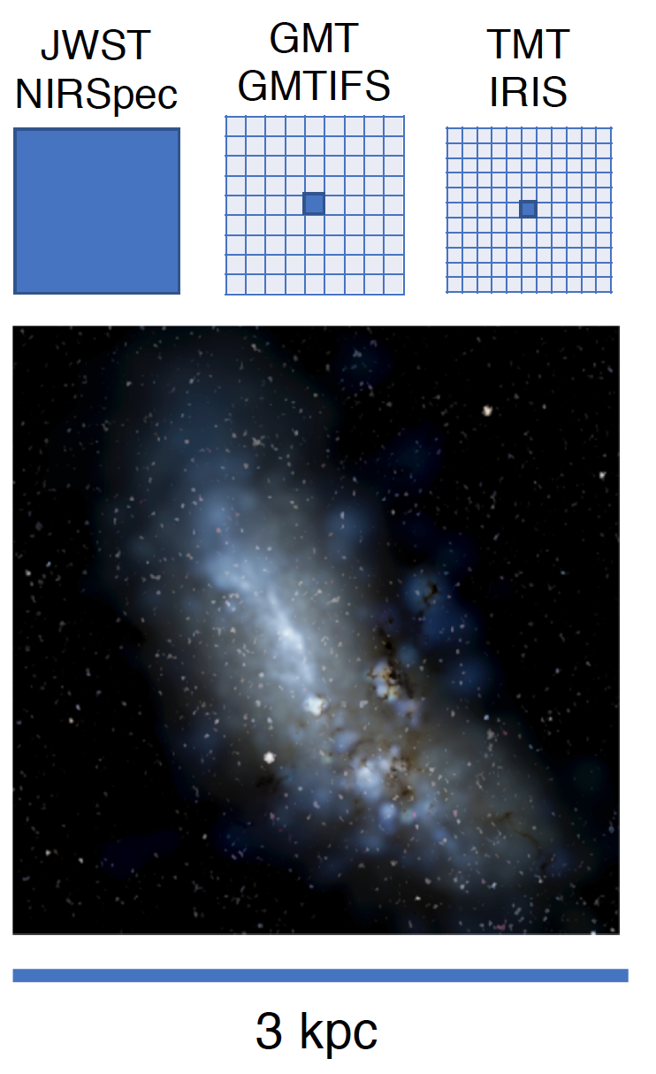
ELTs Dissecting Galaxies at Cosmic Noon/Dawn
JWST/NIRSpec IFU has ~0.1” (~kpc-scale) resolution.
ELT near-IR IFUs (imagers) will enable spectroscopy on the 100 pc scale.
Resolve the launching sites of galactic winds (Hα).
Construct velocity maps/rotation curves to determine dark matter content/structure.
Resolve structural components and heavy element distribution of forming galaxies.
z>6.5 galaxies have typical sizes ~0.2 kpc (Ono+2023)!
(Newman et al. 2019)
Notes:
Cannot be measured directly during the epoch of reionization, so we do this at lower redshift. Today, “lower redshift” means z~3, roughly the highest redshift at which we can perform direct LyC measurements.

Slide 46
Summary
ELTs will enable transformative advances in:
  Optical spectroscopy (e.g., the nature of galaxies reionizing the universe).
  Near-IR spectroscopy (blue edge) (e.g., unveiling the end of reionziation).
  Diffraction-limited imaging and spectroscopy (e.g., placing the assembly of galaxies under the <=100 pc microscope).

