Slide 1
Resolving stars with JWST and the ELTs in the Milky Way and its neighbors
Mario Gennaro

Slide 2
OUTLINE
An overview of ELTs and JWST science in the “Life Cycle of stars” macro-area:
Necessarily incomplete, all omissions are mine
Possible synergies:
I will describe areas where I believe the ELTs and JWST can complement each other
Scientific AND operational challenges: the investment is huge, we need to work towards enhancing the return
this workshop is a great avenue for cross-pollination, and I thank the organizers for the opportunity

Slide 3
The ELTs Science Case
Limited to The Life Cycle of STARS

Slide 4
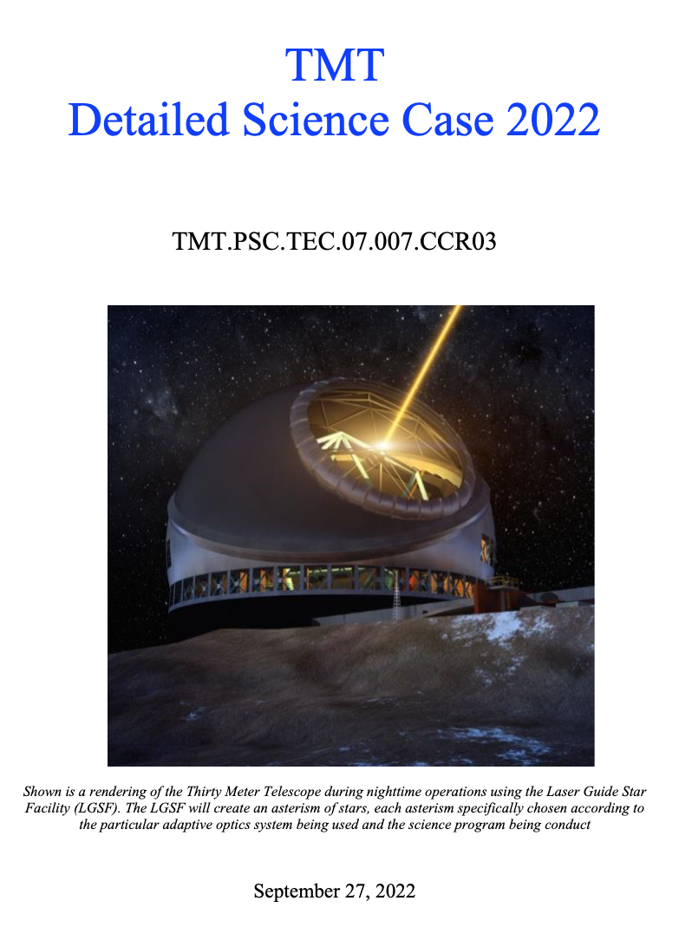
Based on the following

Slide 5
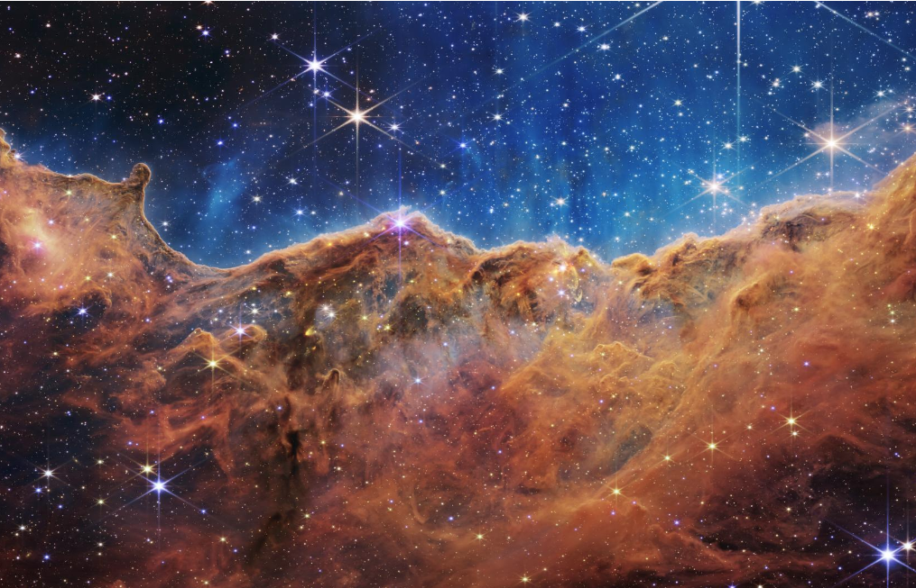
Star Formation
Probing protostellar photospheres (characterizing mass accretion history and its impact on early stellar evolution)
Kinematics of cluster members vs gas (primordial vs dynamical mass segregation, traceback vs mass)
Low-end of the Initial Mass Function (BDs, PMOs with spectroscopically confirmed membership)

Slide 6
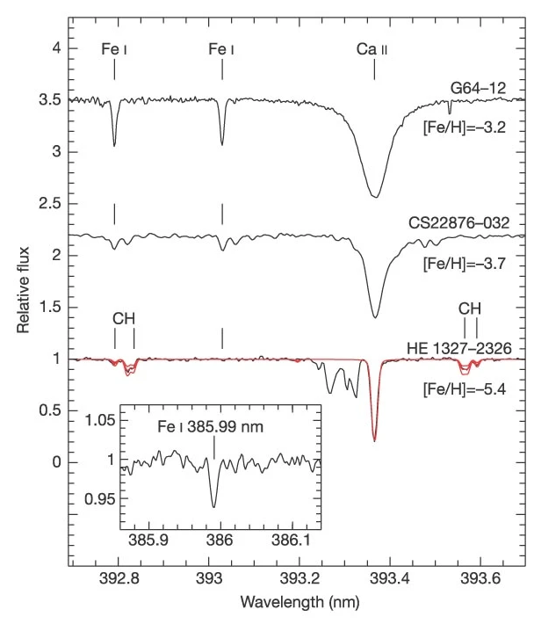
Stars and clusters
Metal poor stars (see also W. Aoki poster):
Massive stars evolution and their role in enriching the ISM (spectra of stars at >10 Mpc)
Initial-Final Mass relation for white dwarfs:
WD/SNII mass boundary: impact on galaxy evolution models (chemistry, energy budget)
Understanding RGB/AGB mass loss: impact on post-MS modeling, SFH reconstruction, integrated light analysis etc.
Globular Clusters:
Kinematic families of GC in the Milky Way
Searching for IMBHs
From Frebel et al. (2005)

Slide 7
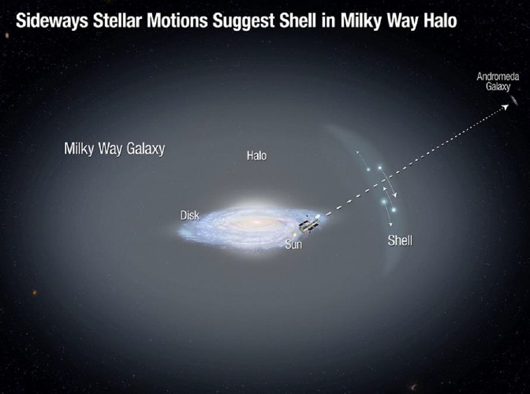
The Milky Way
Galactic Center
Astrometry will enable tests of GR closer to the central Black Hole
The Bulge
Identifying the lowest [Fe/H] stars and their distribution to constrain both star formation/evolution and the first ~100 Myr of the Galaxy
Halo, streams, and other substructures
Chemical abundance of fainter, older, more distant objects

Slide 8
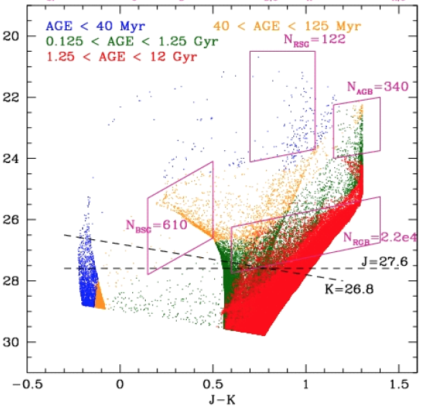
Resolved stellar populations in the Local Group and beyond
Local Group Dwarf Galaxies
Orbits
SFH, mass-metallicity relation
Dark Matter profiles
Pushing the boundary:
SFH of giant ellipticals in the Virgo cluster

Slide 9
The JWST Science Case
Limited to The Life Cycle of STARS

Slide 10
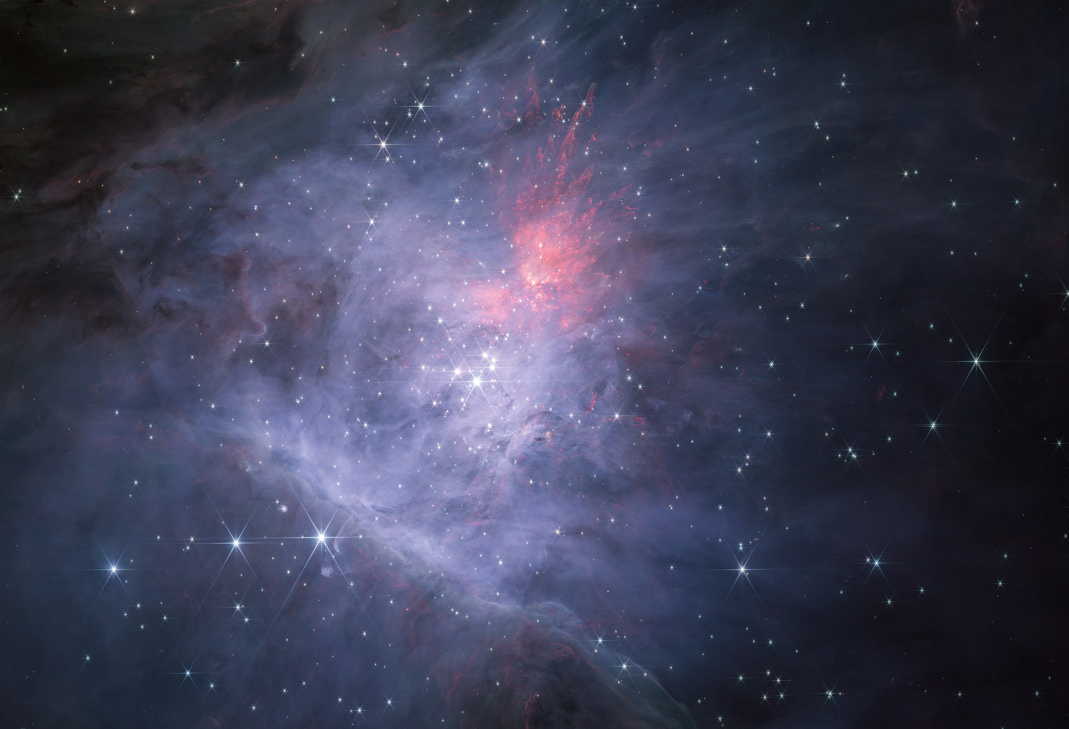
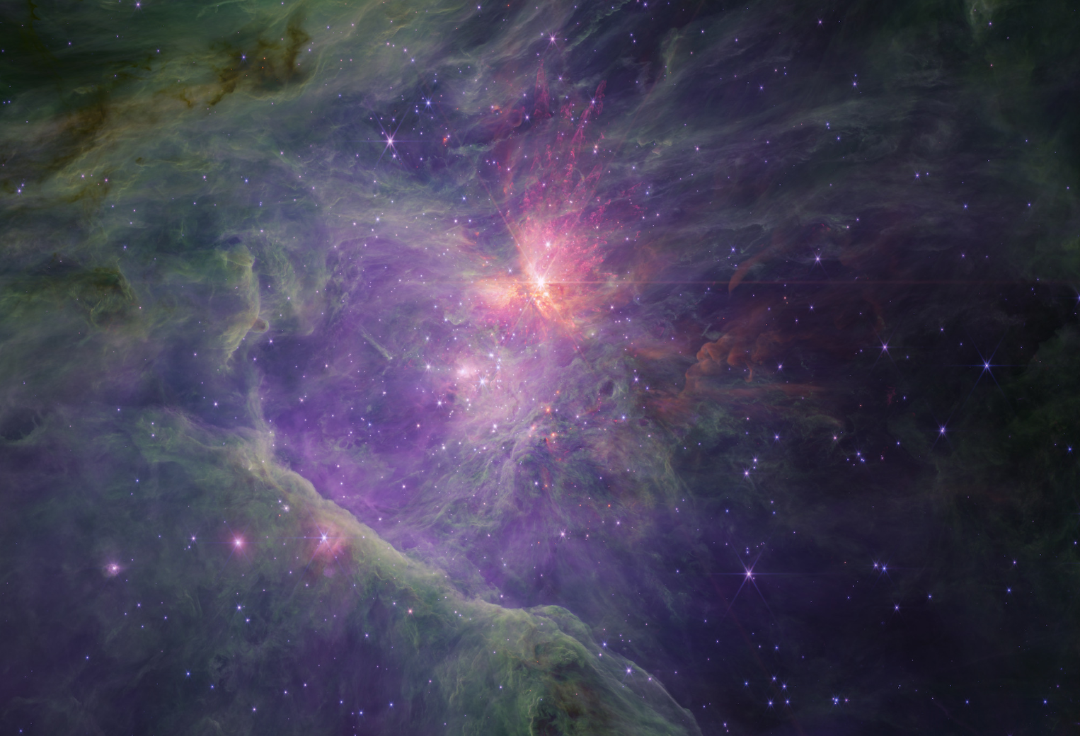
Star formation
1 arcmin
NIRCam SW
NIRCam LW
A JWST survey of the Trapezium Cluster & inner Orion Nebula. I. Observations & overview
McCaughrean & Pearson (2023, arXiv231003552M )

Slide 11
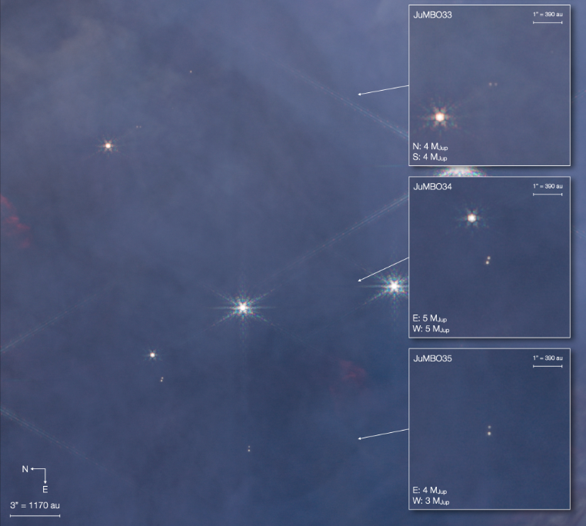
JUMBOs (Jupiter Mass Binary Objects)
Pearson & McCaughrean (2023, arXiv231001231P)
[…] we have discovered and characterised a sample of 540 planetary-mass candidates with masses down to 0.6 Jupiter masses, demonstrating that there is indeed no sharp cut-off in the mass function.
[…] we find that 9% of the planetary-mass objects are in wide binaries, a result that is highly unexpected and which challenges current theories of both star and planet formation.

Slide 12
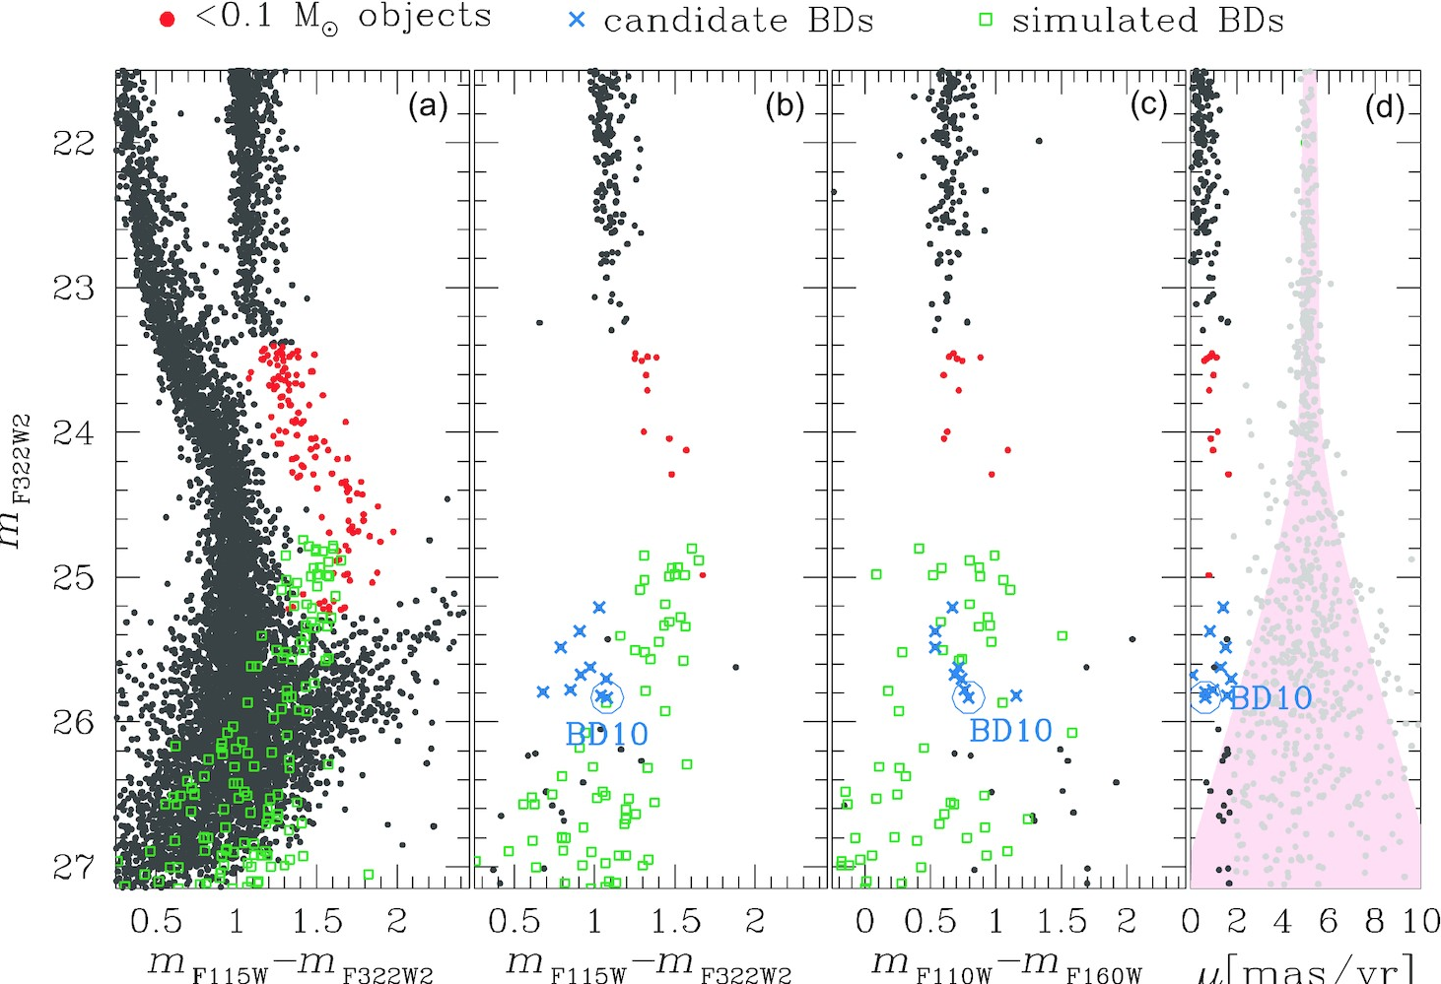
Brown Dwarfs in Globular Clusters
Using “BAD” data
[…] the capabilities of JWST will reach these BDs in GCs, allowing for an independent measurement of the age of GC populations through the HBL gap
Nardiello, Griggio & Bedin (2023)

Slide 13
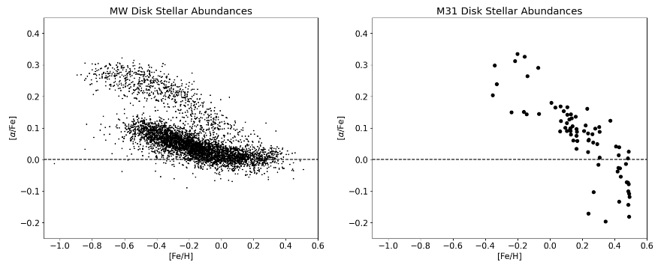
Galactic Archeology in M31
[…] the entire stellar population falls along a single chemical sequence very similar to the MW’s high-α component which had a high star formation rate
[…] M31 has had a more active accretion and merger history than the MW which might explain the chemical difference
Nidever et al. (2023)

Slide 14
ELTs and JWST Synergies
Limited to The Life Cycle of STARS

Slide 15
ELTs
JWST
Access to full MIR
Collecting area
Angular Resolution
Lower background, cold mirror
NIR
Access to Optical
Full sky coverage
High spectral resolution
Sensitivity
“Large” FoV
“Serviceable”
PSF stability

Slide 16
The case for NIR-MOS on the ELTs
Large FoV imaging with JWST/NIRCam will probe stellar population beyond the Local Group, however imaging has obvious limitations.
Spectroscopy is crucial to break the [Fe/H] vs age degeneracy and to determine the kinematic properties of various populations.
LMS, PMOs in star forming regions
BDs in GCs
Dwarf stars in the Bulge (controversy on Bulge age from the few dwarfs stars with available spectra)
LOS velocity (+JWST PPM) and metallicities of dwarf stars in UFDs, (DM profiles)
Science requirements: R of several thousands to ~20,000, access to optical and NIR
Evans et al. (2015 arXiv150104726E)

Slide 17
looking even further towards Roman and HWO

Slide 18
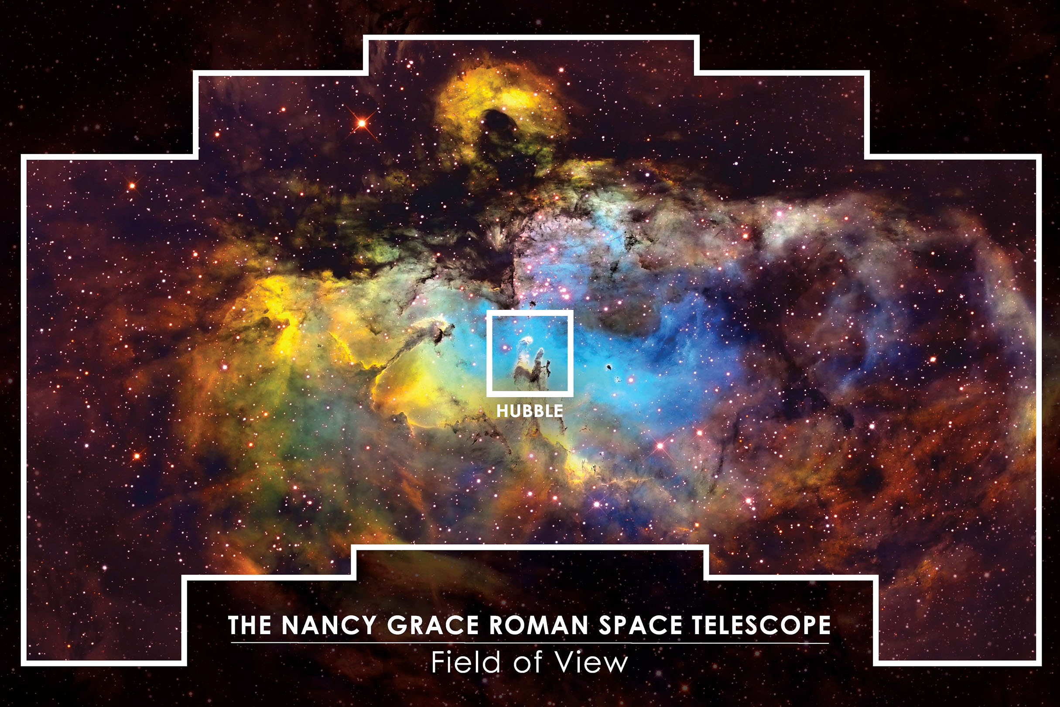
The Nancy Grace Roman Space Telescope
Roman will produce a huge amount of candidates for spectroscopic follow up in many fields of astronomy
The Bulge μ-lensing core survey will identify BH and other exotic targets that will warrant ELTs followup

Slide 19
The Habitable Worlds Observatory
It IS a reality and it will overlap with the ELTs
Matches the λ/D and FoV of the ELTs in the UV-optical
Think about the proven track record of HST + 8 meter telescopes (eg. the ULLYSESS + PENELLOPE surveys)
On-axis, 16m LUVOIR-A concept

Slide 20
The whole is greater than the sum of its parts
can be
SOME thoughts, IN RANDOM ORDER, on How To Enable synergies

Slide 21
We need to be intentional in how we develop synergies between space-based and ground-based facilities AND within the ground-based community
Establish a collaborative framework that may enable such synergies
Bring the ELTs to the broader community:
US-ELTP as the “STScI of the ground” (E. Peng talk)
Establish avenues for active communication and ideas exchange
Learn e.g. from the GW community and the LIGO/VIRGO/KAGRA cooperative model
The science operation model (from the TAC to programs execution and the data processing and release) needs to enable full exploitation of the various capabilities beyond the scope of individual, small programs:
Joint programs? Director initiatives?

Slide 22
Strategize the development and deployment of new instrumentation across the ELTs together with the broader international community
Define a transparent, open process
Have dedicated funds (similar to NASA SAT, APRA)
Use 8m telescopes as demonstrators? (D. Mawet)
Lower barrier to access (Research Inclusion Initiative by US-ELTP)
Standardization of the data and SW
HLSP/science platform:
synergies with e.g. Roman?
Pipeline development with community input (see e.g. Improving JWST Data Products workshop)

