Slide 1
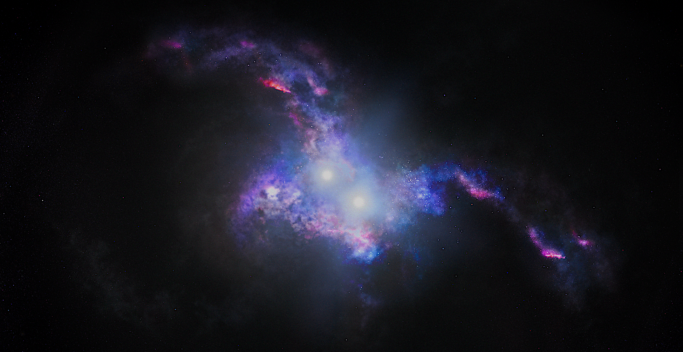
Advancing dual quasar science at cosmic noon and beyond with ELTs Spatially resolved observations with JWST and ALMA
ELT Science in Light of JWST
Yuzo Ishikawa, Nadia Zakamska, Hsiang-Chi Hwang, Yue Shen, Xin Liu, Yu-Ching Chen, Aaron Gross, Andrey Vayner, David Rupke, Sylvain Veilleux, Dominika Wylezalek

Slide 2
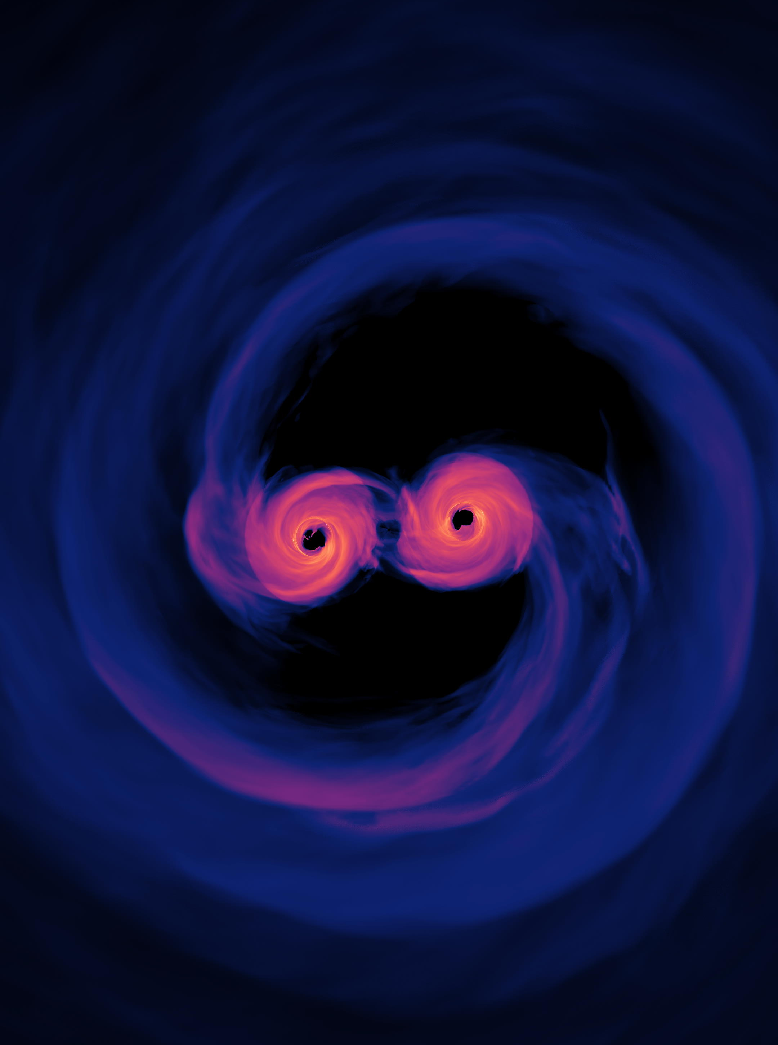
1. Galaxy merger
100s to 10s of kpc
2. Dual quasar
A few kpc
3. Binary quasar
> parsec
4. SMBH merger
Dual quasars at $z>1$ are not well known
Merger & quasar triggering connection?
Host galaxy properties?

Slide 3
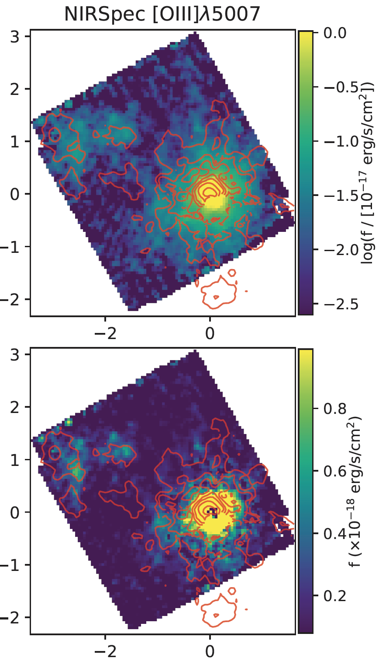
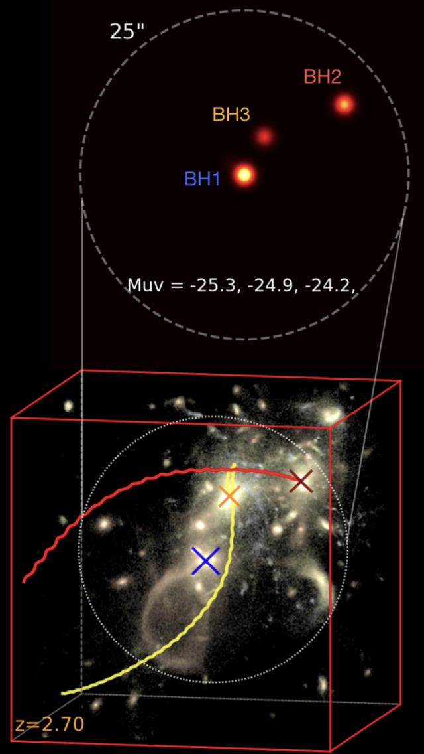
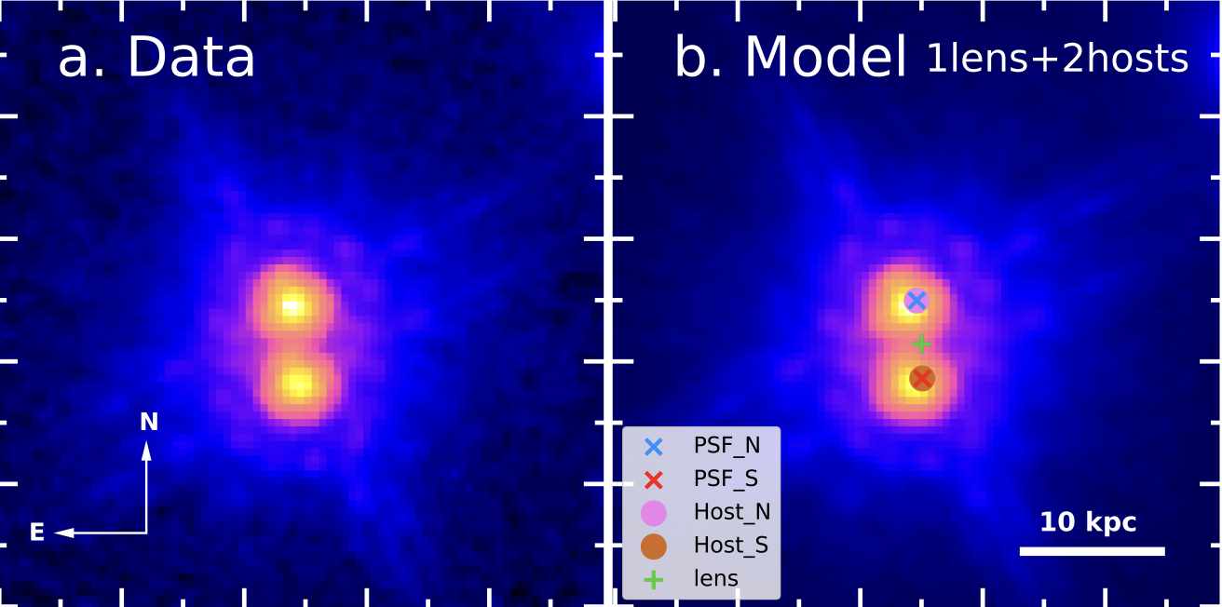
State of dual quasar science
$z\sim 3.3$, $θ\sim 1”\sim 20$kpc
Perna et al. (2023)
JWST GTO 1220
$z\sim 3.1$, $θ\sim 1”\sim 20$kpc
Tang et al. (2020) Subaru HSC
ASTRID simulation Ni et al. (2022)
$z\sim 1.8$, $θ\sim 0.64”$ → LENS
Gross et al. (2023)
$z\sim 1.8$, $θ\sim 0.64”$
Gross et al. (2023)

Slide 4
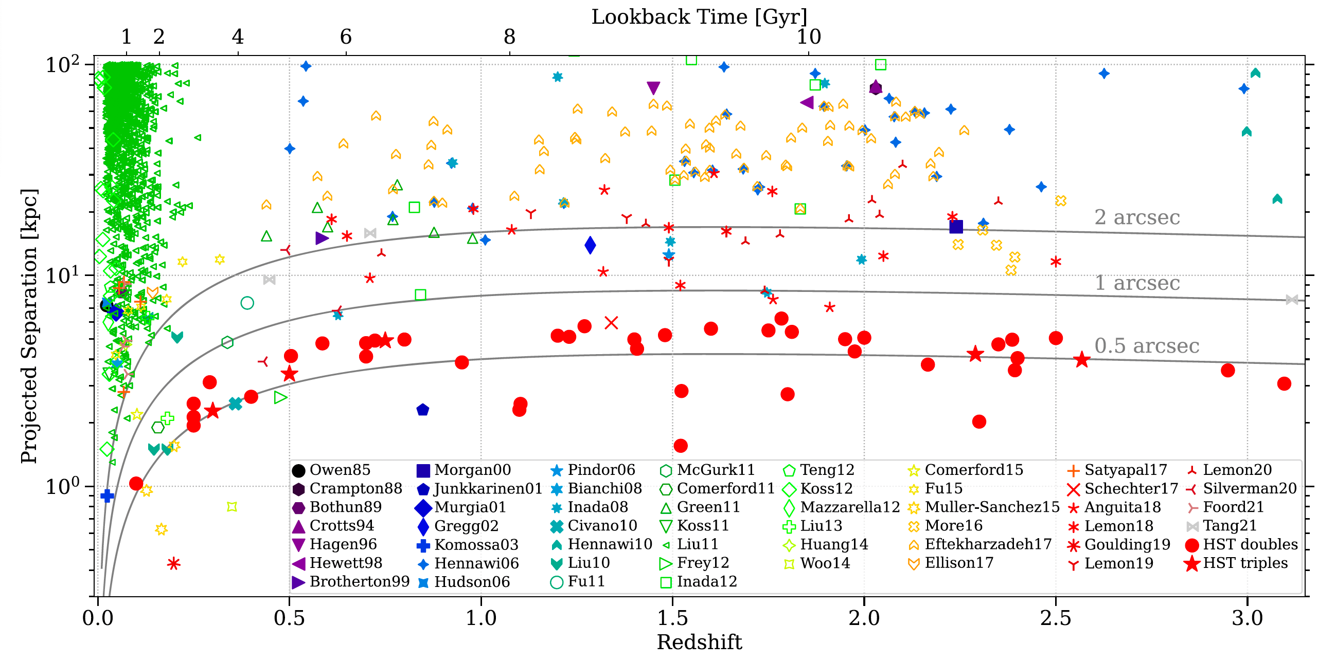
Low z
Large separation
2 arcsec
1 arcsec
0.5 arcsec
Chen et al. (2022)

Slide 5
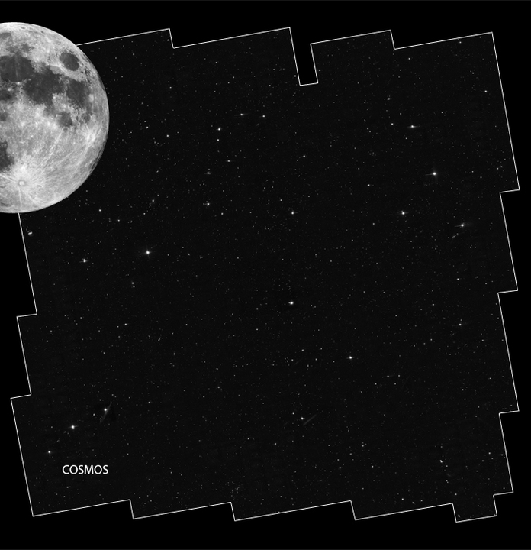
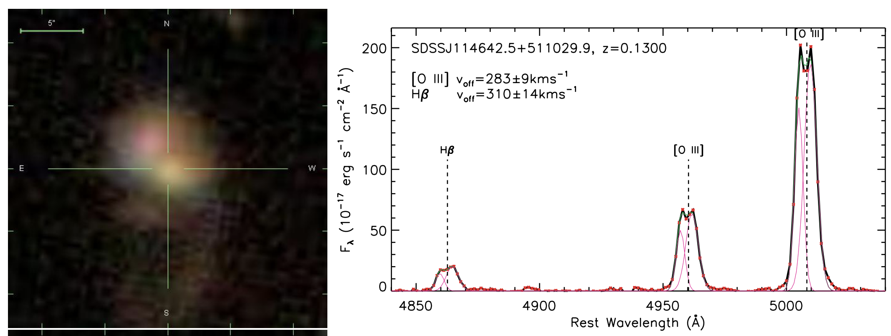
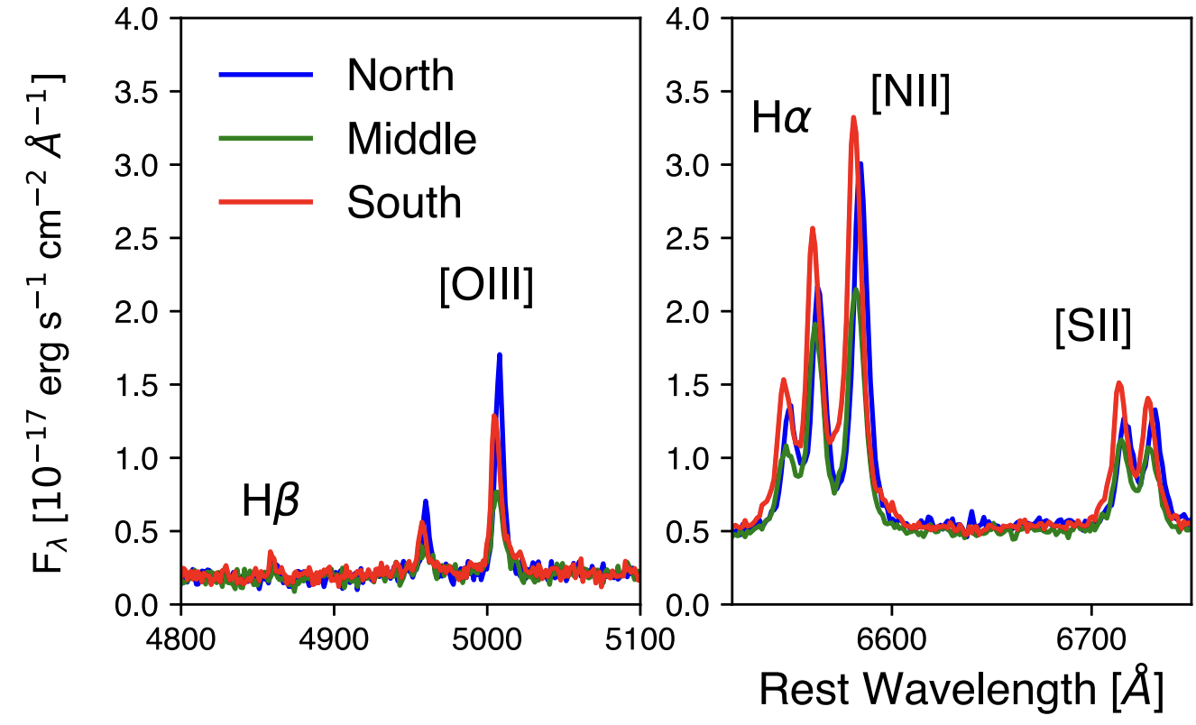
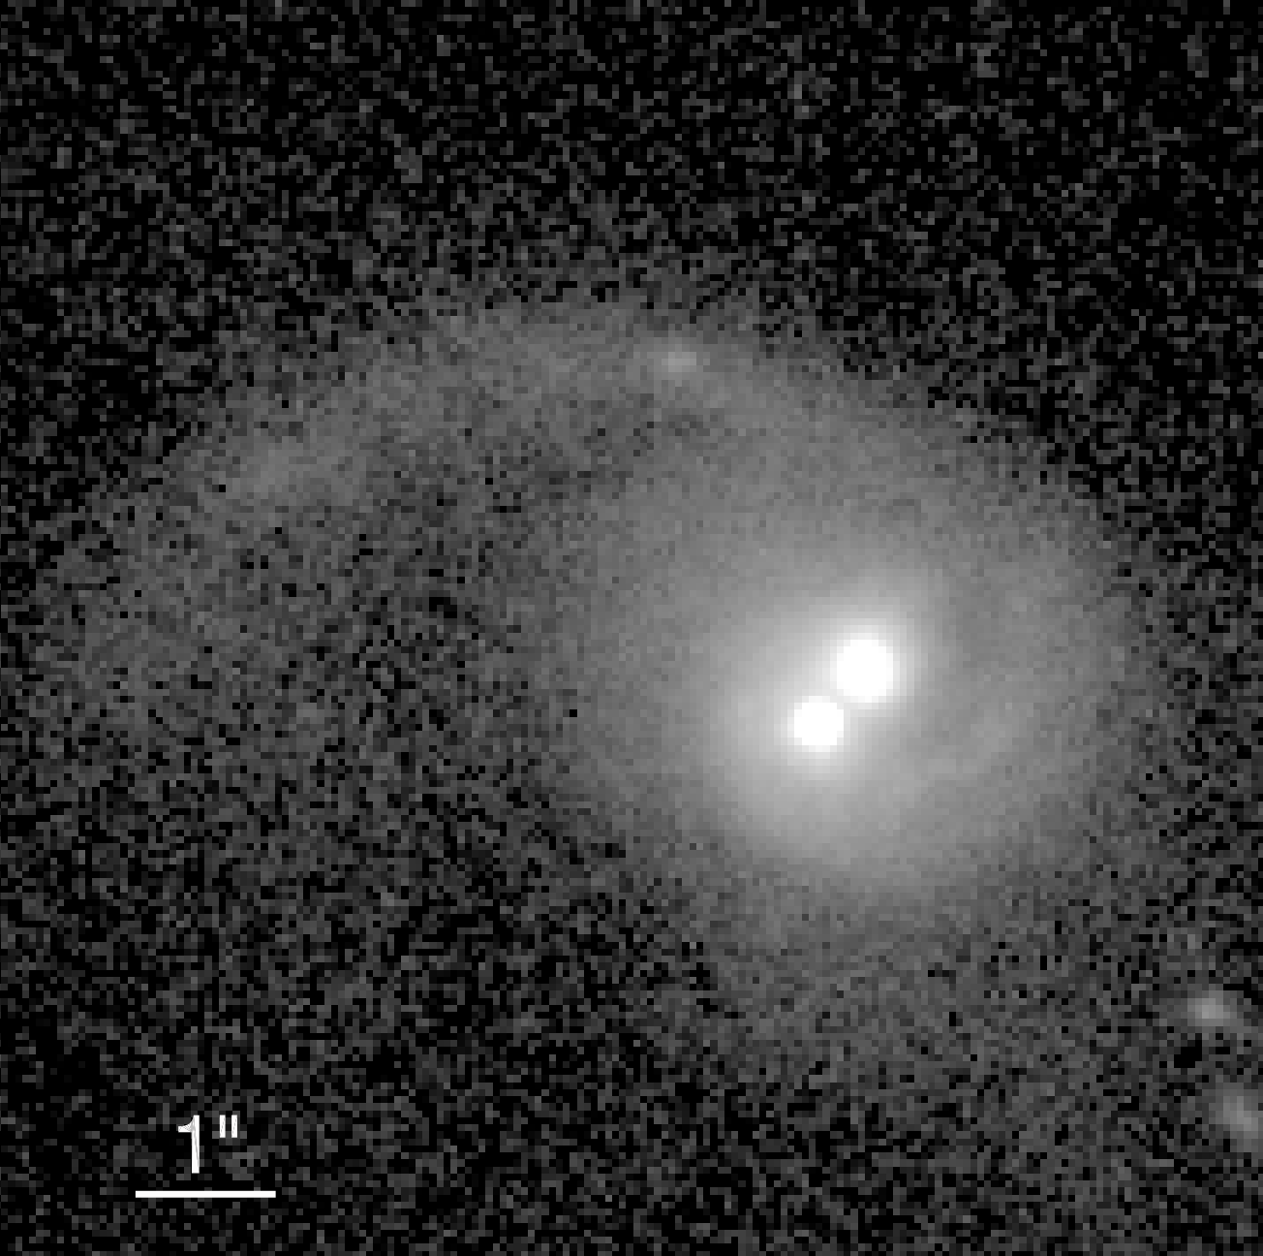
How to find dual quasars?
Imaging surveys
Spectroscopic surveys
Resolved spectra
Koss et al. (2023)
Liu et al (2010)
SDSS -> Double-peak emission lines
Comerford et al (2009)
Stemo et al. (2021)
Many are chance discoveries!
COSMOS

Slide 6
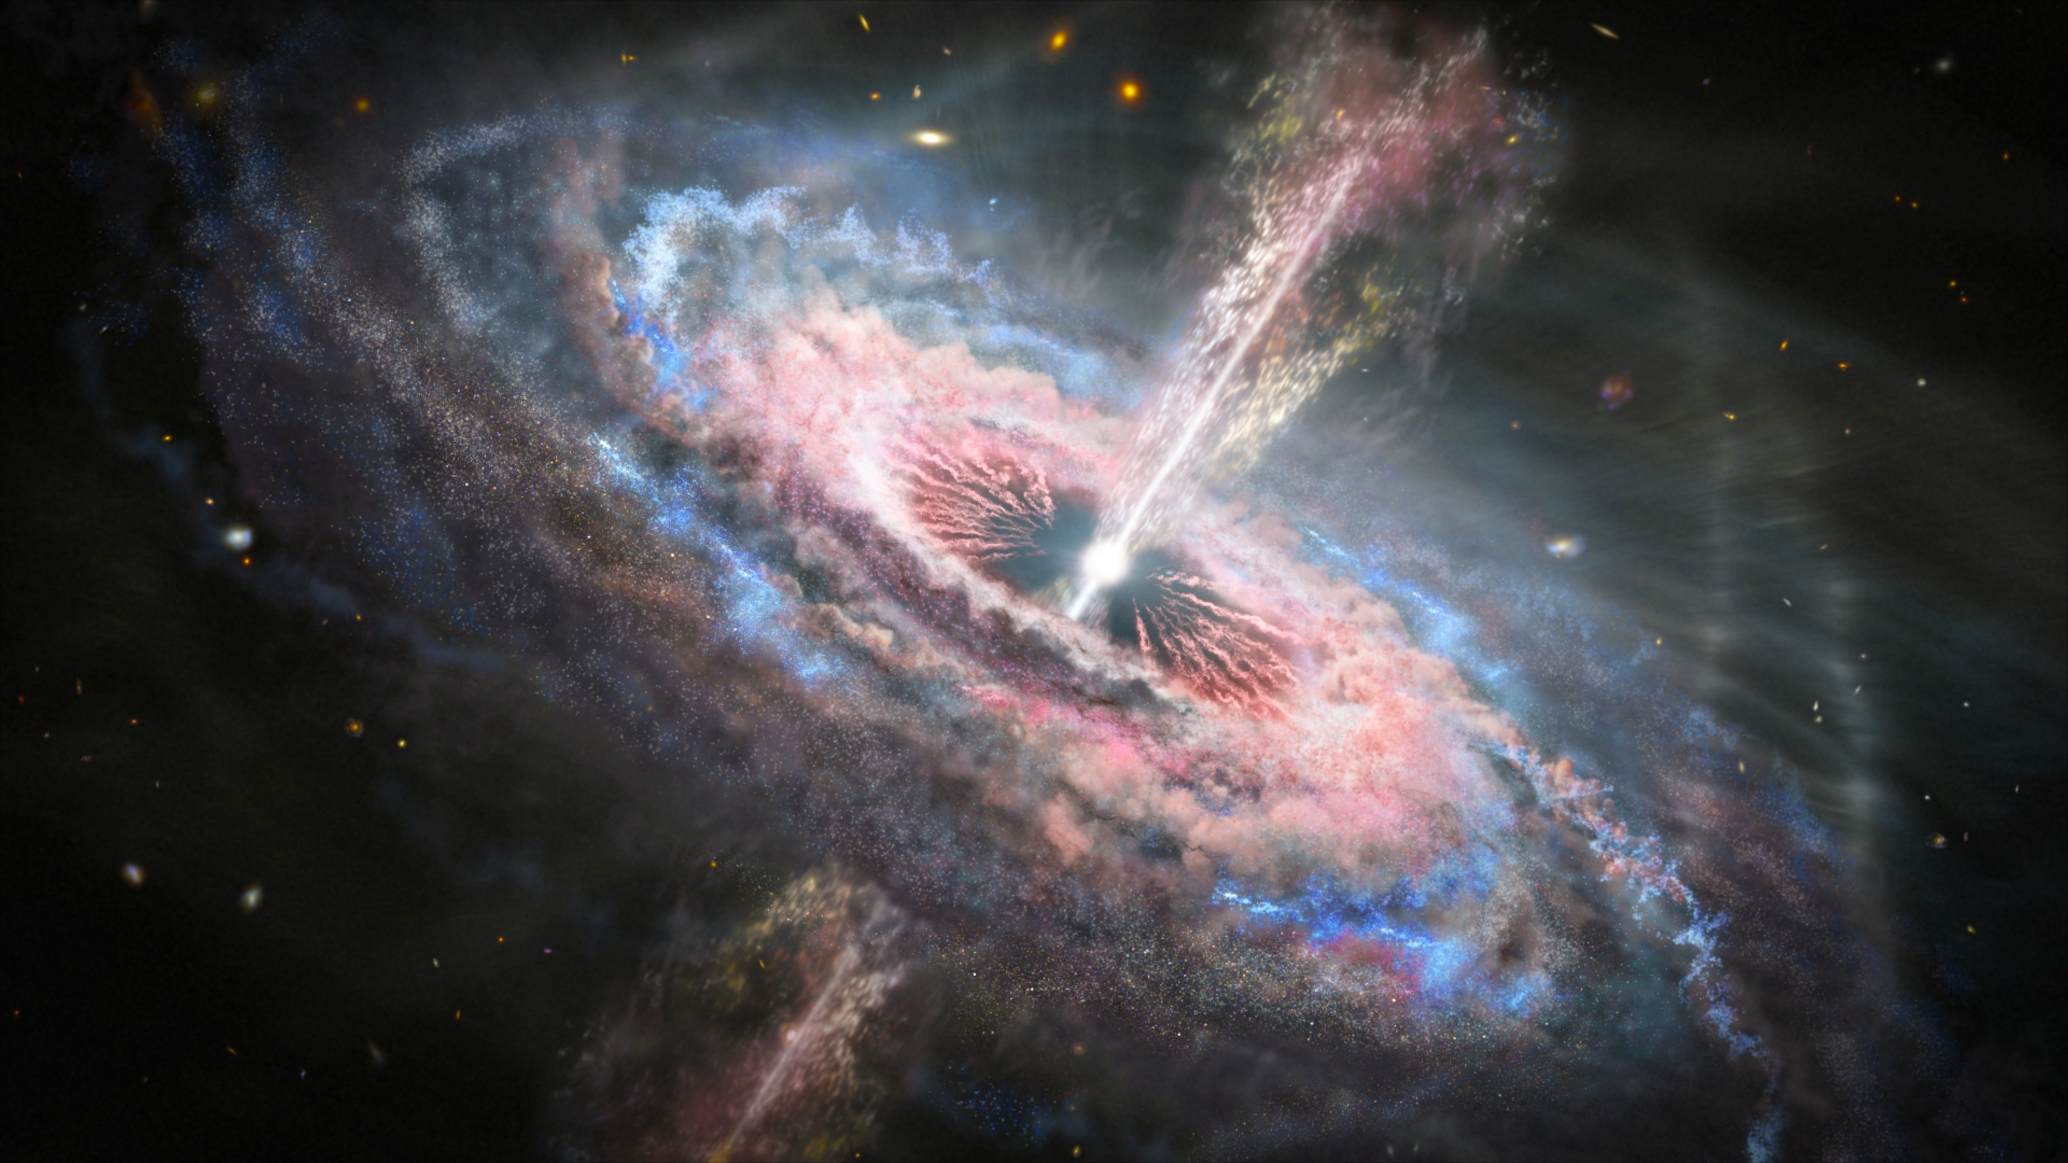
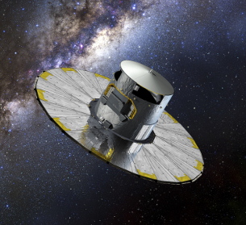
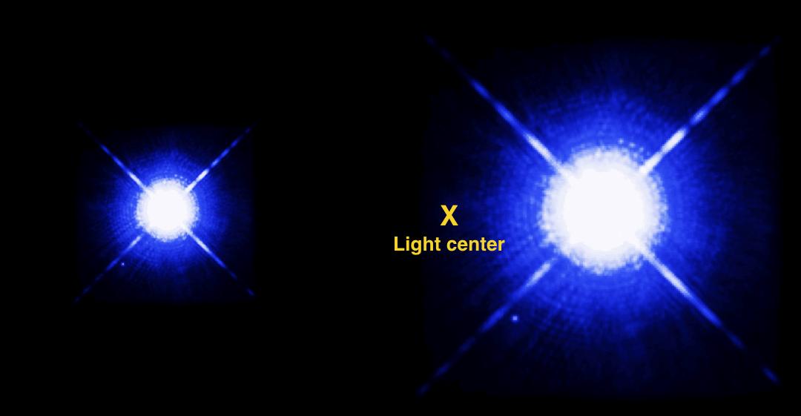
Varstrometry to find < 1” separations
$$σ_{θ}$$
Gaia
e.g. Dual quasars, lensed objects, binary stars
$$∆x$$
Record flux + centroid
Unsynchronized flux variations
Astrometric jitter → angular separation → physical separation
Advantage: we can systematically find many pair-system candidates
Shen et al. (2019)
Hwang et al. (2020)

Slide 7
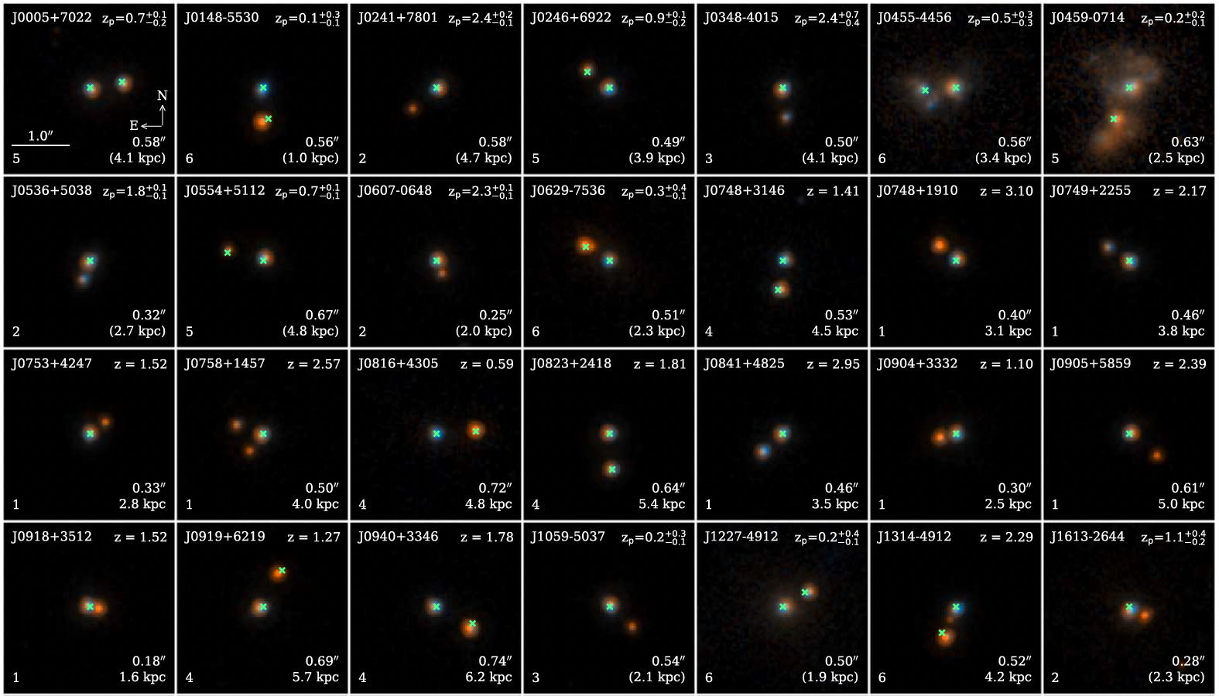
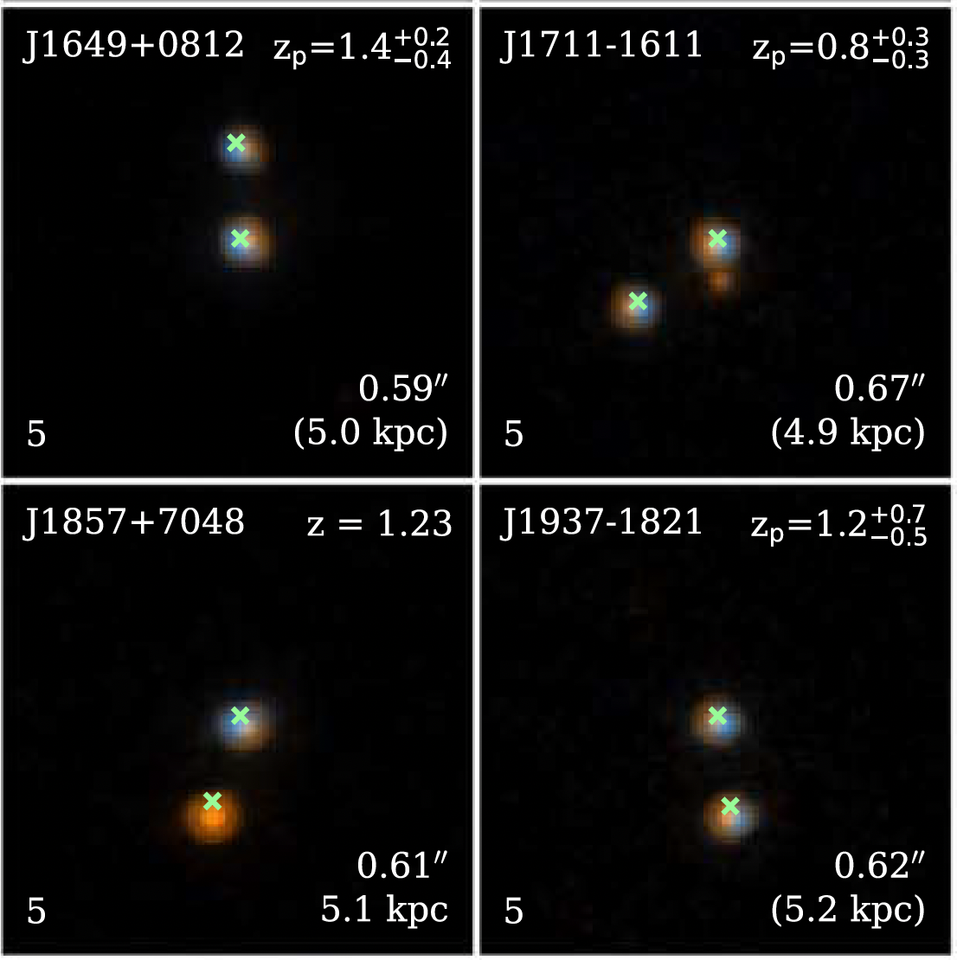
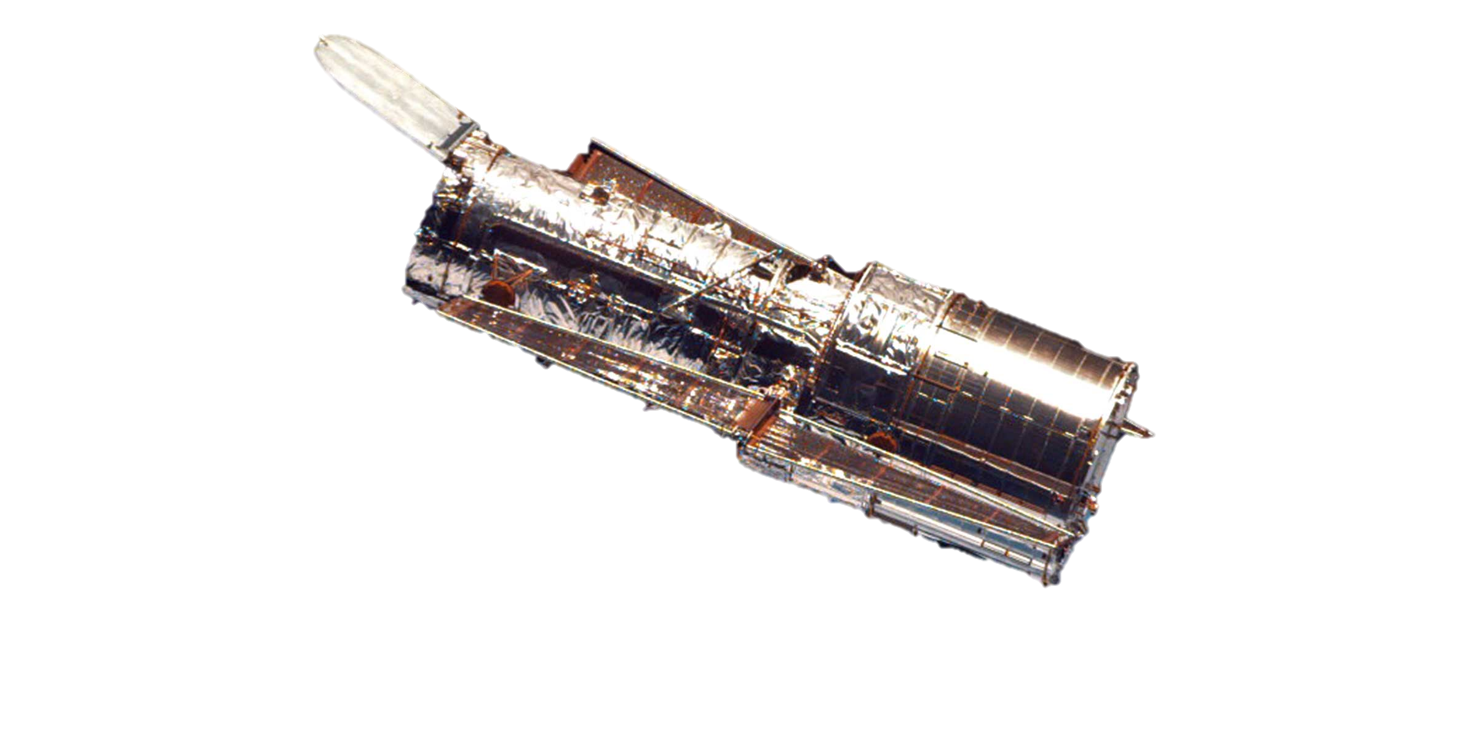
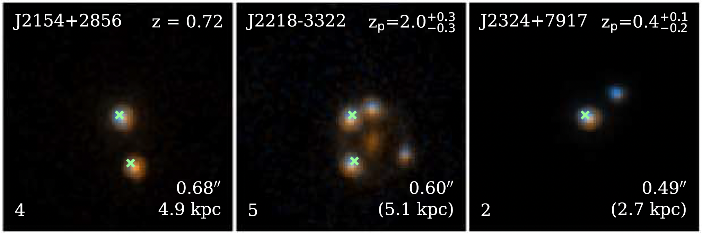
Chosen for JWST Cycle 1 follow-ups
HST snapshot follow-up imaging revealed resolved pairs!
Shen et al. (2021)
Chen et al. (2022)

Slide 8
Low z
Large separation
Small separation
Chen et al. (2022)

Slide 9
Case study: J0749+2255 at z=2.17

Slide 10
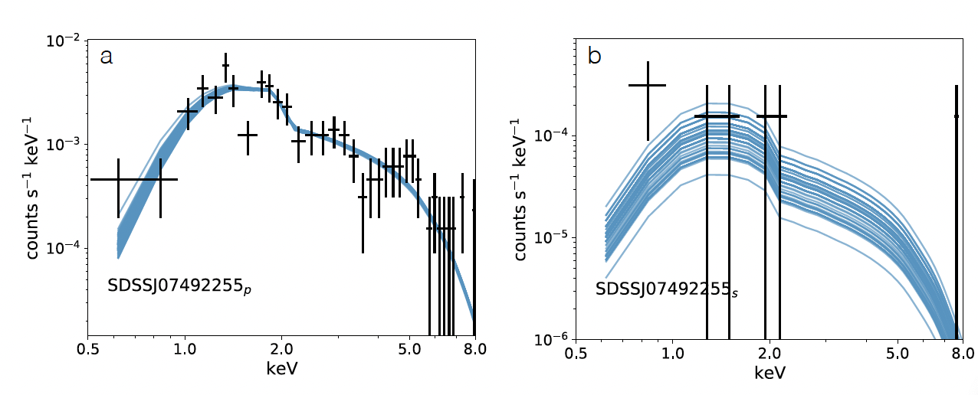
Multi-wavelength study (Chen et al. 2023)
Barely detect the host galaxy
Hubble → indirect evidence of host galaxy
Gemini/GMOS+GNIRS
Keck AO – unable to detect host galaxy
VLBA: imaging
Chandra
SDSS + Gaia selected
Detection of 2 distinct quasars

Slide 11
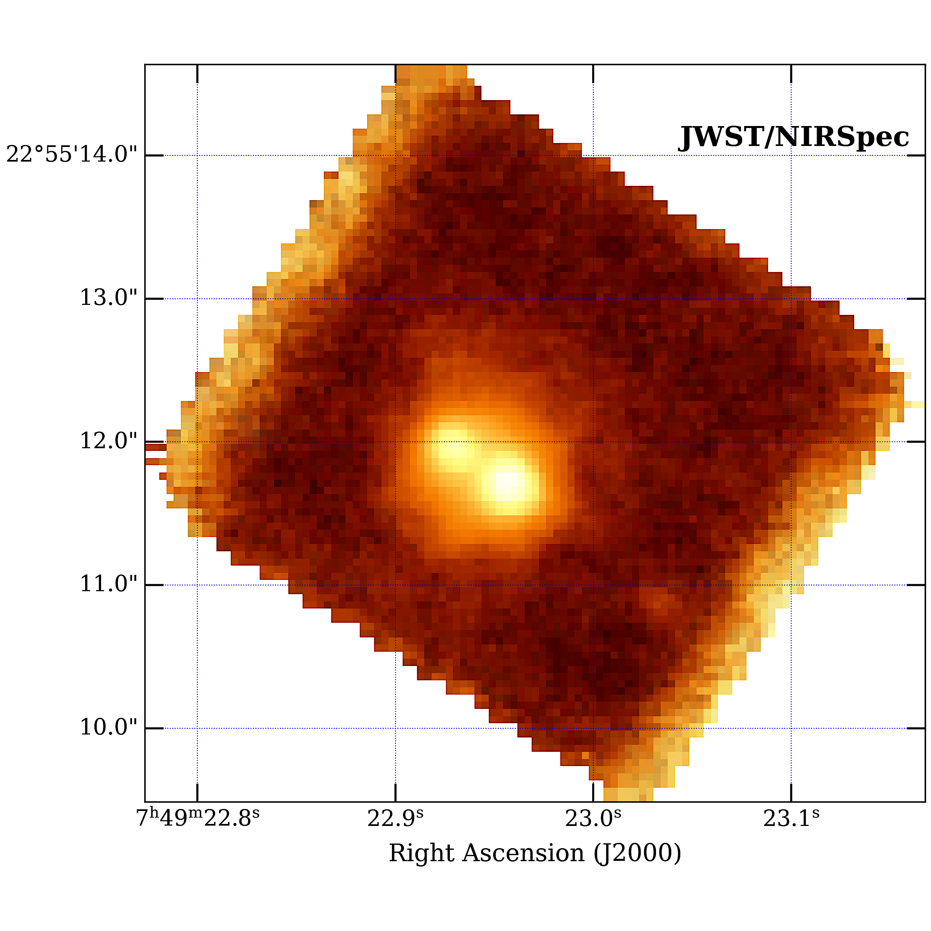
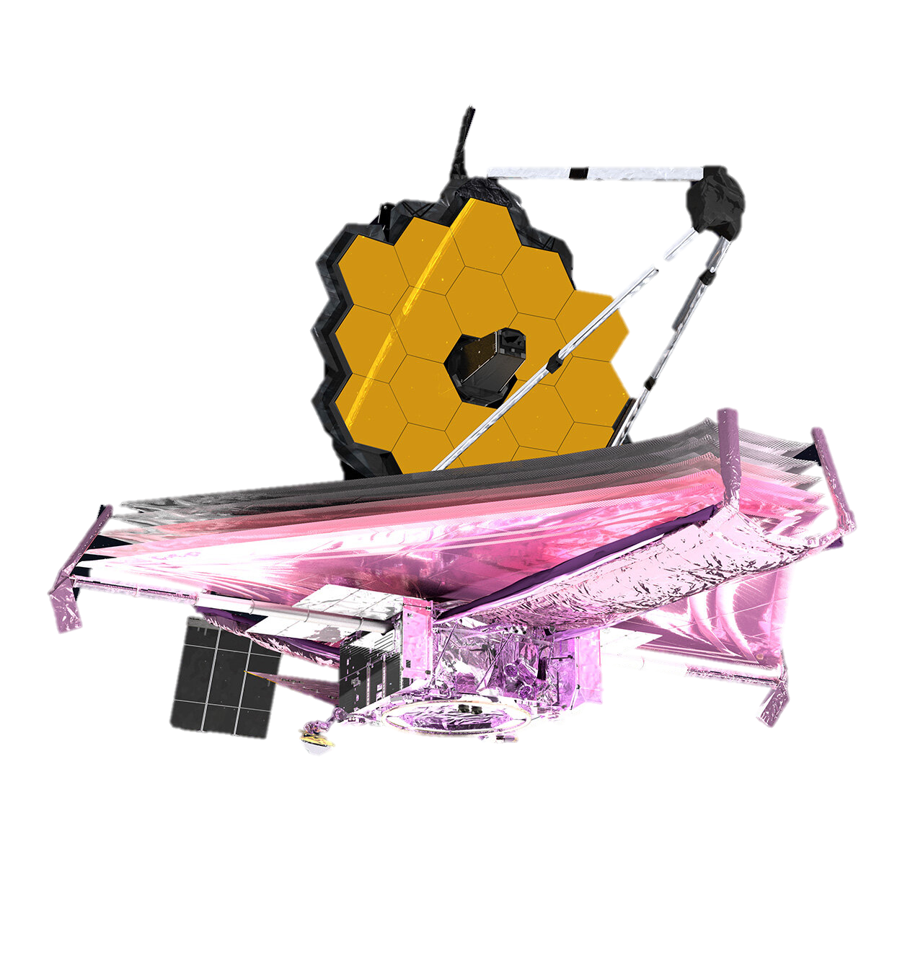
JWST GO 2654
$$z\sim 2$$
SDSS
Quasars resolved with Hubble
$$z\sim 3$$
Quasars & Host resolved with JWST
NIRSpec & MIRI IFS

Slide 12
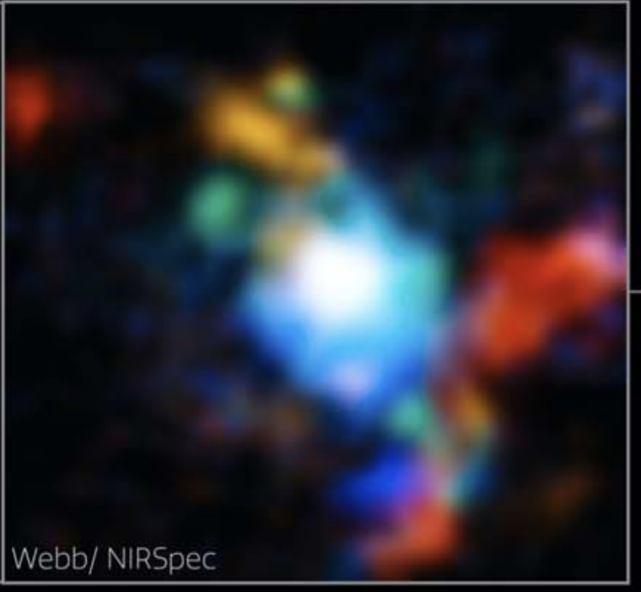
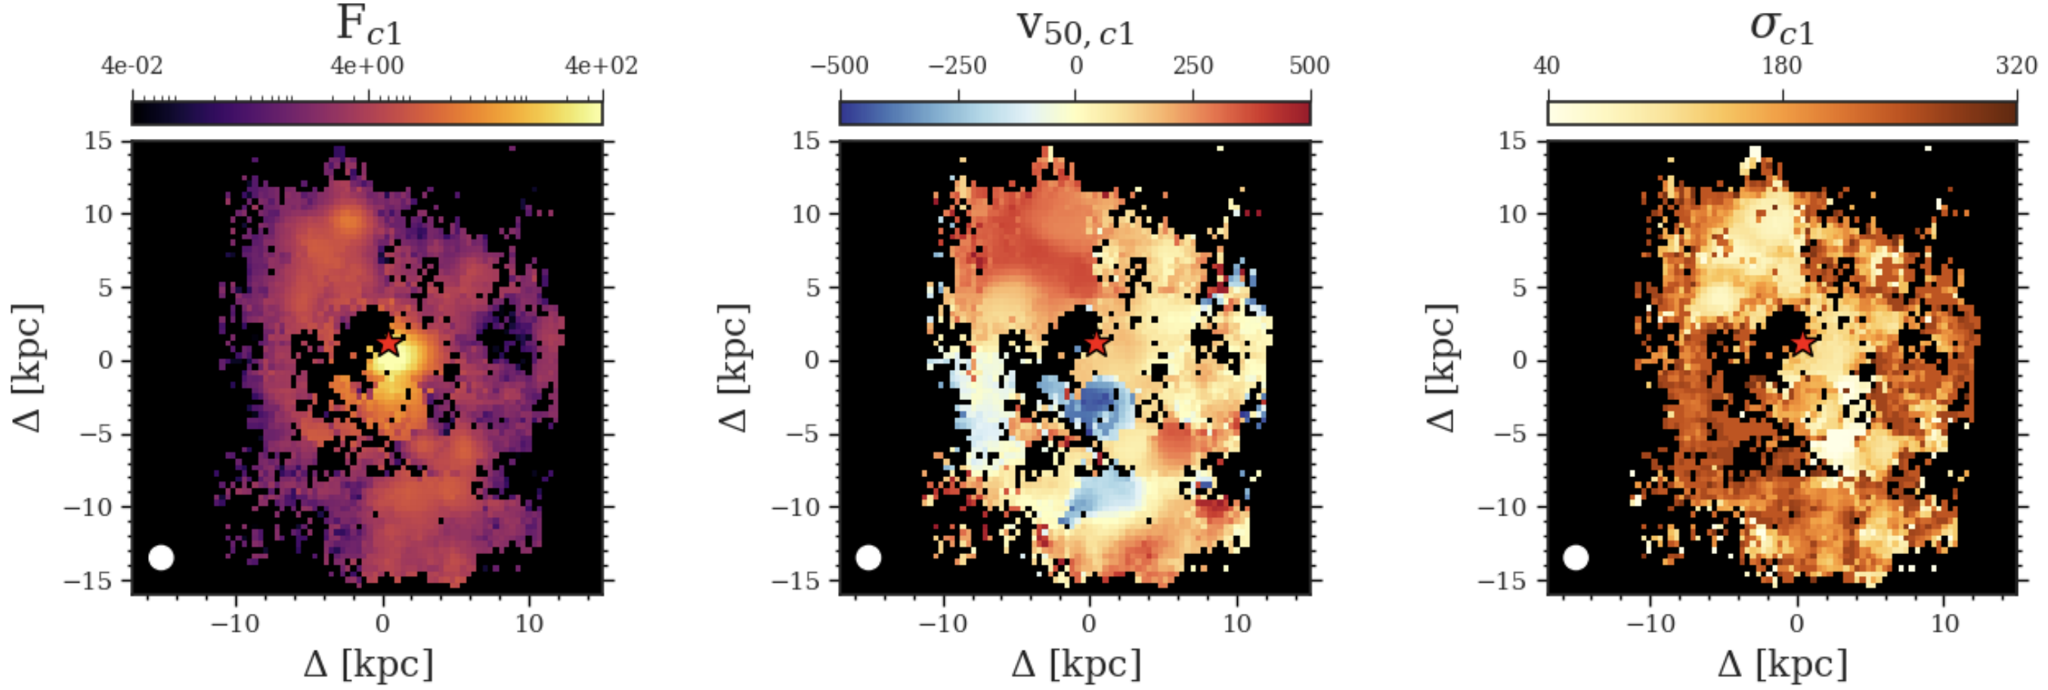
Extracting the host galaxy
Q3Dfit: Quasar PSF-spectral decomposition with IFS
[O III] in $z\sim 3$ quasar
Observe Quasar + Galaxy
Remove Quasar PSF
Extract the faint host galaxy
JWST ERS-1335 (Q3D)
JWST NIRSpec
Wylezalek et al. (2022)
Vayner et al. (2023)

Slide 13
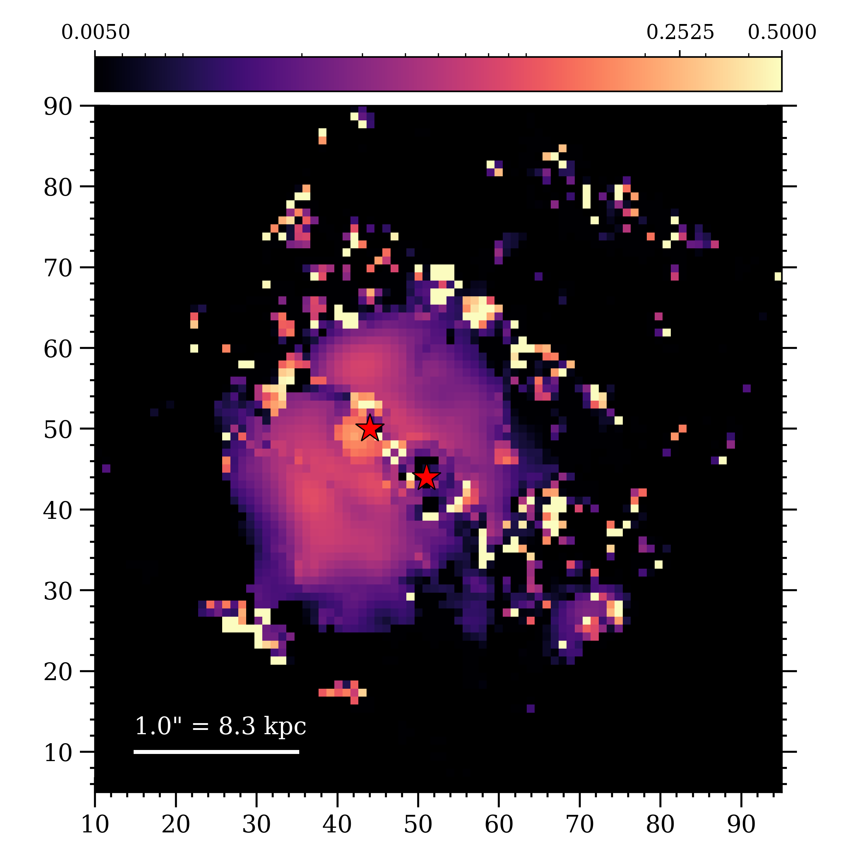
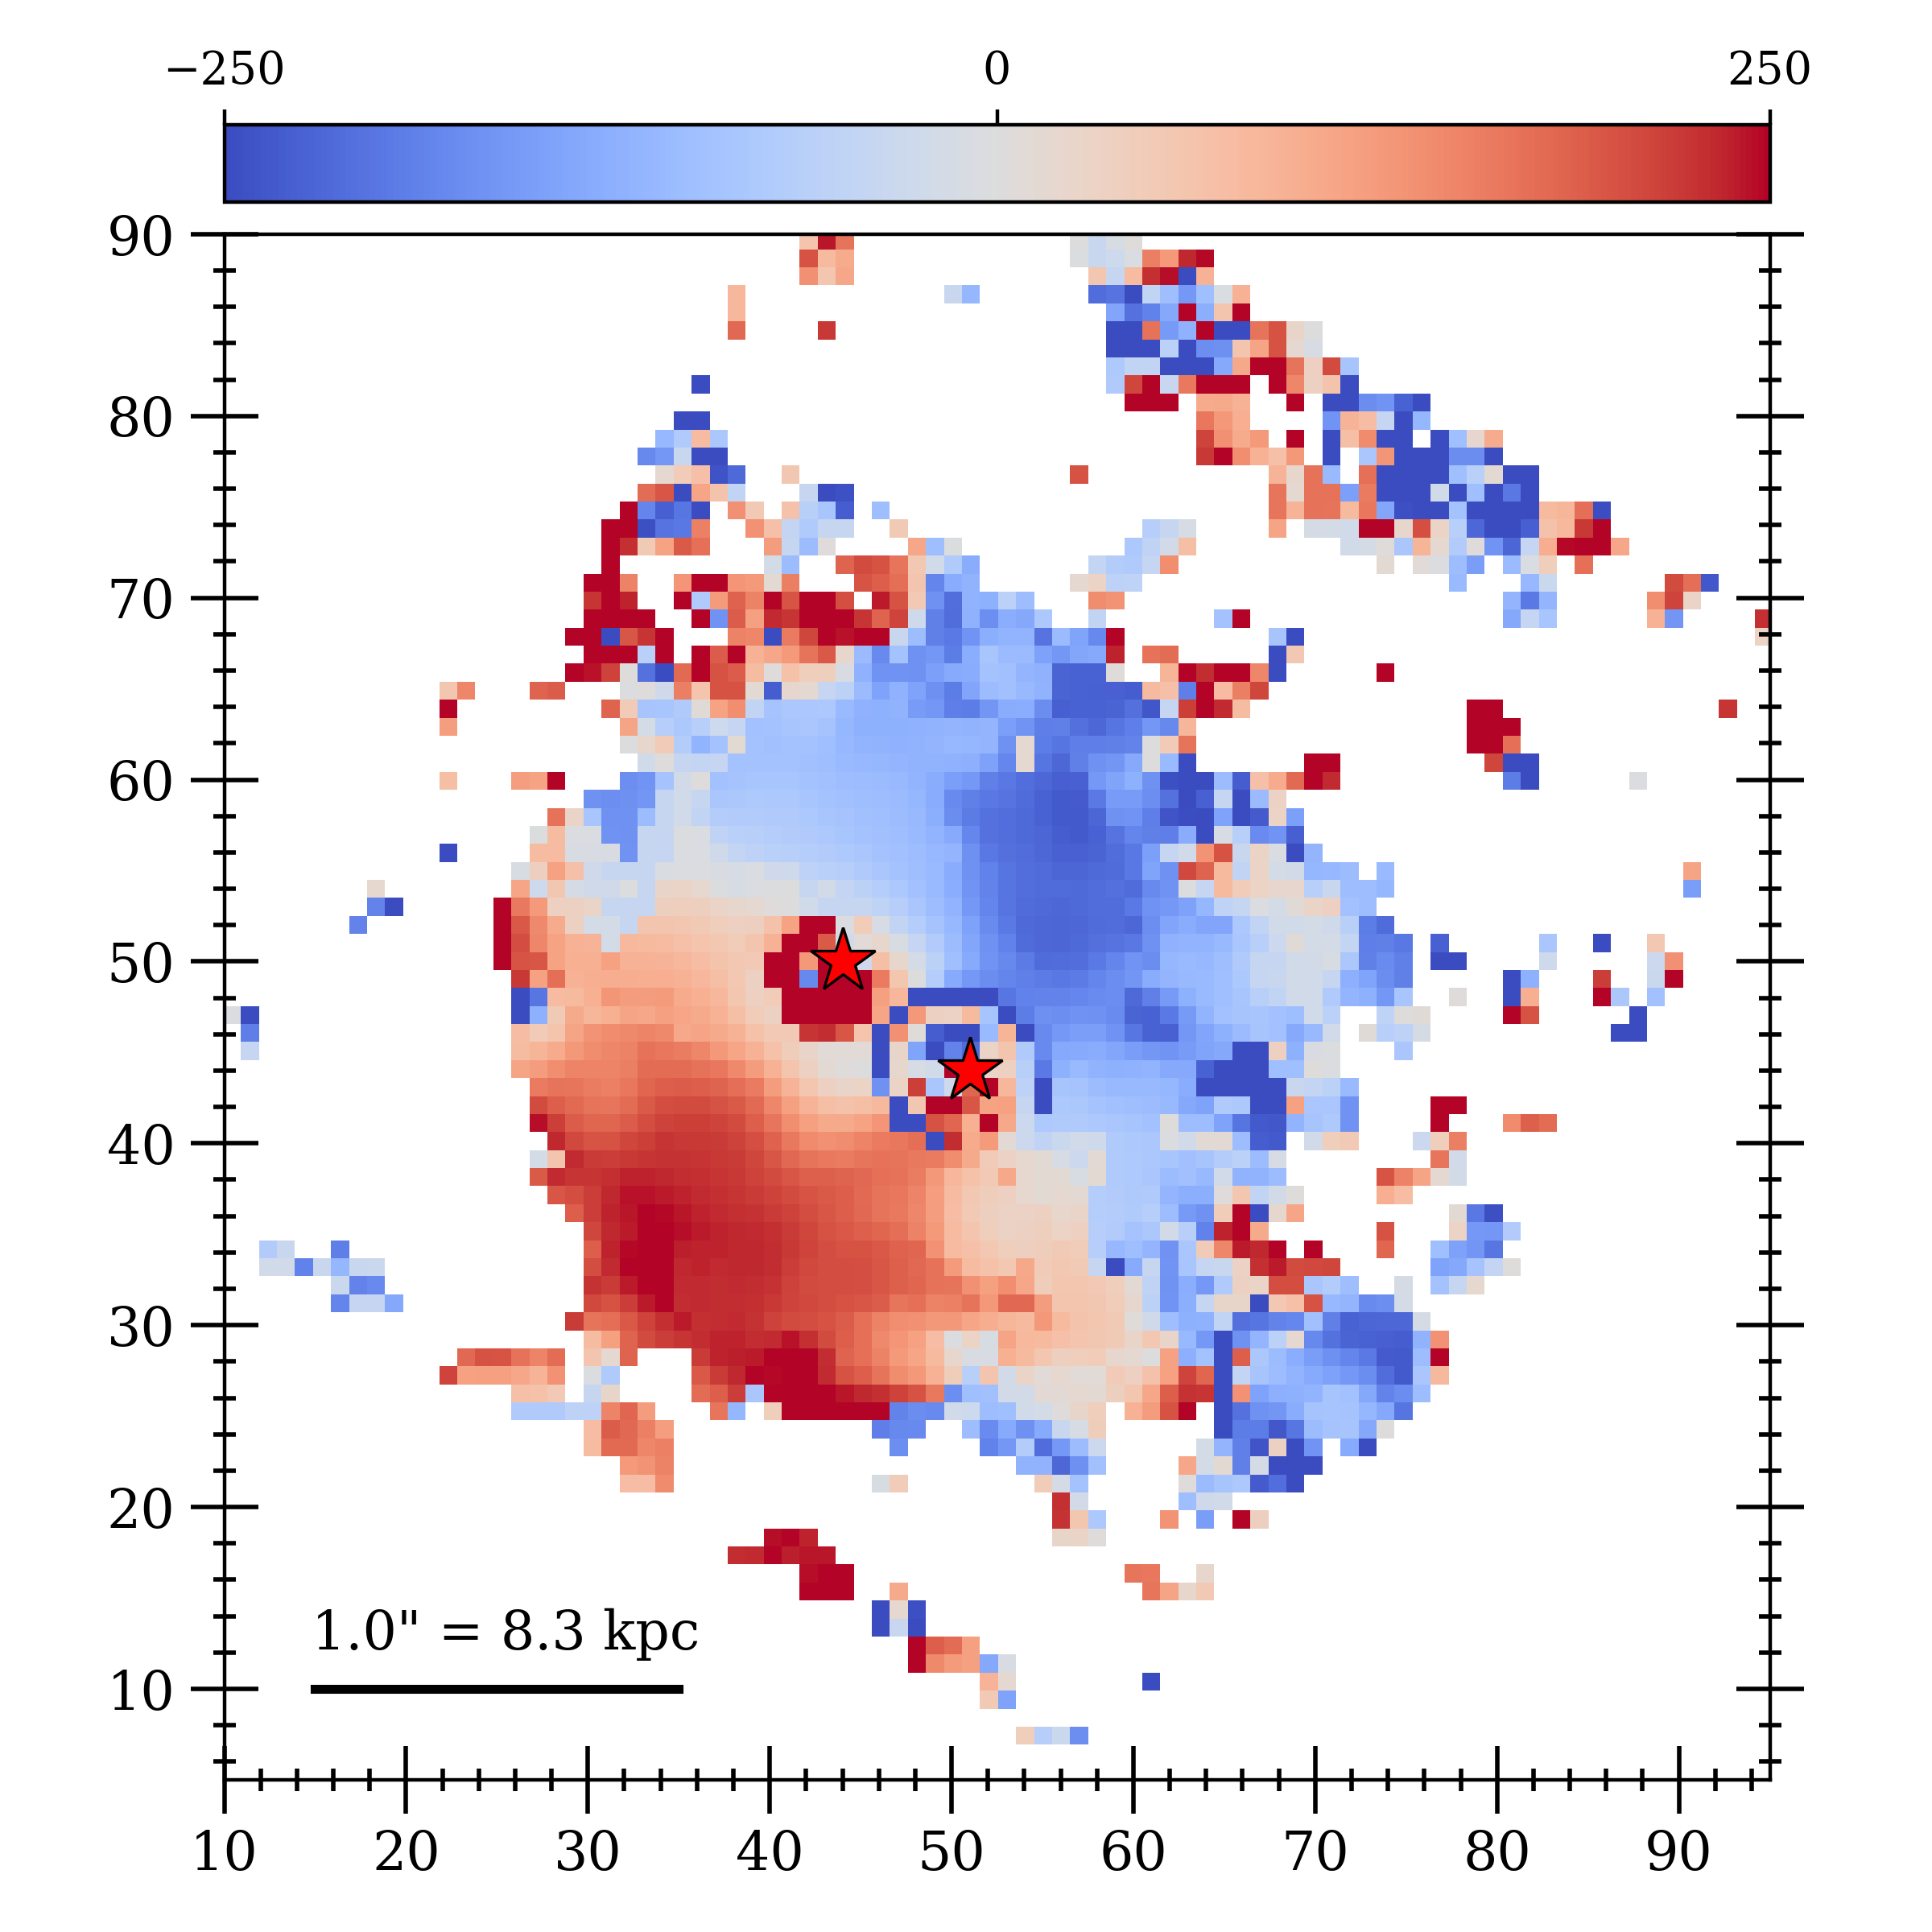
Quasar-subtracted, emission line analysis
Narrow Hα flux map
Narrow Hα velocity map
Large rotating disk??

Slide 14
Optical line ionization diagnostics
$\left[N II\right]/Hα$ vs. $\left[O III\right]/Hβ$
$\left[S II\right]/Hα$ vs. $\left[O III\right]/Hβ$
$\left[O I\right]/Hα$ vs. $\left[O III\right]/Hβ$

Slide 15
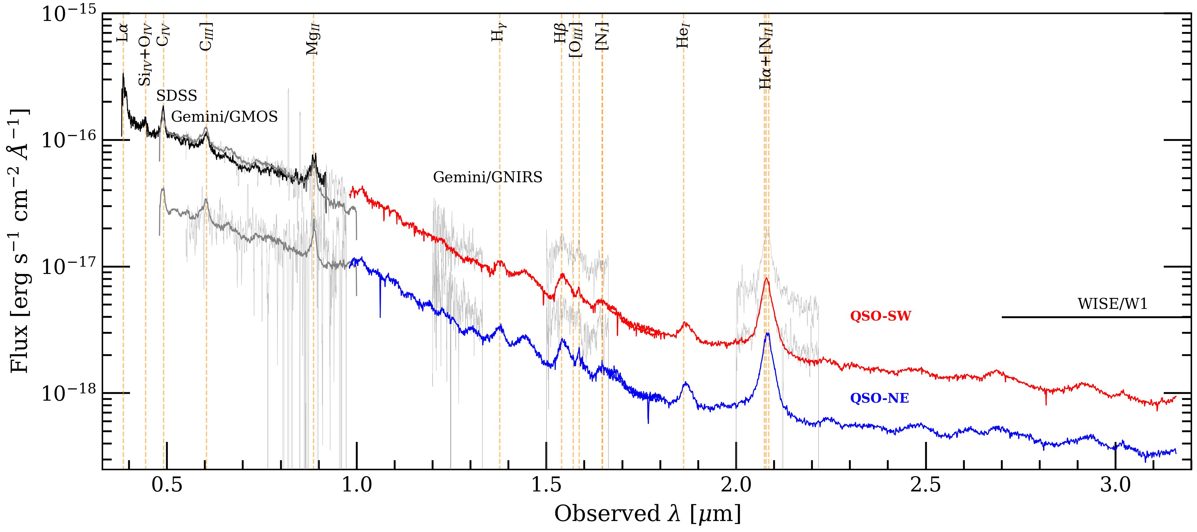
Mystery of two similar quasars
NE
SW
Twin/Symbiotic quasar accretion?
We see Velocity offsets of $\sim 200$km/s
Unlikely to be a lens

Slide 16
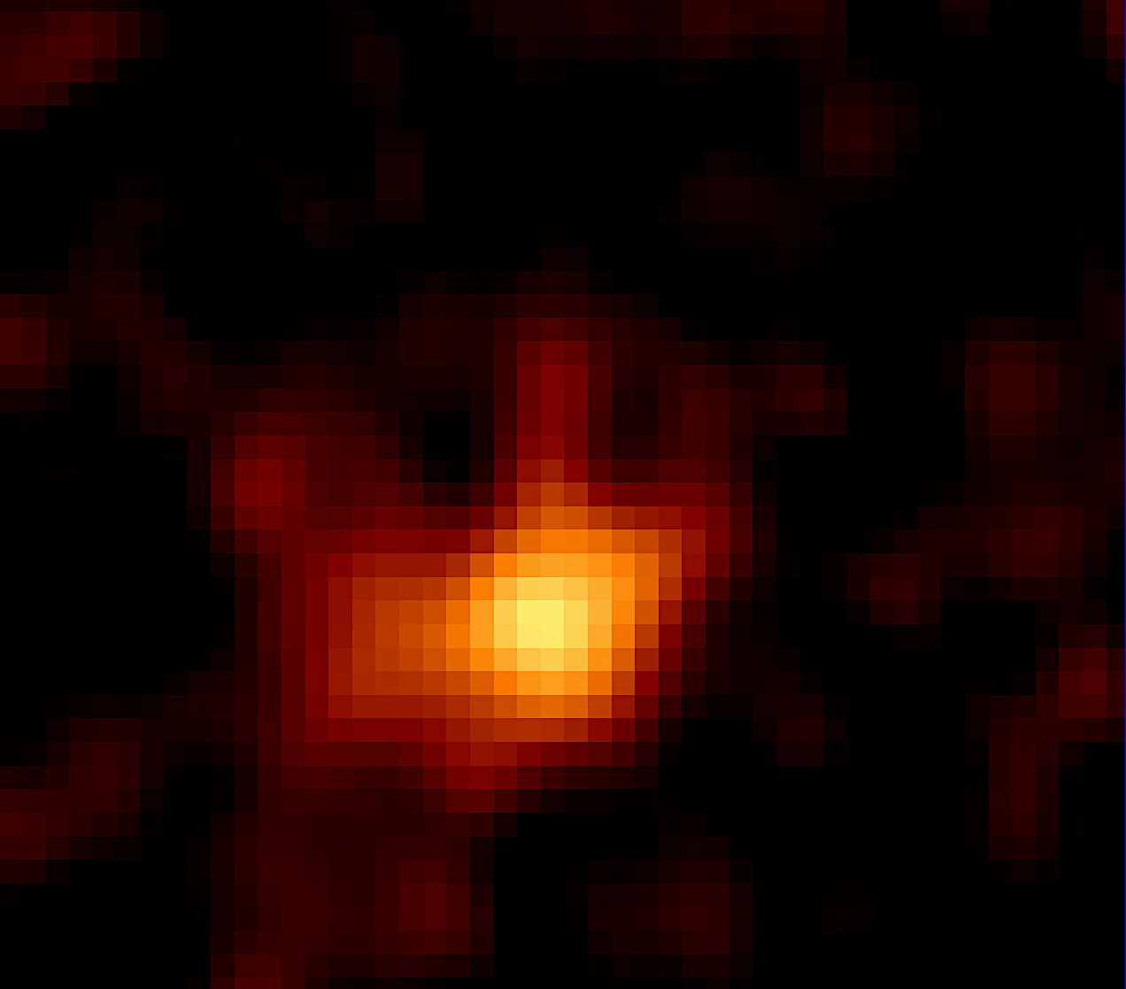
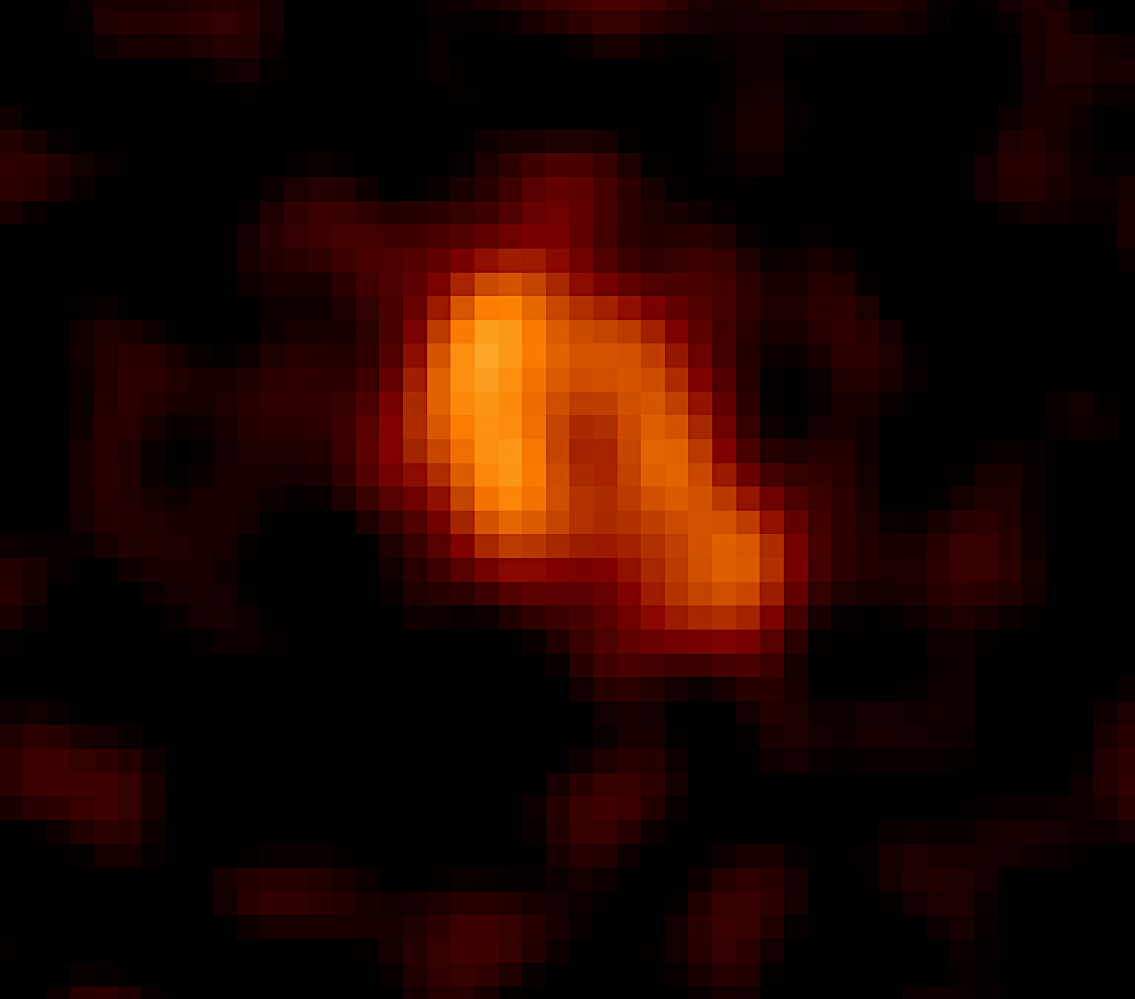
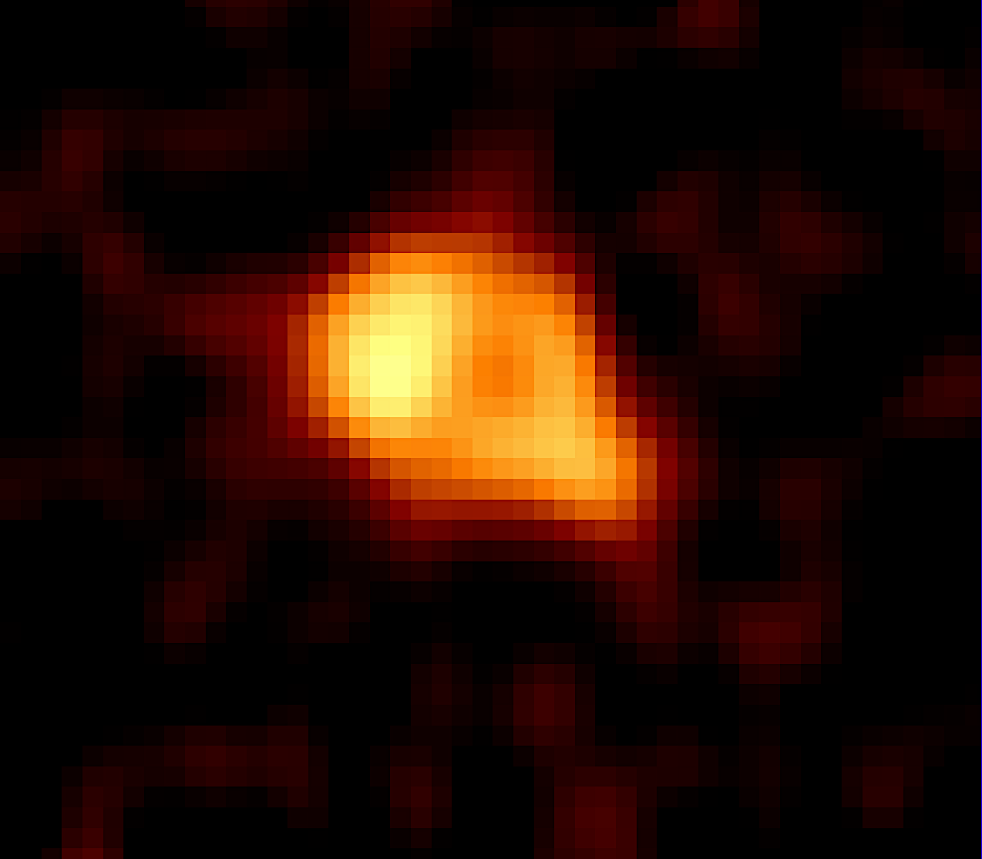
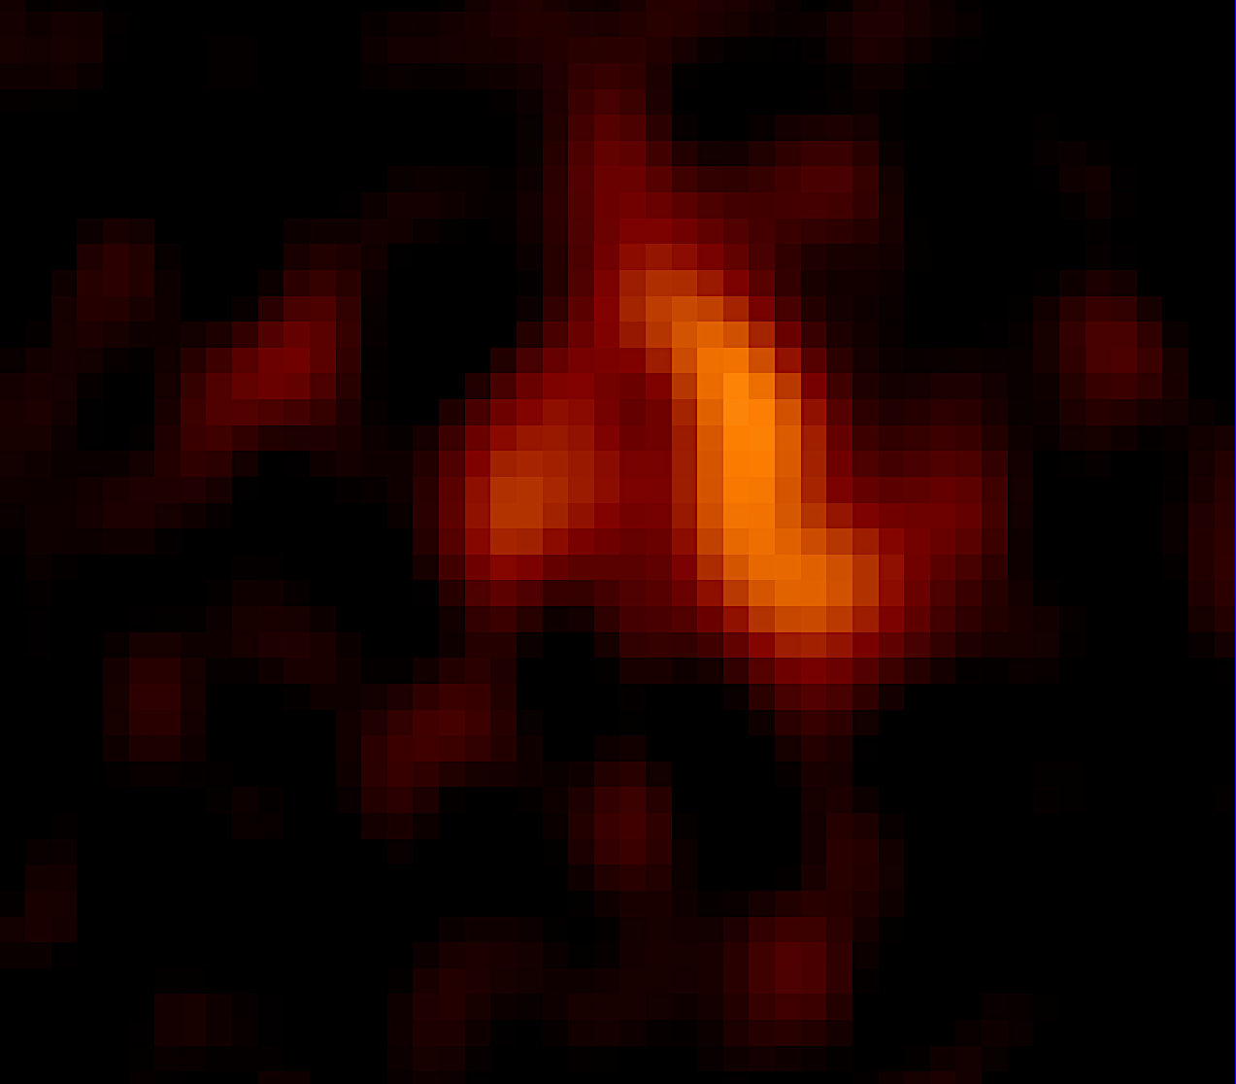
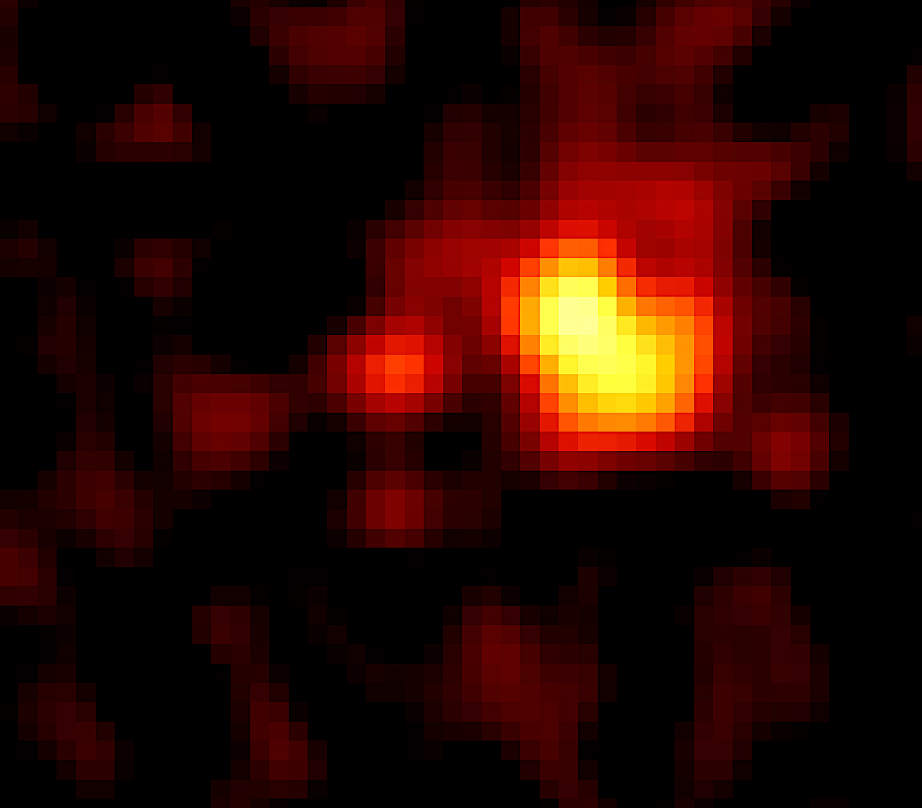
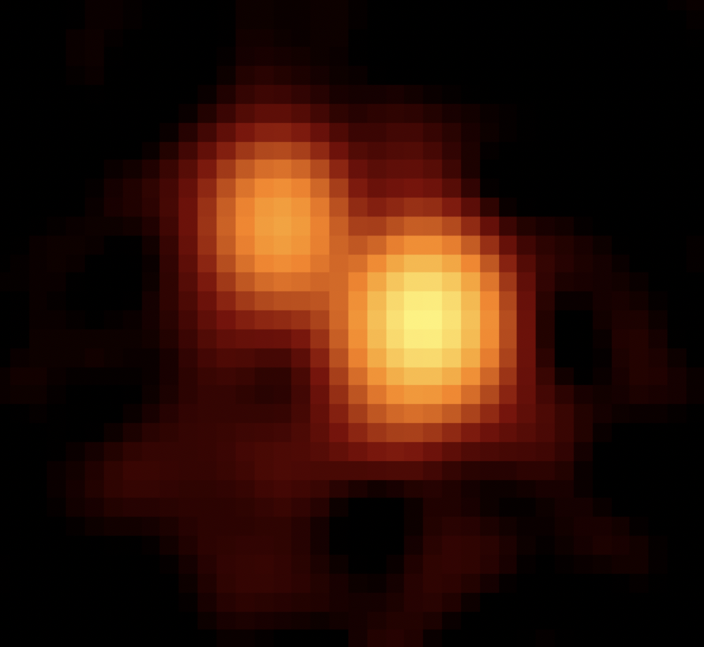
ALMA Cycle 9 – zoom in to the quasars
Continuum image
Complex CO(4-3) emission
Moment 1 Velocity map

Slide 17
How can ELTs address dual quasar science?
The challenges
Candidates require expensive, multi-wavelength follow ups
Confusion with gravitational lensing
High redshift populations still unexplored
We need:
High angular resolution spectroscopy to detect differences between quasars
Ability to detect the host galaxies
A way to confirm the dual-quasar nature from the ground before JWS/ALMA observations

Slide 18
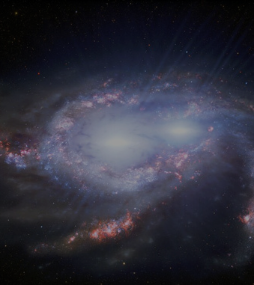
Summary
Vastrometry efficiently identifies dual quasar candidates
Confirmation a complex host galaxy merger with JWST IFS
Complex molecular gas detected with ALMA
J0749+2255 → two quasars with similar accretion properties
Lens vs dual quasar identification is complicated

