Slide 1
WFI 2033-4723:
the first JWST
quad model
devon williams
ELTs in light of JWST 2023
Notes:
fit convergence gif?
new verde plot
animations: perturbers? top-down visual

Slide 2
outline
motivation: Hubble tension
quadruply-imaged quasars
WFI 2033-4723
HST & JWST results
future
implications for TMT
Notes:
try to convince you to care about quads

Slide 3
who cares?
Notes:
motivation for why we care

Slide 4
who cares?
H₀
Notes:
The current expansion rate of the Universe is a fundamental quantity in cosmology.
represented by the Hubble constant,
it is the tool that allows for the conversion of recession velocities (easily measured via redshifts) to
distances: distances being infamously difficult to measure

Slide 5
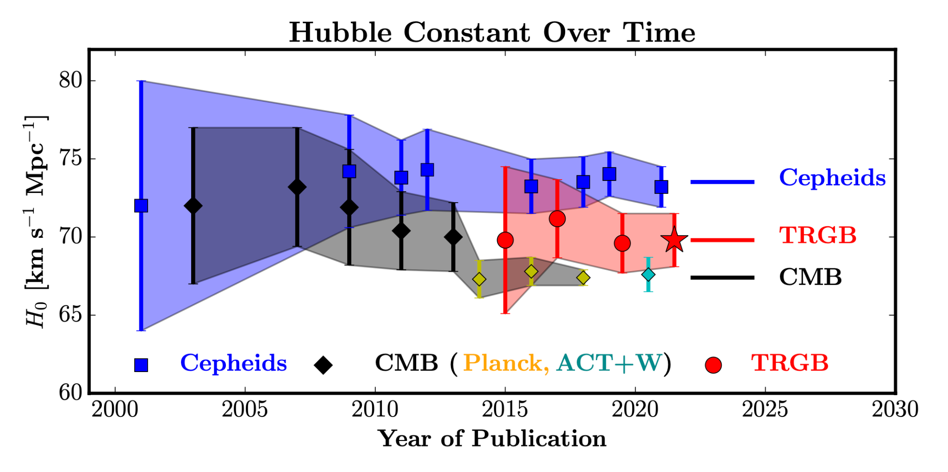
who cares?
Verde et al. 2023
Notes:
summary of the evolution of the Hubble constant constraints over the past two decades
initially two methods were developed: early and late measurements
agreement: “one of the triumphs of the standard model of cosmology”
all changed around 2013

Slide 6
who cares?
Verde et al. 2023
Notes:
after 2013 when the new Planck data came in, the mismatch became increasingly apparent
to the point that the term “Hubble tension” was coined

Slide 7
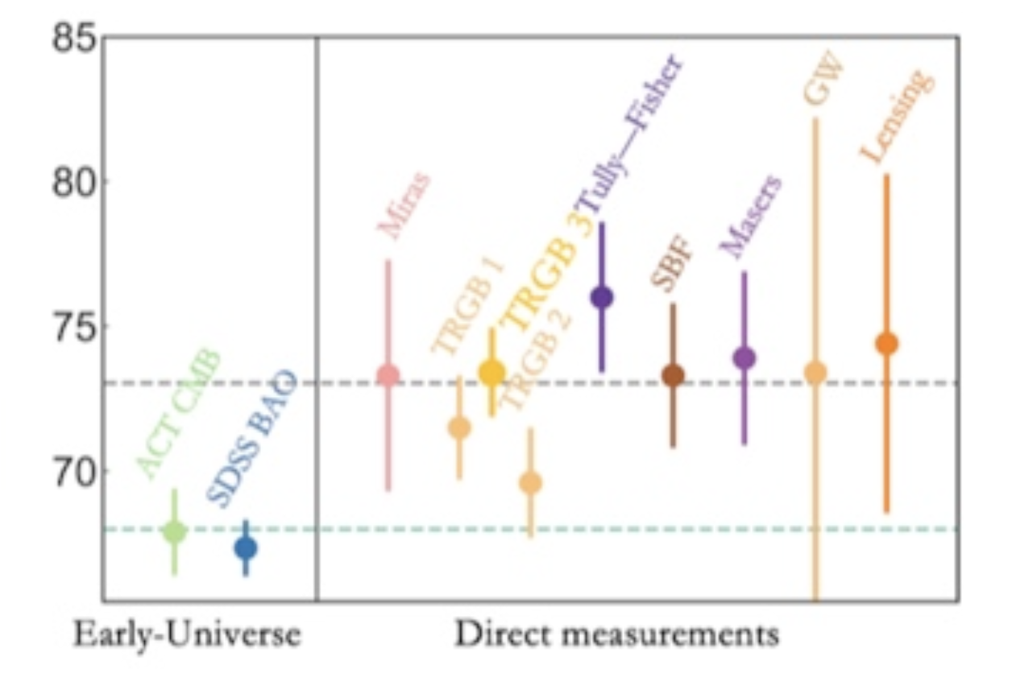
who cares?
Verde et al. 2023
Notes:
tension still remains 10 years later, explanation based on very simple systematic errors would likely have emerged
at the moment, the tightest late-universe measurements use a “distance ladder”
uses objects of known brightness -> standard candles, or known size -> standard rulers
build up a meter stick to measure out to cosmological distances
each of these relies on several assumptions and is potentially affected by unknown systematic errors
e.g. underlying assumption that faraway objects behave like nearby ones, pretty hefty assumption
if the Hubble tension represents a symptom of a systemic failure of the standard cosmological model,
profound implications for our understanding of cosmology
crucial to develop new, independent, measurements -> lensing

Slide 8
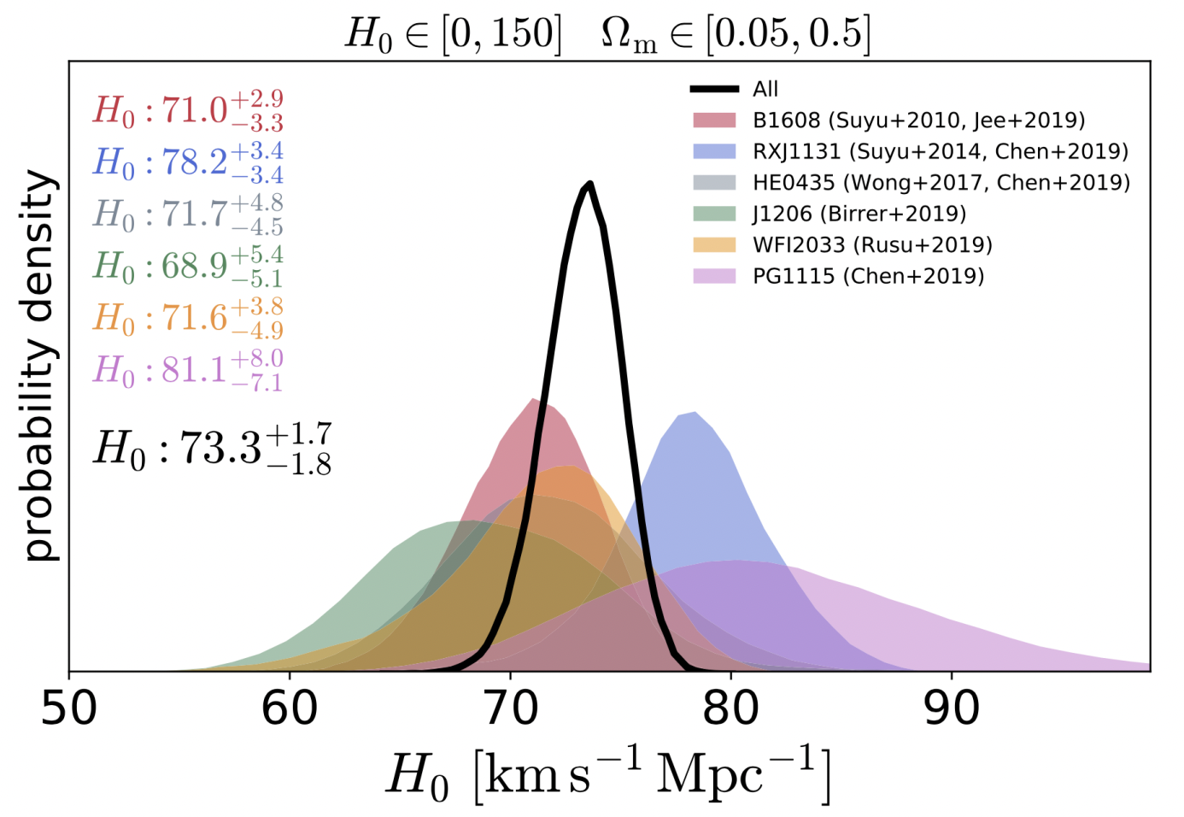
who cares?
Treu, Suyu and Marshall 2020
Notes:
compared to other late-universe measurements, lensing is a completely independent, one-step measurement of H_0
(also has a comparatively very weak dependence on other cosmological parameters)
our goal for lensing is passing the threshold of <2% error -> separate early & late results
1% w/ 40 lensed quasars, or 20 lensed SNe
each of these objects (save 1) is a quadruply-imaged quasar, which is the focus on my talk

Slide 9
multiply-imaged
quasars

Slide 10
multiply-imaged
quasars
image
source
quasar
(cannot see)
lens
galaxy
image
Notes:
(quick explanation)
(if our source is variable -> time delay, with some math and some modeling can get time delay distance -> H_0!)

Slide 11
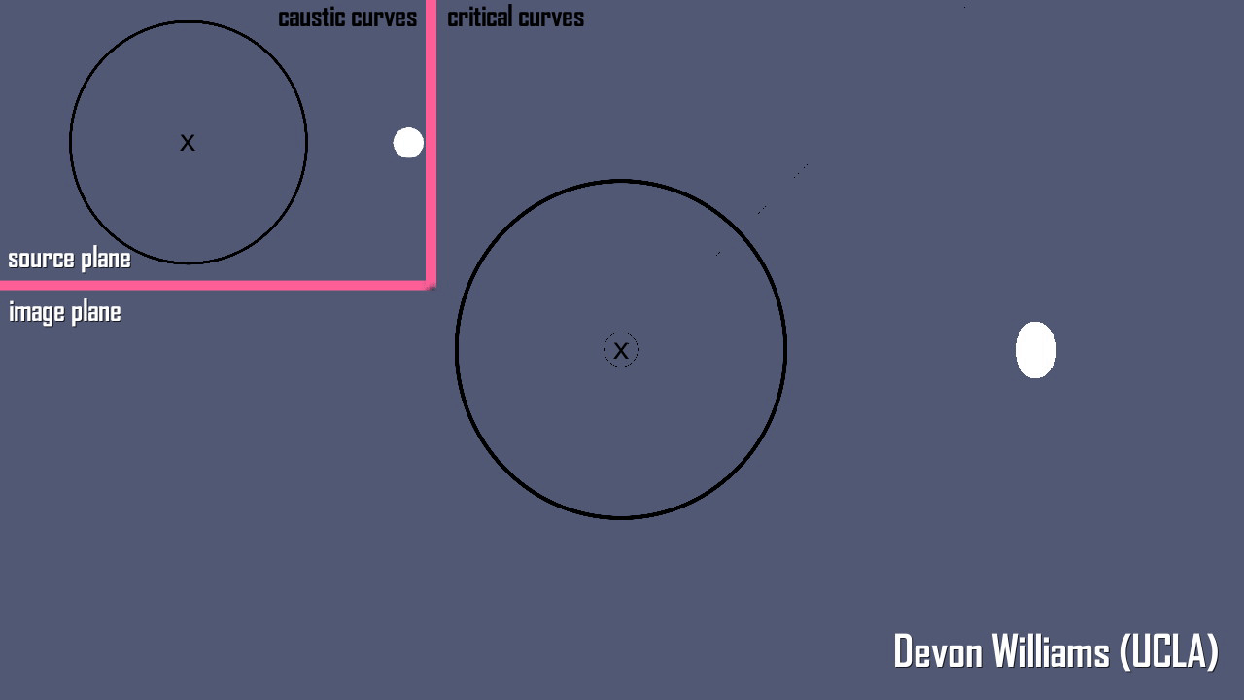
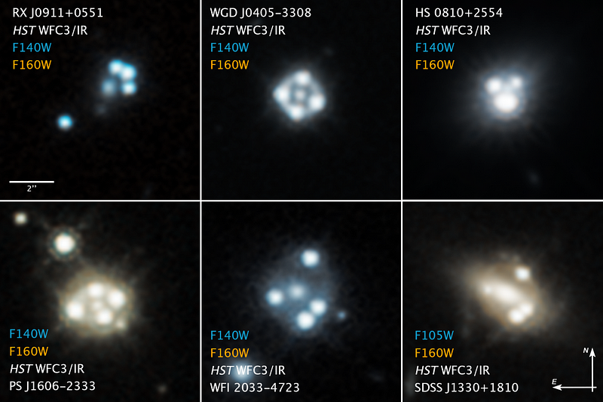
multiply-imaged
quasars
A. Nierenberg, D. Gilman, T. Treu
Notes:
whole point of my research: what information can we glean from these systems based solely on these images?
turns out to be quite a lot…

Slide 12
why quads?
time-delay cosmography:
Hubble tension -> 3 independent H₀ measurements
Notes:
if doubles exist, why use quadruply imaged quasars (if they are more rare?)
quads are extremely valuable for time-delay cosmography
3 ind meas. of H_0 for EACH mass model -> really drop our uncertainties
help tighten constraints on hubble tension for new cosmological models that may be proposed

Slide 13
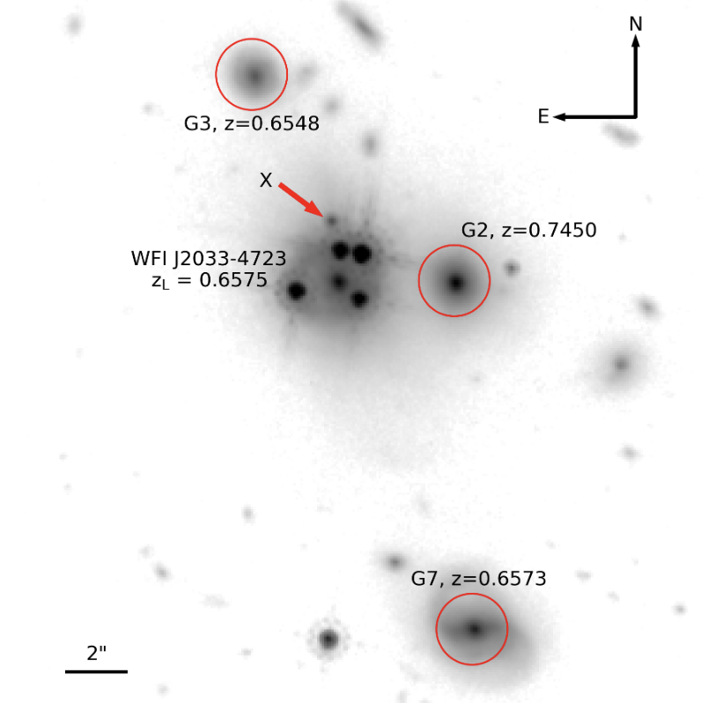
HST: WFI 2033-4723
C. Rusu et al. 2019
Notes:
environment of 2033: a few other galaxies we have to take into account in the analysis, due to them being close to the lensing system
discovered 2004 Morgan et al., monitored for 14 years
Wide Field Camera 3 (WFC3) F160W
(ACS) F814W

Slide 14
HST: WFI 2033-4723
environment: complex
psf: doable (HST, JWST: oh boy)
ring detail: ???
C. Rusu et al. 2019
Notes:
modeling notes:
1) environment: quite difficult, perturbers require significant amount of work to accurately model (for cosmography-grade uncertainties)
G2 behind deflector, makes things spicy
G3 and G7 may have a non-negligible higher-order influence (still looking into this)
2) psf is extremely important due to the next point
3) most important detail, mapping deflector mass to fit 4 points, great, but fitting a full ring gives fantastic radial mass constraints
extent/thickness of this ring is also extremely important for finding how the density changes with radius(?)

Slide 15
HST: WFI 2033-4723
C. Rusu et al. 2019
Notes:
most important detail, mapping deflector mass to fit 4 points, great, but fitting a ring gives every single pixel in that ring
extent/thickness of this ring is also extremely important for finding how the density changes with radius(?)

Slide 16
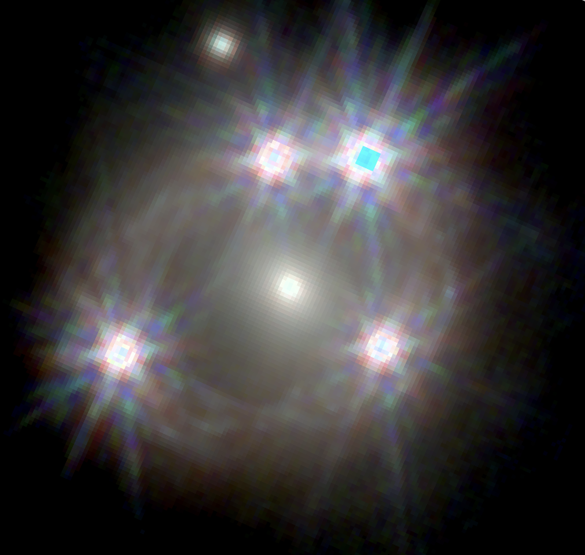
HST vs JWST: WFI 2033-4723
C. Rusu et al. 2019
GTO: Massimo Stiavelli
NIRCam: F115W, F150W, F277W
D. M. Williams et al. (in prep)
Notes:
thanks to massimo stiavelli’s GTO program

Slide 17
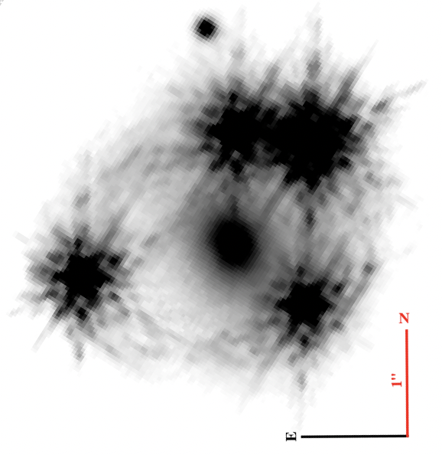
HST vs JWST: WFI 2033-4723
GTO: Massimo Stiavelli
NIRCam: F115W
D. M. Williams et al. (in prep)
C. Rusu et al. 2019
Notes:
just working with the 115 band for now, but this band really makes out the ring detail
want to see the effect JWST imaging has on our modeling precision
one of the biggest changes (other than image resolution, which is fantastic) is the psf
with JWST: more complicated than ever before for lens modeling
one of the tools we use to deal with this is iterative reconstructions during fitting

Slide 18
PSF reconstruction
initial fit from field stars
iteratively reconstruct from quasar images
D. M. Williams et al. (in prep)
Notes:
iterative psf reconstruction:
find a set of stars to get an initial guess
during the modeling process we will update the psf fit based on the quasar images (bright PSFs directly in our data)
pretty good fit, but not the best
back to this later

Slide 19
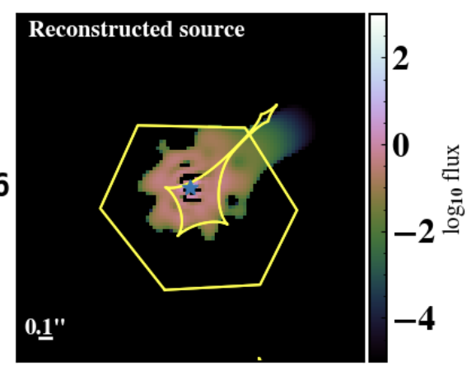
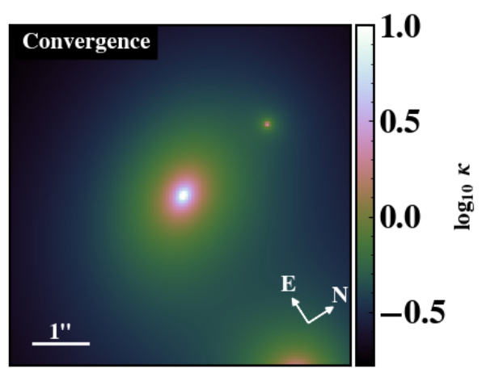
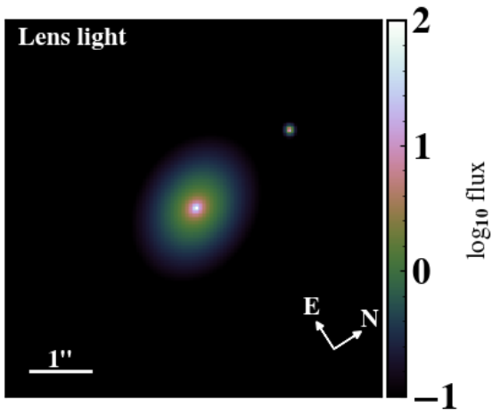
modeling process
light distribution of extended source
lens mass distribution
light of AGN
light of lens (sersic)
D. M. Williams et al. (in prep)

Slide 20
parameterizations:
GLEE (Suyu & Halkola 2010) vs Lenstronomy (Birrer 2019)
component | HST C. Rusu et al. 2019 | JWST D. M. Williams et al. (in prep)
lens mass | SPEMD + shear | SPEMD + shear
lens light | 2 sersics | 2 sersics
source | 50x50 pixel grid | sersic + shapelets
satellite | SIS | SIS + sersic light
perturber | SIE | SIE
D. M. Williams et al. (in prep)
Notes:
different lens modeling software was used, so a direct 1-1 comparison isn’t entirely possible
but we can try to get as close to a fair comparison as possible

Slide 21
reconstruction of images
D. M. Williams et al. (in prep)

Slide 22
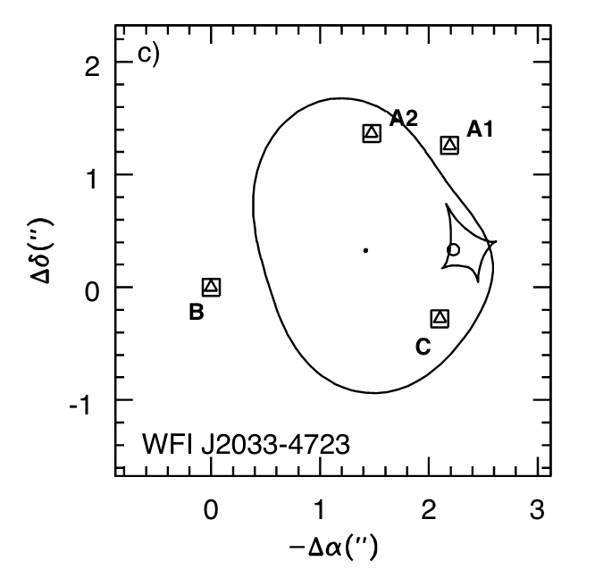
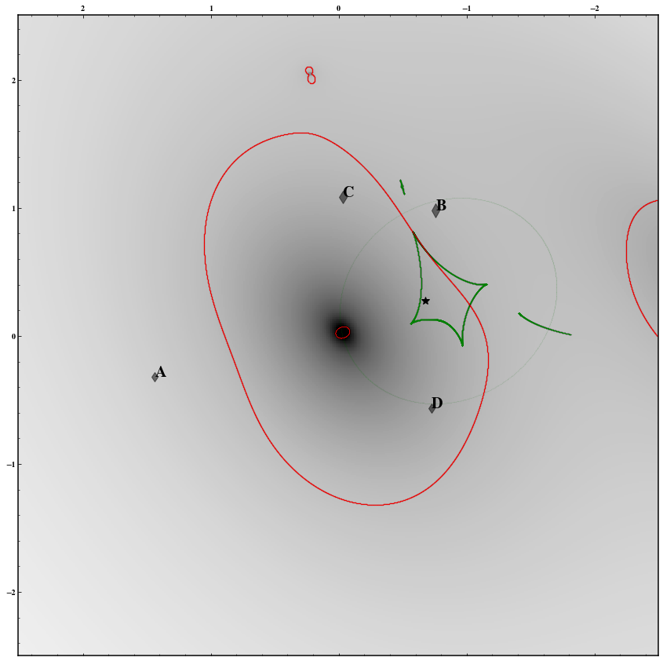
magnification map
Morgan et al. 2004
D. M. Williams et al. (in prep)
Notes:
agree pretty well, jelly bean with a glistening star on it
bit more tomfoolery going on with the perturber than previously expected
particularly, since this model we have gotten much more certain redshift measurements for objects in the field

Slide 23
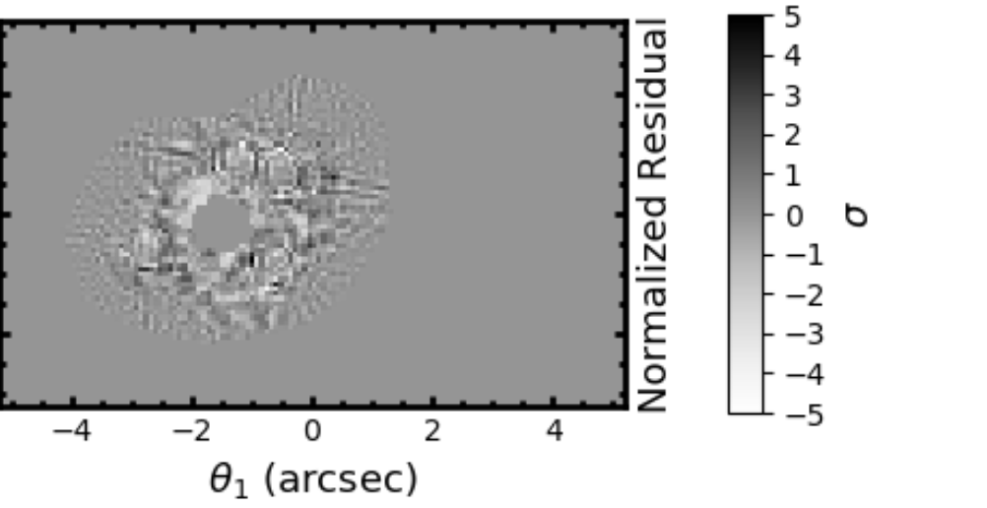
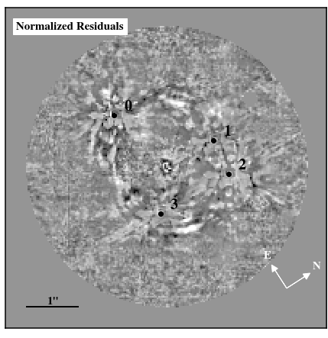
HST vs JWST residuals
HST: WFC3/F160W
C. Rusu et al. 2019
JWST: NIRCam F115W
D. M. Williams et al. (in prep)
Notes:
really highlights the amount of detail

Slide 24
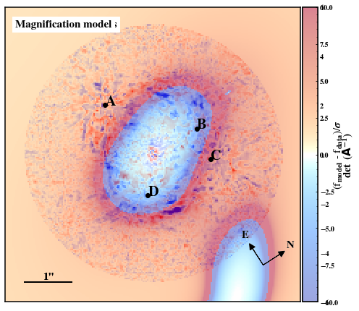
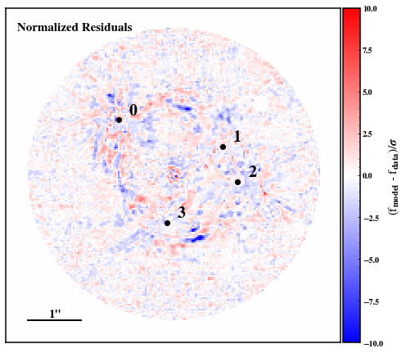
new source?
D. M. Williams et al. (in prep)
Notes:
check the location on critical curves to see if this is a reasonable conclusion
looks like it could be a lensed object!

Slide 25
results
How much does JWST constrain modeling uncertainties for H_0?

Slide 26
results
D. Gilman et al. 2020
Notes:
breakdown of diff uncertainties for the multiply-imaged quasars used for H_0 inference

Slide 27
results
D. Gilman et al. 2020
Notes:
breakdown of H_0 uncertainties due to different components of the lens
fractional uncertainty of modeling is 2.2%

Slide 28
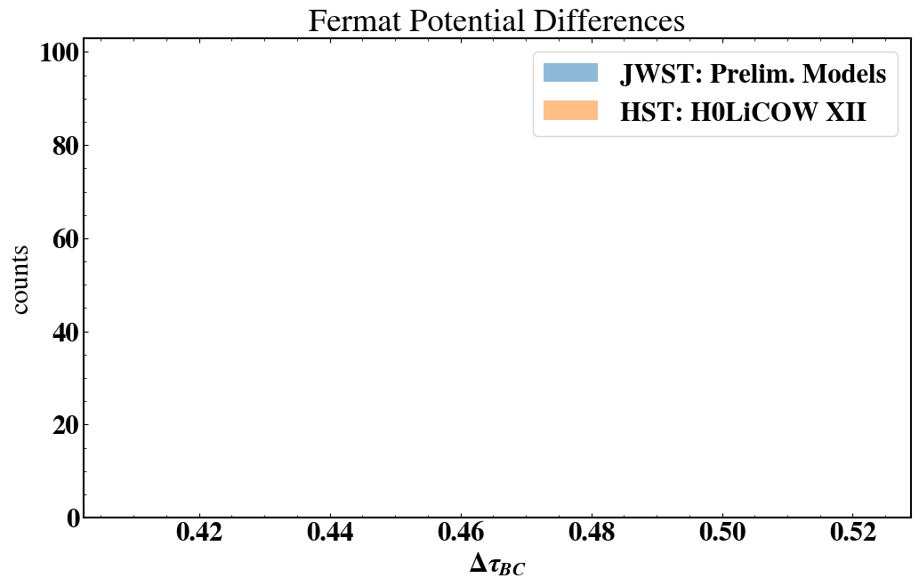
results
THE modeling parameter
D. M. Williams et al. (in prep)

Slide 29
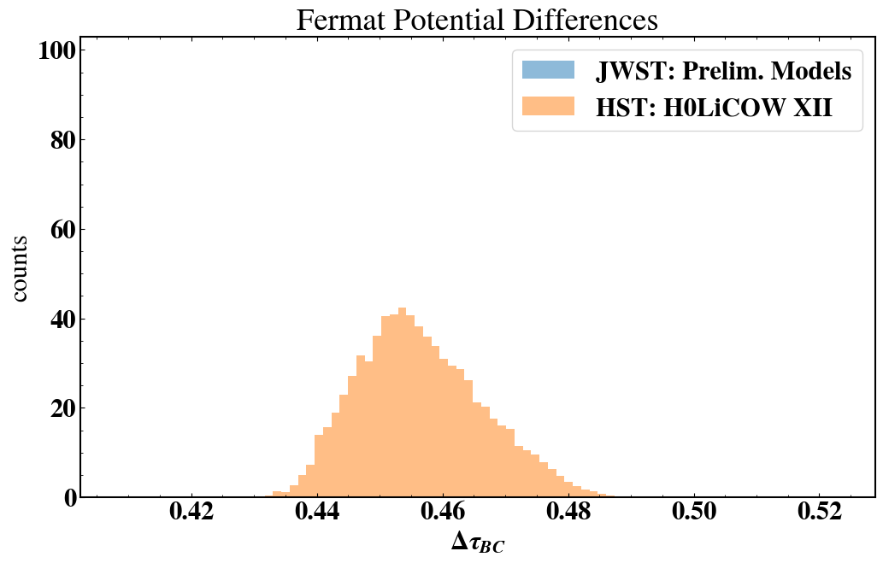
results
𝝈/𝛍 = 2.2%
D. Gilman et al. 2020
THE modeling parameter
D. M. Williams et al. (in prep)
Notes:
with jwst, significantly more pixels to constrain our models, how well does this do?
haven’t even shown tt yet lol

Slide 30
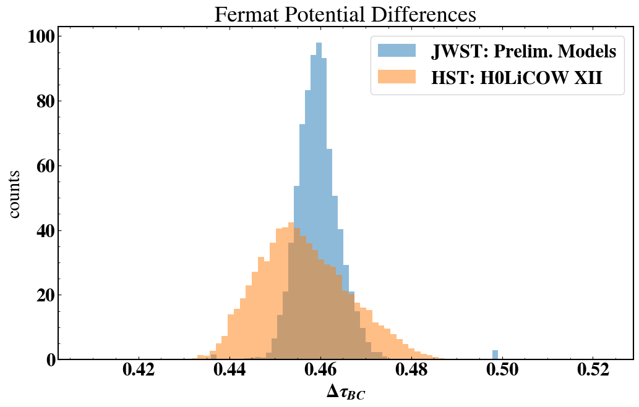
results
𝝈/𝛍 = 1.11%
𝝈/𝛍 = 2.2%
D. Gilman et al. 2020
D. M. Williams et al. (in prep)

Slide 31
results
𝝈/𝛍 = 1.11%
𝝈/𝛍 = 2.2%
50%
improvement
D. Gilman et al. 2020
D. M. Williams et al. (in prep)

Slide 32
new systematics: PSF

Slide 33
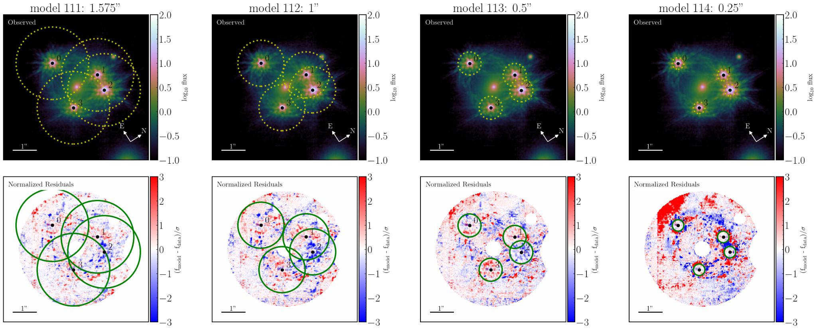
new systematics: PSF
give slightly different results!
D. M. Williams et al. (in prep)
Notes:
have to have a good understanding of what light is coming from the PSF and what light is from the external source
if your PSF model isn’t perfect, you are going to get massive residuals around the point sources
-> artificially increase the noise around the PS to account for our imperfect PS model
still something we are looking into
certainly not outweighing the benefits of JWST, but it is something to keep in mind when discussing potential instruments

Slide 34
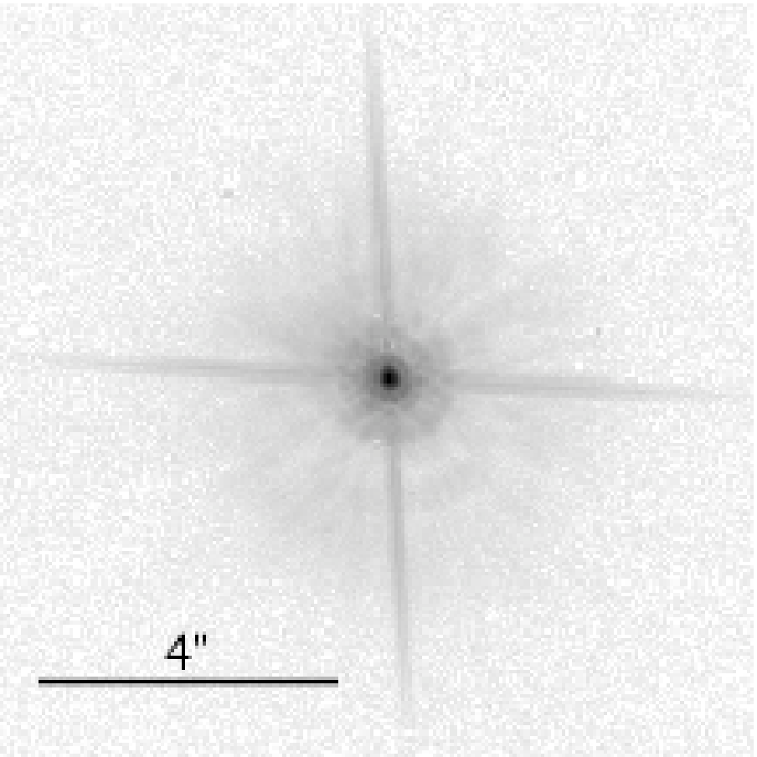
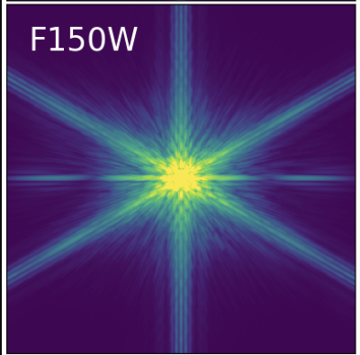
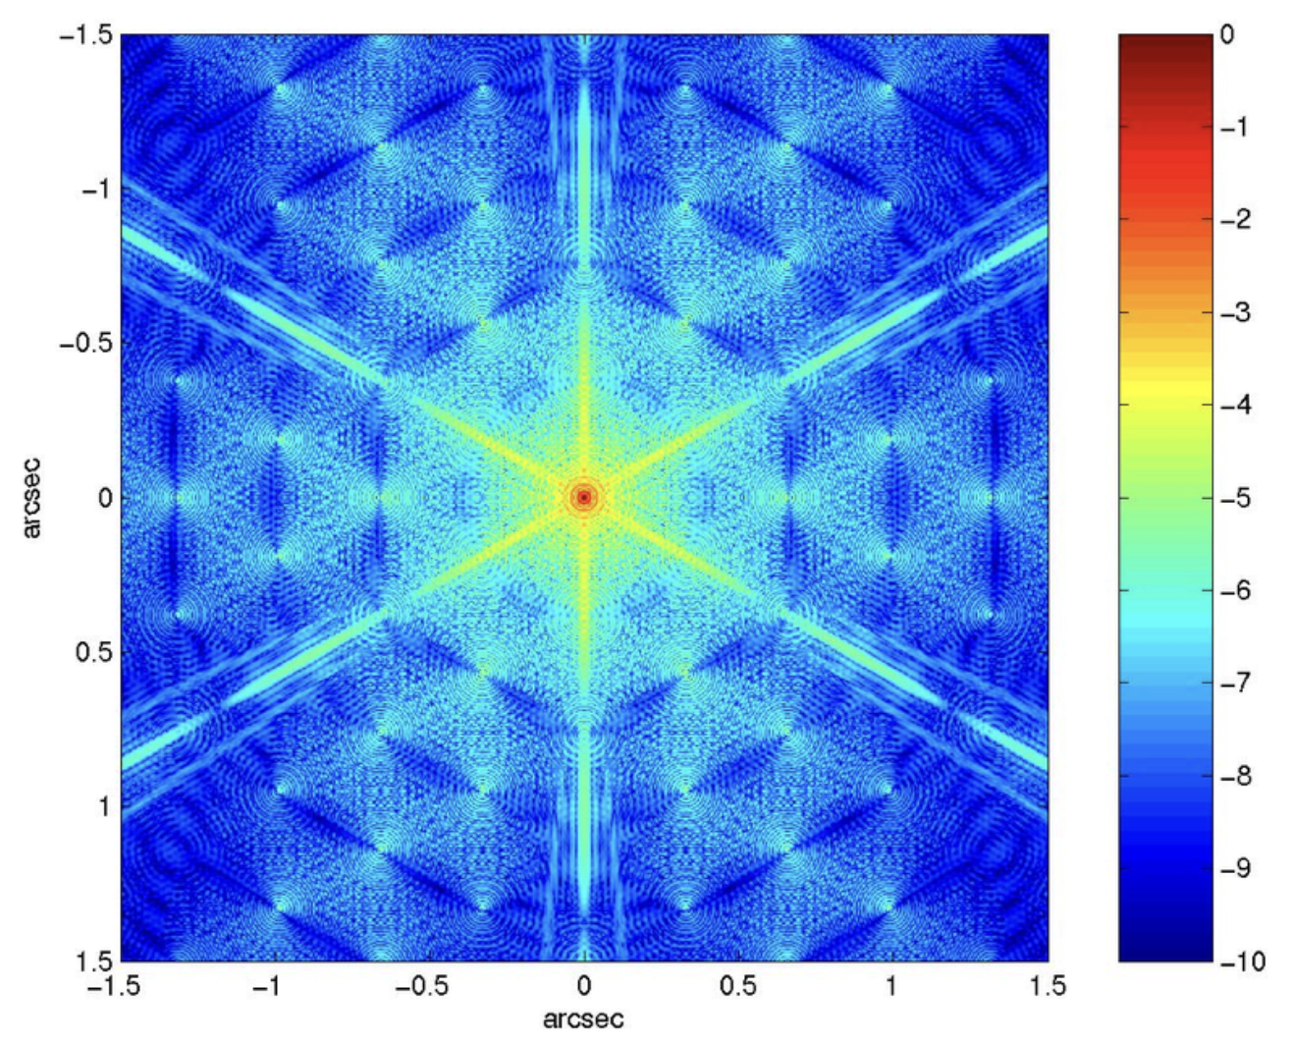
ELTs implications
PSF complexity
HST
JWST
???
B. Macintosh et al. 2006
Notes:
depends highly on what the final PSF looks like for the TMT

Slide 35
TMT implications
PSF complexity
data scale
number of pixels
30 mas vs 4 mas -> 60x the number of pixels
computational time is roughly linear
this lens already takes ~ a week on 36 cores
HST: half a day -> JWST: a week -> TMT: a year
Notes:
fft convolution O ~ N log(N)

Slide 36
takeaways
quadruply-imaged quasars provide an independent, one-step H_0
newer instruments -> tighter constraints on parameters
with better imaging comes more complex modeling
lack of tools for the complexity provided by next ELTs
new methods must be developed, but should be fun :)
Notes:
microlensing: The effect tends to be small, of order ∼days or shorter, and can be modeled and accounted for under proper assumptions (Bonvin et al. 2018). This effect can also be mitigated by using the relative offsets between the measured time delays and those expected from lens modeling (Chen et al. 2018a).
vel disp: 250 +/- 19 km/s
recently started investigating other methods, STARRED which was recently developed

Slide 37
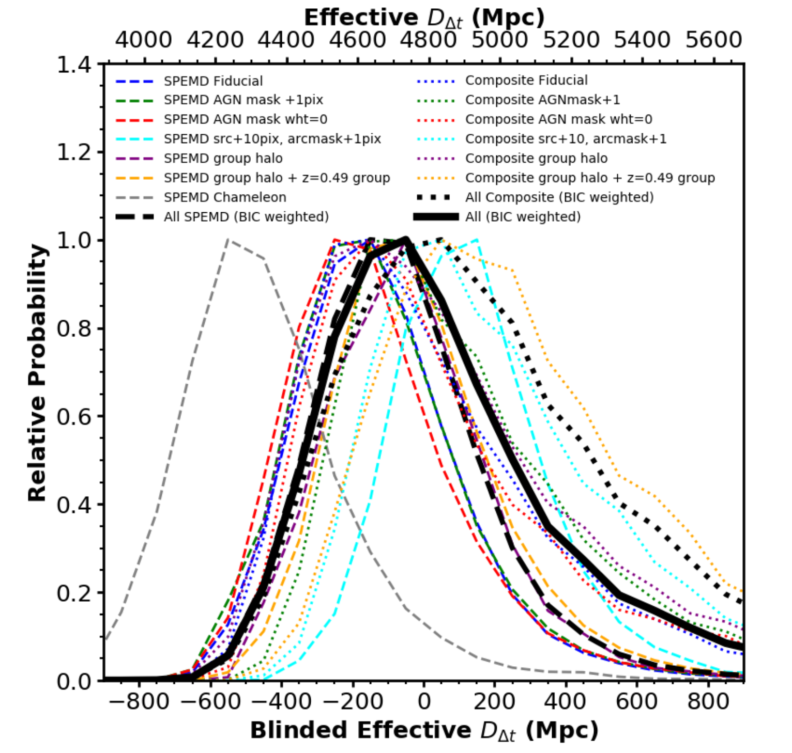

Slide 38
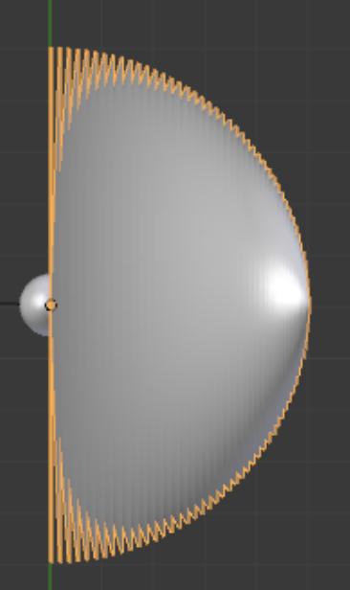
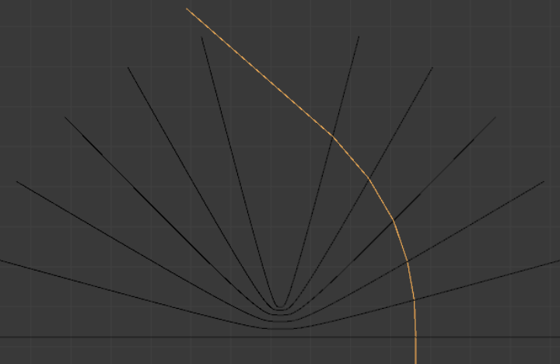

Slide 39
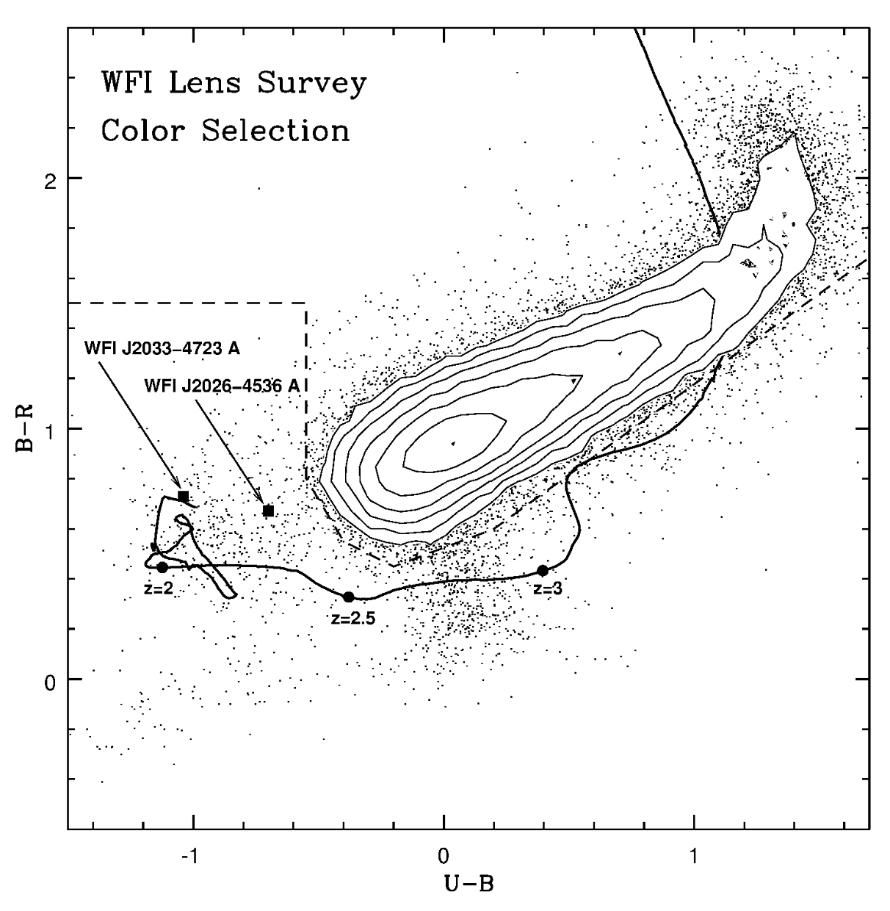
Morgan et al. 2004

