Slide 1
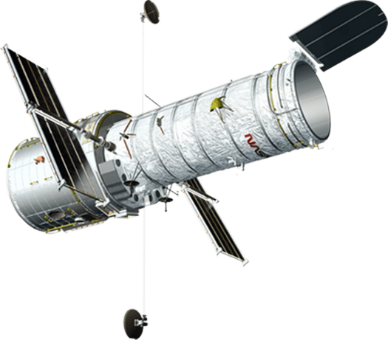
A MUSE-HST synergy to probe
galaxy morphology and Hubble constant
Pritom Mozumdar, Michele Cappellari and Chris Fassnacht

Slide 2
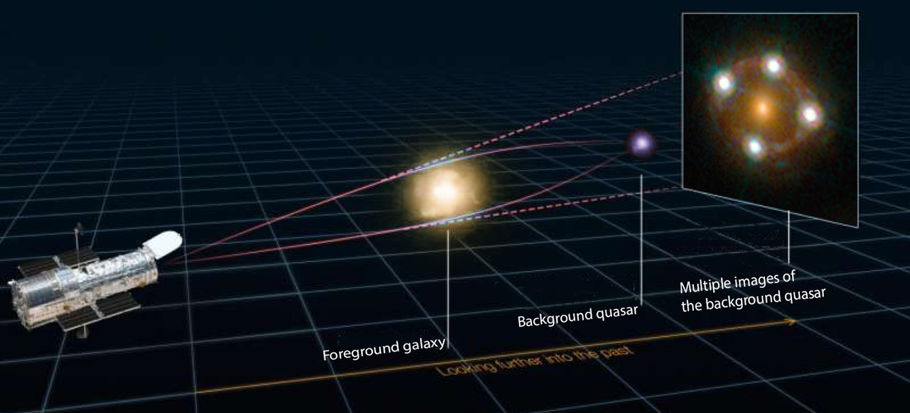
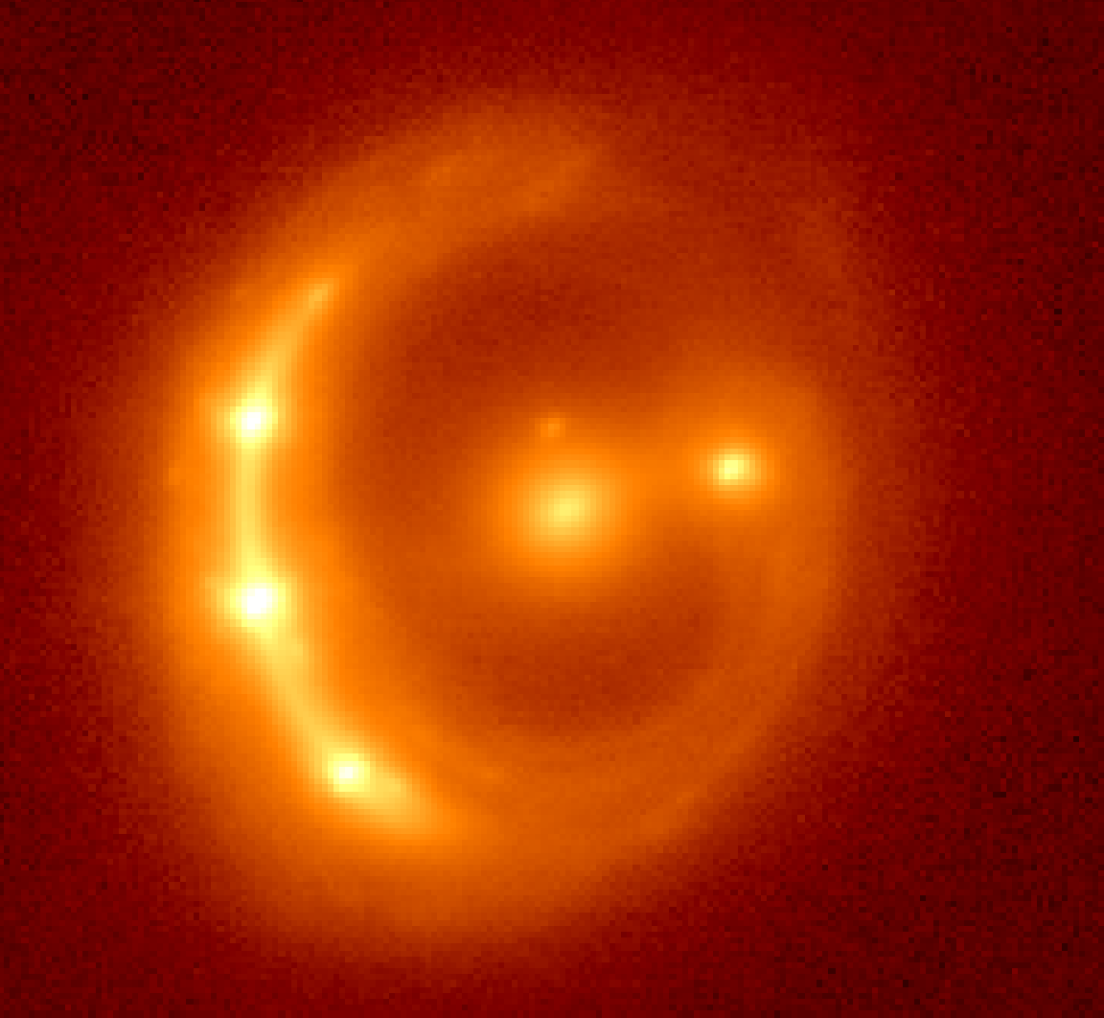
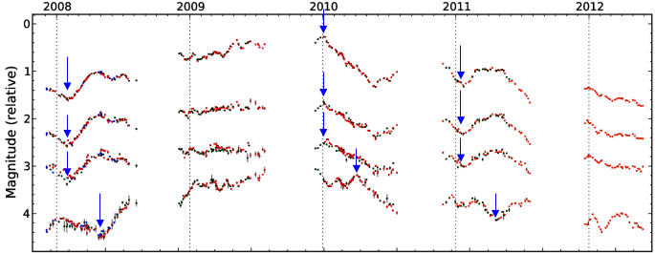
Measuring H0 from strong-lensing time delays
Gravitational
potential difference from high-resolution imaging
Observed time delay
Year :
Courtesy: Millon
Combination of cosmological distances
1-m class telescopes
Hubble constant
Tewes et al. 2013b
Courtesy: Millon & Courbin

Slide 3
Mass-anisotropy degeneracy in stellar velocity dispersion
Larger enclosed mass,
but dispersion tensor aligned less with the line of sight
?
Smaller enclosed mass,
but dispersion tensor aligned more with the line of sight
Spatially resolved
velocity dispersion
breaks this degeneracy.
Courtesy : Anowar Shajib

Slide 4
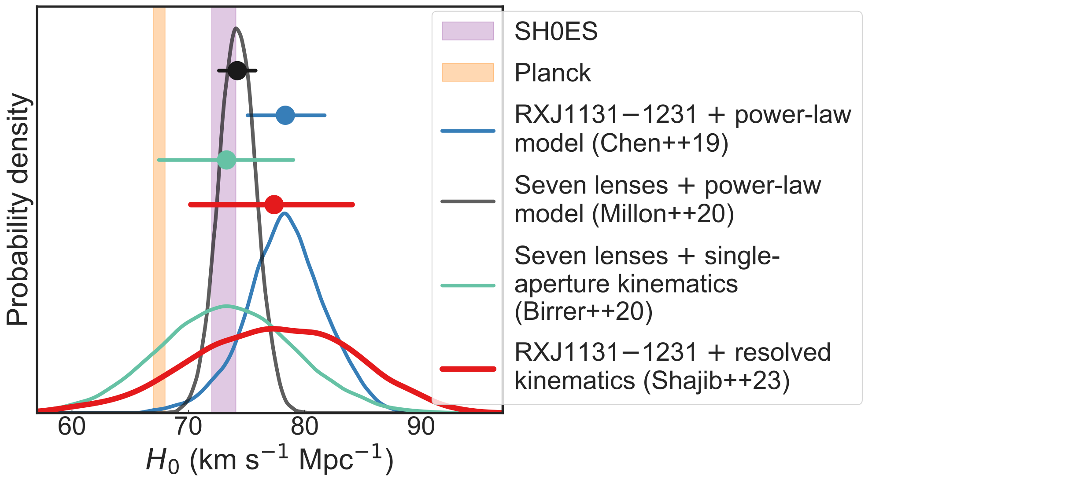
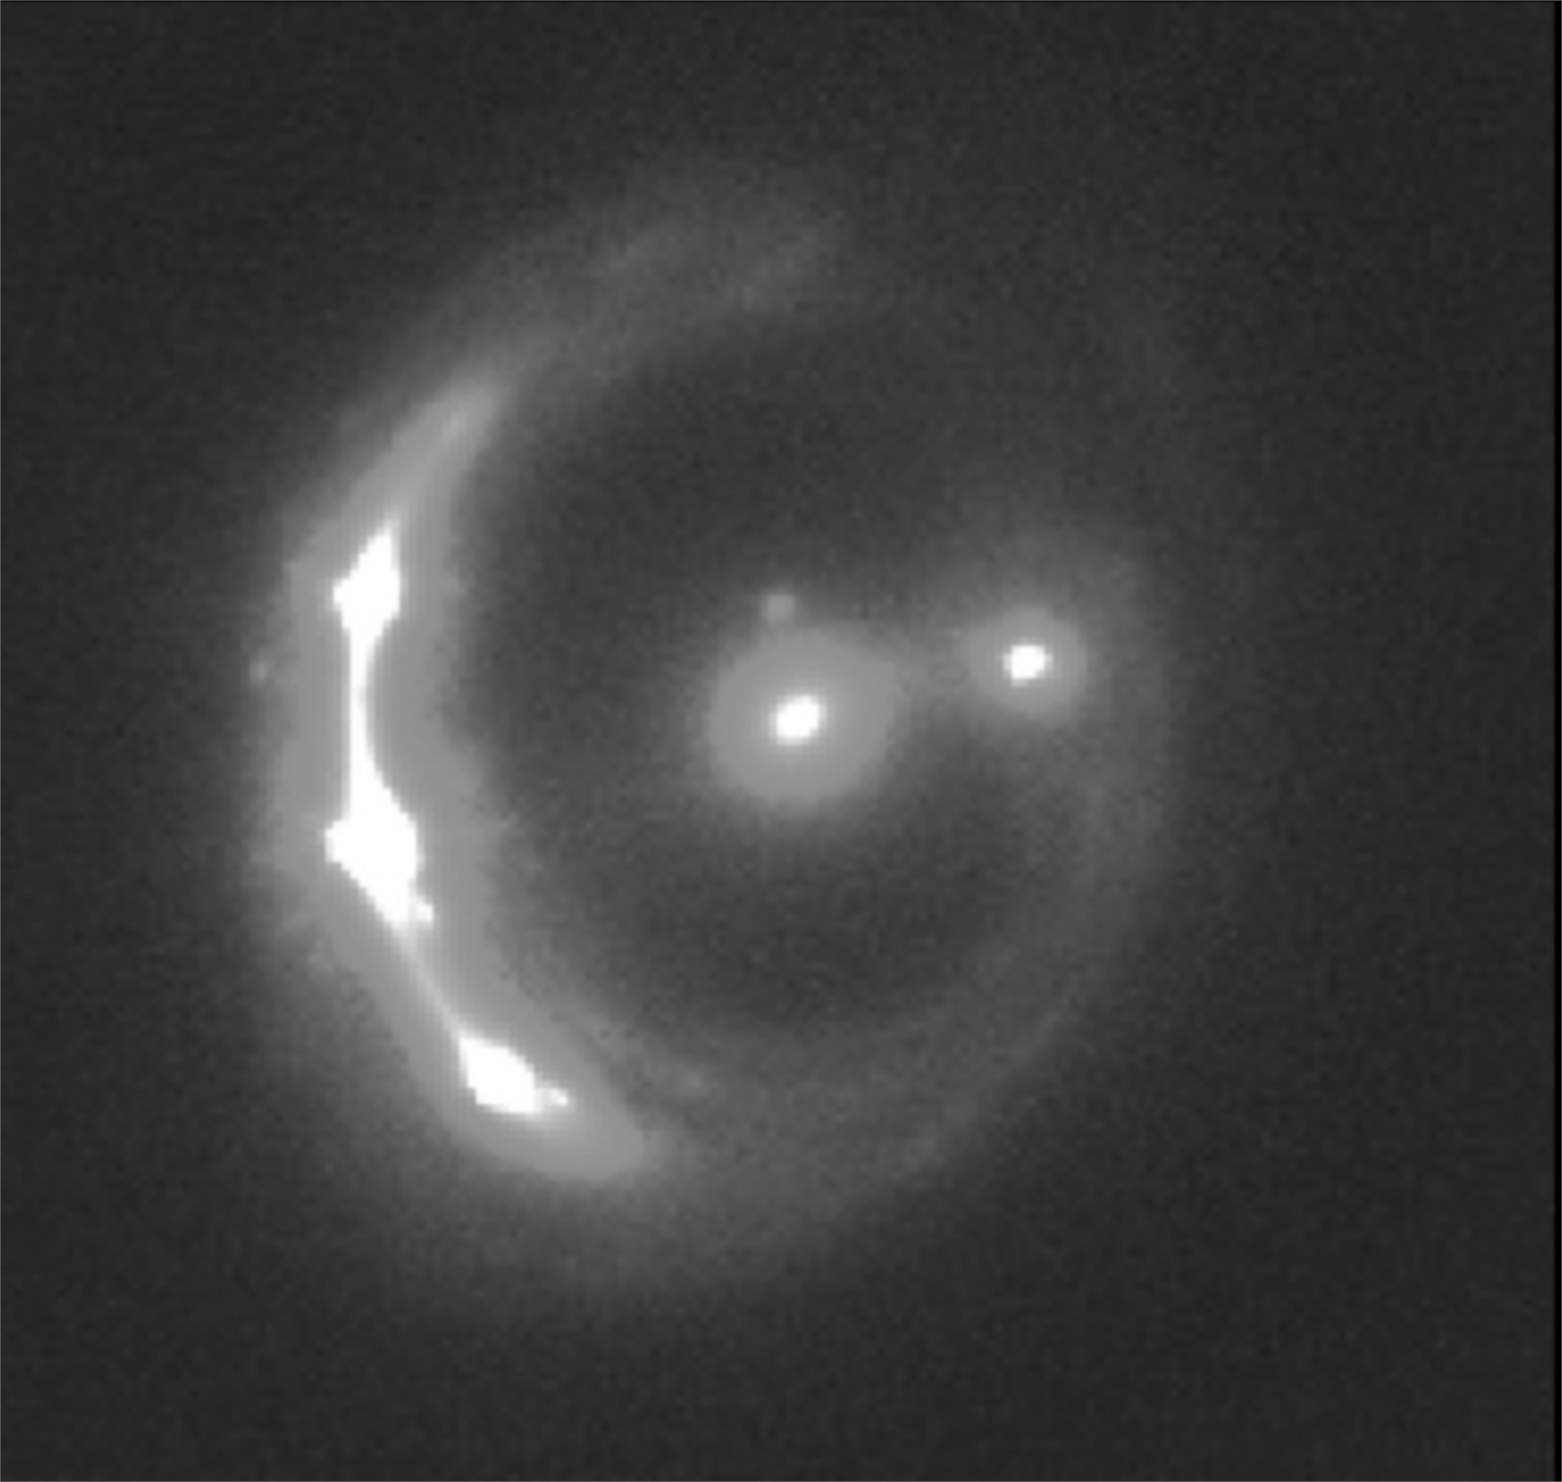
Spatially resolved velocity dispersion from a single system helps constrain H0 to 9% (with a maximally flexible mass model).
KCWI Velocity dispersion
Keck-AO imaging
Time delays
A. Shajib, Mozumdar et al. (2023)

Slide 5
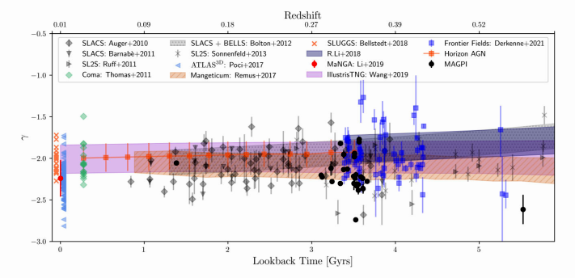
Total density slope evolution :
C. Derkenne et al. 2023

Slide 6
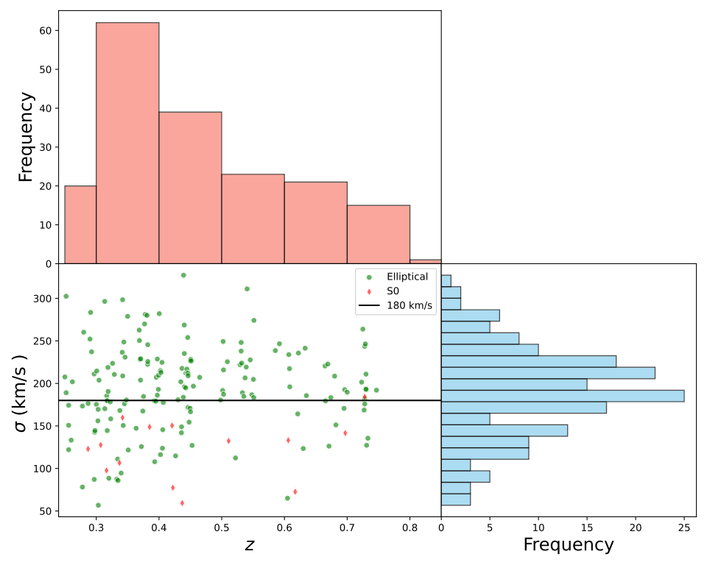
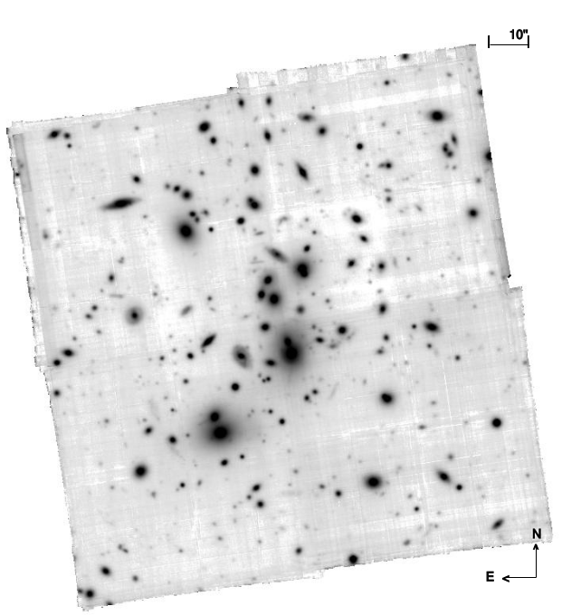
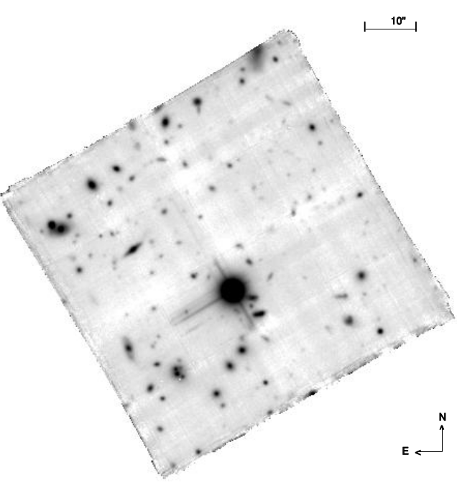
Sample selection :
Abell 2744
z =0.3
Cosmos Field
z = 0.7

Slide 7
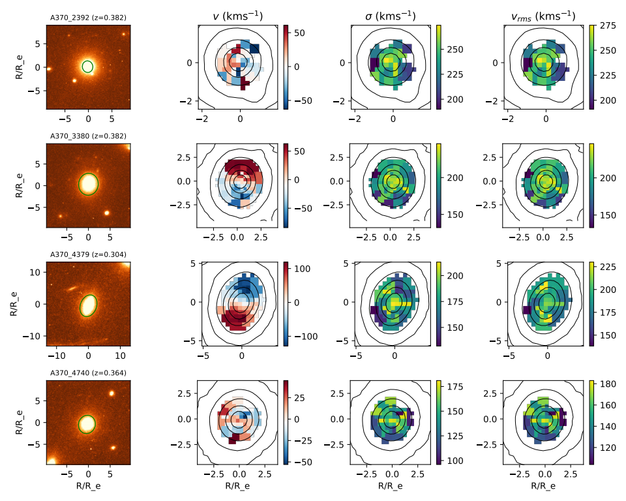
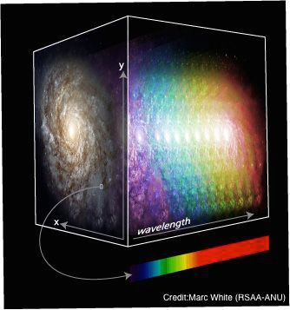
Kinematics Extraction :

Slide 8
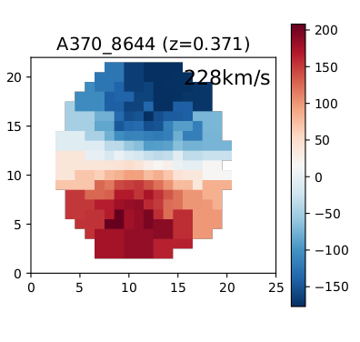
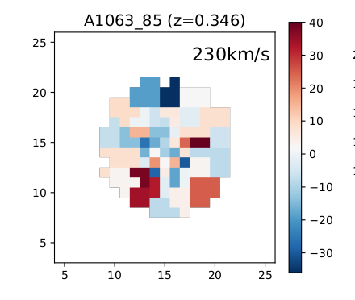
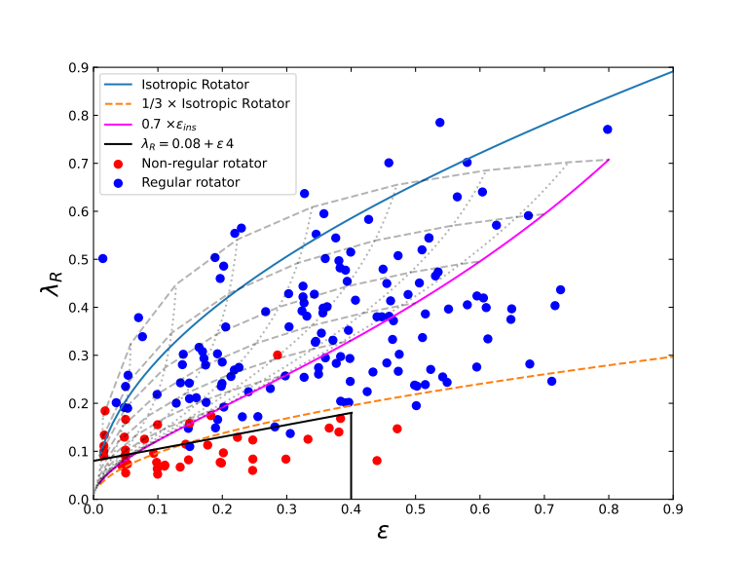
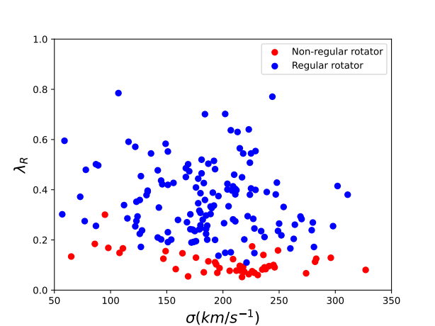
Regular
Non-regular
Kinematics classification :
(Mozumdar et al. in preparation)

Slide 9
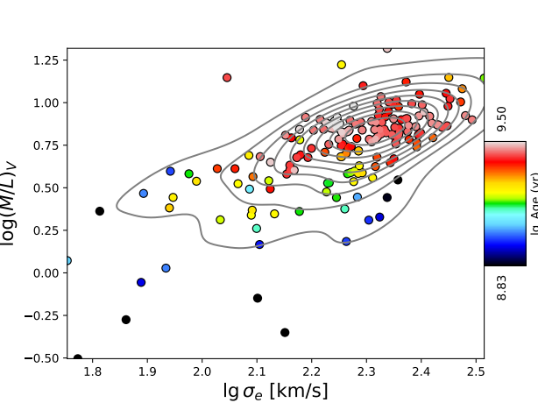
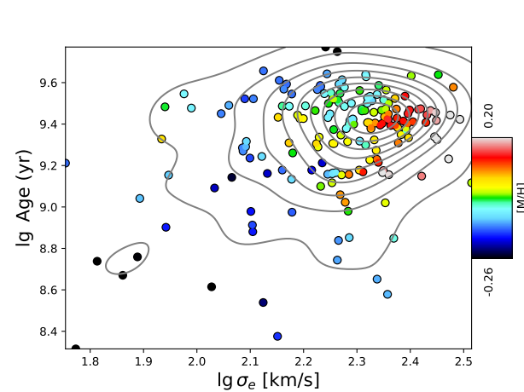
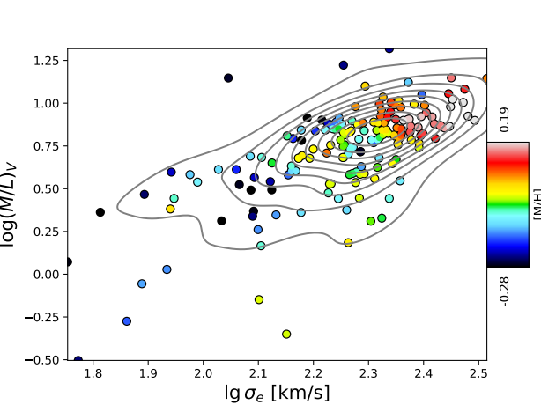
Galaxy Properties :
(Mozumdar et al. in preparation)

Slide 10
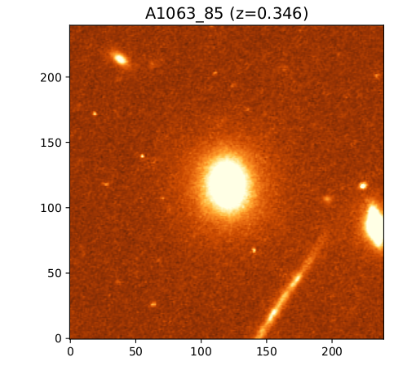
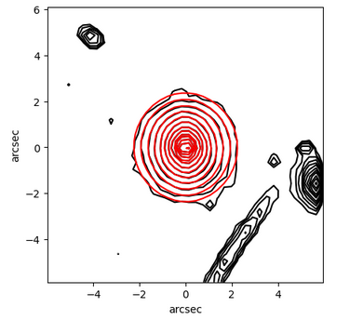
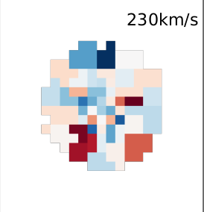
Analysis Method :
MGE
Model surface brightness as a series of Gaussian profiles using HST images
Assume a mass model -power law or
composite model (M/L + NFW)
Assume an anisotropy model – constant or
Osipkov–Merritt model
Predict spatially resolved kinematics via
Jeans anisotropic modeling (JAM)
(M. Cappellari)

Slide 11
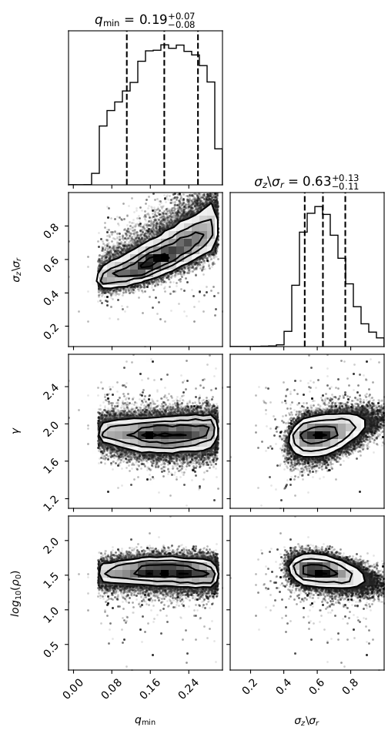
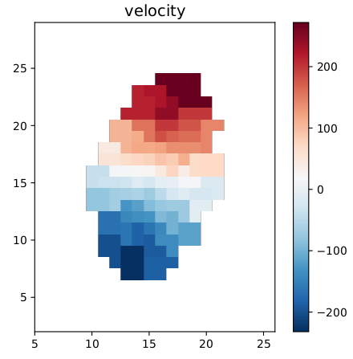
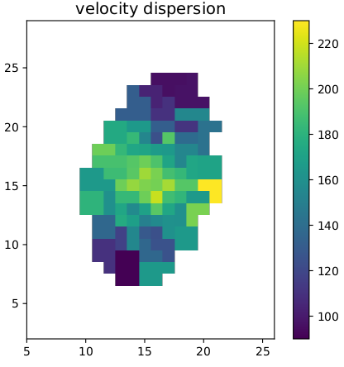
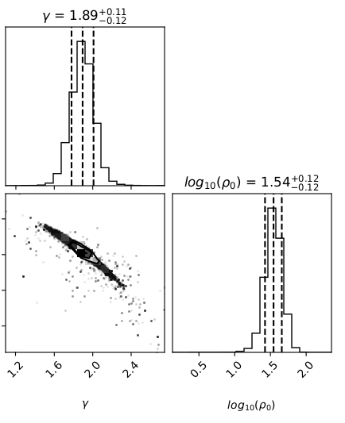
Bayesian Analysis with JAM :
mass model - power law (γ, ρ_{o})
constant anisotropy,
β = 1- (σz/σr)²

Slide 12
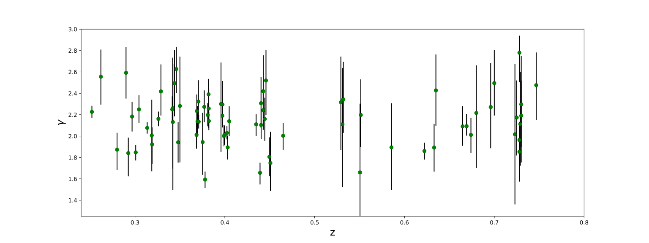
Total denisty slope over redshift :
In total 80 galaxies
No significant evolution trend over z
Environmental effects ?

Slide 13
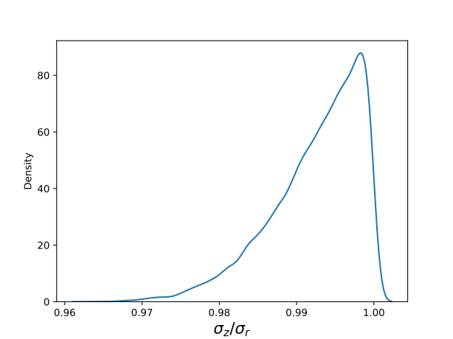
Bayesian Hierarchical approach:
P(β| d) ∞ P(d|β) P(β)
P(d|β) = Π i P(d i | β)
where d = {kin, light} of all galaxies
β = anisotropy parameter
= 1- (σz/σr)²
Constant Anisotropy

Slide 14
Summary :
Galaxy kinematics at z ~ 0.25 – 0.85 could help us to probe evolution history
and environmental effects of critical galaxy properties.
Understanding anisotropy of these galaxies could help gaining higher
precision on the Hubble constant inference via time-delay cosmography.
ELT-MOS could extend this sample size significantly with larger FOV,
higher angular resolution and sensitivity and with better quality data.

Slide 15
THANKS !!!

