Slide 1
The role of dwarf galaxies as progenitors of the intra-cluster light in galaxy groups and clusters
Niusha Ahvazi
University of California, Riverside/Carnegie Observatories
ELT Science in Light of JWST, Dec 12, 2023

Slide 2
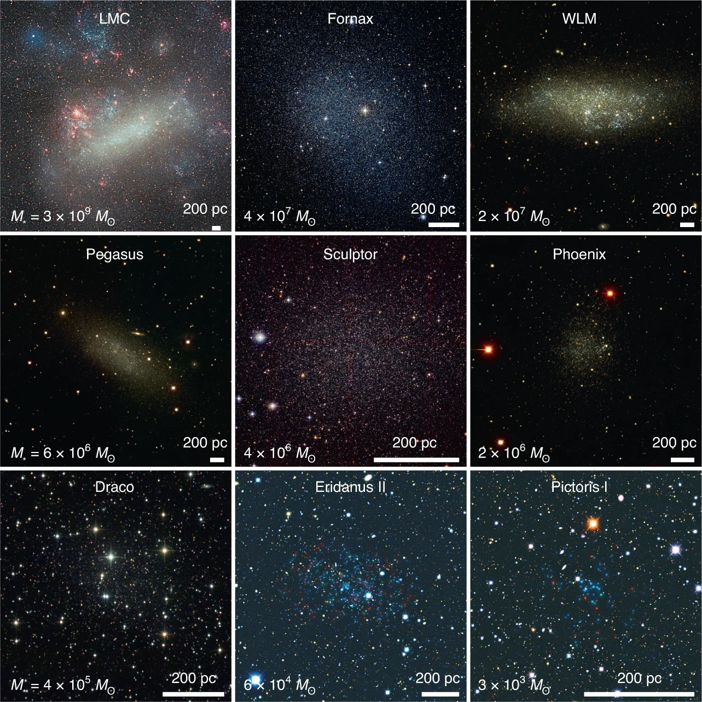
Importance of Dwarf Galaxies
Dwarfs are important for cosmology!
Abundance of dwarf (luminosity functions)
Mass content (cusp vs. cores/ diversity of rot. curves)
Sensitive feedback probes (shallow potential wells)
Most studies of dwarfs are in the Local Group
Denija Crnojević et. al. 2021

Slide 3
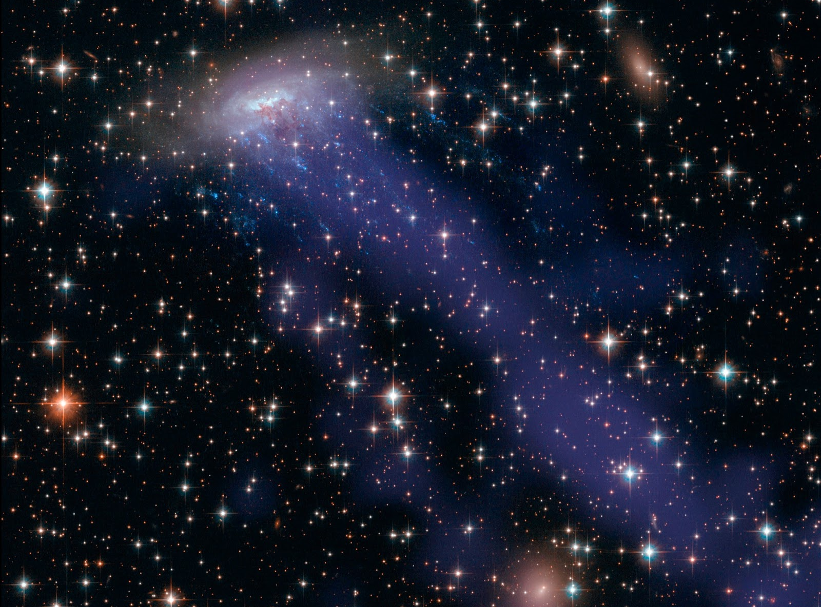
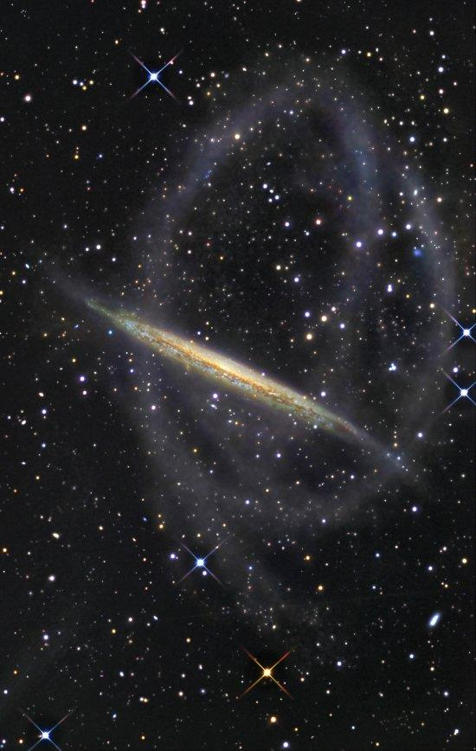
Environmental Effects
Ram-pressure stripping
-> result in quenching of galaxies
Tidal Stripping
-> production of tidal streams
HST image of ram pressure stripping of gas from a galaxy in ESO 137-001
Tidal stream surrounding the spiral galaxy NGC 5907.Credit: R. Jay Gabany

Slide 4
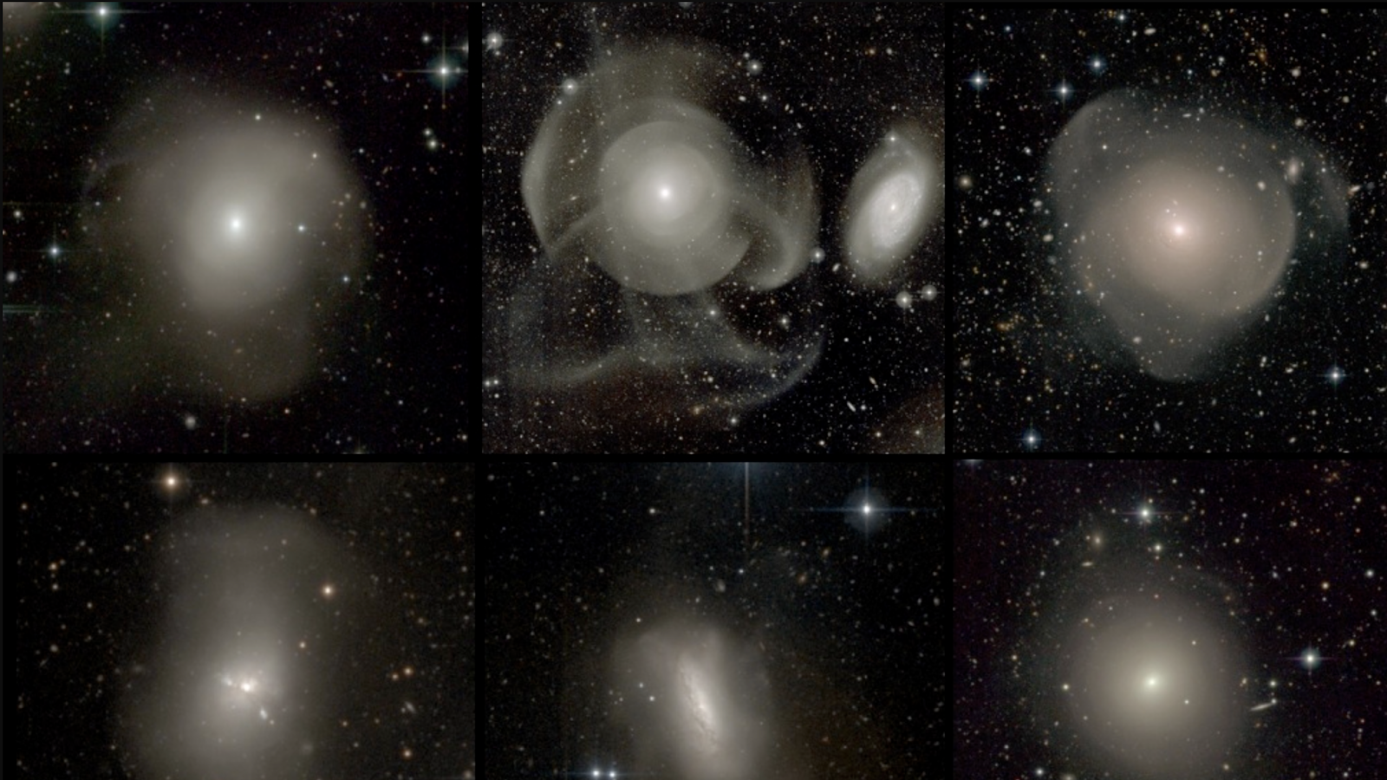
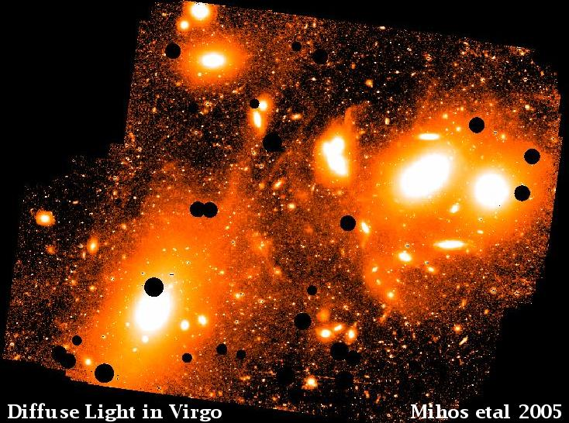
Low surface brightness universe:
Intra-cluster light in simulations
A sample of elliptical galaxies from the Atlas3D survey. image by P.-A. Duc 2011

Slide 5
Questions we are aiming to answer:
arXiv:2308.12340
What do ICL tell us about formation history of groups and clusters?
What is the role of dwarf galaxies in building the ICL?

Slide 6
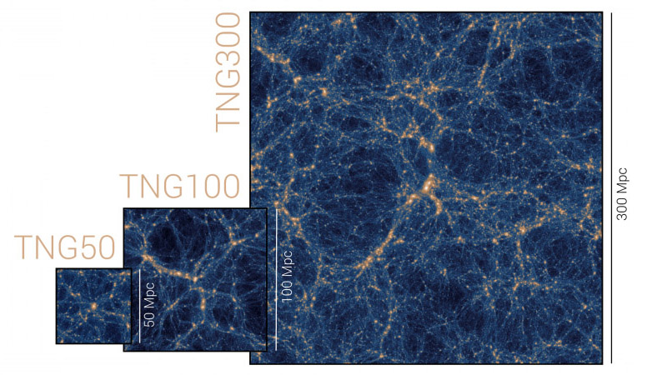
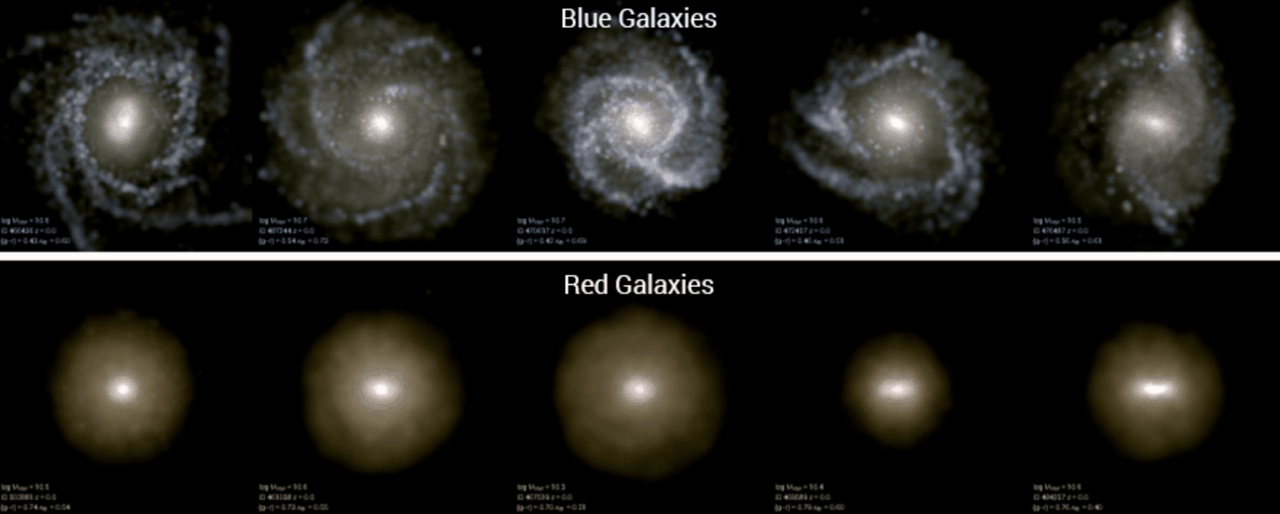
IllustrisTNG simulation
IllustrisTNG/Big volume simulations have become available in the past couple of years.
Producing realistic population of galaxies in a variety of environments
- Morphology
Luminosity function
Color distribution
www.tng-project.org

Slide 7
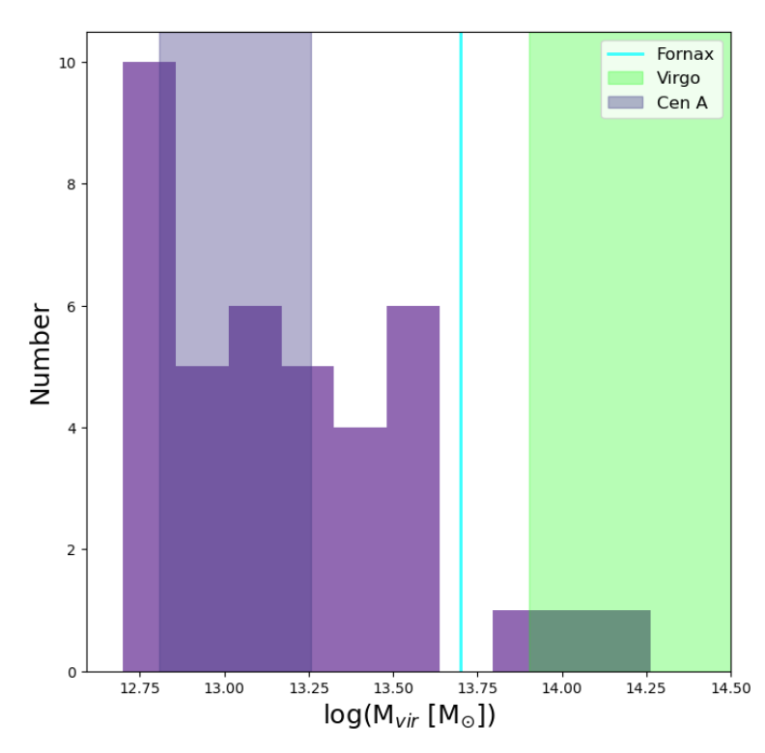
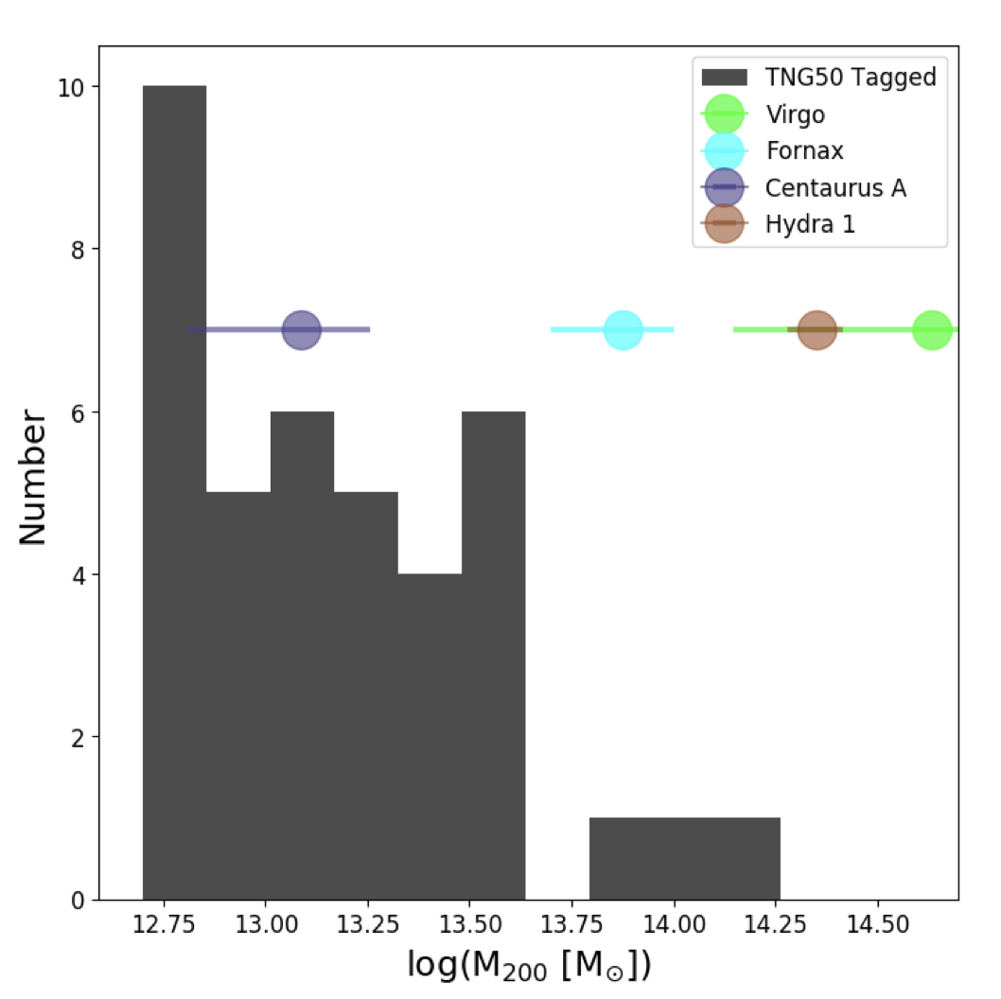
TNG 50 - The highest resolution run of IllustrisTNG suite
Doppel et. al. 2022
Resolution: m_{baryon} = 8.5 ⨉ 10⁴ M_{sun} , m_{DM} = 4.5 ⨉ 10⁵ M_{sun}
Box of TNG50 was chosen to include 1 "massive" Virgo-like object, M₂₀₀ ~2⨉10¹⁴ M_{sun}.
Our sample: virial mass of groups $≥5×{10}^{12} M_{⨀}$
Number
log (M₂₀₀ [M⊙])

Slide 8
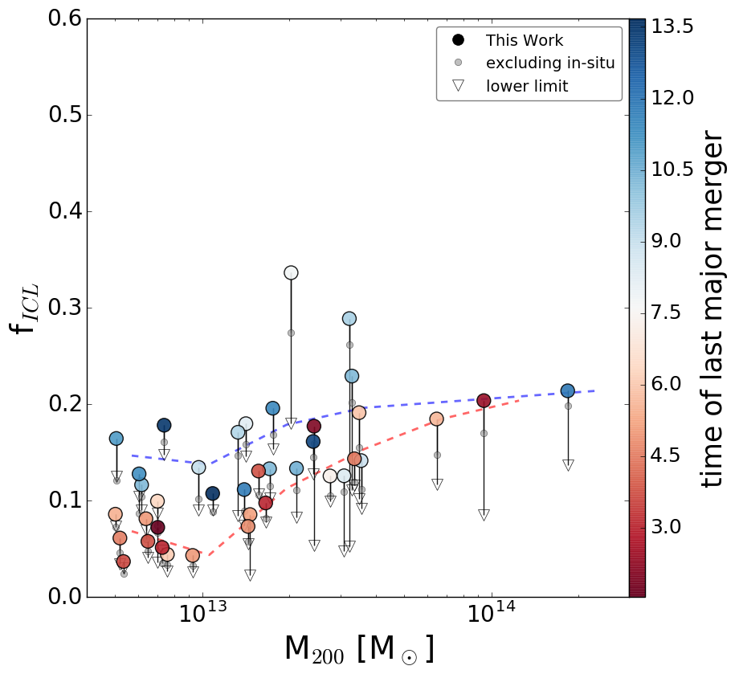
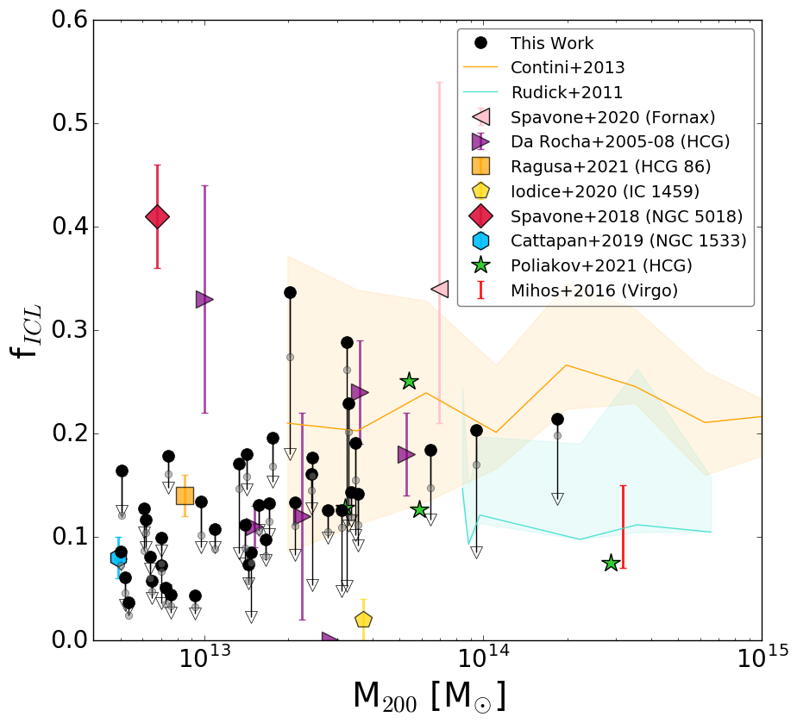
Fraction of ICL
TNG50 predictions for ICL fractions are broadly consistent with previous observations and theoretical predictions

Slide 9
Fraction of ICL
[Gyr]
The dispersion in the ICL fraction-M₂₀₀ relation corelates with the time of the last major merger

Slide 10
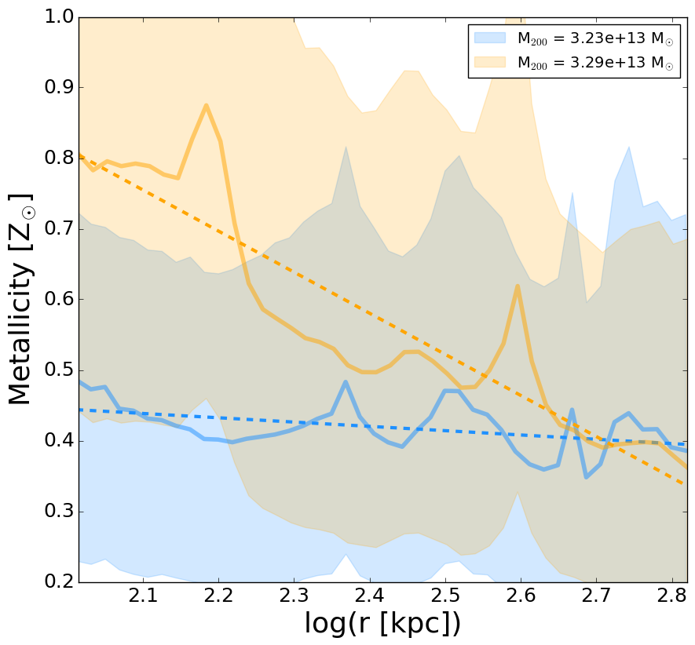
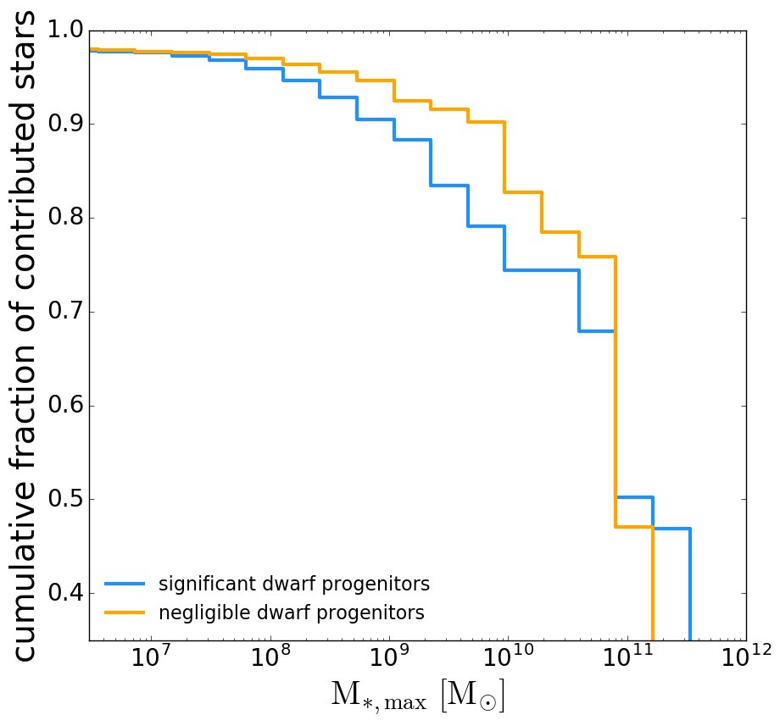
Role of dwarf galaxies in building the ICL
More than 10% difference in the fraction of stars contributed by dwarf progenitors.
Groups with more contribution from dwarf population have on average lower metallicity and shallower metallicity profiles in the ICL.

Slide 11
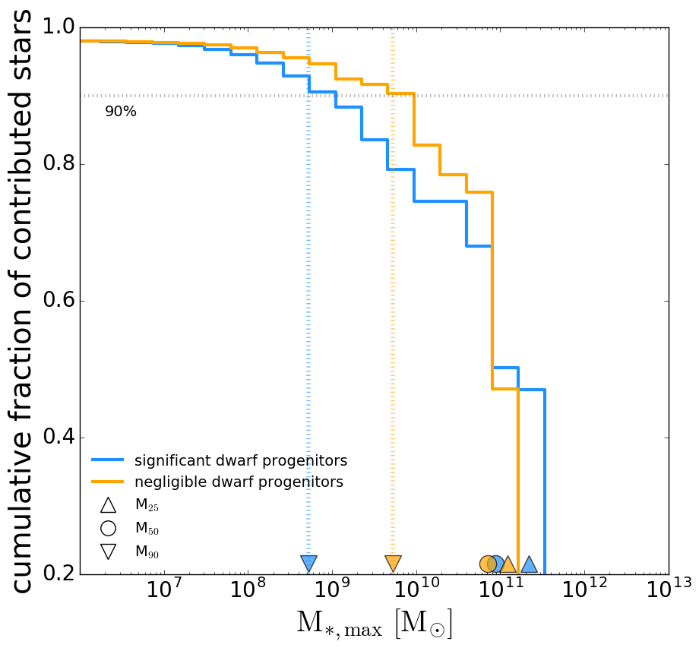
Role of dwarf galaxies in building the ICL
The smaller the M₉₀, the more important the role of dwarf galaxies in the build up of this particular ICL.
M₂₅
M₉₀
M₅₀

Slide 12
Main contributors to ICL:
Main contributors to ICL do not scale with virial mass
Major contributors of ICL seem to be MW-mass galaxies with M * ∼ 10^{10.5} M⊙, regardless of group mass in our range.
Dwarf galaxies have a wide range of relevance as builders of the ICL -> leaving mark on the metallicity content of ICL and the slope of metallicity profile

Slide 13
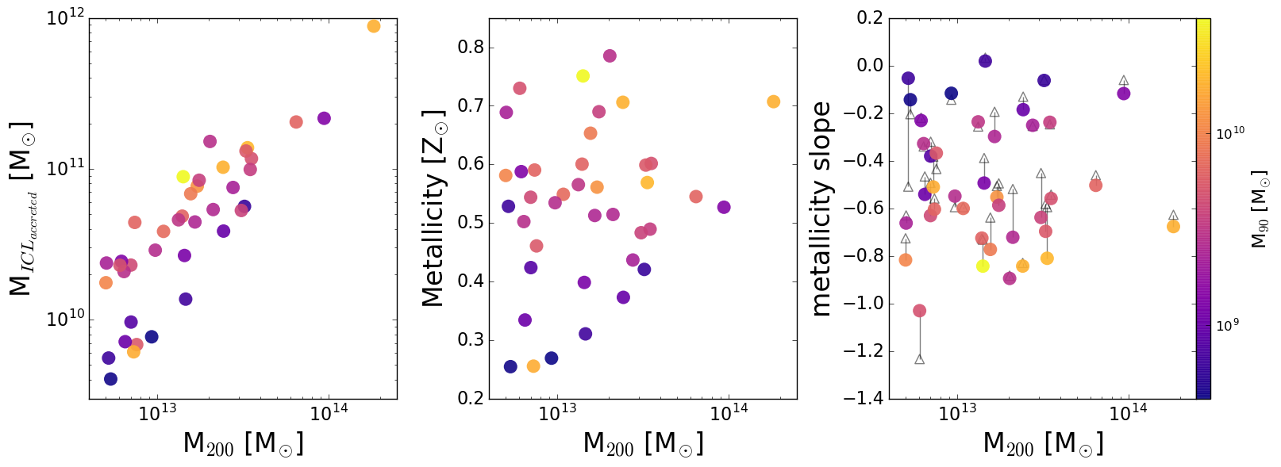
Dwarf contribution signatures

Slide 14
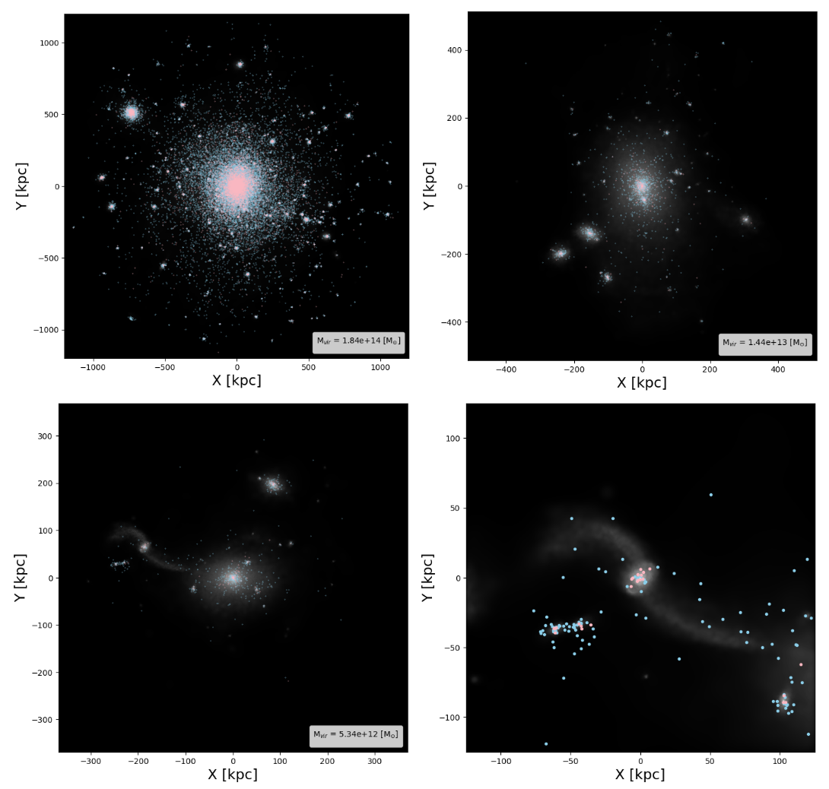
Globular cluster component / ICGC:
GCs are interesting cause they are bright! (detected in JWST results by Lee et al. 2022)→ possible candidates to follow ICL formation history
They are tagged using dynamical cuts at the time of subhalo’s infall
Similar definition to stellar ICL→ ICGC
Doppel et. al. (2022)

Slide 15
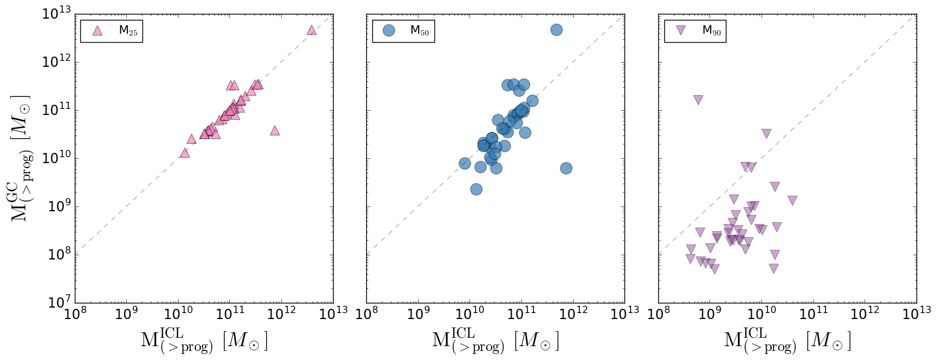
Stellar vs. GC component:
Progenitors of GC have lower mass in the dwarf regime than ones in the ICL
1 – 1 relation
GCs component seem comparable to ICL , a good tool to reconstruct the history of accretion of the cluster.

Slide 16
Quick Recap:
Fraction of ICL scales with mass of the halo and the dispersion corelates with time of the last major merger
Main contributors to the ICL are MW-mass galaxies with M* ~ 10 ¹⁰ – 10 ¹¹ M⊙ , but dwarf galaxies have a wide range of relevance as builders of the ICL -> the metallicity and the slope of the metallicity profiles of the ICL retain information on these different assembly histories
ICGCs are good tracers for ICL formation history
What is the fraction of ICL in halos of different virial masses?
What is the difference in the makeup of the ICL based on the formation time of the group, distribution of progenitor masses?
How is the ICL related to the intra-cluster GC component?
arXiv:2308.12340

Slide 17
Contact information:
niusha.ahvazi@email.ucr.edu
nahvazi@carnegiescience.edu

Slide 18
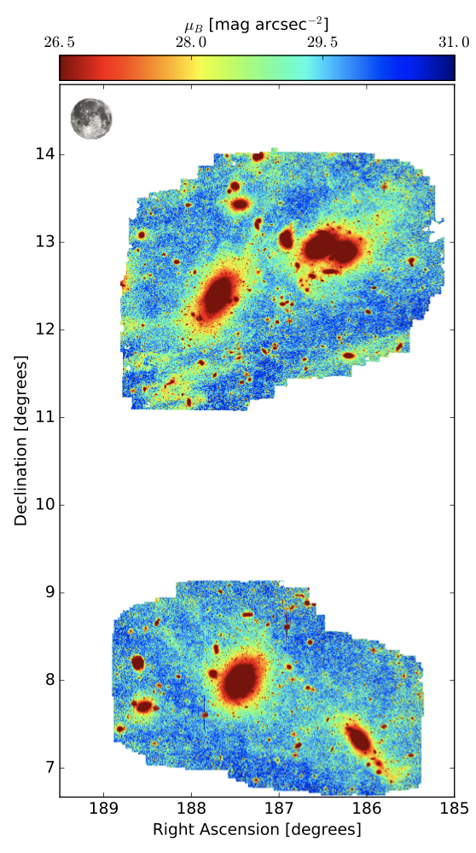
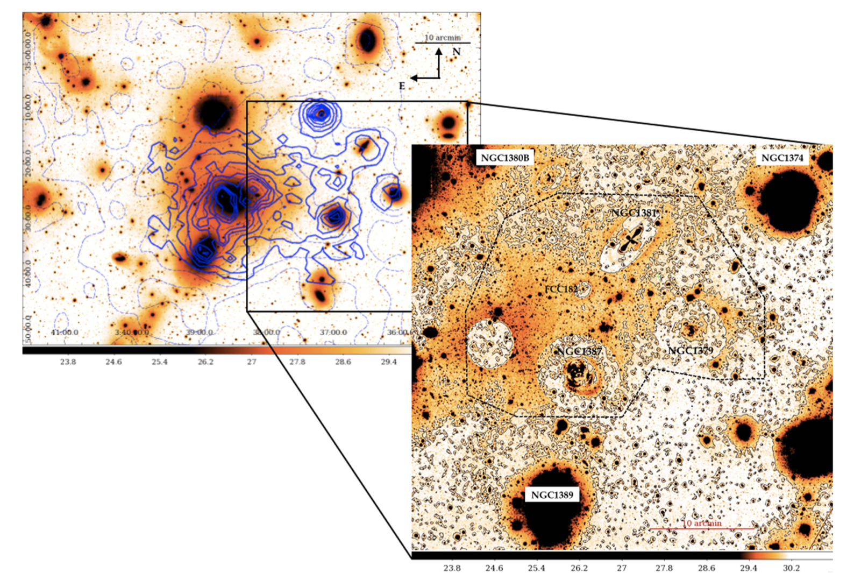
Extras:
Rudick+2011: hydro- simulation of a suite of 6 clusters
Mihos+2016: observation of Virgo cluster, concentrated around the cores of Virgo subclusters A and B
Our observations span roughly 16 degrees2 in two filters, reaching a 3σ limiting depth of μB=29.5 and μV =28.5 mag arcsec−2.
measure the color of the diffuse tidal streams and intracluster light in the Virgo core near M87, in fields adjacent to the core including the M86/M84 region, and to the south of the core around M49 and subcluster B, along with the more distant W′ cloud around NGC 4365.
Iodice+2017: Observation of Fornax cluster, they only targeted a small region (~1%) compared to the total extension of the Fornax cluster.
The total g-band luminosity of the ICL is Lg ~ 8.3 *10⁹ L_{sun} , which is ∼5% of the total luminosity of NGC 1399.
Morishita+2017: 6 Hubble Frontier Field (HFF) clusters at 0.3< Z <0.6

Slide 20
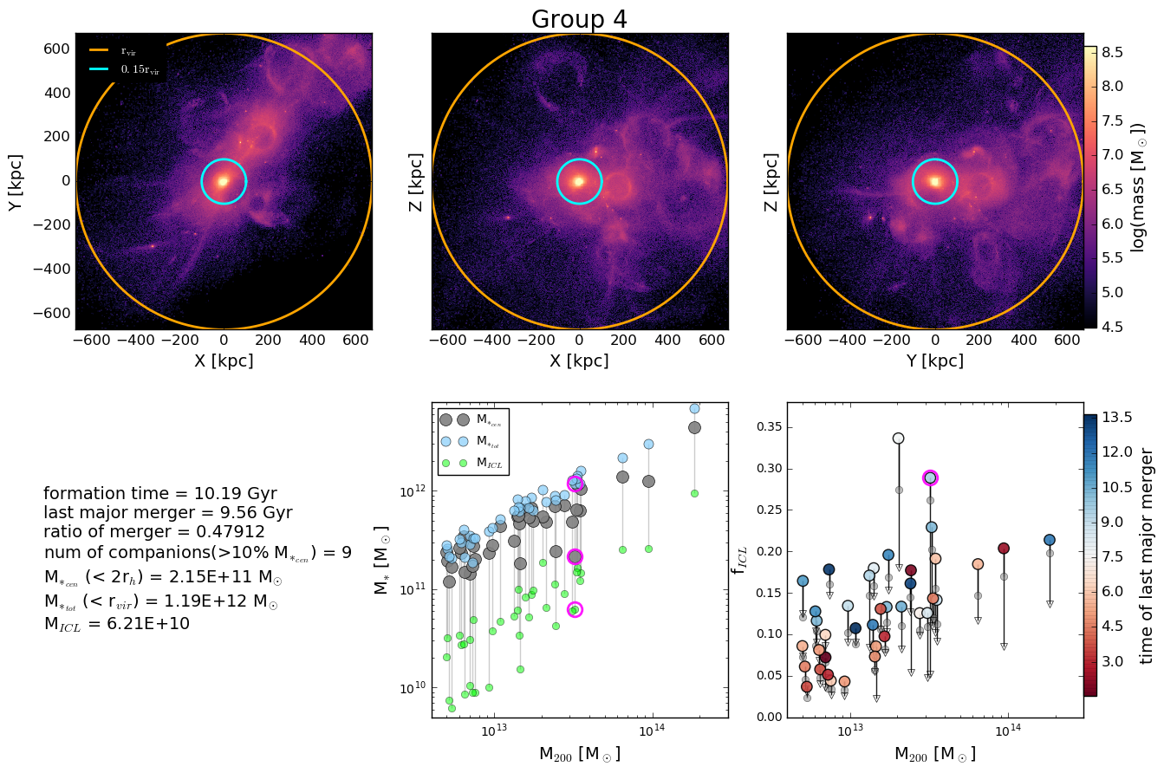

Slide 21
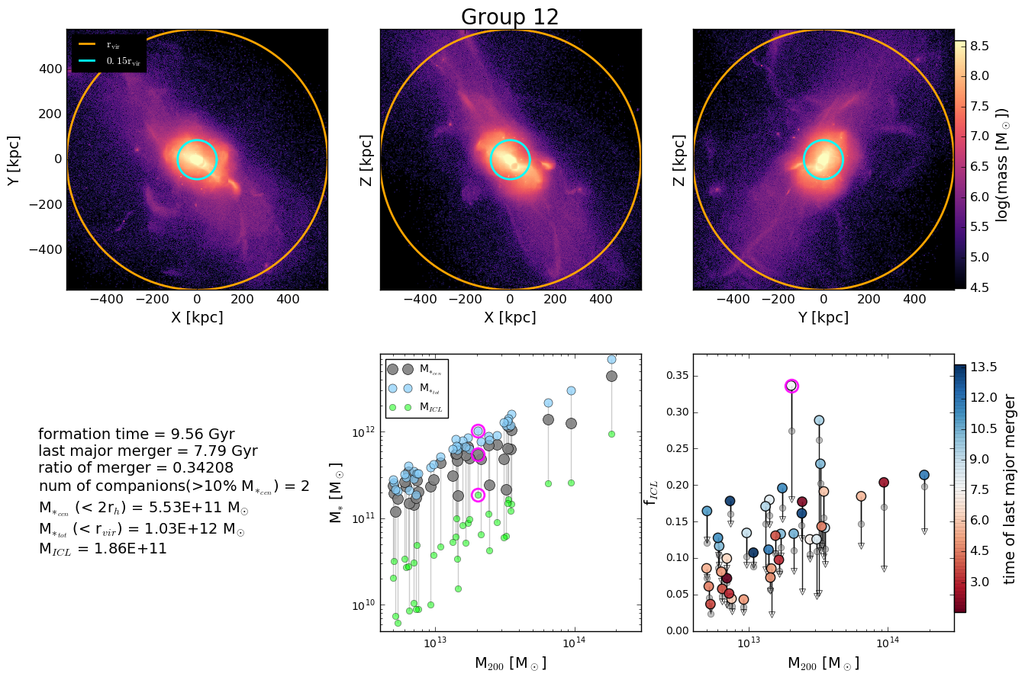

Slide 22
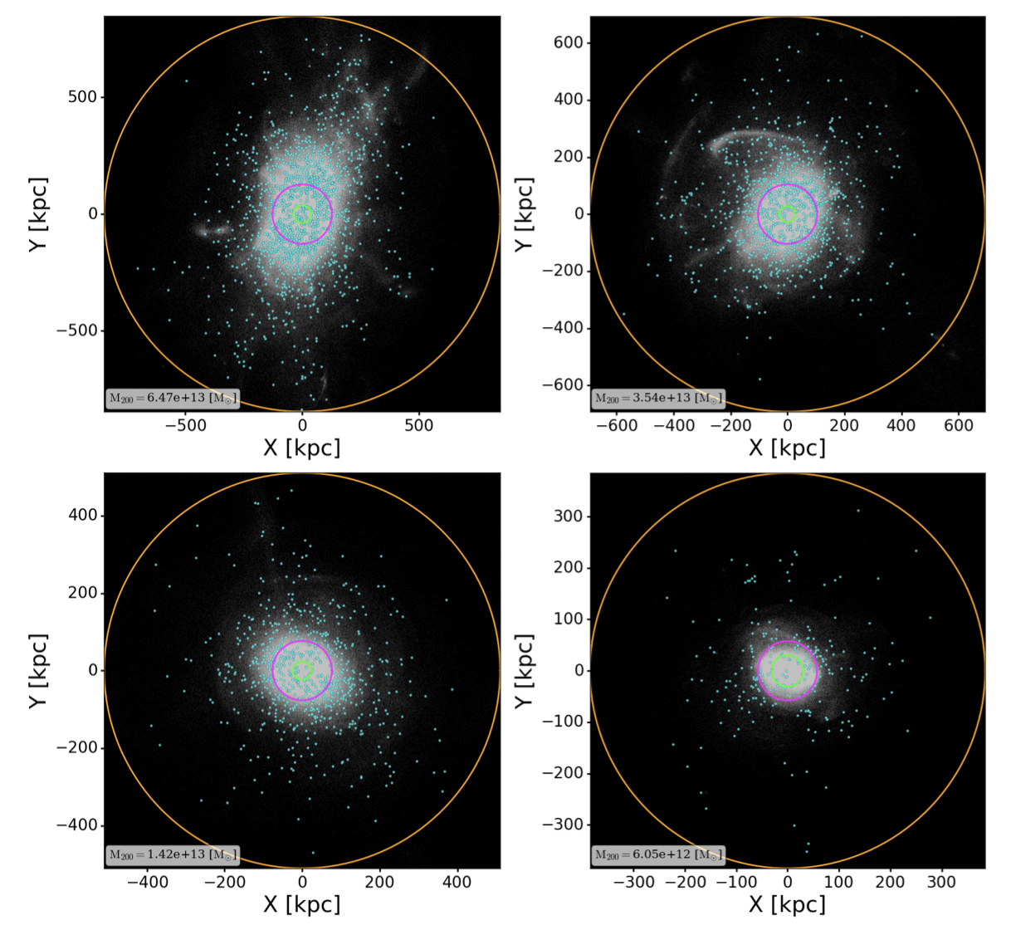

Slide 23
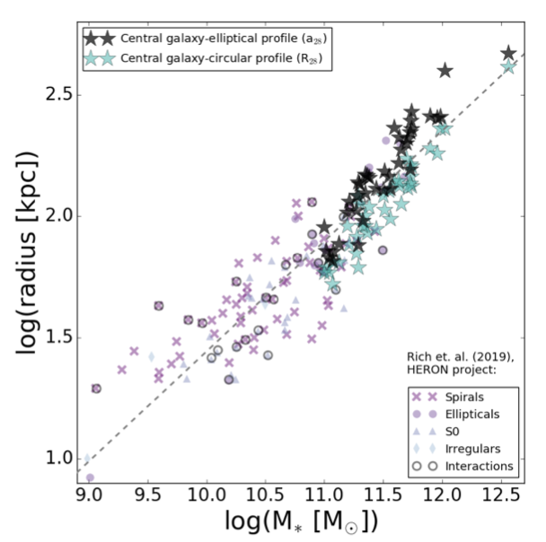
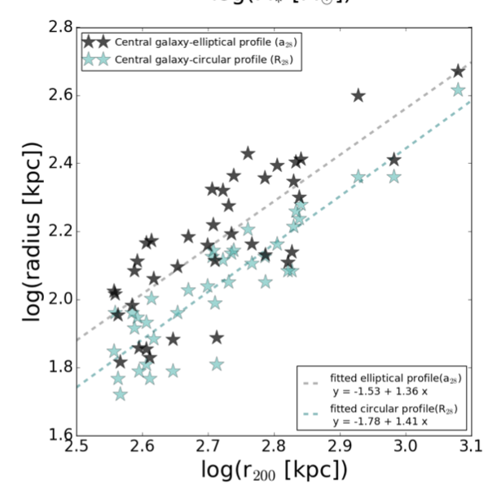

Slide 24
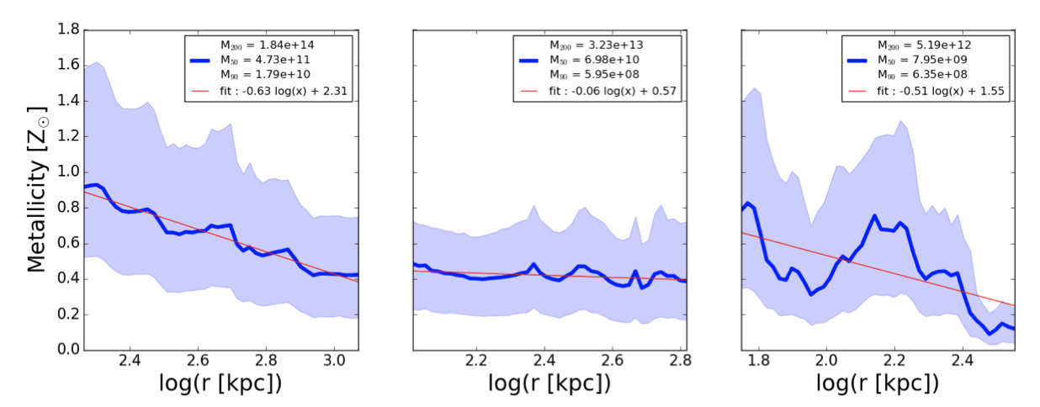

Slide 25
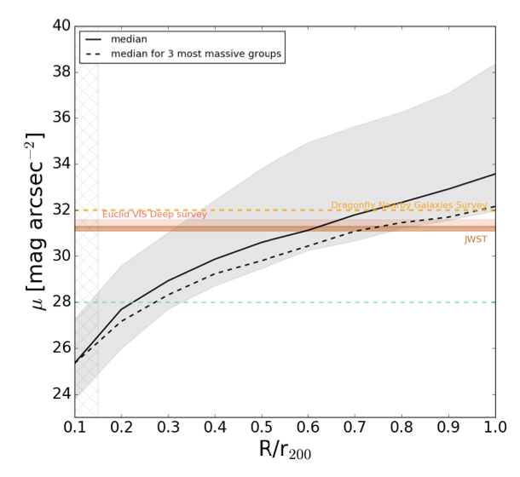

Slide 26
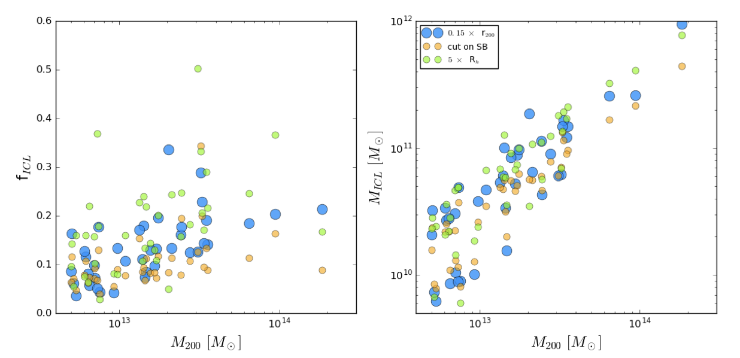

Slide 27
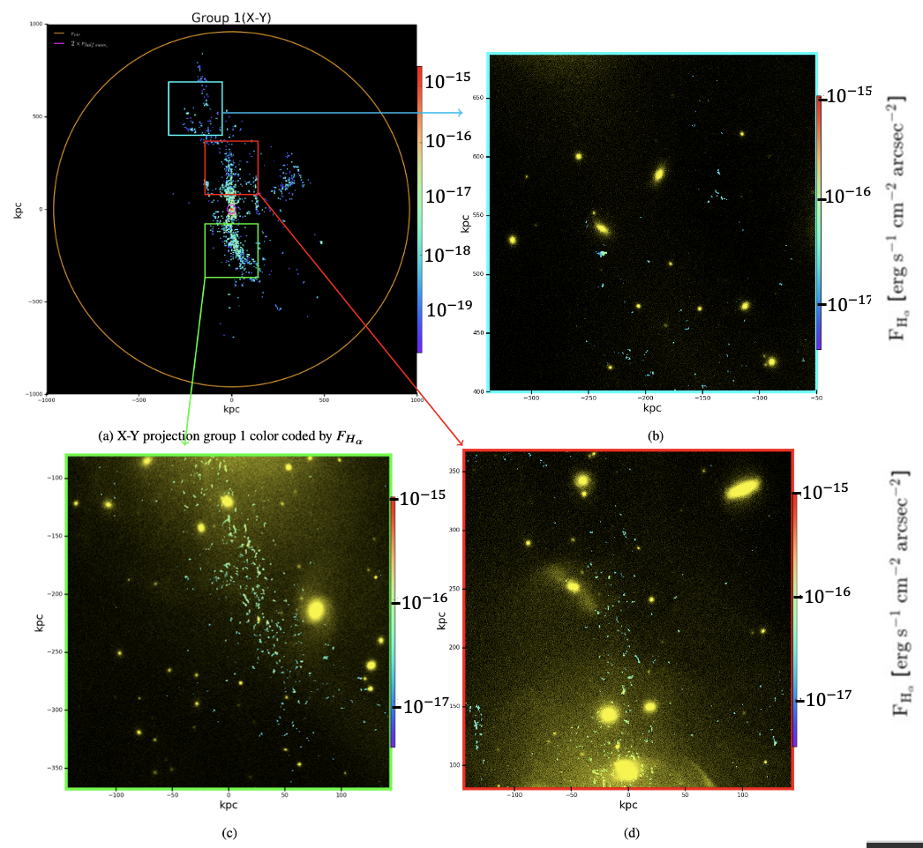
In-situ ICL component
Even though most of the start in ICL are ex-situ we detect a significant fraction born from cooling of the CGM gas (Ahvazi et al. in prep).

Slide 28
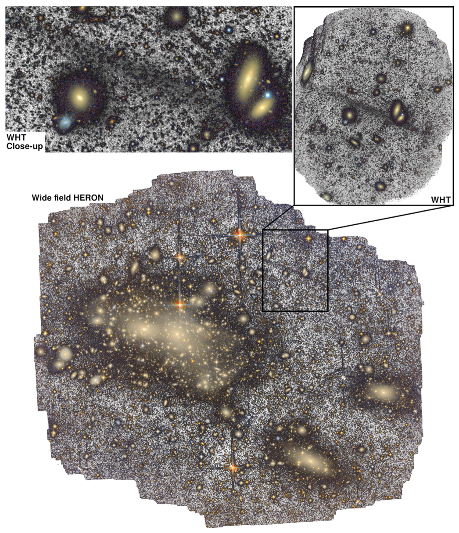
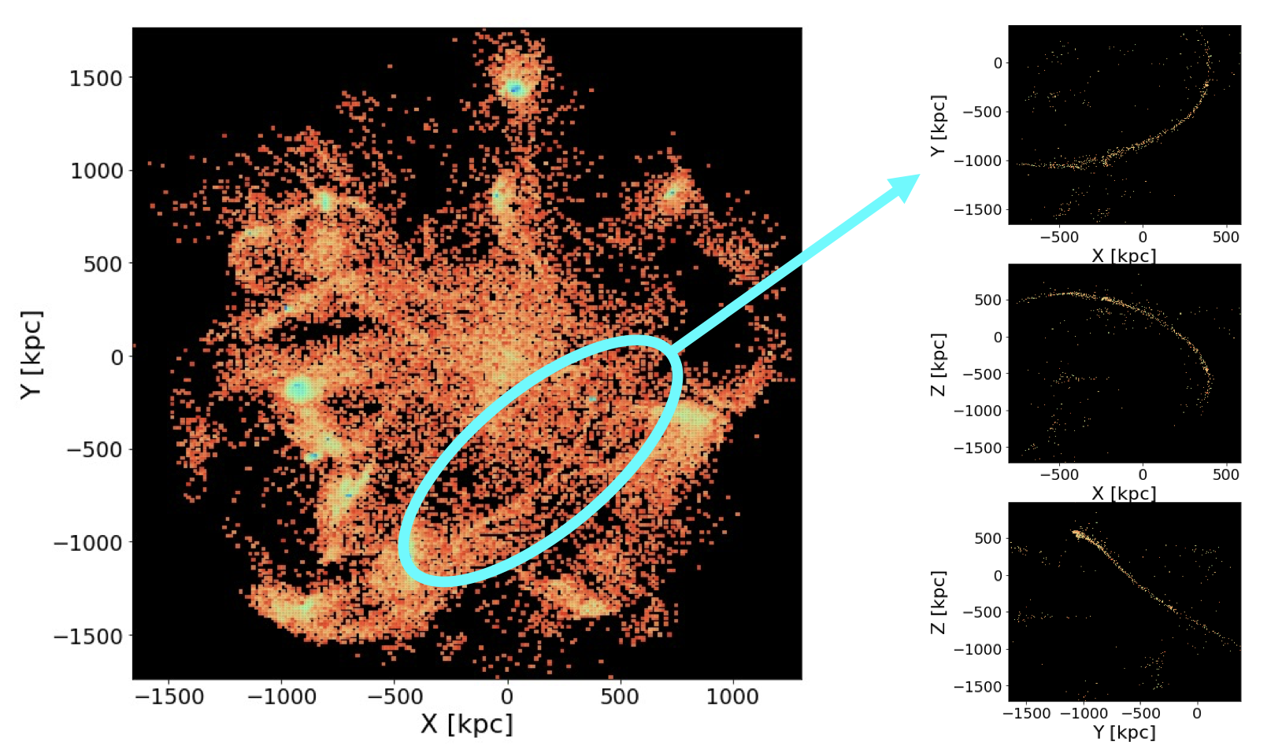
(arXiv:2305.03073)
Constraining mass of the progenitor of a giant thin stellar stream in the Coma Galaxy Cluster.

