Slide 1


ELT-JWST synergy for dark matter measurements
Anna Nierenberg
University of California, Merced

Slide 2
Dark matter is one of the biggest mysteries of modern physics
Universe matter ingredients
Electrons, protons, neutrinos → stars, gas, planets…
??
Ordinary Matter
Dark Matter
Credit: ESA/Planck Collaboration
Notes:
Brighter = denser

Slide 3
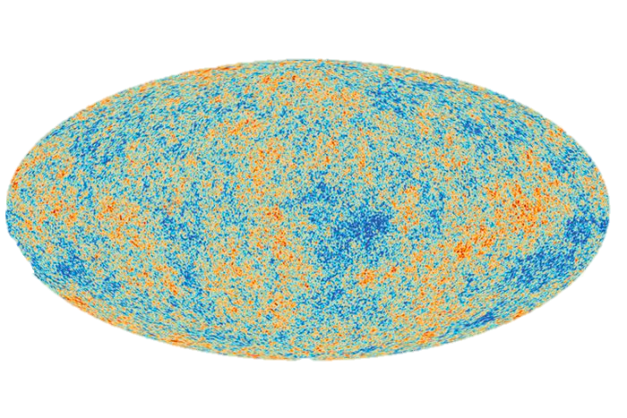
Dark matter explains many phenomena
The motion of gas and stars in galaxies
The motion of galaxies in groups and clusters
The present day distribution of structure as well as its evolution throughout the history of the Universe
Garrett et al. 2010
Cosmic Microwave Background
Planck Collaboration

Slide 4
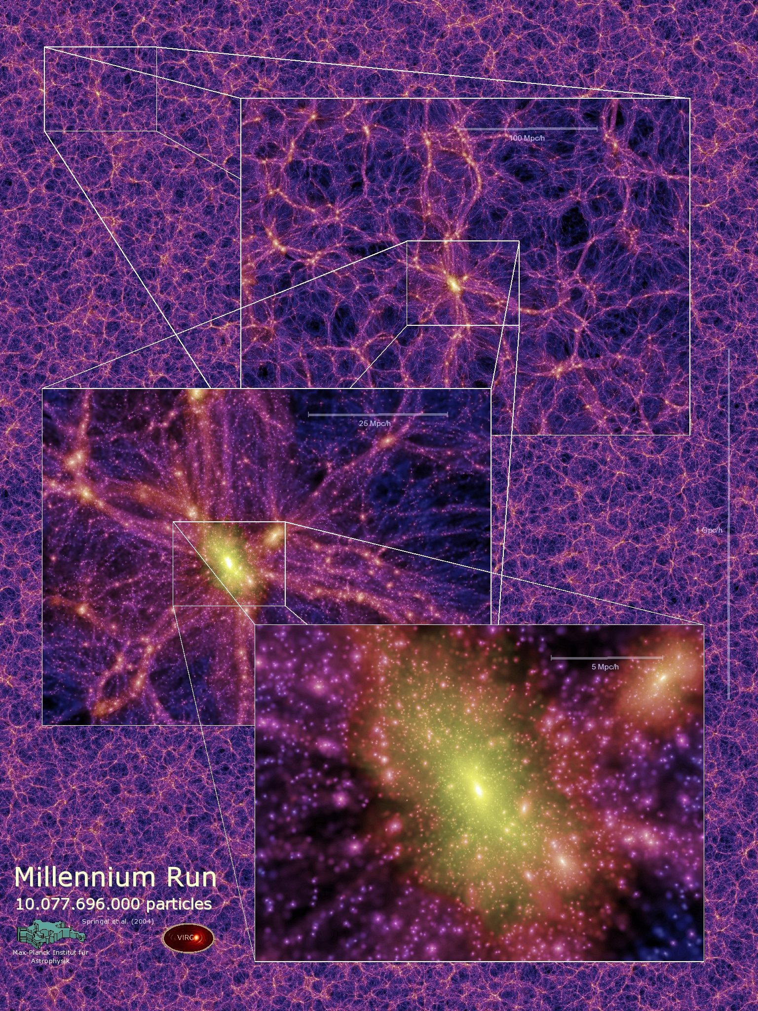
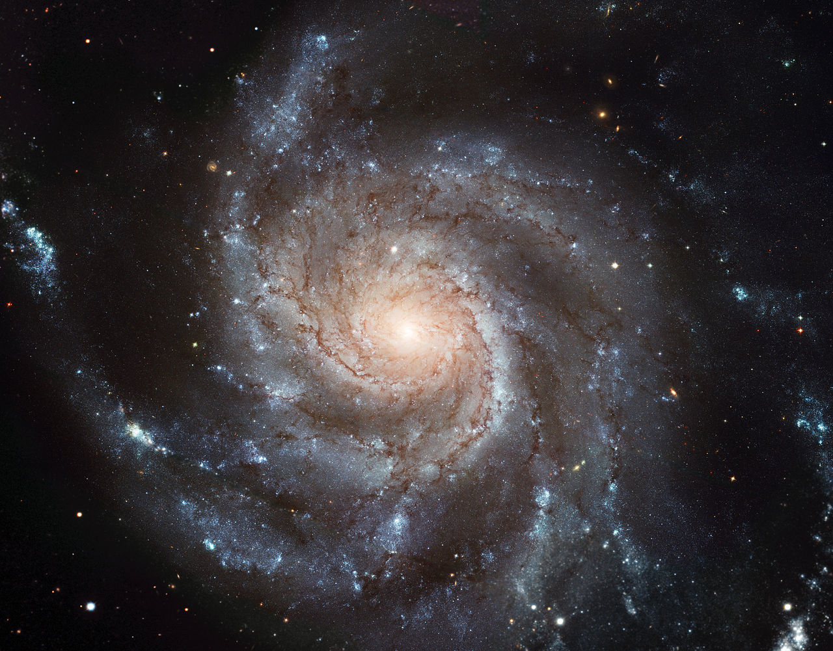
If we could see dark matter…
Dark matter ‘halo’ – self-gravitating dark matter structure
Galaxy - gas+stars
Dark matter ‘halo’ ~100x more extended than galaxy stars
Galaxy Image Credit; ESO/NASA
Millenium Simulation, Springel et al. 2005

Slide 5

Many dark matter candidates
Weakly Interacting Massive Particles (WIMP miracle)
Sterile Neutrinos (neutrino masses)
Axions $≪$eV scalar field, would explain strong CP violation problem
Primordial black holes (LIGO)
size of MW
Schive et al. 2014

Slide 6
Can we test these models?

Slide 7
Different dark matter models produce different dark matter halos
Cold Dark Matter e.g. WIMP
Warm Dark Matter – e.g. Sterile Neutrino
Credit: Lovell et al. 2014

Slide 8
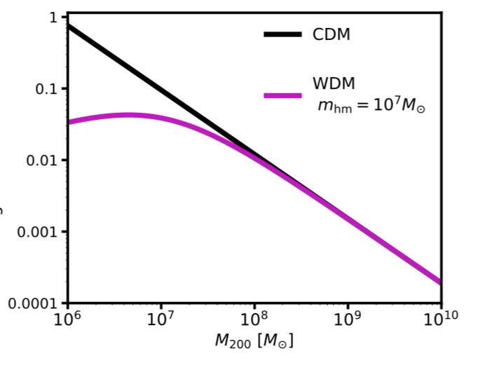
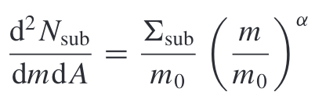
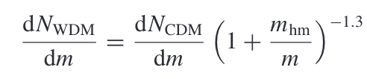
Different dark matter models produce different dark matter halos
Credit: Lovell et al. 2014
Cold Dark Matter e.g. WIMP
Warm Dark Matter – e.g. Sterile Neutrino
Projected Number/kpc²
Half mode mass characteristic cutoff scale
Halo Mass (M☉)
CDM mass fn WDM mass fn

Slide 9
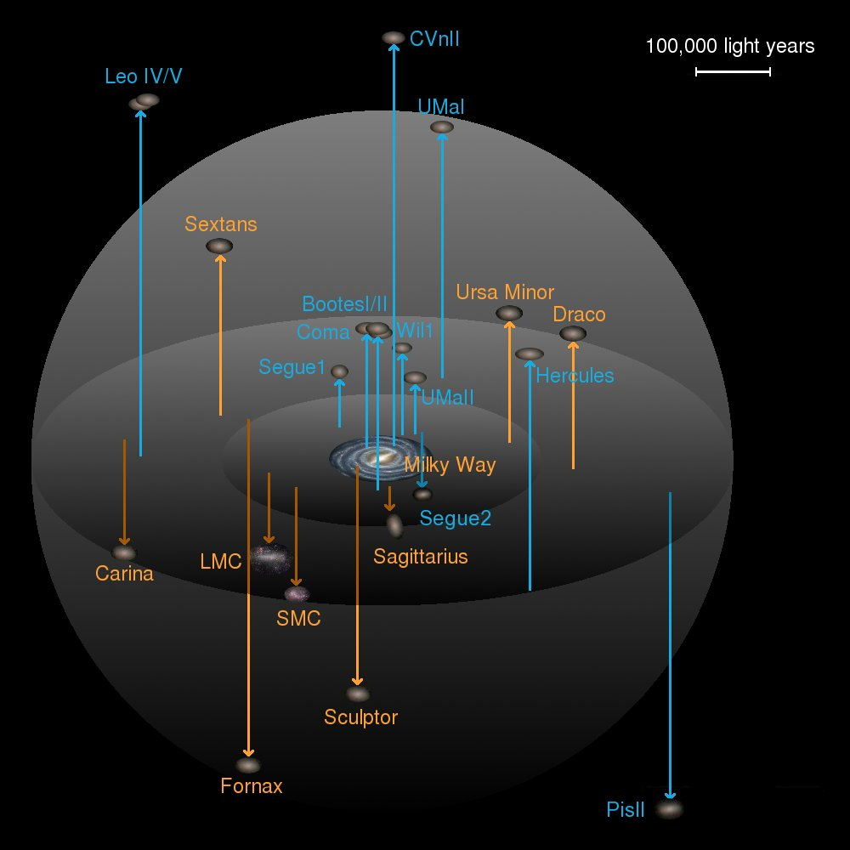
Dark matter structure measurements traditionally rely on galaxies as tracers
Cold Dark Matter Prediction
Observed Milky Way Structure
Credit: Lovell et al. 2014
Credit: J.T.A de Jong
Galaxies are collections of stars, which we believe to be embedded in a dark matter halos, so there are two solutions:
There are a large number of halos below some mass scale which do not contain enough gas or stars for us to see (almost certainly true)
Dark matter doesn’t form structure on small scales

Slide 10
Goal: Detecting halos in the dark regime
Fraction of satellites hosting a galaxy
Log₁₀(Peak subhalo mass)
Nadler et al 2020
Credit: Strigari 2008

Slide 11
Dark matter measurements with strong gravitational lensing
Credit: STSCI, GO-15177, 13732 PI Nierenberg

Slide 12
Signal of a perturbation in an unresolved source
Observed lens
Best 1 halo model fit
Magnification ∝ second derivative
Deflection (positions) ∝
first derivative
Gravitational Potential

Slide 13
Signal of a perturbation in an unresolved source
Observed lens
Perturbation needs to be localized and small scale – positions unperturbed
Best 1 halo model fit

Slide 14
With enough lenses we can statistically distinguish these scenarios
Cold Dark Matter e.g. WIMP
Warm Dark Matter – e.g. Sterile Neutrino
Credit: Lovell et al. 2014

Slide 15
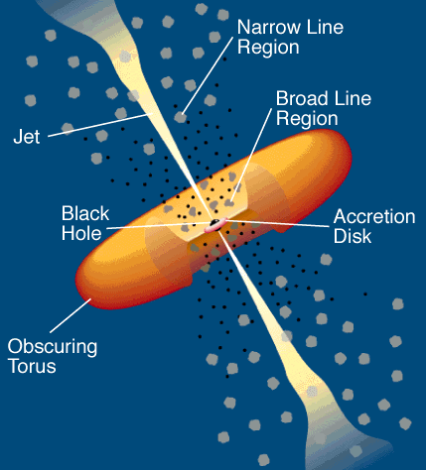
Need to use care:
Choose only lenses with elliptical deflectors to avoid impact from baryons
Source must be large enough to be unmicrolensed
Hsueh et al. 2017
Subhalo lensing
Stellar micro-lensing

Slide 16
Un-microlensed, Unresolved source types were rare
Radio jets - traditional, e.g. Mao and Schneider 1998, Dalal and Kochanek 2002
-Very rare, only 7 known, 2 contain disks

Slide 17
Advances possible thanks to
New source type – quasar narrow-line emission (Moustakas and Metcalf 2003)
+ Extended (10s to 100s of pc) (Mueller Sanchez et al 2011)
+ Detectable in virtually all quasars
- Requires spatially resolved spectroscopy of quasar images
Typical QSO spectrum

Slide 18
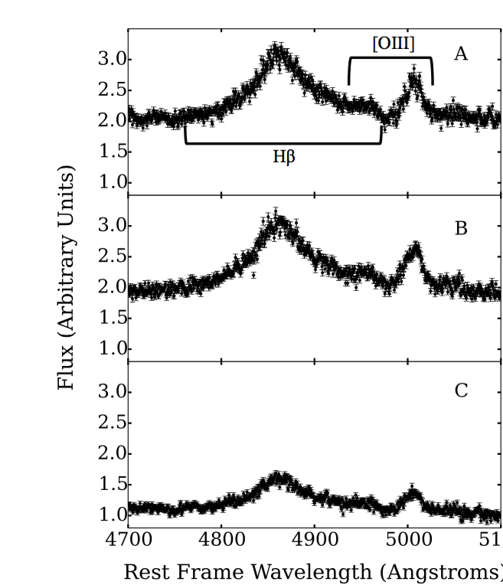
Measurement with integral field spectroscopy and adaptive optics at Keck
Keck OSIRIS-IFU with Adaptive Optics Extracted Spectra Perturbation detected
Uncorrected
Nierenberg et al. 2014

Slide 19
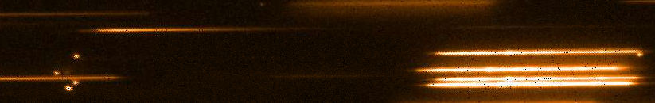
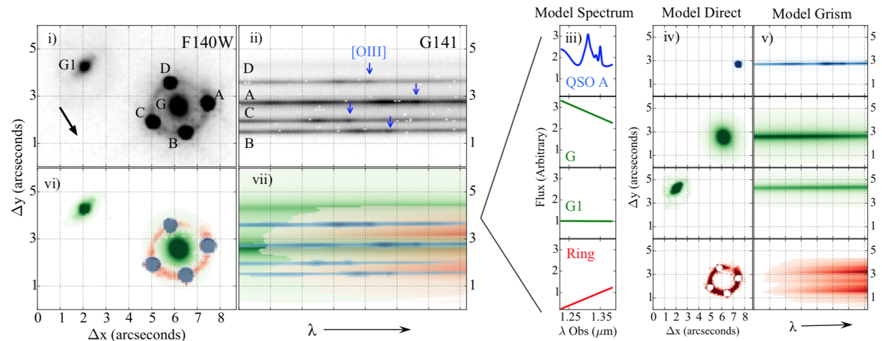
Measurement with HST-grism
GO-13732, 15177 (PI Nierenberg)
NL sample of 8 new lenses
Nierenberg et al. 2017

Slide 20
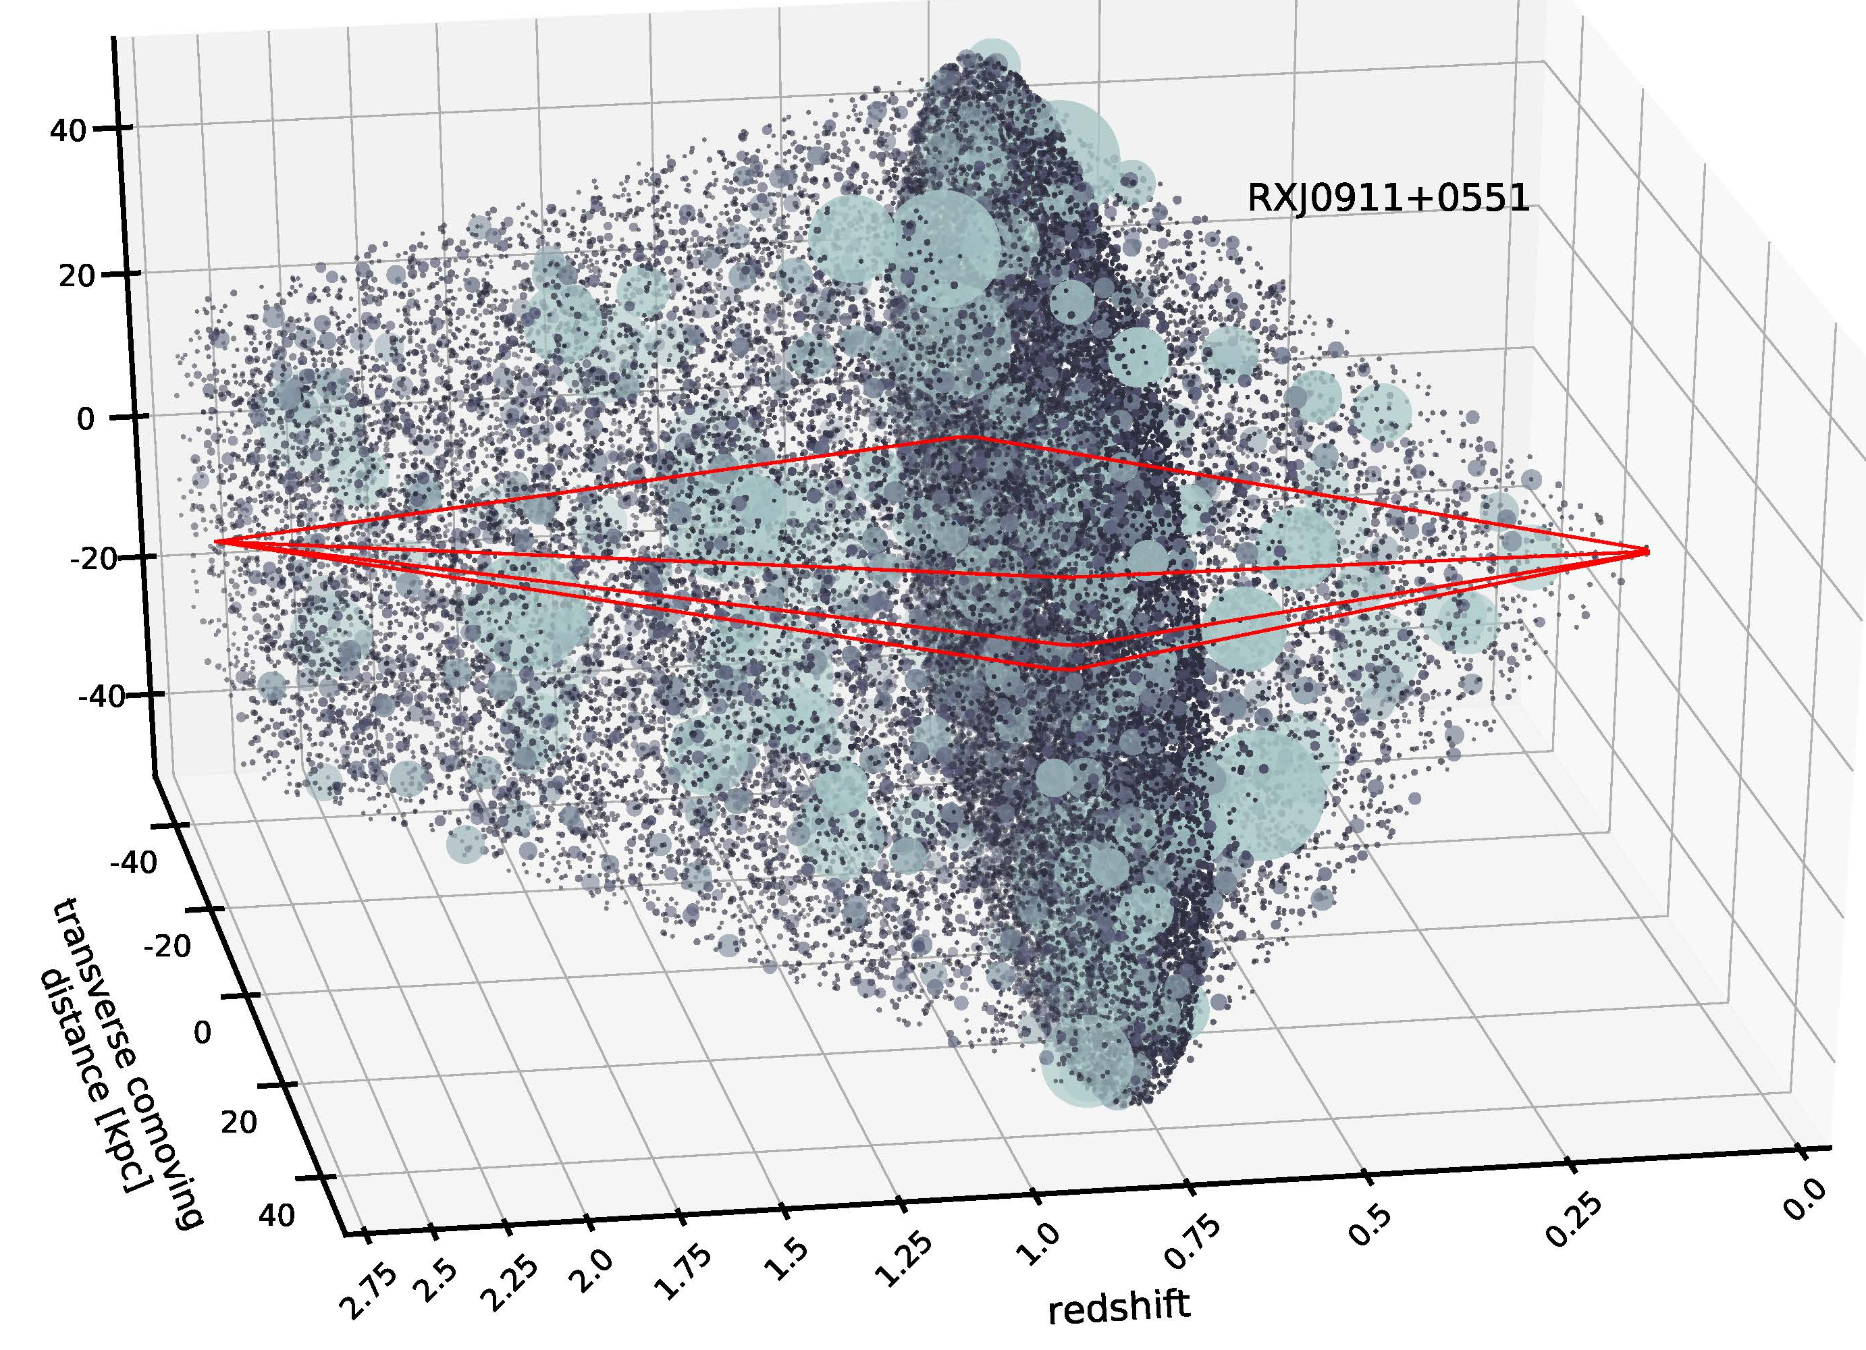
Comparison of flux ratios with predictions from full cosmological dark matter predictions
Subhalos
The mass function of halos bound to the main lens
Effects of tidal stripping and disruption
The spatial distribution of halos bound to the main lens
The mass function of halos outside of the main lens
The mass-concentration relation
Unknown finite source size
Line of sight halos
Gilman et al 2019, 2020

Slide 21
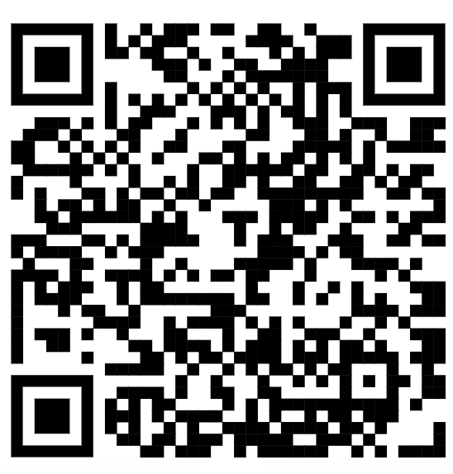

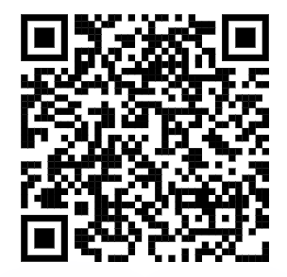
All software is open source and publicly available on github
Lenstronomy: All data analysis and gravitational lensing calculations. (Birrer and Amara 2018, Birrer et al. 2021)
PyHalo: Generates populations of dark matter halos and profiles along the line of sight and in the main lens. (Gilman et al. 2022)

Slide 22
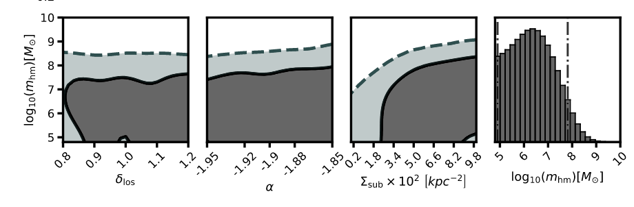
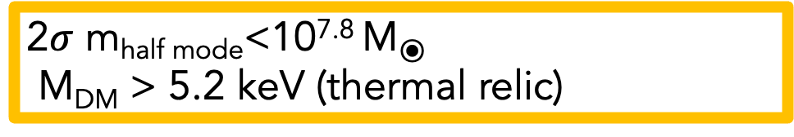
NL Flux Ratios Results from 8 lenses
2$σ$ m_{half mode}<10^{7.8} M⦿
M_{DM} > 5.2 keV (thermal relic)
C.f. consistent results also from Hsueh et al. 2020 with radio loud quads
Gilman, et al. 2020a

Slide 23
Measuring the halo mass function where majority of halos are dark
Est. transition to majority of halos dark

Slide 24
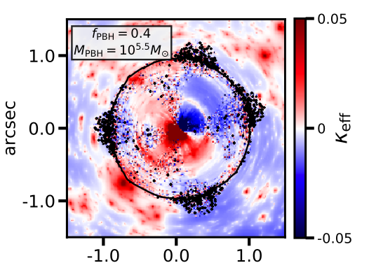
Many other dark matter models tested
SIDM with resonance (Gilman et al. 2022)
Fuzzy dark matter (Laroche et al. 2023)
Primordial power spectrum (Gilman et al. 2022)
Primordial black hole dark matter (Dike et al. 2022)
Four different sterile neutrino models (Zelko et al. 2022)
Dike et al. 2022
Gilman et al. 2022

Slide 25
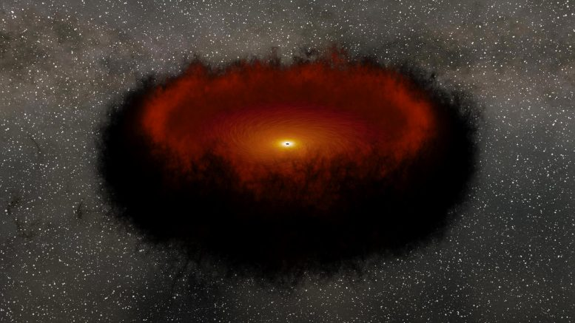
Another source for detecting dark matter: Quasar ‘warm’ dust
Simulation from Caltech/JPL, based on Yang et al 2020

Slide 26
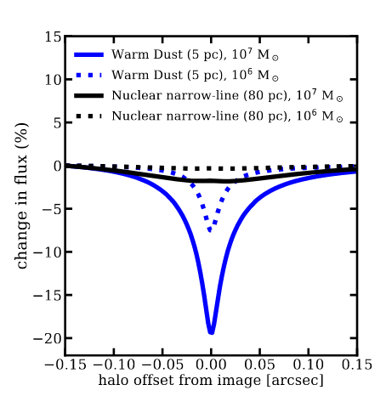

Why the warm torus?
Smaller source sensitive to individual 10⁶ M⦿ perturbers
Narrow line
Warm Dust
Nierenberg et al. 2023
Notes:
The cold torus is a compact region emits in the rest-frame mid-IR (requires JWST)
Benefits relative to NL- very bright, and can be measured with just a few broad bands of JWST imaging (no spectroscopy required) – fewer systematics with deblending spectral features
Intrinsically smaller than NL, so sensitive to lower mass halos

Slide 27
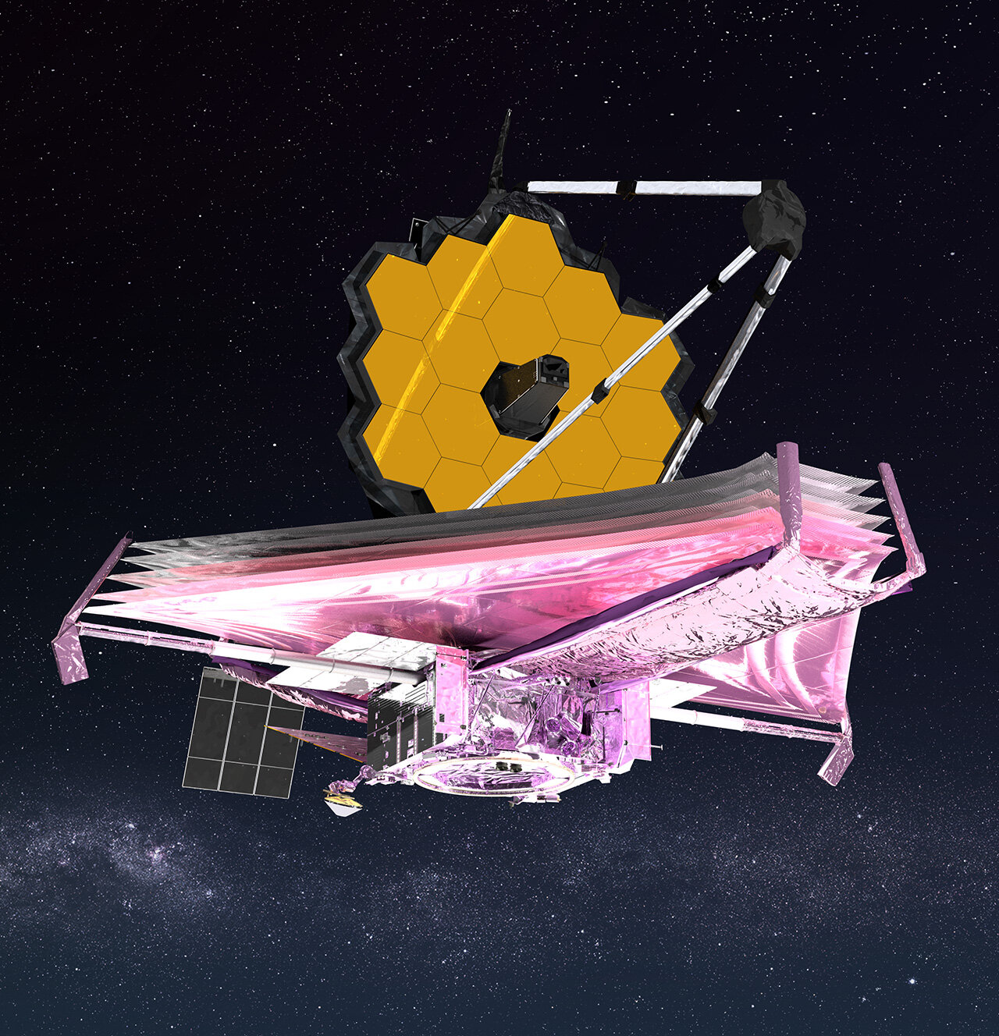
31 Mid-IR flux ratios with JWST
GO-02046 PI Nierenberg
All known quadruply imaged quasars detected in WISE W4, with image separation greater than 0.1 arcsecond, and no disk in the deflector
43 hours, medium program
Mid-Infrared Instrument (MIRI) broad band imaging at 5.6, 12.8, 18 and 25.5 microns
Short exposures 55s for F560, F1280 and F1800W, 570s for F2550W.

Slide 28
First data
DES J0405
Nierenberg et al 2023.

Slide 29
JWST Measurement Precision
We achieve about 2% measurement uncertainties on the warm dust flux ratios
Sensitive to completely dark, dark matter halos if they exist.
Nierenberg et al. 2023

Slide 30
Stay tuned for dark matter measurement from first 10 systems mid December.
Look for Keeley et al. !

Slide 31
Forecast constraint based on flux ratio precision
We will detect completely dark halos if they exist
Forecast based on Gilman et al. 2019

Slide 32
The future- JWST-ELT synergy

Slide 33
Thousands of quadruply imaged quasars will be detectable in LSST Euclid and Roman
LSST
What are the best ways we can take combine the advantages of JWST and ELTs?
Oguri and Marshall 2010

Slide 34
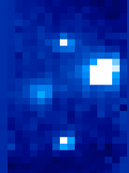
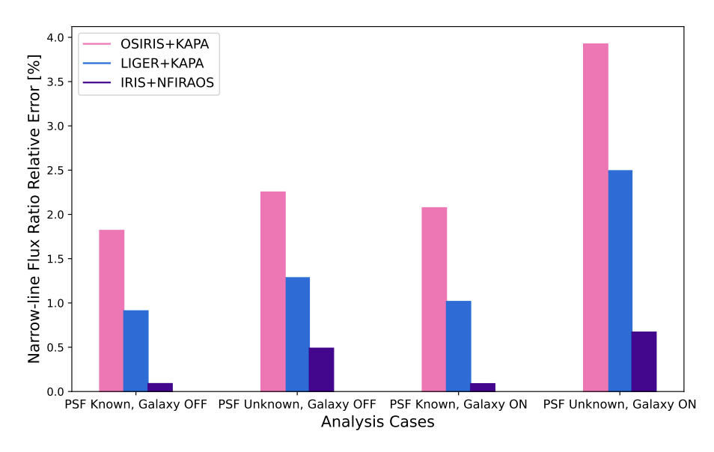
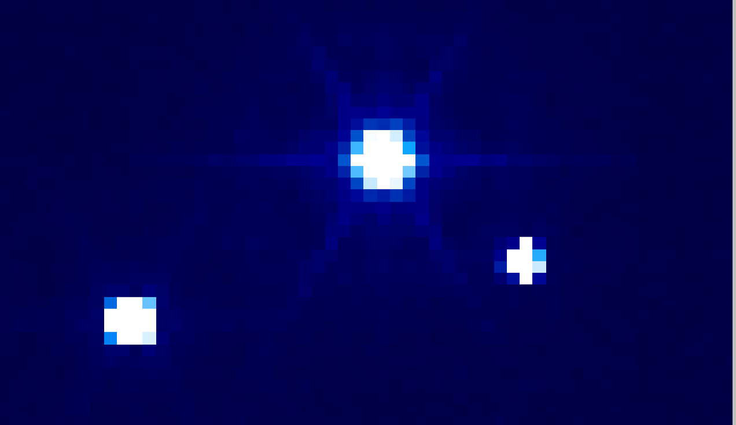
Measuring narrow-line flux ratios with IRIS
OSIRIS Kbb 100 mas, 900s
With just a few minutes on TMT we reach our target flux ratio goal
1 2 3
Flux Ratio Precision ( %)
IRIS K 50 mas, 10s
Zelko et al. 2023 (600s exposures)
IRIS Simulation by Nils-Erik Rundquist (UCSD)

Slide 35
The synergy I Multiple Source Sizes
Our signal is degenerate in perturber position/mass space
With two source sizes we gain information about the mass scale
Strategy: Measure narrow-line and mid-IR flux ratios for as many lenses as possible
JWST NIRSPEC takes ~4000s vs ~100s for ELT for NL flux ratios
Nierenberg et al. 2014
Nierenberg et al. 2023

Slide 36
Synergy II – numbers vs sensitivity
TMT slew and acquisition time 3 minutes
JWST slew and acquisition time 30 minutes
ELT Strategy:
Hundreds of lenses
Trends with redshift and host properties
Detection of rare events
JWST Strategy (fantasy)*:
One hundred lenses
- Detect the lowest mass halos
Example Dark Matter science cases:
-Subhalo properties as a function of host properties
-Field halo evolution
-Mass-concentration relations
Example Dark Matter science cases:
-Improving low-mass limits on dark matter models such as WDM, SIDM, primordial black hole dark matter ect.

Slide 37
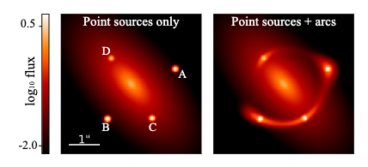
Synergy III – Lensed quasar host galaxy
Strategy: High resolution imaging from ELT gives extremely precise macromodel constraints, and enables detection of massive subhalos near lensed arc as well as the point sources
HST quality image
Quasar host galaxy gives factor of ~2-5 improvement in model precision -> ~0.5 dex improvement in half mode mass
Simulation by Simona Vegetti
Oh et al. (in prep)

Slide 38
Conclusions
JWST and Keck can provide some of the best constraints on a broad variety of dark matter models
ELT with JWST will enable a significant improvement on the sample size, and sensitivity, enabling us to extend our measurement to hundreds of lenses

Slide 39
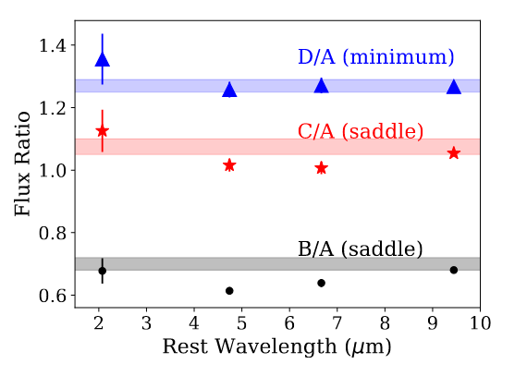
Flux ratios vs. wavelength
Nierenberg et al. 2023

Slide 40

Microlensing – micro-arcsecond perturbations to a gravitational lens
Magnification due to stars in the lens galaxy
Continuum source ~$μ$as
Radio source ~mas
Gardsten et al. 2009
Stalevski et al. 2012
Some people study microlensing to learn about source/microlens properties

