Slide 1
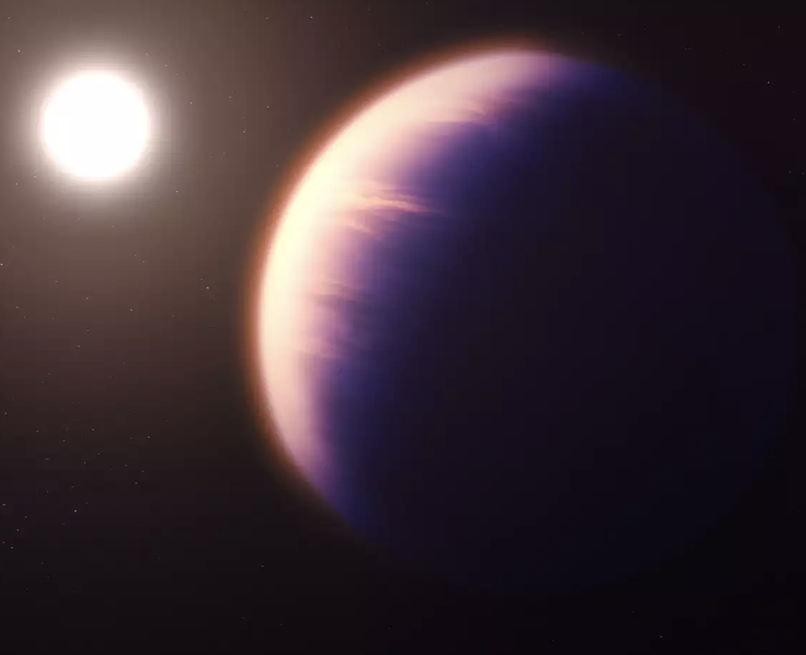
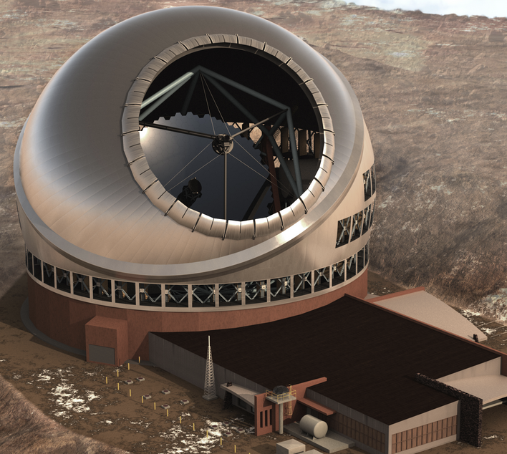
Exoplanetary System Imaging in the Combined Era of Ground and Space-based Vantage Points
Kimberly Ward-Duong
Assistant Professor, Smith College
Science Member, JWST Telescope Scientist GTO Team
ELT Science in Light of JWST– Dec. 12, 2023 – UCLA

Slide 2
Outline
Overview of direct imaging of exoplanetary systems
JWST capabilities (direct imaging, spectroscopy, contrast performance) and recent and upcoming science
Comparison with ELTs – what do we have on the horizon?
ELT capabilities and complementarity – Where will JWST continue to be fruitful? Where will ground based observations have an advantage? (some prognostication)

Slide 3
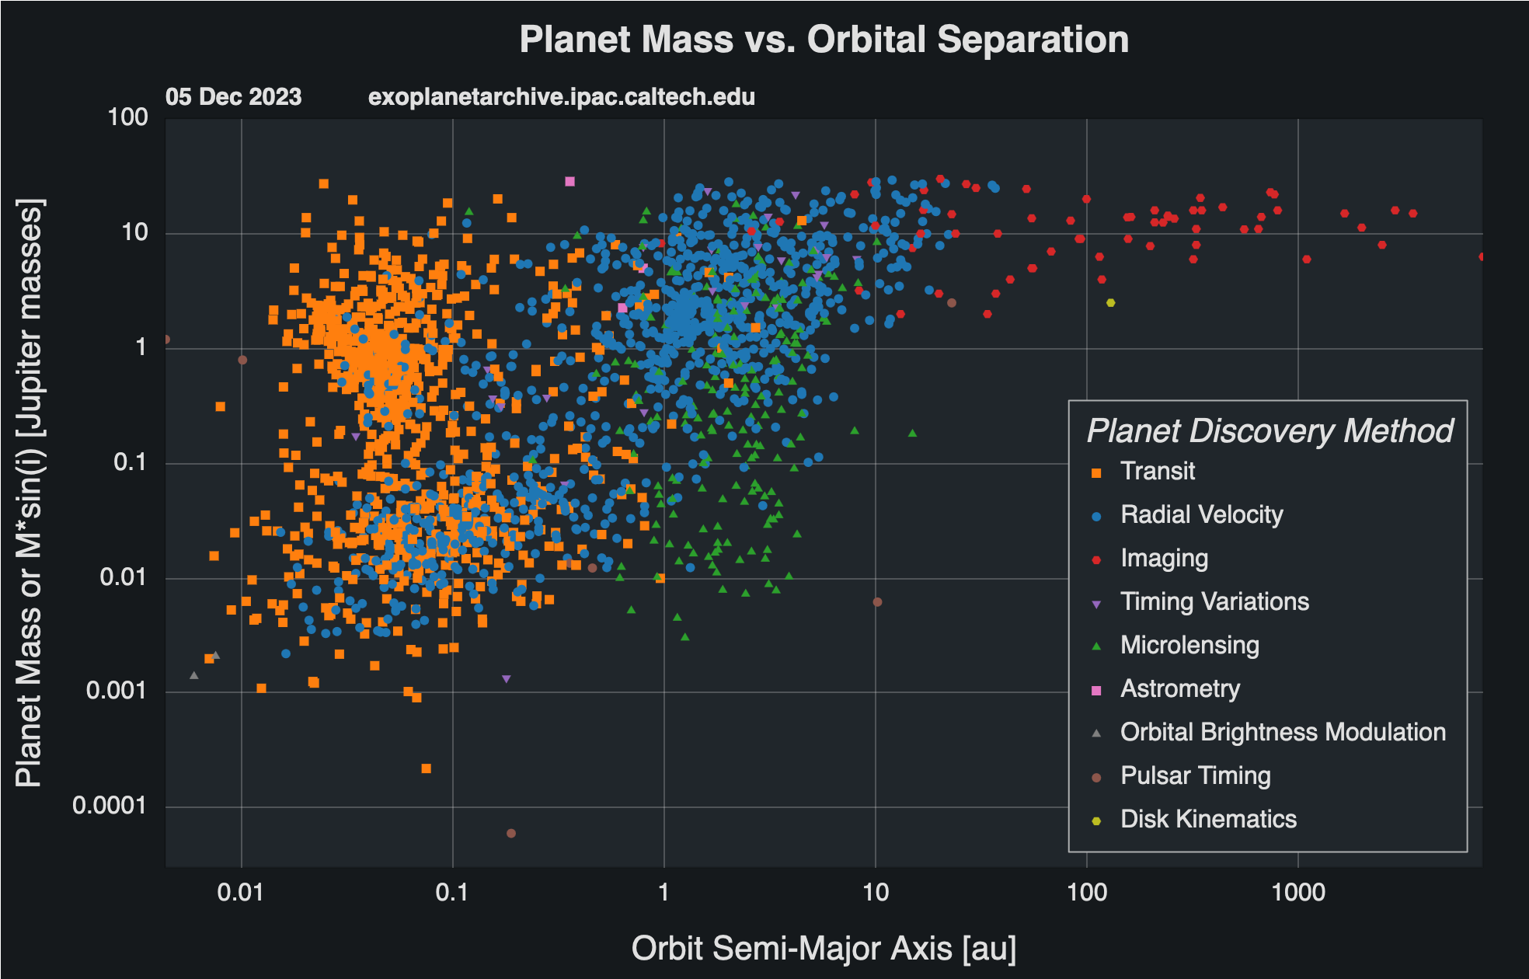
The Classic Exoplanet Plot

Slide 4
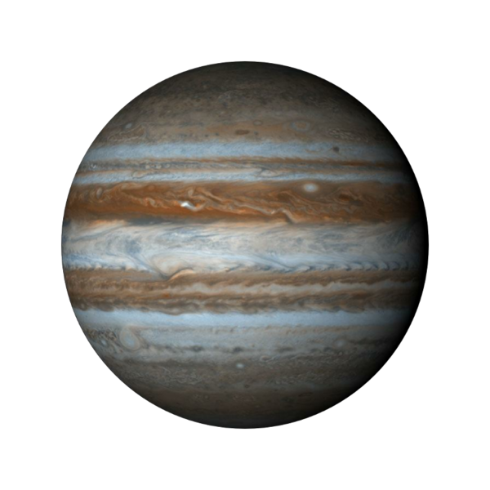
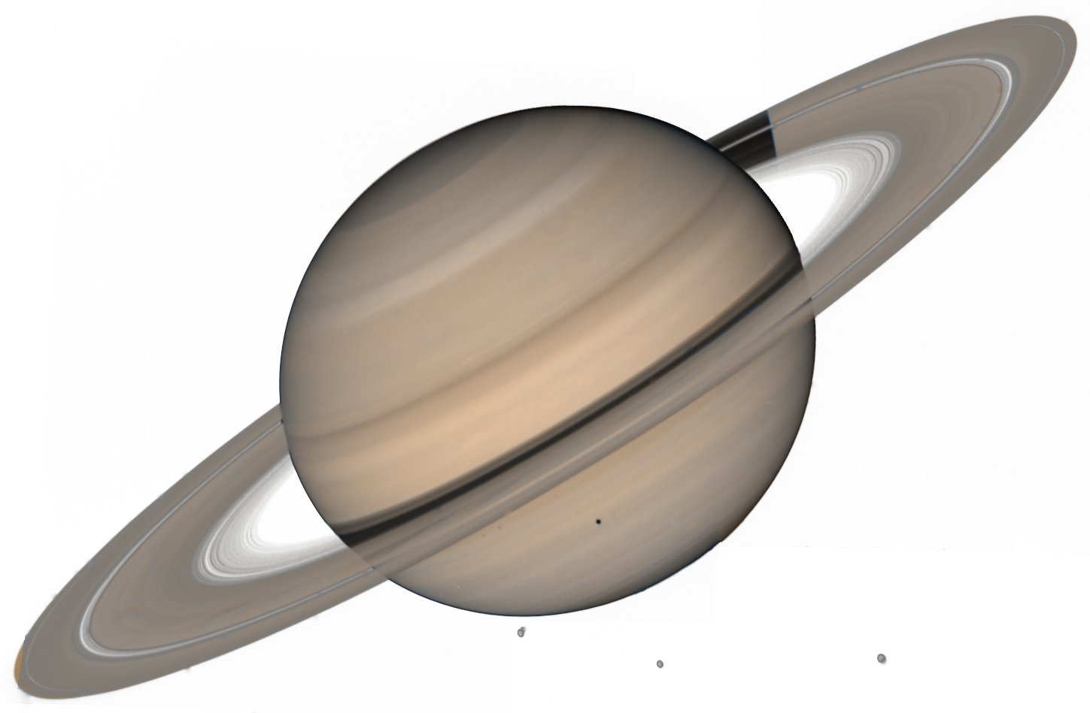
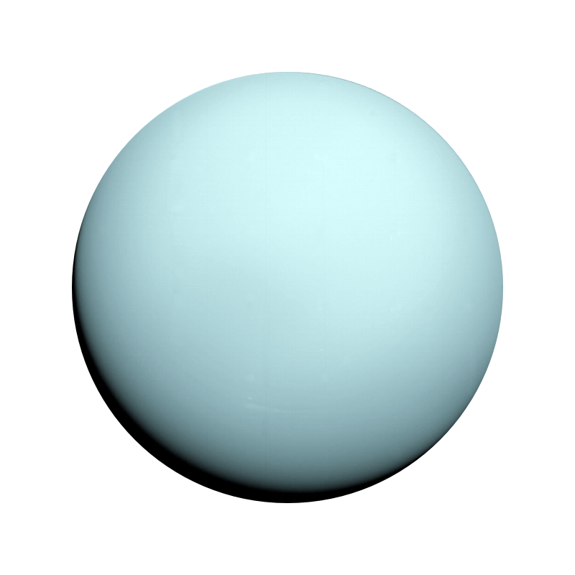
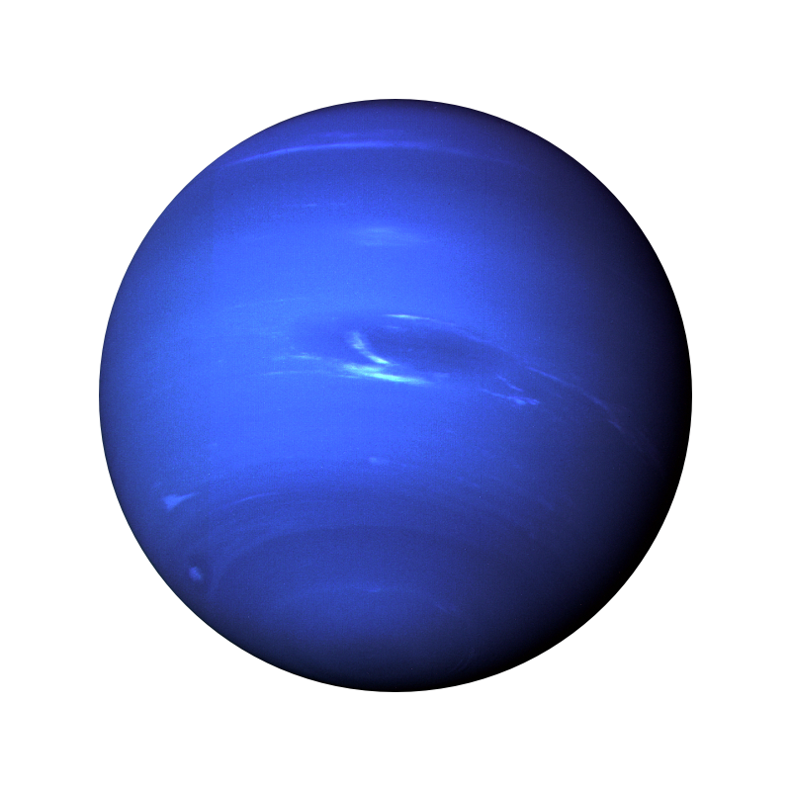
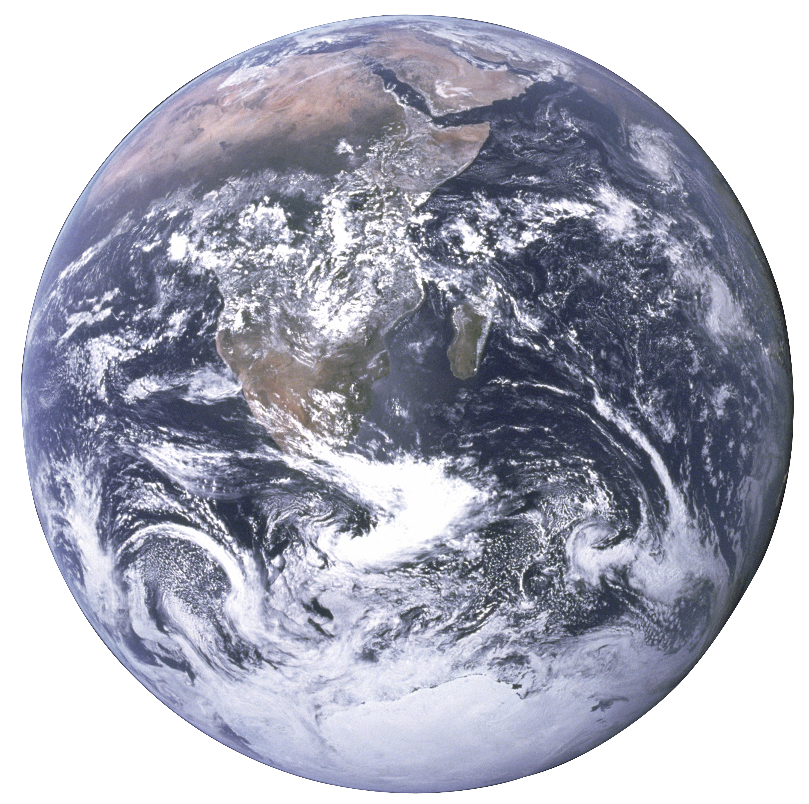
The Classic Exoplanet Plot
Jupiter
Saturn
Neptune
Uranus
Earth

Slide 5
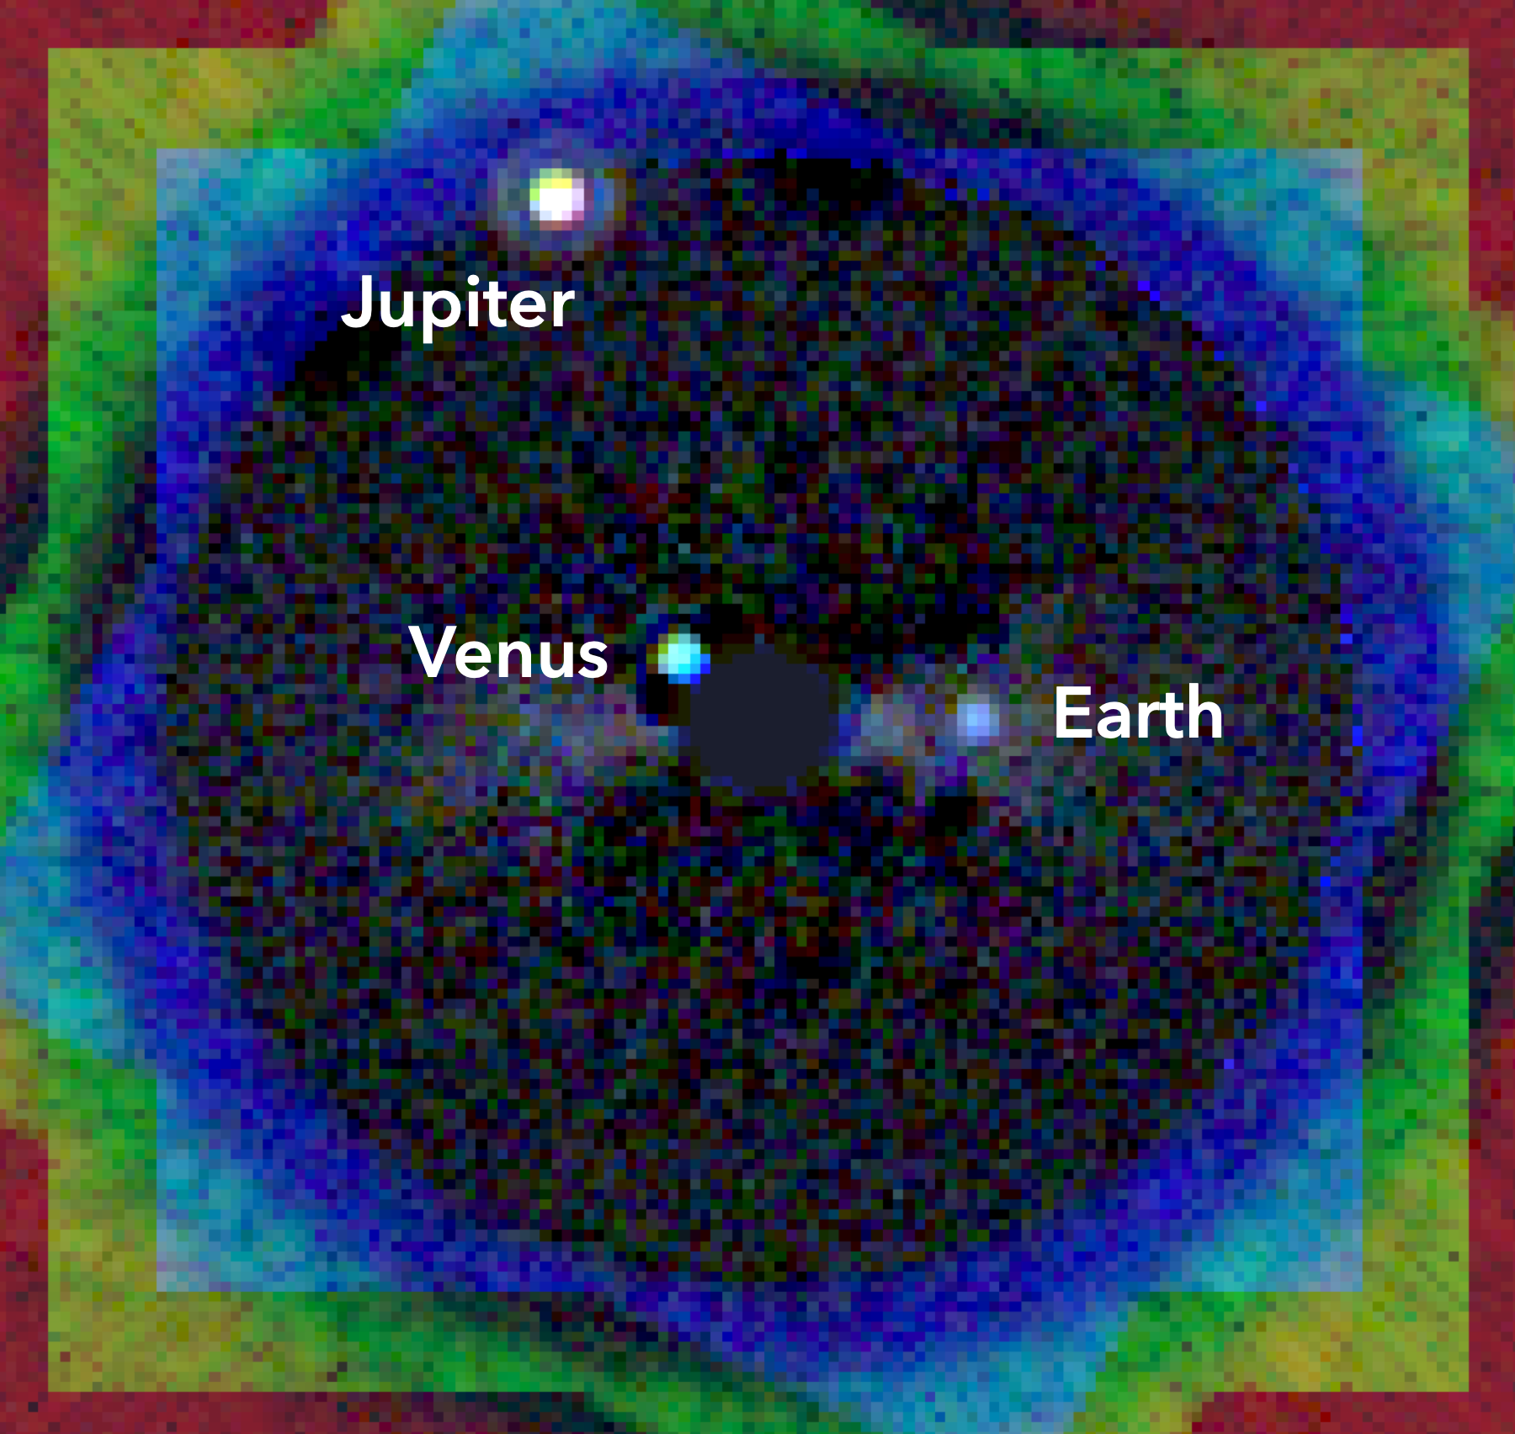
Foundations of High Contrast Imaging
Goal: Factor of 10⁶ (young Jupiter) to 10⁹ (Earth) fainter!
AO-fed Diffraction Limit
Contrast: ~10³
With Coronagraph
Contrast: ~10⁴
Differential Imaging
Contrast: ~10⁶
Simulated imaged inner solar system at 10 pc w/LUVOIR (image: L. Pueyo, A. Roberge et al.)
We are here!

Slide 6
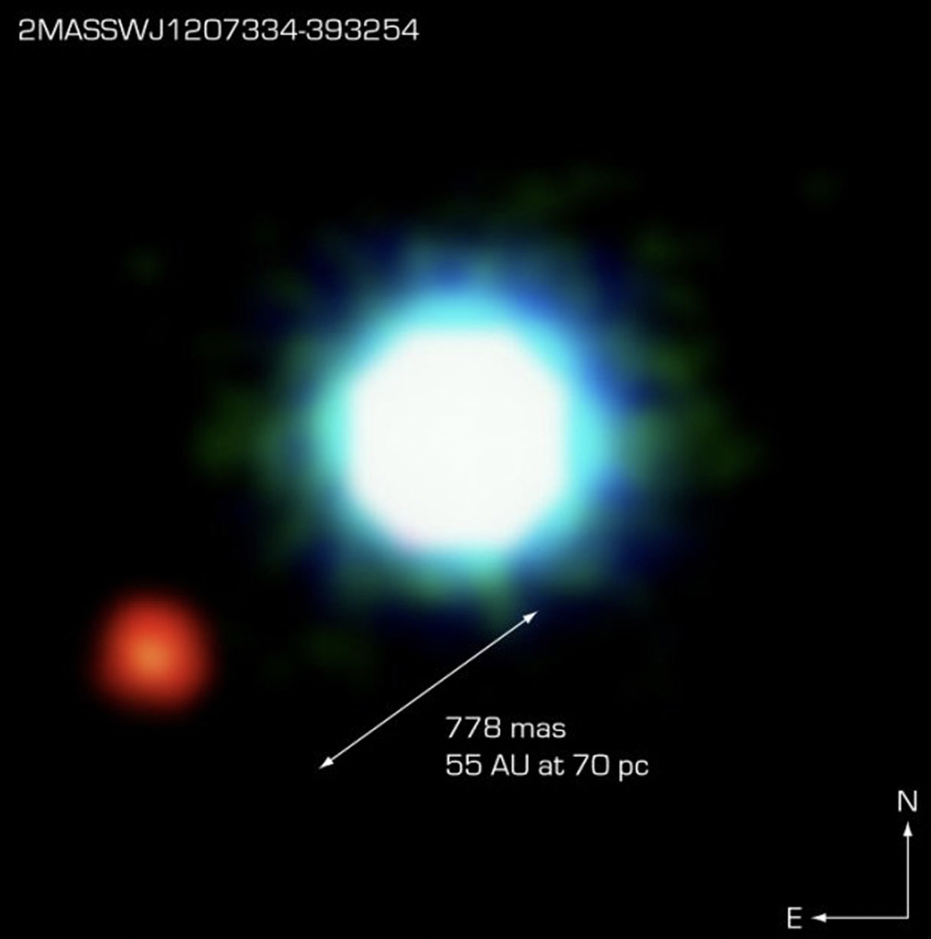
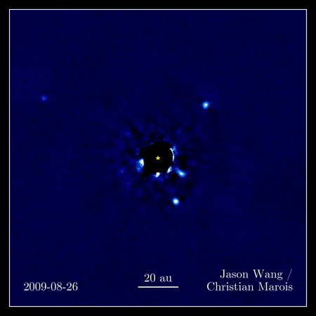
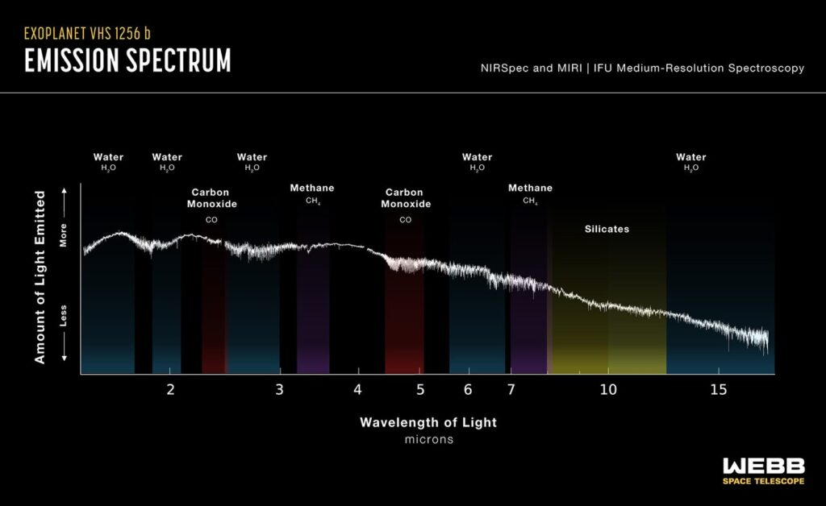
Impact of Technical Advances
Sensitivity
Unprecedented detector sensitivity (esp. at new wavelengths) – new populations of cool companions and novel circumstellar features
Chauvin et al. (2004)
Contrast at Close Separation
Pushing to smaller angular separations – moving ever inwards toward innermost architectures of planetary systems
Marois et al. (2008)
Spectral Resolution/Grasp
Broader wavelength coverage and/or higher spectral resolution – new chemistry, kinematics, evolutionary tracers
Miles et al. (2023)
Notes:
JWST has most recently improved all of these things, and the ELTs will continue that growth – so where are we now?

Slide 7
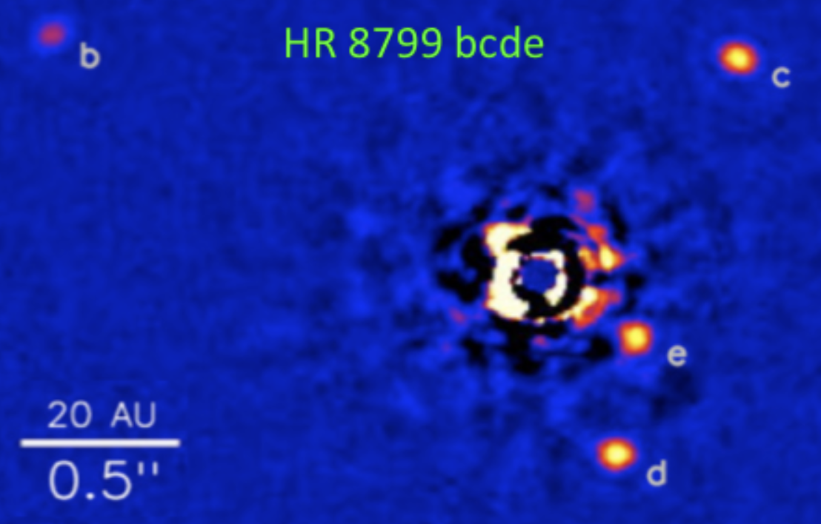
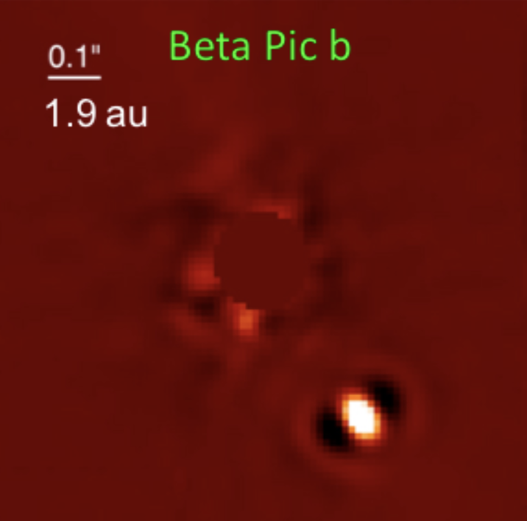
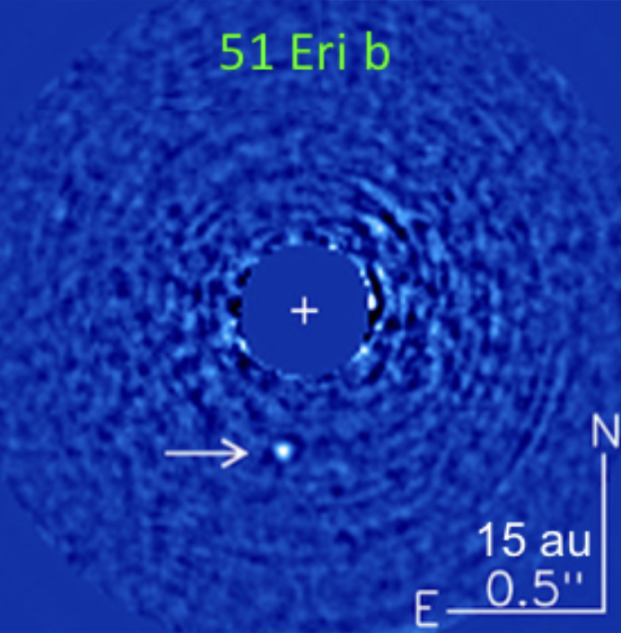
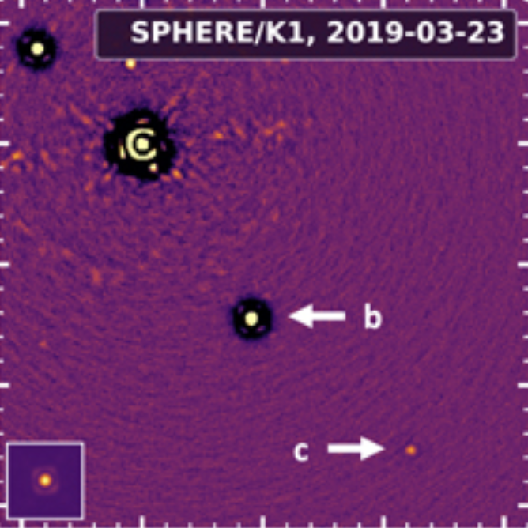
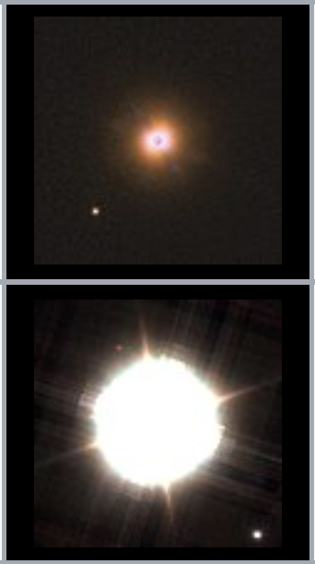
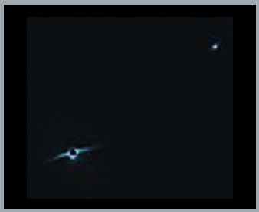
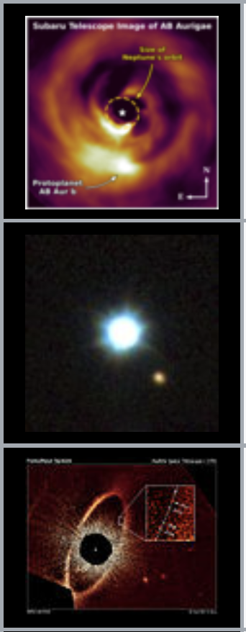
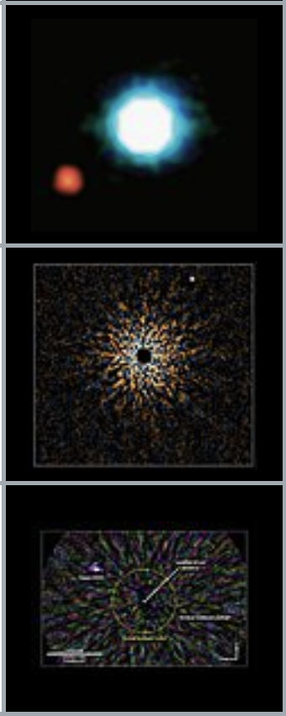
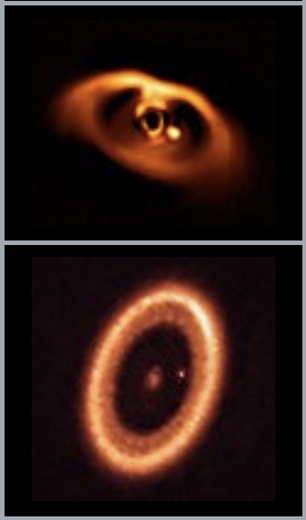
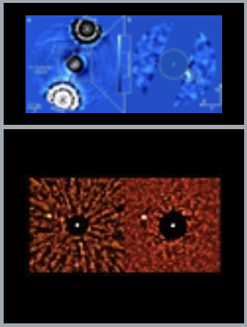
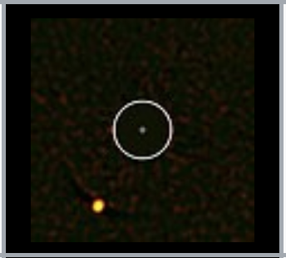
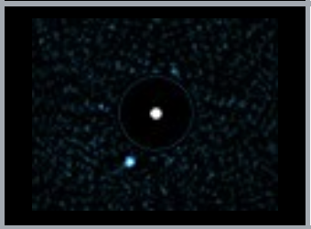
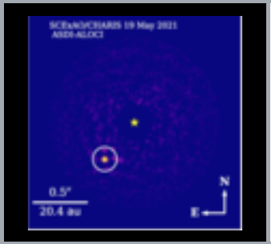
Current Landscape: Imaged Exoplanets
TYC 8998-760-1 bc
1”
95 au
Marois et al. (2010b)
Lagrange et al. (2019)
Macintosh et al. (2015)
Bohn et al. (2020)
Notes:
Down to the 1 mjup limit; multiple planet systems, systems with interior planets detected by RV and astrometry, and ensemble of other systems including candidates and uncertain masses

Slide 8
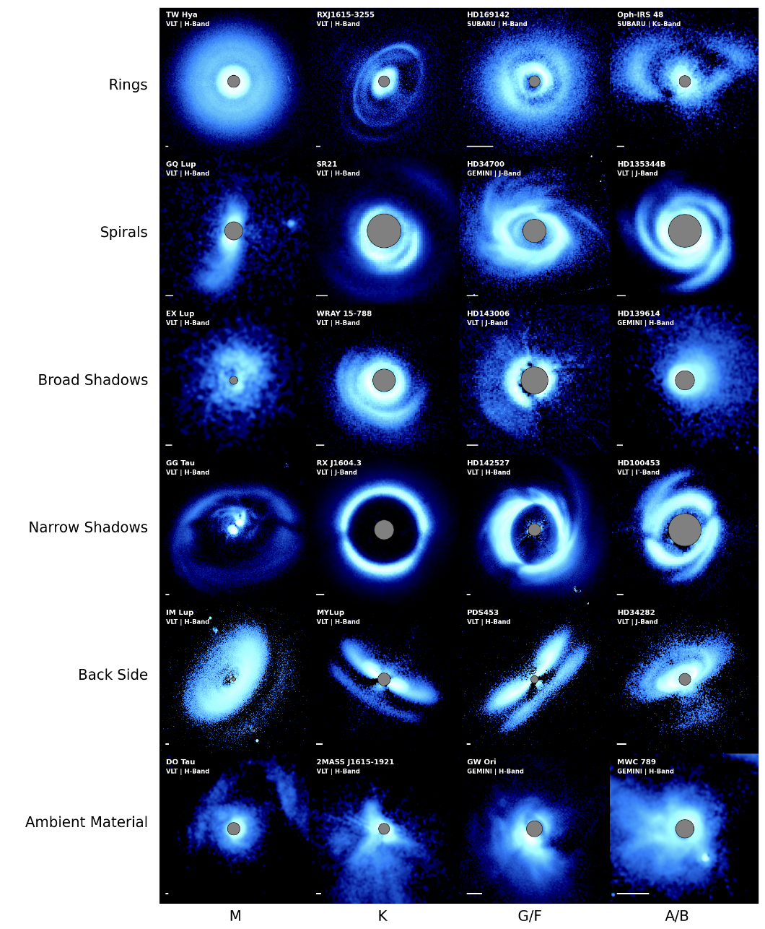
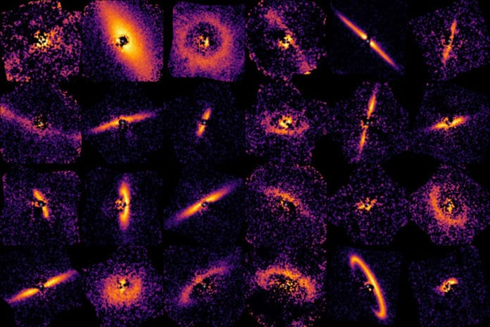
Current Landscape: Protoplanetary & Debris Disks
GPIES Debris Disks (Image: Tom Esposito)
Benisty et al. (2023)
Notes:
See Camryn Mullin’s talk from Monday

Slide 9
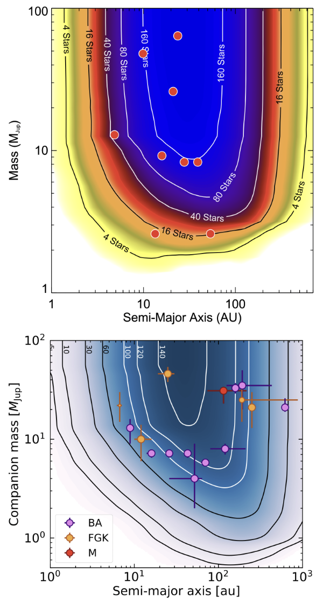
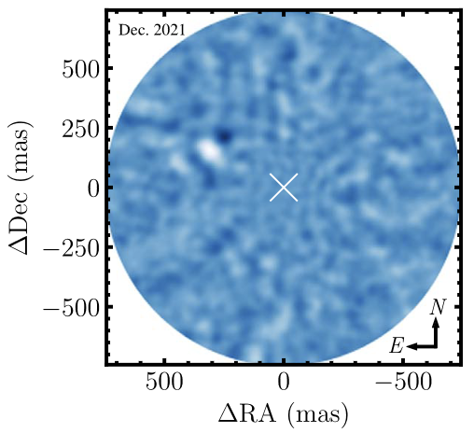
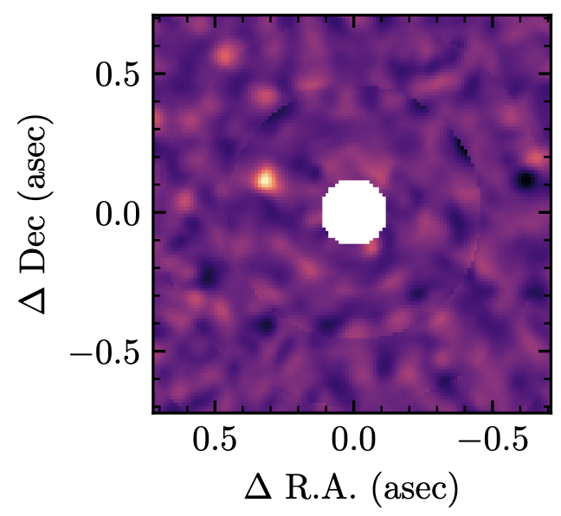
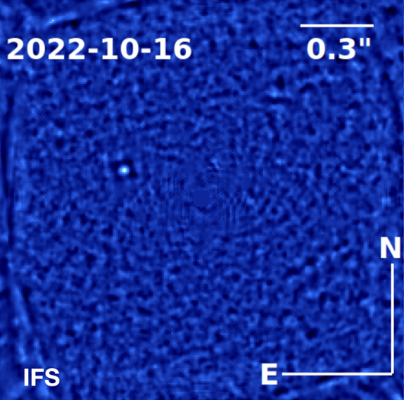
Imaging Demographics & Survey Strategy
Large statistical surveys
Targeted, highly-biased surveys
Hundreds of stars
‘Uninformed’ approach to avoid bias/ensure completeness
Statistically significant sample selection
Tens of stars
Pre-selected to likely harbor image-able planets: RV trends, Hipparcos-Gaia accelerations, youth/disks/proximity
Design: maximize detection yield
Example: AF Lep b
Nielsen et al. (2019), Vigan et al. (2021)
Franson et al. (2023), De Rosa et al. (2023), Mesa et al. (2023)

Slide 10
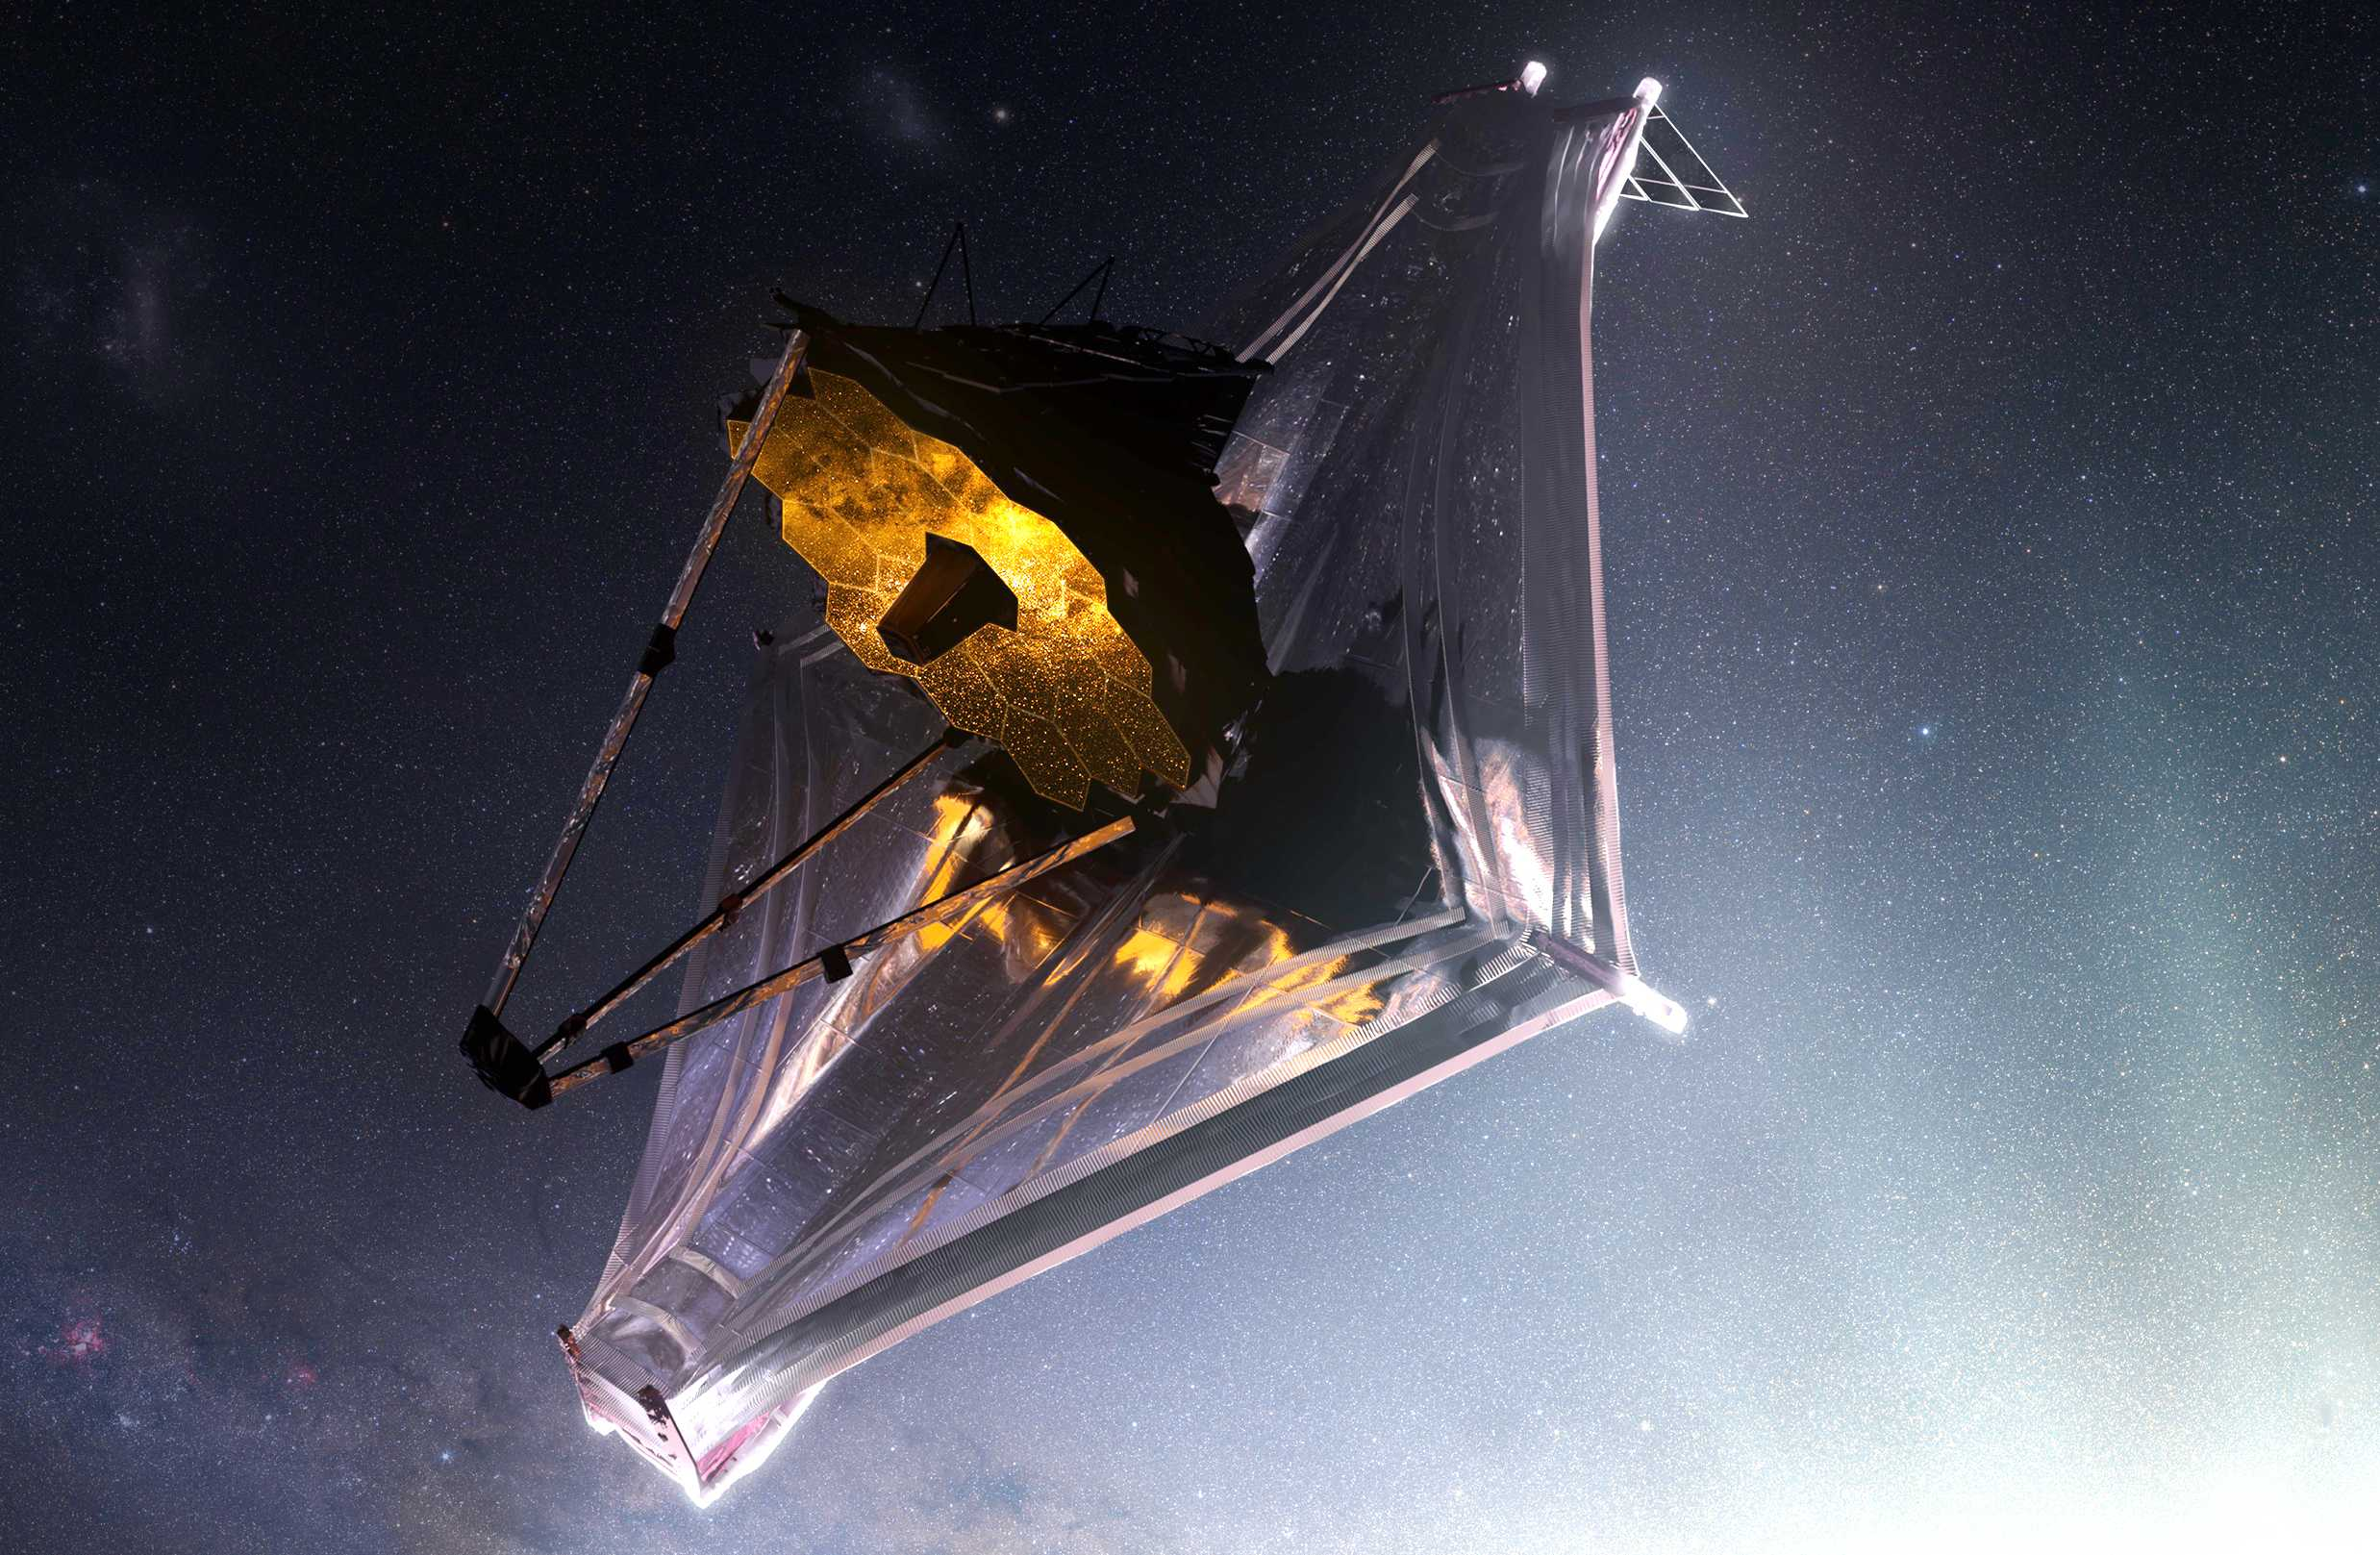
How does this connect to what we can do with JWST?
And what’s coming next?

Slide 11
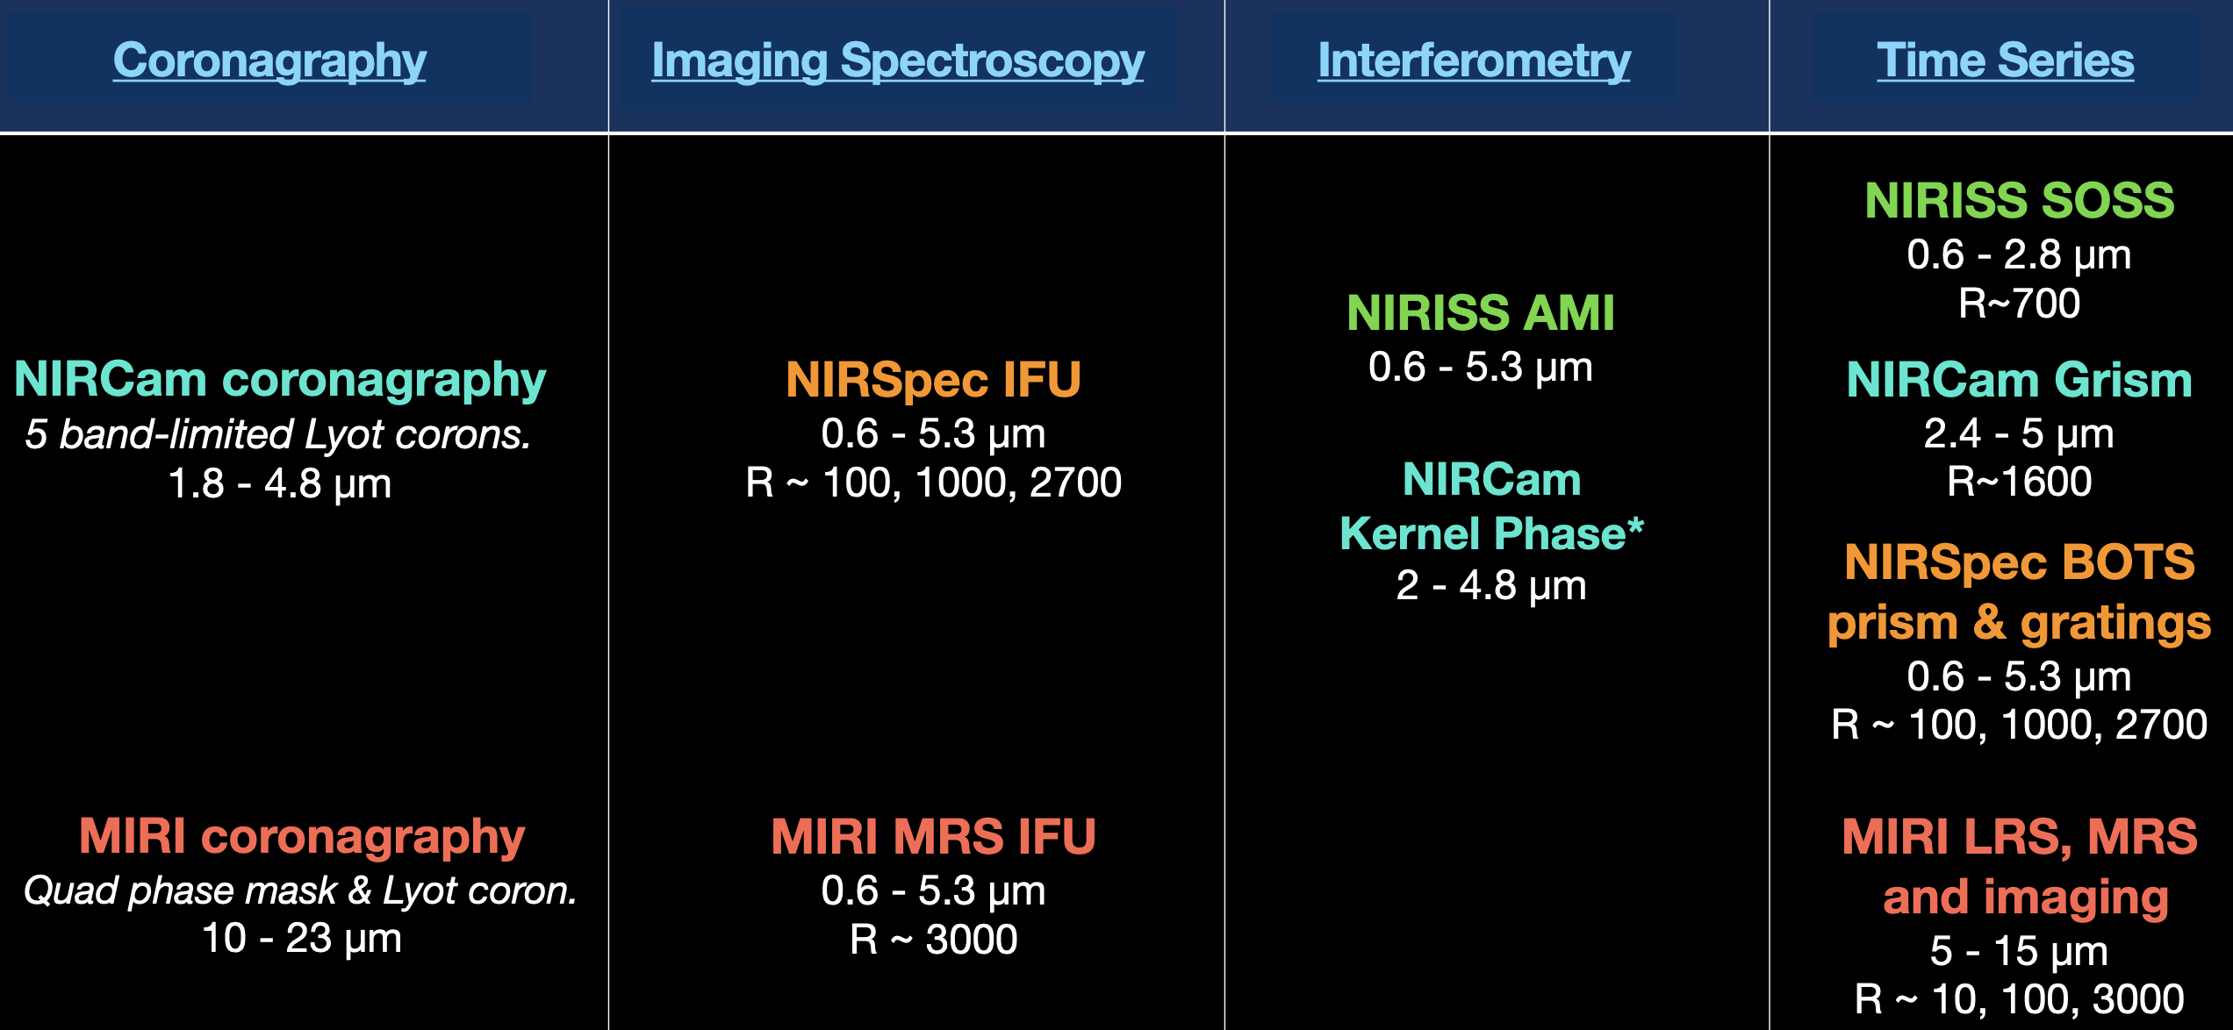
JWST Exoplanet and Circumstellar Disk Capabilities
Slide courtesy of Marshall Perrin

Slide 12
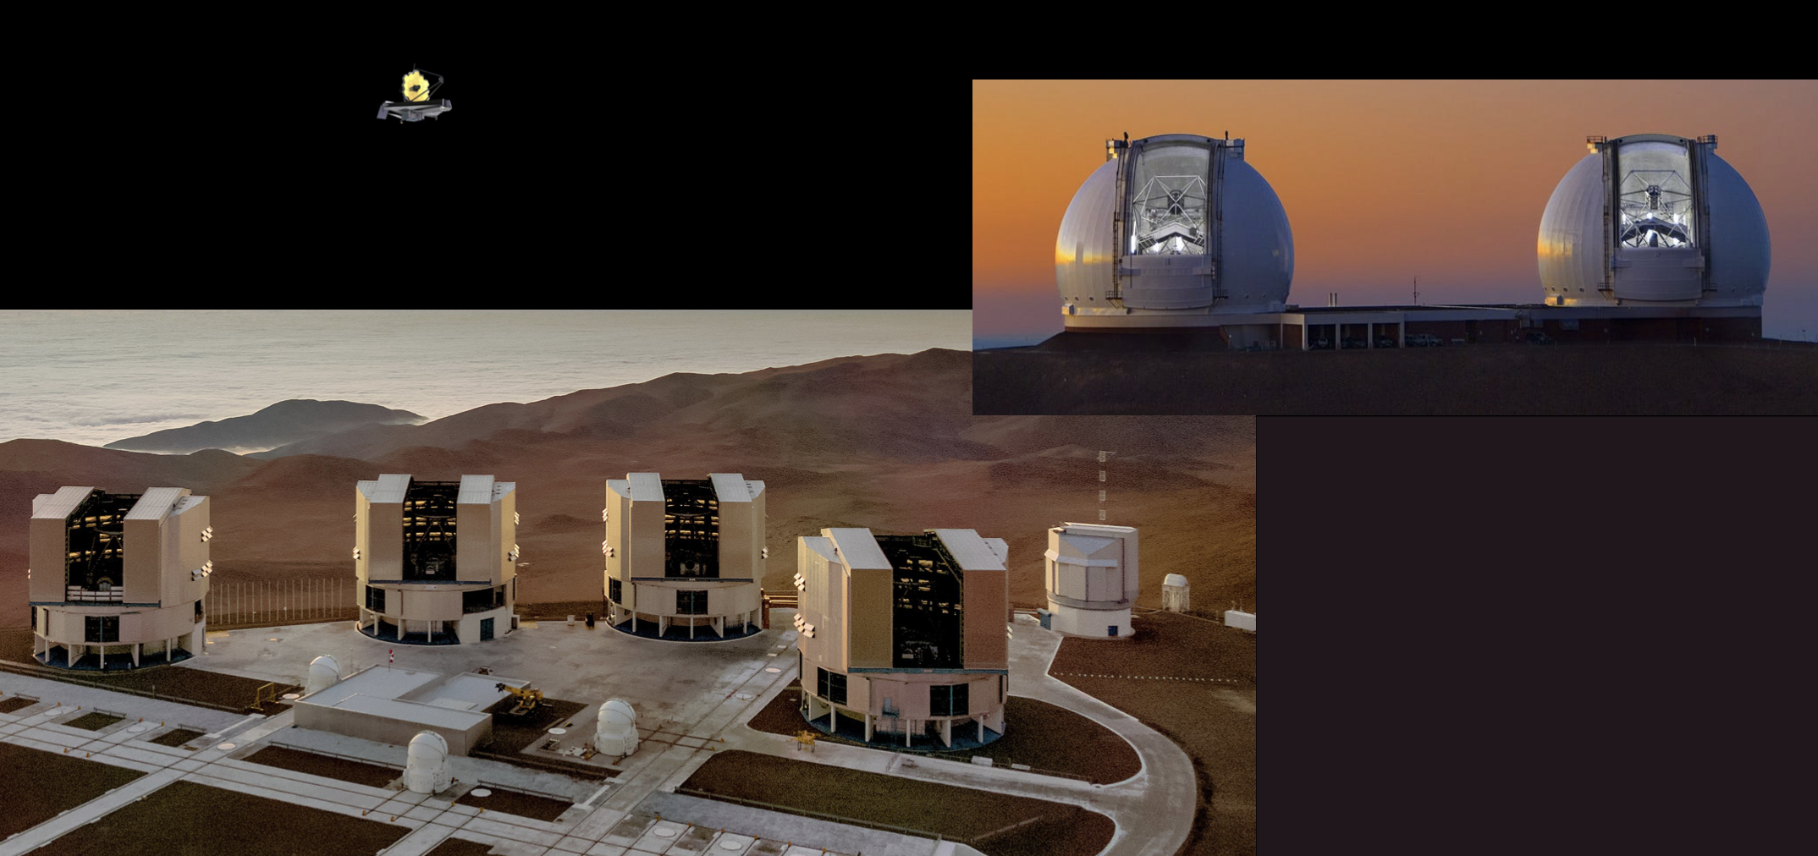
JWST is not that large of a telescope!
… but it IS exquisitely stable and not limited by atmosphere, telluric absorption
Adapted from slide courtesy of Marshall Perrin
Notes:
Significant implications in the thermal infrared

Slide 13
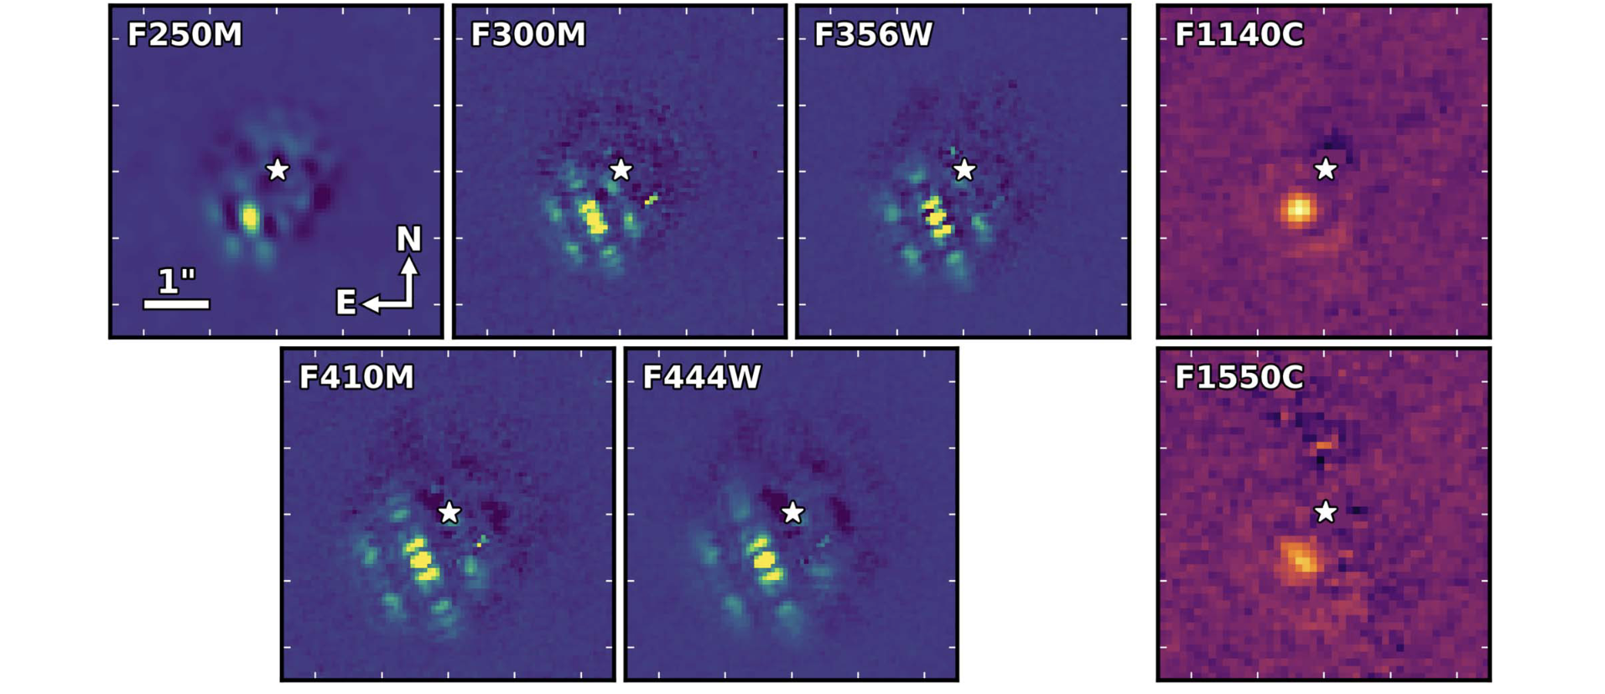
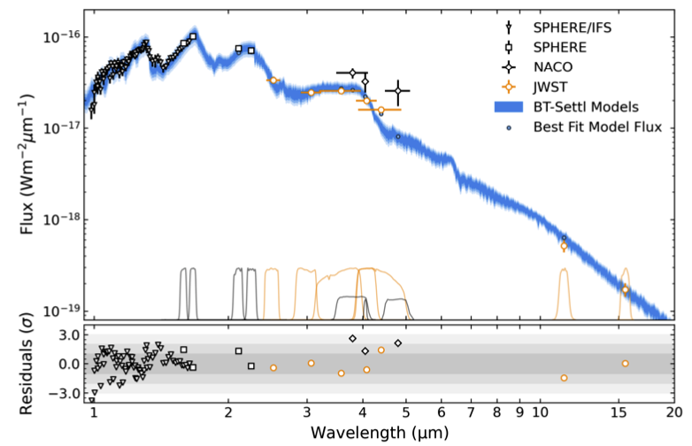
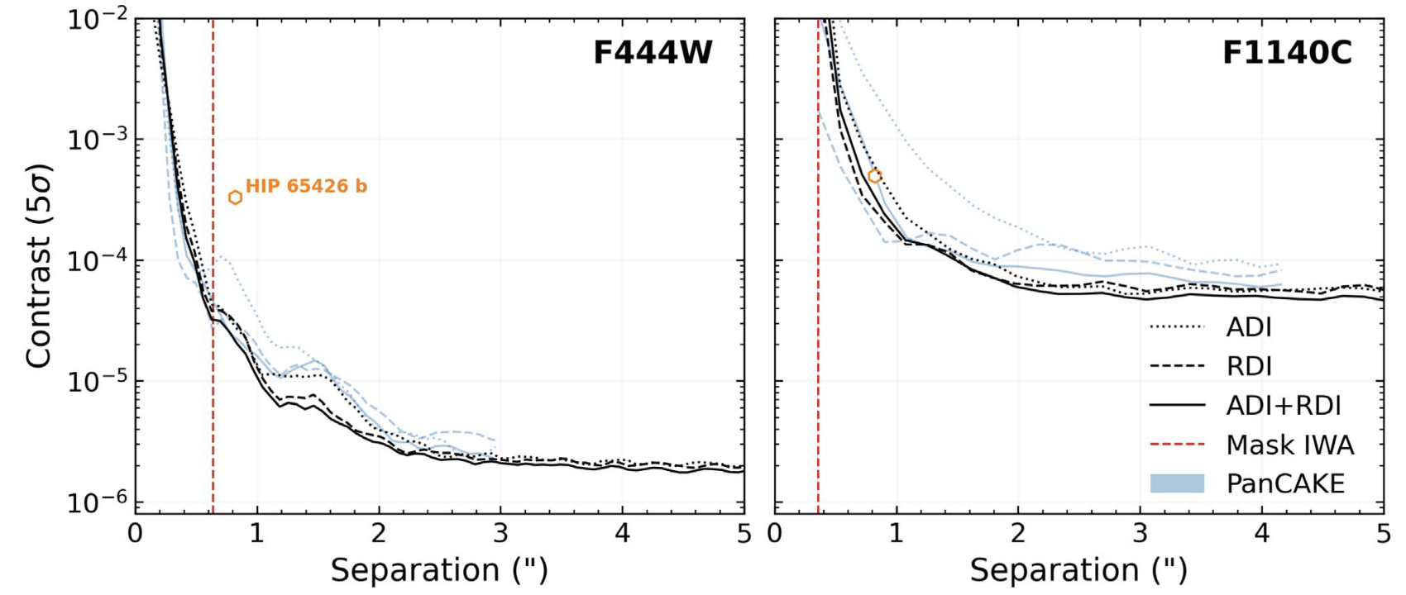
ERS: HIP 65426 b
The first 11-15µm images of an exoplanet
Carter et al. (incl. KWD), 2023

Slide 14
ERS: VHS 1256 b
NIRSpec + MIRI IFU Spectroscopy
Miles et al. (incl. KWD), 2023

Slide 15
Imaging in the MIR – HR8799bcde
10.65 µm
11.40 µm
15.50 µm
21 µm (non-coron)
Boccaletti et al. (2023)
All four planets detected (plus fun bonus: a z~1 background galaxy)
First resolved image of inner warm debris disk in system (15 au)
MIR photometry favors larger radii and cooler temperatures than those estimated from previous NIR observations (data discrepancy? atmospheric model limitation?)

Slide 16
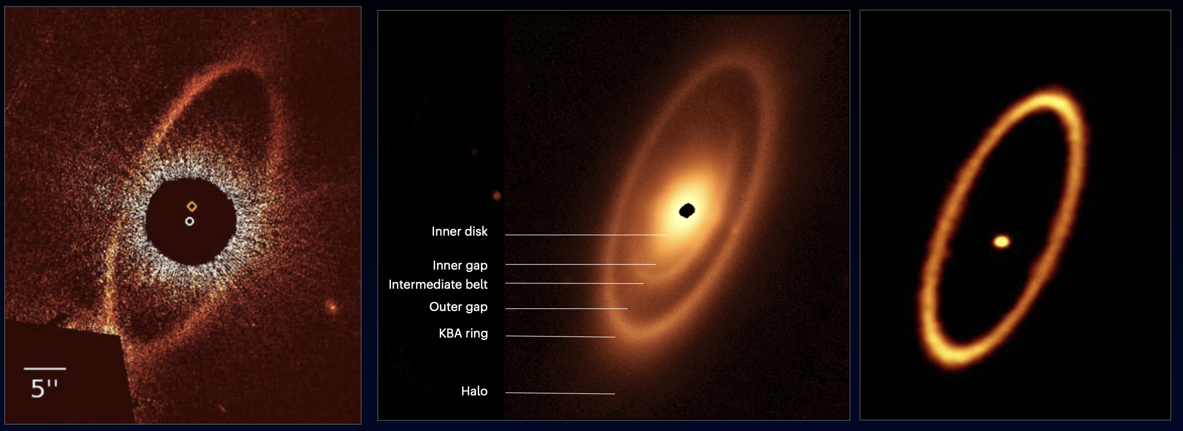
Imaging in the MIR – Fomalhaut
HST/STIS. (0.5 µm)
Kalas et al. (2008)
JWST/MIRI (25 µm)
Gaspar et al. (incl. KWD) (2023)
ALMA (1.3 mm)
Macgregor et al. (2017)

Slide 17
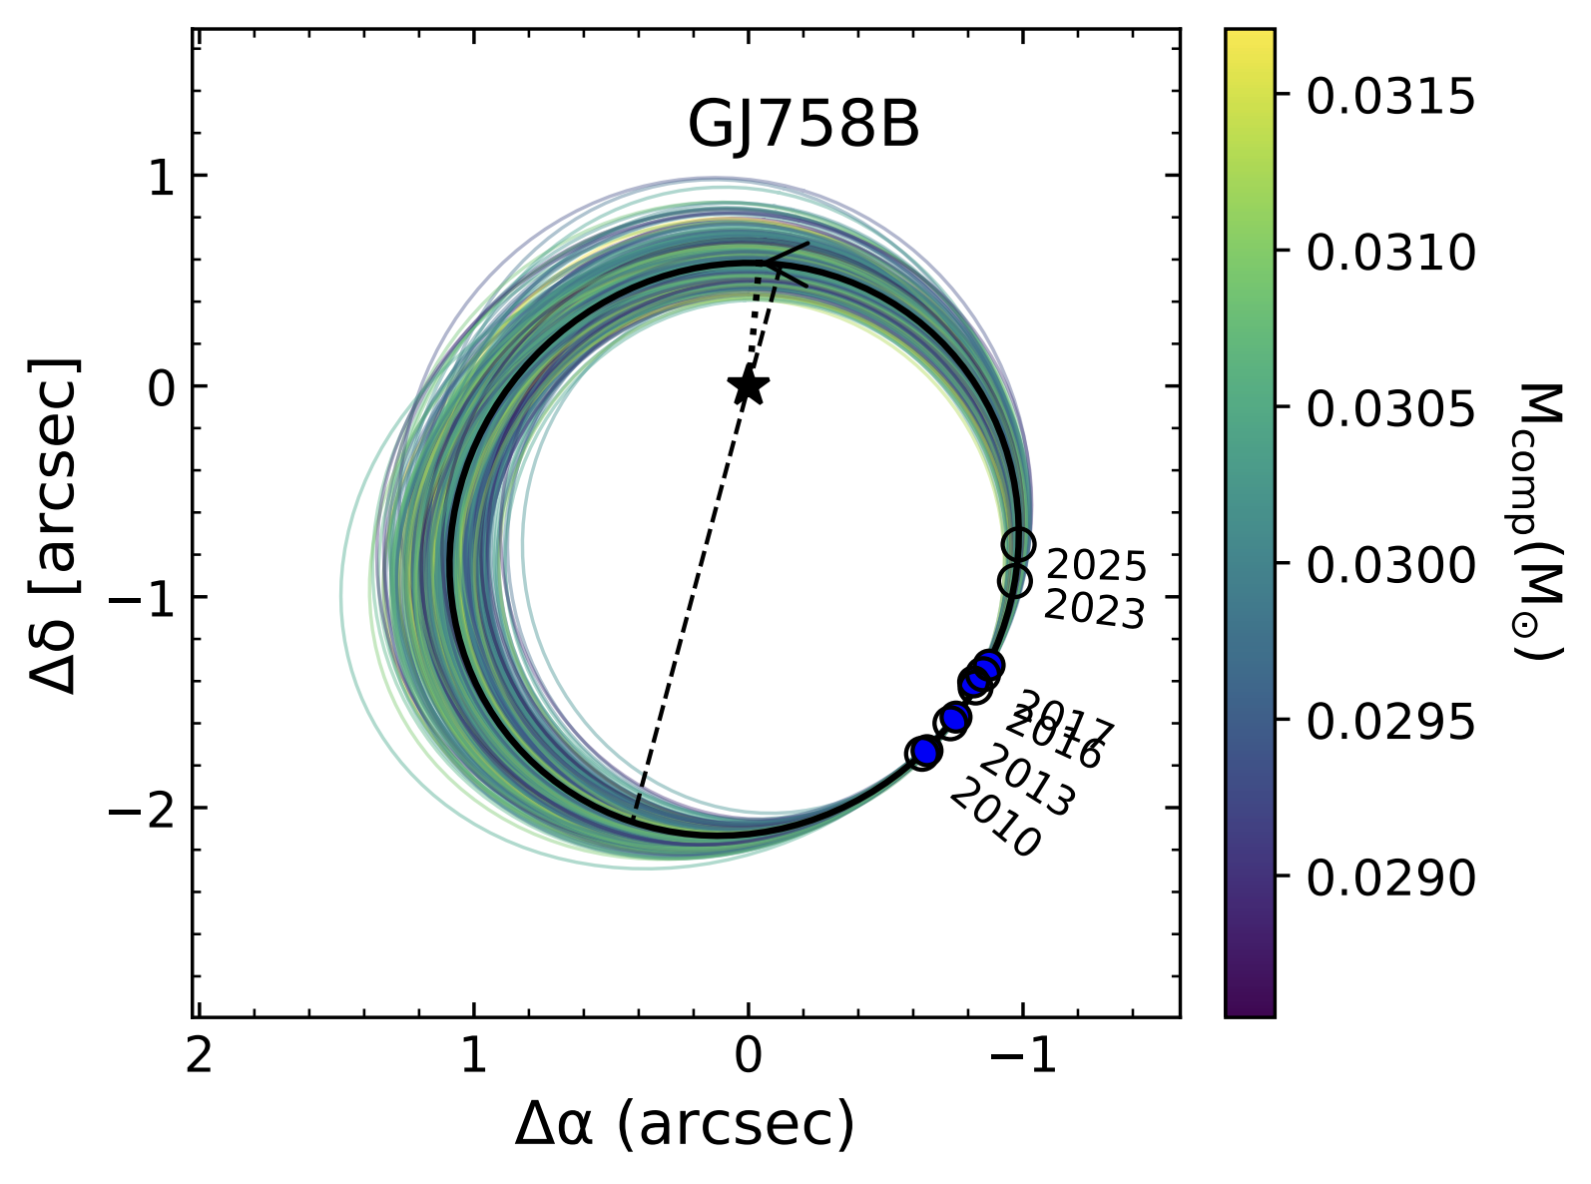
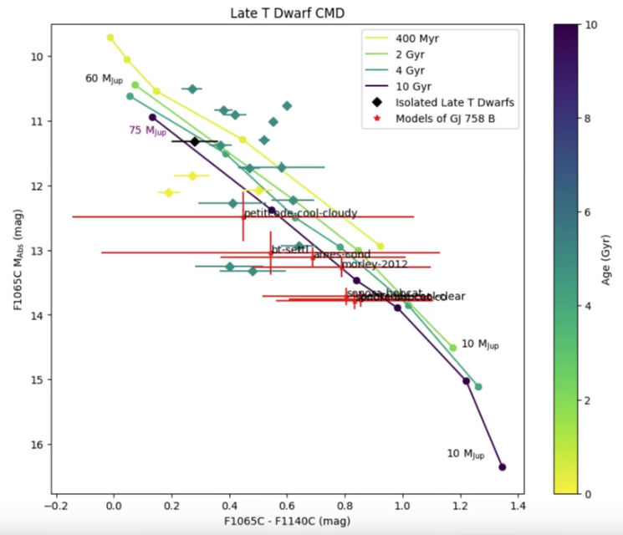
Imaging in the MIR – GJ 758 B
10.65 µm
Ash Messier
(Smith ‘25)
Hannah Sun
(Smith ‘25)
Moiz Khalil
(UMass Amherst ‘24)
Becca Michelson
(Smith ’25J)
Benchmark substellar companion: well-constrained orbit, dynamical mass
Cool (600-800 K) T-dwarf, ammonia chemistry study
Potential offsets from evolutionary models vs. atmospheric fits
Ward-Duong et al. (in prep)

Slide 18
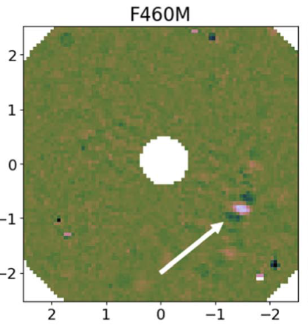
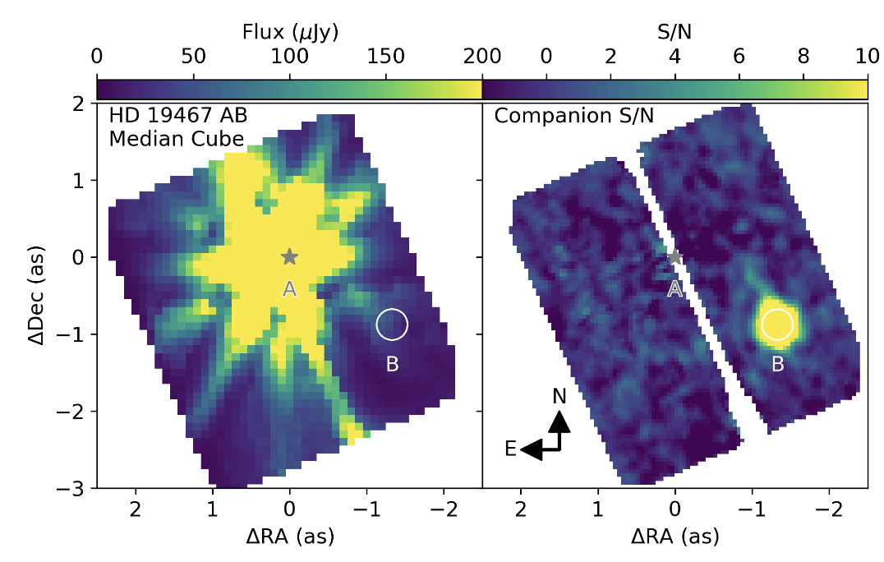
High-Contrast Imaging + IFU Spectroscopy - NIR
Greenbaum et al. (2023)
Ruffio et al. (2023)
Notes:
Few e-6 at 4.6µm at 1 arcsec
2e-7 at > 3 arcsec at 3 µm

Slide 19
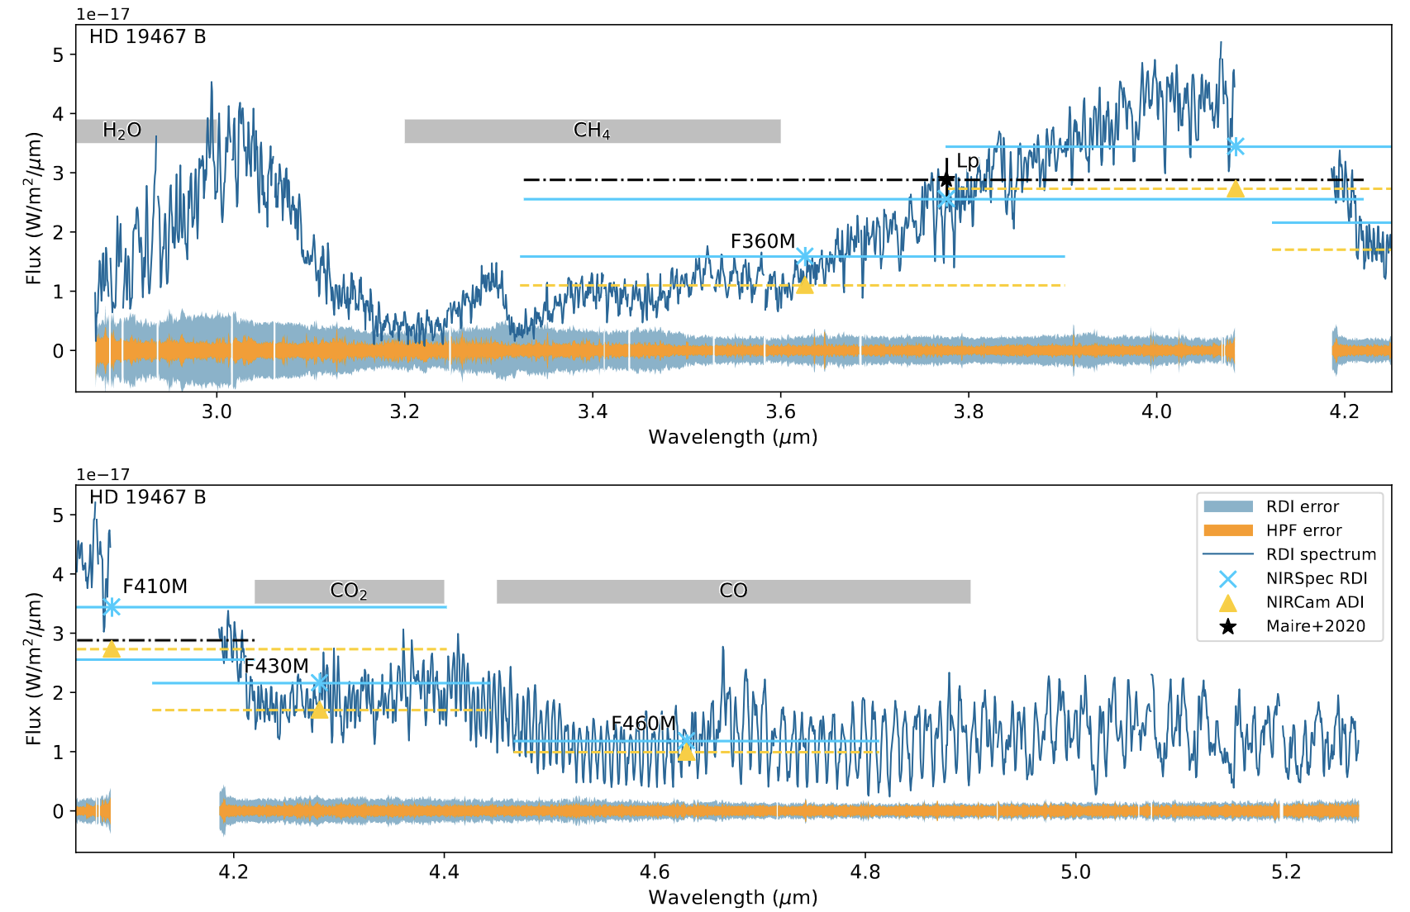
IFU High-Contrast Spectroscopy - NIR
3-5 µm, R~2700 spectra with forward modeling of companion + starlight
In best-case scenarios capable of reaching reaches few x 10⁻⁷ to 10⁻⁶ contrast at and > 1”
Ruffio et al. (2023)
Notes:
7-8e-7 contrast beyond 1” in best-case scenario

Slide 20
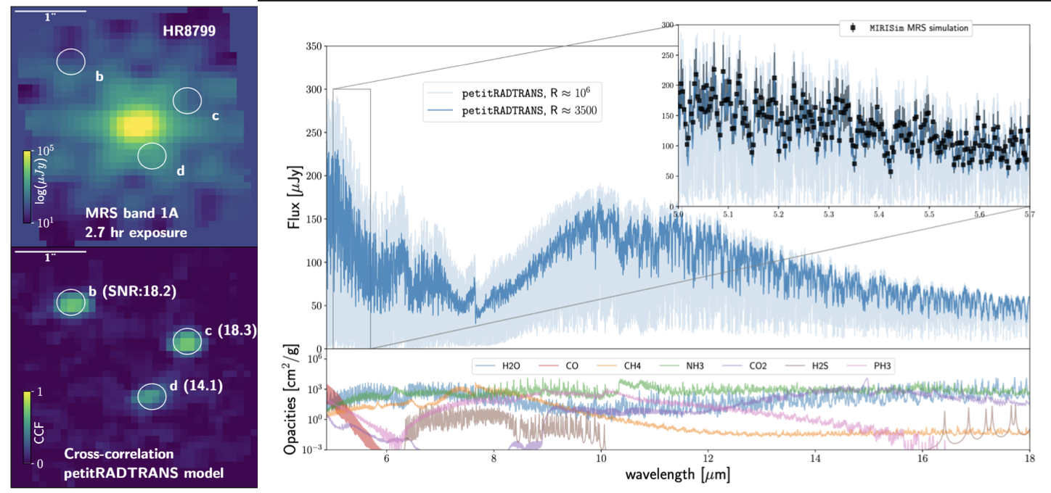
IFU High-Contrast Spectroscopy - MIR
Patapis et al. (2022)

Slide 21
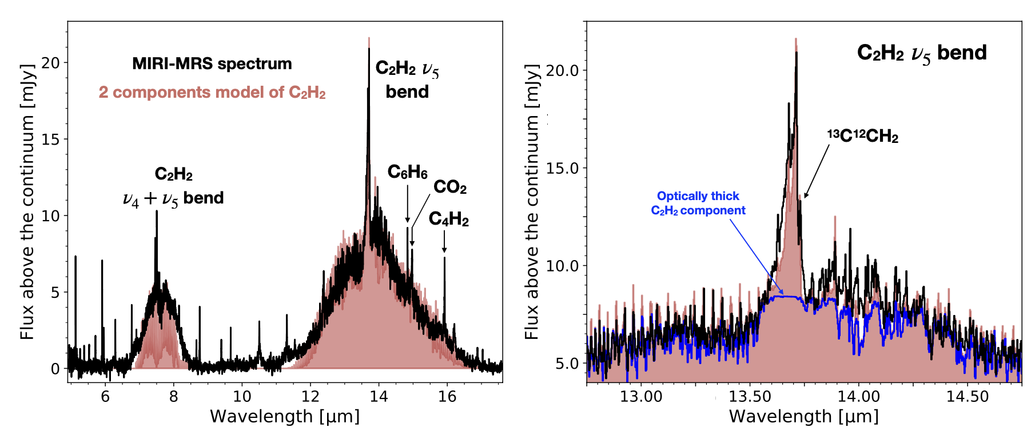
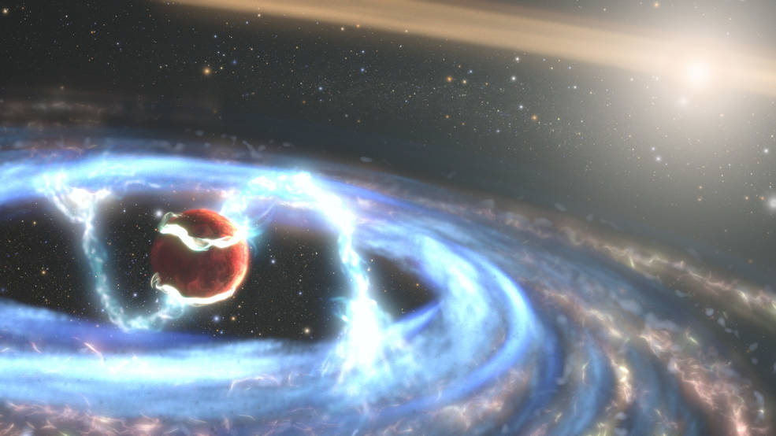
IFU High-Contrast Spectroscopy - MIR
Hydrocarbon species, accretion diagnostics, in protoplanetary disks around very low-mass stars
(Tabone et al. 2023)
Unique to JWST: Extend studies of disk chemistry (composition, winds, outflows) and accretion to circumplanetary disks
Note: Various molecular species inaccessible from ground from 6-16 µm, compare w/4.6µm CO feature where Earth’s atmospheric transmission < 0.3

Slide 22
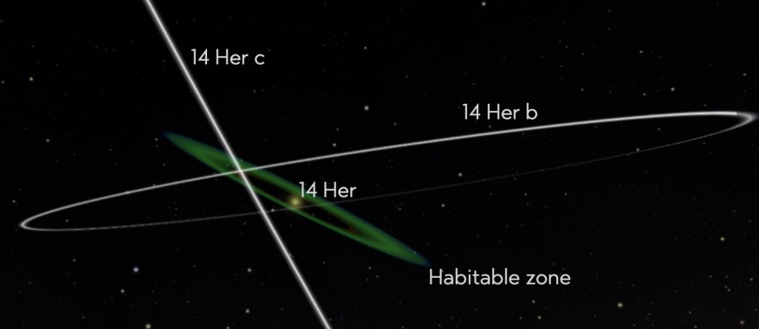
DDTs and Upcoming High Contrast Programs
Imaging planets with well-constrained dynamical masses (PI Franson), e.g. long-term RV + astrometry (PI Bardalez-Gagliuffi)
Variability of planetary mass companions with NIRSpec IFU (PI Zhou)
Searches for kinematically-detected or substructure-causing protoplanets within disks (PI Benisty, PI Bowler)
MIRI coronagraphy of the coldest imaged exoplanet orbiting a sunlike star (PI Patapis)
First directly-imaged sub-Saturn mass candidate planet (PI Bogat)
Notes:
AF Lep lowest mass imaged planet with dynamical mass

Slide 23
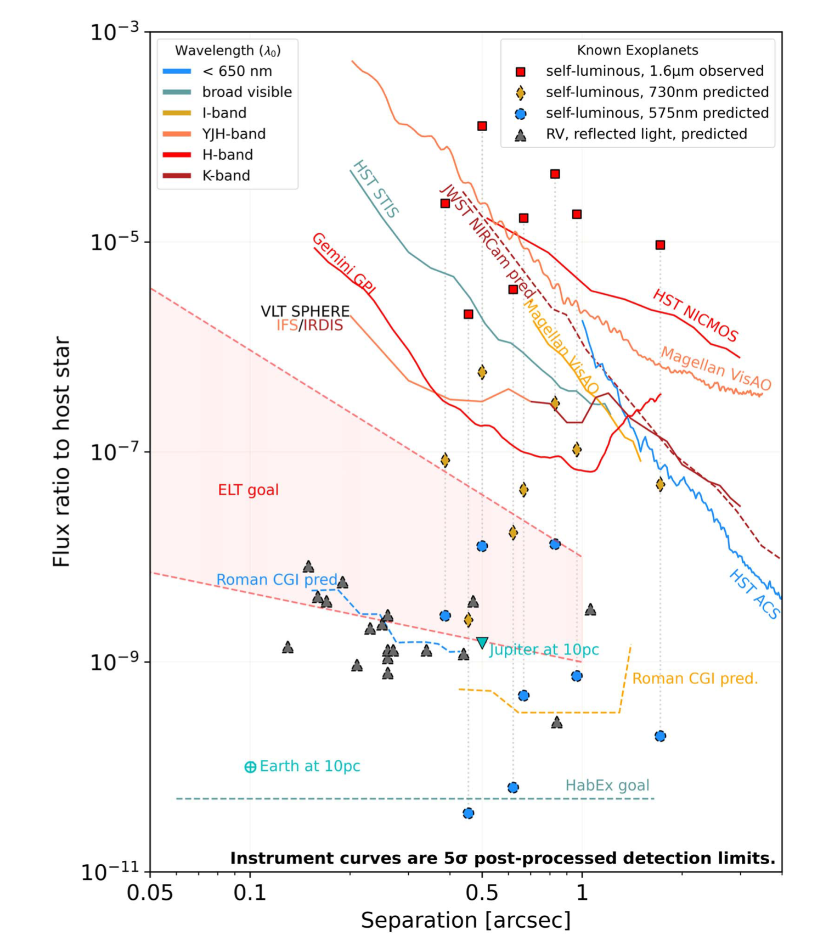
How do ELT instruments and JWST complement each other?
Inner Working Angle
Deeper achievable contrasts at much closer angular separations afforded by ELTs!
Wavelength Coverage
ELT optimized sensitivity shortward of 5 µm; only ELT/METIS first-gen overlap with JWST/MIRI.
(pt source ~ IRAC; spectral ~ JWST)
Rigby et al. (2023)
Follette (2023), based on tools by Vanessa Bailey

Slide 24
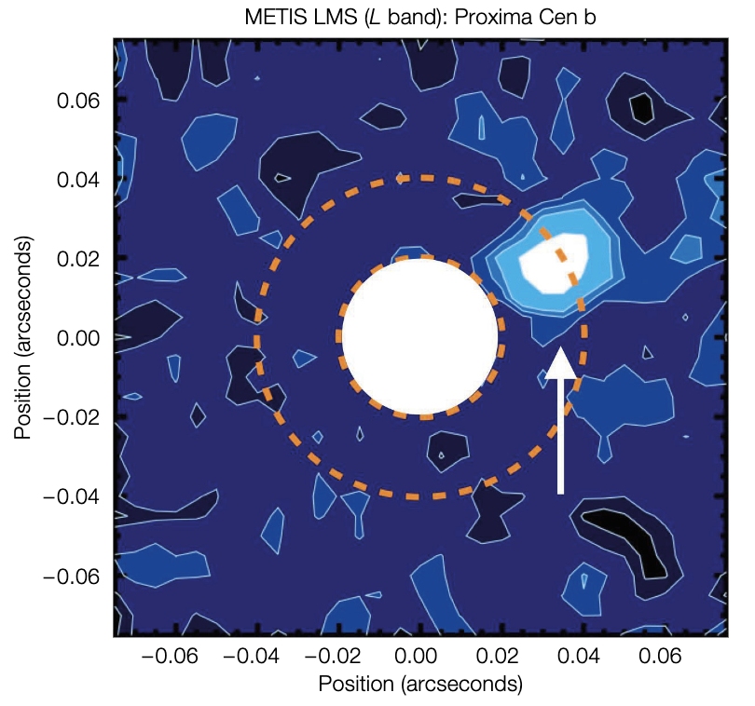
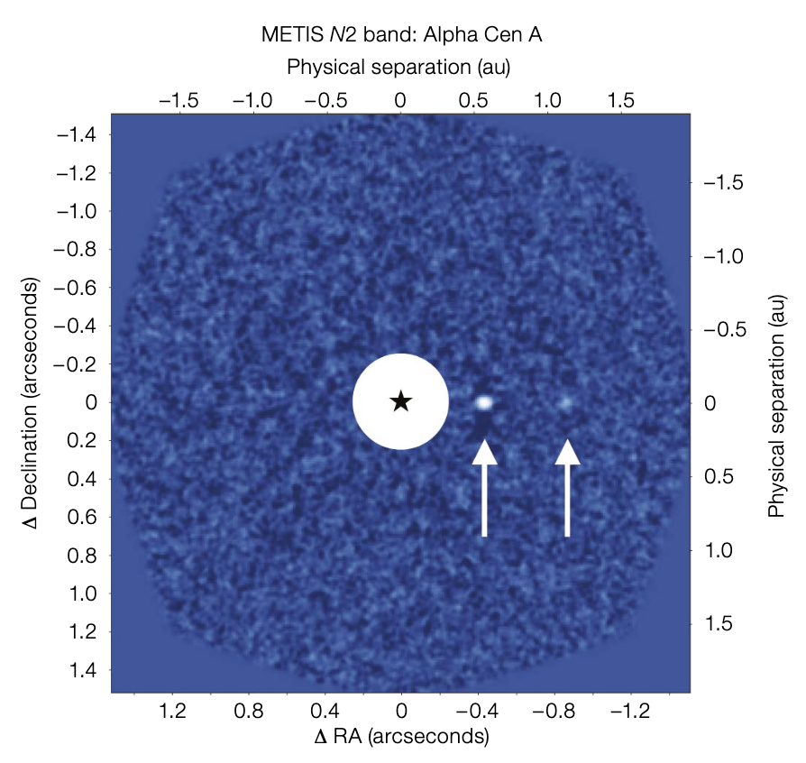
ELT Capabilities
ELT/METIS:
Reflected light temperate terrestrial planets for the closest systems (Alpha Cen @ 11 µm, Prox. Cen @ 3.8 µm)
Young warm Saturn & Neptune-like planets
L-band:
2 x 10⁻⁴ contrast @ 40 mas
2 x 10⁻⁵ contrast @ 100 mas
Longslit spectra, L & M-band IFU spectroscopy; see also ELT/HARMONI (2 x 10⁻⁶ @ 2.2 µm, 100 mas)
Brandl et al. (2021)
Notes:
See Dimitri Mawet’s talk from Monday –(Skemer et al. 2022 for SCALES) – PSI coupling coronagraphy and IFU spectroscopy (Fitzgerald et al. 2019)

Slide 25
ELT Capabilities
TMT/PSI + MODHIS:
Imaging planets within habitable zone for closest M-dwarf systems, over 100 accessible planets that can be imaged of varying size, temperature
Anticipated contrasts of 1 x 10⁻⁷ spanning 2-10 µm at 1-2 λ/D (10-30 mas)
Imaging, polarimetry (0.6-5.3µm)
IFS from R~30 (8-13 µm) to R~200-5000 across opt/NIR
MODHIS: R~100,000 spectroscopy (1-2.5µm)
Fitzgerald et al. (2019)
(See also TMT/MICHI - MIR, AO-fed IFU; Packham+2018)
Notes:
See Dimitri Mawet’s talk from Monday –(Skemer et al. 2022 for SCALES) – PSI coupling coronagraphy and IFU spectroscopy (Fitzgerald et al. 2019)

Slide 26
ELT Capabilities
GMT/GMagAO-X:
Reflected light temperate planets across range of radii, masses (RV sample)
Mass, orbital constraints (precision RV fed to G-CLEF)
Lower-mass self-luminous young planets, accreting protoplanets
Visible light (g to y-bands) corongraphy and NIR coronagraphy
Raw contrast on order of 1 x 10⁻⁵ at 3 λ/D (20 mas)
Image: GMagAO-X team
Males et al. (2022), Kautz et al. (2023)
Notes:
See Dimitri Mawet’s talk from Monday –(Skemer et al. 2022 for SCALES) – PSI coupling coronagraphy and IFU spectroscopy (Fitzgerald et al. 2019)

Slide 27
What might we expect in upcoming 10-15 years?
JWST | ELTs
Wide orbit sub-Jovian detections and population constraints | Reflected light planets and their characterization, frequency of true Jovian analogs
NIR to MIR atmospheric chemistry from coronagraphy & moderate-resolution IFUs | Opt/NIR atmospheric chemistry from high-dispersion coronagraphy
Faint large-scale circumstellar disk structures in thermal emission | Scattered light circumstellar disk features at high angular resolution (also polarization)
Outer (JWST) and inner (ELTs) architectures of planetary systems: formation, migration, scattering
Circumplanetary disk chemistry through MIR; complementarity of ground/space molecular species (below 1 Jupiter mass, CPDs might require > 15 µm; Chen & Szulágyi 2022)
Broad wavelength to constrain bolometric luminosities of planetary-mass companions, informing evolutionary and atmospheric models | Bolometric luminosity at short wavelengths

Slide 28
Toward the Future
Don’t forget!
JWST direct imaging will remain critical in the MIR > 5µm and at wide separations, and will offer excellent stability for science cases such as atmospheric variability
Where JWST/ELT sensitivities overlap → offers important cross-validation between ground/space high contrast
ELTs will uniquely push toward inner architectures of planetary systems, reveal understanding of reflected light planets, small rocky planets around the closest stars
New surprises always await new observational parameter space – substructures, architectures, compositions, and likely much more ahead of us…
Thank you!

