Slide 1
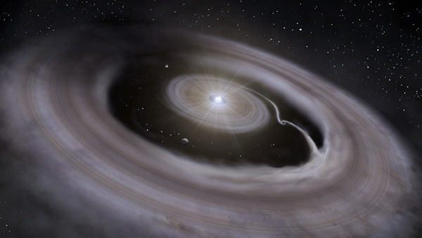
Direct Imaging of YSOs: Observing Five Circumstellar Disks to Search for Forming Planets
Camryn Mullin, MSc Student, University of Victoria
Supervisor: Ruobing Dong
G. Cugno, T. Greene, D. Johnstone, J. Leisenring, M. Meyer, K. Wagner, S. Wolff
ELT Science in Light of JWST Dec 2023 @ UCLA
Notes:
Thank you for the introduction. Since I’m the last talk of the day I’ll try to keep this timely.

Slide 2
Our NIRCam GTO Team
Program: NIRCam Imaging of YSOs
PI: Jarron Leisenring, University of Arizona
Team members (alphabetical):
Gabriele Cugno, University of Michigan
Ruobing Dong, University of Victoria
Thomas Greene, NASA Ames Research Center
Doug Johnstone, NRC Hertzberg Institute of Astrophysics
Michael Meyer, University of Michigan
Camryn Mullin, University of Victoria
Kevin Wagner, University of Arizona
Schuyler Wolff, University of Arizona
Notes:
LIE SEN RING

Slide 3
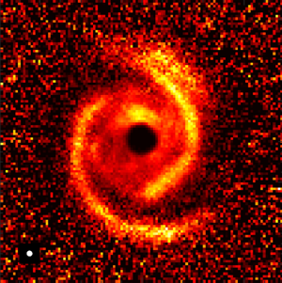
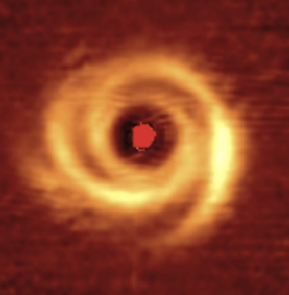
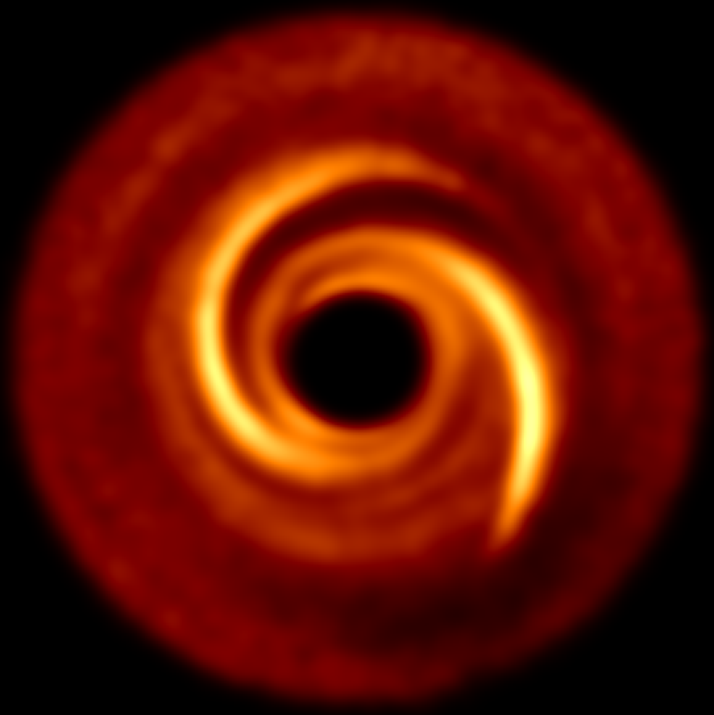
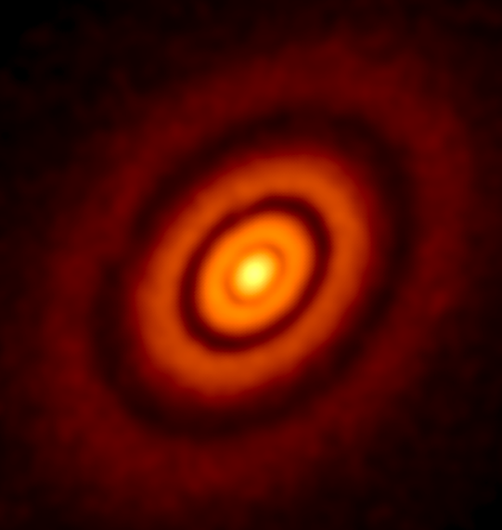
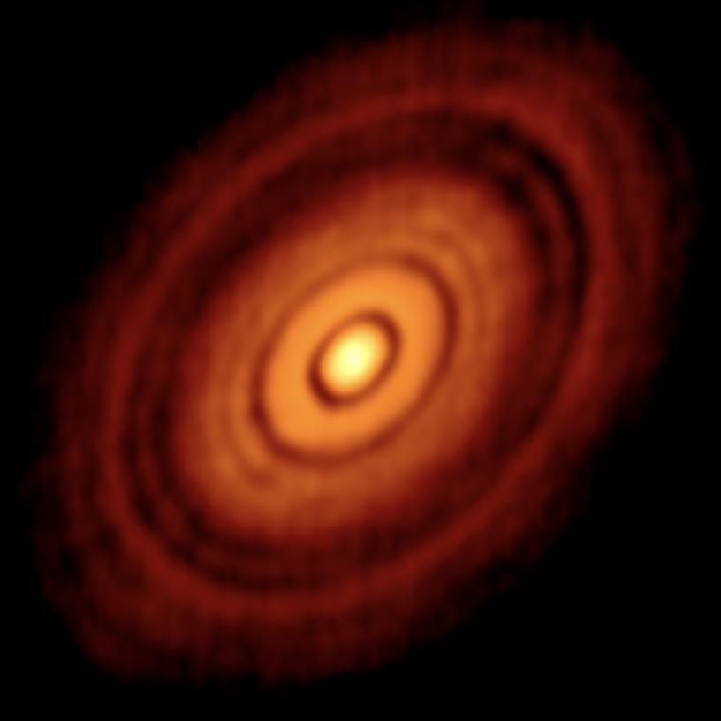
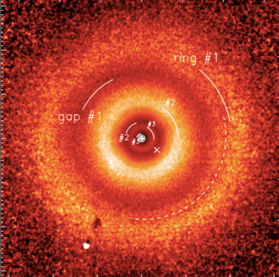
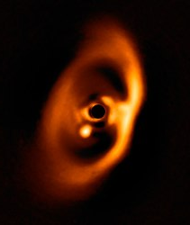
Our 5 Targets
MWC 758
SAO 206462
Models
Multi-M_{J} @ ~100 AU
Spirals
Benisty et al. 2015
Garufi et al. 2013
Wagner et al.
Cugno et al.
HL Tau
TW Hydra
PDS 70
Gaps /
Rings /
Cavities
Planets
ALMA Partnership et al. 2015
van Boekel et al. 2017
Muller et al. 2018
3 Saturns at 12, 30 and 65 AU
Mullin et al.
Wolff et al.
Leisenring et al.
Dong, et al. 2015a,b
Notes:
Each disk has a publication coming lead by different relatively junior members of the team, who’s names are listed below their respective disk. Some of these publications are still in prep, so I would ask that you please refrain from sharing any of these images outside the conference

Slide 4
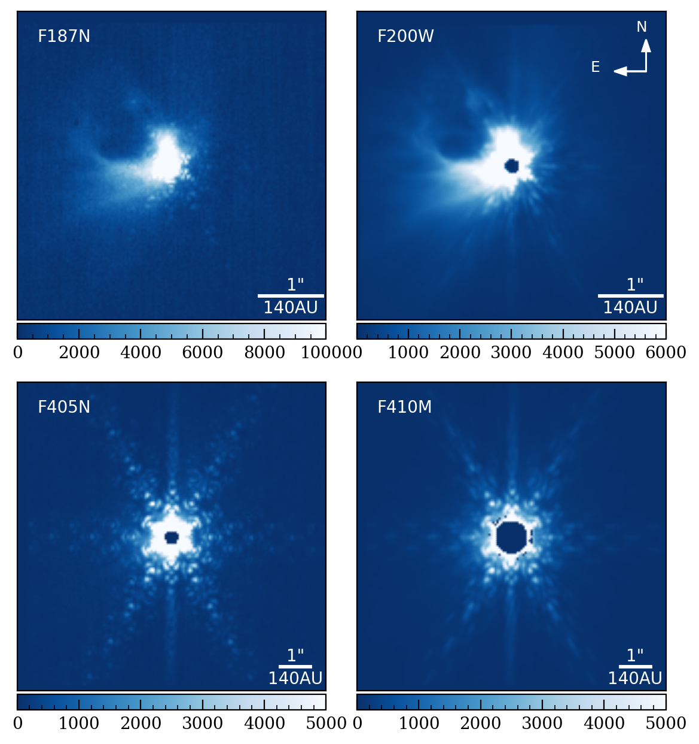
The Data
The Data
Direct imaging mode (no coronagraph)
960 images per filter, two roll angles 10˚ apart, 4 dithers per angle
4 filters:
F187N (Pa-⍺)
F200W (2µm continuum)
F405N (Br- ⍺)
F410M (4µm continuum)
Shown here: HL Tau centered calints files
Notes:
2 narrow filters for accretion signatures and 2 for continuum emission.
For each filter, we utilized 2 roll angles to allow for ADI and 4 dithers per angle.
We took all of our data shown here in direct imaging mode, so we did not elect to use the coronagraph

Slide 5
HL Tau
N
E
2014 ALMA image overlaid with NIRCam F200W data
Envelope and outflow clearly visible at this wavelength
Note: PSF not subtracted in this image
Outflow
Surrounding envelope
ALMA Partnership et al. 2015
PSF
Notes:
The first disk I will discuss is the one I am most familiar with - HL Tau.
The image you see here is the famous image from the 2014 ALMA long baseline campaign. So how does our NIRCam data change this picture?
Here I’ve taken the ALMA mm image in red and overlaid our NIRCam data in at 2µm in blue.
The key features you see here are the stellar envelope that HL Tau is still embedded in, since this is a young star, around 100,000 years old and therefore still embedded.
We detect a c-shaped outflow previously imaged at other wavelengths, but never with this level of precision in the infrared.
You may also notice that the PSF is not subtracted in this image - this is relatively raw data

Slide 6
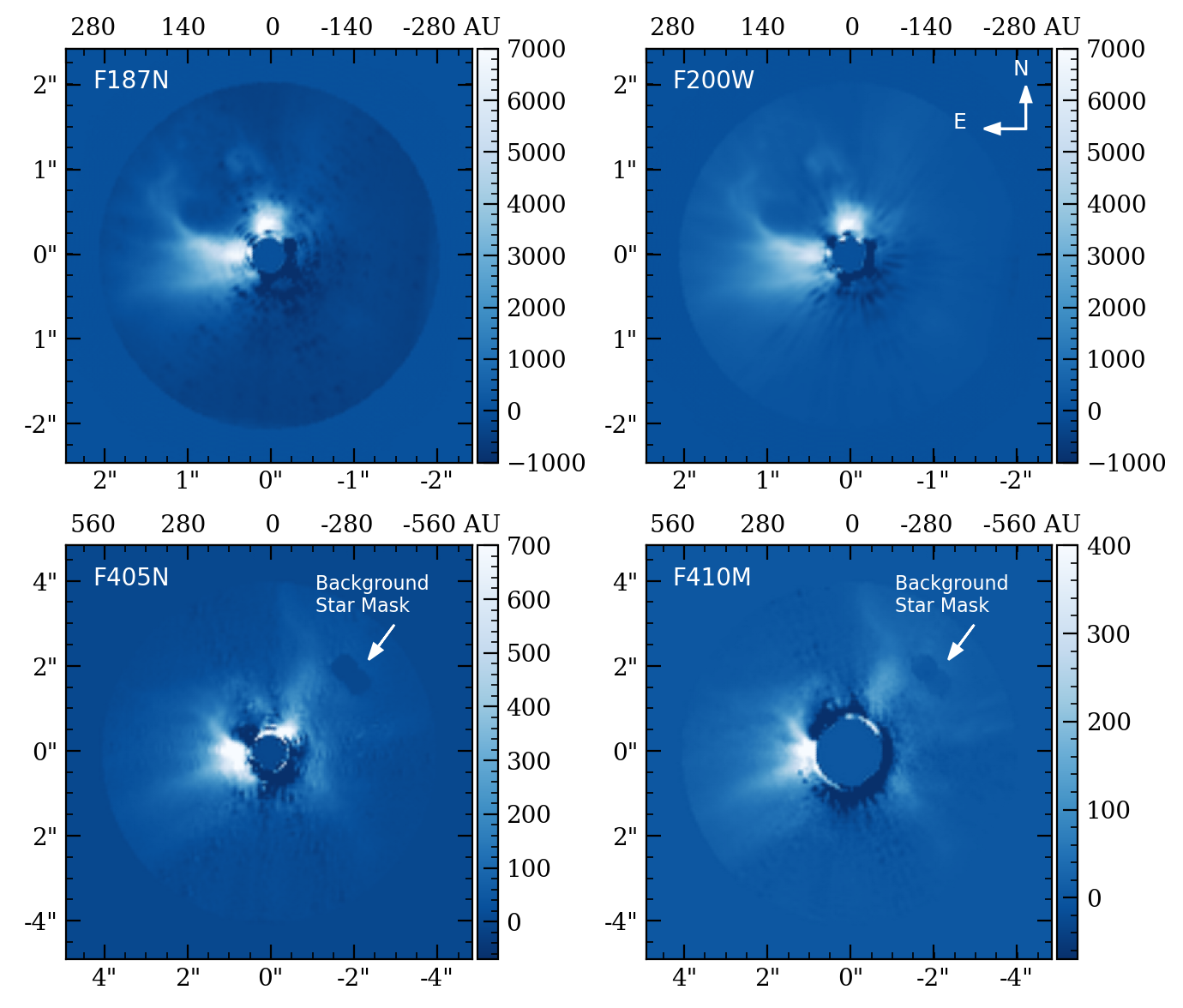
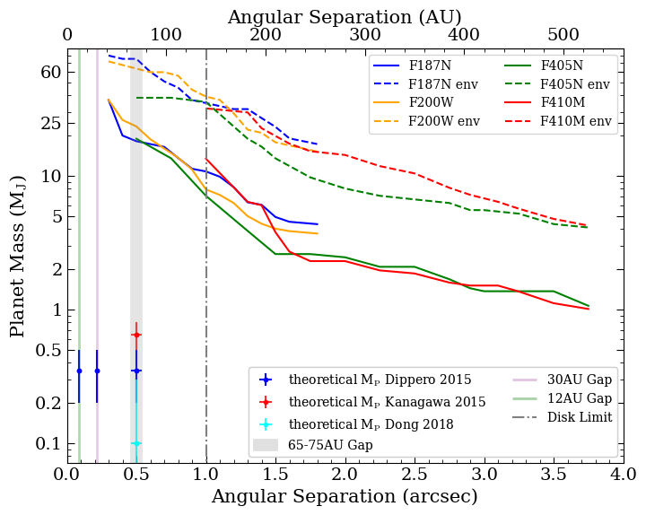
HL Tau Sensitivity Limits
PSF Subtraction Method: PCA with MWC 758 as PSF reference
High saturation at inner angles
No planet candidates
Notes:
our detection limits are sensitive to planets as small as 1MJup at 4” and very massive multi Mjup planets in the disk region

Slide 7
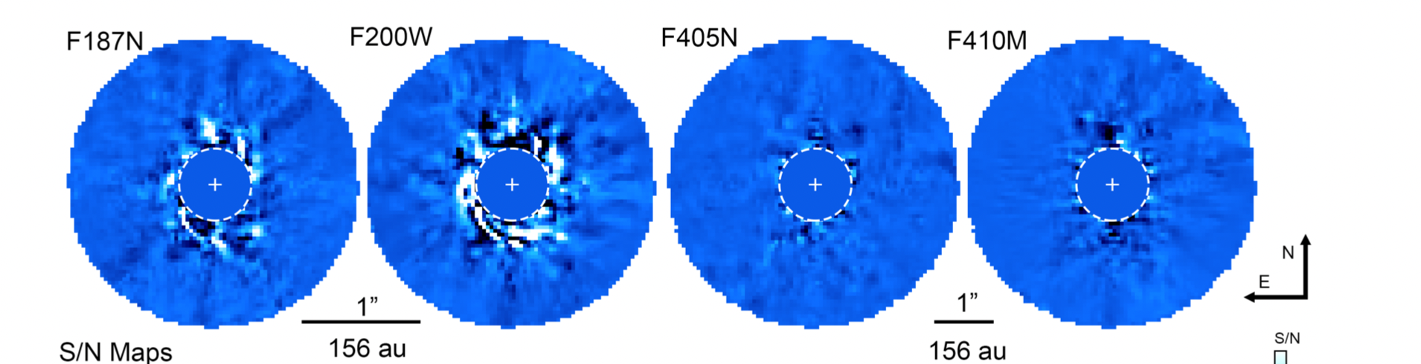
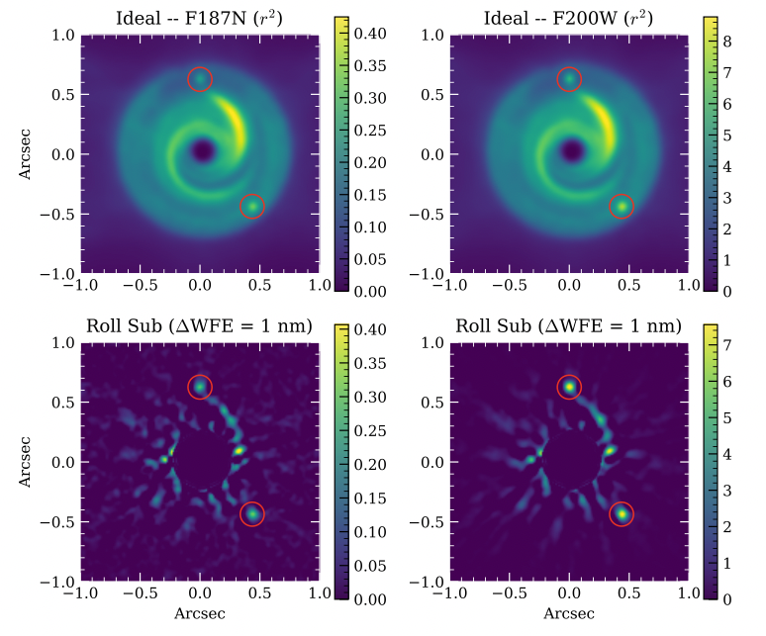
The Data
MWC 758
PSF Subtraction Method: Roll subtraction with eigen images
Detect Spirals
No clear companions
Benisty et al. 2015
Simulation of disk and test point sources in F187N and F200W
NIRCam data F187+F200W

Slide 8
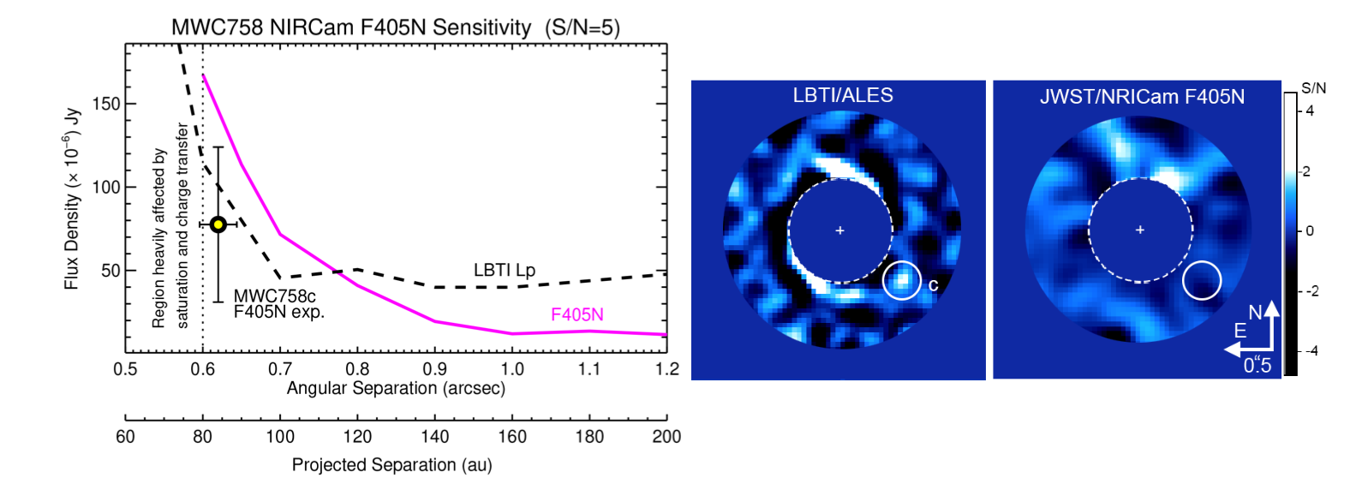
The Data
MWC 758 Missing(?) Companion
NIRCam not sensitive enough under these conditions
<0.”7 region
at 4µm
in direct imaging mode
MWC 758c
LBTI Wagner et al. 2023 candidate not visible
Observations suffered from saturation
Need deeper limits to detect MWC 758c
Coronagraphic imaging in cycle 2
Approximate planet location

Slide 9
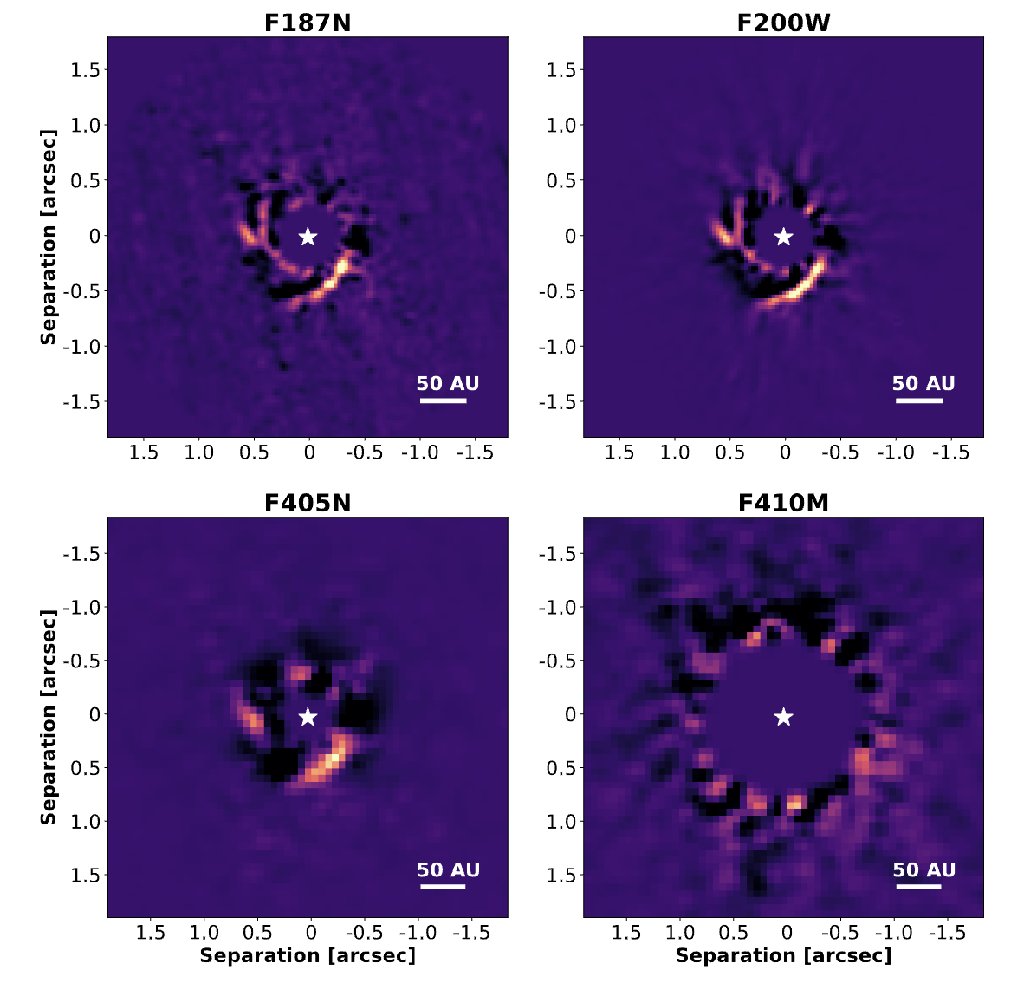
The Data
SAO 206462 (aka HD 135344B)
Garufi et al. 2013
PSF Subtraction Method: PCA with roll subtraction
Sign of planet candidate in NW region of image
Only visible in F410M filter

Slide 10
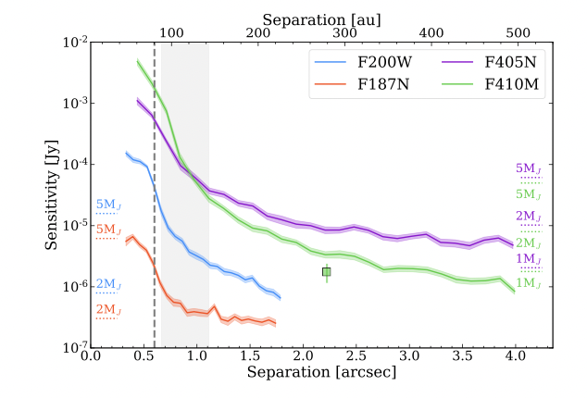
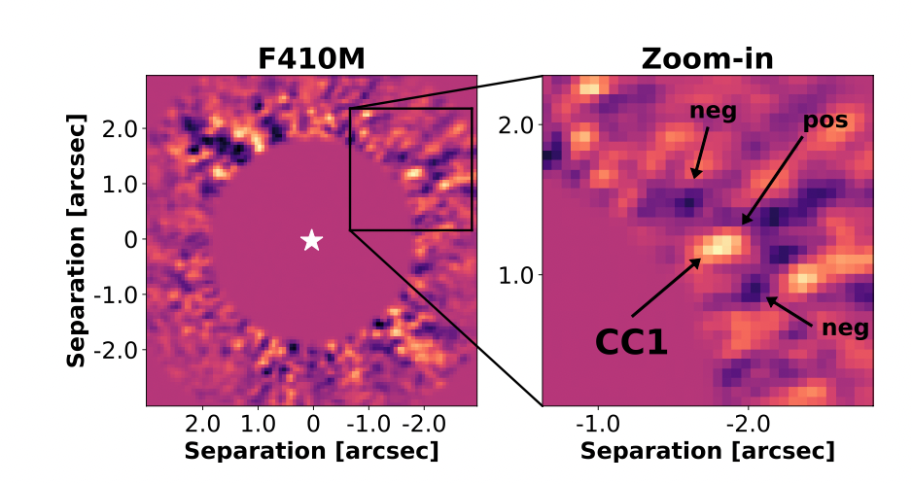
The Data
SAO 206462 Companion Candidate
2.25𝜎 from predicted position to drive eastern spiral
Detected with 4.4 S/N
Expected to be 0.8 ± 0.3 MJ
Deeper observations needed
CC1
Notes:
CC1 at 2”.2 from central star
CC1 had a probability of 0.008 of being a background galaxy

Slide 11
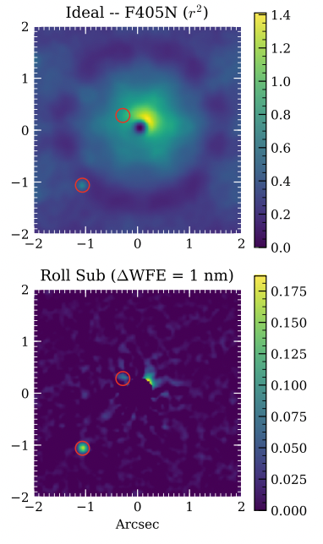
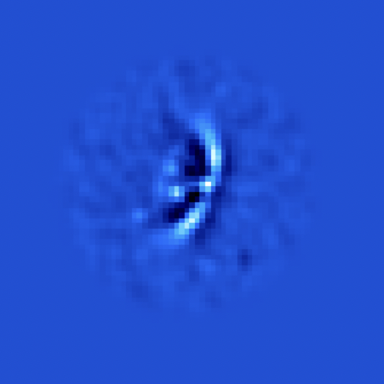
Next Steps
F405N
F187N
F200W
F405N
Saturation high due to 10-20% higher than expected throughput
→ coronagraph for observations of TW Hydra
Data reduction underway for PDS 70
Future ELT observations?
TW Hydra simulated through F405N

Slide 12
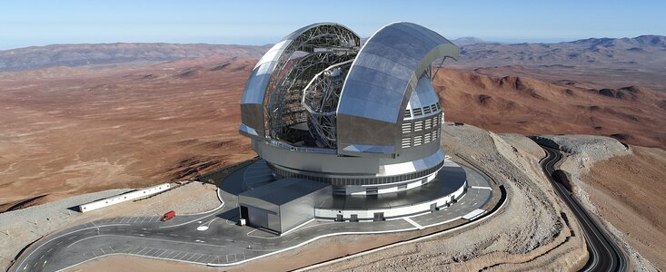
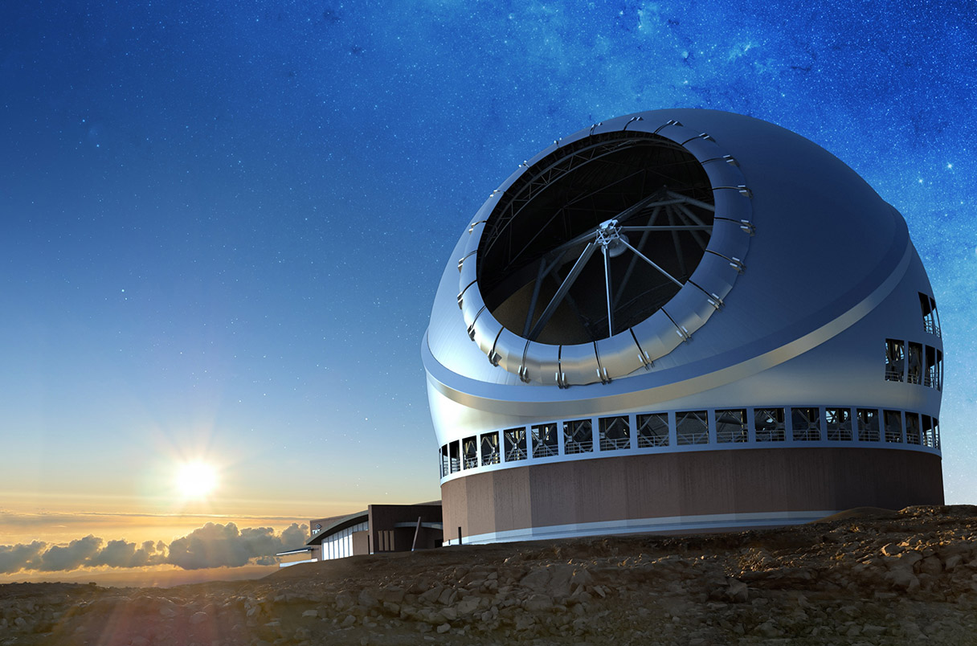
ELT Observing Potential
ELT Mid-infrared ELT Imager and Spectrograph (METIS) will target exoplanets and circumstellar disks
TMT should be able to detect ≤ 0.1MJ planets ≤ 10AU at 140pc
Could be useful for a target like HL Tau
140pc distance
Searching for Saturn mass planets at ≤ 80AU
ELT
TMT
Notes:
From 2015 science case

Slide 13
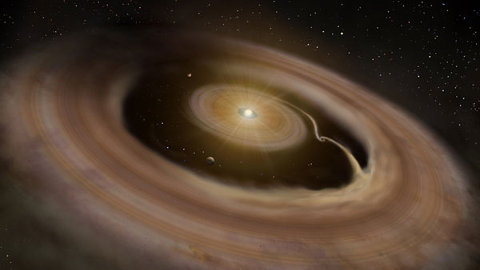
Thank You
Publication Status for all Targets:
MWC 758 – paper accepted! (Wagner et al.), follow-up observations in cycle 2
SAO 206462 – paper submitted (Cugno et al.)
HL Tau – paper submitted (Mullin et al.)
PDS 70 – paper in prep (Leisenring et al.)
TW Hya – waiting on data December 2023 (Wolff et al.)
Contact me: camrynmullin@uvic.ca
Or my supervisor: rbdong@uvic.ca
Notes:
With that, I’ll leave this publication status here, and I’ll be happy to take any questions

Slide 14
Backup Slides

Slide 15
The Data
PDS 70
Disk visible in all wavelengths
Point sources visible at approximate location of PDS 70 b and c
PDS70c?
PDS70b?
Muller et al. 2018
F187N
F200W
F405N

Slide 16
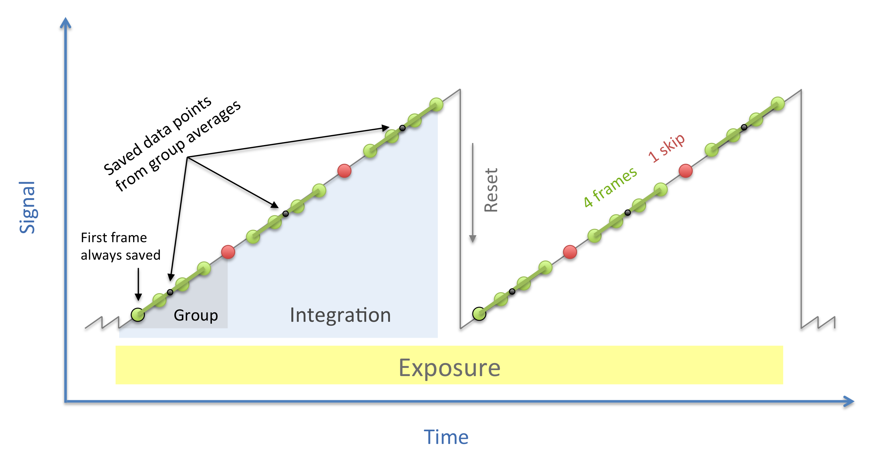
Obtaining Calibrated Data
Obtained calibrated data which has gone through JWST ramp fitting
From stage 1 get uncalibrated slopes
Detects how many electrons are in each pixel and builds up measurements as a function of time (ramp)
Calibrate the slopes
Jump rejection threshold set to 6 sigma

Slide 17
HL Tau Wavelength Comparison
Top:
ALMA continuum contours
Disk not visible in data
Bottom:
HCO+ ALMA contours
NE protrusion lines up at 2µm and 4µm
Spiral feature visible at 4µm
Inflowing spiral?

Slide 18
HL Tau Wavelength Comparison
Top:
ALMA continuum contours
Disk not visible in data
Bottom:
HST F625 contours (0.6µm)
Outflow cavity broadens as WL increases
Upward stream shifts West as WL increases

Slide 19
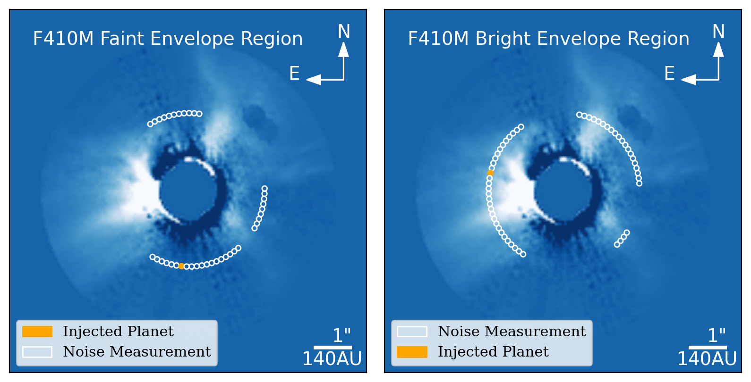
HL Tau sensitivity
Bright envelope
No bright envelope

Slide 20
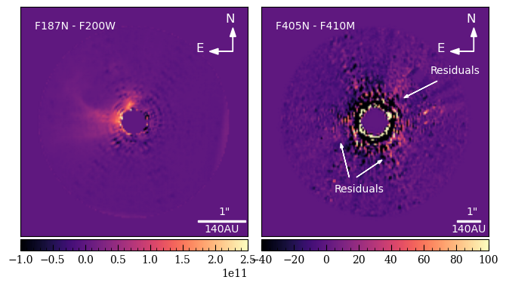
Accretion

Slide 21
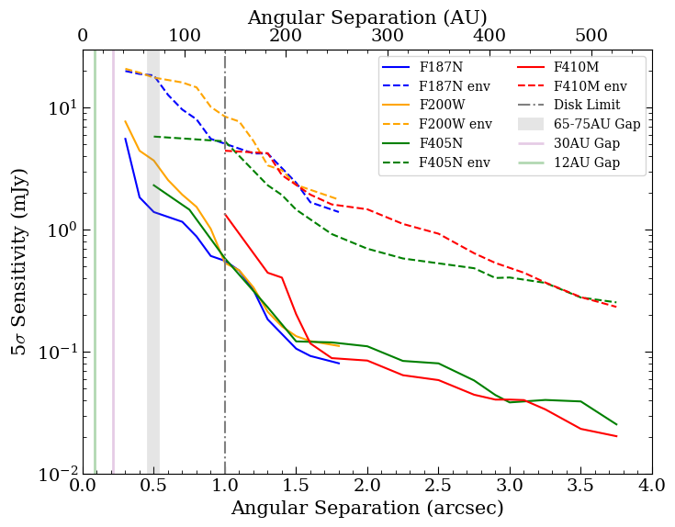
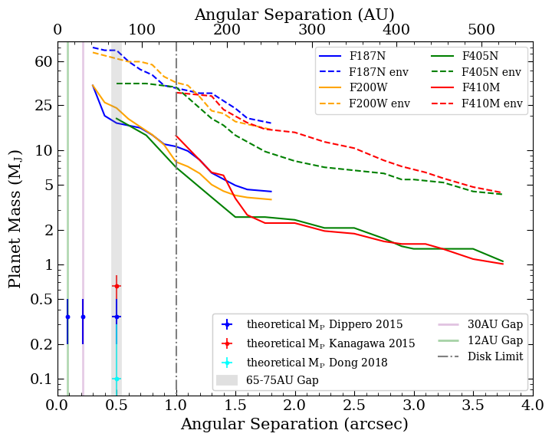
HL Tau sensitivity & mass limits
Used BEX and AMES/COND models for planets of 1Myr

Slide 22
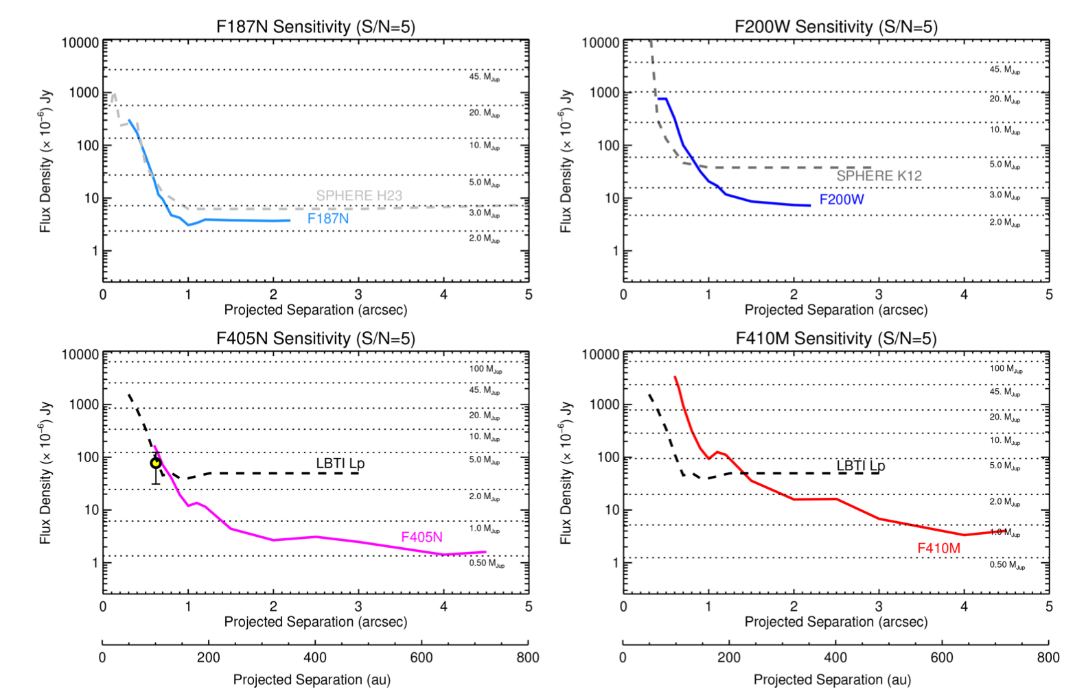
Mass limits MWC 758
Candidate around 4MJ but sensitive to around 7MJ at that separation
Reach 0.5MJ at 4”
Notes:
We placed new limits on planets exterior to the known spiral disk, down to ∼0.5 MJup in the back- ground limit at ≳600 au projected separation and below 2 MJup at ≳150 au (both in the F405N filter, in which we reach the deepest sensitivity).

