Slide 1
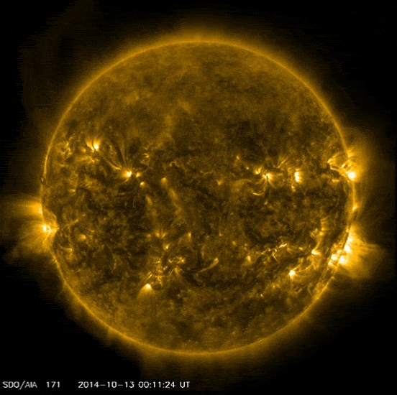
The March to Young Stars through High-Precision Radial Velocities
Quang H. Tran
FINESST Fellow, The University of Texas at Austin
Collaborators: Brendan Bowler, Bill Cochran, Mike Endl, Gummi Stefánsson,
Suvrath Mahadevan, Joe Ninan, Chad Bender, Samuel Halverson, Arpita Roy, Ryan Terrien, Megan Bedell, Dan Foreman-Mackey, Rodrigo Luger
Image Credit: NASA/SDO

Slide 2
The March to Young Stars through High-Precision Radial Velocities
Quang H. Tran
FINESST Fellow, The University of Texas at Austin
Collaborators: Brendan Bowler, Bill Cochran, Mike Endl, Gummi Stefánsson,
Suvrath Mahadevan, Joe Ninan, Chad Bender, Samuel Halverson, Arpita Roy, Ryan Terrien, Megan Bedell, Dan Foreman-Mackey, Rodrigo Luger
Image Credit: NASA/SDO
Notes:
Hi everyone, today I’ll be discussing my work on young stars and planets, how these systems inform our understanding of planet formation and evolution, and how the high-precision radial velocities from the ELTs will allow us to characterize young systems better than ever before.

Slide 3
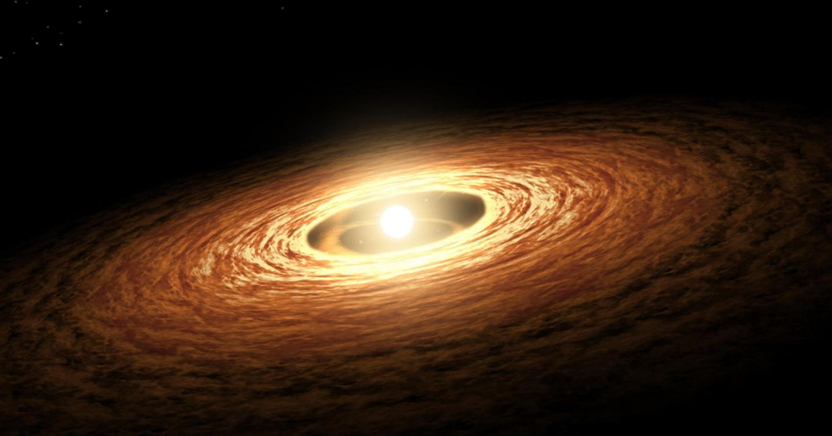
Young Stars Provide Valuable Information on
the Origin and Migration of Close-in Giant Planets
Protostar
Protoplanetary Disk
e.g.,
Martin & Livio 2012,
Alibert+2005, Albrecht+2012
Quang Tran (UT Austin) – ELT Science in Light of JWST – December 11th, 2023
Image Credit: NASA/JPL/Caltech
Notes:
Studying young stars and the planets that orbit them provides valuable information on the evolutionary processes of planets, such as for example: the origin and migration of close-in giant planets which remains a major open question
Here, I am showing…

Slide 4
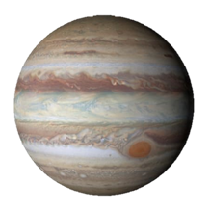
Young Stars Provide Valuable Information on
the Origin and Migration of Close-in Giant Planets
Giant planets are expected to form beyond the water ice line
e.g.,
Martin & Livio 2012,
Alibert+2005, Albrecht+2012
Quang Tran (UT Austin) – ELT Science in Light of JWST – December 11th, 2023
Image Credit: NASA/JPL/Caltech
Notes:
As a result, we expect giant planets to predominantly form beyond this radial distance, which we call the water ice line.

Slide 5
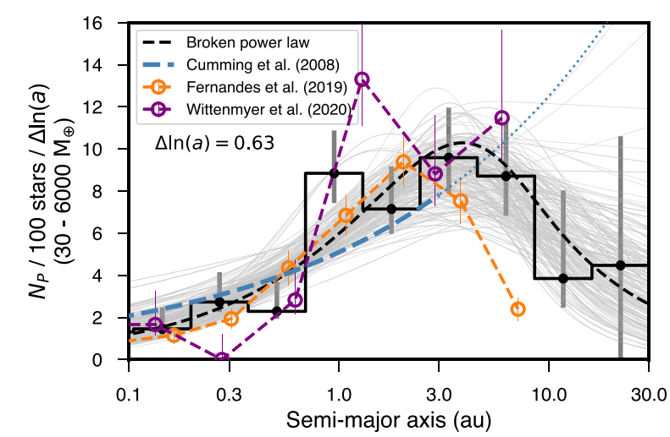
Giant Planets are Commonly Found at Close-in Separations
Fulton et al. 2021
Water Ice Line
Quang Tran (UT Austin) – ELT Science in Light of JWST – December 11th, 2023
Notes:
Despite these theoretical expectations, what we actually observe is that…
What I am showing here is the frequency of giant planets as a function of their semi-major axis in AU, taken from Fulton et al. 2021
The different curves here are different models and measurements of this frequency and I’ve overlaid a vertical blue line to represent the water ice boundary at ~2.5 AU. We can see that in additional to a broad peak in this frequency between 1-10 AU, giant planets still occur fairly frequently at close-in separations much less than that 2.5 AU boundary.
Furthermore, as in the case for the first exoplanet ever discovered, 51 Peg b, we know that giant planets can occur as close as several stellar radii from their host stars.
So, if our theoretical expectations that giant planets should form far away is correct, then the fact that we often observe them at close separations implies that…

Slide 6
The Inward Orbital Migration of Giant Planets is Common
Notes:
Indeed, there are two broad orbital migration mechanisms that can explain the population of close-in giant planets, and produce the observed demographics of this population.

Slide 7
The Inward Orbital Migration of Giant Planets is Common
Disk Migration
(Rapid, ~10 Myr)
e.g., Ward 1997; Papaloizou 2007; Levrard+2009;
Kley & Nelson 2012; Albrecht+2012; Batygin 2012
Image Credit: Triaud 2016
Notes:
Indeed, there are two broad orbital migration mechanisms that can explain the population of close-in giant planets, and produce the observed demographics of this population.

Slide 8
The Inward Orbital Migration of Giant Planets is Common
Disk Migration
(Rapid, ~10 Myr)
Dynamical Interactions
(Slow, >10 Myr)
e.g., Ward 1997; Papaloizou 2007; Levrard+2009;
Kley & Nelson 2012; Albrecht+2012; Batygin 2012
e.g., Wu & Murray 2003; Fabrycky & Tremaine 2007; Jurić & Tremaine; Chatterjee+2008; Triaud+2010; Naoz+2011
Image Credit: Triaud 2016
Notes:
Indeed, there are two broad orbital migration mechanisms that can explain the population of close-in giant planets, and produce the observed demographics of this population.

Slide 9
The Inward Orbital Migration of Giant Planets is Common
Disk Migration
(Rapid, ~10 Myr)
Dynamical Interactions
(Slow, >10 Myr)
Close-in
Giant
Planets
e.g., Ward 1997; Papaloizou 2007; Levrard+2009;
Kley & Nelson 2012; Albrecht+2012; Batygin 2012
e.g., Wu & Murray 2003; Fabrycky & Tremaine 2007; Jurić & Tremaine; Chatterjee+2008; Triaud+2010; Naoz+2011
Image Credit: Triaud 2016
Notes:
Each process likely plays a role in creating close-in giant planets. However, the degree to which each mechanism affects observed demographics of this population remains undetermined.

Slide 10
The Inward Orbital Migration of Giant Planets is Common
Disk Migration
(Rapid, ~10 Myr)
Dynamical Interactions
(Slow, >10 Myr)
Migration Pathways Operate
on Distinct Timescales
Close-in
Giant
Planets
e.g., Ward 1997; Papaloizou 2007; Levrard+2009;
Kley & Nelson 2012; Albrecht+2012; Batygin 2012
e.g., Wu & Murray 2003; Fabrycky & Tremaine 2007; Jurić & Tremaine; Chatterjee+2008; Triaud+2010; Naoz+2011
Image Credit: Triaud 2016
Notes:
… As a result, we can observationally distinguish between them by observing systems at young ages, when these different processes have not fully terminated. By tracing how the close-in giant planet population evolves over time, we can identify when giant planets migrate.

Slide 11
The Inward Orbital Migration of Giant Planets is Common
Disk Migration
(Rapid, ~10 Myr)
Dynamical Interactions
(Slow, >10 Myr)
Migration Pathways Operate
on Distinct Timescales
Determine When Giant Planets Migrate
to Disentangle How They Migrate
Close-in
Giant
Planets
e.g., Ward 1997; Papaloizou 2007; Levrard+2009;
Kley & Nelson 2012; Albrecht+2012; Batygin 2012
e.g., Wu & Murray 2003; Fabrycky & Tremaine 2007; Jurić & Tremaine; Chatterjee+2008; Triaud+2010; Naoz+2011
Image Credit: Triaud 2016
Notes:
And, again, because the pathways operate on distinct timescales, if we can determine WHEN giant planets migrate, we can disentangle HOW they migrate.
This is just one of many questions, one that I am particularly interested in, that studying young stars can help us answer.

Slide 12
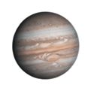
In Search of Young Planets: Noise from Stellar Activity
Old, Less Active Star
Notes:
Of course, studying young stars and the planets around them is made difficult by the intrinsic measurement noise introduced by magnetic stellar activity. For young stars, this activity is primarily driven by cool spots on the surface of the star.
Here, I am showing an example of the kinds of radial velocity measurements you can obtain for an older, less spotted star that hosts a giant planet. The measurements are precise and follow closely the dynamically induced signal from the planet, shown in the black curve.

Slide 13
In Search of Young Planets: Noise from Stellar Activity
Old, Less Active Star
Young, More Active Star
Notes:
However, for younger, more magnetically active stars, this is not the case. These young stars have a much higher starspot coverage fraction, which introduce noise, producing very high RV scatter that can completely mask planet signals.
So, as you move from older, less active stars to younger, more active stars, you introduce more noise.

Slide 14
In Search of Young Planets: Noise from Stellar Activity
BJD – 2459000
Notes:
And just to further emphasize how large this scatter can be: here is some real RV timeseries of a young, Sun-like star. You can see that the amplitude of this noise is incredibly high, with a over half a km/s: much higher than the RV amplitudes dynamically induced by massive, close-in planets.

Slide 15
In Search of Young Planets: Noise from Stellar Activity
Luger et al. 2019, Tran et al. 2023
Haywood 2016
Notes:
Furthermore, this noise is correlated and typical ground-based observing cadence (on the order of every couple of days or even weeks) makes it difficult for us to uncover what is actually happening in our measurements. Here, I’m showing a simulation of a rotating star with emerging and decaying spots (on the right) and the resulting radial velocity variations (represented by the solid black line on the left).
As spots on the stellar surface rotate in and out of view, they cause distortions in the spectral line profile, leading to quasi-periodic variations in our RV measurements.
So, every couple of nights, we might be able to get one new RV measurement, represented here by the orange points. However, this sparse sampling limits our understanding of how the stellar noise is behaving as there exists very complicated structure in between each point.
This could potentially lead us to believing that the observed variations are due to a planet when in reality it is just correlated noise from stellar activity.
This makes it difficult to robustly detect and characterize planets around young stars.

Slide 16
In Search of Young Planets: Stellar Activity Models
e.g. Aigrain+2012, Rajpaul+2015, Jones+2017, Gilbertson+2022, Disele+2022, Hara & Baptise 2023
Tran et al. 2023
Total RV variations
Notes:
There have been a number of statistical methods developed to disentangle stellar noise and planetary signals. One example is shown here, which is a novel Gaussian process framework that I have developed.
Here, I am showing synthetic RV timeseries of a spotted star that hosts a giant planet, using a simulation similar to the one I just showed.
The full synthetic dataset are the black points, and a handful of sparsely sampled points, shown as yellow stars, are used to train the model.
The best fit model is shown in blue.
Here, using only about 10 measurements, the model does an excellent job of accurately predicting the total RV variations, which is a sum of both the stellar noise and a planet planet.

Slide 17
In Search of Young Planets: Stellar Activity Models
e.g. Aigrain+2012, Rajpaul+2015, Jones+2017, Gilbertson+2022, Disele+2022, Hara & Baptise 2023
Tran et al. 2023
Total RV variations
Stellar Activity
Planet Signal
Notes:
What is even more important, though, is that the model can distinguish between these two contributions.
Since these are simulations, we know the “truth”, so we know what both the stellar noise and the planet are doing.
Those contributions are shown in these bottom two panels here, as grey lines.
The model is able to simultaneously fit for both the stellar activity and the planet and those predictions are shown in the pink. If it is hard to distinguish between those two lines, that’s because the model is very accurately predicting how both contributions are behaving.
Statistical tools and frameworks like this one, alongside a number of other instrumental advances, have opened up the possibility of detecting giant planets around young stars for the first time.

Slide 18
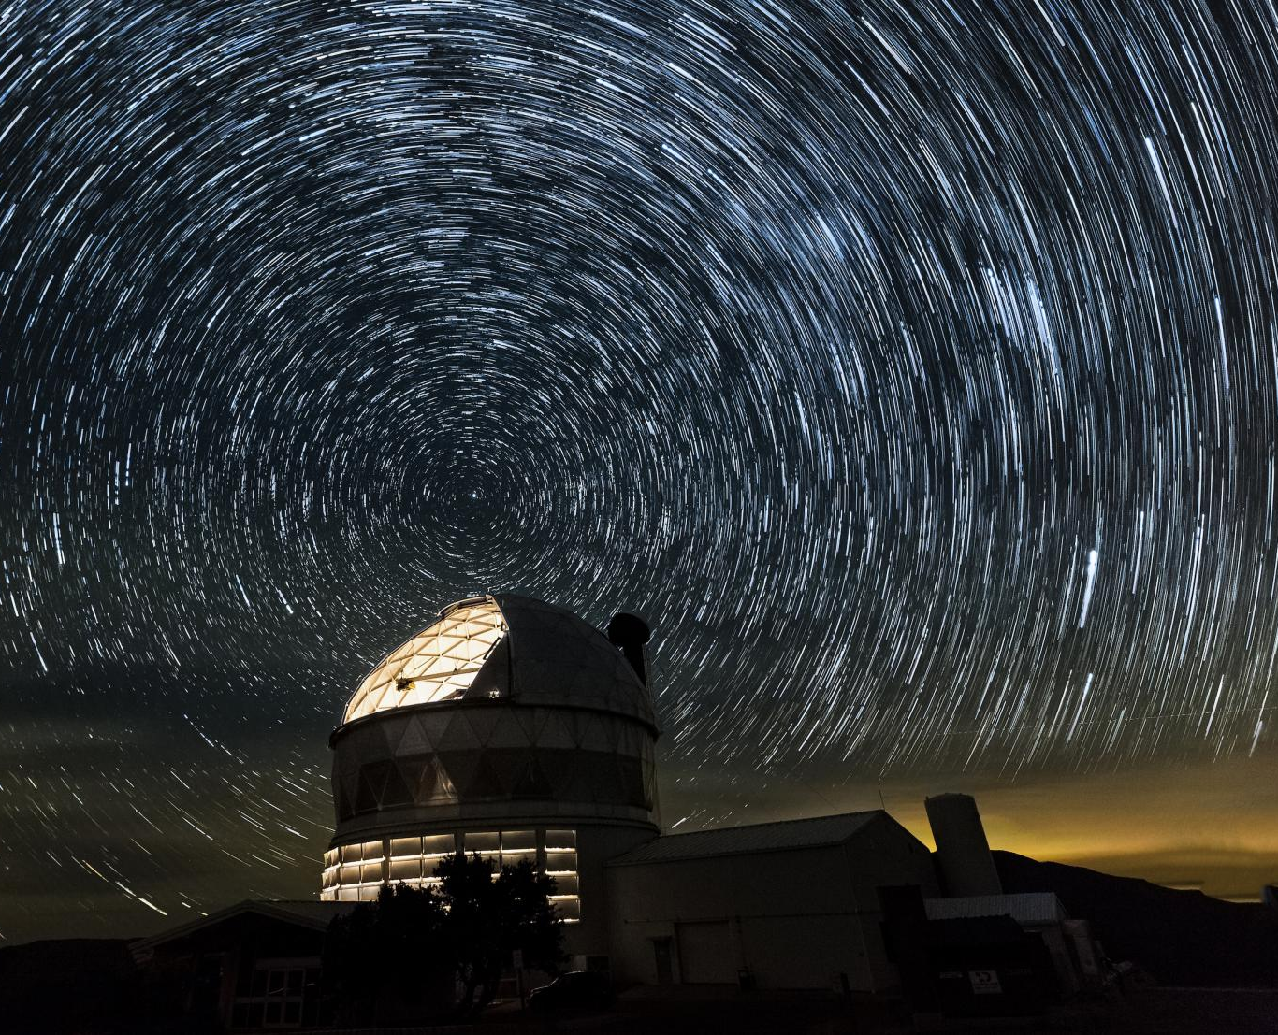
The Epoch of Giant Planet Migration (EGPM) RV Survey
Image Credit: HET/McDonald Observatory
Notes:
At UT Austin, I am conducting a long-term radial velocity survey to do exactly that: search for giant planets around young stars and determine the epoch of giant planet migration.

Slide 19
The Epoch of Giant Planet Migration (EGPM) RV Survey
Habitable-zone Planet Finder (HPF): a high-resolution, near-infrared spectrograph
Image Credit: HET/McDonald Observatory
Notes:
HPF

Slide 20
The Epoch of Giant Planet Migration (EGPM) RV Survey
Habitable-zone Planet Finder (HPF): a high-resolution, near-infrared spectrograph
45 nights over 4 years targeting 100 stars
Image Credit: HET/McDonald Observatory
Notes:
The survey has been on-going for about 4 years now, with 45 nights worth of observations targeting around 100 stars.

Slide 21
The Epoch of Giant Planet Migration (EGPM) RV Survey
Habitable-zone Planet Finder (HPF): a high-resolution, near-infrared spectrograph
45 nights over 4 years targeting 100 stars
NIR RV Noise of Young Sun-like Stars
Image Credit: HET/McDonald Observatory
Notes:
As part of this survey, the first thing we wanted to do was to characterize the level of stellar noise in the survey, which we did for a subsample of the targets.

Slide 22
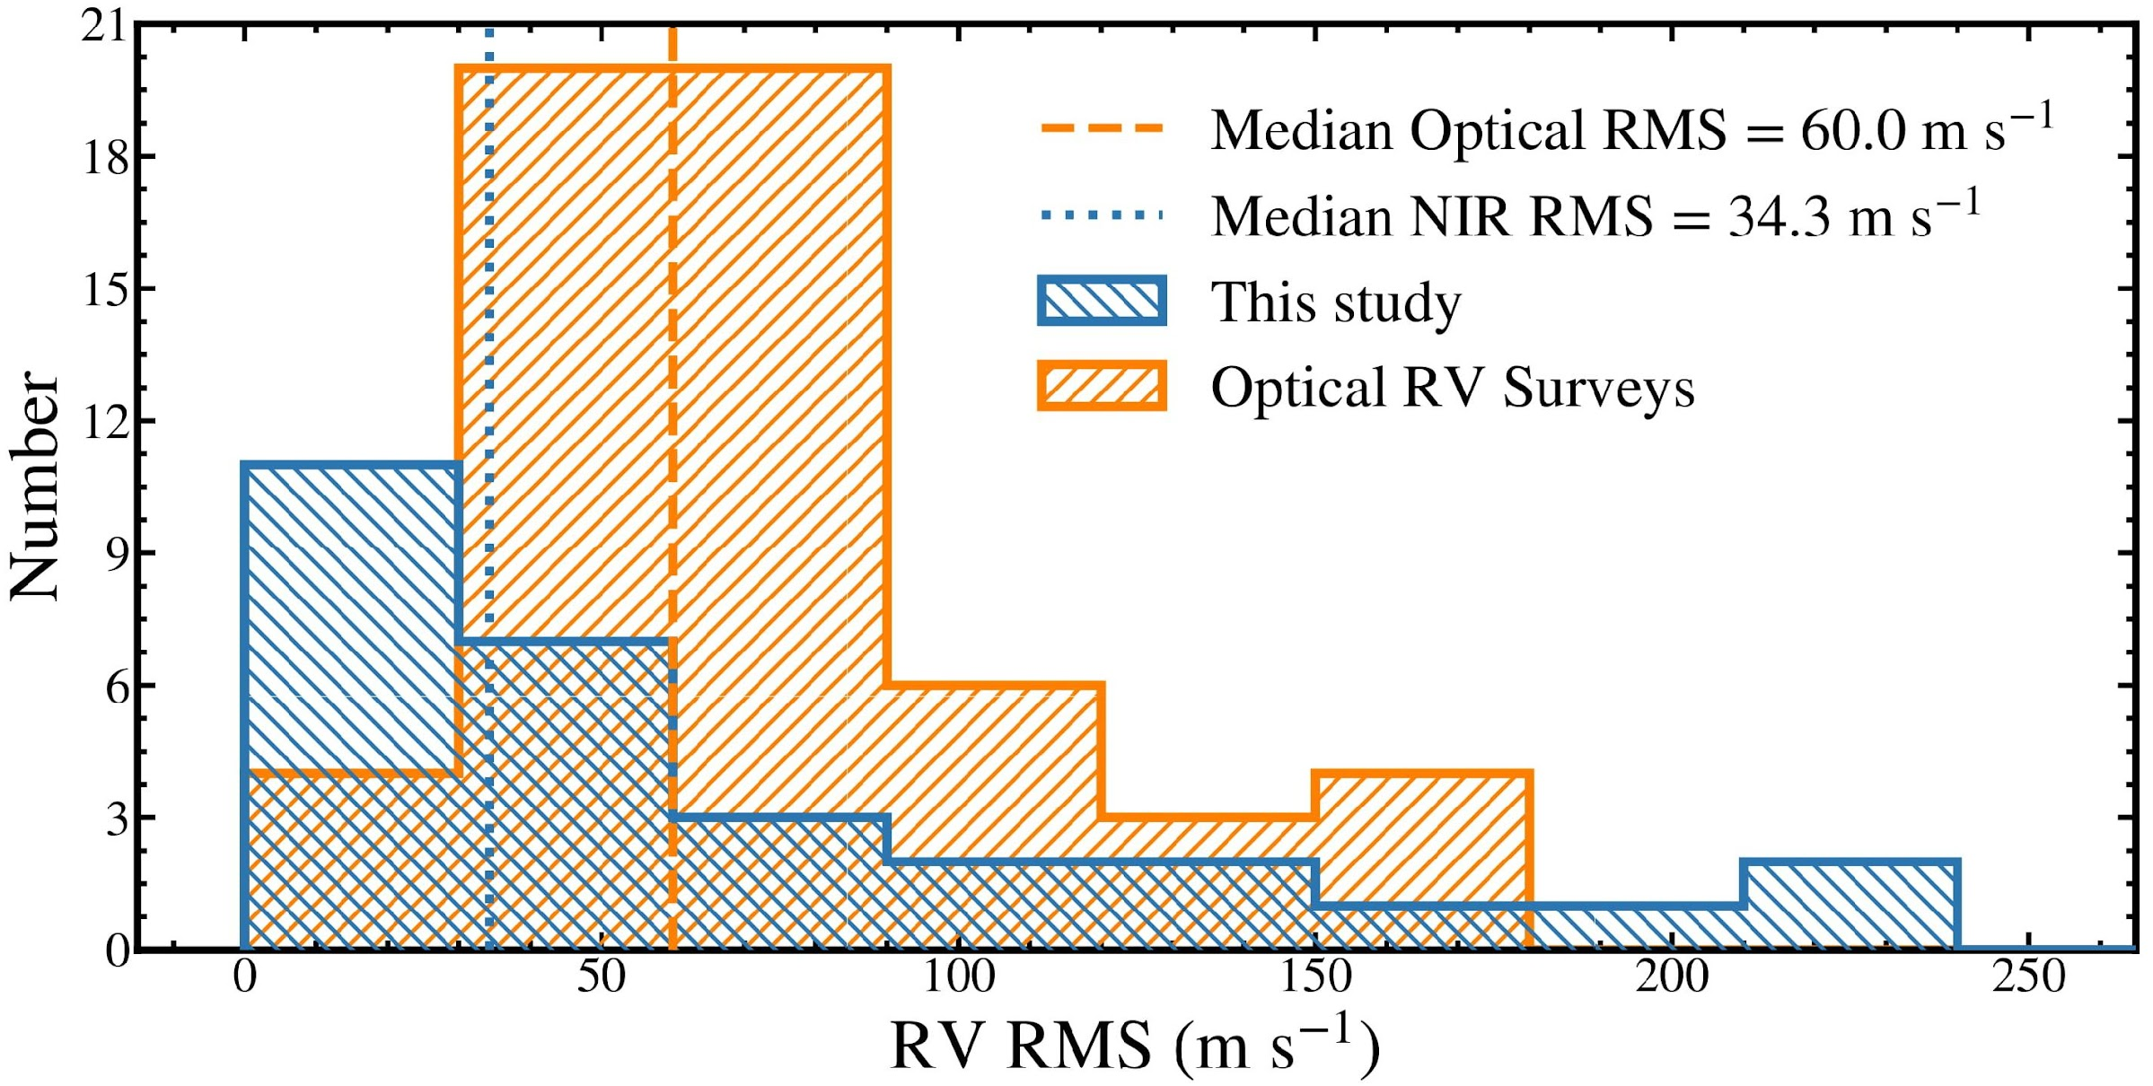
Noise from Stellar Activity is Reduced
in the NIR Compared to the Optical
Tran et al. 2021
Optical RV Noise
Median Optical Scatter = 60.0 m s^{–1}
Median NIR Scatter = 34.4 m s^{–1}
This study
Optical RV Surveys
NIR RV Noise
RV Scatter (m s^{–1})
Notes:
Here, I am showing the distribution of the NIR RV noise, or scatter, as measured for a subsample of the young, Sun-like stars from my survey.
In orange, I am showing the measured optical RV noise for a sample of young stars from optical RV surveys that have similar physical properties such as spectral type, rotational velocities, and ages.

Slide 23
Noise from Stellar Activity is Reduced
in the NIR Compared to the Optical
Tran et al. 2021
Optical RV Noise
Median Optical Scatter = 60.0 m s^{–1}
Median NIR Scatter = 34.4 m s^{–1}
This study
Optical RV Surveys
NIR RV noise is reduced by ~2X compared to optical RV noise
NIR RV Noise
RV Scatter (m s^{–1})
Notes:
What we find is that the NIR RV jitter… This early result was very encouraging, as it signified that RV noise is weaker in the NIR as compared to the optical,
facilitating the possibility of robustly detecting planetary signals around young stars for the first time.

Slide 24
The Epoch of Giant Planet Migration (EGPM) RV Survey
Habitable-zone Planet Finder (HPF): a high-resolution, near-infrared spectrograph
45 nights over 4 years targeting 100 stars
NIR RV Noise of Young Sun-like Stars
Image Credit: HET/McDonald Observatory

Slide 25
The Epoch of Giant Planet Migration (EGPM) RV Survey
Habitable-zone Planet Finder (HPF): a high-resolution, near-infrared spectrograph
45 nights over 4 years targeting 100 stars
NIR RV Noise of Young Sun-like Stars
A new young hot Jupiter
Image Credit: HET/McDonald Observatory
Notes:
A more recent and even more exciting result from the survey is the discovery of a new young hot Jupiter!

Slide 26
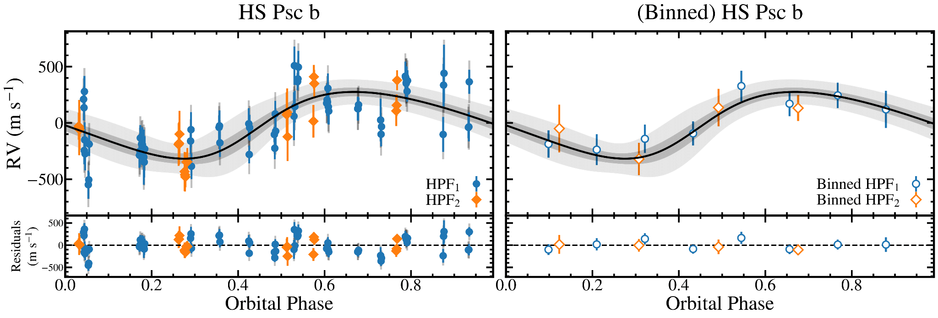
A Young Hot Jupiter
Demonstrates Early Formation or Migration is Possible
m_{b}sin i* = 1.8 M_{Jup}, P_{b} = 4 days, e_{b} = 0.15
Tran et al. submitted
Notes:
Here, I’m showing the phased RV data and best fit planet model (solid black line) on the left. The grey contours represent the 1 and 3 sigma uncertainties of the model fit. The right plot is the same but with the data points median binned to help guide the eye.
We recover a 1.8 Jupiter mass planet on a 4 day orbit, with a modest but non-zero eccentricity of 0.15.
The orbital period is neither the same or a harmonic integer of the rotation period, which we know precisely from the TESS light curves, supporting the planetary nature of the signal. Now, this discovery of a young hot Jupiter is exciting for many reasons.
First, it joins only a handful of such systems, as there are less than 5 discovered planets with masses at this age.
Second, its non-zero eccentricity suggests that it is actively undergoing tidal circularization. And finally, regardless of the different possibilities of its origin, it demonstrates that hot Jupiters can form and potentially migrate as early as ~100 Myr.

Slide 27
The Epoch of Giant Planet Migration (EGPM) RV Survey
Habitable-zone Planet Finder (HPF): a high-resolution, near-infrared spectrograph
45 nights over 4 years targeting 100 stars
NIR RV Noise of Young Sun-like Stars
A new young hot Jupiter
Image Credit: HET/McDonald Observatory

Slide 28
The Epoch of Giant Planet Migration (EGPM) RV Survey
Habitable-zone Planet Finder (HPF): a high-resolution, near-infrared spectrograph
45 nights over 4 years targeting 100 stars
NIR RV Noise of Young Sun-like Stars
A new young hot Jupiter
Final statistical results will inform when and how giant planets migrate to close orbits
Image Credit: HET/McDonald Observatory
Notes:
Finally, the statistical results of the survey will do exactly I described earlier: it will clarify when giant planets migrate to determine how they migrate.
The survey will conclude in the next couple of months, so please stay tuned for the results!

Slide 29
The March to Young Planets
with the ELTs
Luger et al. 2019, Tran et al. 2023
Notes:
But, those results aren’t the only thing I’m excited for in regards to the future of characterizing young stars and planets.
If you recall, this was the picture of current ground-based RV campaigns shown earlier.

Slide 30
The March to Young Planets
with the ELTs
Current Ground-based Observing Cadence
Luger et al. 2019, Tran et al. 2023
Notes:
As I’ve described, current observations of young stars are limited by this relatively sparse observing cadence,
which makes it difficult to trace the correlated noise from stellar activity and ultimately limits our power to detect planets around these young stars. This is a natural consequence of the cost of high-cadence observing.

Slide 31
The March to Young Planets
with the ELTs
Current Ground-based Observing Cadence
Future Observing Cadence with the ELTs
Luger et al. 2019, Tran et al. 2023
Notes:
However, with a Thirty-meter class telescope, the apertures are 3-5 times larger than the current largest available telescoapes. And so for the same cost at current facilities, the ELTs will be able to improve the observing cadence by a factor of 10 to 20 times! This will allow us to precisely track activity from a variety of sources and timescales, including not just spots but also granulation and oscillations. Even more saliently, this improved cadence will allow us to more robustly and precisely detect and characterize planets hidden within that noise.

Slide 32
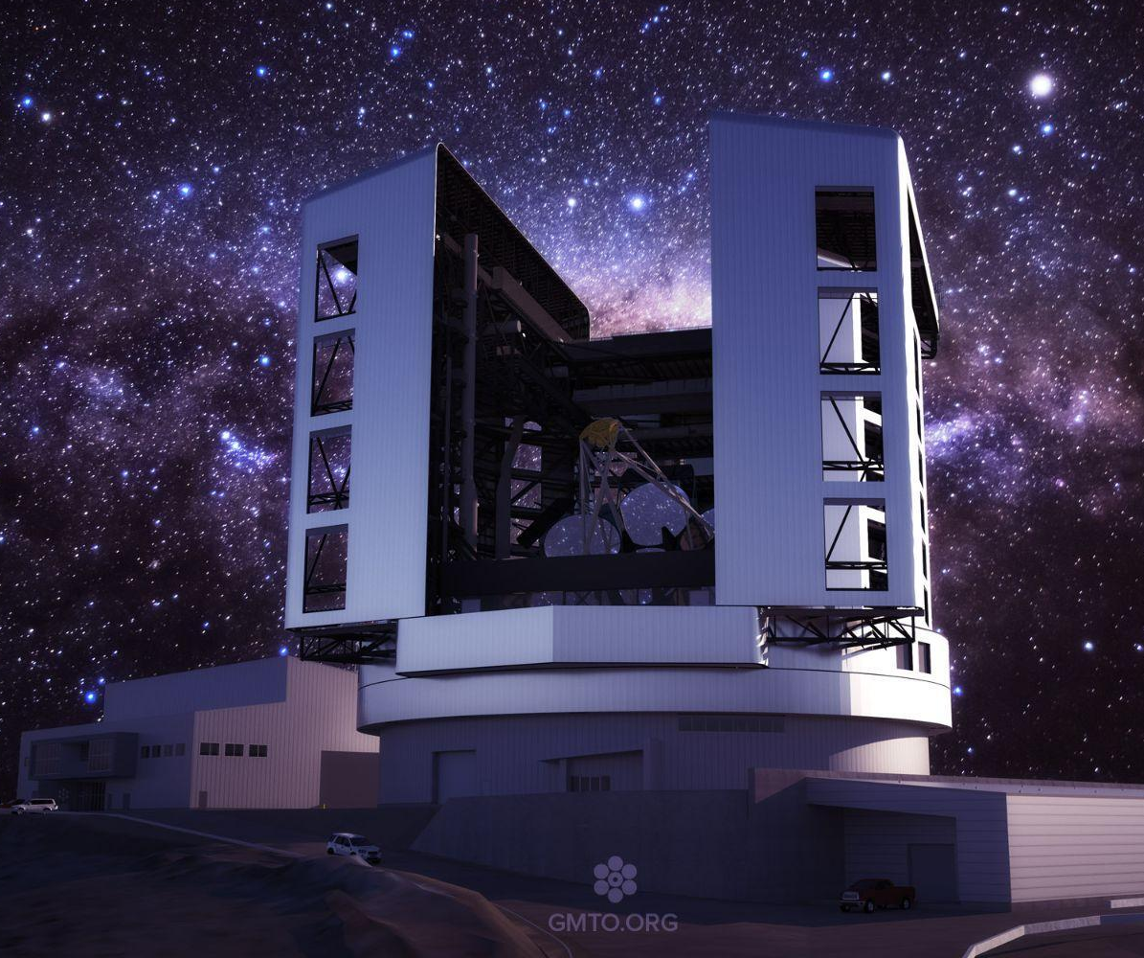
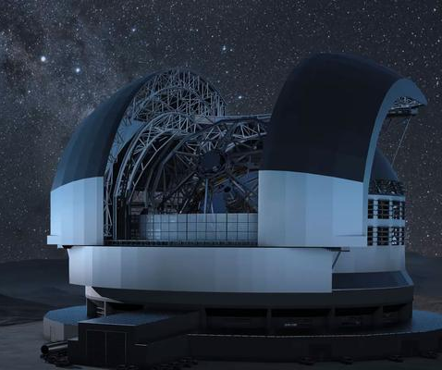
The March to Young Planets
with the ELTs
Image credit: M3 Engineering
and GMTO Corporation
Image Credit: SCHOTT
Image credit: TMT
GMT – G-CLEF
ELT – ANDES
TMT – MODHIS
e.g. Szentgyorgyi et al 2016
e.g. Palle et al 2023
e.g. Konopacky et al 2023
First-generation
High Resolution (R ~ 100,000)
0.35–0.95 μm
Next-generation
High Resolution (R ≥ 100,000)
0.5–1.8 μm
First-generation
High Resolution (R ~ 100,000)
0.98–2.46 μm
Notes:
So, that is why I am very excited for the ELTs, which will host a fantastic set high-resolution, high-precision spectrographs that span a broad wavelength range and that are capable of doing exactly what I just described!
In particular, G-CLEF on the GMT and MODHIS on the TMT will be first-generation instruments, so the march to young planets is closer than ever!
And with that…

Slide 33
Supplementary Slides

Slide 34
Observationally distinguish migration pathways
by studying close-in giant planet population over time
Notes:
Indeed, we can observationally distinguish between migration pathways by measuring the frequency of close-in giant planets and see how it evolves over time.

Slide 35
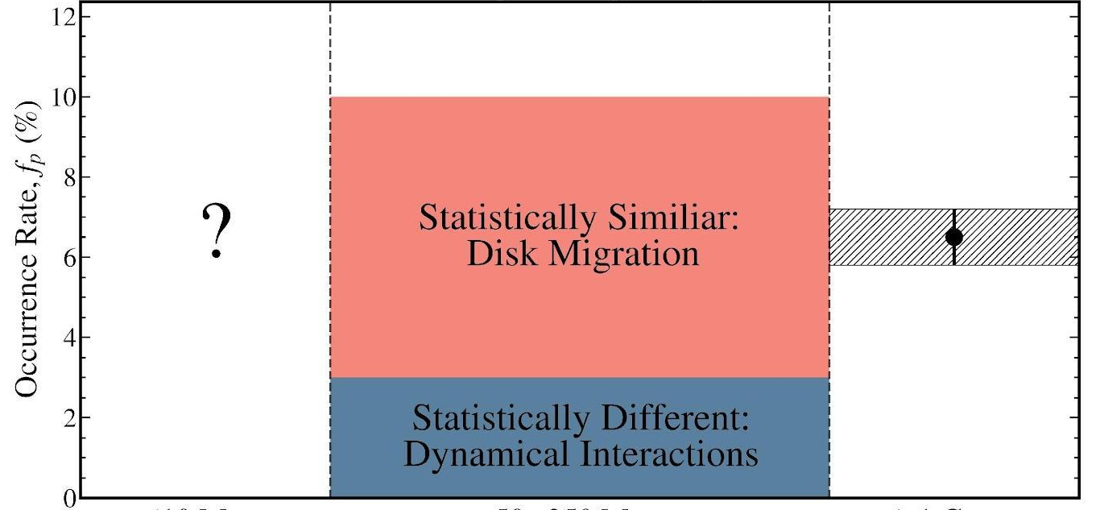
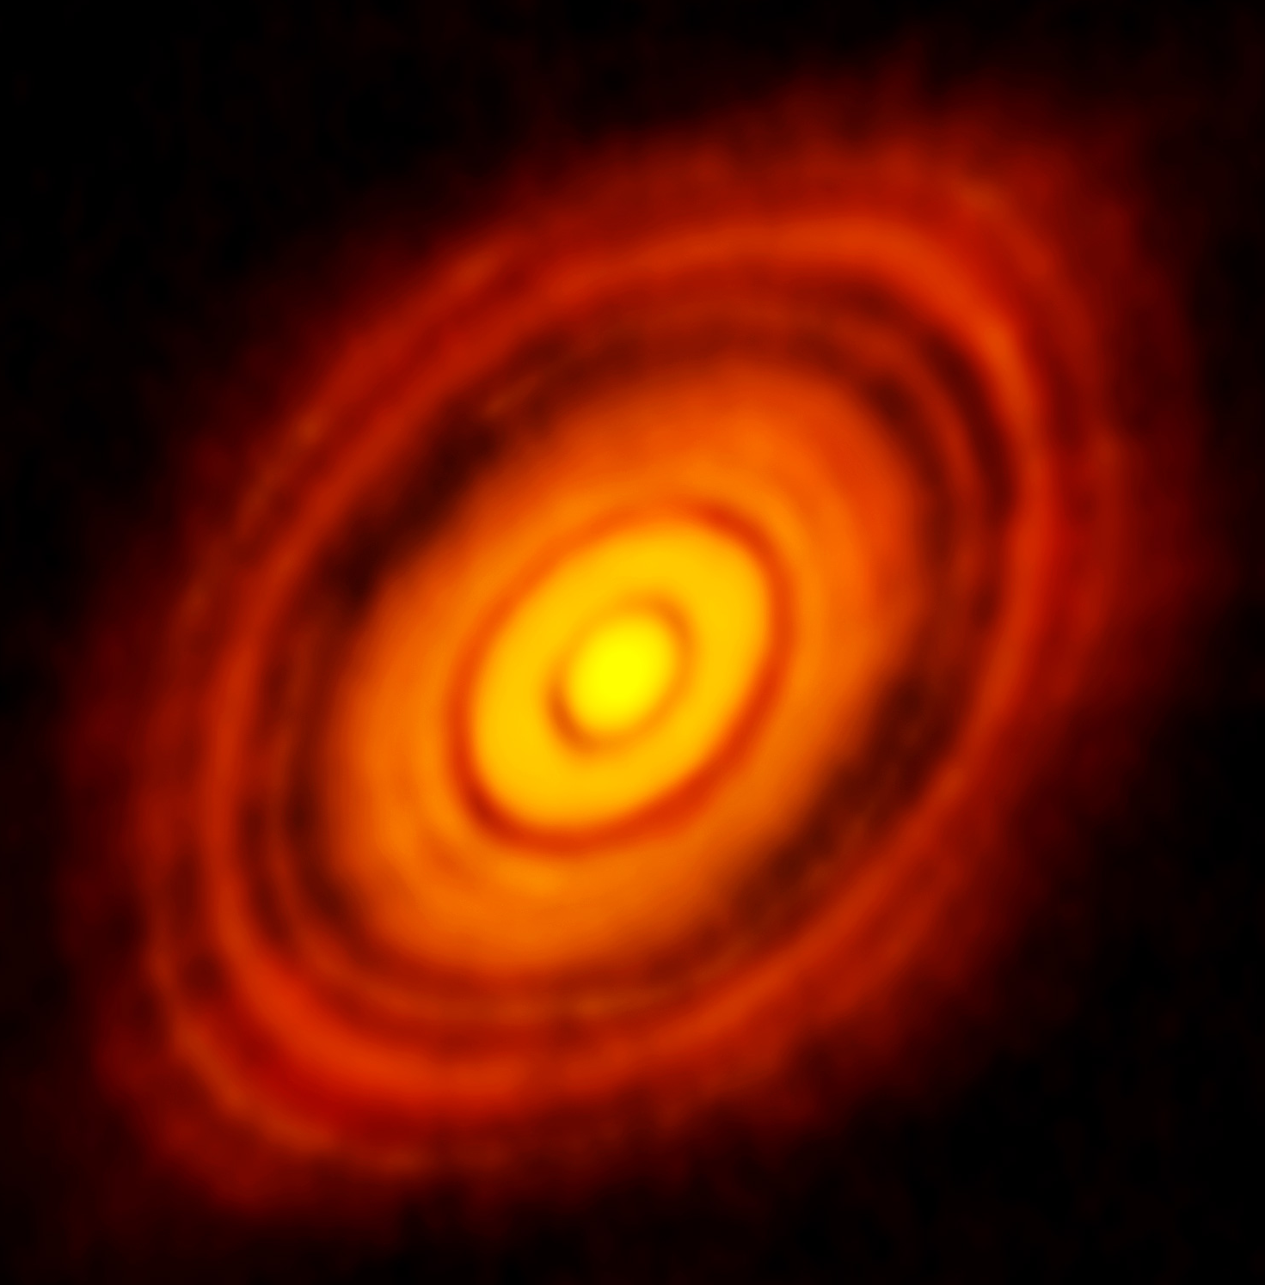
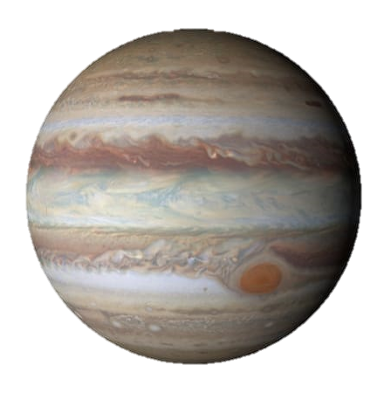
Observationally distinguish migration pathways
by studying close-in giant planet population over time
Image Credit:
ALMA (ESO/NAOJ/NRAO)
6.5 ± 0.7%
(Johnson et al. 2010)
Frequency of Close-in
of Giant Planets (%)
Giant Planet
Formation
Orbital Migration
Migration Terminates
Notes:
By determining the frequency of close-in giant planets at young ages
(here at 20-200 Myrs)
we can compare that value to the measurement at older ages and assess its evolution over time. This comparison then allows us to constrain the dominant migration pathway of close-in giant planets.

Slide 36
Observationally distinguish migration pathways
by studying close-in giant planet population over time
Image Credit:
ALMA (ESO/NAOJ/NRAO)
Very Fast:
Planet Ingestion
6.5 ± 0.7%
(Johnson et al. 2010)
Frequency of Close-in
of Giant Planets (%)
Fast:
Disk Migration
Slow:
Dynamical Interactions
Giant Planet
Formation
Orbital Migration
Migration Terminates
Notes:
Finally, if the frequency of close-in giant planets actually decreases over time, then then this suggests that inward orbital migration is much efficient and rapid than predicted leading to frequent engulfment or ingestion of the giant planet by its host star.

Slide 37
Observationally distinguish migration pathways
by studying close-in giant planet population over time
Image Credit:
ALMA (ESO/NAOJ/NRAO)
Very Fast:
Planet Ingestion
6.5 ± 0.7%
(Johnson et al. 2010)
Determine When Giant Planets Migrate
can Disentangle How They Migrate
Frequency of Close-in
of Giant Planets (%)
Fast:
Disk Migration
Slow:
Dynamical Interactions
Giant Planet
Formation
Orbital Migration
Migration Terminates
Notes:
Finally, if the frequency of close-in giant planets actually decreases over time, then then this suggests that inward orbital migration is much efficient and rapid than predicted leading to frequent engulfment or ingestion of the giant planet by its host star.

Slide 38
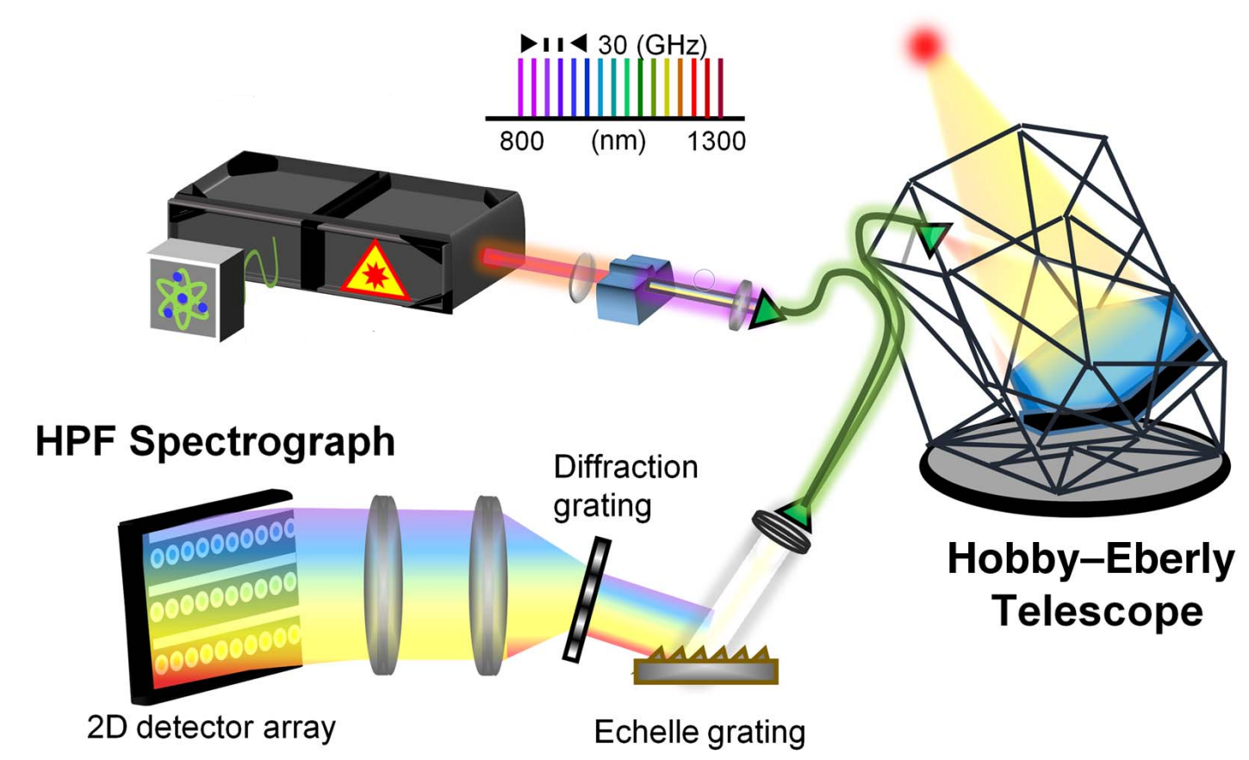
Habitable-zone Planet Finder (HPF) Spectrograph
Laser Frequency Comb
Near-Infrared (NIR)
Temperature Stabilized
Queue-mode Observing
Fiber-fed
High Resolution (R ~ 55,000)
Hobby-Eberly
Telescope
Mahadevan+2012,
Stefansson+2016,
Ninan+2018, Kaplan+2018, Metcalfe+2019a, Stefansson+2020

Slide 39
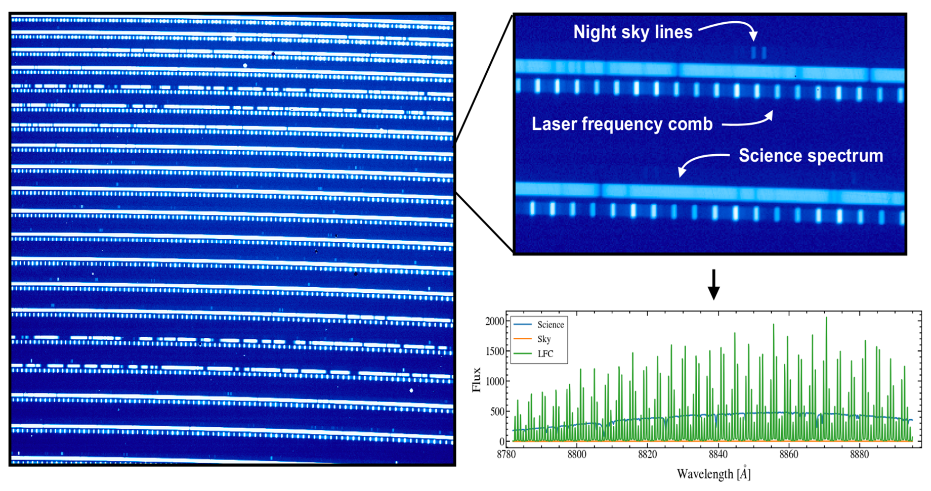
Example HPF Data

Slide 40
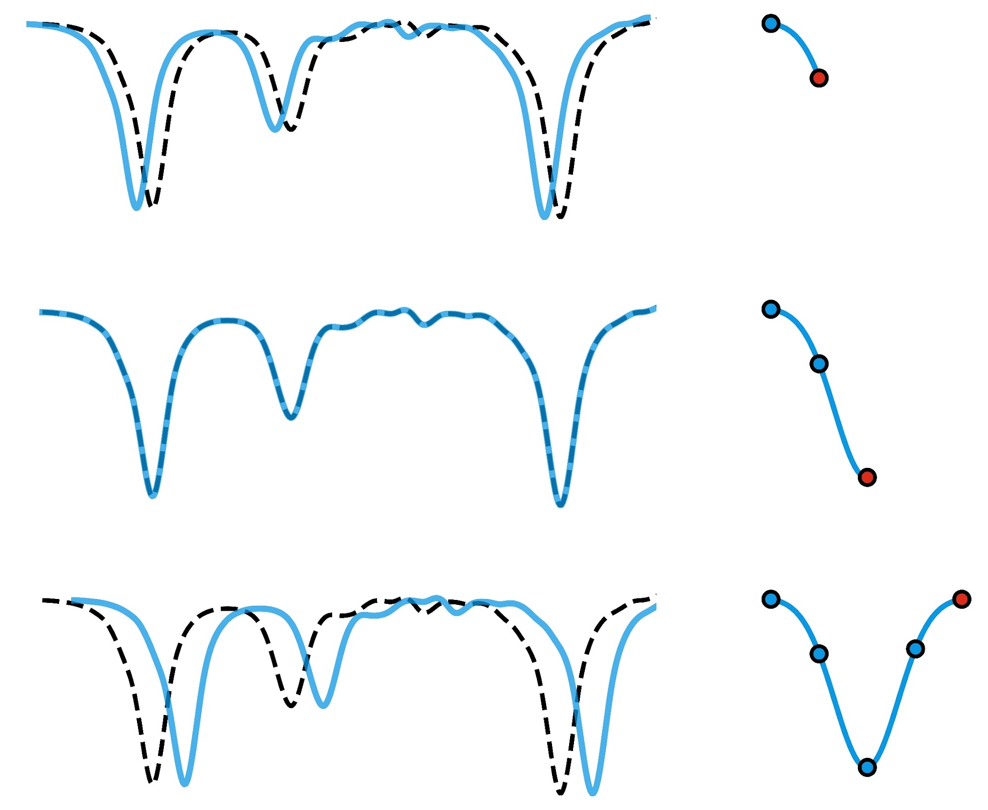
Custom Precision Radial Velocity Pipeline:
Least-Squares Matching
1) V_{Template} < V_{Target}
Science
Spectrum
2) V_{Template} = V_{Target}
Template
3) V_{Template} > V_{Target}
e.g., Zechmeister et al. 2018

Slide 41
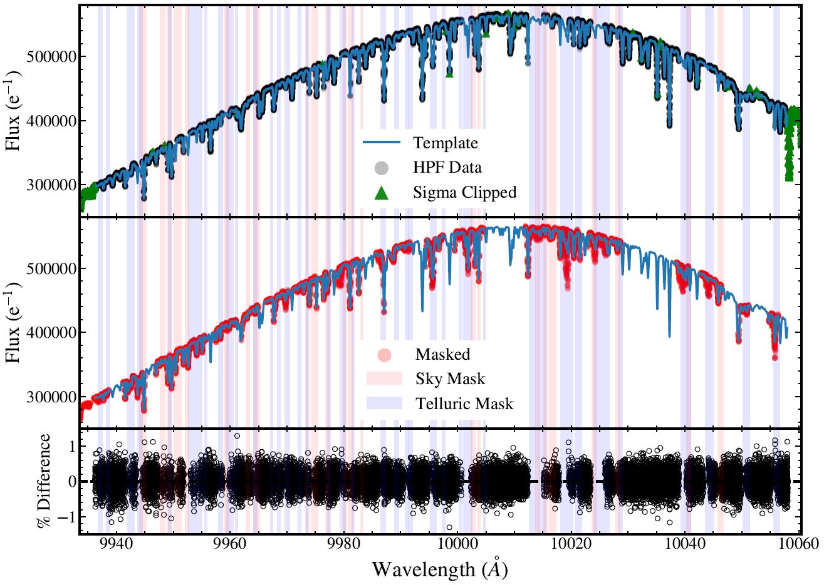
Custom Precision Radial Velocity Pipeline: Template Creation
Echelle Order 14
σ = 0.27%
Tran et al. 2021

Slide 42
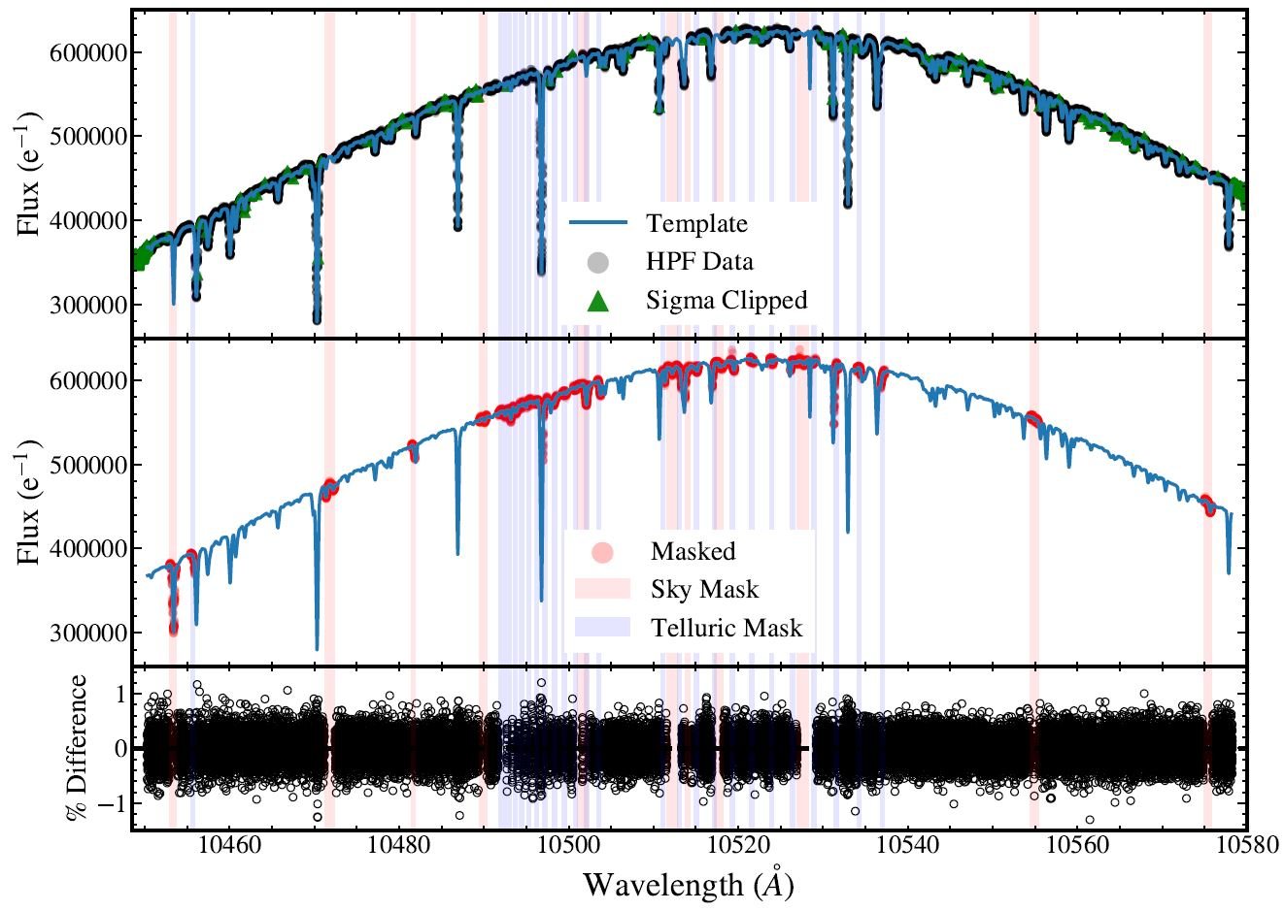
Custom Precision Radial Velocity Pipeline: Template Creation
Echelle Order 14
σ = 0.26%
Tran et al. 2021

Slide 43
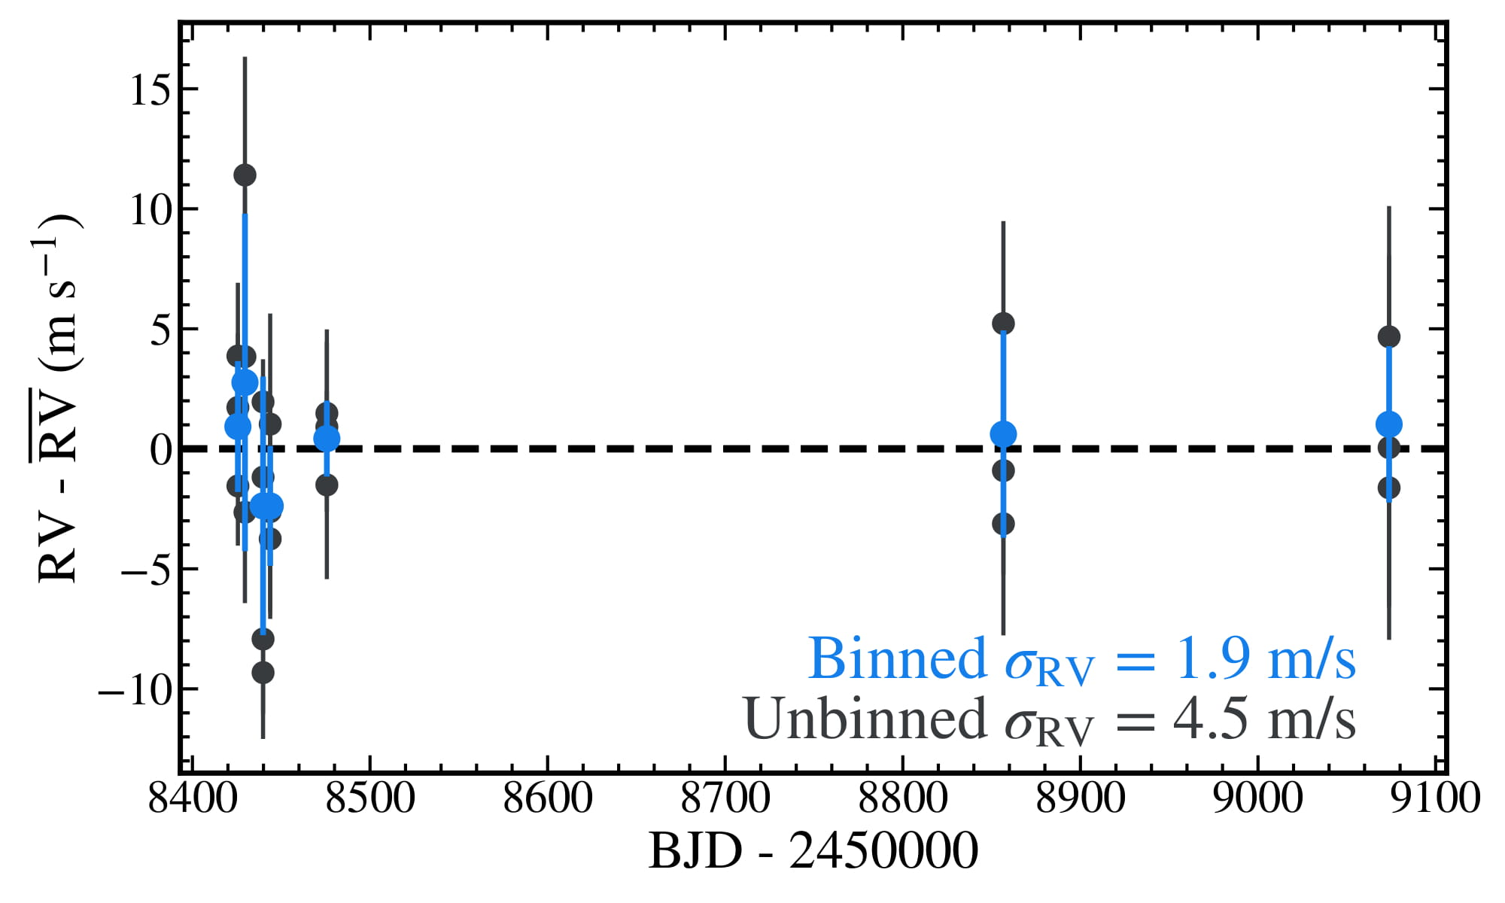
Custom Precision Radial Velocity Pipeline:
<2 m/s Stability on RV Standard
Tran et al. 2021
K2, J = 5.7 mag
Notes:
Comparable to the observed jitter in the optical

Slide 44
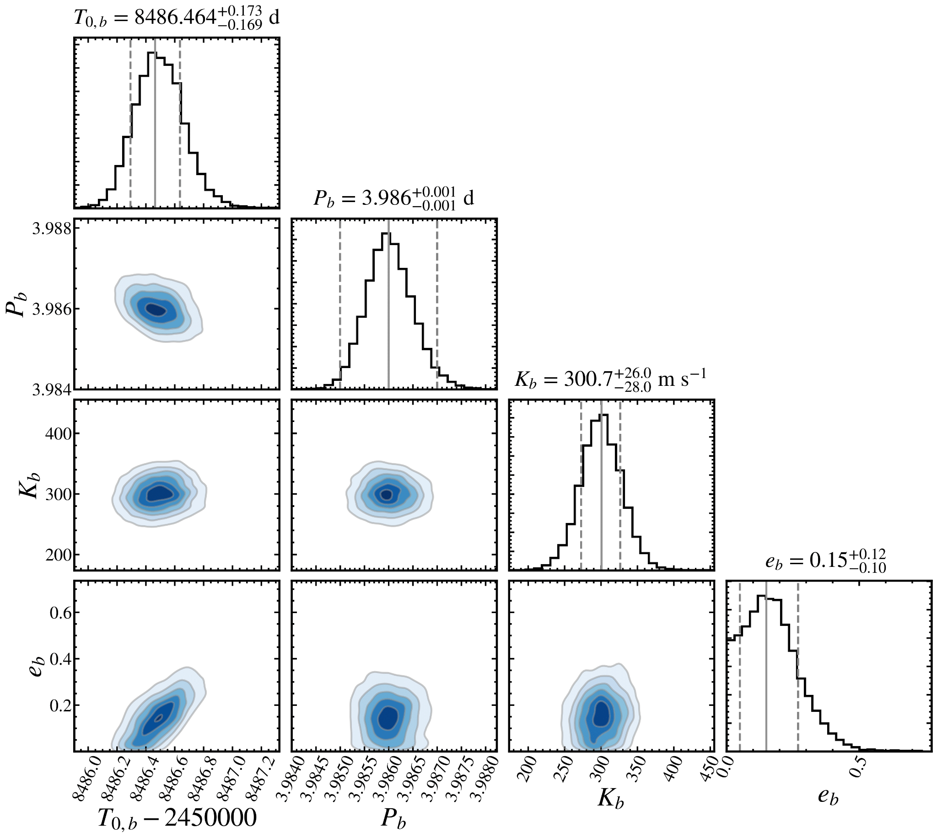
Tran et al. submitted

Slide 45
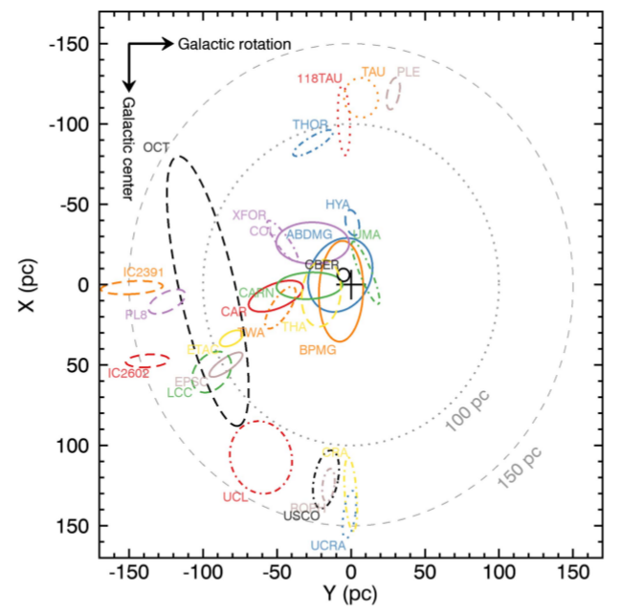
Pleiades, AB Dor, β Pic, Carina, Argus, Car-Near, Octans, 32 Ori, Tuc-Hor

Slide 46
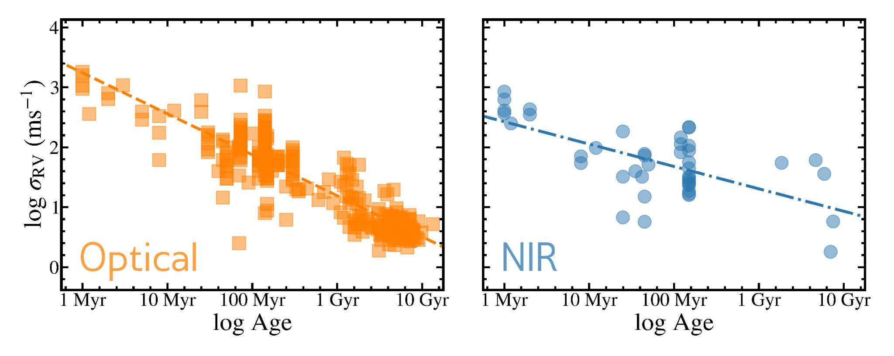
Noise from Stellar Activity is Scales
Logarithmically in the Optical and NIR

Slide 47
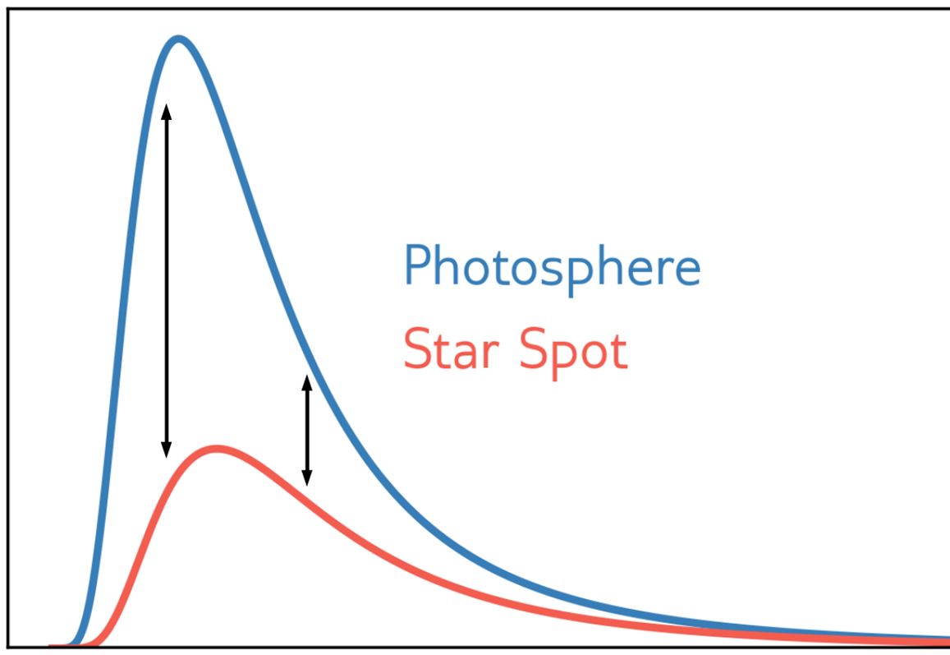
Observing at near-infrared wavelengths is expected to reduce the radial velocity contributions of starspots
Larger Contrast
Flux
Smaller Contrast
Stellar Photosphere
Starspot
Optical
Near-Infrared

Slide 48
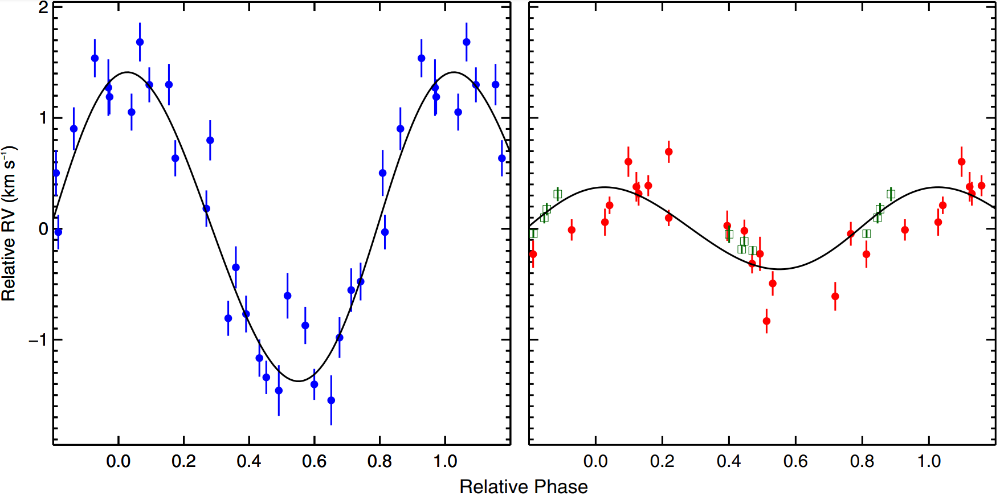
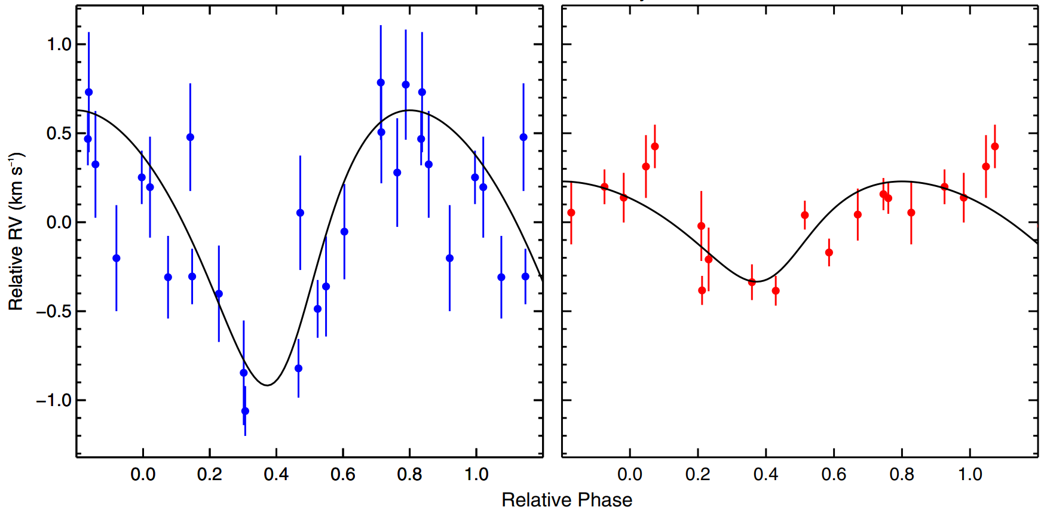
Observing at near-infrared wavelengths is expected to reduce the radial velocity contributions of starspots
Hubble I 4
DN Tau
RV (km s⁻¹)
RV (km s⁻¹)
Optical
NIR
Relative Phase
Relative Phase
Crockett et al. (2012)

Slide 49
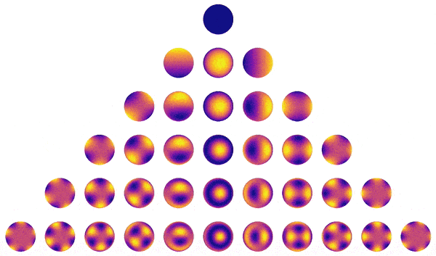
Using starry, we analytically model stellar surface maps as sums of spherical harmonics
Luger et al. (2019)

Slide 50
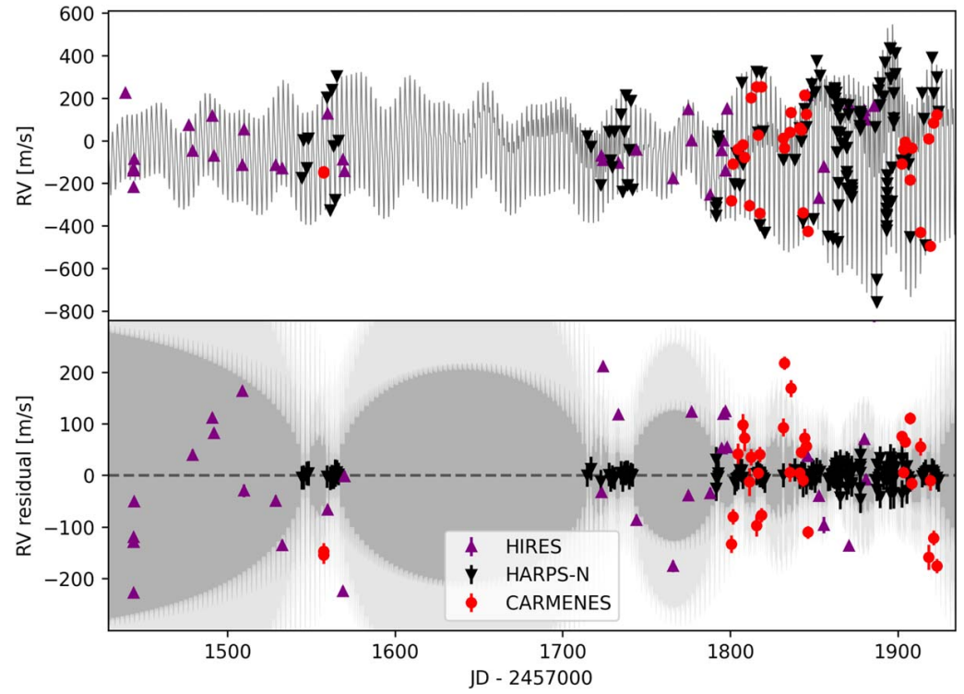
In Search of Young Planets: Stellar Activity Models
Overfitting and Systematic Biases
Blunt et al. 2023

Slide 51
In Search of Young Planets: Stellar Activity Models
Overfitting and Systematic Biases
Blunt et al. 2023
Tran & Bowler in prep.
Planet + Activity
Inferred K (m s⁻¹)
Planet-only Inferred K (m s⁻¹)

