Slide 1
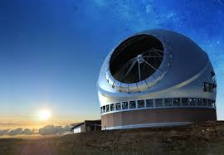
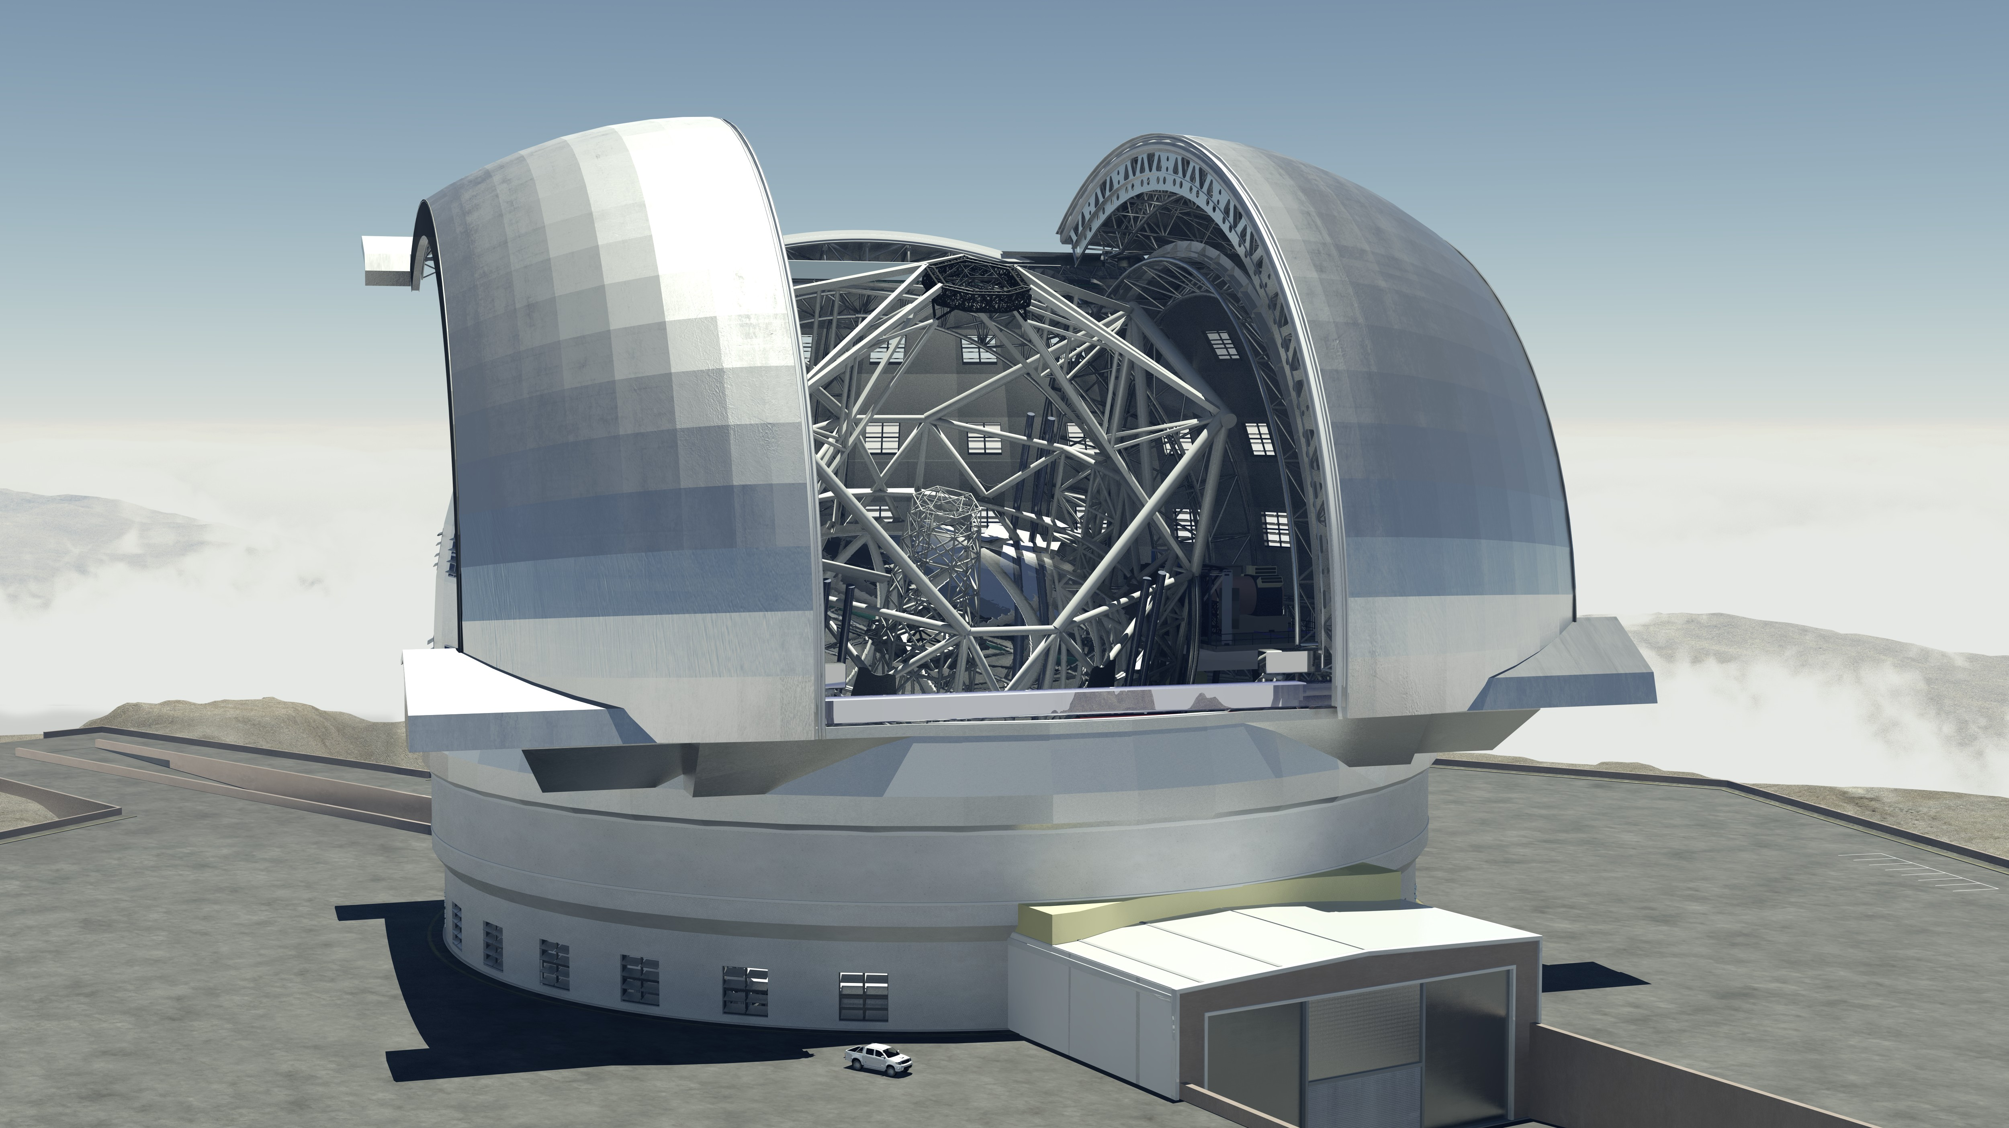
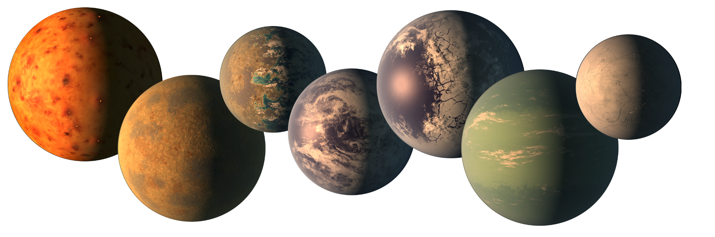
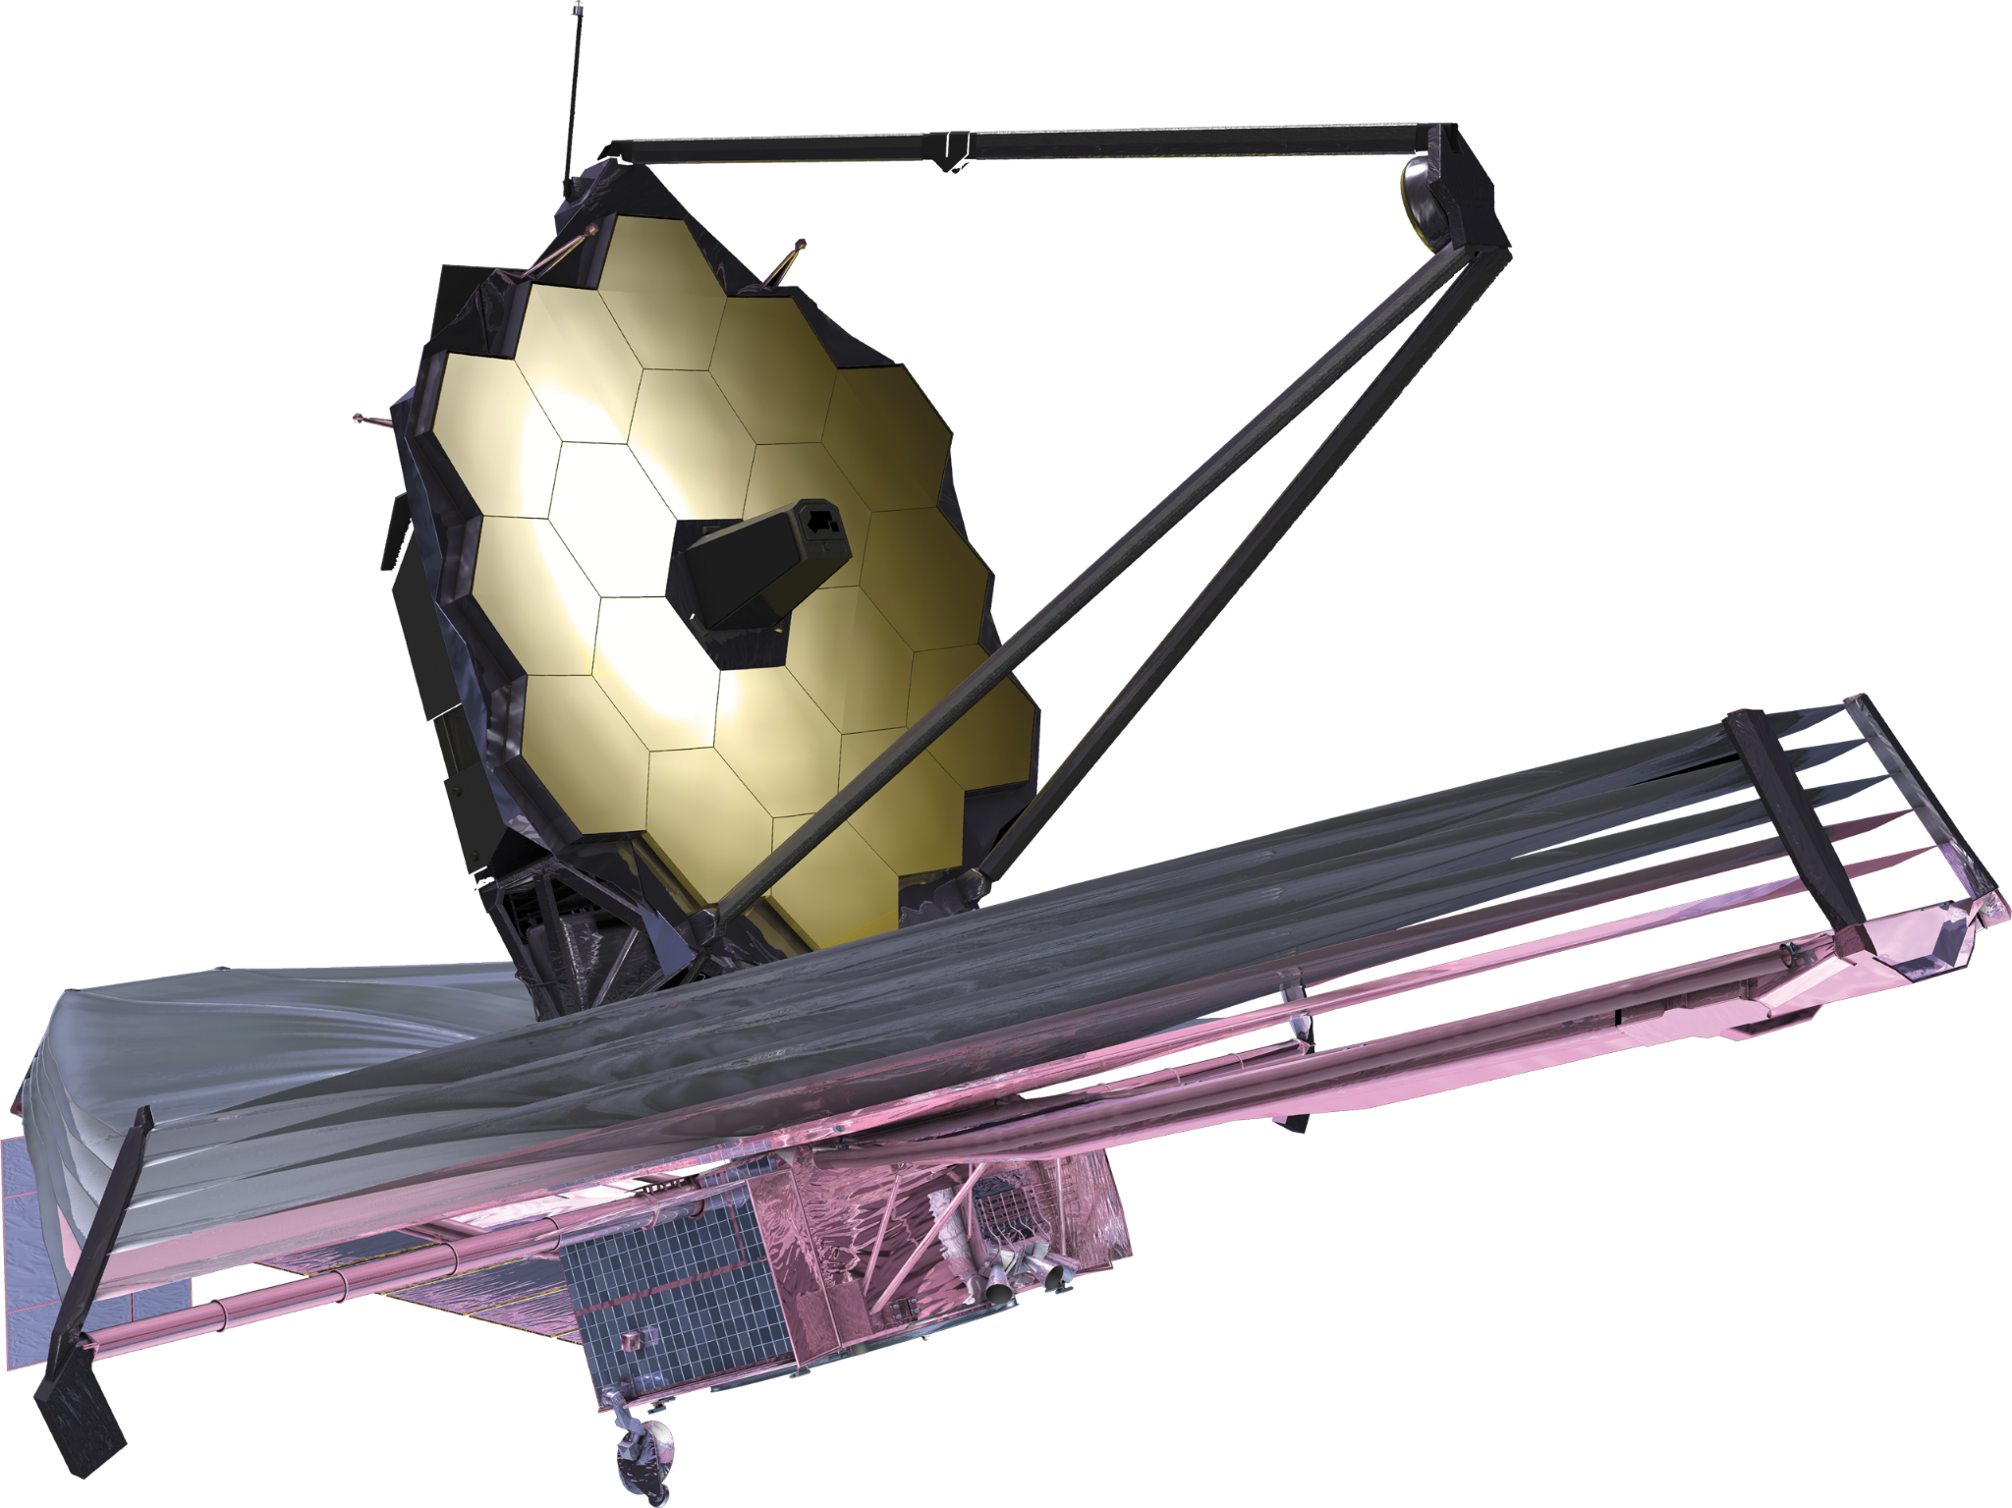
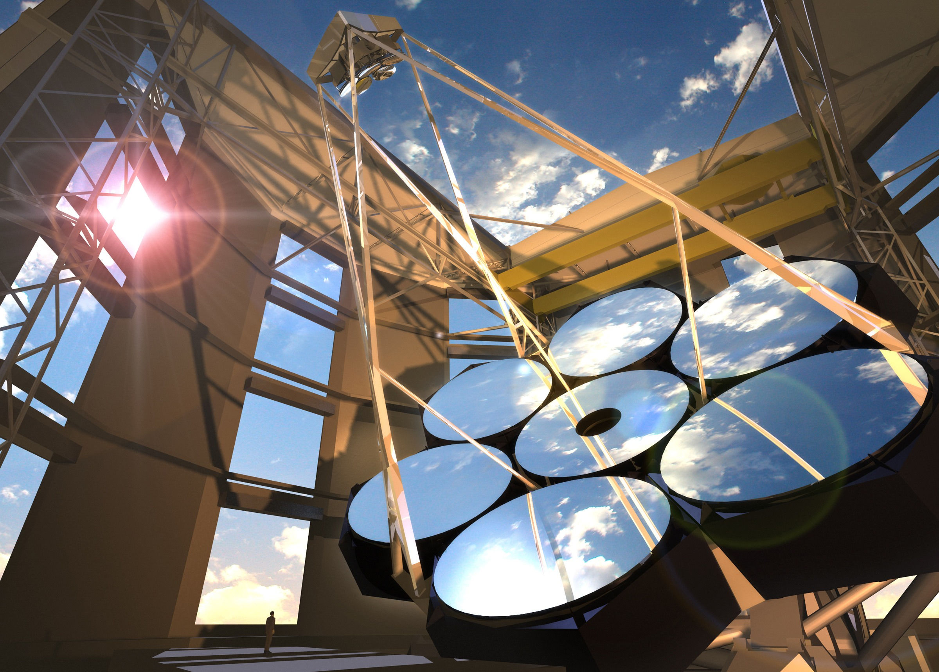




Atmospheric Characterization of Temperate Rocky Exoplanets - A JWST and ELT Perspective
René Doyon + many collaborators
ELT Science in Light of JWST – 11 December 2023

Slide 2
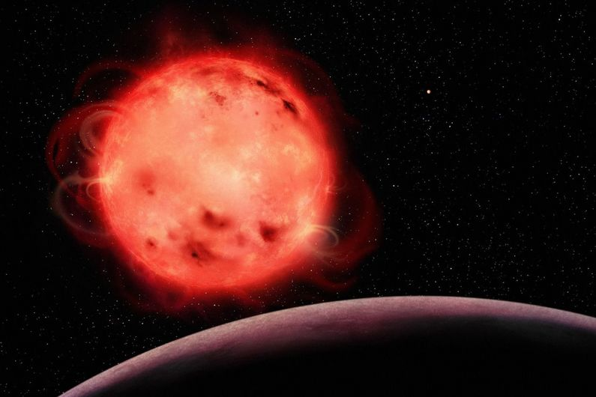
Can rocky planets atmospheres survive the intense X-ray/UV conditions of an M dwarf ?
Artist impression of Trappist-1b and its star

Slide 3
The Most Common Exoplanets: Super-Earths and Mini-Neptunes

Slide 4
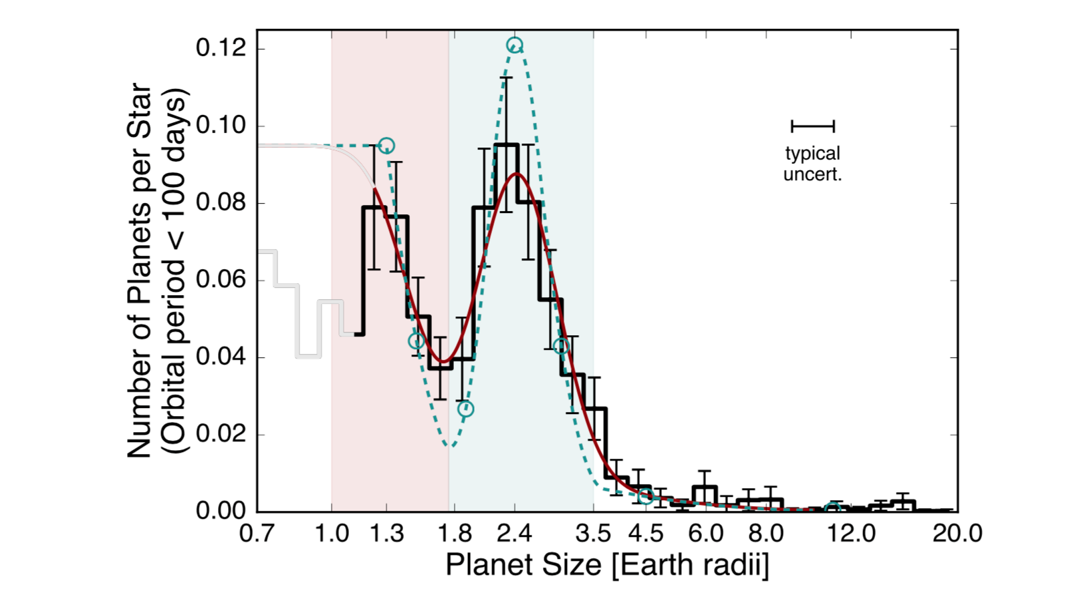
Radius distribution of small exoplanets
Fulton et al. (2017)
Super-Earths
Sub-Neptunes
Signpost of atmospheric escape processes and/or formation history

Slide 5
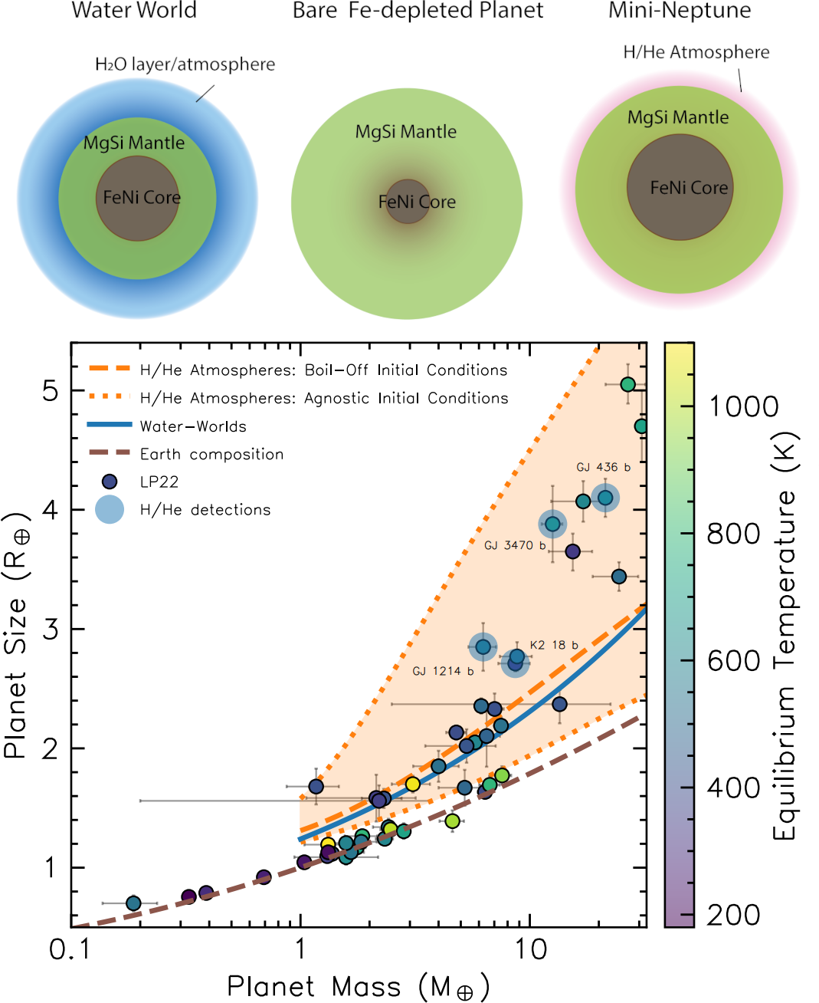
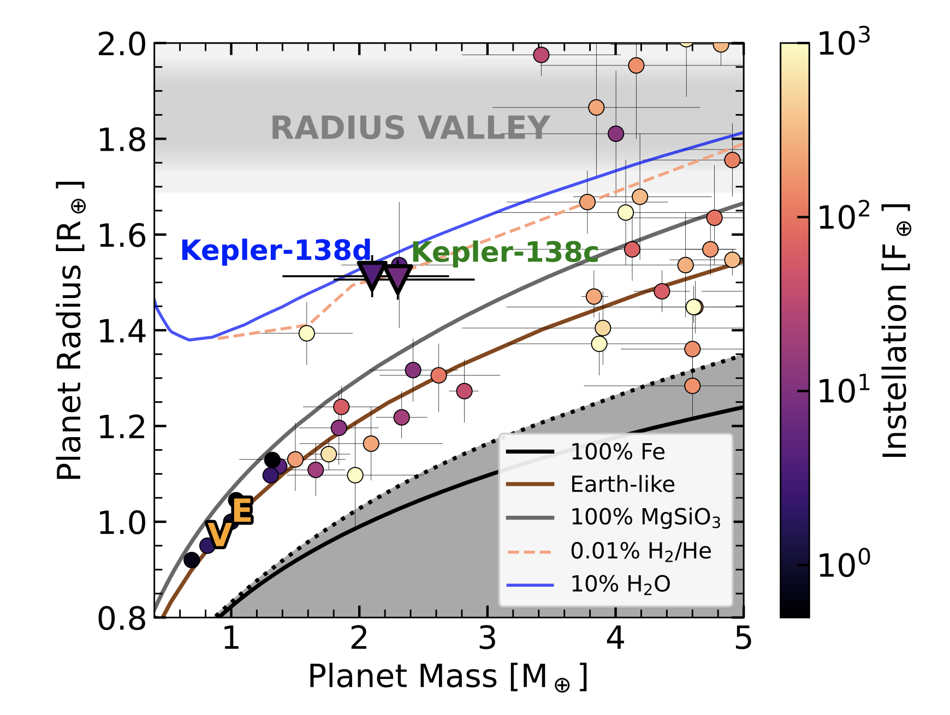
Do water worlds exist ?
Piaulet et al. (2022)
Rogers (2023)

Slide 6
Atmospheric detection is key to constrain the nature of exoplanets

Slide 7
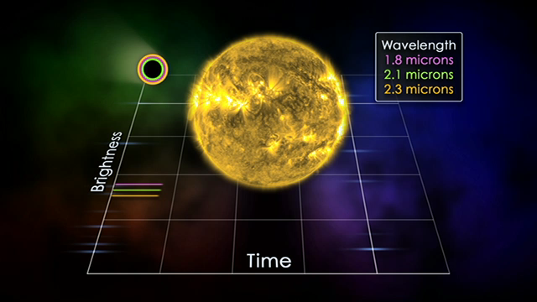
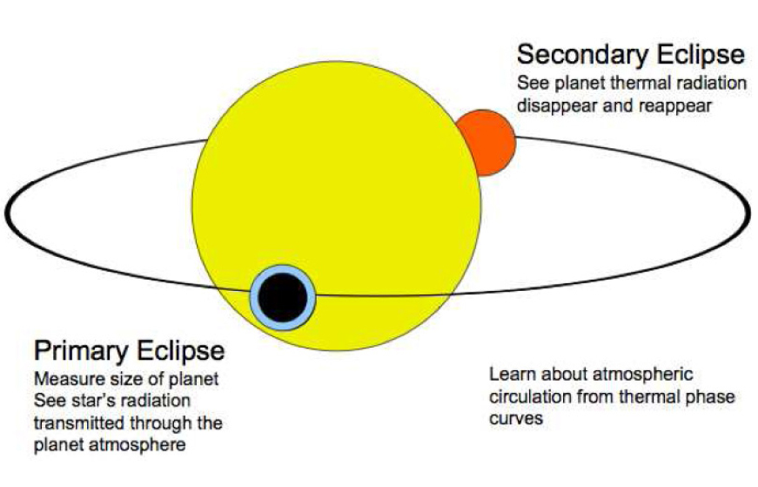
Probing exoplanet atmospheres in transiting systems

Slide 8
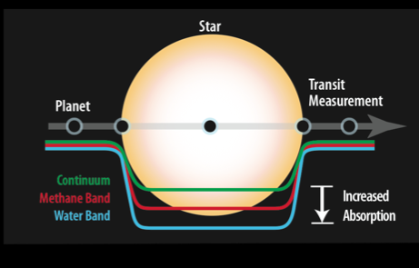
Transit Spectroscopy 101

Slide 9

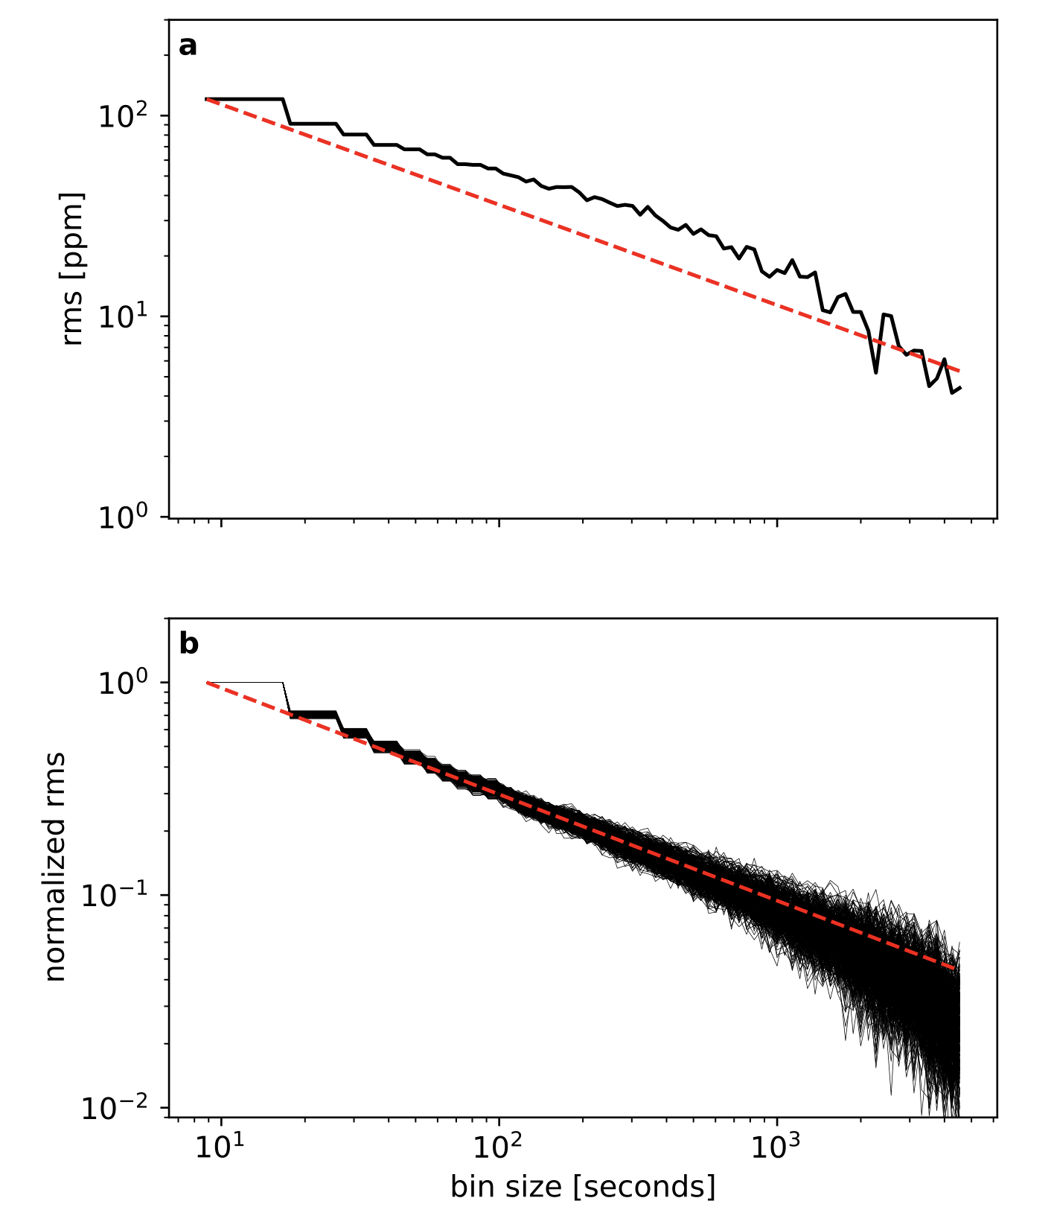
Wasp-18 phase curve
(white light curve residuals)
- - - Photon noise
~5 ppm in hr
L-P. Coulombe
Coulombe et al. (2023)

Slide 10
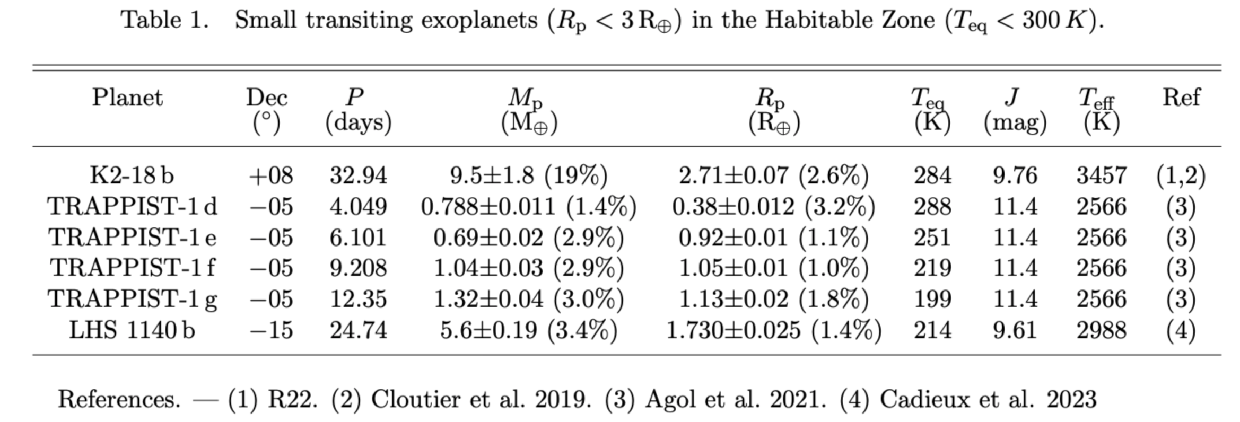
Best Characterized Small Temperate Transiting planets

Slide 11
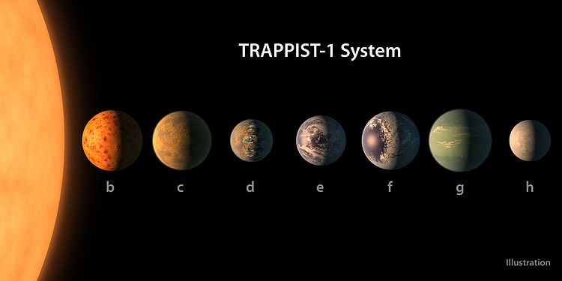

Trappist-1 System
All planets mass and radii known to an exquisite accuracy (a few %)
Habitable zone

Slide 12
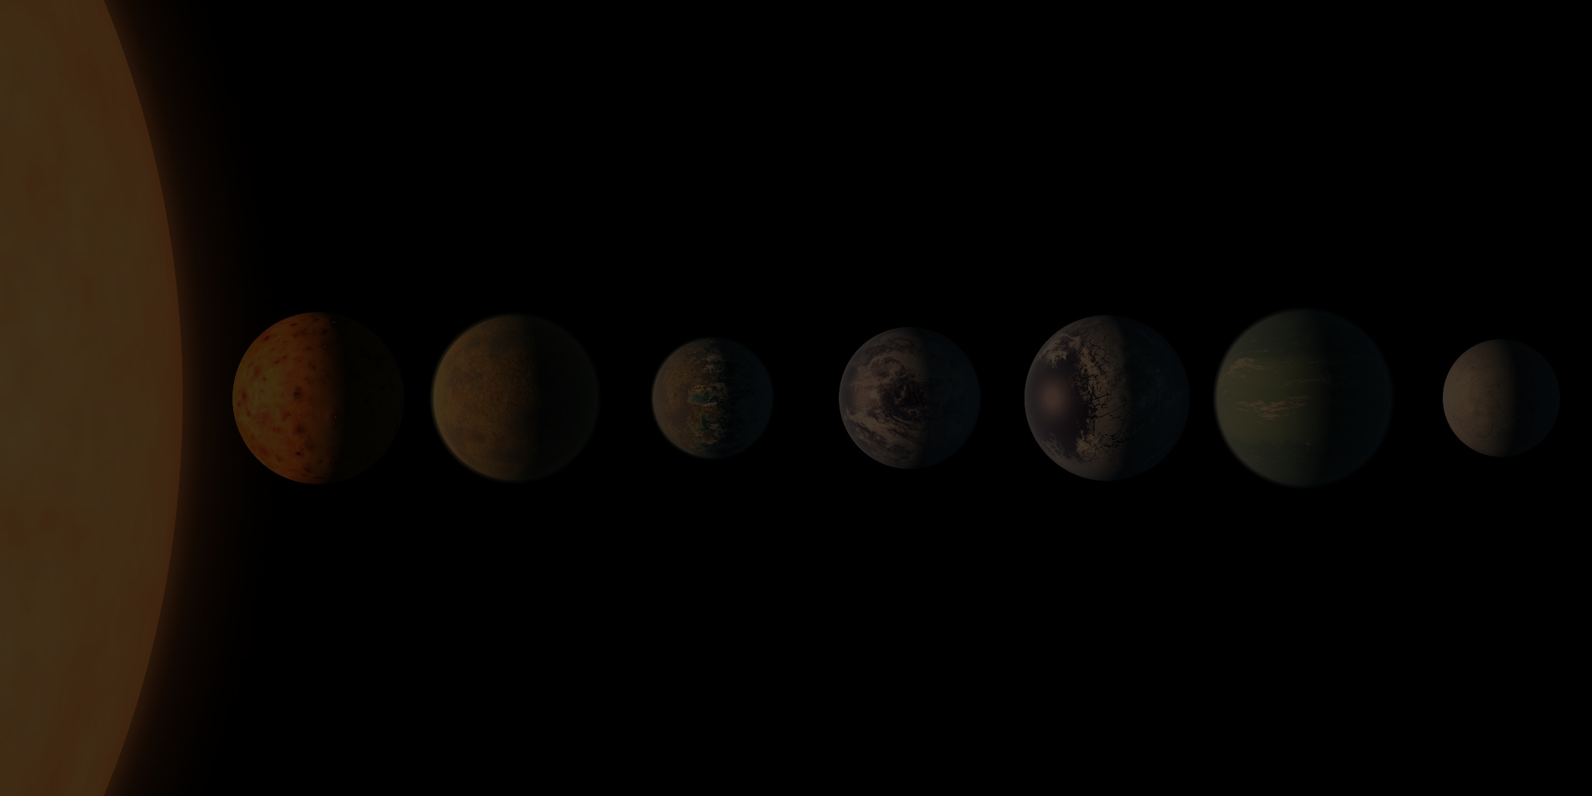
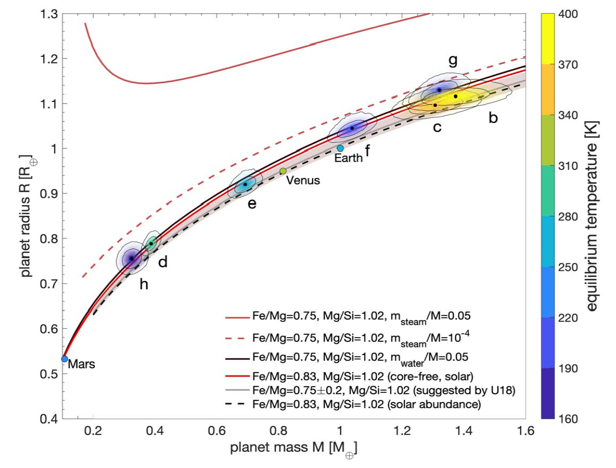
Trappist-1 Mass-Radius Diagram
All planets consistent with a similar rocky composition
with slightly lower densities than Earth.
Agol et al. (2021)
Image: NASA/JPL-Caltech/R. Hurt, T. Pyle (IPAC)
Notes:
Background image credit: NASA/JPL-Caltech/R. Hurt, T. Pyle (IPAC)

Slide 13


Slide 14
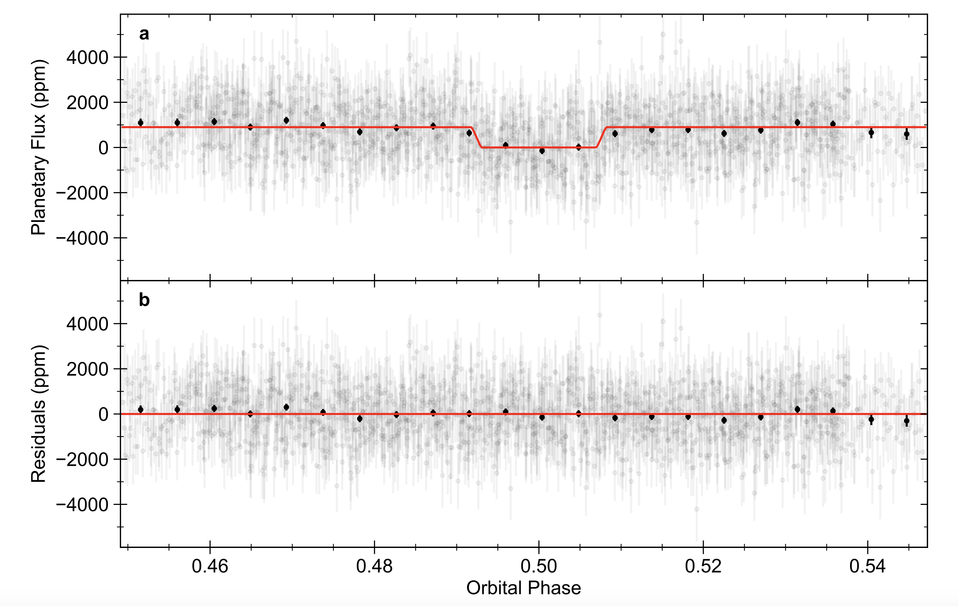
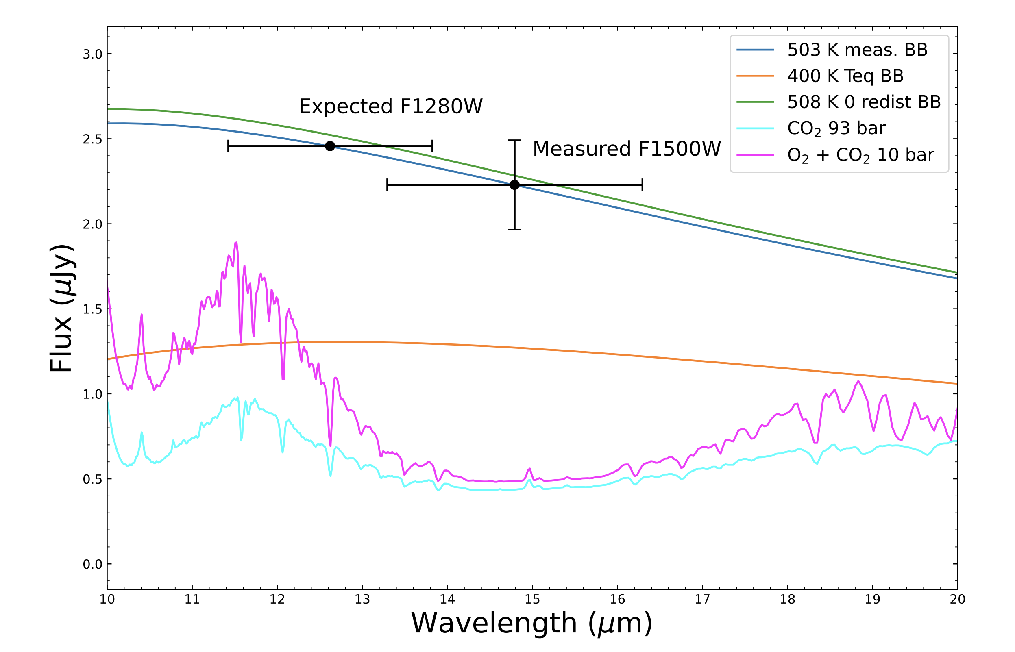
Eclipse Photomery of Trappist-1 b (MIRI)
Greene et al, Ih et al (2023)
Image: NASA/JPL-Caltech/R. Hurt, T. Pyle (IPAC)
Notes:
Background image credit: NASA/JPL-Caltech/R. Hurt, T. Pyle (IPAC)

Slide 15
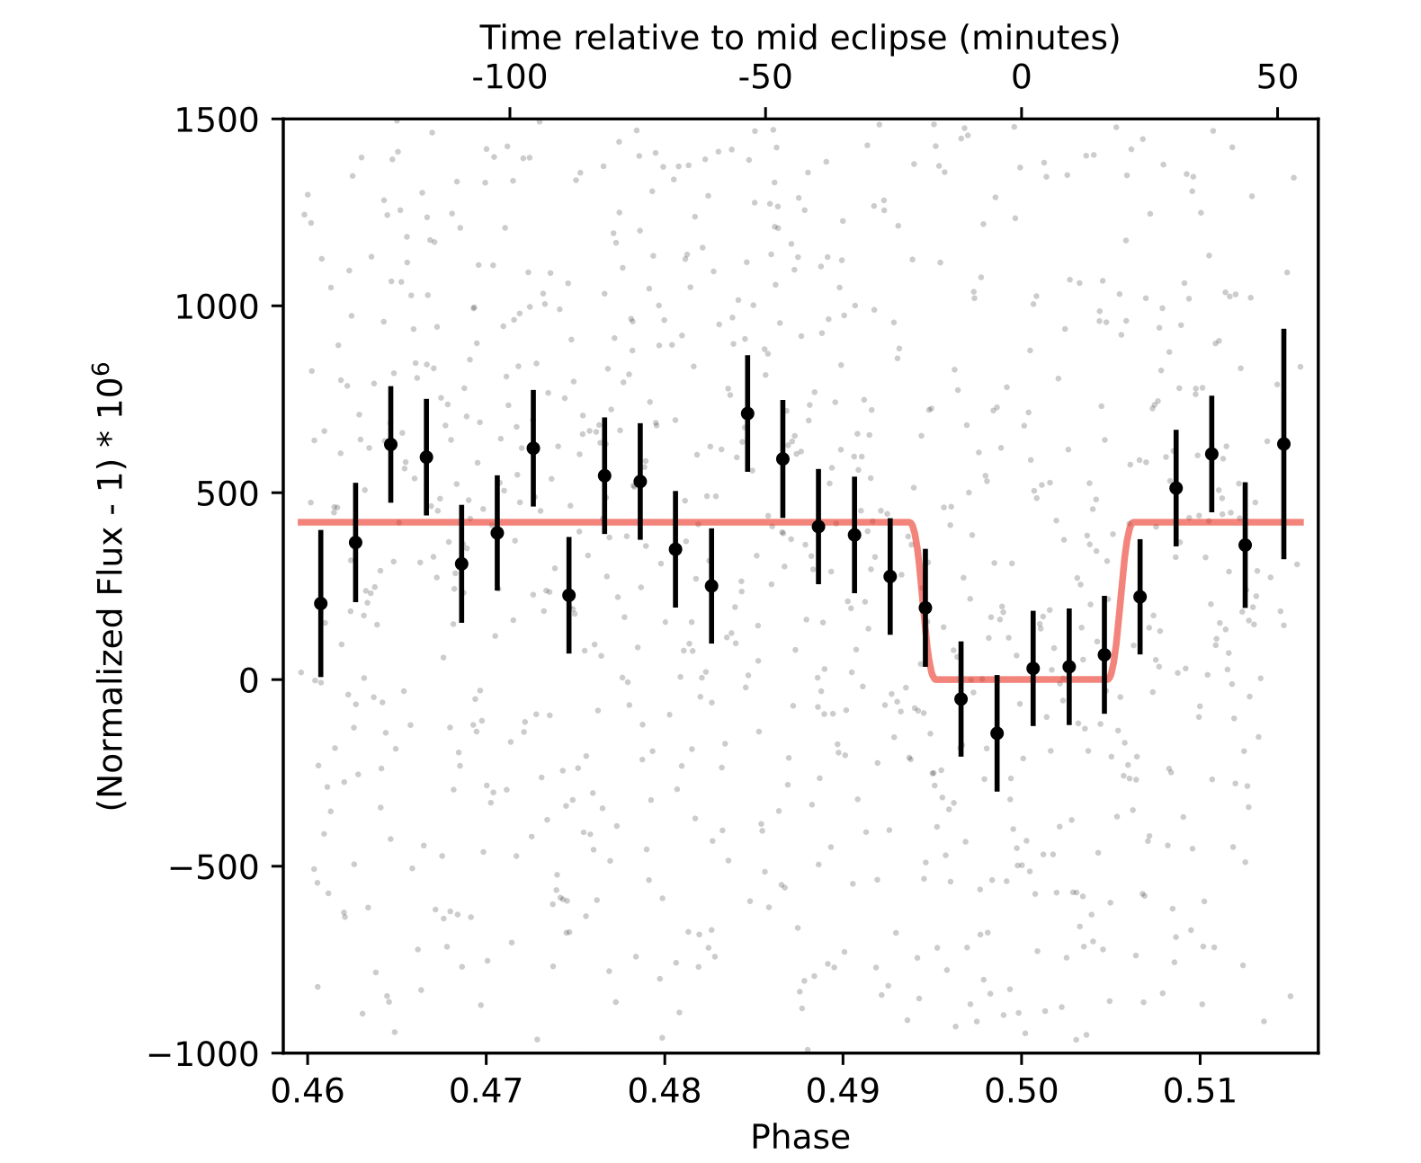
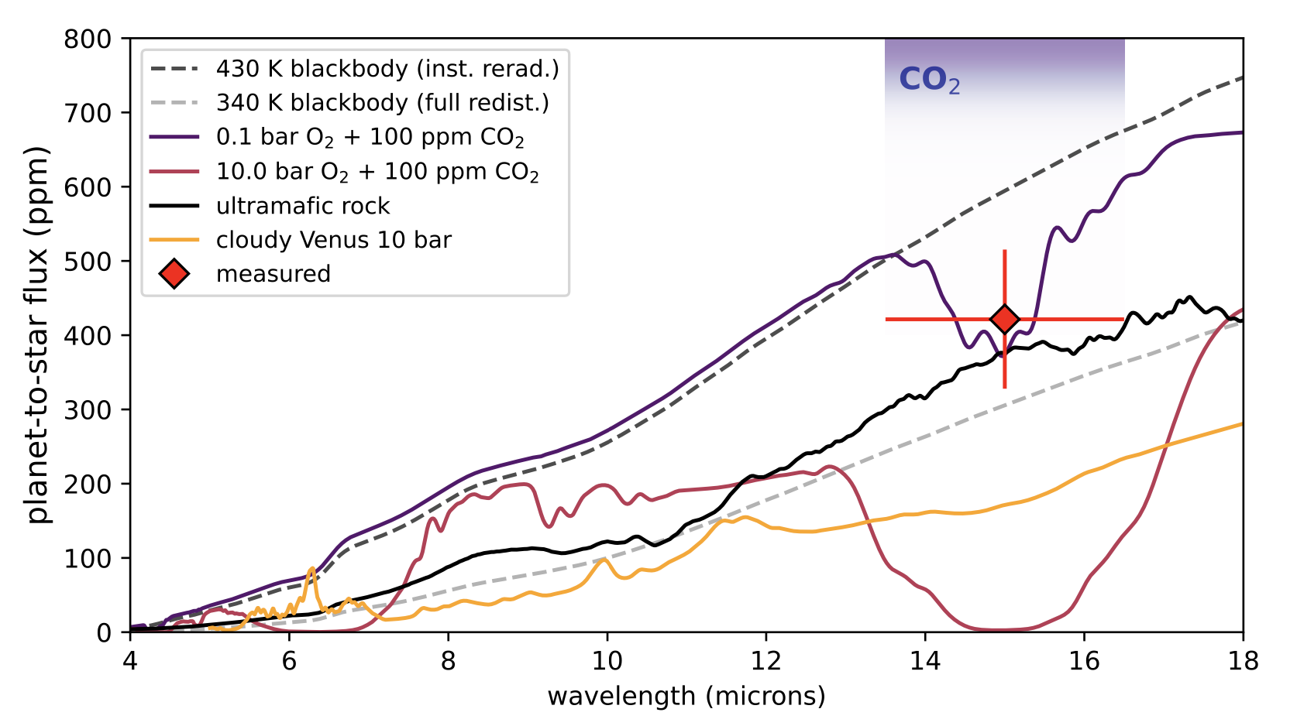
Eclipse Photomery of Trappist-1 c (MIRI)
Zieba et al (2023)
Trappist-1b/c are most likely airless.
Image: NASA/JPL-Caltech/R. Hurt, T. Pyle (IPAC)
Notes:
Background image credit: NASA/JPL-Caltech/R. Hurt, T. Pyle (IPAC)

Slide 16

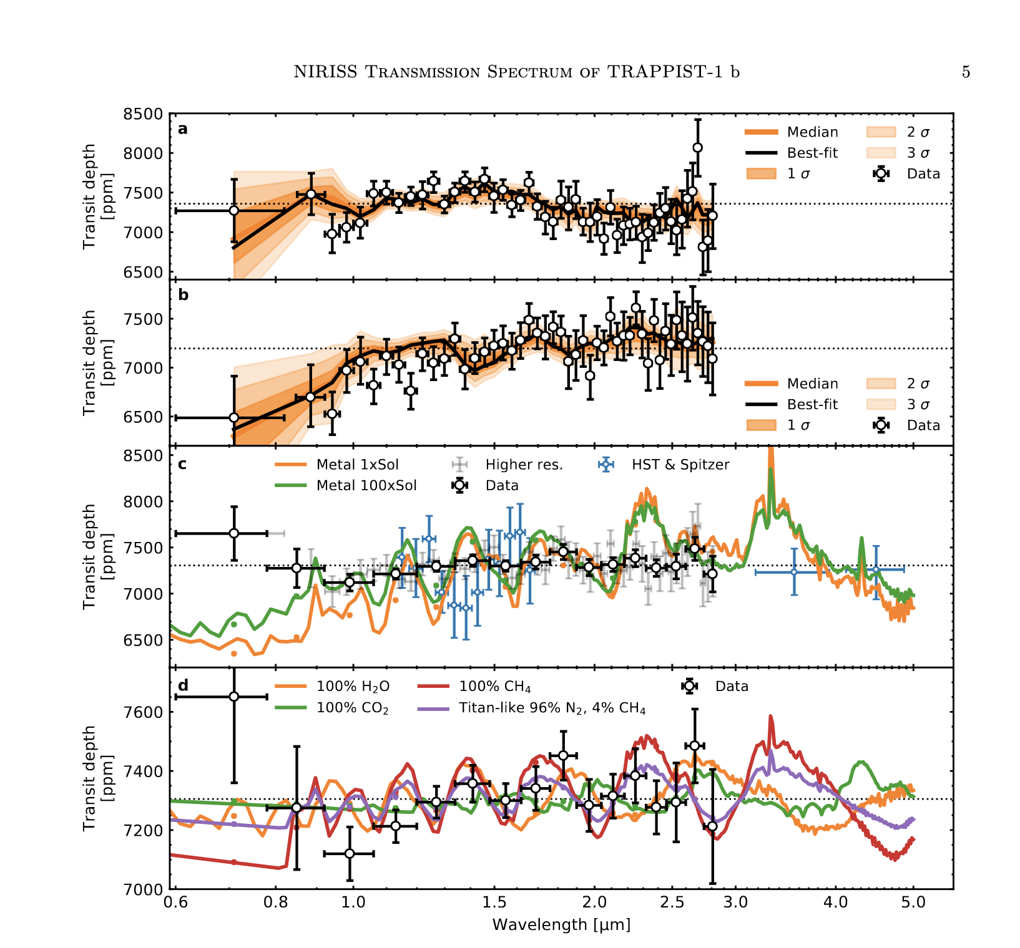
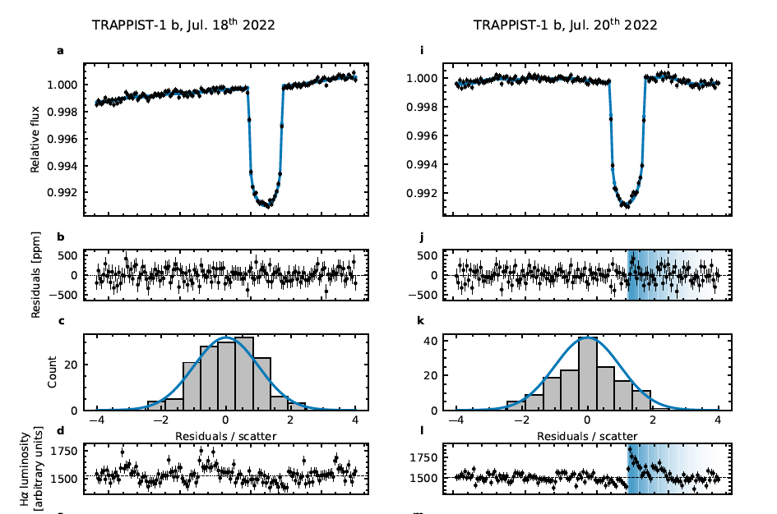
TRAPPIST-1b (NIRISS/SOSS)
JWST’s first transmission spectra of a Trappist-1 planet
O. Lim
Lim et al. (2023)
Image: NASA/JPL-Caltech/R. Hurt, T. Pyle (IPAC)
Notes:
Background image credit: NASA/JPL-Caltech/R. Hurt, T. Pyle (IPAC)

Slide 17
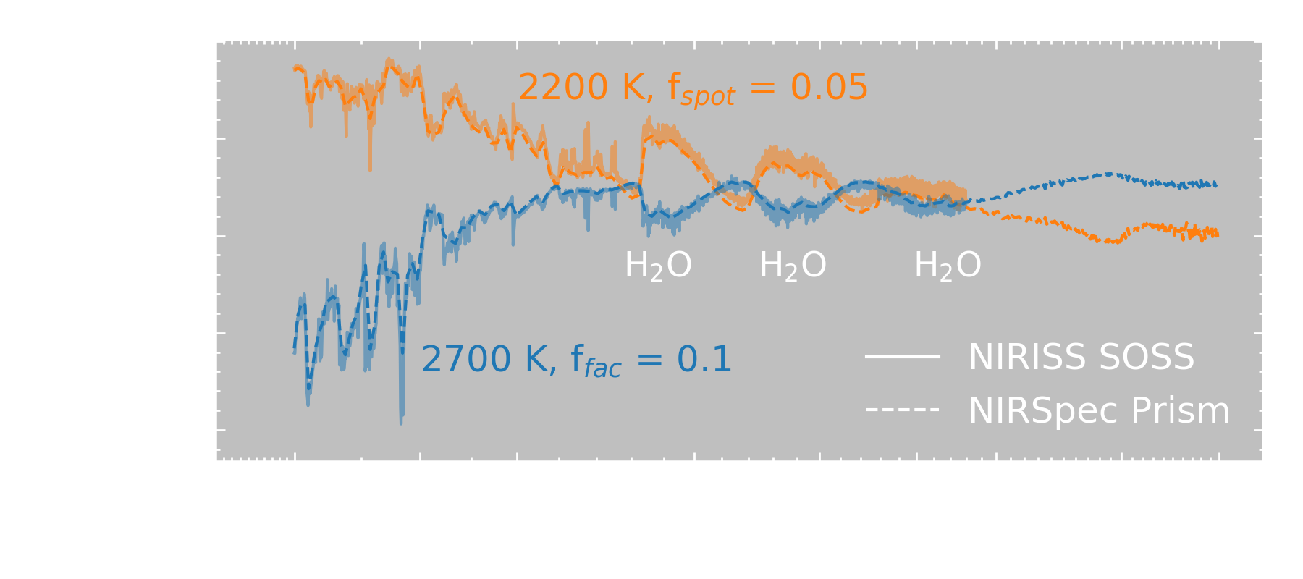
The Transit Light Source Effect
Spot
Facula
Crédit: Olivia Lim
Ghost atmospheric signal induced by stellar activity
Image: NASA/JPL-Caltech/R. Hurt, T. Pyle (IPAC)
Notes:
Background image credit: NASA/JPL-Caltech/R. Hurt, T. Pyle (IPAC)

Slide 18
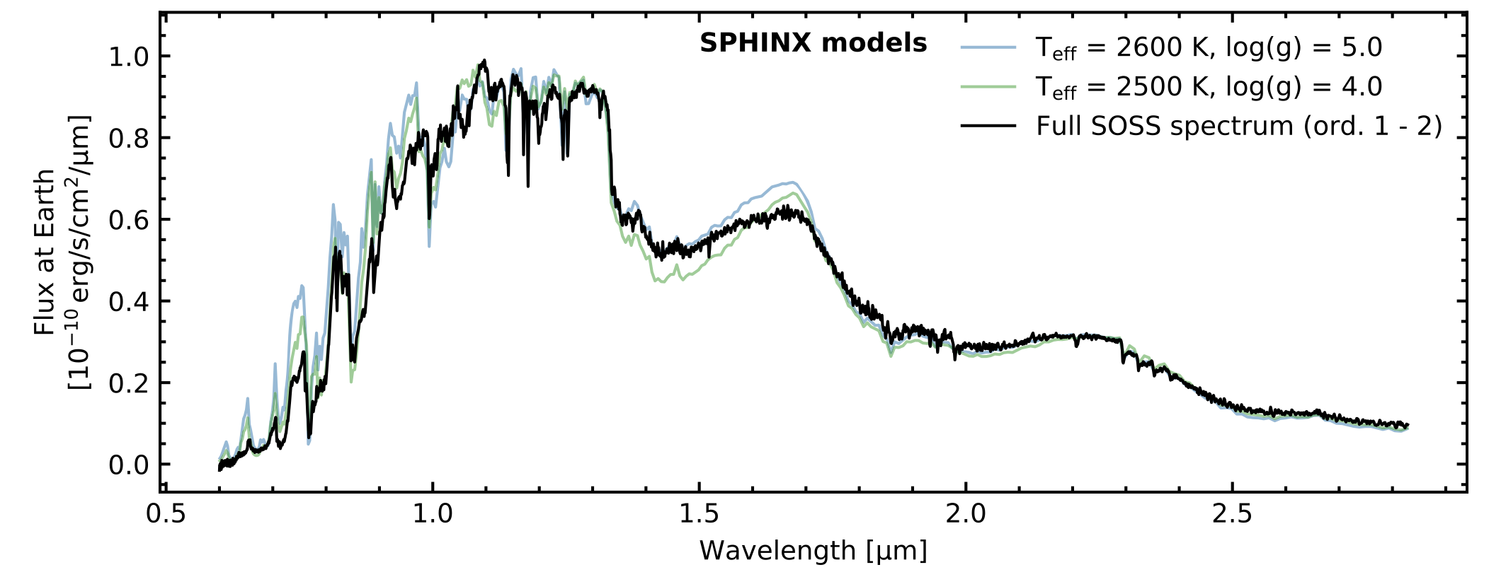
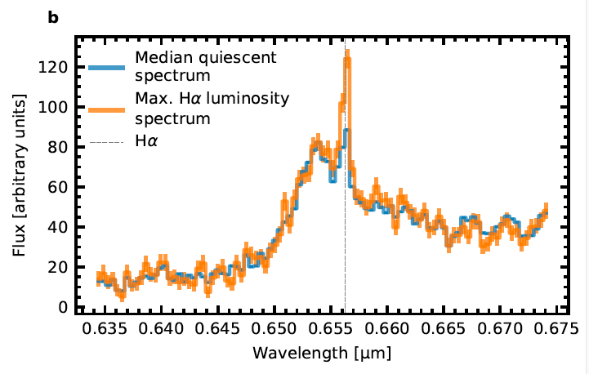


Flares are very frequent on Trappist-1
Frequency: one very 6-7 hours (Howard et al. 2023)
  ∼10× higher than previous predictions from K2
Amplitude: 500 - 2000 ppm (∼10× higher than the planetary signal)
Can be monitored through H$α$
H$α$
Lim et al. (2023)

Slide 19
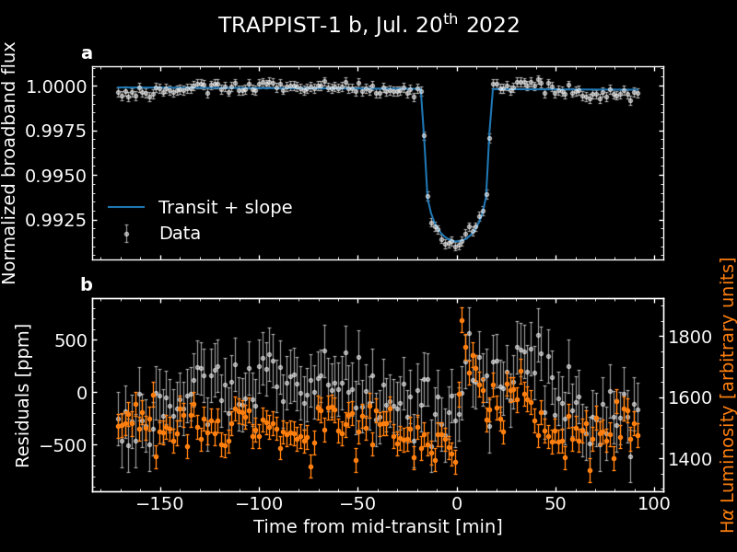
Small flare event on Trappist-1b
Lim et al. (2023)

Slide 20
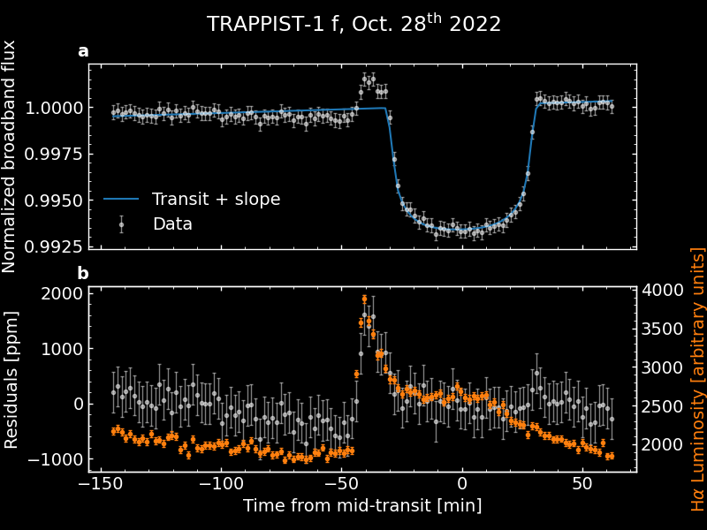
A bigger flare on Trappist 1-f
About half of transit events are affected by flares
Flare spectroscopic properties have yet to be characterized.

Slide 21
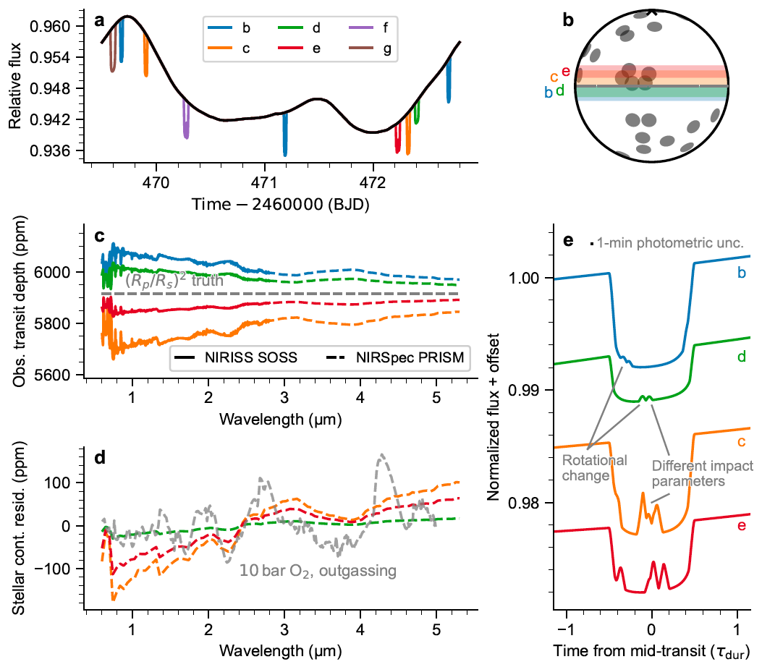
Next steps for Trappist-1 ?
Continuous monitoring over one full rotation (3.3 d) to characterize flares and stellar heterogeneities.
More transit data of all planets. At least 10 each.
  Sub-30 ppm already achieved
Favor multi-transits events (paired with b) to correct for stellar activity to 1st order.
De Wit, Doyon et al, Nat. Astro (under review)
Image: NASA/JPL-Caltech/R. Hurt, T. Pyle (IPAC)
Notes:
Background image credit: NASA/JPL-Caltech/R. Hurt, T. Pyle (IPAC)

Slide 22

H$α$ variability (NIRISS/SOSS)

Slide 23

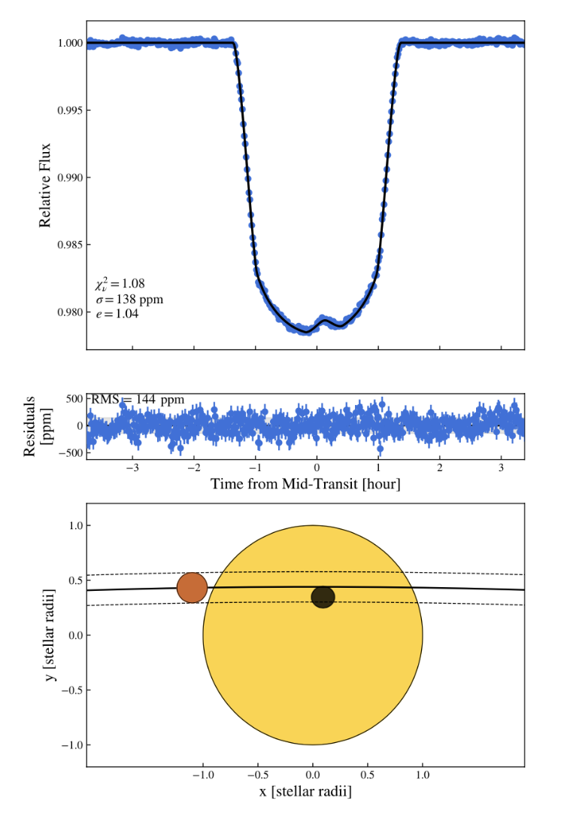
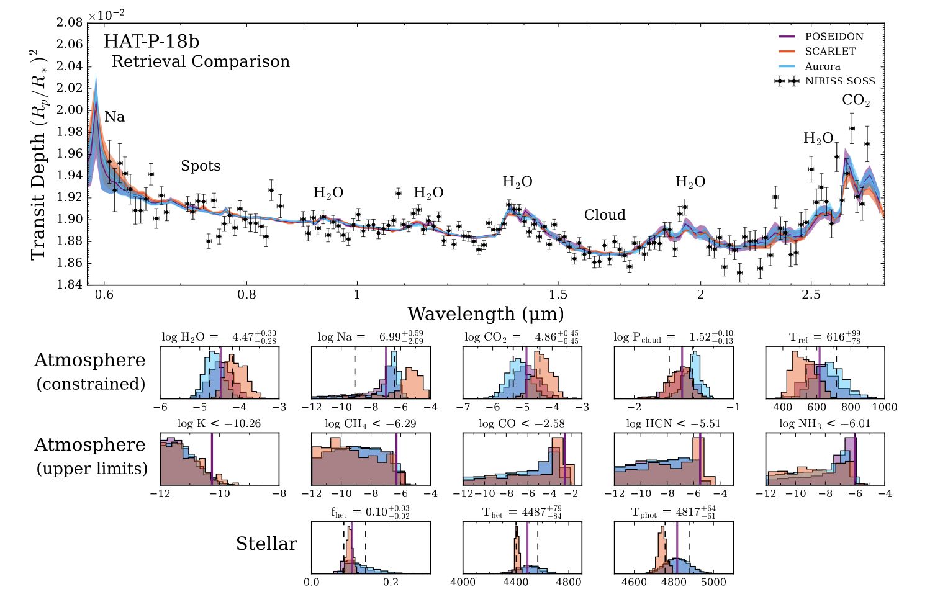
Stellar activity not restricted to M dwarfs
M. Fournier-Tondreau
Fournier-Tondreau et al. (2023)
Improper treatment of stellar activity can yield wrong abundances

Slide 24
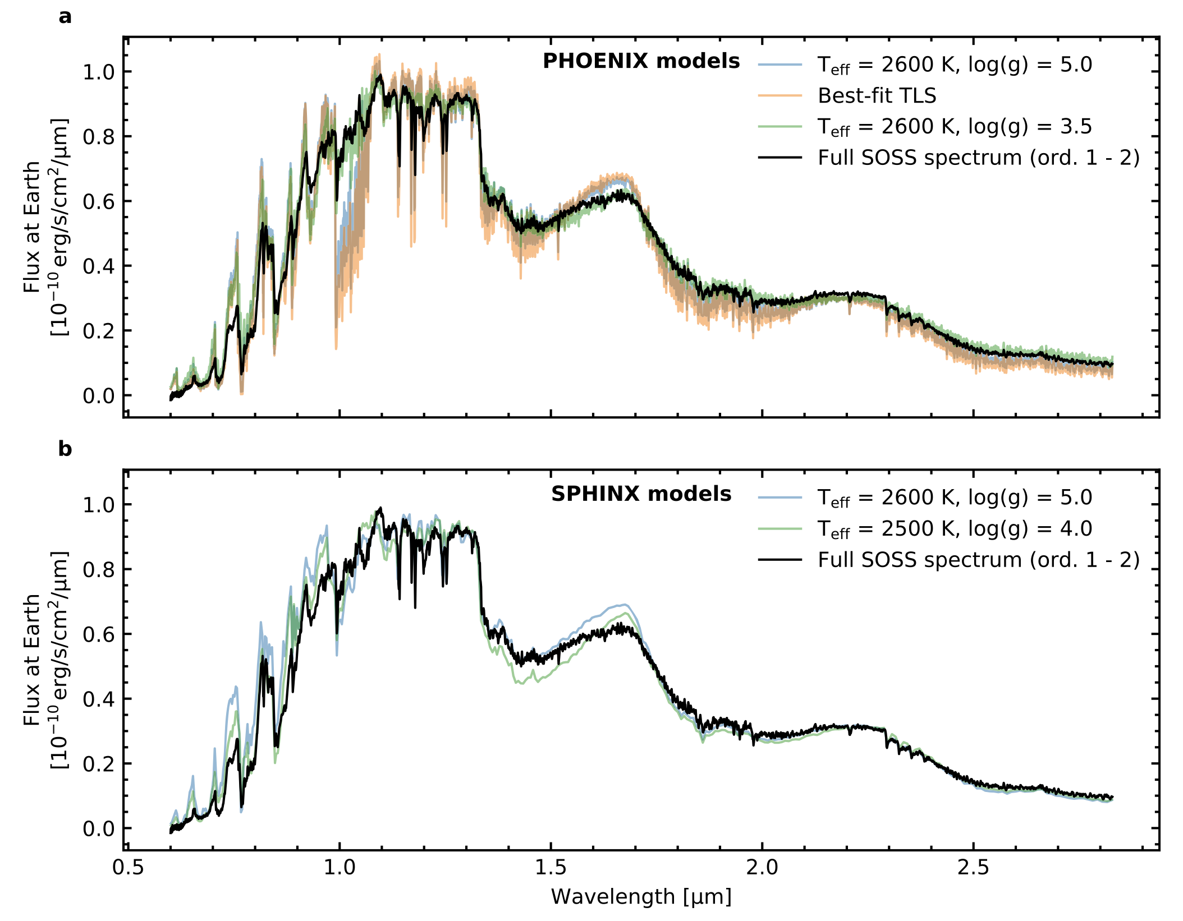
Atmosphere models are good but not perfect
Significance differences also confirmed through high-resolution IR spectroscopy

Slide 25
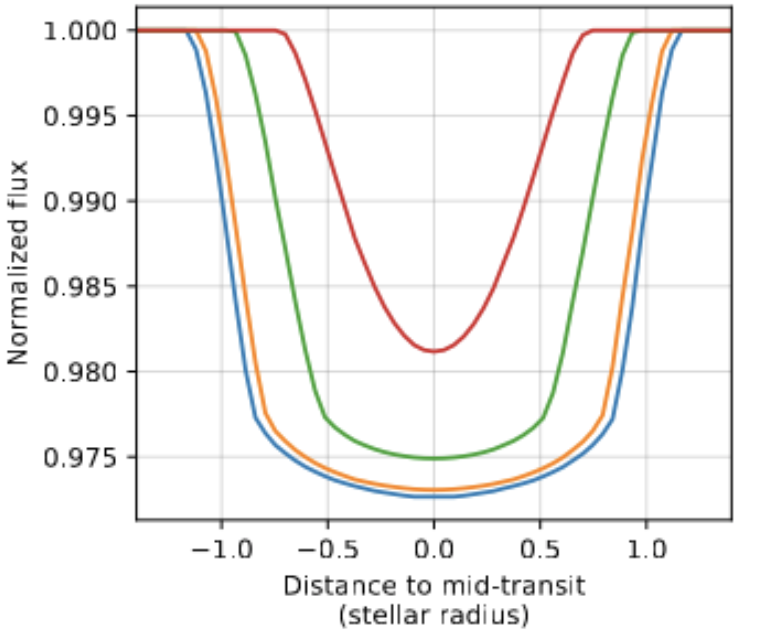
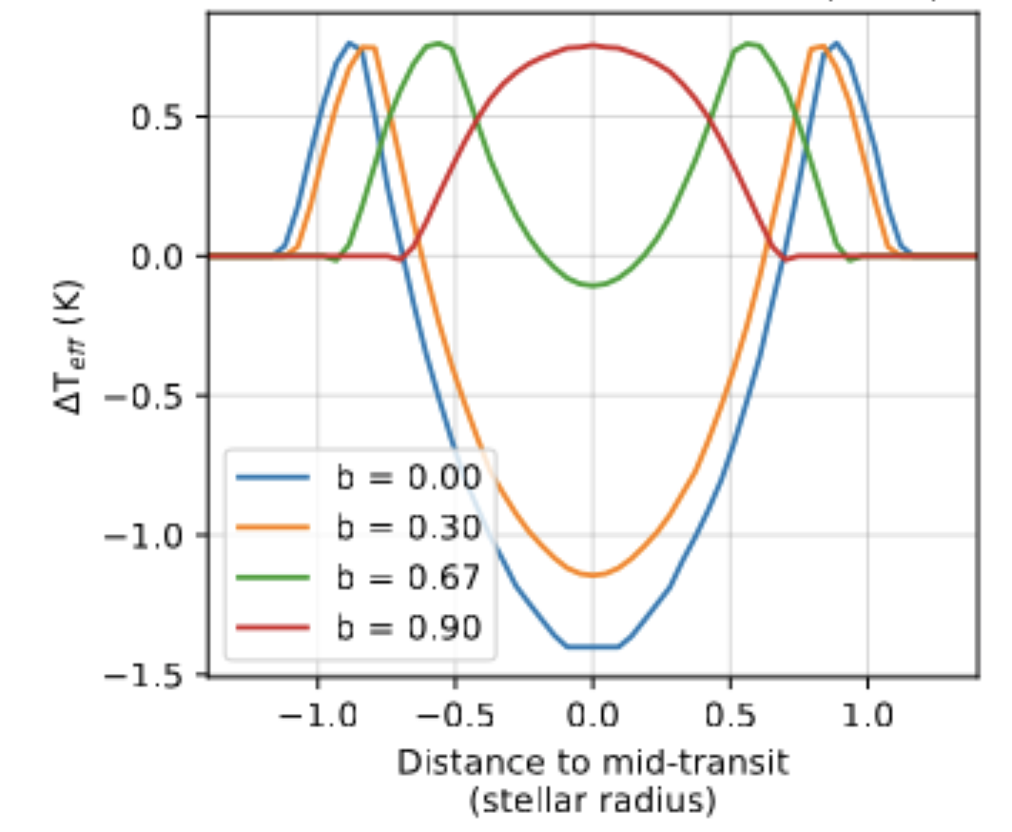
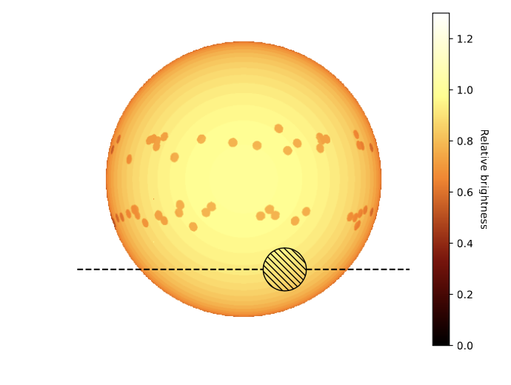
Measuring sub-Kelvin differential T_{eff} through high-resolution spectroscopy
Artigau et al, in prep

Slide 26
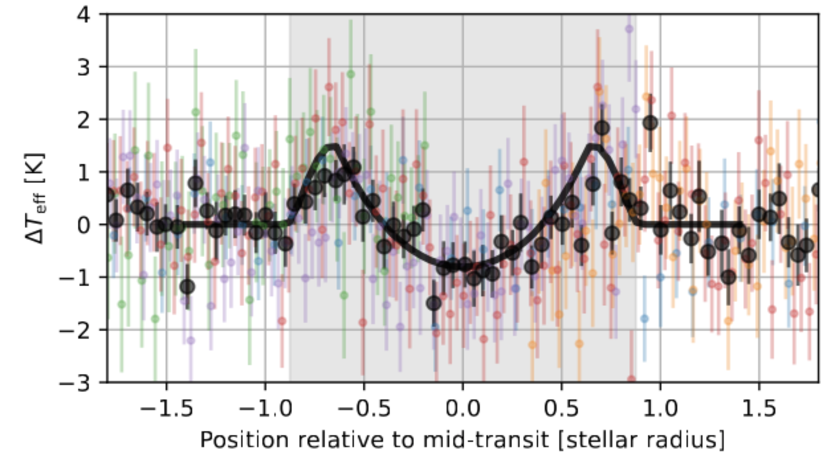
Test case: HD189733b (Hot Jupiter)
Using an empirical calibration (stars of known T_{eff})
The differential temperature signature due to limb darkening is clearly detected
Artigau et al, in prep

Slide 27
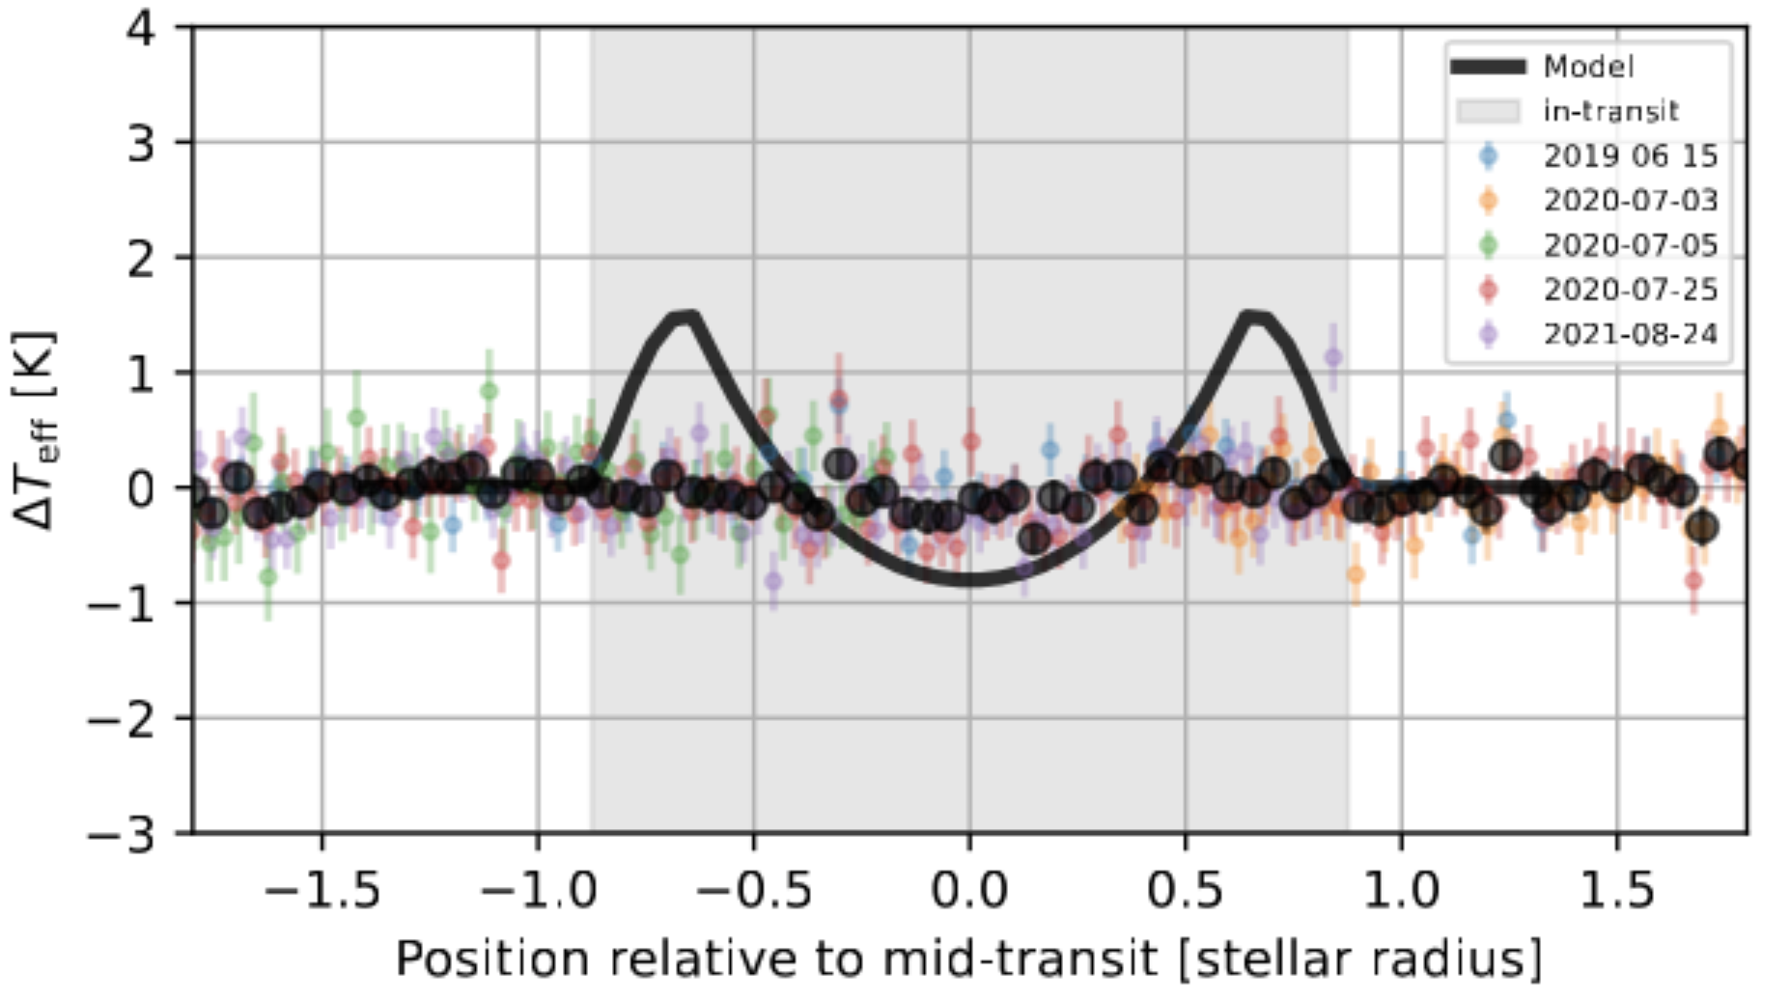
Test case: HD189733b (Hot Jupiter)
Using atmosphere models
Atmosphere models fail to describe SED variations induced by small T_{eff} variations
Artigau et al, in prep

Slide 28

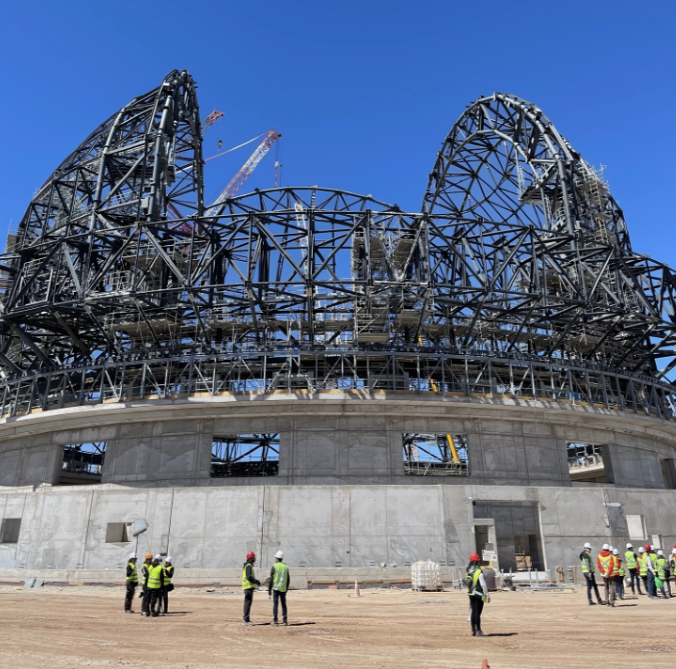
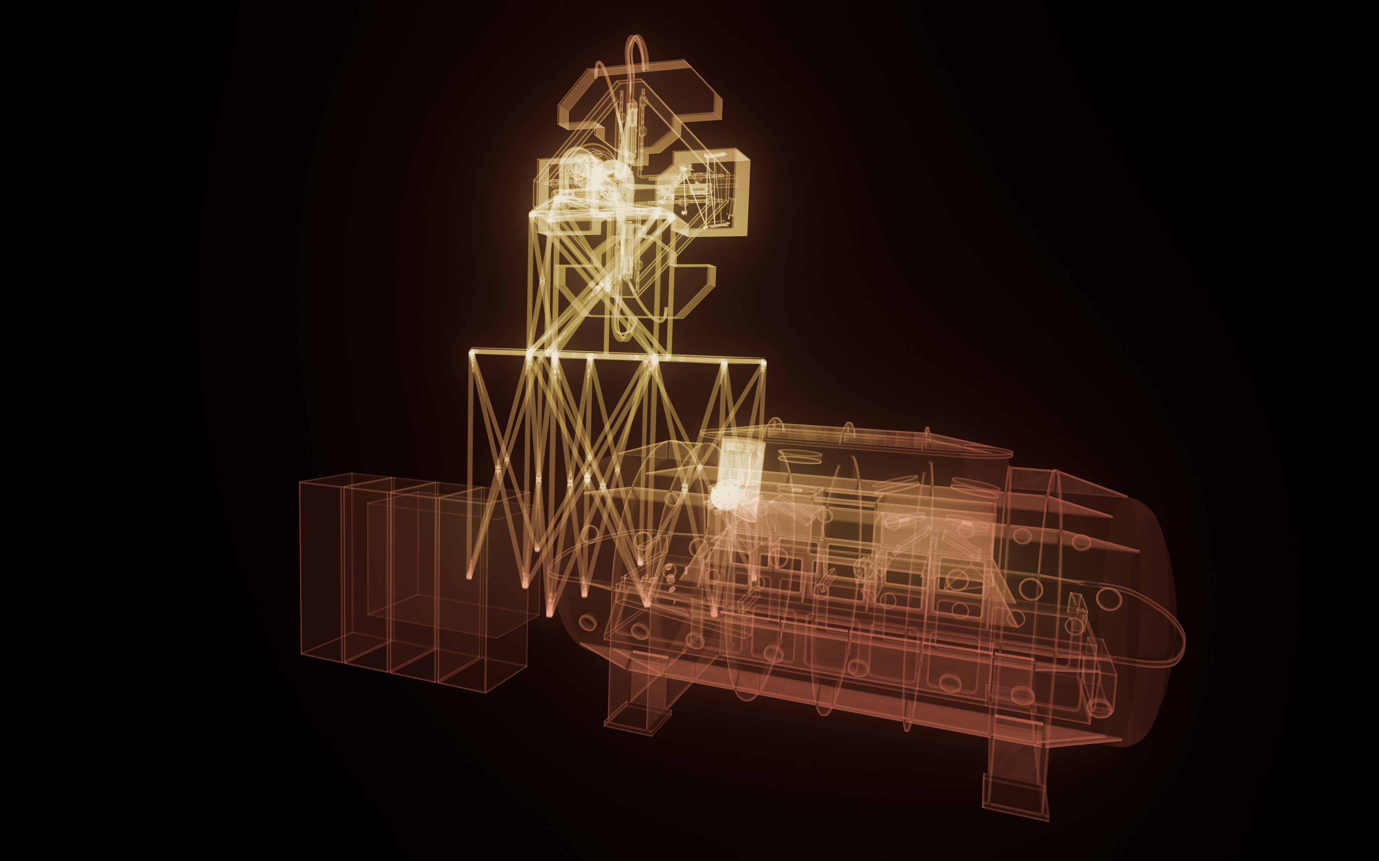
Detecting exoplanet atmospheres in reflected light with ANDES@E-ELT

Slide 29
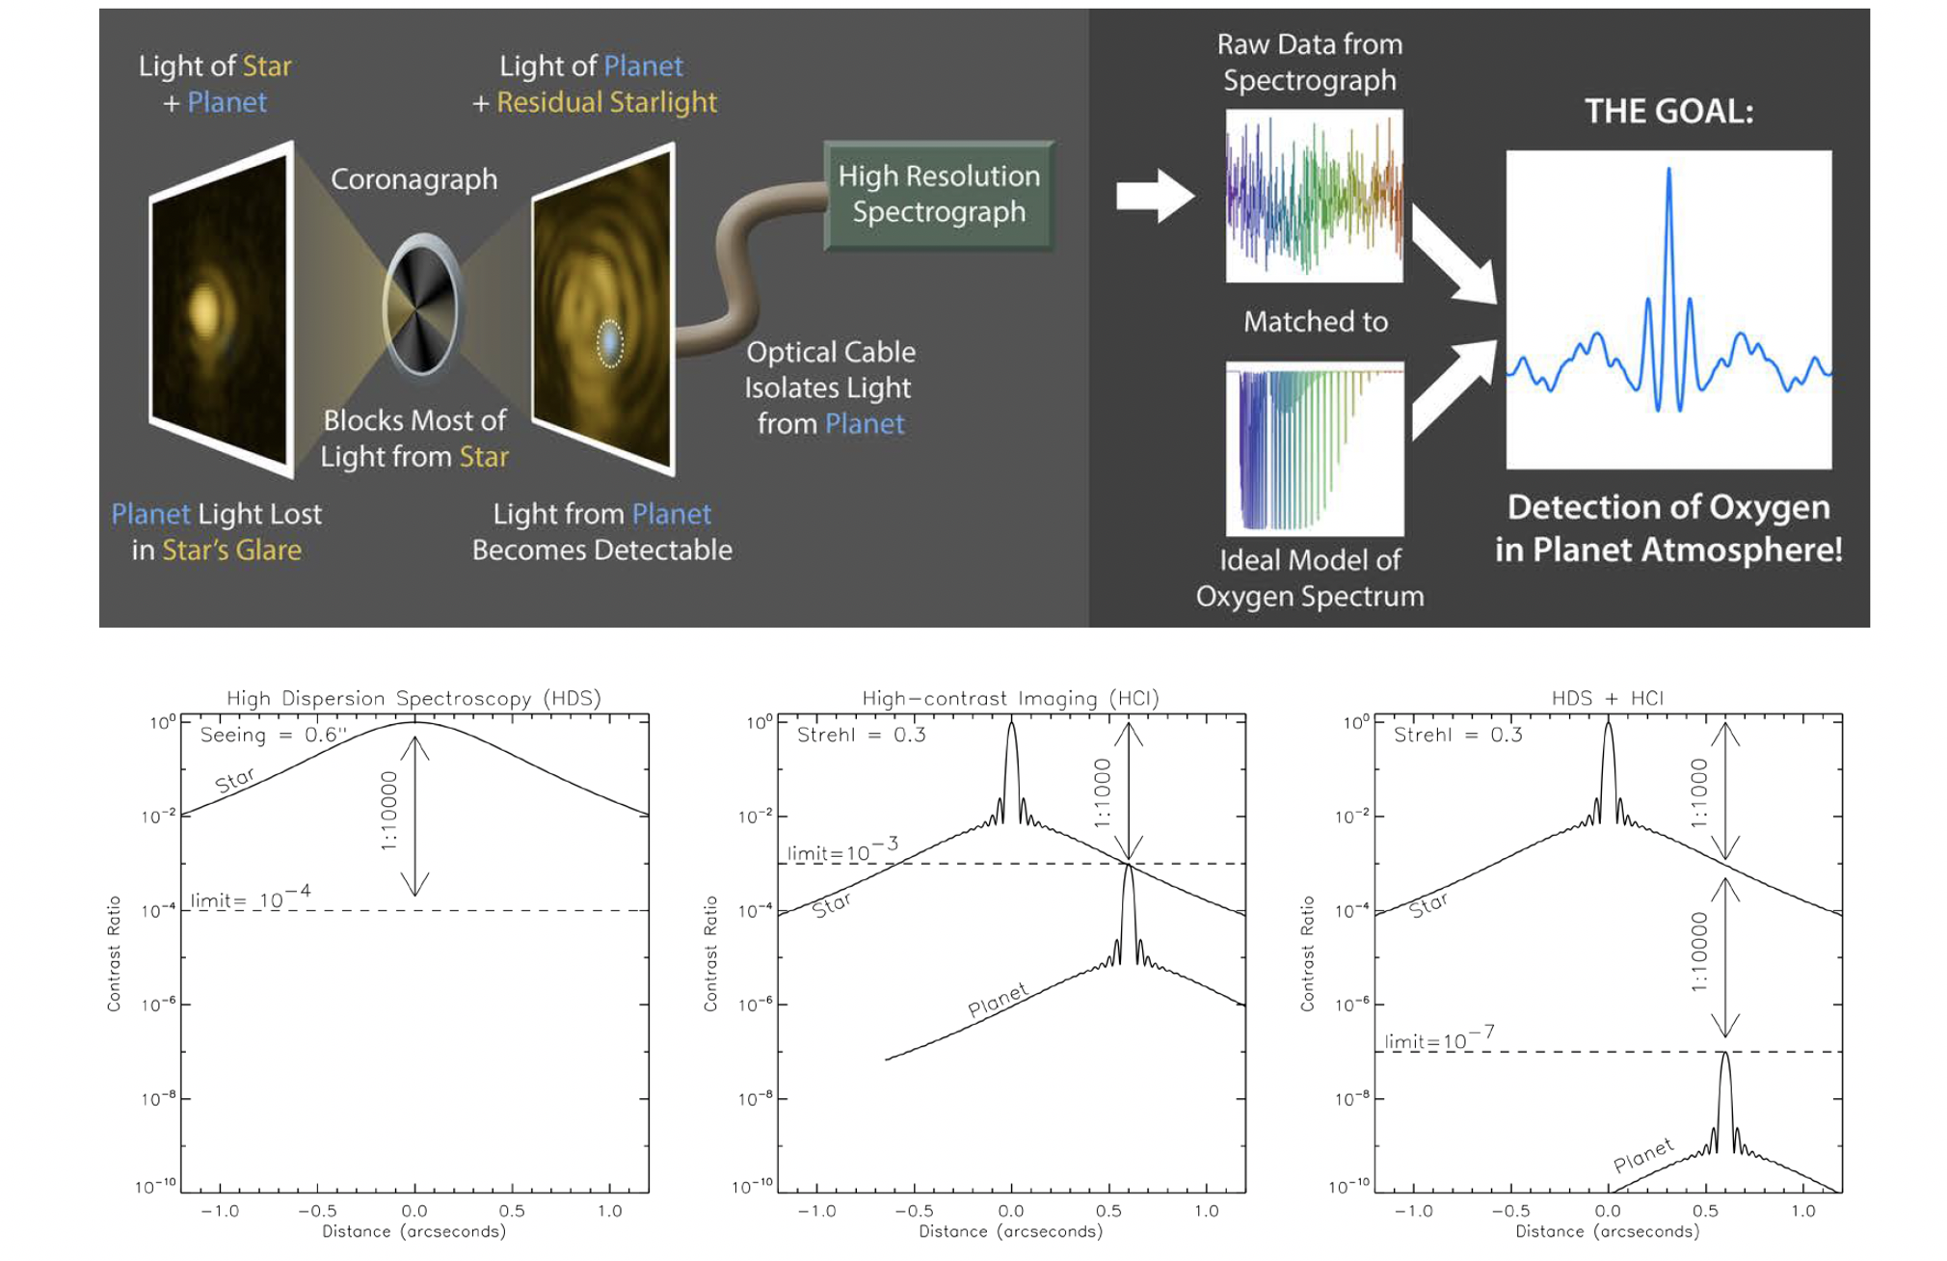
Combining High-Dispersion Spectroscopy
and High-Contrast Imaging
Snellen et al. (2015)

Slide 30
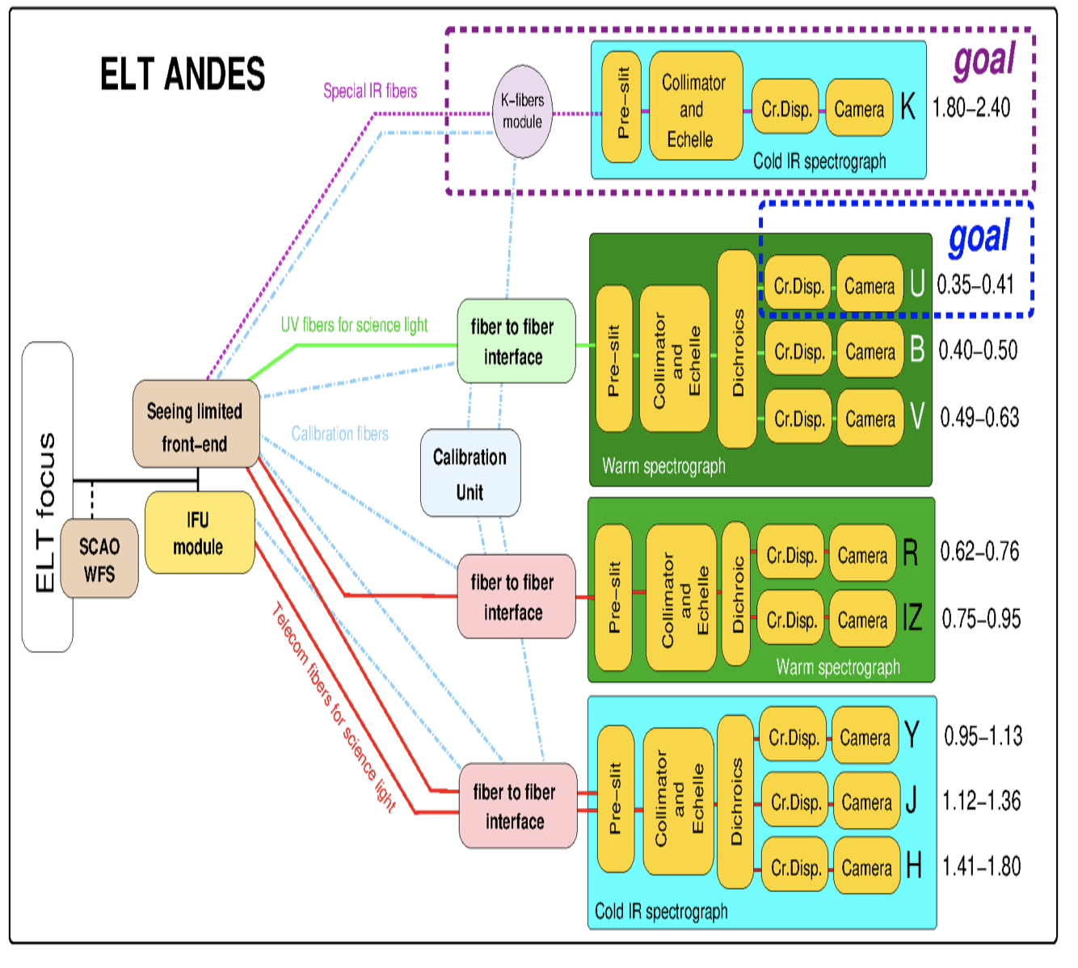
ANDES specifications
Wavelength range: 0.35 – 2.40 μm
“Seeing-limited” observing mode: R~100,000 0.4-1.8 micron
  two apertures for simultaneous object and sky observations.
IFU observing mode: R~100,000 1.0-1.8 micron
  Diffraction limited AO-assisted IFU with maximum 61 spaxels
  4 spaxels scales in the 5-100 mas range.
Science programs from biosignature detection to cosmology
Currently under Phase B

Slide 31
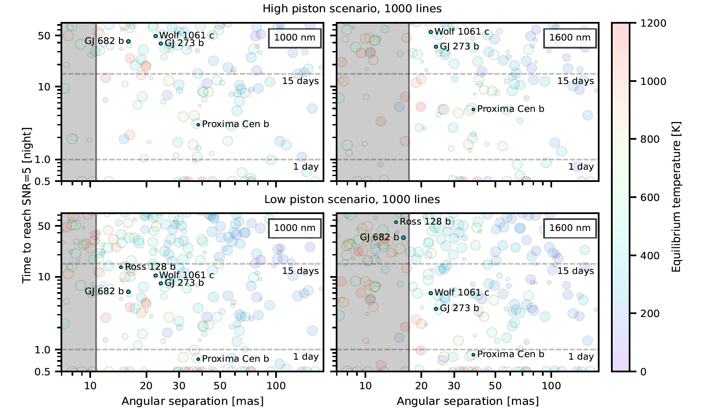
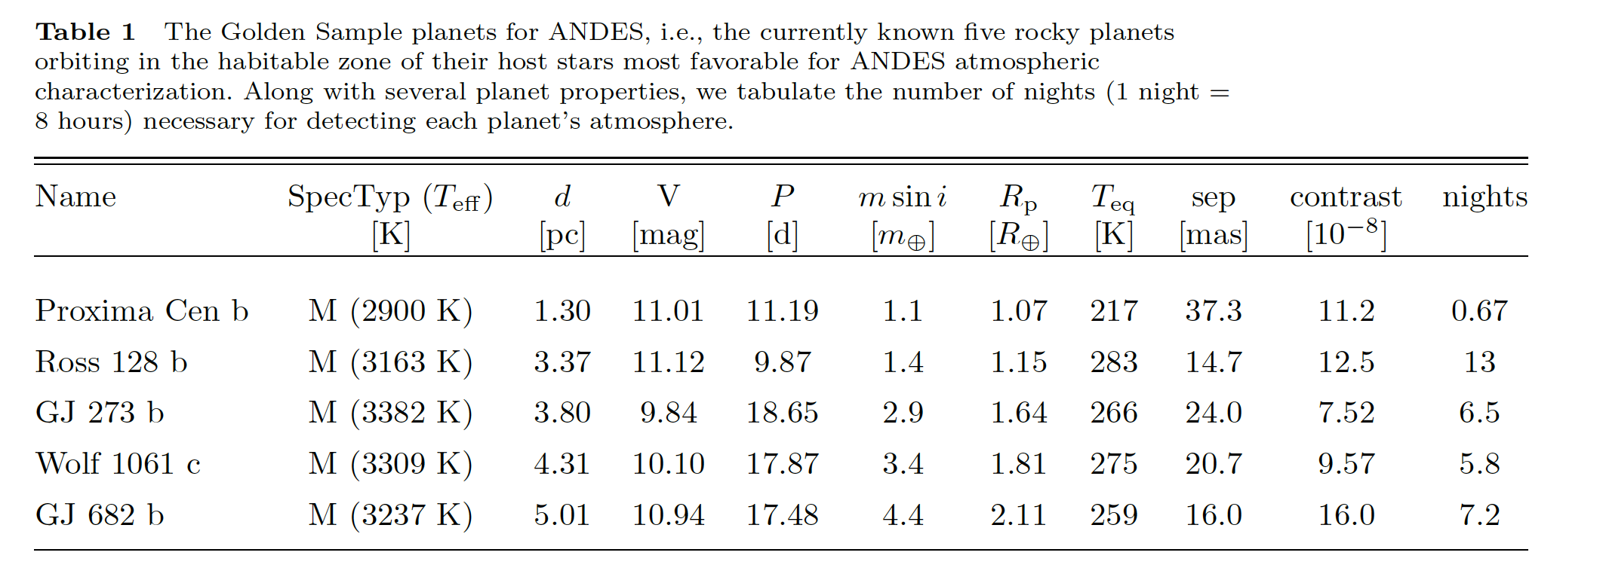
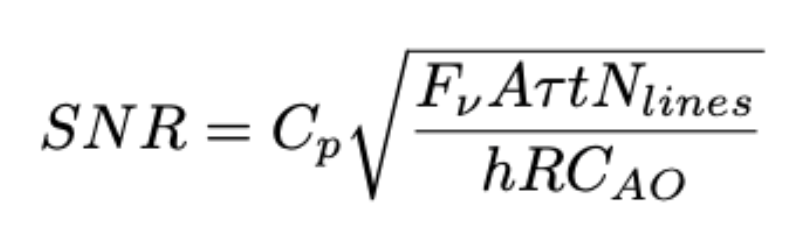
One night to detect Earth-like atmosphere on Proxima b
Palle et al (2023)

Slide 32

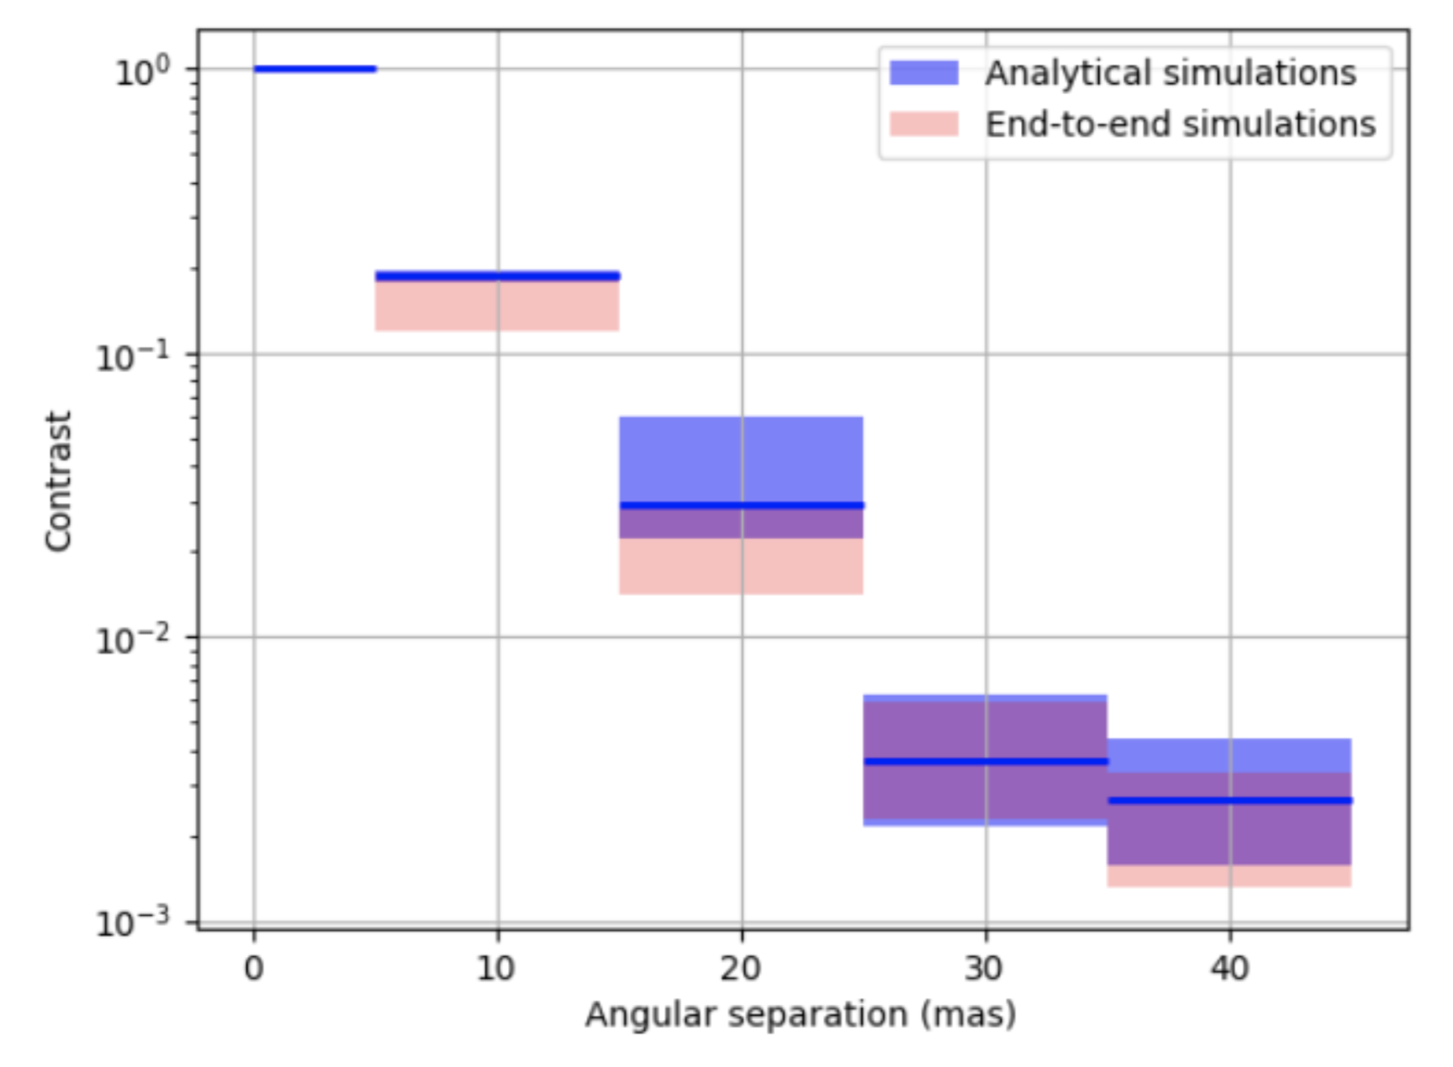
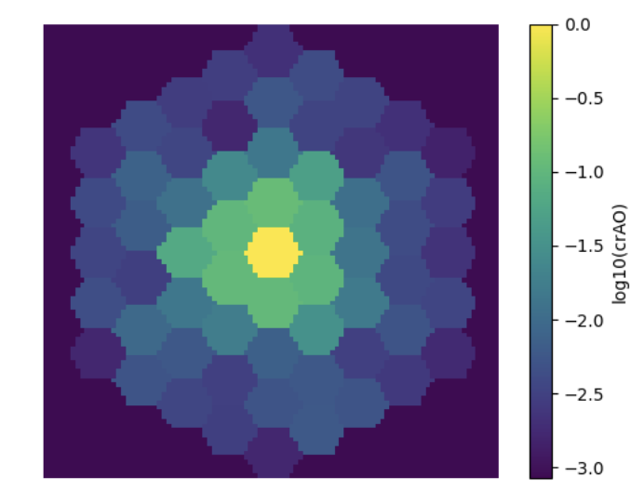
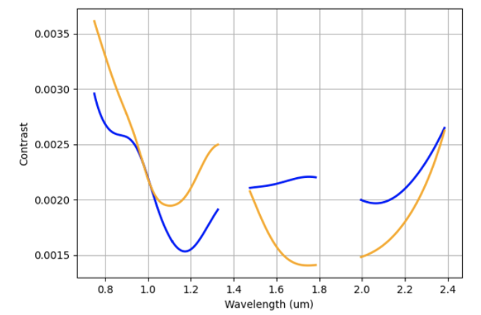
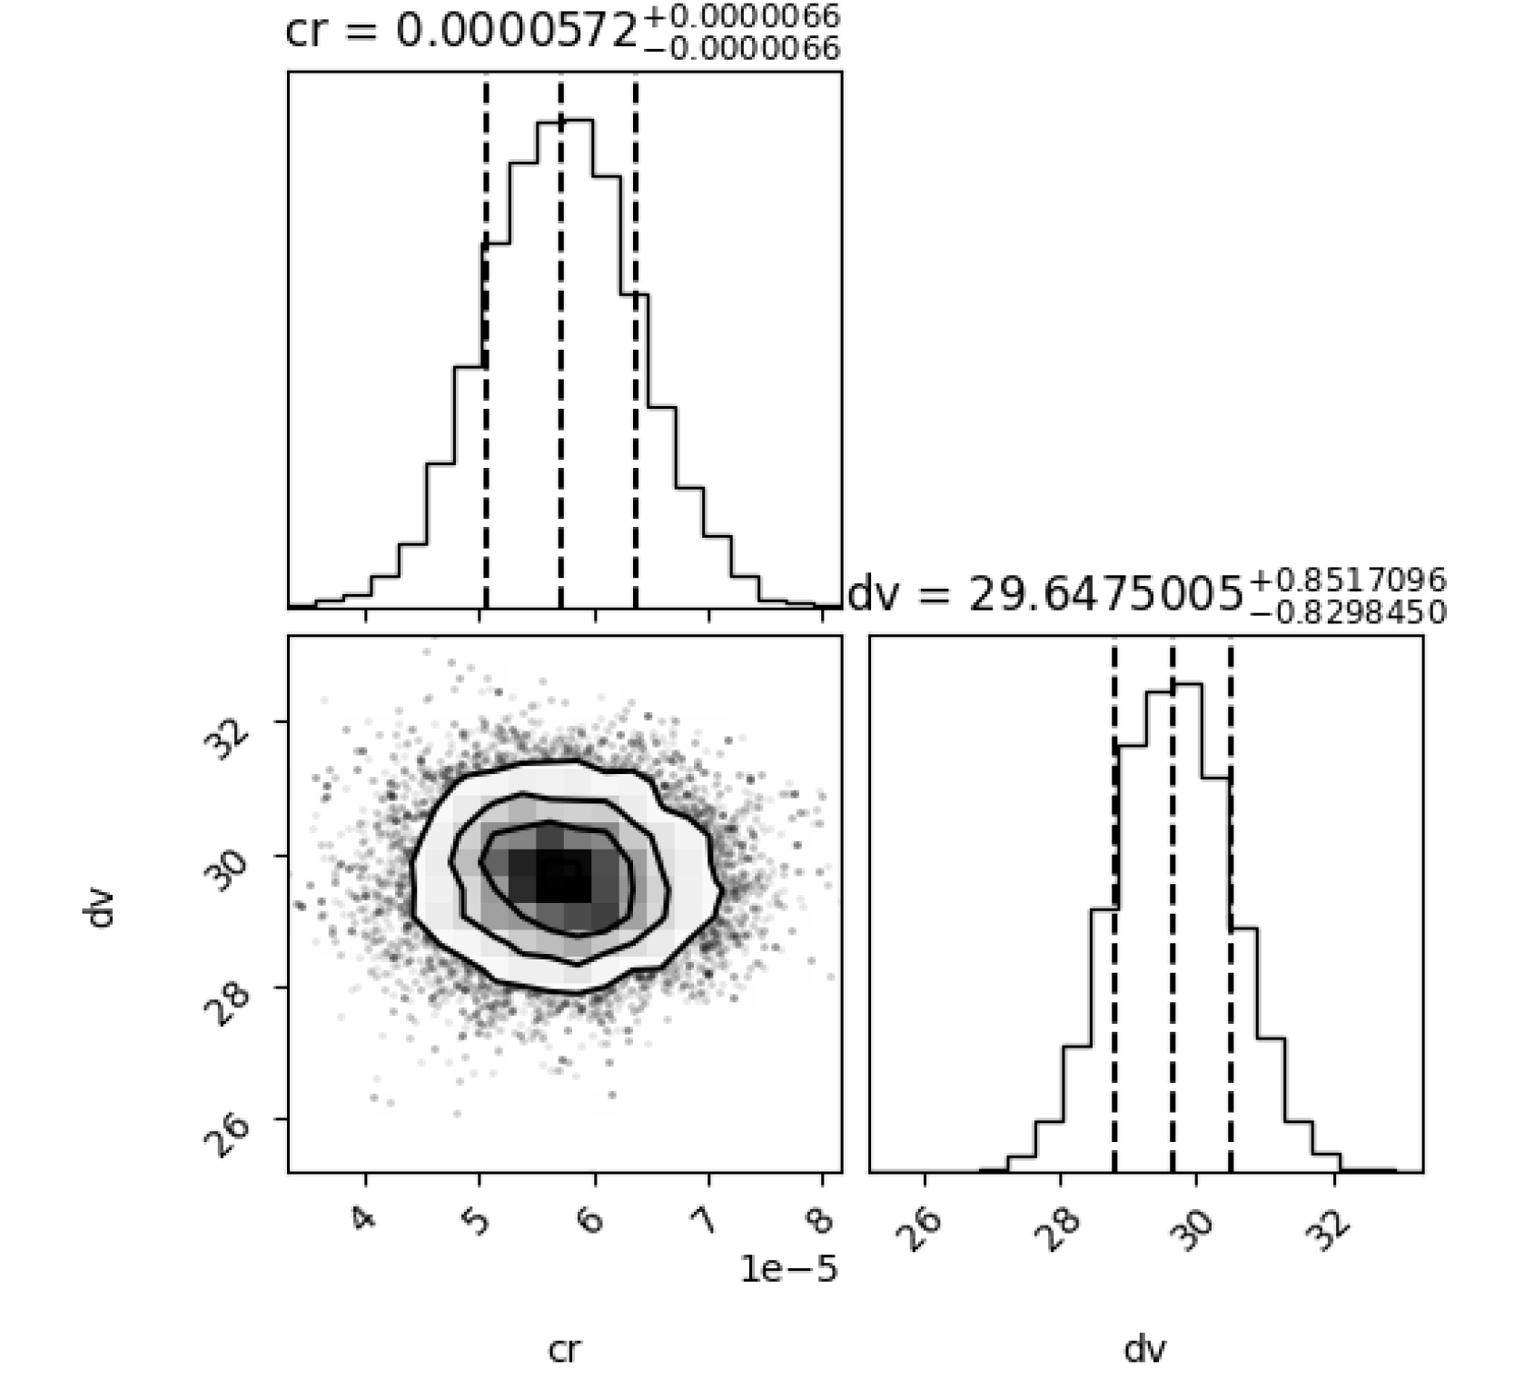
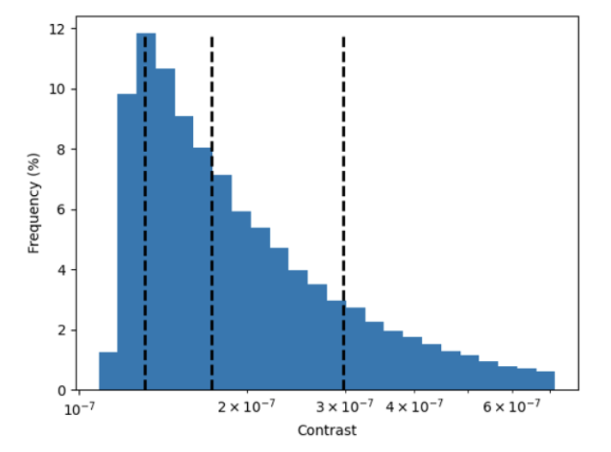
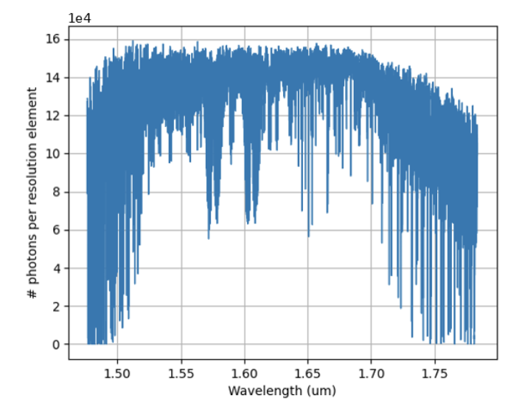
Results confirmed throught more detailed simulations
AO performance
Spaxel data cube @ R=100 000
A. Beaudoin
Spectral Extraction
Contrast distribution
Reference spectrum + tellurics
Beaudoin et al, in prep

Slide 33

O₂ detected at 5-$σ$ on Proxima b in 20-50 nights
Palle et al (2023)

Slide 34
Summary
JWST is a powerful capabilty for probing atmospheres of rocky temperate planets in eclipse and transmission.
Stellar activity is a serious (but tractable) problem for studying exoplanet atmospheres of M and K stars.
  Know thy star, know thy planet
JWST should answer the question whether M dwarfs are suitable environments for rocky planets to maintain a secondary atmosphere with habitable conditions.
  In-depth studies of keystone systems are key.
ELTs will close this chapter by studying the closest systems in reflected light.

Slide 35
Thank you!

