Slide 1
How Science Cases Influence Observatory Design and Operations
Warren Skidmore
Recognition to
TMT Systems Engineering: Gelys Trancho, Kayla Hardie, John Miles
The TMT ISDT Members
ELT Science in Light of JWST
UCLA 12/11/2023

Slide 2
Science Cases for Astronomical Facilities
The uses of, or needs for Science Cases
Outward - Project inception, building partnerships, seeking resources
Inward - Informing engineers what the observatory needs to do
Process to develop (and update) the science case depends on
The vision for the observatory scope – Specific/narrow versus broad science goals
Maturity of the project and project needs - Pre-design/Initiation, planning and design, construction and beyond
Process always involves community input
Narrower and focused, smaller group, shorter process
Broader and higher level, larger group, longer process
Outcome is guidance for the design, and motivation for the project
The situation for the ELTs
Notes:
Two main uses for science cases. I focus on the 2nd.

Slide 3
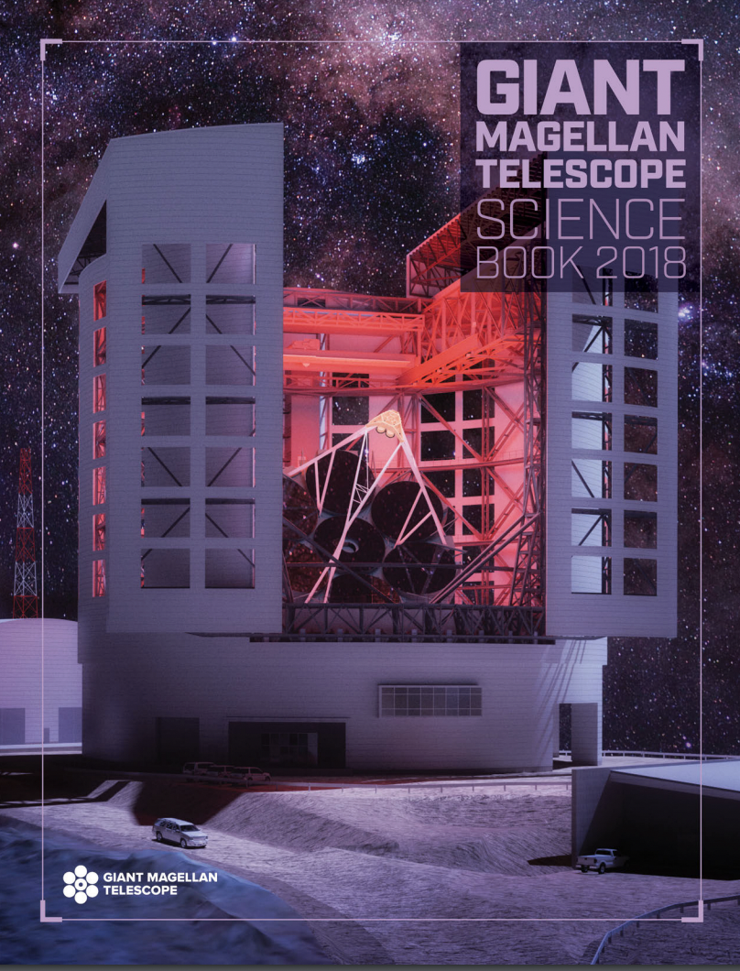
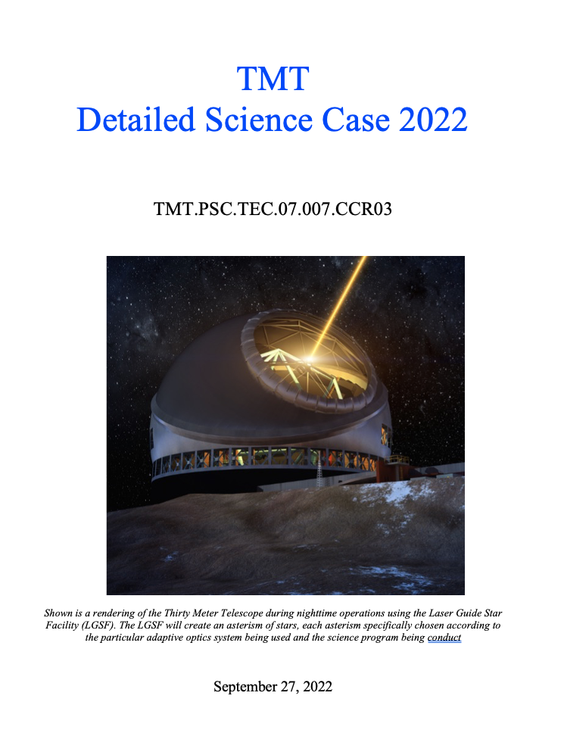
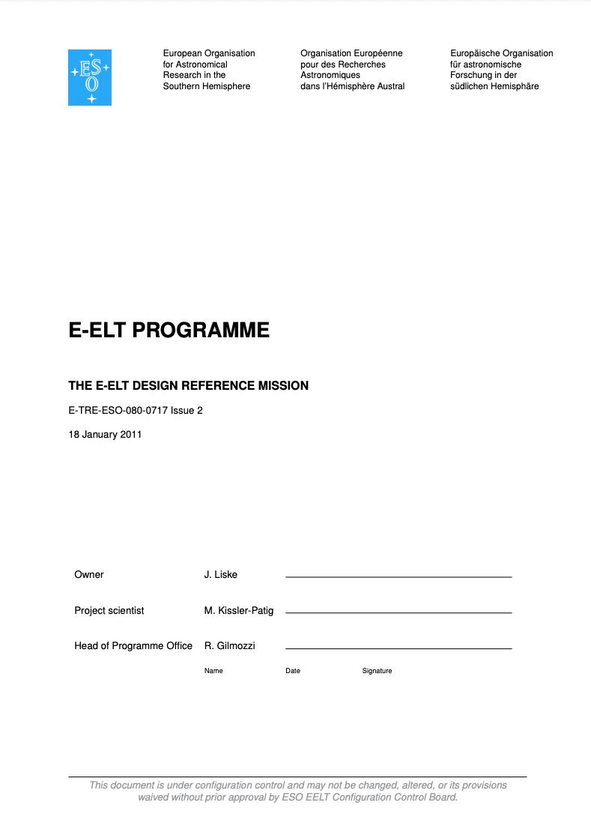
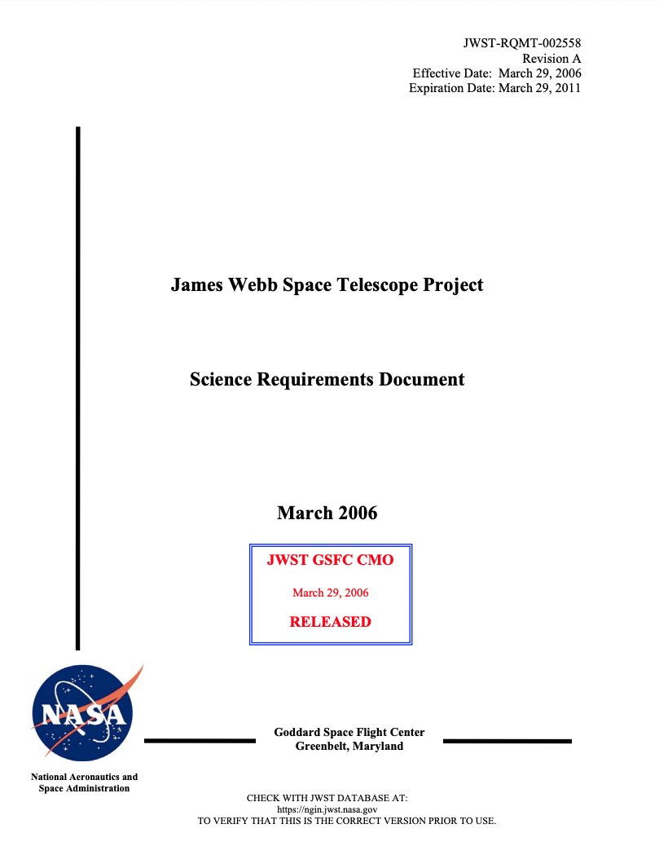
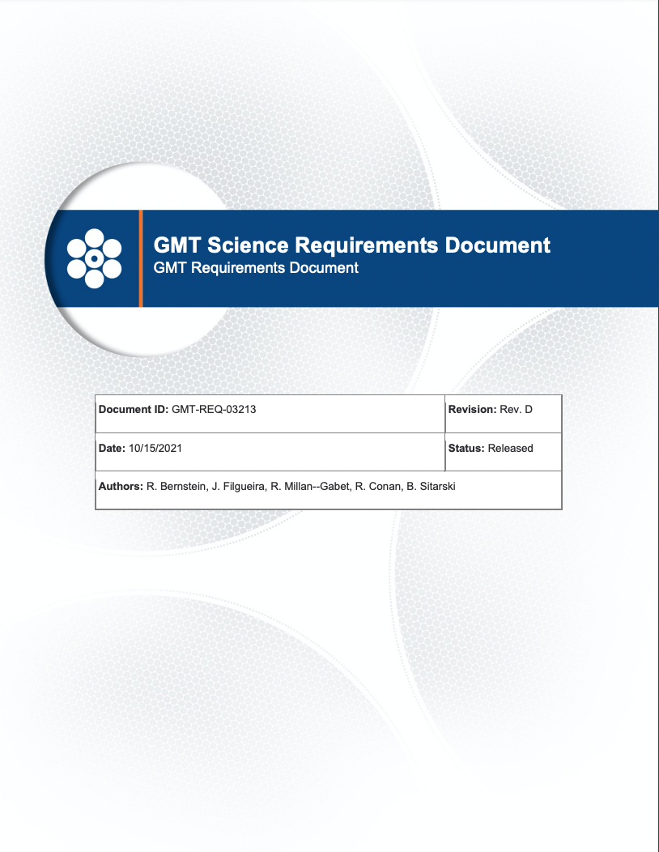
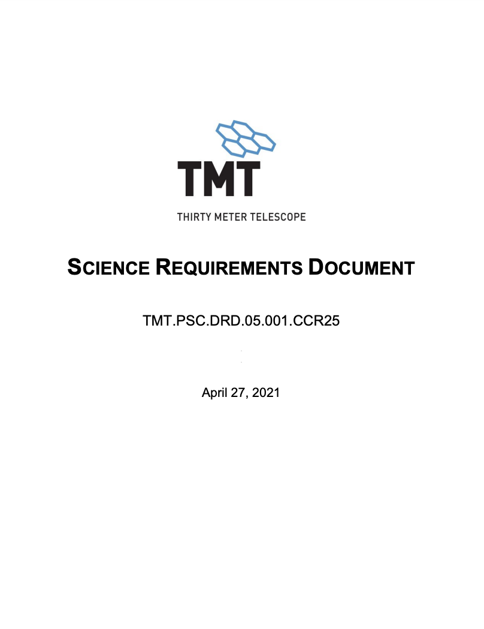
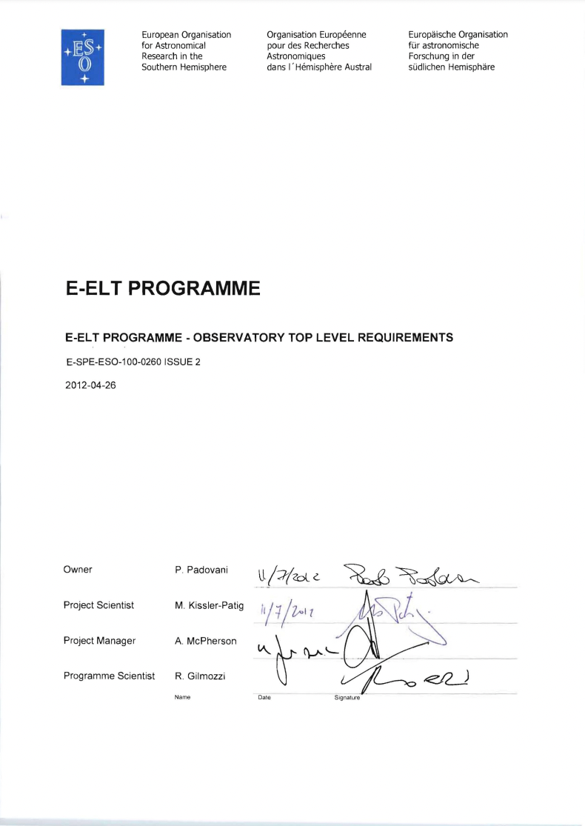
JWST - Science cases and requirements in one

Slide 4
The TMT Perspective
Science and the ability to do it has always been the key consideration
Science landscape evolves
Notes:
Different projects develop, process, update and utilize their science cases in different ways. I’ll use TMT as an example, but all projects use some variation of the same processes.
Science considerations were core to the individual projects that combined to form TMT. The development and upkeep of the TMT Detailed Science Case has been an important component of the project since inception.

Slide 5
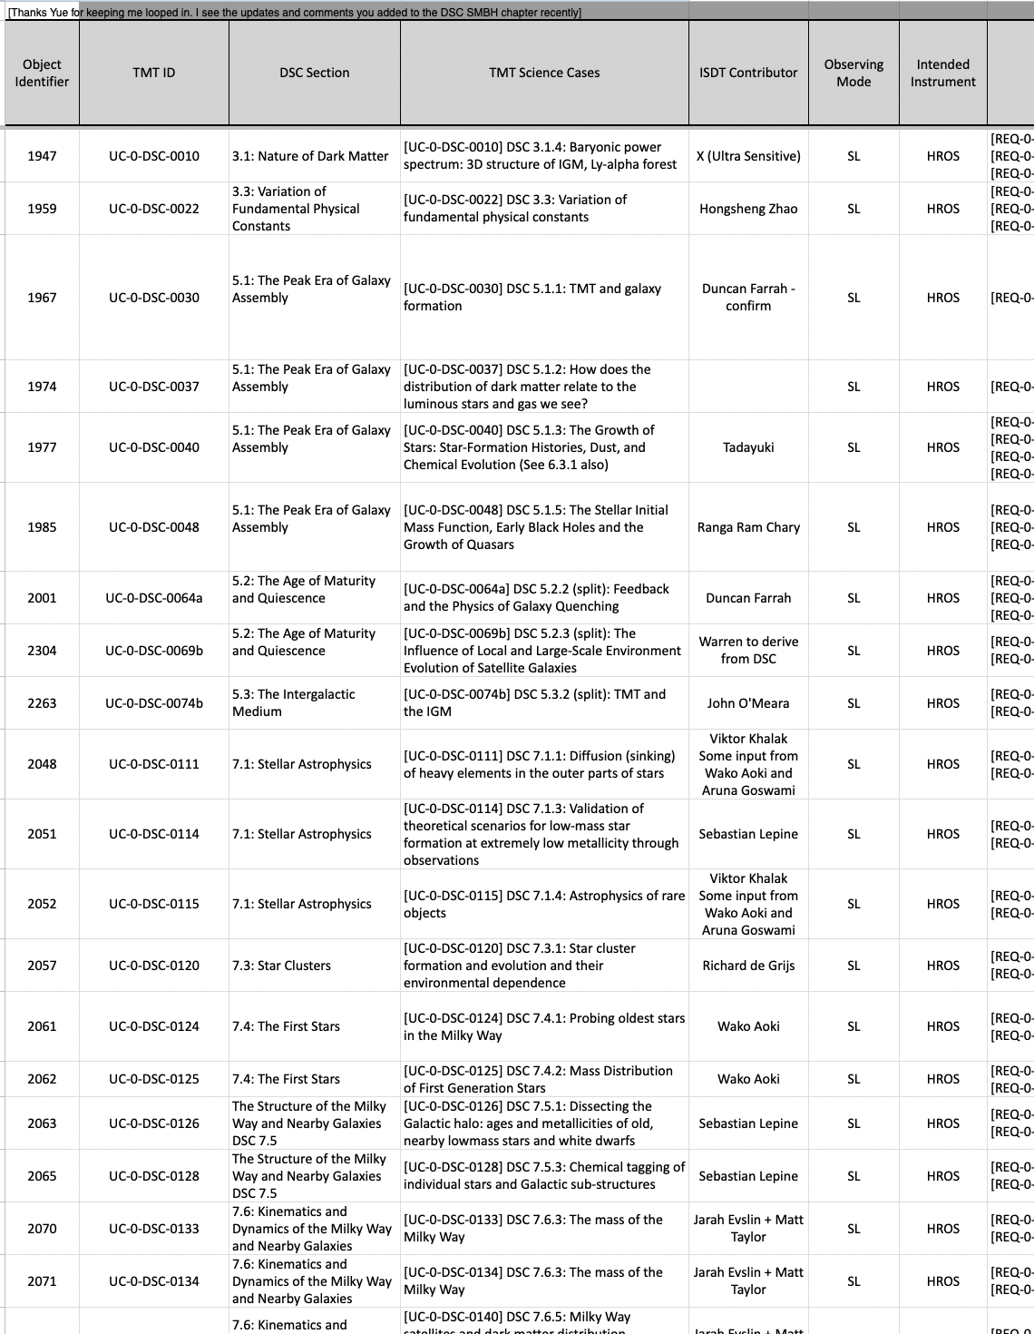
The 2022 TMT Detailed Science Case
238 pages, 277 science cases, 351 observing programs
Fundamental physics and cosmology
Early Universe
Galaxy Formation and the Intergalactic Medium
Supermassive Black Holes
Exploration of the Milky Way and nearby galaxies
The birth and early lives of stars and planets
Time-Domain Science
Exoplanets
Our Solar System
Science Capabilities Matrix
Observing program technical parameters
https://www.tmt.org/download/Document/10/original

Slide 6
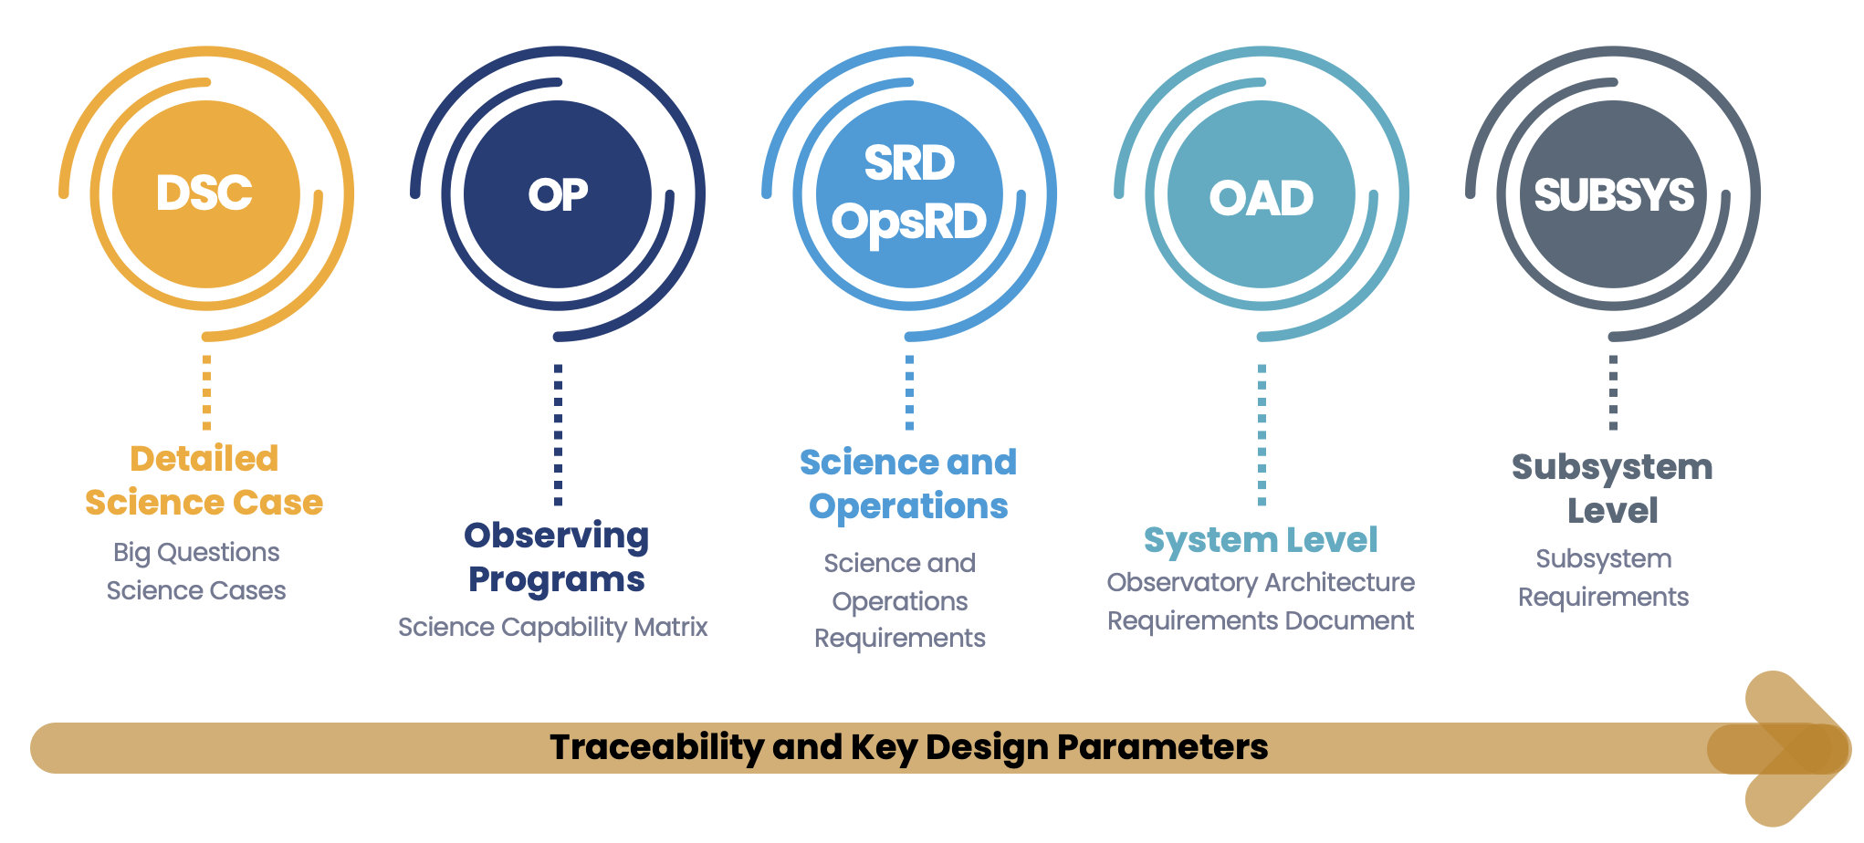
Science Cases and Science Requirements
Science cases drive the technical requirements used by the project
Rigorous Flowdown Process
Operations and Observing Capabilities
Science cases and observing programs are the foundation
40 technical observing parameters for each program is critical for deriving technical requirements
Consideration of many science cases ensures flexible capabilities

Slide 7
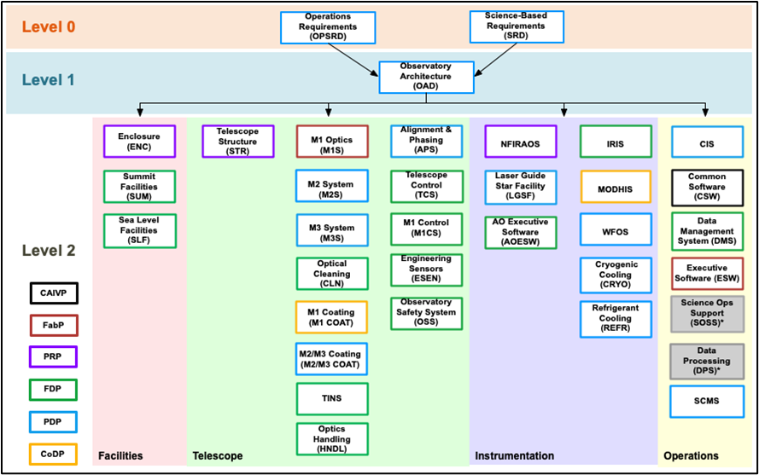
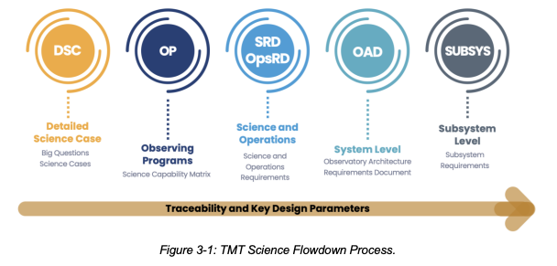
Requirements Flowdown
Full traceability between TMT DSC and TMT SRD and OpsRD
Driving science cases of Key Performance Parameters identified
KPPs directly tied to science cases
Systematic flow-down of science requirements to quantitative technical requirements and specifications
Notes:
Full traceability between TMT DSC and TMT SRD and OpsRD
Clearly definition of the decomposition and levels. Systematic flow-down of science requirements to quantitative technical requirements and specifications

Slide 8
Requirements Management
Systems Engineering Group
IBM DOORS (Dynamic Object-Oriented Requirements System) – TMT’s requirements management tool
Captures, tracks, traces, and analyze requirements
TraceTree uses the data in DOORS to show traceability
ASTRO2020 TMT DSC SRD OAD Subsystems, e.g. instruments
Notes:
Requirements and interfaces are formally managed in DOORS and traceability is visualized in TraceTree
Guess which science needs the highest astrometric precision – Studies of the dark matter distribution in dwarf galaxies.

Slide 9
Change Control
Requirements are rigid but can be modified if needed through the Change Control Process
Formal requests go to the Change Control Board
Engineering/design/performance
Impact of performance estimations on key driving science cases is assessed
Instrument science and technical teams
Issues affecting science brought to the SAC before formal change request

Slide 10
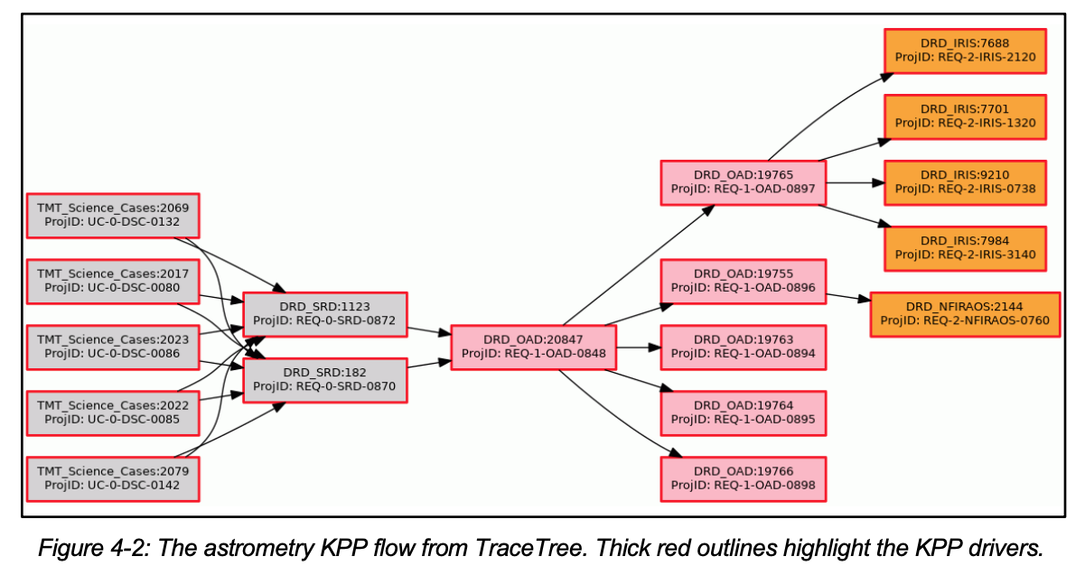
Performance Budgets and KPPs
Key Performance Parameters (KPPs)
Acquisition Time - AO
Acquisition Time - Seeing Limited
Astrometry
Heat Dissipation
Maintenance Time
Mass
NFIRAOS LGS MCAO Wavefront Error
NFIRAOS NGSAO Wavefront Error
Absolute Photometry
Differential Photometry
Pointing Error
Preset Time
Seeing-Limited Image Quality (PSS)
Seeing-Limited Off-Axis Image Quality
Pupil Stability
Reliability and Availability
Services
Throughput
Vibration
Performance requirements connected thru performance budgets (Level 0 to 2)
Performance Budgets supported by analysis, modeling and/or simulation
Performance Budgets tracked thru KPPs
Notes:
Performance requirements connected thru performance budgets (Level 0 to 2)
Performance Budgets supported by analysis, modeling and/or simulation
Performance Budgets tracked thru KPPs
Example here Astrometry KPP

Slide 11
Change Control
Requirements are rigid but can be modified if needed through the Change Control Process
Formal requests go to the Change Control Board
Engineering/design/performance
Impact of performance estimations on key driving science cases is assessed
Instrument science and technical teams
Issues affecting science brought to the SAC before formal change request
Cost and schedule
Design process may identify issues that raise cost or lengthen schedule
Descope options can be assessed in terms of science impact
Change Control process is the same as if a technical issue arises
Changes in the scientific and technical landscape
External influences that affect the instrument roadmap

Slide 12
Summary
Science Cases are the rationale for developing any astronomical facility
Critical for pre-construction stages of a project, defining goals and requirements
Measuring communities evolving interests and needs
Well established methods to identify technical requirements from science cases
Management - Flowdown and traceability
Change Control if requirements need to be modified as project evolves and matures
Key performance, cost and schedule
Consequences for scientific capabilities
COMMUNITY INPUT IS VITAL TO DEVELOPING ROBUST SCIENCE CASES

Slide 13
Any questions?

Slide 14
Acknowledgments
The TMT Project gratefully acknowledges the support of the TMT collaborating institutions. They are the California Institute of Technology, the University of California, the National Astronomical Observatory of Japan, the National Astronomical Observatories of China and their consortium partners, the Department of Science and Technology of India and their supported institutes, and the National Research Council of Canada. This work was supported as well by the Gordon and Betty Moore Foundation, the Canada Foundation for Innovation, the Ontario Ministry of Research and Innovation, the Natural Sciences and Engineering Research Council of Canada, the British Columbia Knowledge Development Fund, the Association of Canadian Universities for Research in Astronomy (ACURA), the Association of Universities for Research in Astronomy (AURA), the U.S. National Science Foundation, the National Institutes of Natural Sciences of Japan, and the Department of Atomic Energy of India.

Slide 15
Backup slides

Slide 16
Community provides science cases and technical information about required observations
Science Cases are developed initially with some instrument concepts in mind
TMT made a call for instrument concepts and supporting science cases (~2006)
Creates Detailed Science Case and Science Capabilities Matrix
SAC identifies the highest priority science cases
Systems Engineering derives science requirements through the science flowdown process
Requirements at all levels are traceable back to science cases
Collections of related observing requirements define the instruments
Instrument development teams design instruments according to the requirements
Supported by Instrument Science Team that provides detailed information to guide operational concepts development and assesses impact of design on ability to conduct science
Development of the Operations Plans to support science cases and operation and maintenance of instruments

Slide 17
Examples of science case flowdown
Level 3 requirement traces back to a science case (most often, multiple science cases)

Slide 18
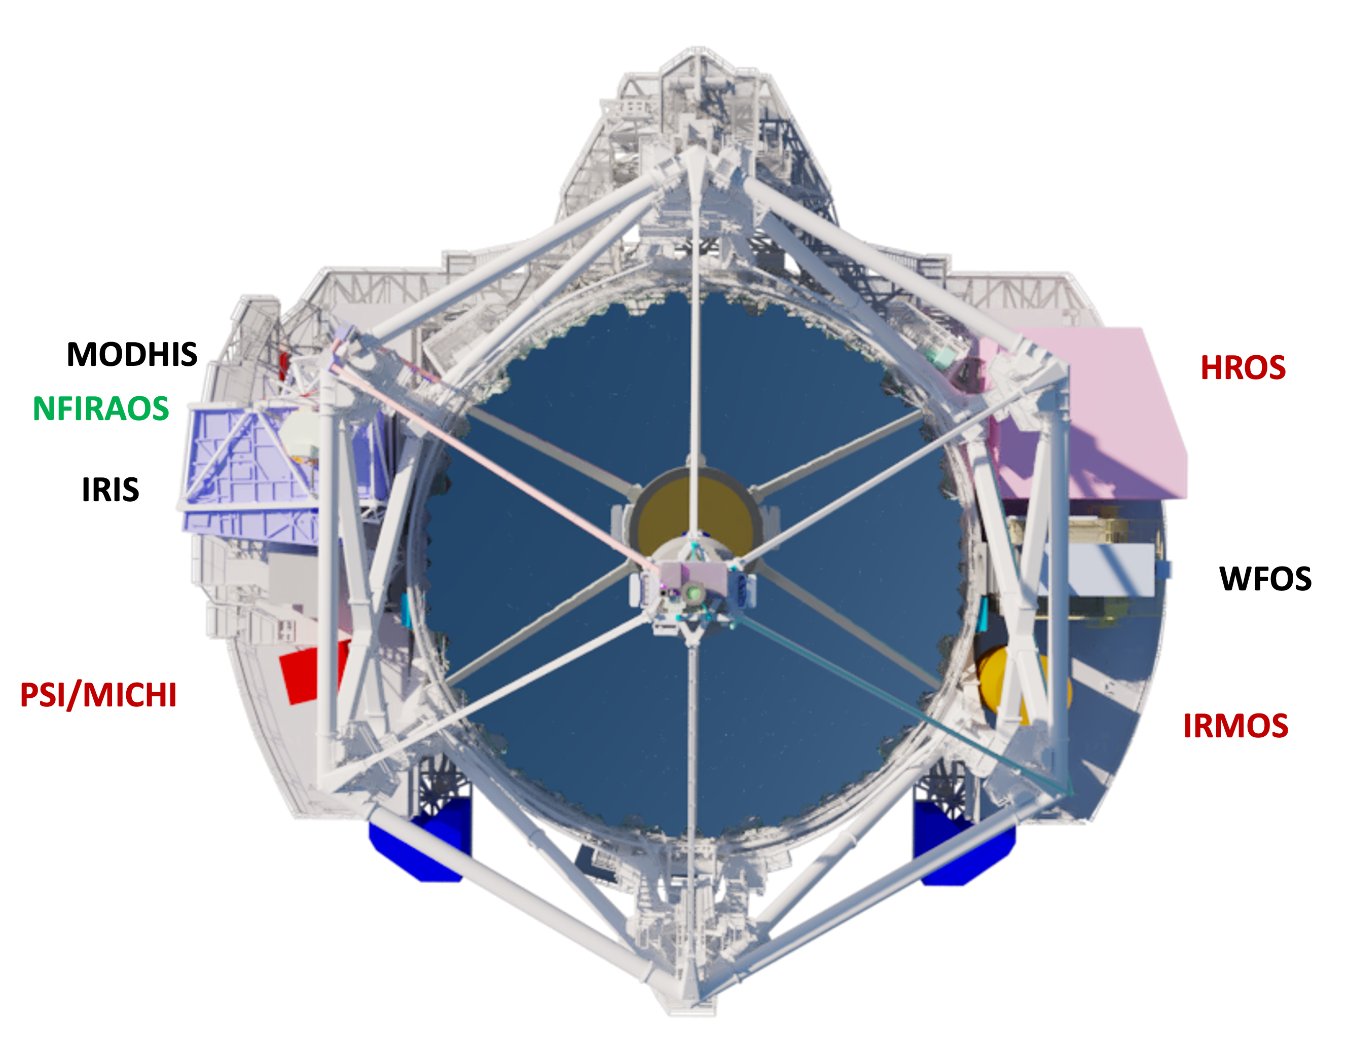
Introduction
Christophe discussed the science that motivates the development of TMT observatory
Dave presented the instruments, their capabilities and development status
How do we determine what instruments to build? - ‘road map’
Science priorities
Priorities for collections of capabilities
The story of instrument development for TMT has been complicated by the length of the project and the evolution of the scientific landscape
I’ll present an ‘idealized’ story based on the plan for future instrument development

Slide 19
TMT instrument development process
COMMUNITY EXPLORATIONS
Partner communities, ISDTs, instrument science teams, unsolicited proposals, new technologies, mini-studies and white papers, etc. all provide inputs
TMT Detailed Science Case and Science Capabilities Matrix
Community interactions inform SAC prioritization of TMT instrumentation and science goals
Science cases, observation concepts and technology readiness
SAC (Science Advisory Committee) PRIORITIZATION
SAC develops the TMT science priorities, and TMT instrument priorities and phasing based on the capabilities needed to support the highest priority science (agreed with TMT Board)
First Light and 2nd Generation Instruments
Iterative and slowly dynamic with a long timescale (scientific and technological landscapes evolves)
CALL FOR PROPOSALS/CONCEPTUAL DESIGNS/RECOMMENDATIONS (Ideal Case!)
Determined by the Board with guidelines on scope/funding
Proposal execution and review process
SAC recommendation to the Board

Slide 20
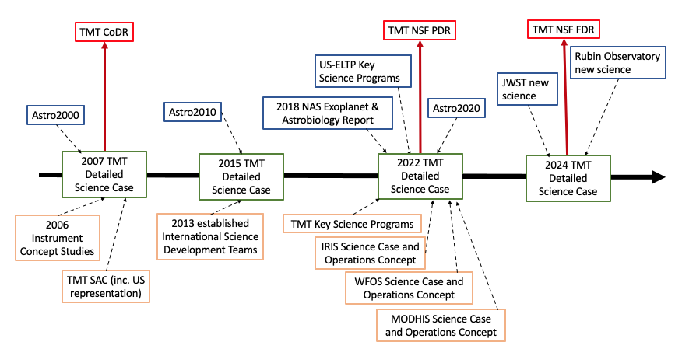
TMT Detailed Science Case Update
Happening NOW!
TMT Detailed Science Case 2024
Content updates
Content updates by TMT ISDTS
Both DSC text and Science Capabilities Matrix
See me if you want to be involved
was@tmt.org

Slide 21
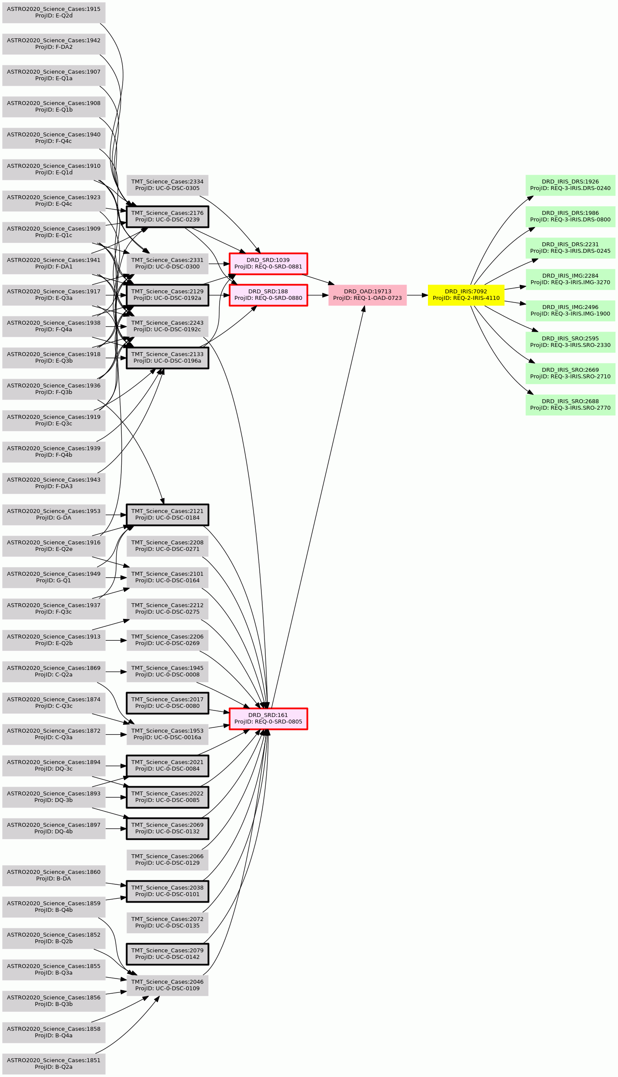
Requirements Management
and Performance (Error) Budgets
ASTRO 2020 Science Cases
E.g. IRIS
All ~300 requirements from level 2 and 8x level-3 Design Requirement Documents (IRIS subsystems) are stored in TMT DOORS
Traceability is shown in Tracetree tool
Example: IRIS Image Blurring Budget [REQ-2-IRIS-4110] flows from [REQ-1-OAD-0723], 3 Science Requirement Document Requirements, and 10 driving Science Cases. The 8 level-3 requirements flow down technical specs
TMT Detailed Science Cases
IRIS Subsystem Requirements (level 3)
Observatory Architecture Requirement (OAD, level 1)
Science Requirements (SRD, level 0)
IRIS Req (level 2)
REQ-1-OAD-0723: NFIRAOS/IRIS combined image smearing shall be greater than 0.992 PSSN in J-band, 0.995 PSSN in H-band, and 0.997 PSSN in K-band in NGS and LGS observing modes

Slide 22
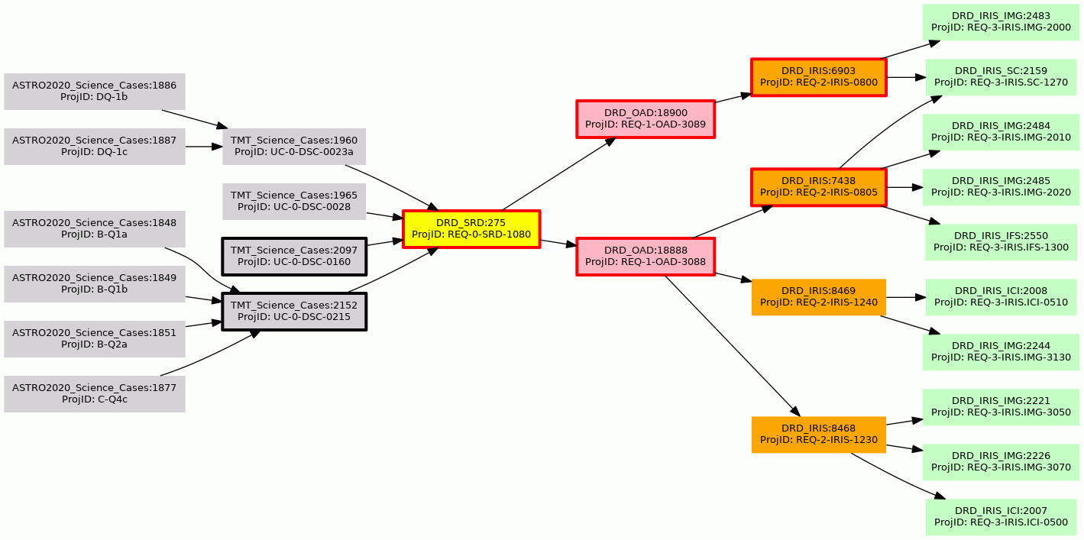
IRIS Throughput Traceability
IRIS Subsystem Requirements (level 3)
Observatory Architecture Requirement (OAD, level 1)
IRIS Req (level 2)
Science Requirements (SRD, level 0)
Imager Throughput >50%
ASTRO 2020 Science Cases
TMT Detailed Science Cases
Cryostat window>96%
REQ-1-OAD-3089: Throughput of the IRIS imager from entrance window to detector shall be greater than 45%, not including telescope or NFIRAOS
Imager Throughput in slicer mode >60%
REQ-0-SRD-1080: The IRIS IFU throughput shall be > 30% (excluding the AO system and telescope).
Imager Throughput in lenslet mode >60%
IFS throughput >30% over 5% range for each mode
REQ-1-OAD-3088: Throughput of the entire IRIS instrument from entrance window to detector shall be greater than 30%, not including telescope or NFIRAOS
Sequencer controls ADC
ADC deployable
Cold stop maintains alignment with pupil
Traceability enables instrument team to understand how potential changes will affect upstream requirements and ultimately the science
Cold stop assembly deployable
Sequencer controls Cold stop assembly

Slide 23
The TMT Perspective
TMT Project Inception
2002 GSMT Frontier Science Goals
2002 VLOT Project Book Science Case
2002 CELT Conceptual Design, inc. Science Motivations
First Light Instrument Plan Updated
Science and the ability to do it has always been the key consideration
Science landscape evolves
Notes:
Different projects develop, process, update and utilize their science cases in different ways. I’ll use TMT as an example, but all projects use some variation of the same processes.
Science considerations were core to the individual projects that combined to form TMT. The development and upkeep of the TMT Detailed Science Case has been an important component of the project since inception.

