Slide 1
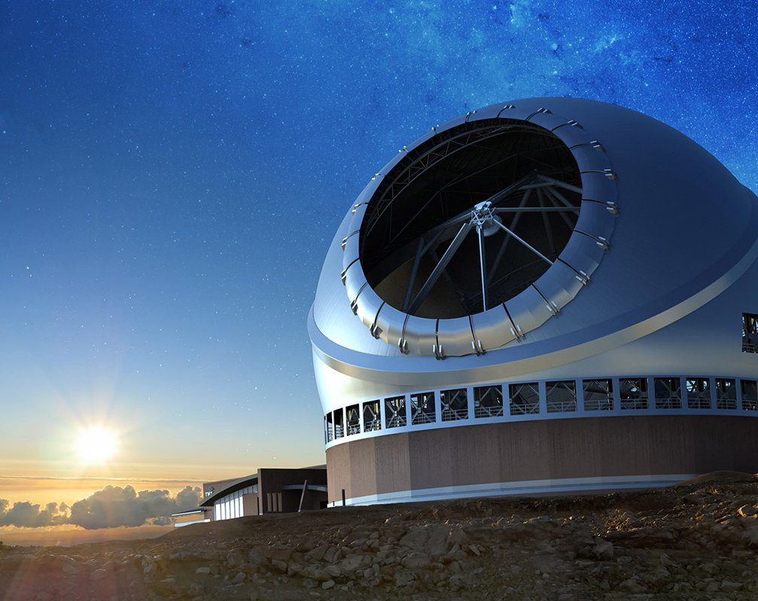
Next-generation diffraction-limited fiber-fed high-resolution infrared spectrographs for Keck and TMT
Dimitri Mawet (CIT, PI), Michael Fitzgerald (UCLA, co-PI), Quinn Konopacky (UCSD, PS), Nem Jovanovic (CIT, PA), Ashley Baker (CIT, IS), Rob Bertz (CIT, PM), Larry Lingvay (CIT, PM), Hiroshi Terada (TMT, PM), Dave Andersen (TMT, IPM), on behalf of the MODHIS team
ETL-JWST, 11 Dec 2023

Slide 2
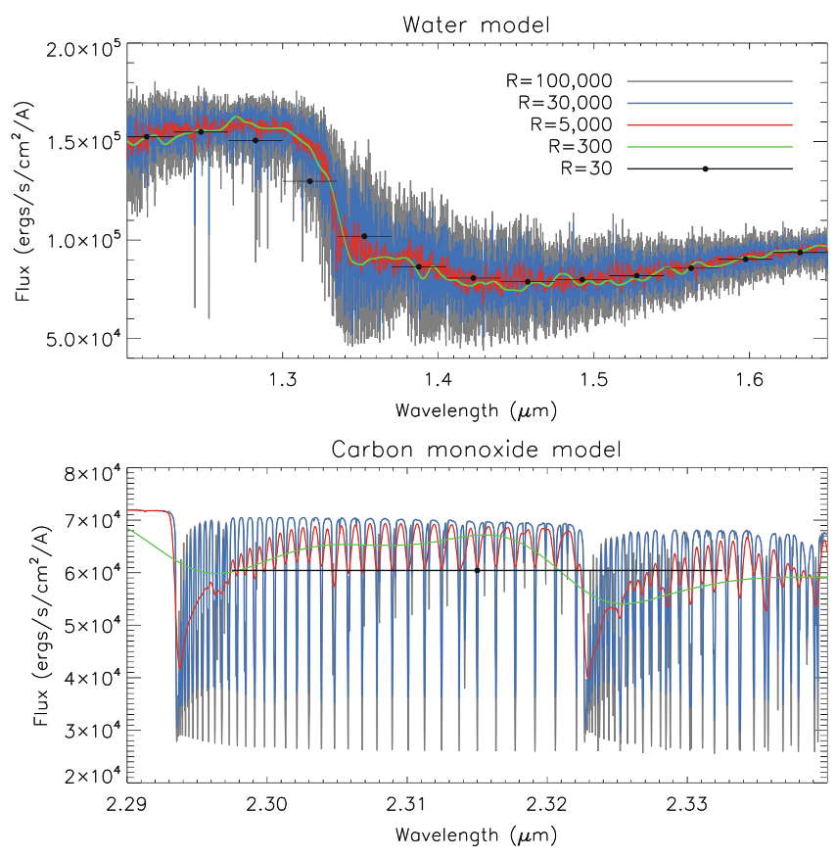
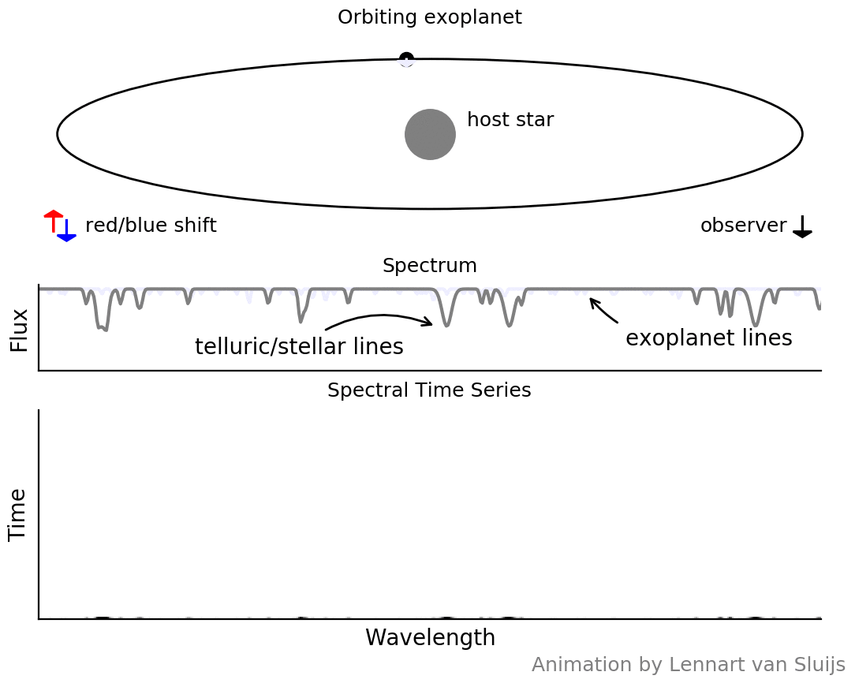
High-resolution spectroscopy unlocks full information content of molecular lines => PRV, close-in/transits, direct

Slide 3
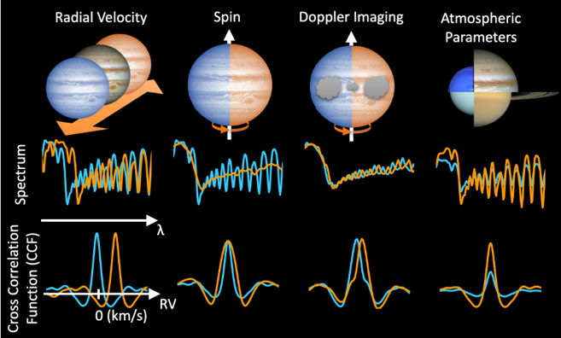
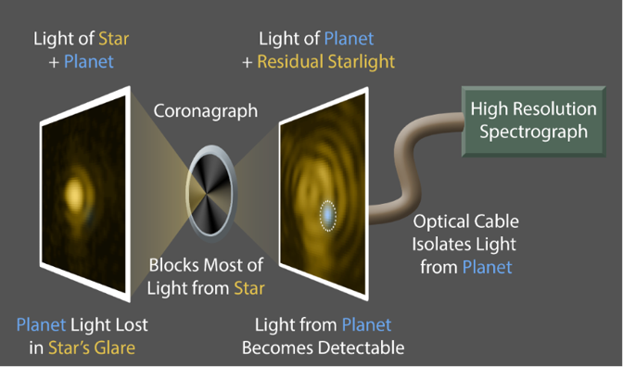
High-Dispersion Coronagraphy: characterization of exoplanets at high contrast

Slide 4
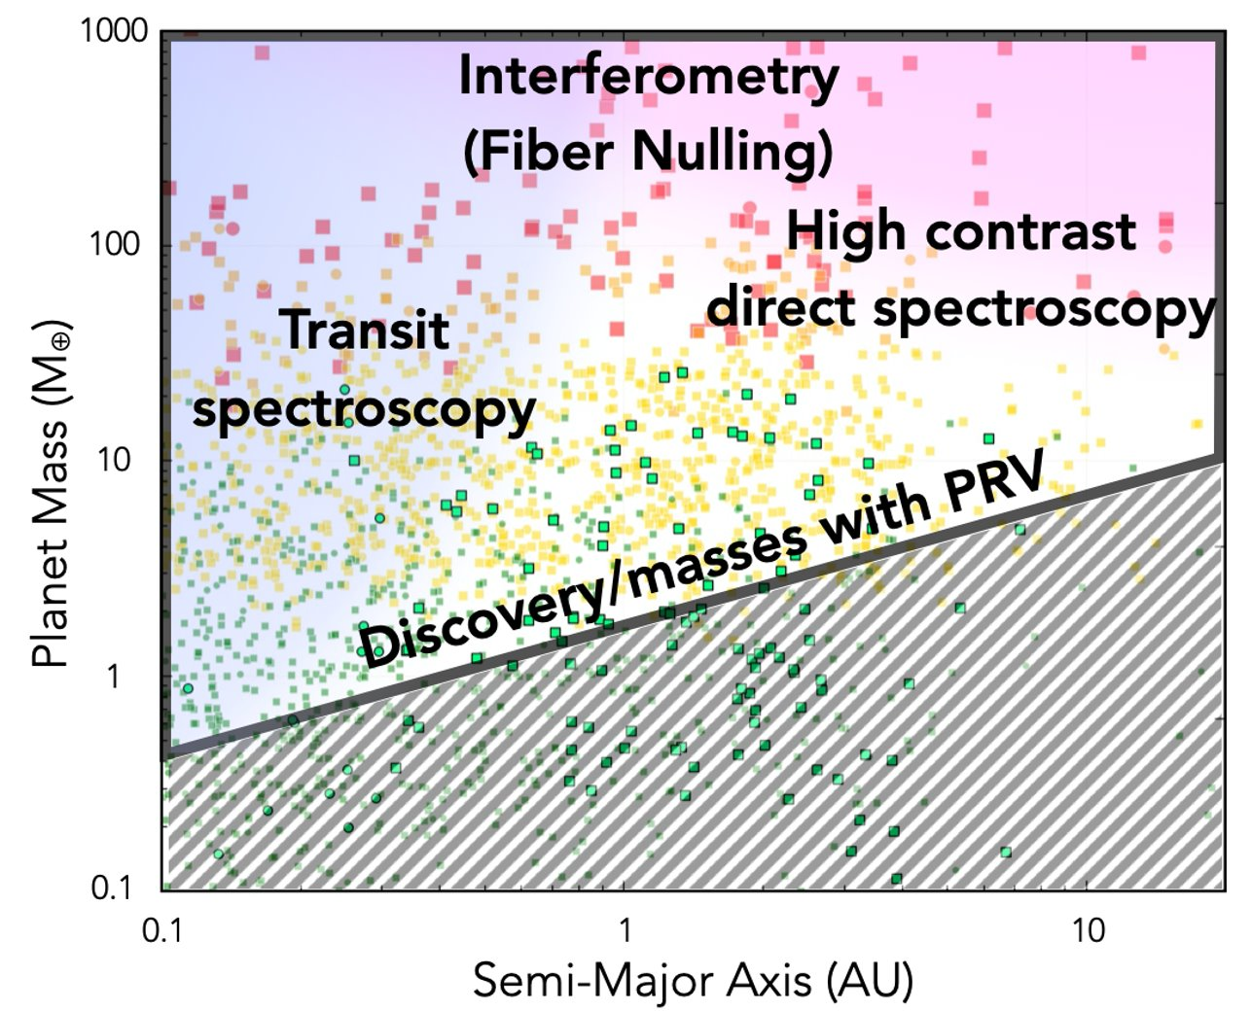
Exoplanet science at high-R
Keck-HISPEC and TMT-MODHIS enables four complementary exoplanet detection and characterization techniques covering a substantial phase space

Slide 5
Atmospheric composition (C/O, C/H, O/H, metallicity+isotopologue ratios) as a tracer of formation (Oberg+2011, Madhusudhan 2011)
Differing composition
between host star and planet
Chemical homogeneity

Slide 6
The next frontier: Characterizing exoplanet atmospheres & search for biosignatures

Slide 7

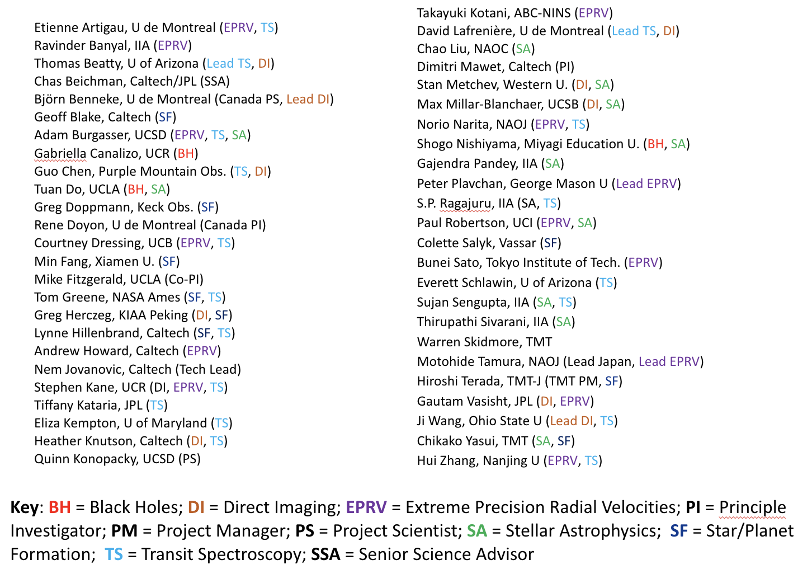

Keck-HISPEC
&
TMT-MODHIS team

Slide 8
Top-level requirements
 | Requirements | Comments
Wavelength Range | 0.98-2.46 µm | Simultaneous
Field of View | ~4-6” diameter (at the diffraction limit: 7-17 mas) | Acquisition and guiding
Spectral Sampling | 3 pixel LSF | Doppler measurements
Resolving power | 100,000 on average | Driven by transits
Efficiency | >10% | Internal (excludes atmosphere)
Observing modes | Single-object on-axis Off-axis, high contrast | See next slide
Acquisition and guiding | < 15-17 mag | Limited by AO performance
Internal RV precision | < 30 cm/s | Fiber to fiber

Slide 9
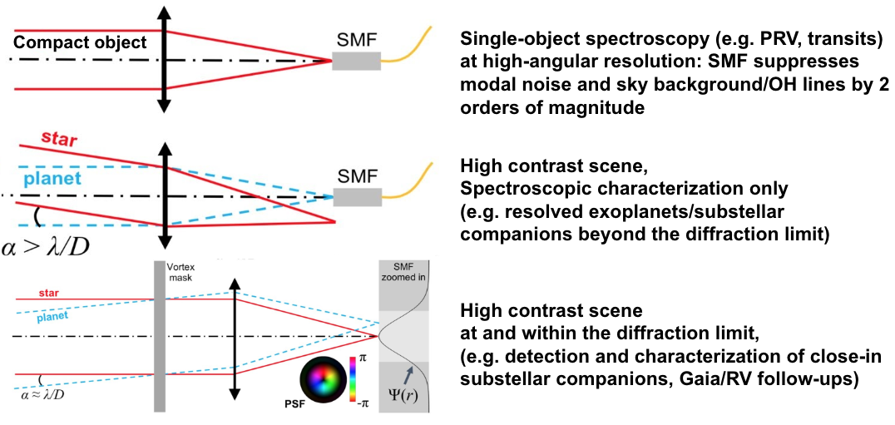
Single-mode Fiber: observing modes

Slide 10
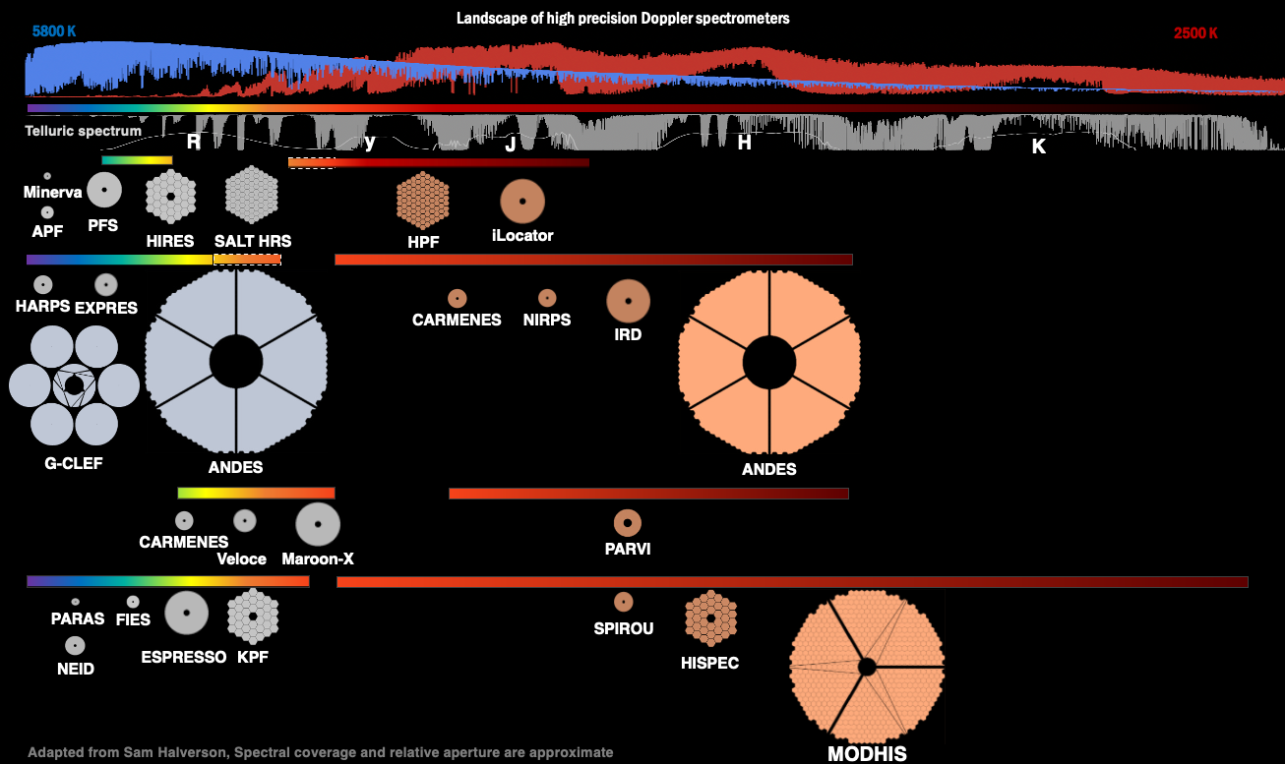

Slide 11

Heritage across collaboration
Canada: CFHT-SPIRou, ESO-NIRPS (just achieved <1 m/s!)
Japan: Subaru-IRD
Caltech/JPL: Palomar-PARVI, KPIC
Plus many others to learn with and from: HPF, iLocater
UC: NIRSPEC, IRIS-LIGER

Slide 12
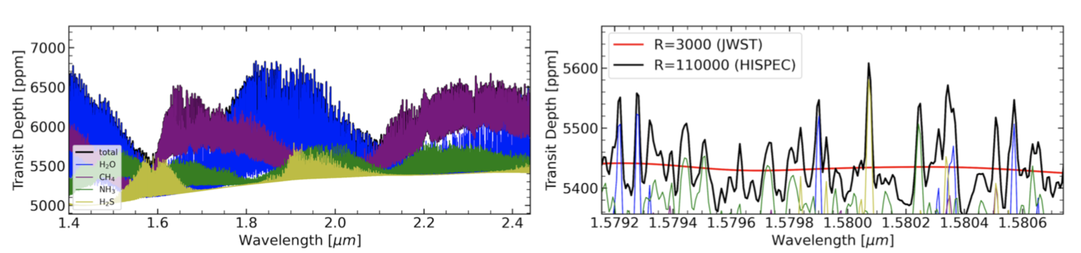
HISPEC and MODHIS will continue the trend of detailed atmospheric characterization of transiting planets at high spectral resolution.
B. Benneke

Slide 13
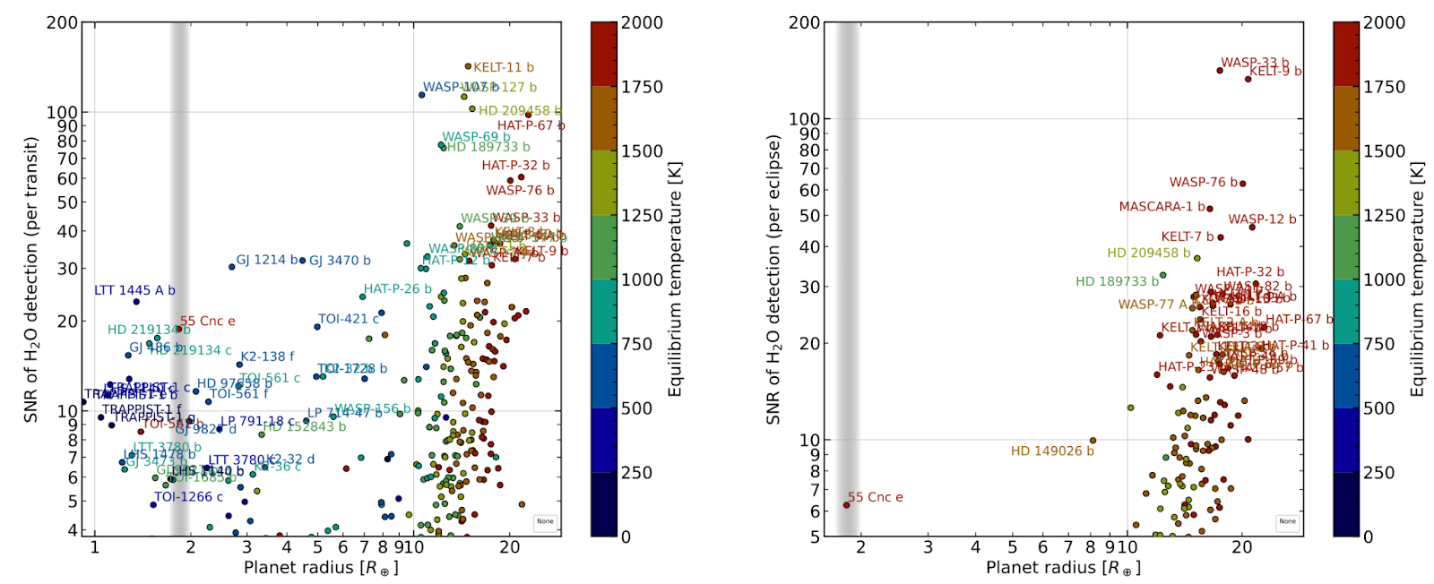
HISPEC & MODHIS will characterize the atmosphere of many exoplanet types from hot Jupiters to mini-Neptunes, Super-Earth, and Earth-size planets

Slide 14
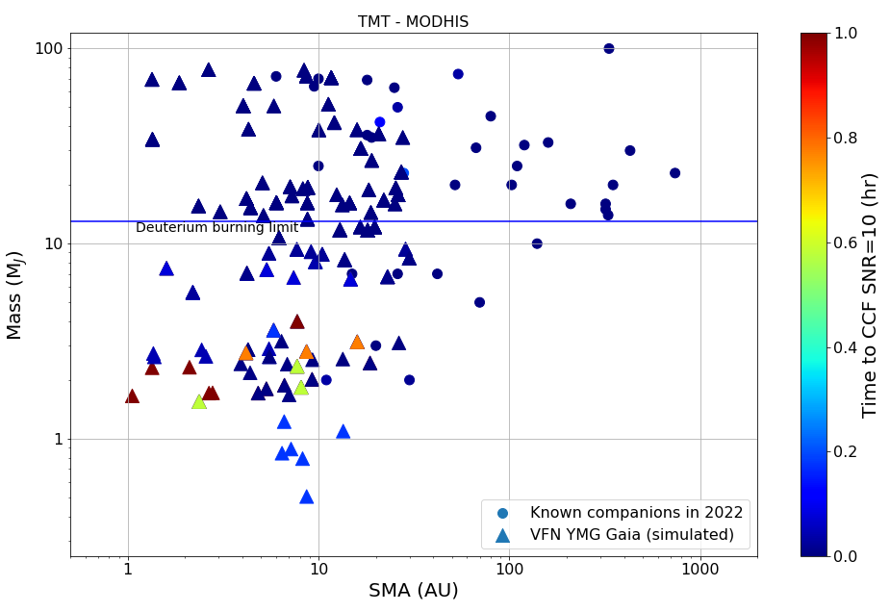
HISPEC/MODHIS High Contrast Spectroscopy survey capabilities
Keck-HISPEC and TMT-MODHIS will readily detect dozens of existing low-mass companions across the deuterium burning limit, investigating the formation and evolution of gas giants and through their shaping influence, whole planetary system
Each detection through cross-correlation or forward modeling will enable extensive dynamical (spin and orbital) and atmospheric characterization

Slide 15
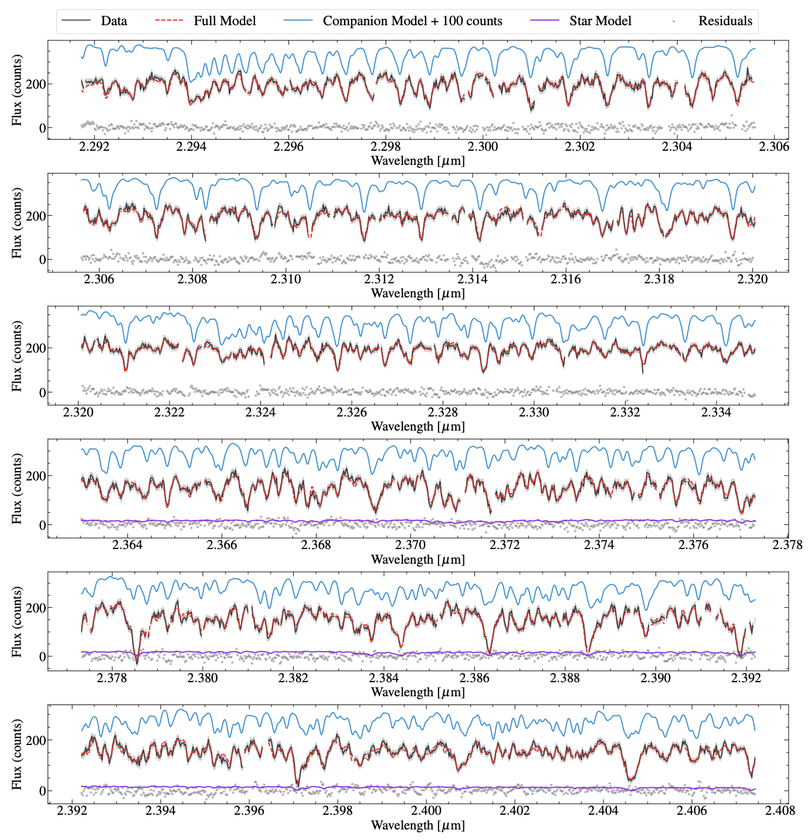
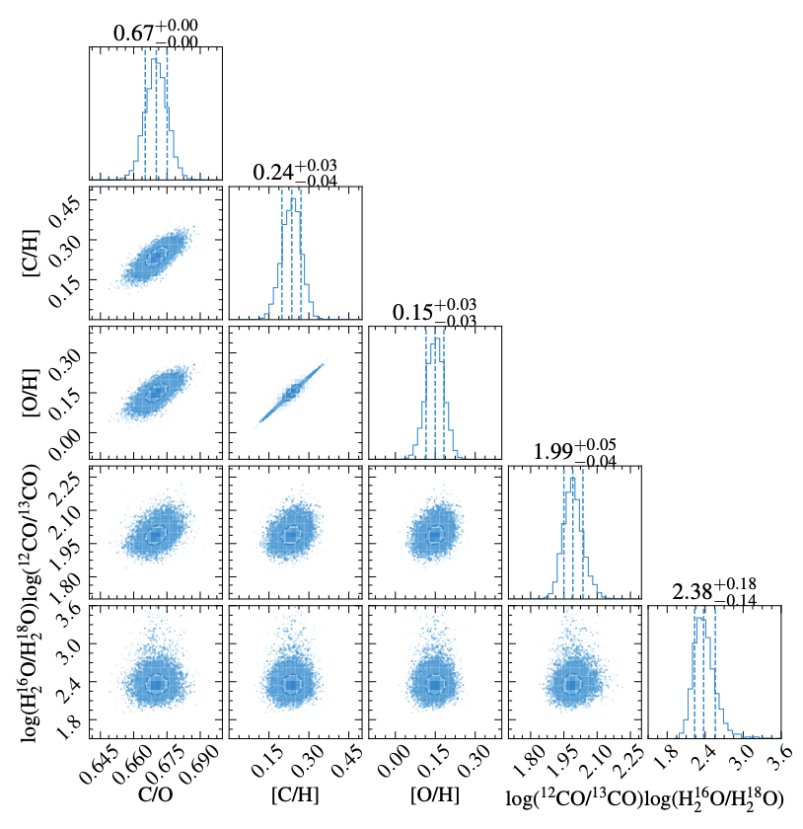
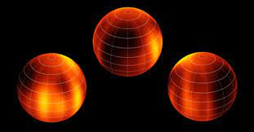
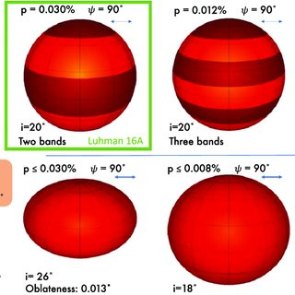
Abundance measurements and atmospheric dynamics
Measuring abundances (e.g. C/O and Fe/H) at high spectral resolution probes a wide range of atmospheric pressures below, at, or above the clouds
High-resolution spectroscopy is sensitive to minor species such as isotopologues (formation tracers)
High-resolution spectroscopy on large telescopes (high SNR) enables Doppler imaging, revealing 3D cloud structure, oblateness and dynamics
Crossfield+14
Xuan et al. 2023
Millar-Blanchaer+19

Slide 16
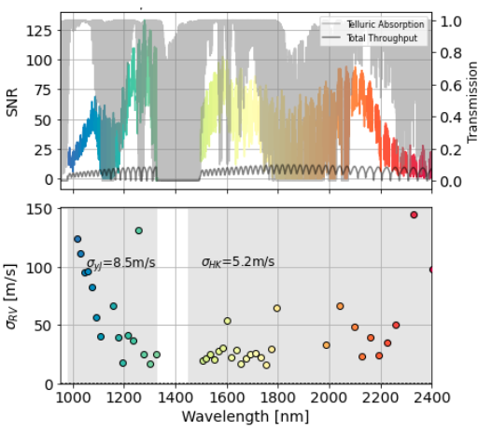
Example: HR8799c

Slide 17
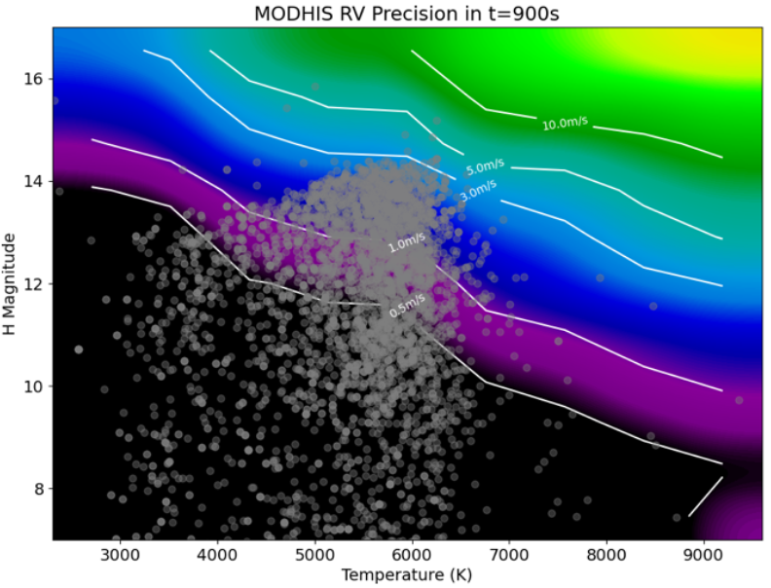
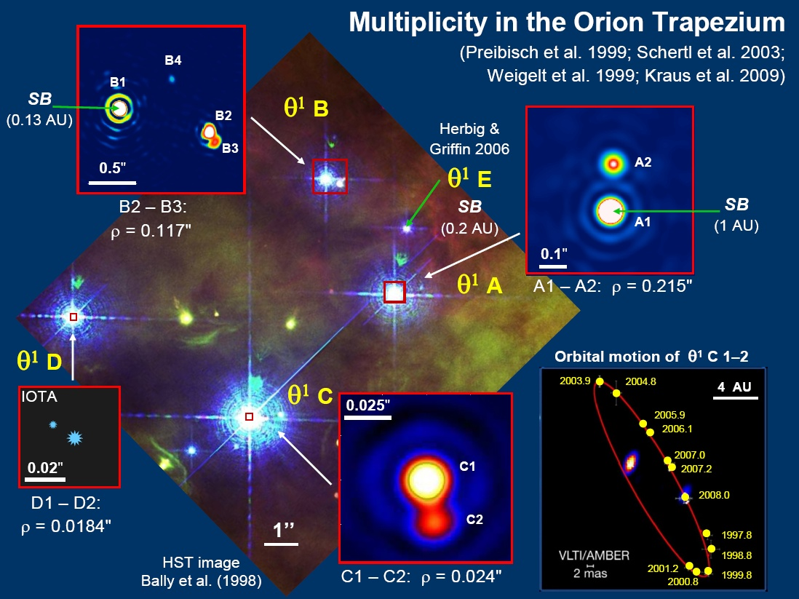
NIR Precision Radial Velocity
NIR PRV enables the following science on large telescopes:
Exoplanet demographics in young systems. NIR PRV has demonstrated 2-4x less stellar jitter than optical PRV
Orbital Obliquity of Planets Orbiting Young and/or Cool Stars via the RM effect
Demographics in binary or multiple systems inaccessible to seeing-limited instruments and smaller telescopes

Slide 18
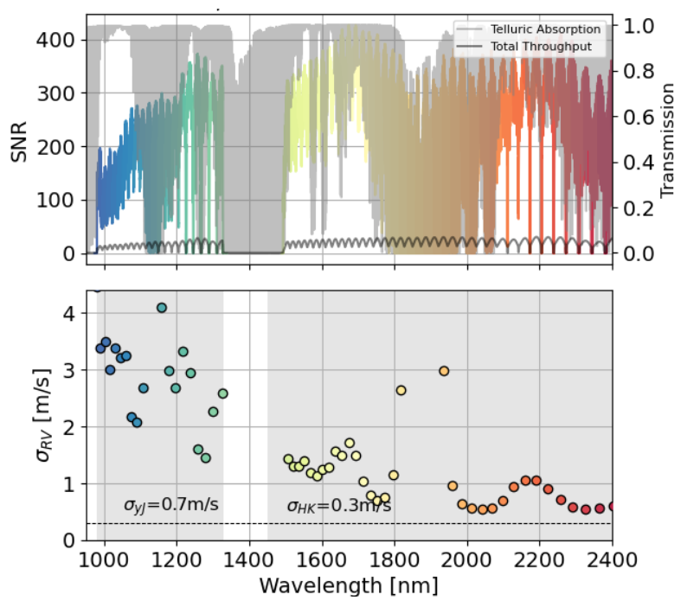
Example Trappist 1

Slide 19
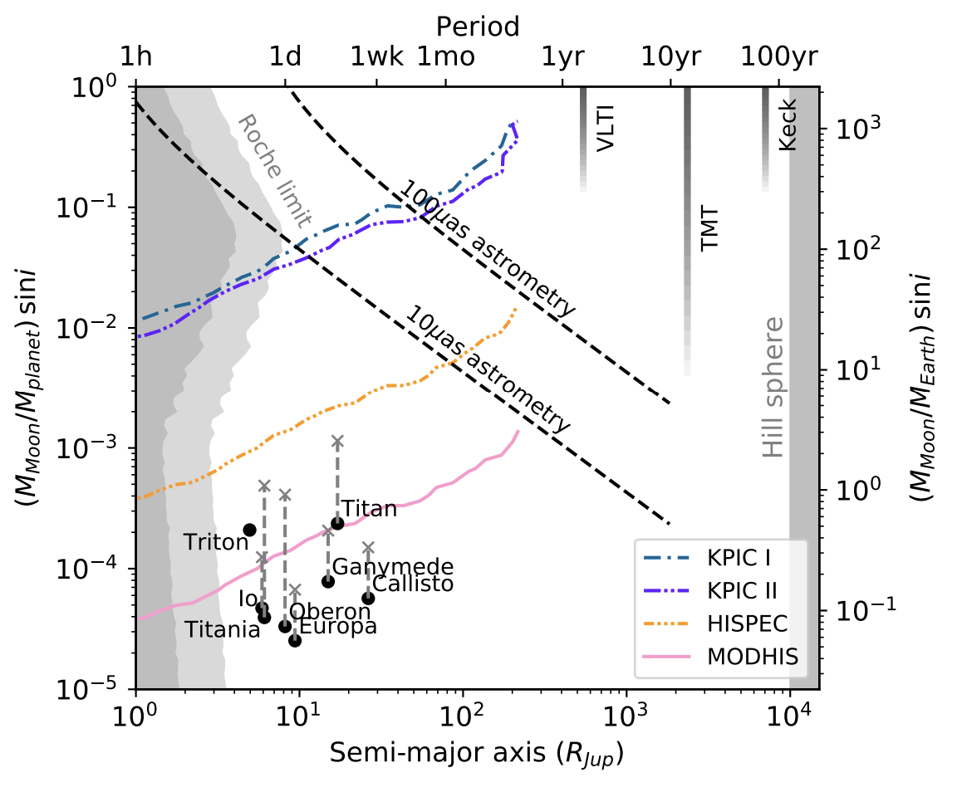
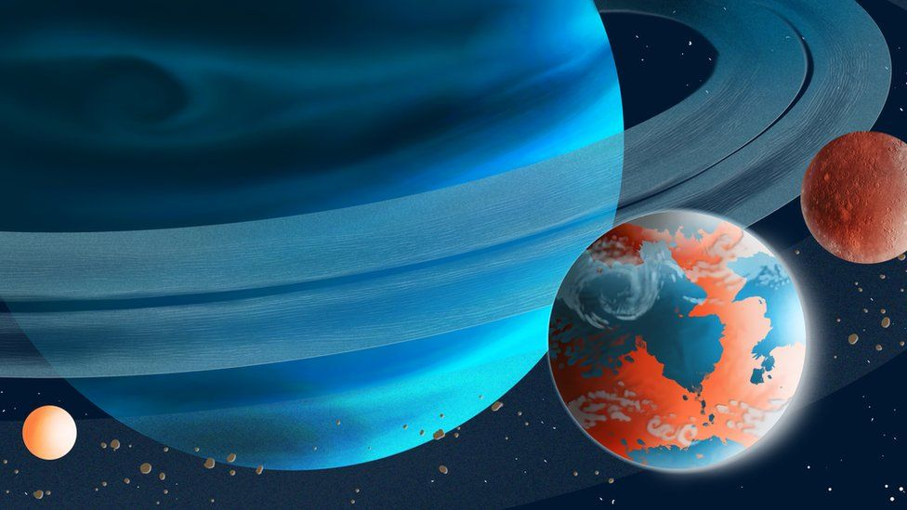
Exomoons around young giant exoplanets
Ruffio et al. 2023

Slide 20
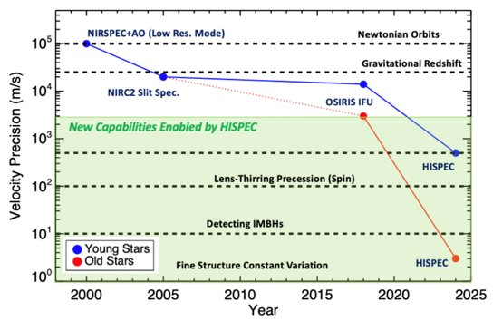
Galactic Center
MODHIS will enable a 2+ order of magnitude improvement in radial velocity measurements at the Galactic Center, providing the necessary complement to astrometry (Gravity) in velocity space, enabling the following science:
  Fine Structure Constant measurements
  Central black hole spin
  Intermediate-mass BHs
3x better angular resolution than Keck

Slide 21
Other Science
Proto-planetary and circumplanetary disk dynamics​
Global circulation models for Venus through ultra-precise wind measurements​
Abundance measurements in Galactic bulge (subject to confusion with traditional means)​
Internal kinematics of stars in dwarf galaxies​
Probe AGN-driven outflows close to the SMBH sphere of influence​
More to be explored with science team during CoDP-2​

Slide 22
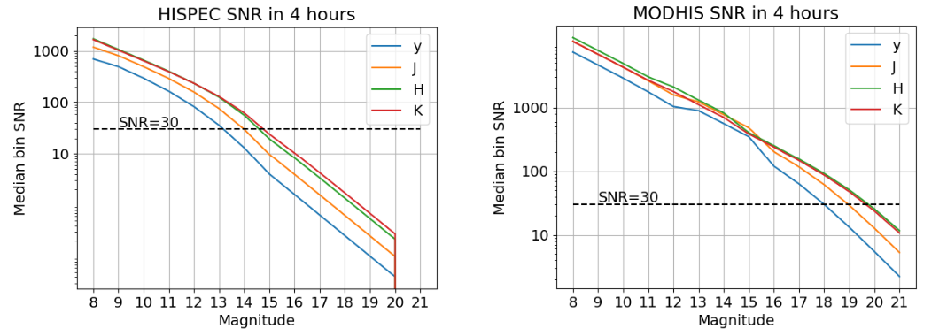
HISPEC & MODHIS sensitivity – 4 hours
https://specsim.astro.caltech.edu

Slide 23
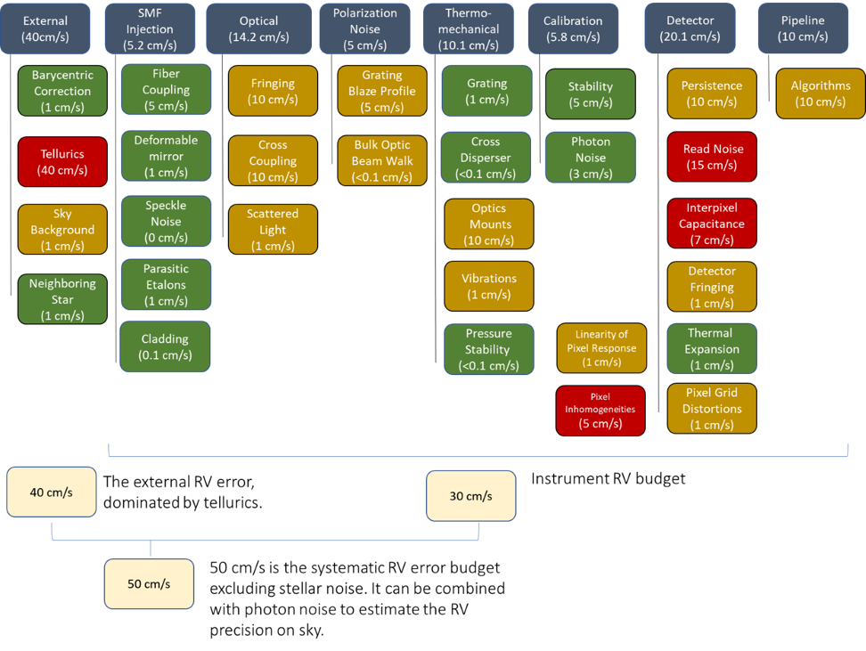
RV error budget

Slide 24
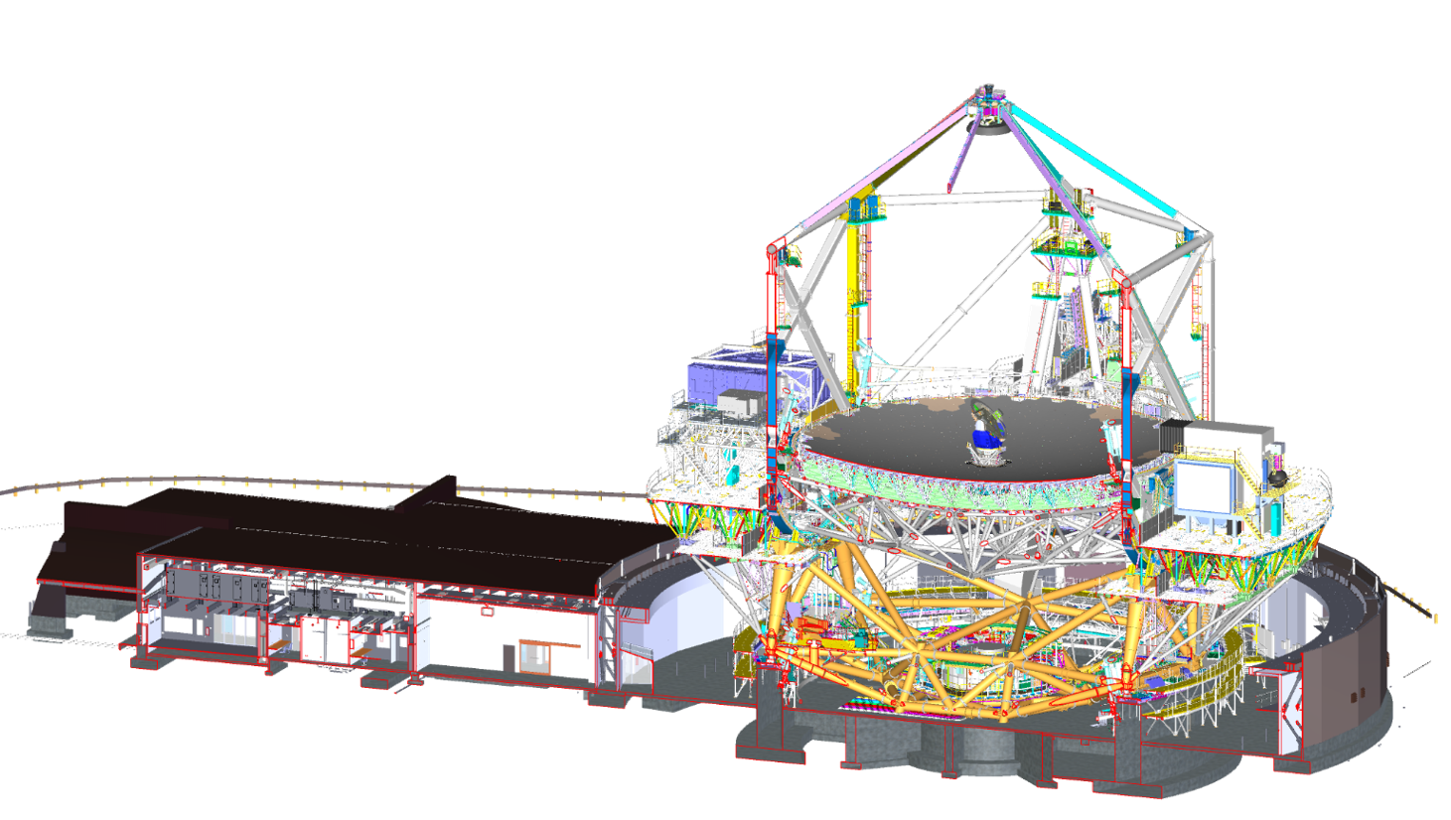
Instrument architecture
SRO+FEI
NFIRAOS
FIB
SPEC
CAL

Slide 25
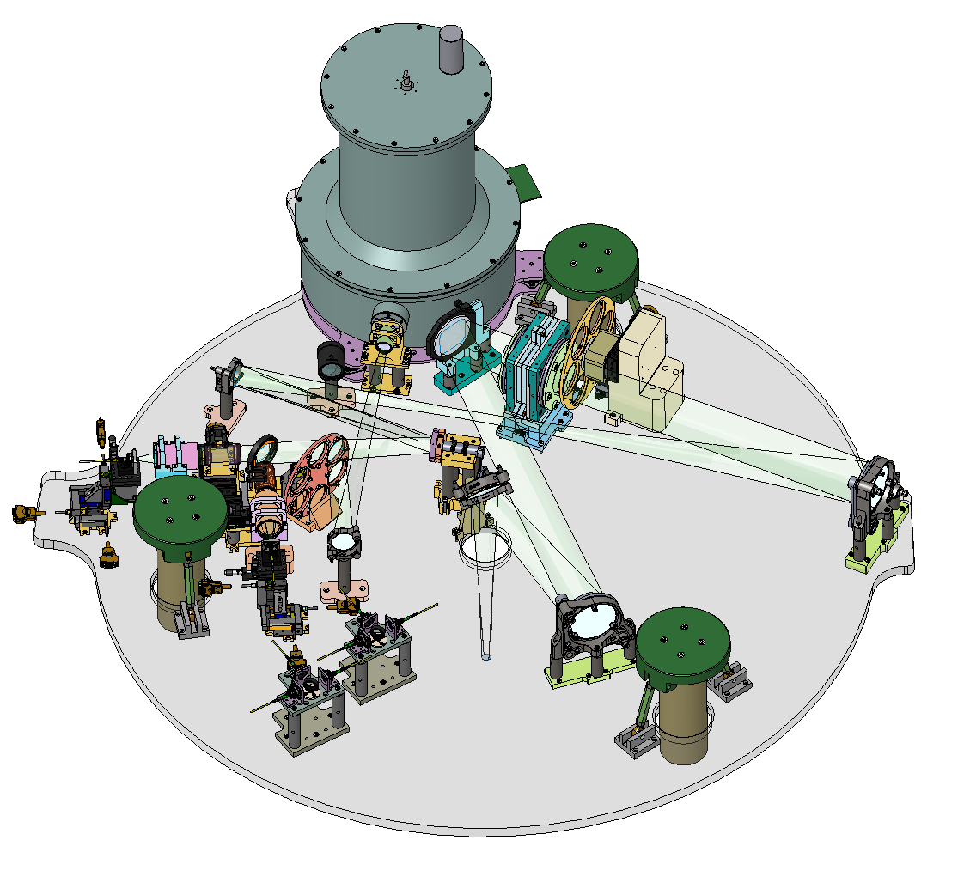
FEI mechanical design
APIC dewar
CC
MS
OAP
BS
TTM
ADC
OAP
OAP
Fiber injection
Optical bench
from NFIRAOS
Bipod Assembly
Internal pylon
PolBox
NFIRAOS focal plane (below plate)

Slide 26
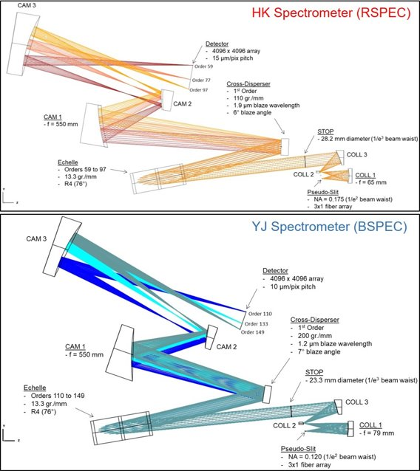
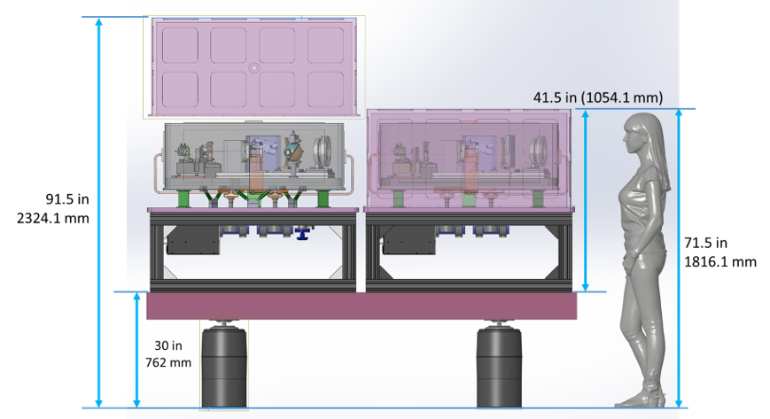
Spectrometers

Slide 27
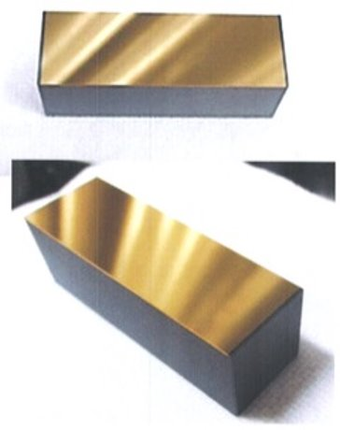
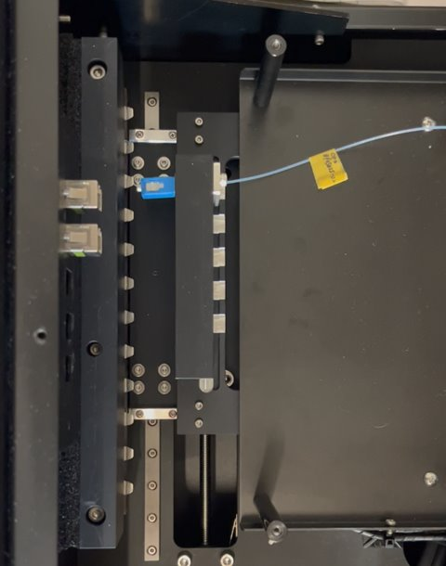
Other enabling technologies
High-efficiency echelle grating from Canon and robotic fiber switchers (ABC contributions)​

Slide 28
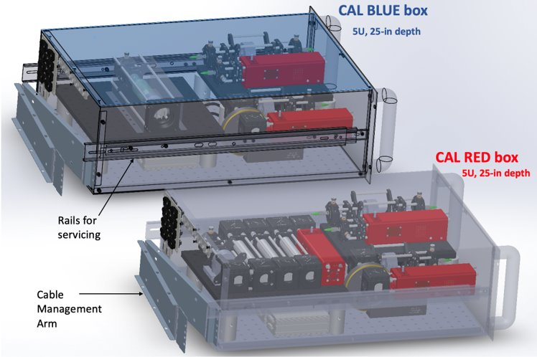
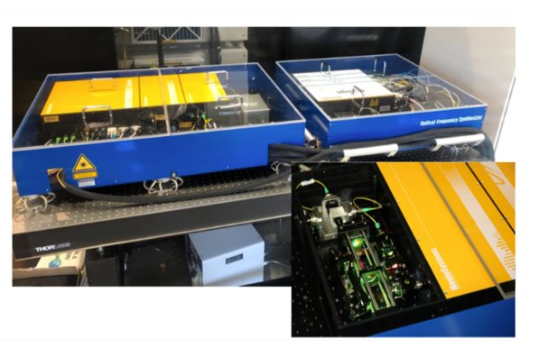
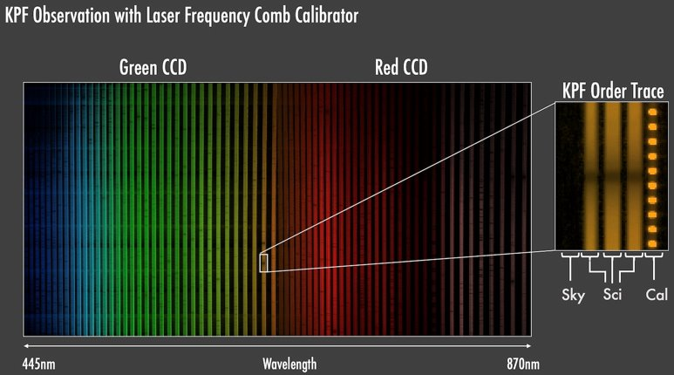
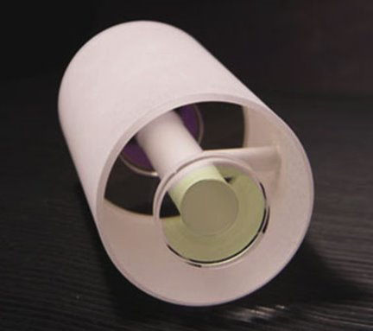
Extensive suite of calibration sources
Fabry-Perot Etalons
Laser Frequency Combs
Gas/arc lamps
Flat field lamp

Slide 29
HISPEC and MODHIS status
Precursor instrument HISPEC passed PDR and entered Full-Scale Development:
  HISPEC first light in 2026
MODHIS in Conceptual Design Phase.
  Flesh out other science cases (e.g. Solar system science)
  Spectro-polarimetric science case
  NFIRAOS Support Structure, Rotator, and On-Instrument Wavefront Sensor (SRO) interface
  Fiber routing and spectrograph location

Slide 30

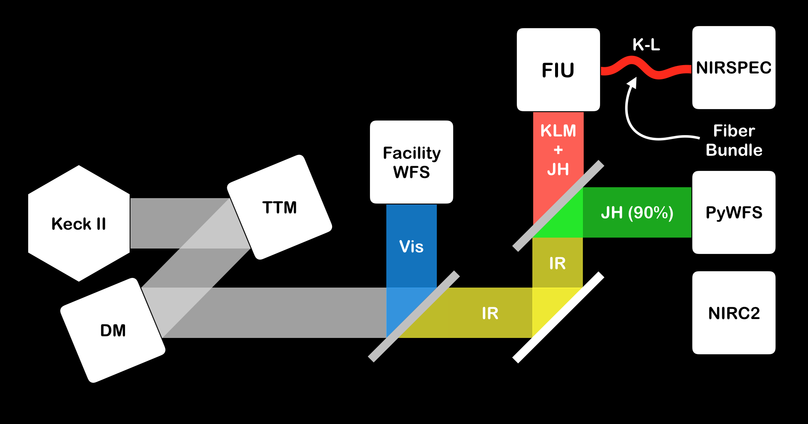
What is KPIC?
K, L, M band vortex coronagraphy
IR Pyramid WFS
K and L band spectroscopy
  R ~ 35,000
Credit: Jacques-Robert Delorme

Slide 31
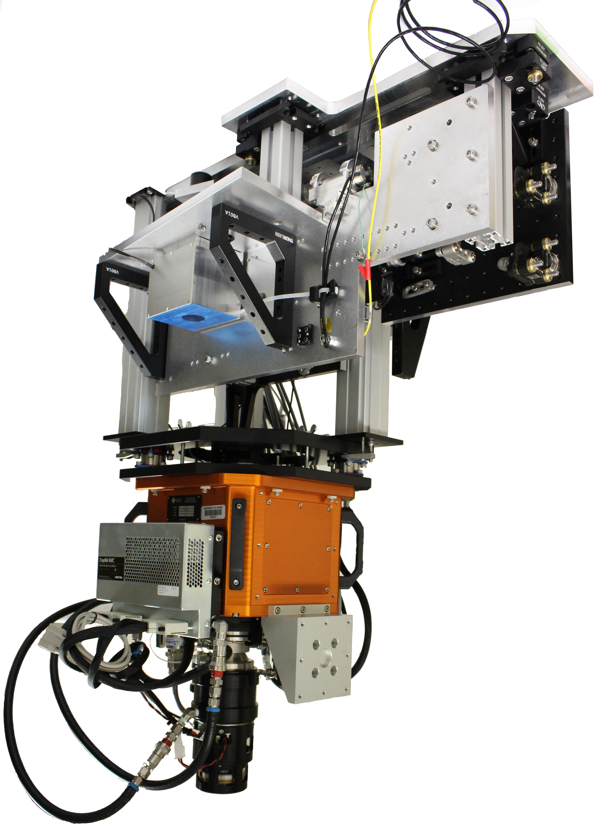
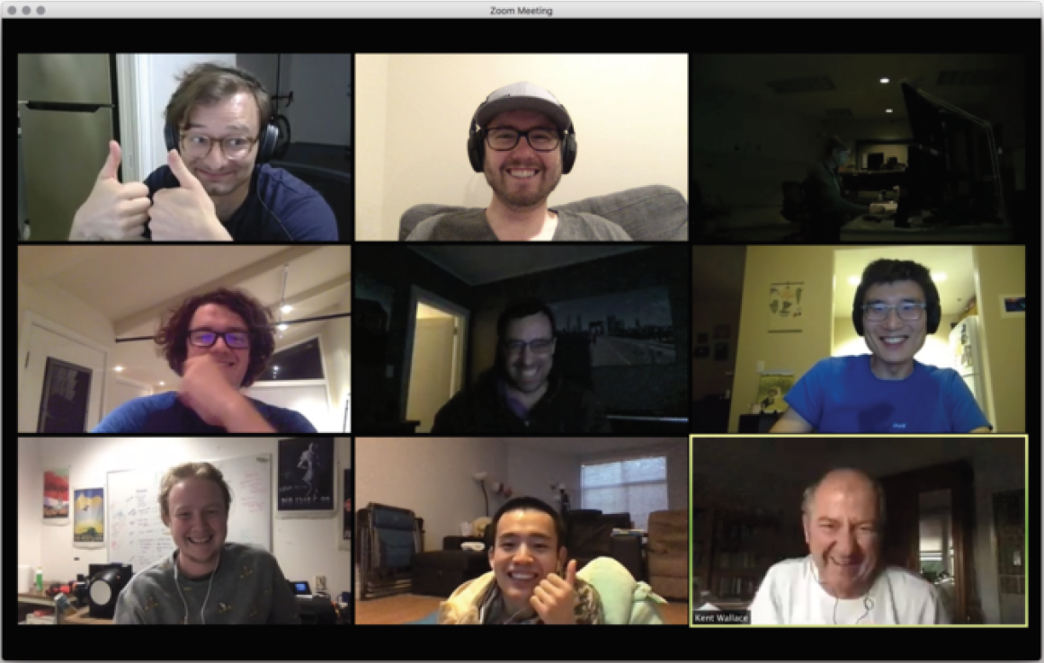
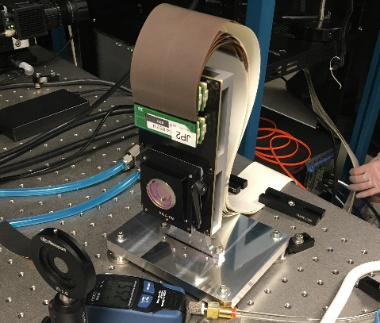
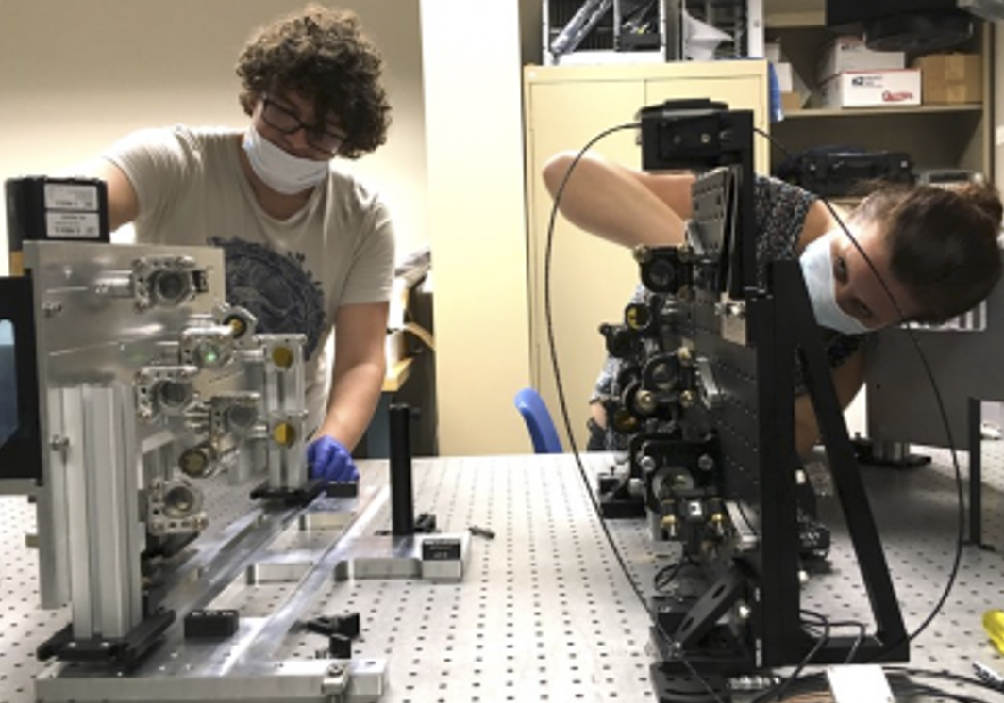
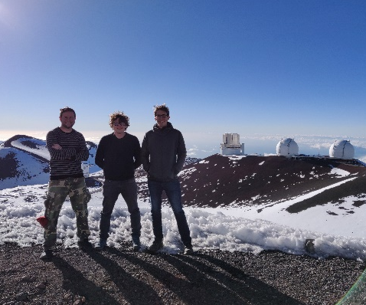
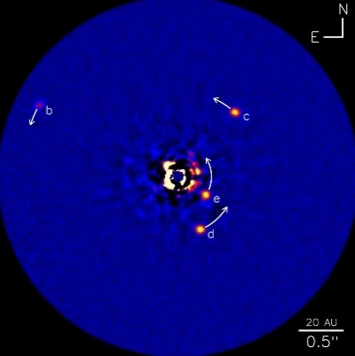
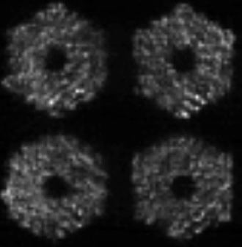
The Keck Planet Imager and Characterizer (KPIC)
Pyramid WFS plate
Fiber injection
unit
plate
April 2018
KPIC fully assembled
Nov. 2018
PyWFS - First light
2019-2020
FIU Commissioning
2023
KPIC2 + LFC
Dec. 2017 – March 2018
Plate assembly and lab testing
Sept. 2018
Installation on Keck II
Dec. 2018-2019
PyWFS commissioning and science verification + new vortex masks
2020-2023
Survey + science
2026
HIPSEC
Caltech: D. Mawet (PI), N. Jovanovic(Co-PI), J. Wang, D. Echeverri, J. Llop, K. Matthews,​ J. Pezzato, B. Calvin, T. Schofield, J.-B. Ruffio JPL: J.K. Wallace, R. Bartos, G. Ruane, E. Serabyn, G. Vasisht, M. Bottom, AJ Riggs​ W.M. Keck Observatory: P. Wizinowich(PI), J.-R. Delorme, S. Cetre, S. Lilley, S. Ragland, C. Alvarez, C. E. Wetherell University of Hawaii: M. Chun(Co-PI), C. Baranec, D. Hall, D. Atkinson, S. Goebel, C. Lockhart, E. Warmbier​ University of Liege: O. Absil, E. Huby, B. Carlomagno, C. Gomez, A. Jolivet, J. Surdej, S. Habraken, C. Delacroix Uppsala University: E. Vargas, P. Forsberg, M. Karlsson​ UCLA: M. Fitzgerald, E. Wang, E. Martin, K. Magnone, C. Johnson, R. Lopez​ UCSC: A. Skemer, E. Morris, E. Martin Subaru: O. Guyon​ LAM: T. Fusco​ Arcetri: C. Plantet, S. Esposito​ ANU: F. Rigault​ STFC: C.Z. Bond OSU: J. Wang

Slide 32
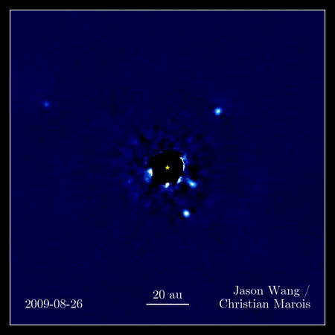
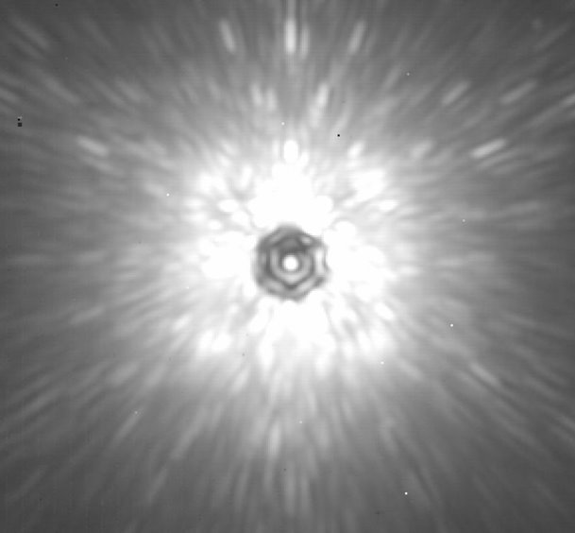
Postprocessed >1h Stack
As seen by the instrument

Slide 33

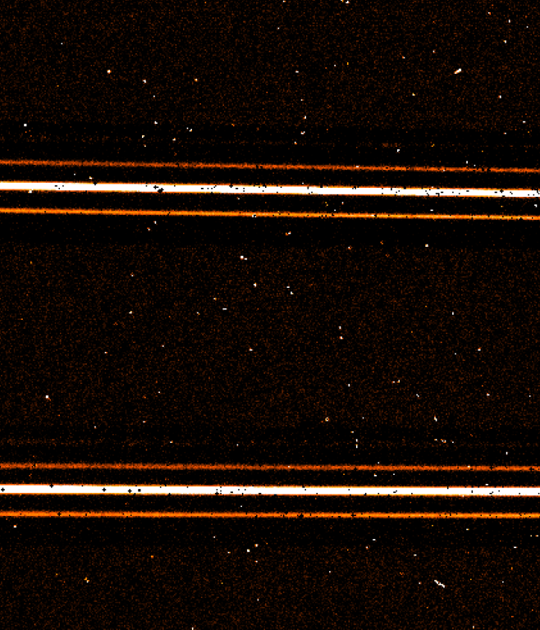
Spectroscopy with single mode fibers
Imaging/Fiber Placement
Spectrograph
Order N
Wavelength
Starlight Only
Planet + Star
Star Only
Order N+1
Planet + Star
Planet + Star
Star Only

Slide 34
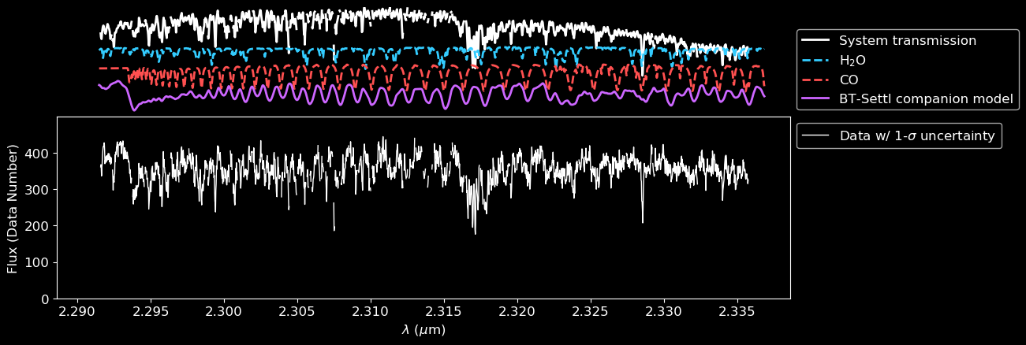
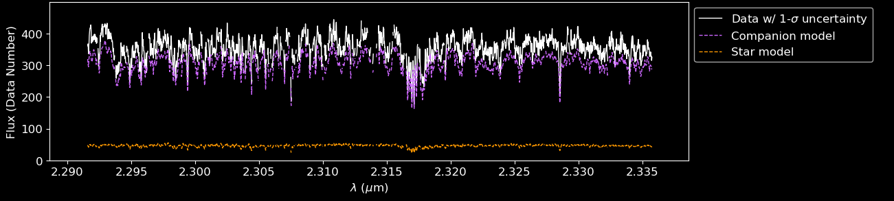
High spectral resolution resolves molecular signatures
Delorme+2021

Slide 35
The star and the planet have different spectral signatures…
Delorme+2021

Slide 36
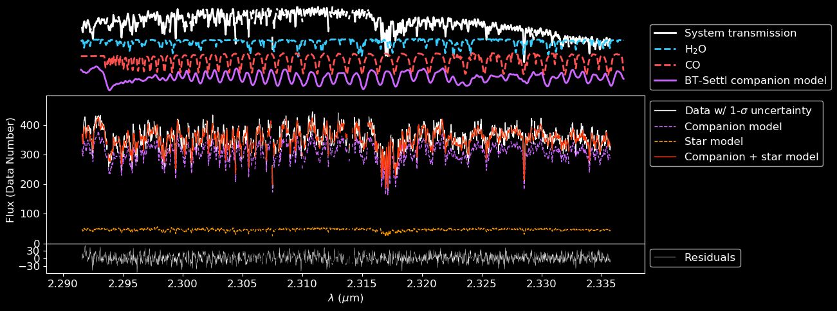
…So the star and the planet signal can be fitted jointly…
Delorme+2021

Slide 37
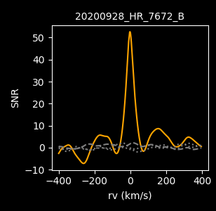
… And a cross correlation function obtained.
Delorme+2021

Slide 38

First spin measurements for the HR 8799 planets
Orbital Velocity
Planetary Spin
Atmospheric Properties
Wang+2021

Slide 39

Comparative study on benchmark BD HD 4747 B
Xuan et al. 2022
Dynamics from RV, DI, Gaia-Hipparcos:
Dynamical mass ~67 M_{J}
Orbit: a~10 AU, e~0.73
Cloudy, L/T spectral transition,
Teff ~ 1400K￼(Crepp+2018, Peretti+2019)

Slide 40

Low resolution vs high resolution retrievals

Slide 41
Exquisite, clean spectra with KPIC (HD55507) yield precise abundance measurements
Including
isotopologues
Xuan+2023

Slide 42





On-going survey:
~30 companions detected
20+ nights requested in 2024A
HR7672b
κAndb
Liu et al. 2002
NAOJ / Subaru / J. Carson / T. Currie
Kraus et al. 2013

Slide 43

Finding more exoplanets to characterize requires a couple breakthroughs, starting with Gaia

Slide 44

Characterizing new planets with the Vortex Fiber Nuller
Ruane et al. 2018, Echeverri et al. 2020, 2023ab, Xin et al. 2022, 2023
VFN allows exploration of the inner solar system
Operating regime of existing coronagraphs
0
1.3
2.6
3.9
5.2
[AU] @ 50 pc

Slide 45

VFN first light and proof of concept
Daniel Echeverri et al. 2023ab
HIP 21543: G0V + M4V spectroscopic binary system with a ~50:1 K-band flux ratio and a separation of ~50 mas

