Slide 1
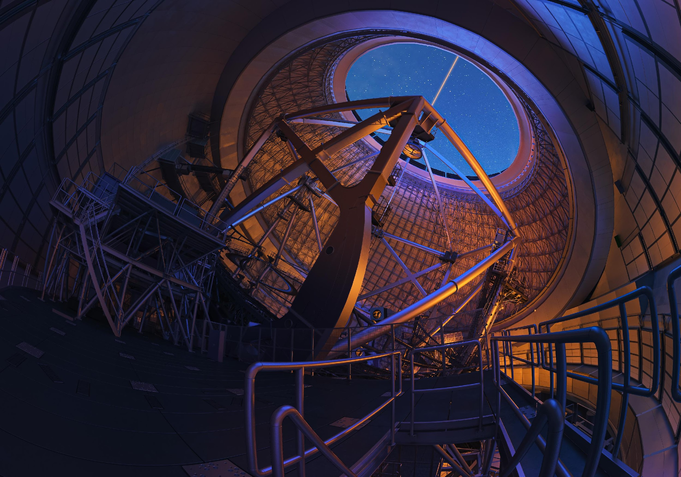
The Thirty Meter Telescope: Where are we now?
Robert Kirshner
Executive Director
Thirty Meter Telescope International Observatory
JWST & ELT
11 December 2023

Slide 2
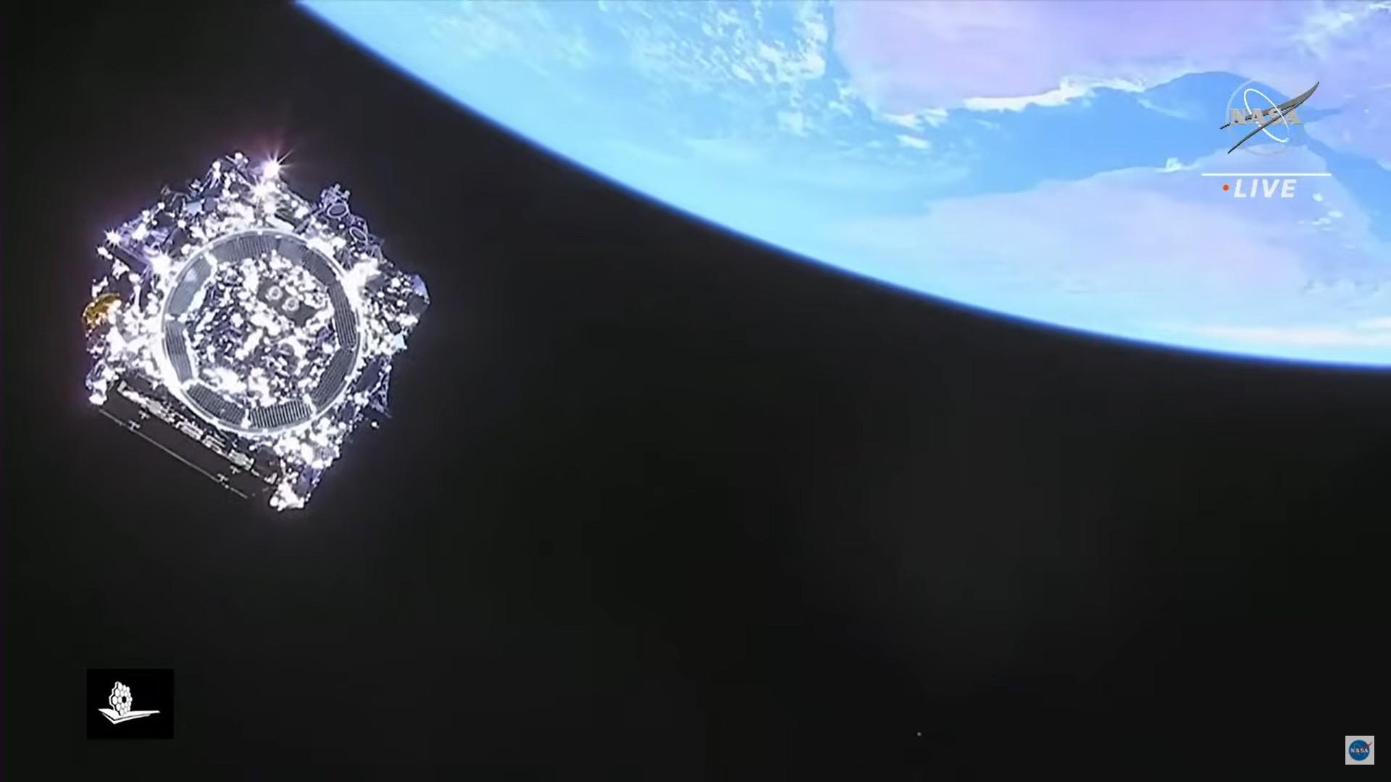
Good things take time!
1996: HST and Beyond
2021: JWST Launch

Slide 3
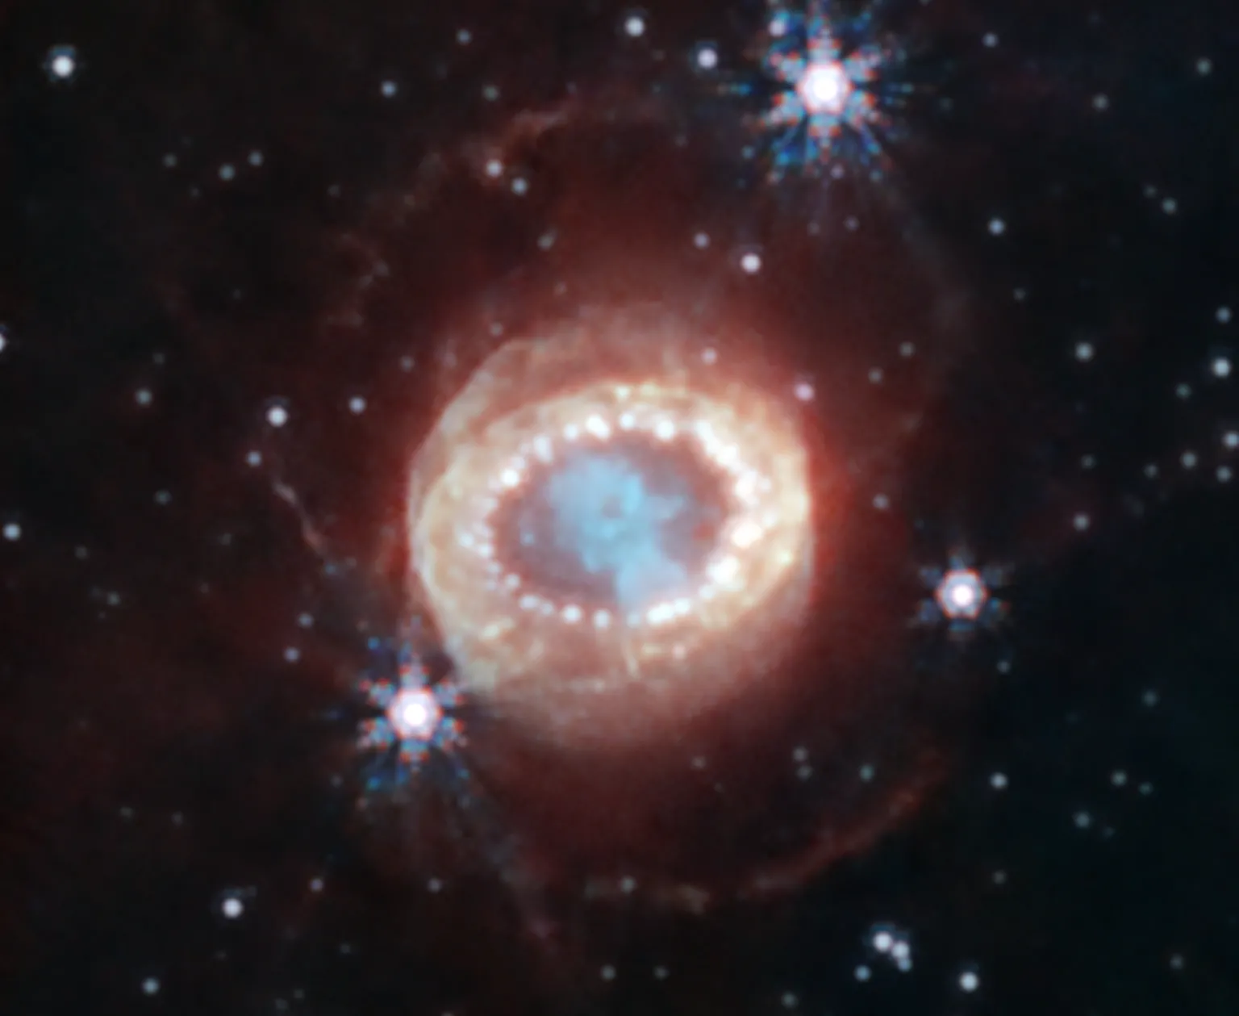

Slide 4
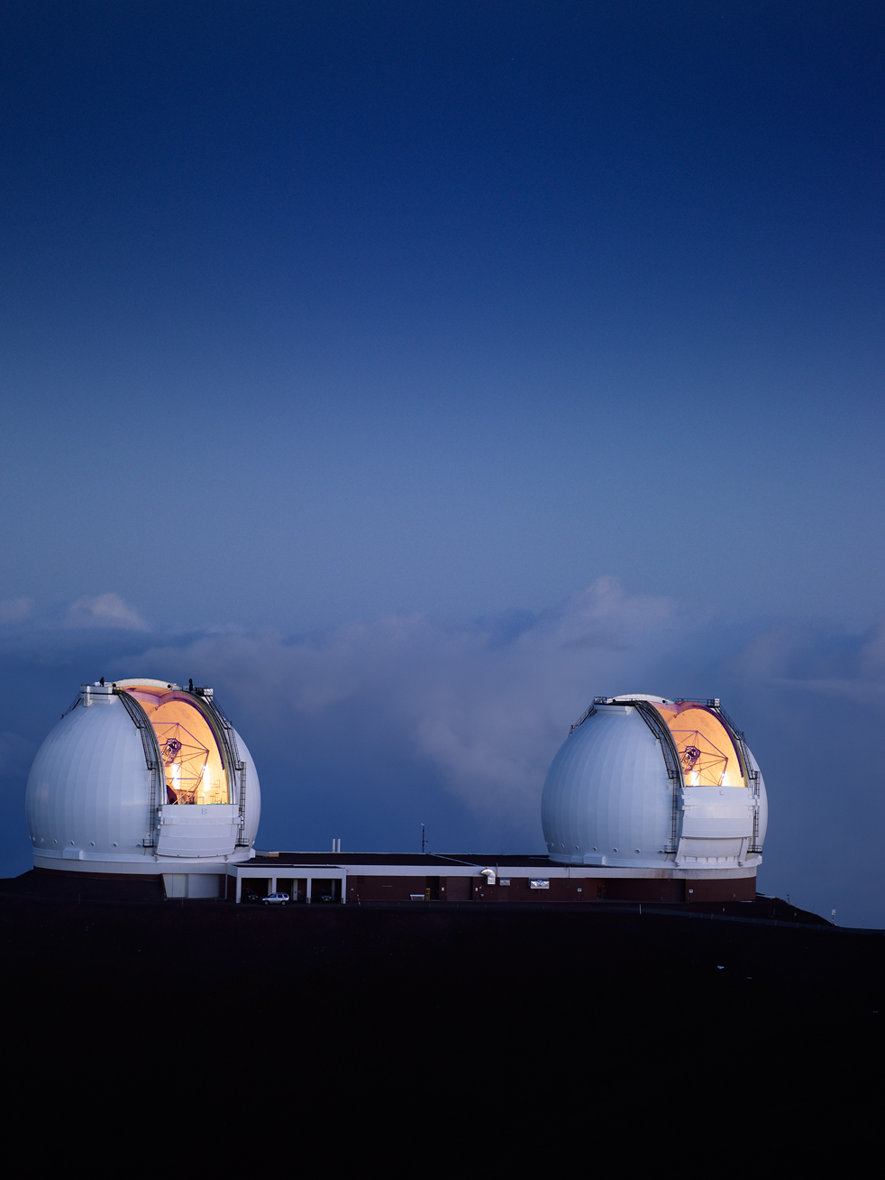
Jerry Nelson (1944 – 2017): Father of Segmented Telescope
Notes:
Prof. Jerry Nelson with the Univ. of California foresaw that the 10m class telescope had to be based on segmented mirrors.
He proved that he was able to phase the segments to behave like a monolithic mirror, at optical wavelength.

Slide 5
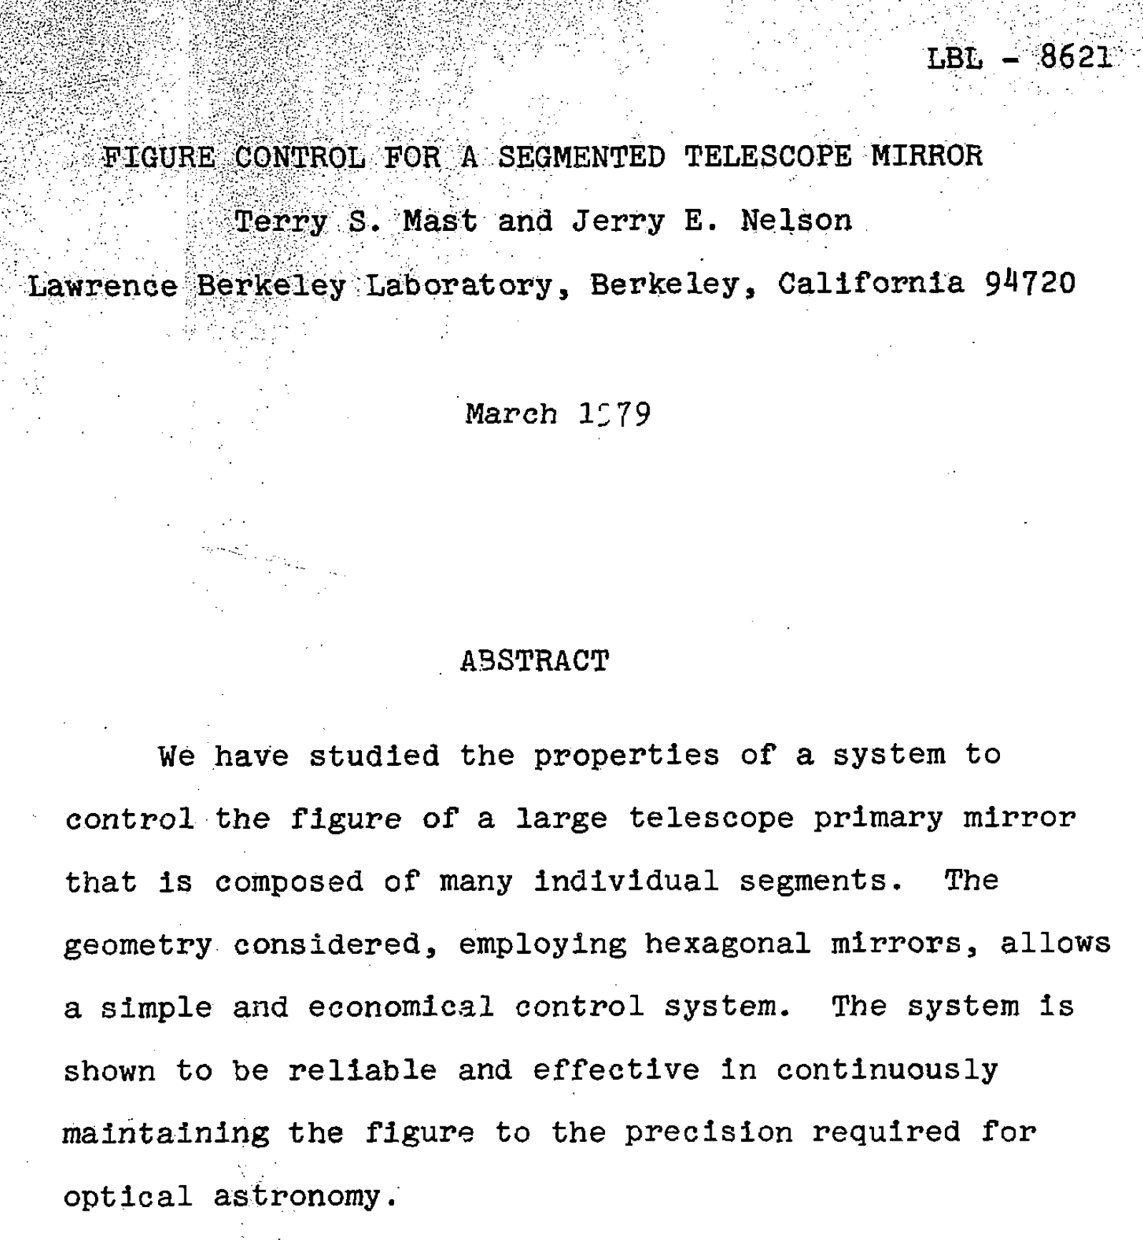
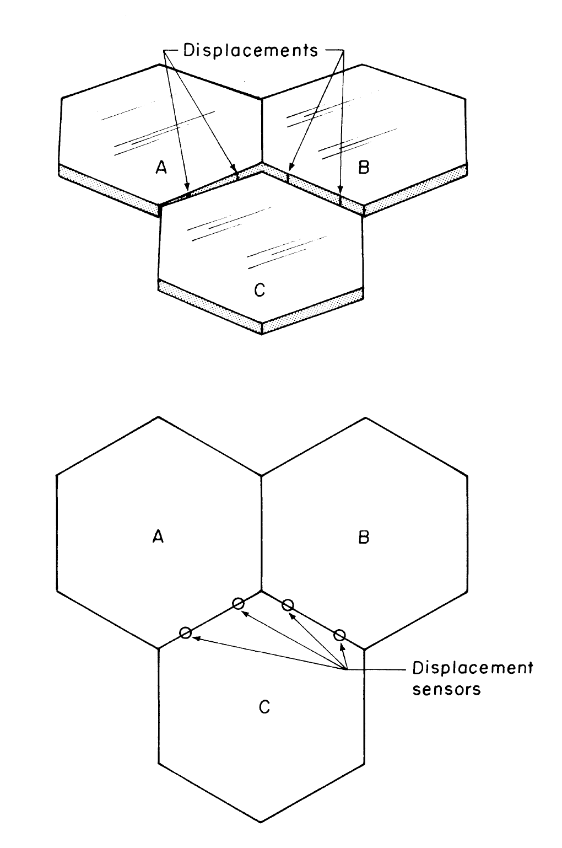
Notes:
Here was the paper by Terry Mast and Jerry Nelson in 1979, using capacitance sensors placed across neighboring segments, plus actuators below each segment, and control computers to continuously phase and maintain the overall figure to optical precision, so all segments perform as a large monolithic mirror.

Slide 6
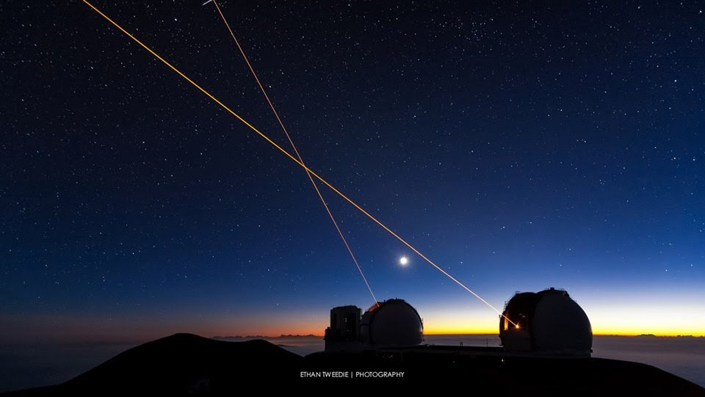

Slide 7
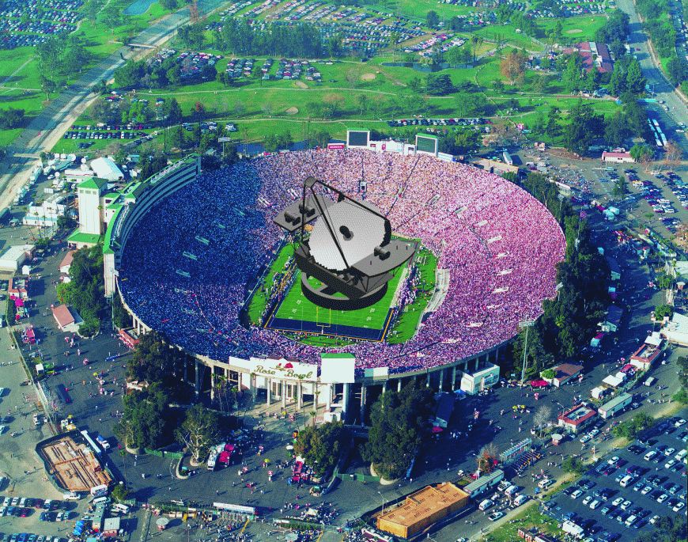
Unraveling Cosmic History with CELT
Richard Ellis, Caltech
Gordon & Betty Moore Foundation: August 4th 2003

Slide 9
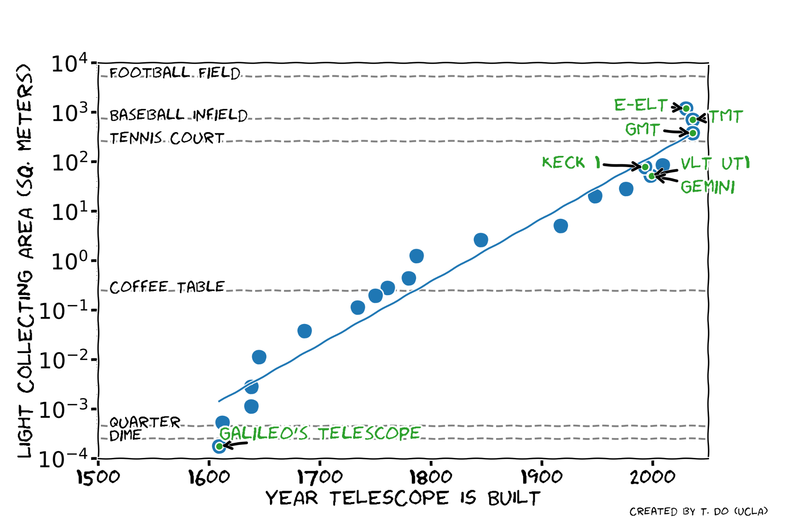
Moore’s Law for Telescopes

Slide 10
Thirty Meter Telescope 2003- Where are we now?

Slide 11
Notes:
A big advance on the state of the art!

Slide 12
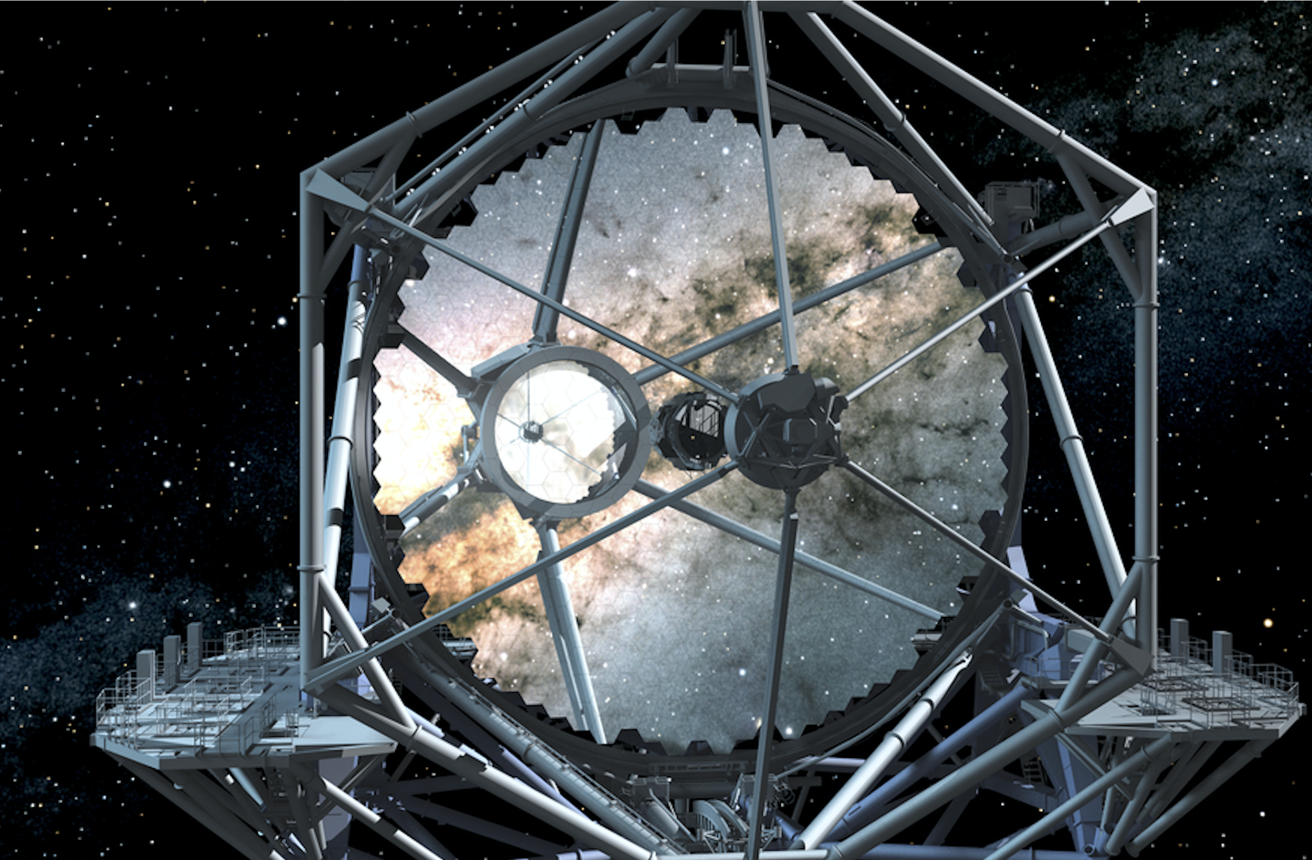

Slide 13
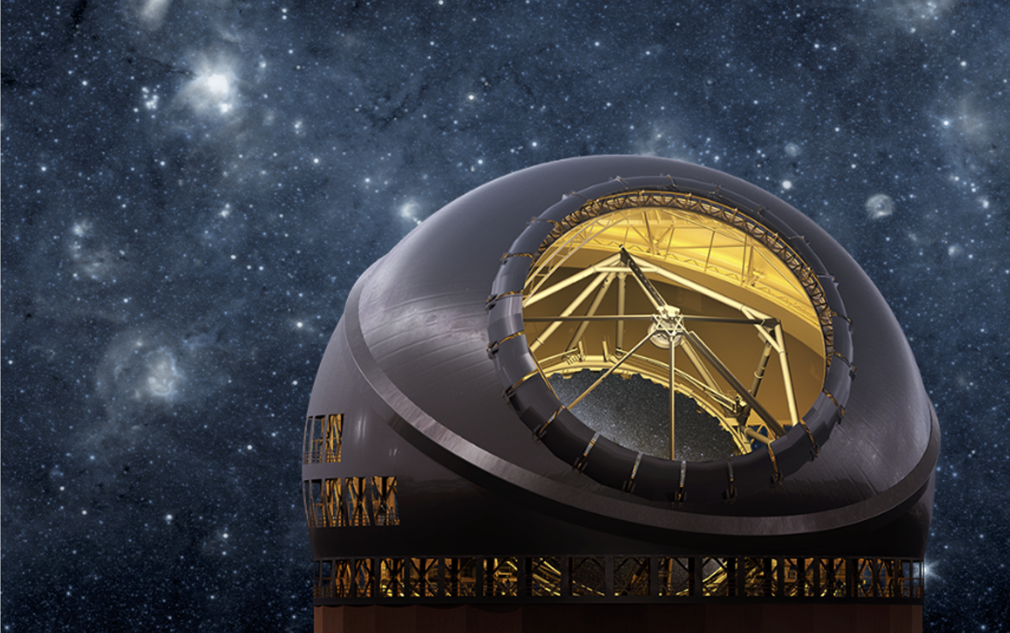

Slide 15
Top Priority of ASTRO 2020
Because of the powerful potential that large (20–40 m) telescopes with diffraction-limited adaptive optics have for astronomy, and because of the readiness of the projects, the survey’s priority for a frontier ground-based observatory is a significant U.S. investment in the Giant Magellan Telescope (GMT) and Thirty Meter Telescope (TMT) projects, ideally as components of a coordinated U.S.
Extremely Large Telescope Program (ELT) program
Notes:
The TMT and the Giant Magellan Telescope, along with NOIRlab, joined together in their presentations to the ASTRO 2020 Decadal Survey and were ranked as the top priority for a frontier ground-based observatory, ideally as components of a coordinated U.S. Extremely Large Telescope program. And that what we’re here today to discuss.

Slide 16
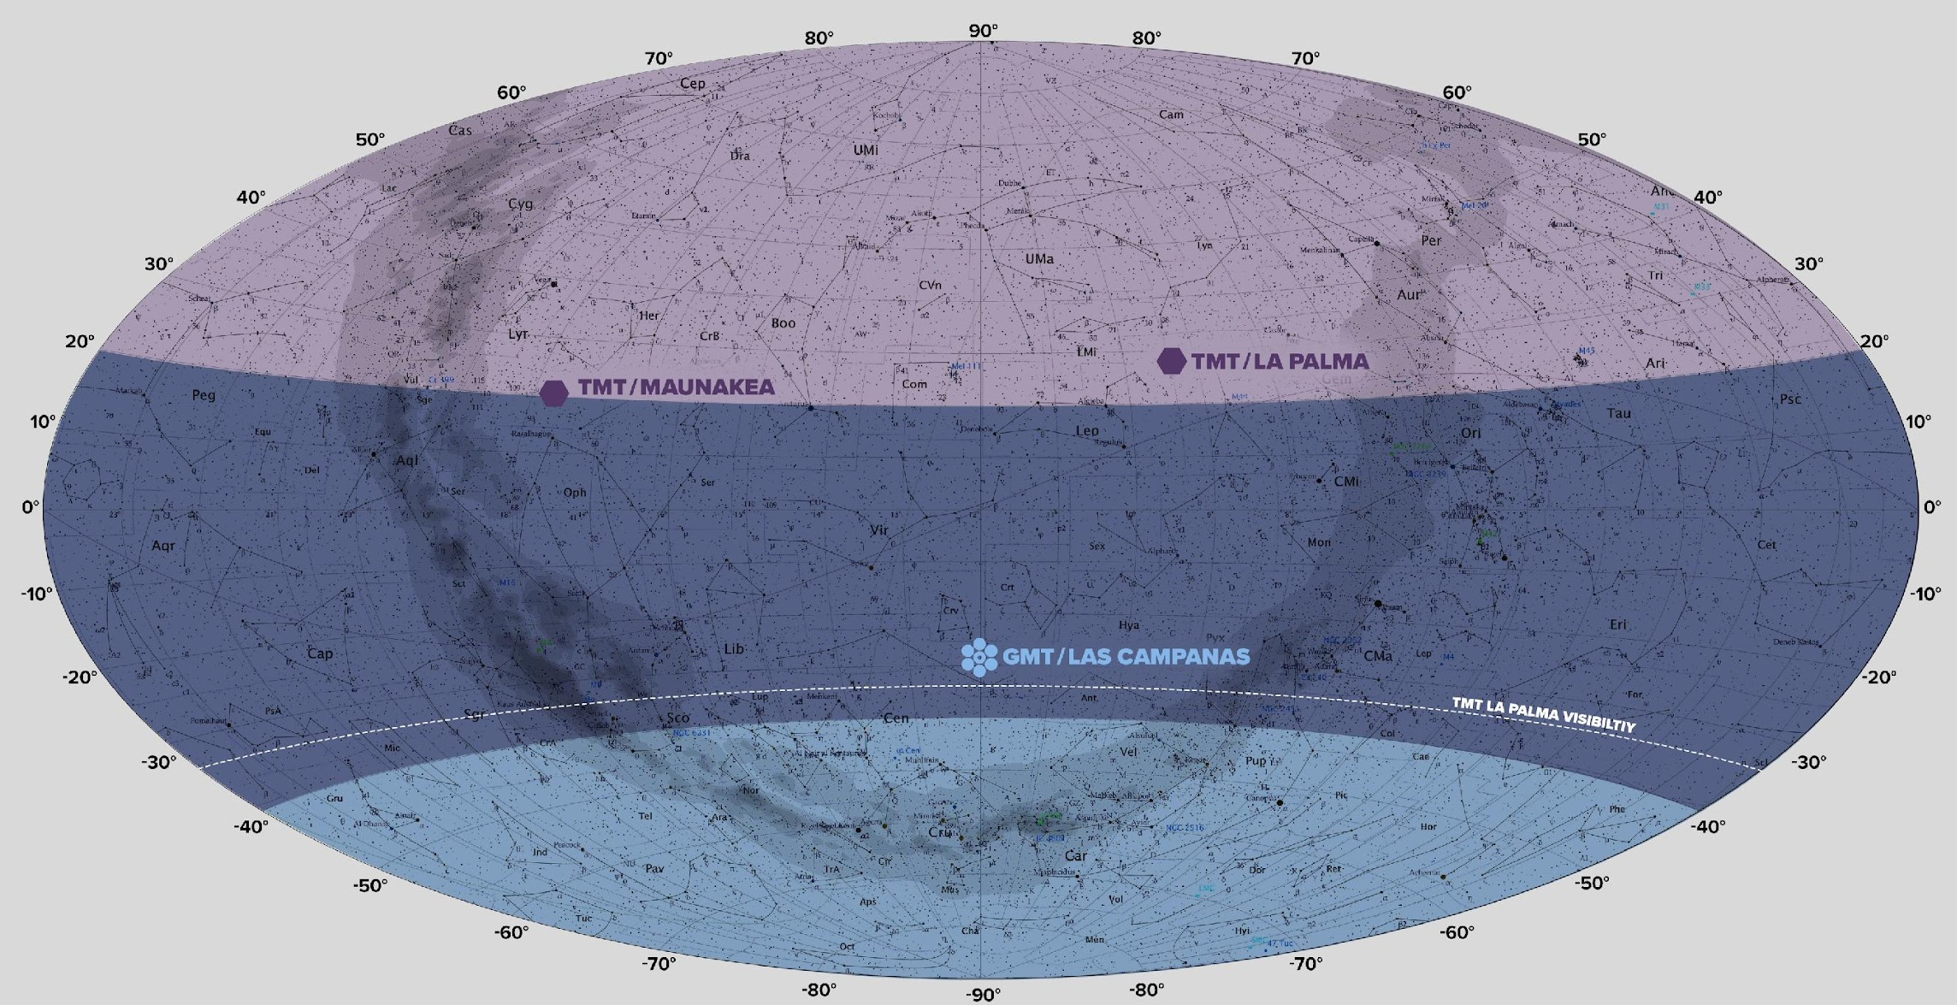
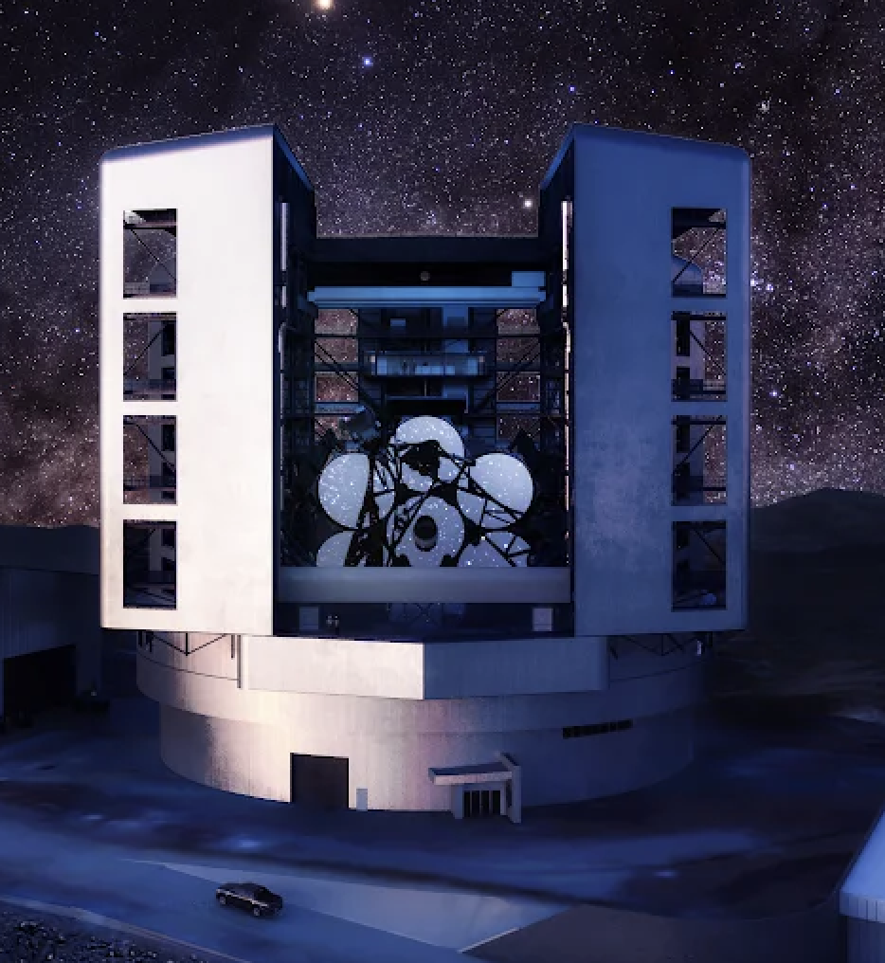
Access to the whole Universe for US Astronomers
Notes:
The plan for the USELT program is to have one telescope in the Northern Hemisphere and one in the South. This means US astronomers will (uniquely) have access to the whole sky for a broad range of science that covers all the principal areas of the Pathways to Discovery: Worlds and Suns, New Messengers and New Physics, and Cosmic Ecosystems.

Slide 17
“The key takeaway from the technical and project management reviews is that the TMT project is judged to be ready to proceed into the NSF Final Design Phase (FDP)”

Slide 18
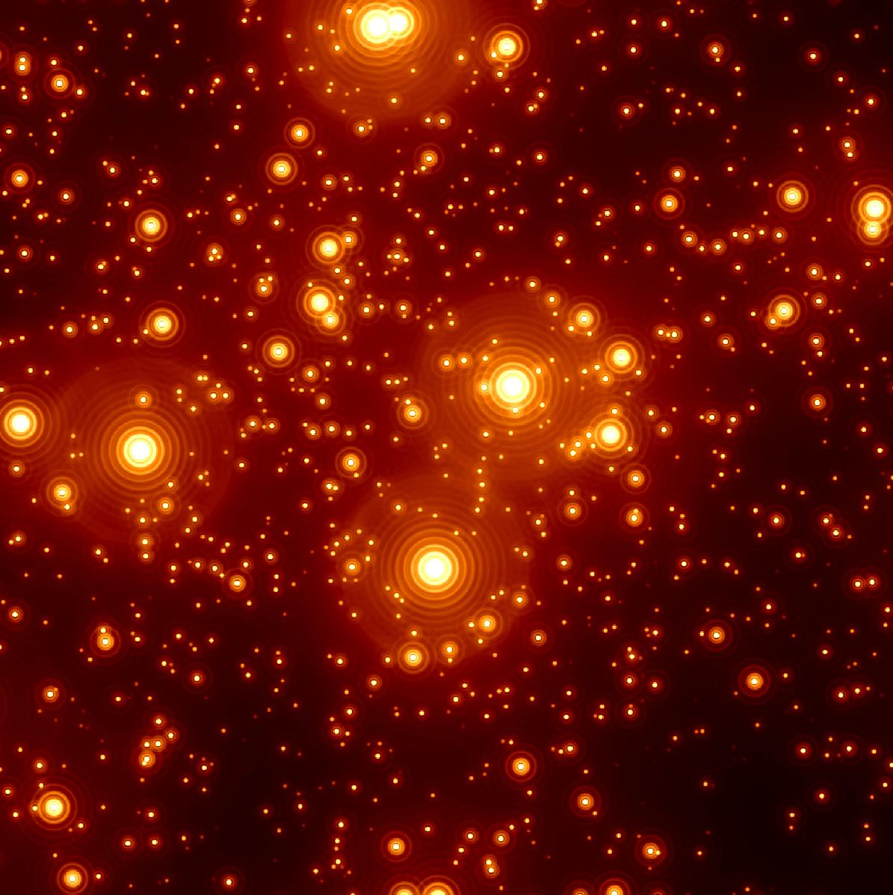
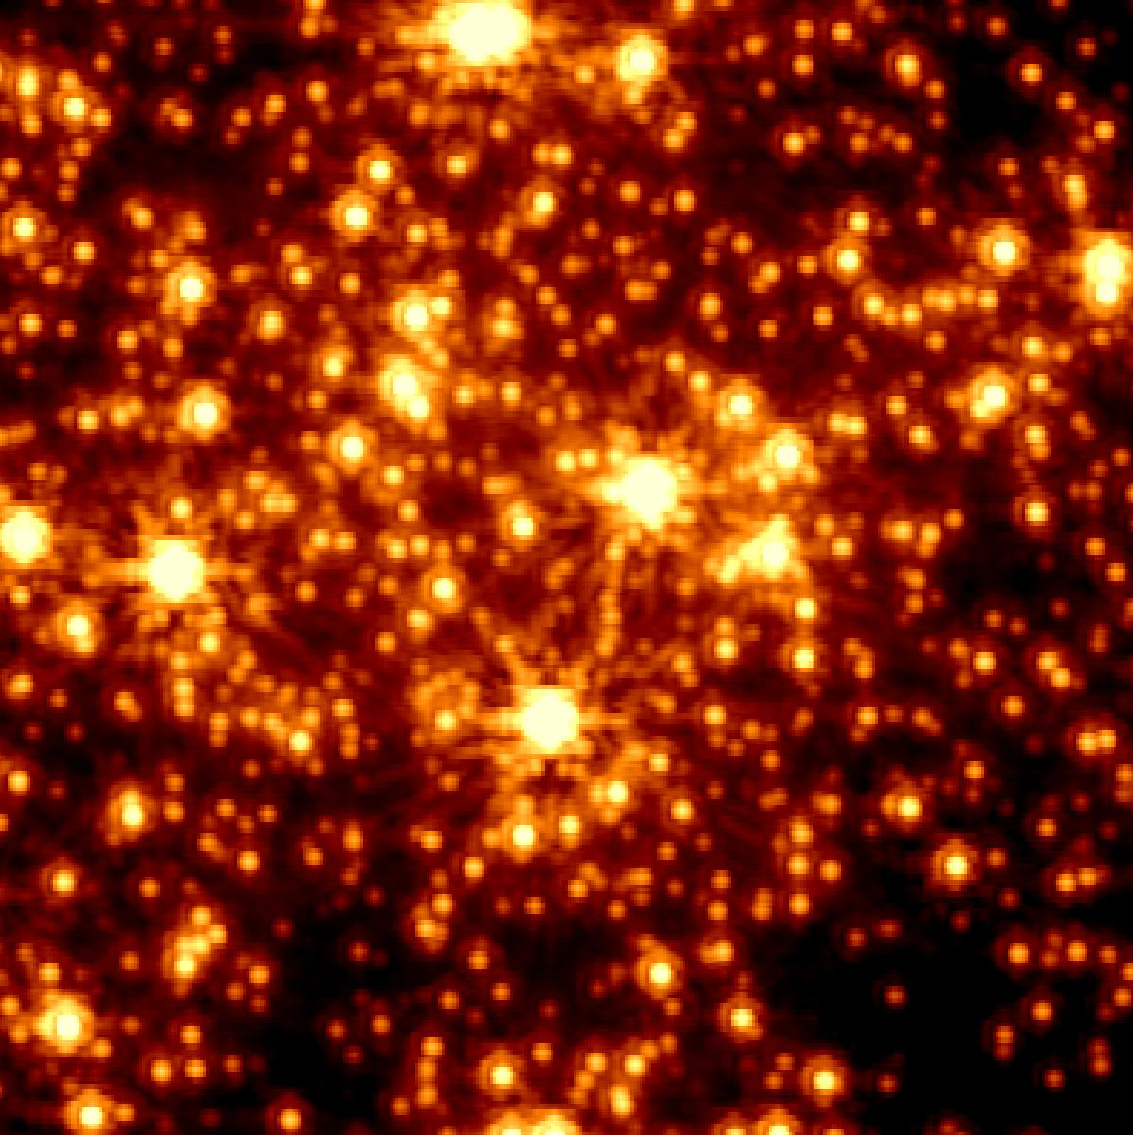
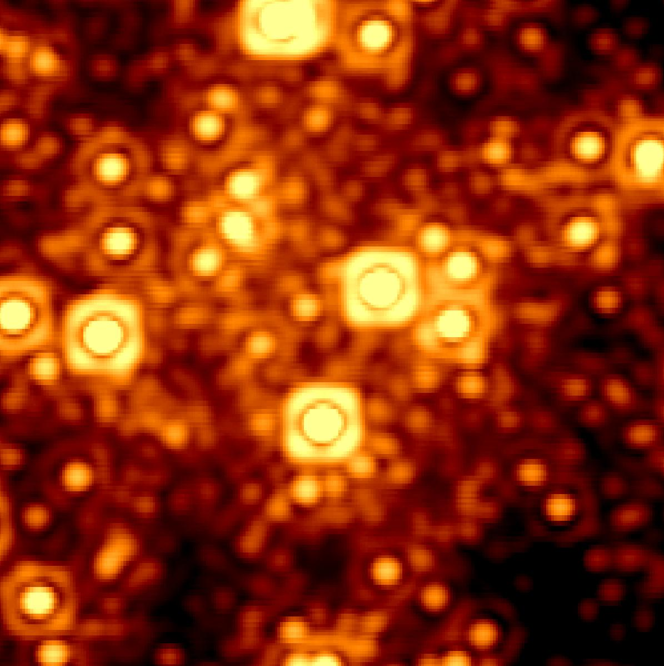
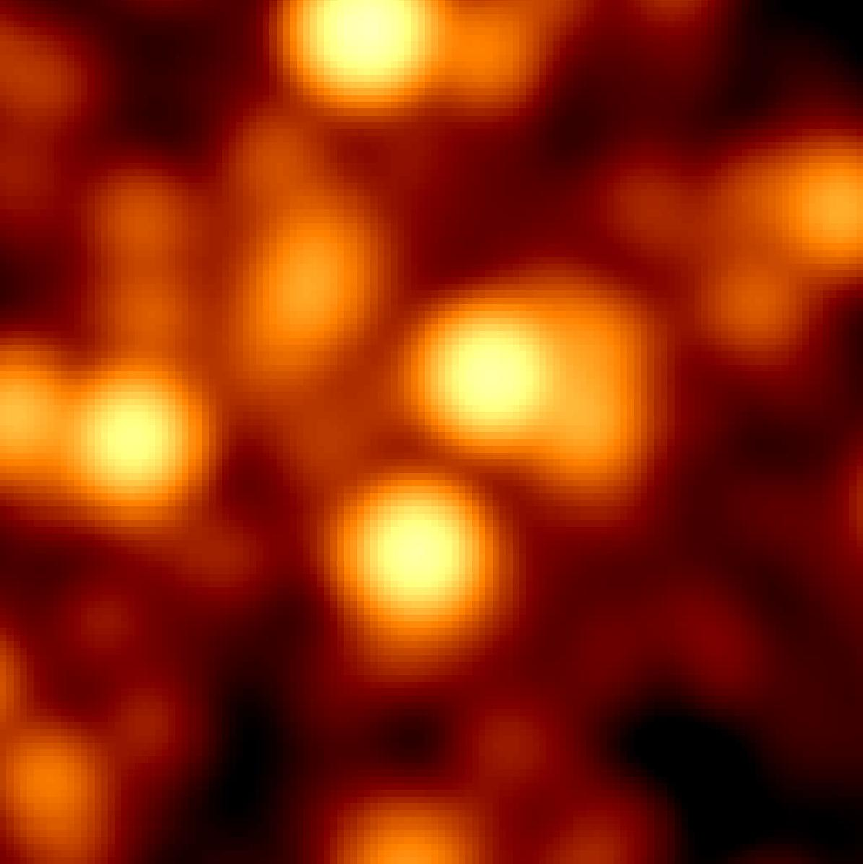
I
TMT advances the State of the Art
SHARPER! 4 x sharper than JWST ~ D²
FASTER! 20 x more light ~ D²
In some settings, D⁴
So 30m = 81 times better than 10m State-of-the-art into the 50 year future
Notes:
My neighbors asked me why we needed to build the Thirty Meter Telescope when JWST was so powerful.
There are significant ways in which TMT is going to be much more powerful for pursuing the cosmic questions that JWST has made more vivid.
With adaptive optics to take out the wiggles of the Earth’s atmosphere, The very big TMT mirror, more than 4 times the diameter of JWST’s can make images 4 times as sharp, as I’ll illustrate in a minute.
With a TMT collecting area that’s 20 times as big, you can make a measurement in 3 minutes that’s equivalent to an hour on JWST. That matters for the faintest objects and fast-changing ones.
And.. TMT has other advantages– a bigger field of view, state-of the art technology that we can upgrade over the coming decades. It’s easier to build, much easier to fix, and we can continue to improve it over the next 50 years.
OK, now for the animation. If you go to a ground-based telescope like Keck and take a picture, the unsteady atmosphere of the Earth blurs the images as suggested in this frame.
The Hubble Space Telescope is small, but at a very good site, and does 10 times better, as shown
JWST is bigger, and does 3 times better than the Hubble Space telescope.
And TMT with adaptive optics is 4 times better than that. These quantitative changes make a qualitative difference in the science you can do.
We should look forward to a time when JST and TMT can work together in complementary ways.

Slide 19
Mirrors from the A-Team at Coherent
95 Polished roundels
80 Polished by Coherent
13 Polished by Japan
2 Polished by India
Coherent producing 10 roundels per quarter
Ohara has delivered 336 blanks (~60%)
preparing a new furnace to complete the remaining 40%

Slide 20
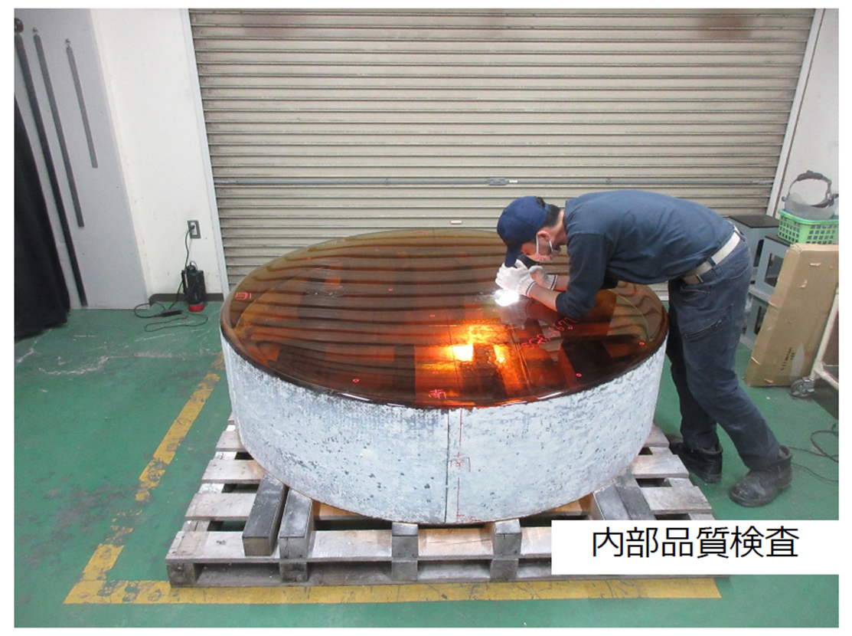
Mirrors from the A-Team at Coherent
95 Polished roundels
80 Polished by Coherent
13 Polished by Japan
2 Polished by India
Coherent producing 10 roundels per quarter
Ohara has delivered 336 blanks (~60%)
preparing a new furnace to complete the remaining 40%

Slide 21
Primary Mirror Map

Slide 22
Mirror and Support

Slide 23
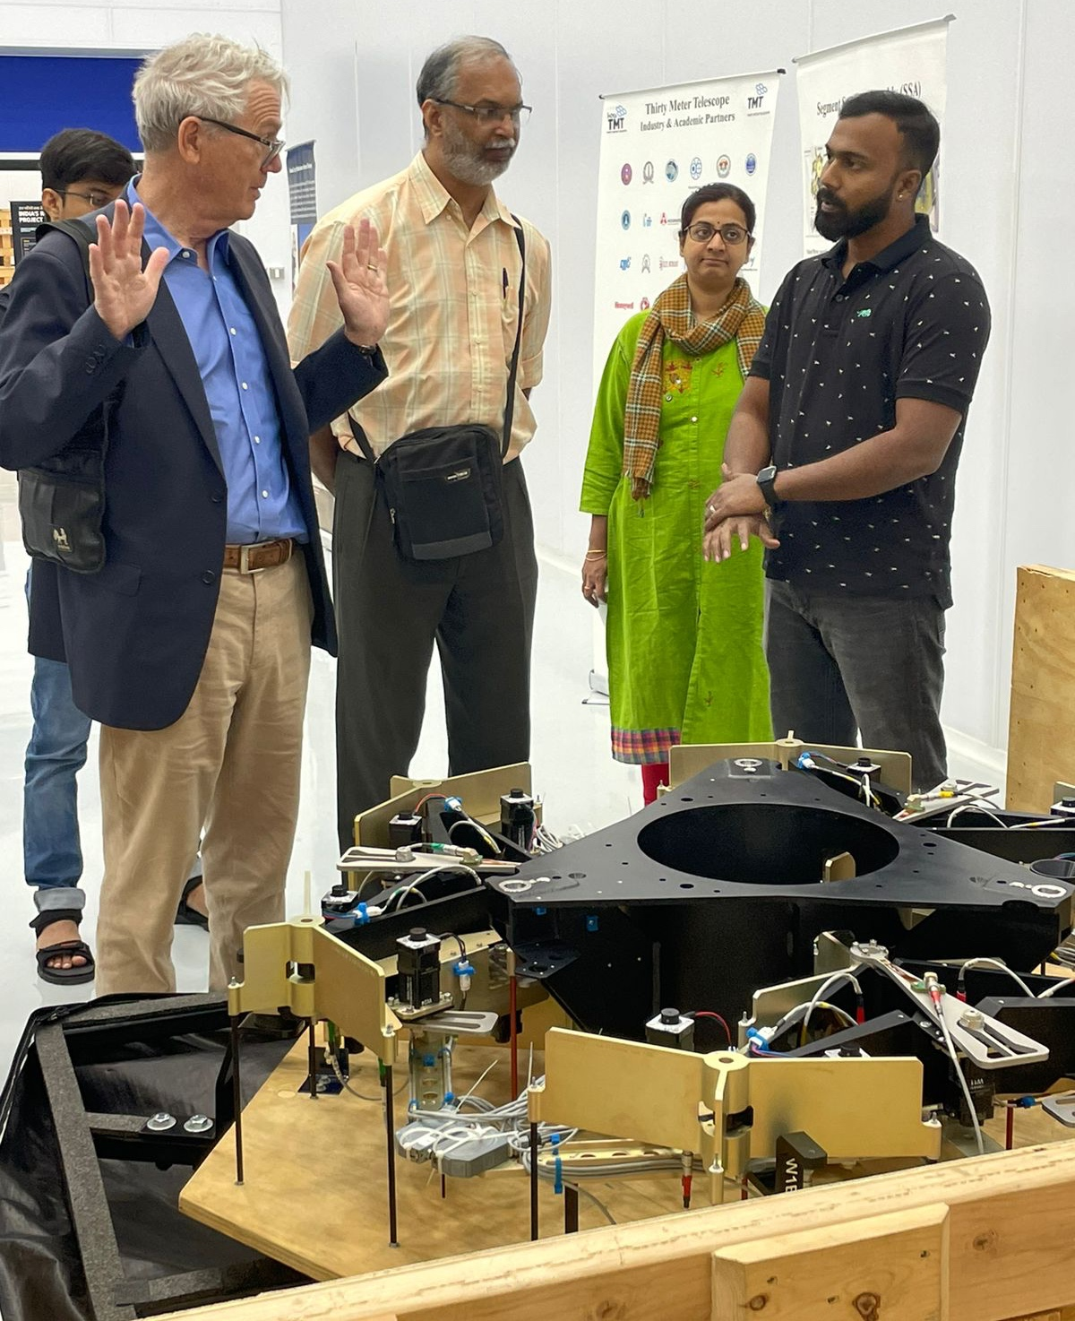
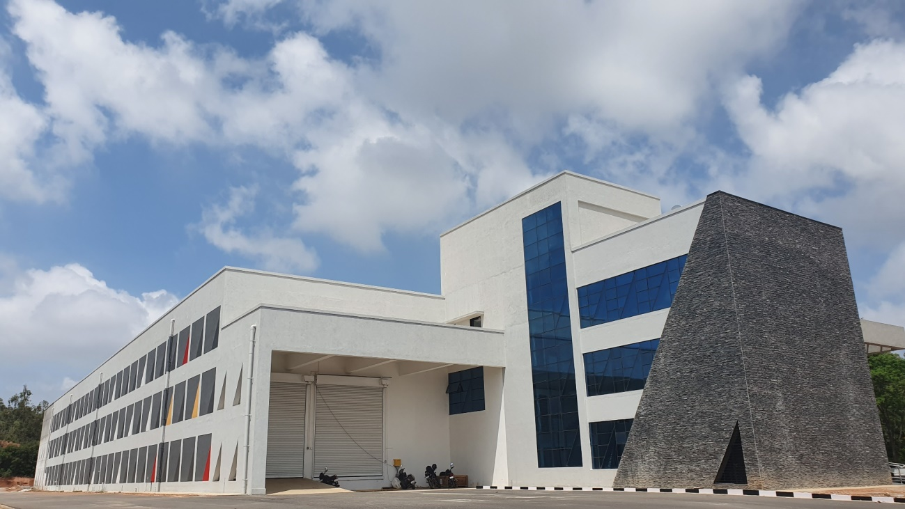
India TMT Optical Fabrication Facility (ITOFF)

Slide 24
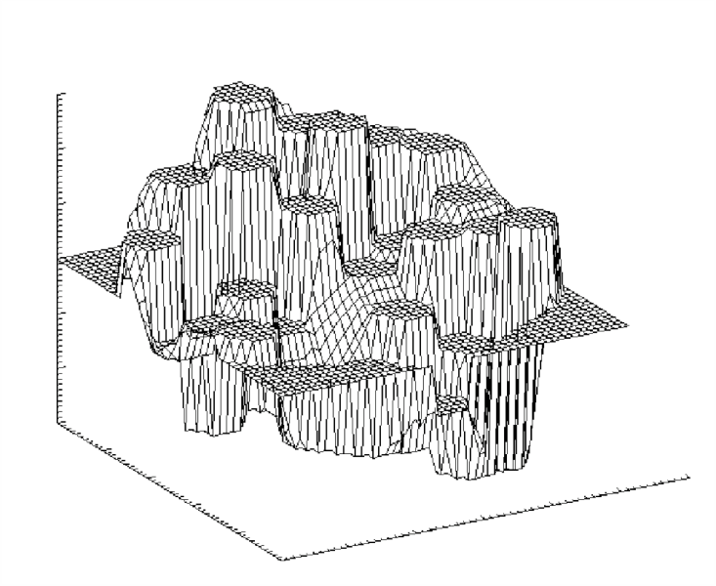
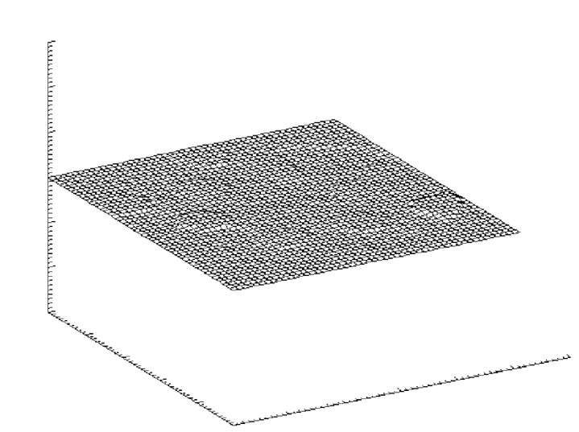
Telescope Alignment and Phasing System (APS)
First Light Keck-2 Phasing
30 μ
0 μ
-30 μ
After
Before
Notes:
Patrick Morrissey will manage and lead the effort. Patrick was recently Delivery Manager for the photon counting cameras of the Roman coronagraph instrument (CGI), and prior to that was Principal Research Scientist at Caltech, where he was the technical lead and optical designer of the KCWI integral field spectrograph installed at Keck.

Slide 25
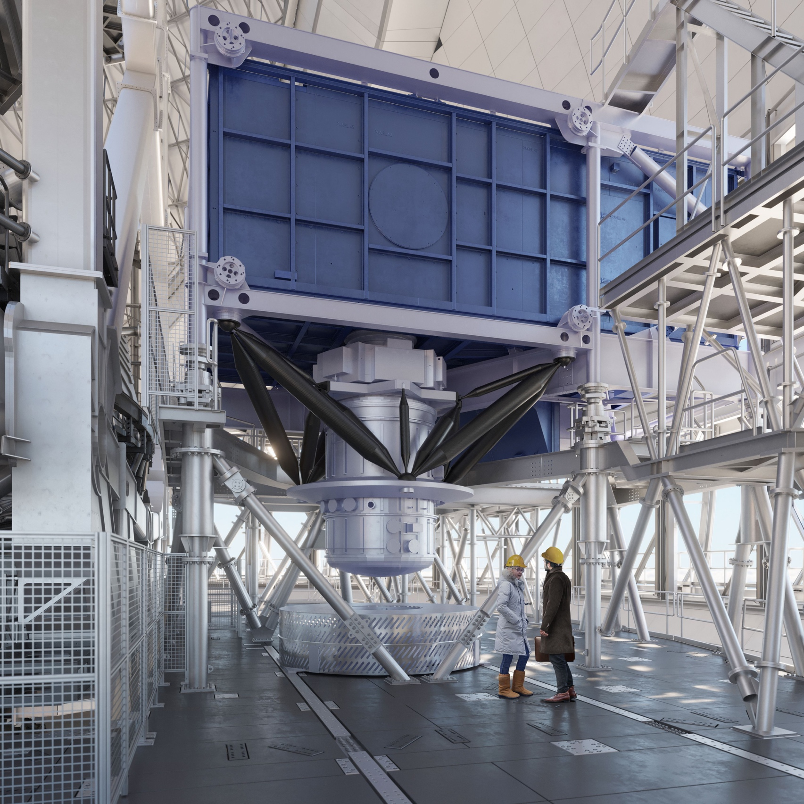
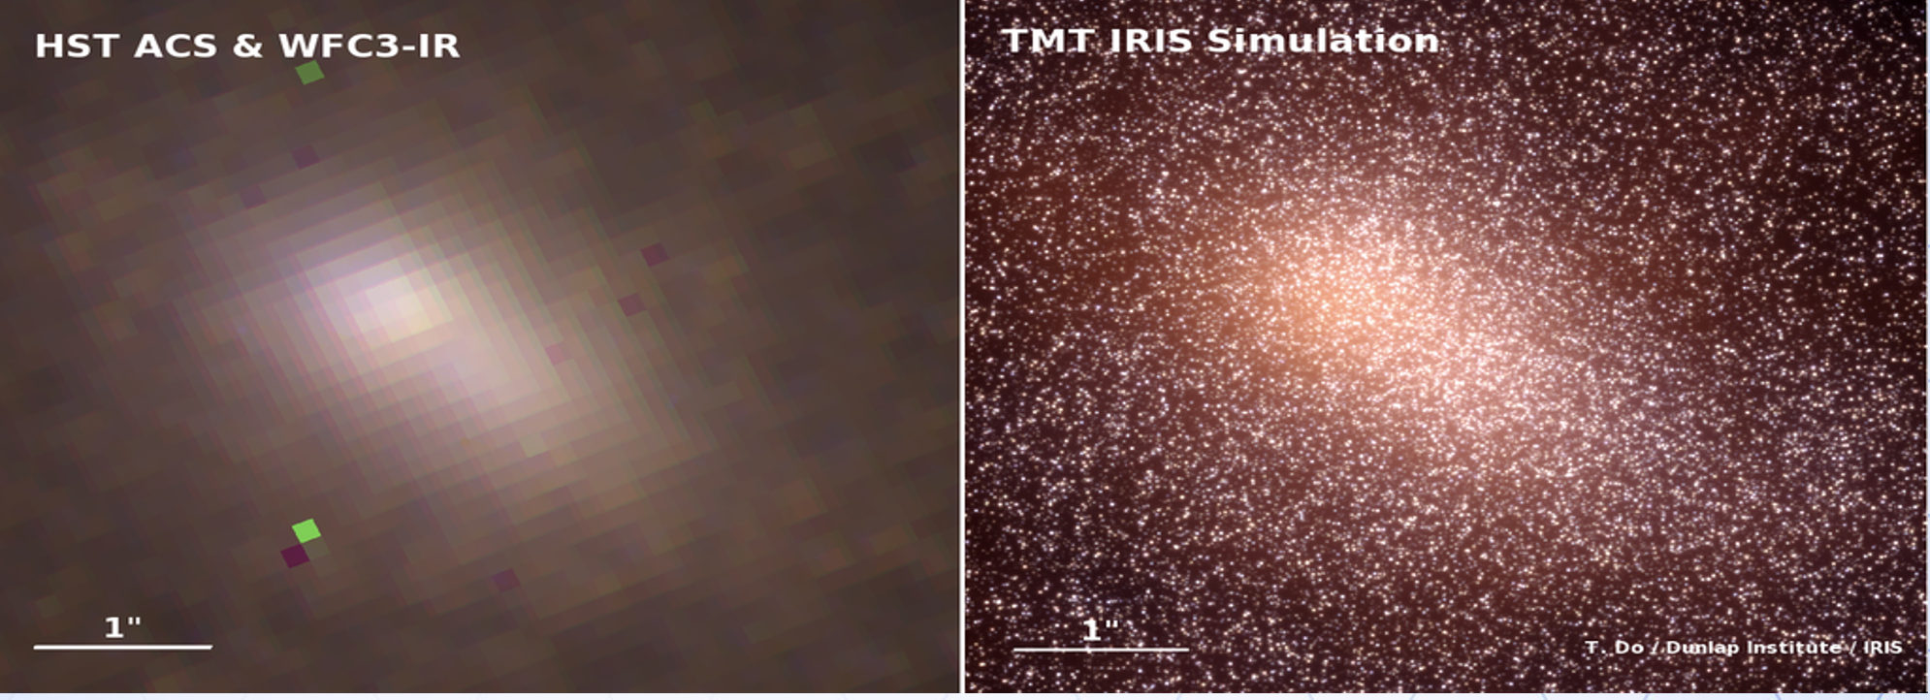
NFIRAOS at NRC (Narrow-field Infrared AO System)
Multi-conjugate AO system– feeds
IRIS or MOHDIS
Northern Site: M32 and M31 like the LMC and SMC for the South

Slide 26
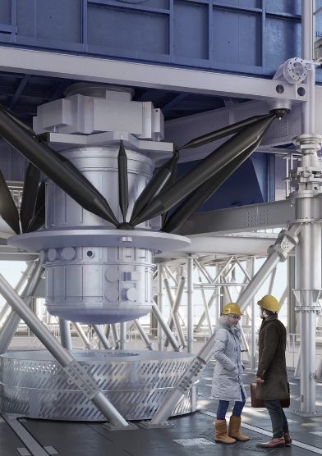
IRIS in Final design
Workhorse instrument for TMT
Shares many components with the Keck instrument
LIGER– which recently received funding from Heising-Simons and the Gordon and Betty Moore Foundation
Learn more at UCLA IR Lab Tour

Slide 27
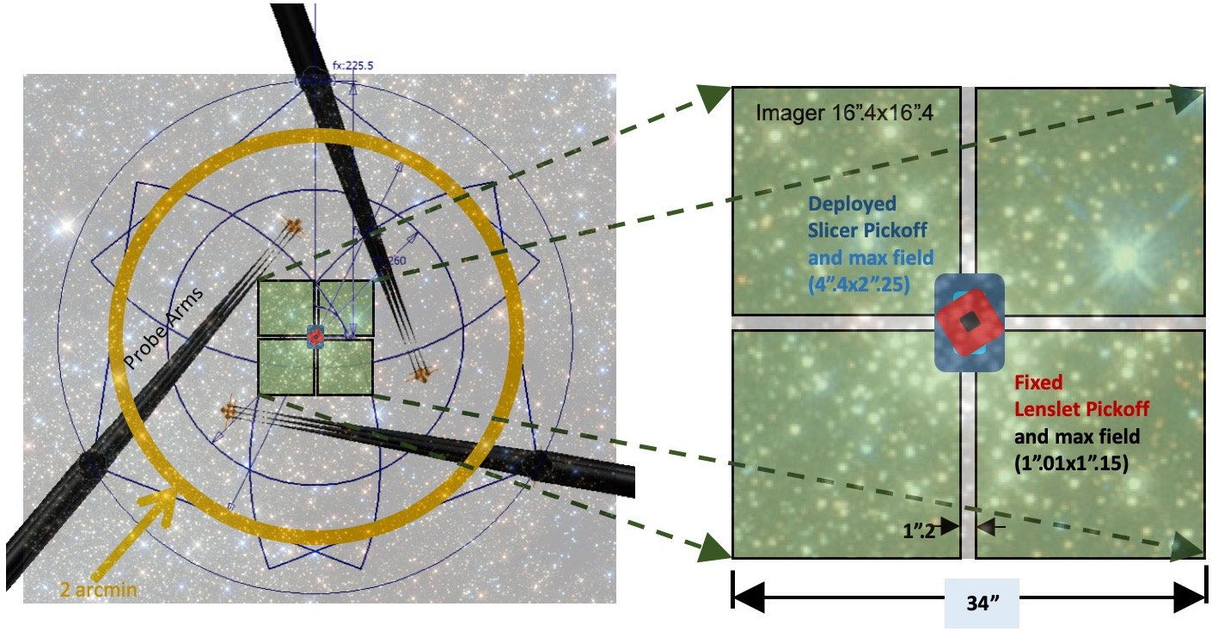
IRIS Focal Plane
Imager scale: 0.004”/pixel

Slide 28
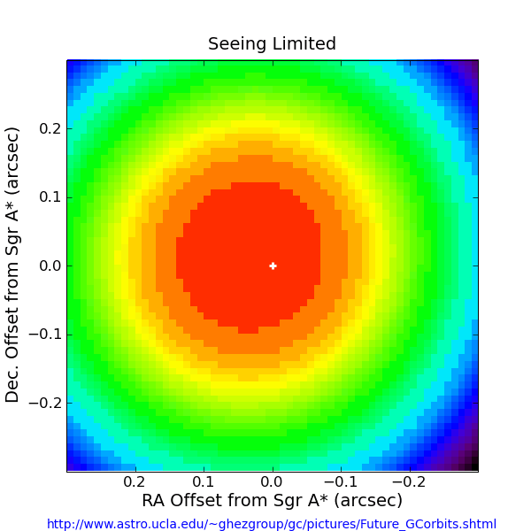
Black Holes in Galactic Centers
Andrea Ghez, UCLA

Slide 29
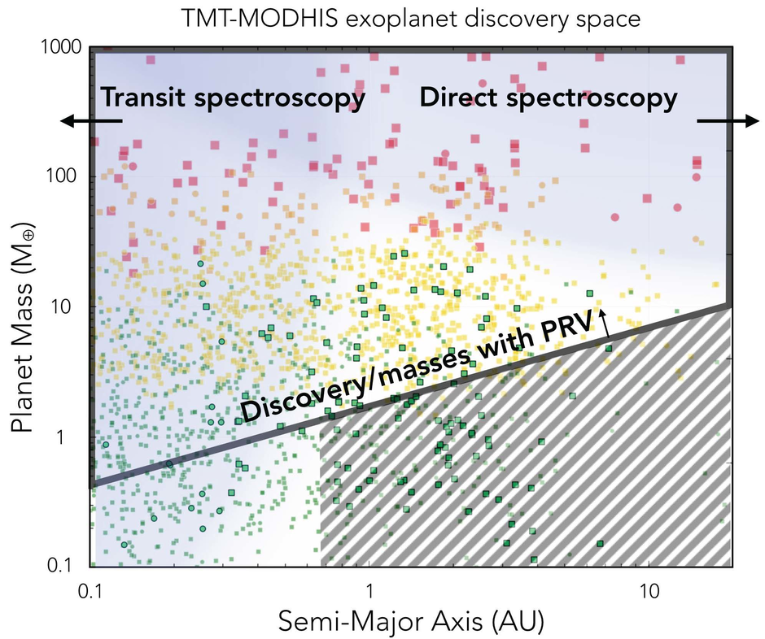
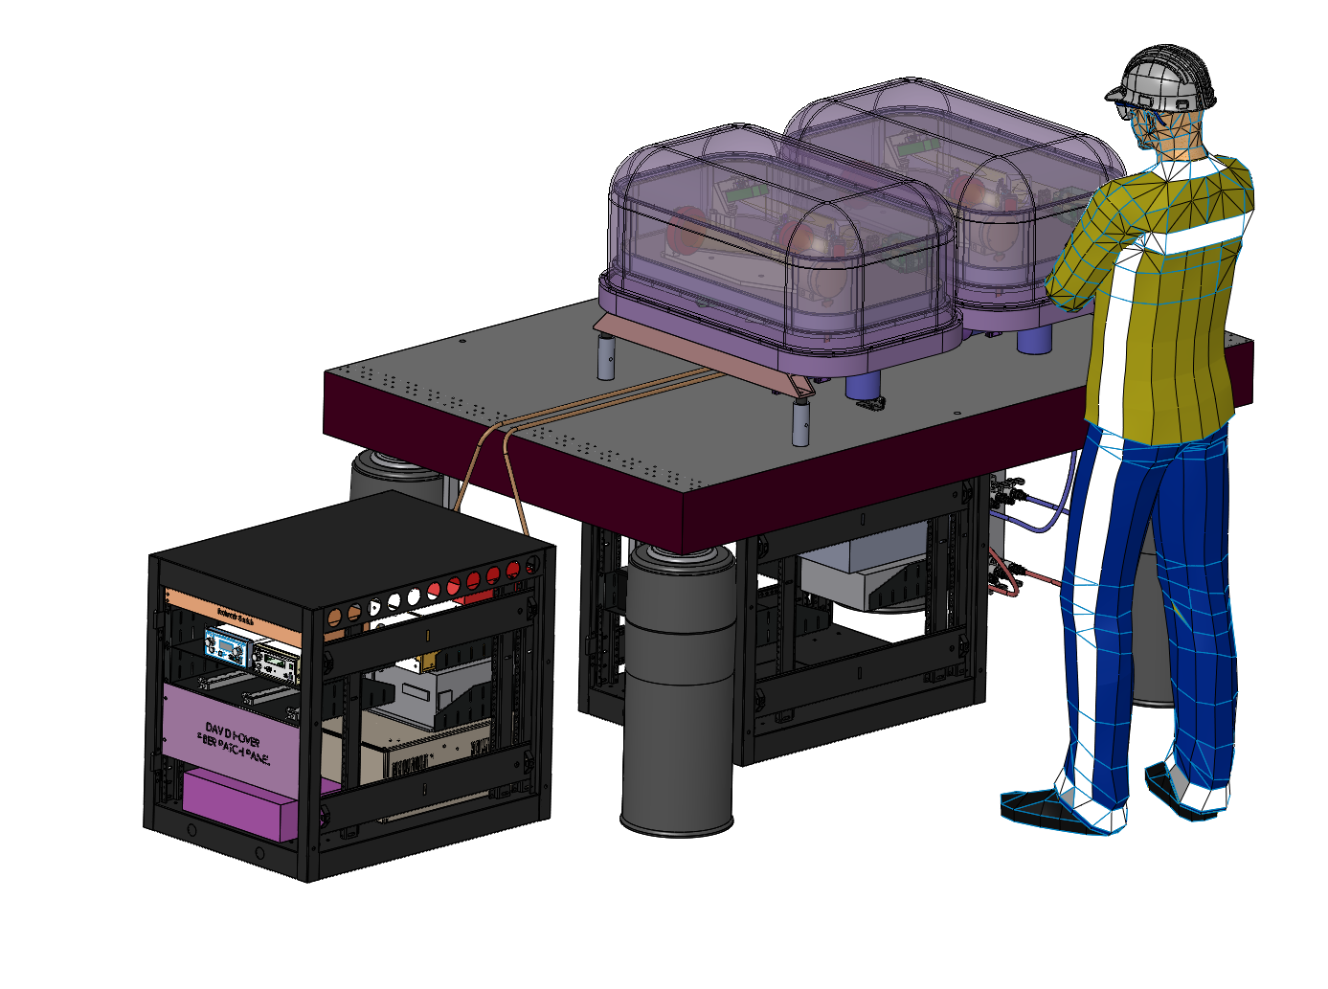
MOHDIS
See ArXiV2309.11050
AO fed high-resolution spectrometer
Follows HISPEC at Keck

Slide 30
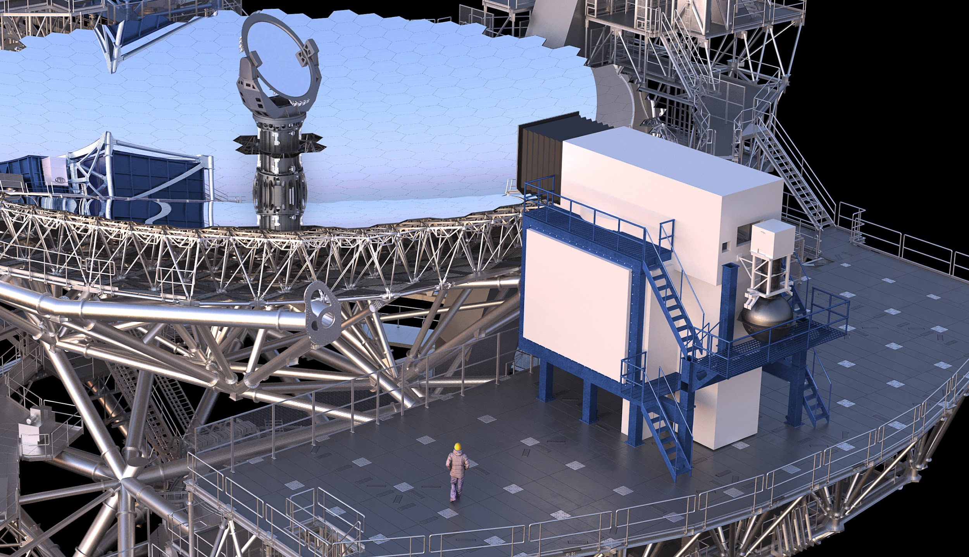
WFOS

Slide 31
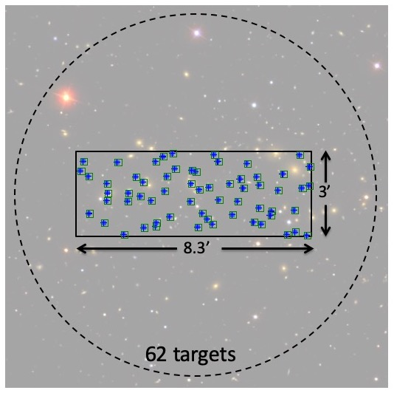
WFOS focal plane
Seeing limited
0.05”/pixel
R~1500-3500
0.3-1.0μ
Configurable slits

Slide 32
The Future

Slide 33
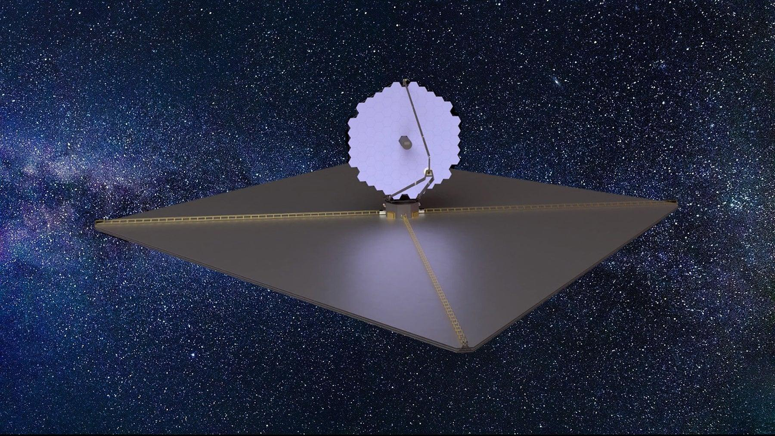
LUVOIR: Something like TMT in space!

Slide 34
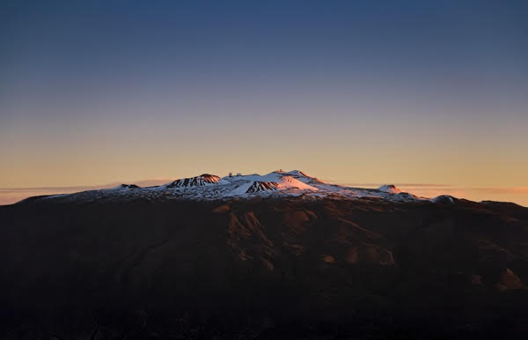

Slide 36
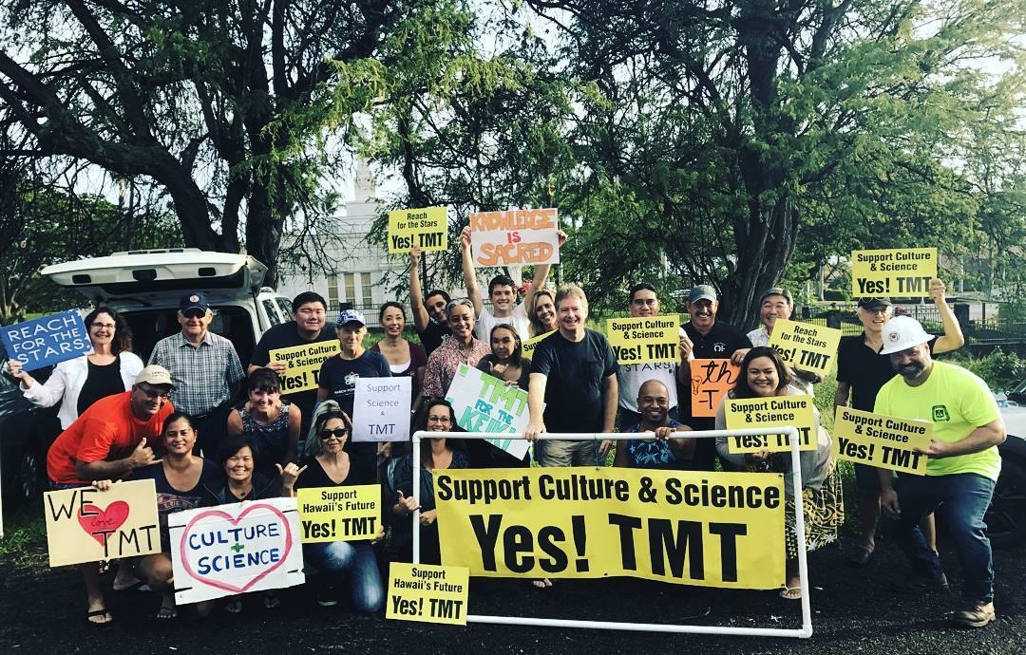
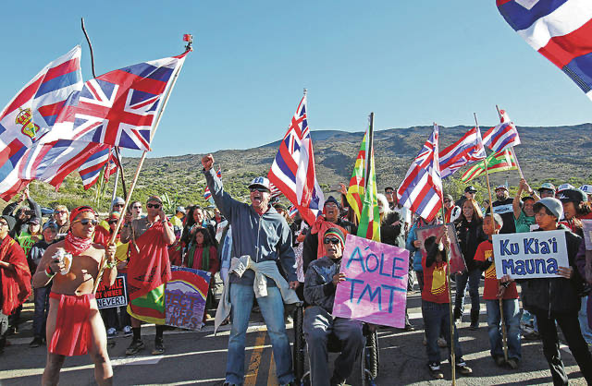
Community Division

Slide 37
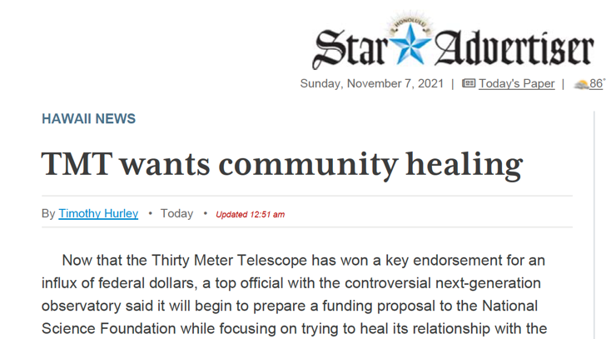
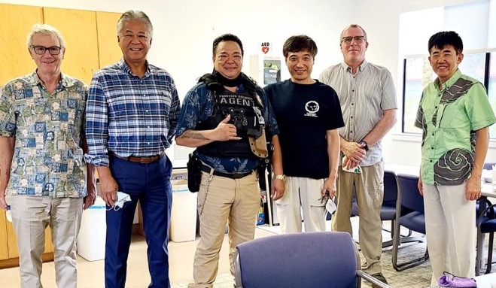
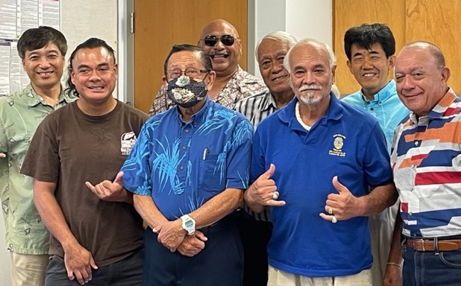
Dialog with Local Community
TIO team at Merrie Monarch Parade
With Royal Order of KamehamehaI

Slide 38
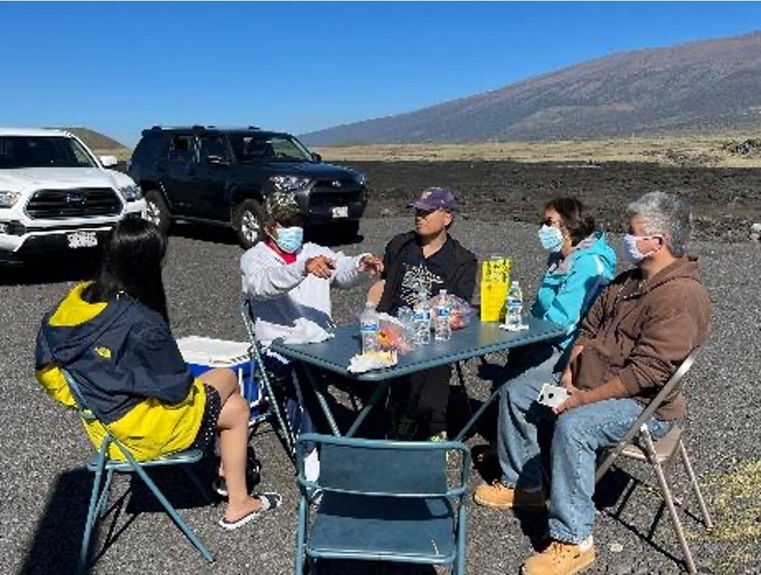

Slide 39
Community Astronomy
A catalyst not a lightning rod

Slide 40
Mauna Kea Stewardship and Oversight Authority
Replaces University of Hawaii and Department of Land and Natural Resources as the manager of Maunakea
Members include representatives of astronomy and of Native Hawaiians –recently confirmed by Hawaii Senate
We will work with the MKSOA

Slide 41
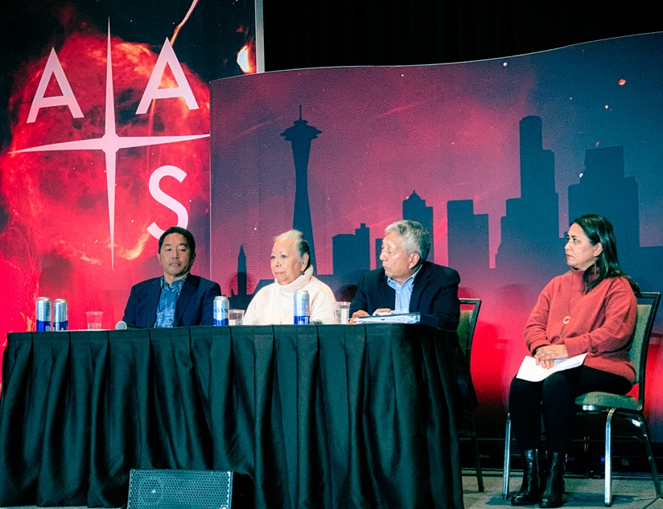

Slide 42
TMT is committed to a community model of astronomy based on the values of respect, inclusion, and mutual stewardship.
That means conducting scientific research in a way that respects local culture and tradition, especially those of Native Hawaiians, many of whom consider Maunakea sacred.
It means ensuring that everyone in Hawaiʻi shares the benefits of astronomical exploration. And it means working together to build a better future for the next generation.

Slide 43
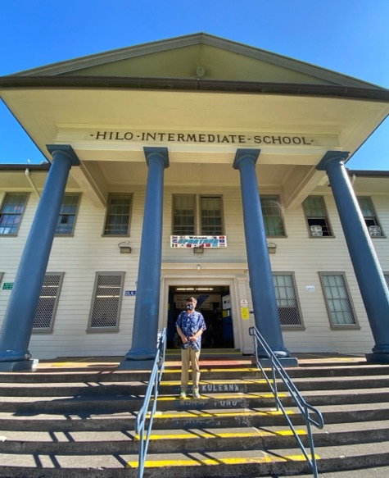
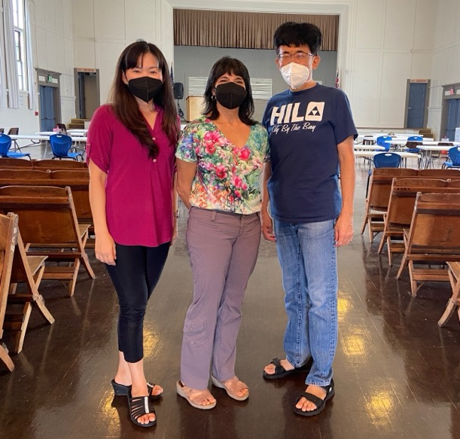
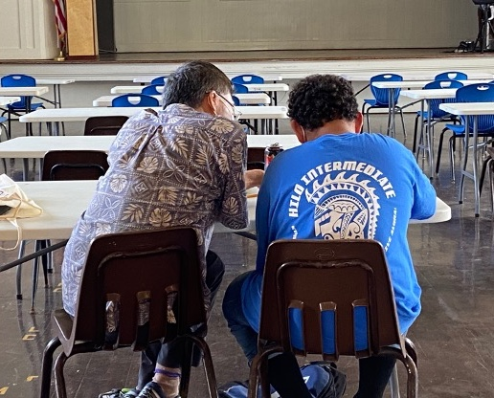
Astronomy Community Assisting
Local Students
TMT staff with weekly, in-person, one-on-one tutoring since Fall 2021
Reduced the number of students failing classes

Slide 44
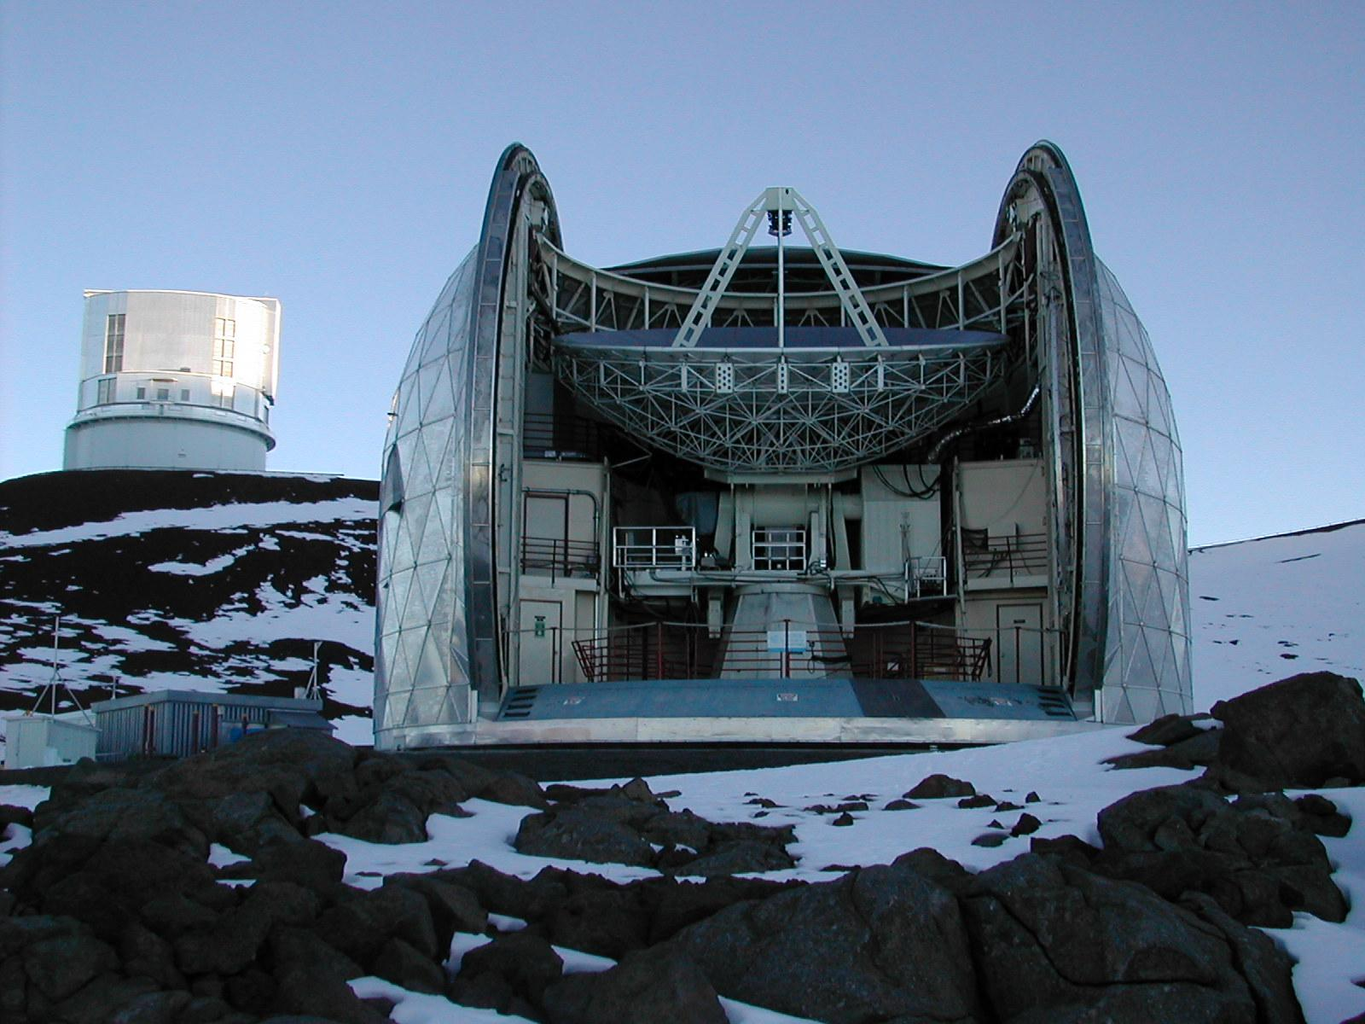

Slide 45
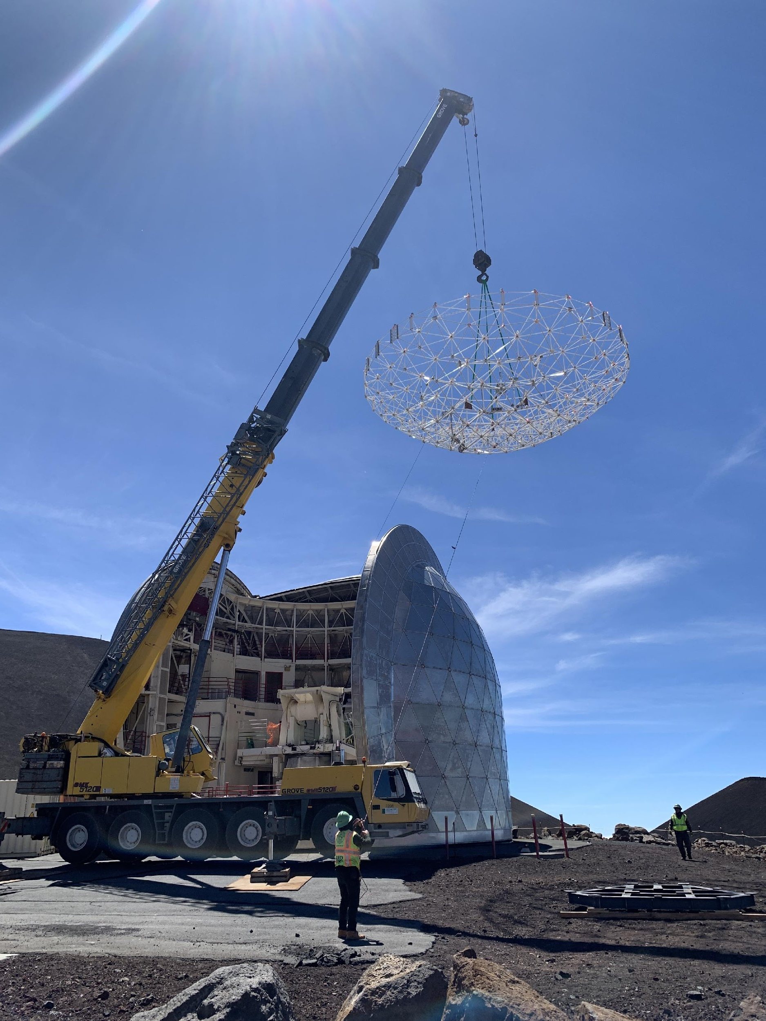

Slide 46
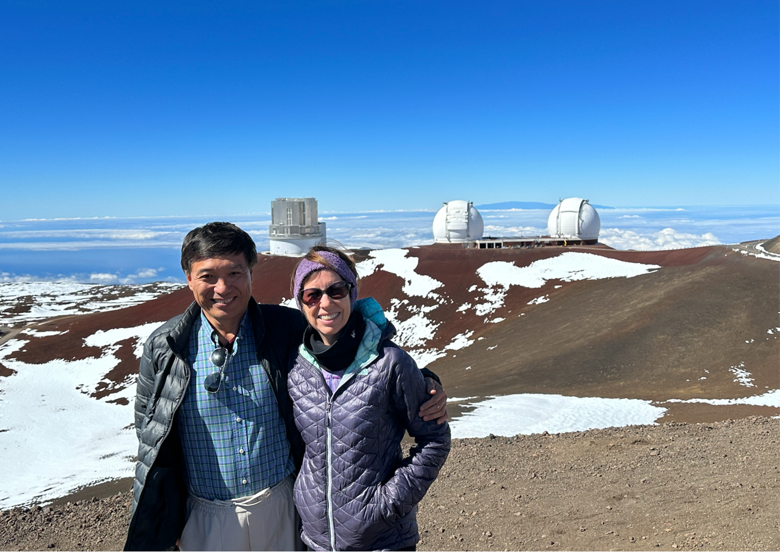
Consistent with National Science Board Vision 2030
NSB Vision 2030: The Missing Millions
A vast untapped talent pool that exists as a result of the underrepresentation of women and many communities of color in the science and engineering workforce.

Slide 47
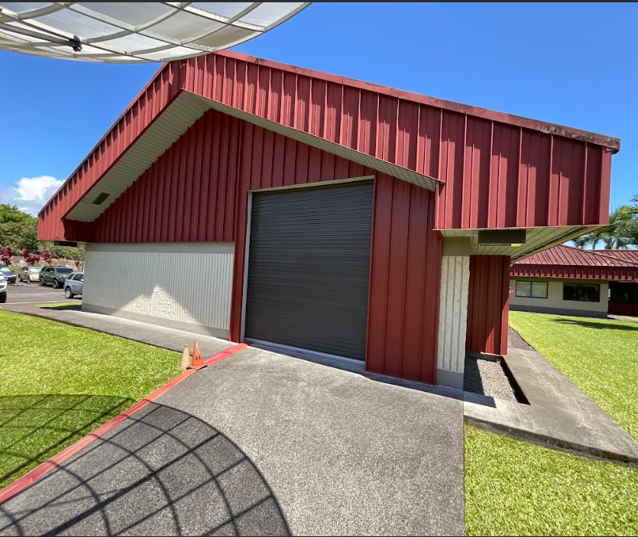
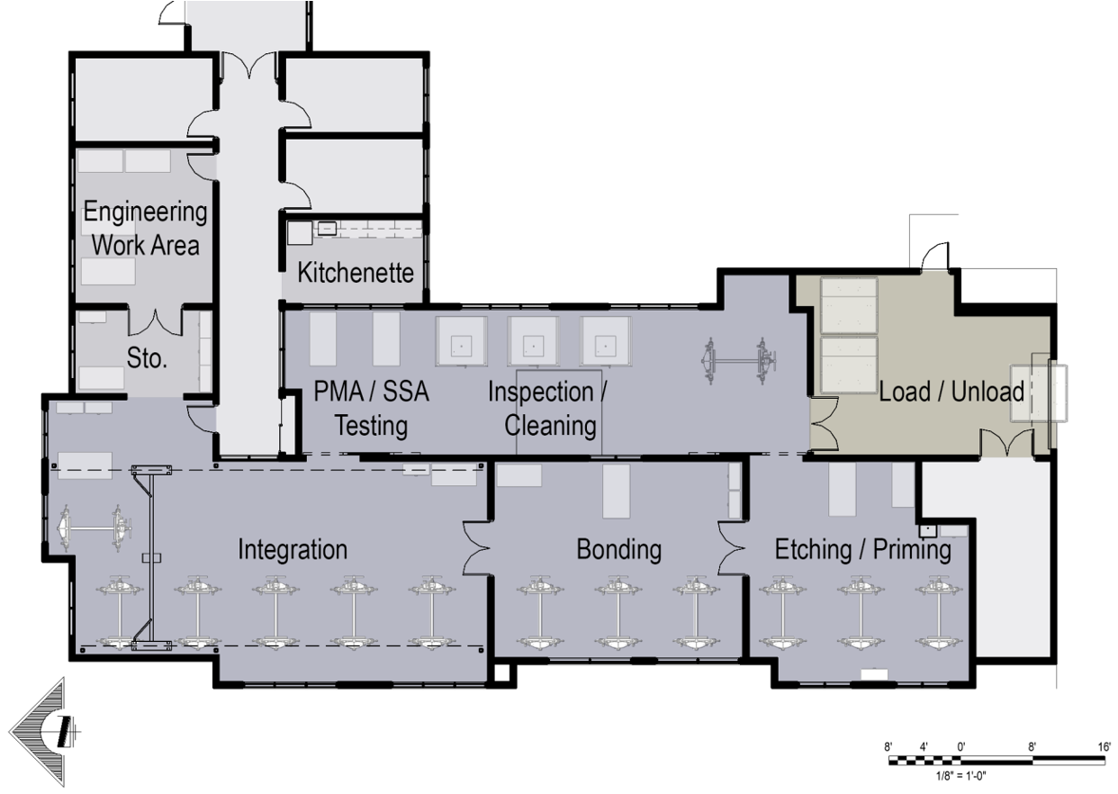
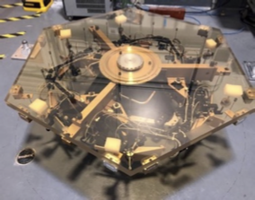
Hilo Mirror Assembly Center?
Investigating “Joint Astronomy Center” building for primary mirror segment assembly
Notes:
Potential outreach benefits, develops our own MK workforce, building collaborations with other observatories, synergy with potential instrument integration facility

Slide 48
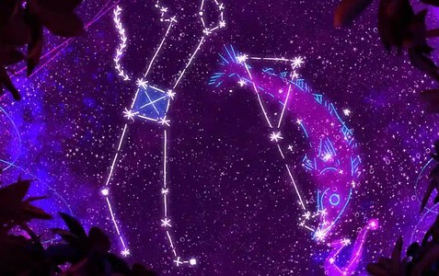
Integrating Indigenous Knowledge into Outreach
ʻOhana Stargazing (PI: ʻOhana Kilo Hōkū)
One Sky Project (PI:ʻImiloa Astronomy Center)
Short planetarium films featuring cultural and indigenous astronomy in TMT partner countries (USA-Hawaiian & Navajo, Canada-First Nation, Japan, & India)
OneSkyProject.org

Slide 49
…a powerful reminder of the scientific payoffs that can result from the combination of persistence and ingenuity, built on the foundation of engineering prowess.
Tom Rosenbaum
https://noirlab.edu/us-eltp/
Notes:
After an inspiring visit to Palomar Mountain, Caltech President Tom Rosenbaum captured the essence of our efforts toward the US Extremely Large Telescope program. {Telescopes} are a powerful reminder of the scientific payoffs that can result from the combination of persistence and ingenuity built on the foundation of engineering prowess. Persistence and ingenuity built on the foundation of engineering! This is a great enterprise we are taking on to benefit future generations, not just of scientists, but of everybody who cares about where we came from, where we’re going, and how the world works. Thank you for your attention.

Slide 51
ORM, La Palma, Canary Islands

