Slide 1
Observatory Publications July 2021 Update 2015 -2019
Dennis Crabtree NRC Herzberg Astronomy & Astrophyics

Slide 2
Introduction
This update includes data for 2015 – 2019 publications
Citations updated April 2021
SMA added to data; AAT dropped
Productivity numbers for multi-telescope facilities divided by the # of telescopes to give productivity per telescope.
ApJ used as the journal used to normalize citations for the “age effect”.
The impact of a paper is the ratio of the number of citations that paper has received to the citation count for the median ApJ paper of the same year
AIPP – Average Impact per Paper; MIPP – Median Impact per Paper

Slide 3
Productivity
The following slide shows telescope productivity for the period 2015 – 2019
Productivity is the number of papers per telescope – multi-telescope facilities such as Keck have their numbers normalized
Note the steadily increasing paper production of ALMA – expected from a new facility, as well as Blanco as a result of the large survey it has done
HST continues to be a paper producing machine!

Slide 4
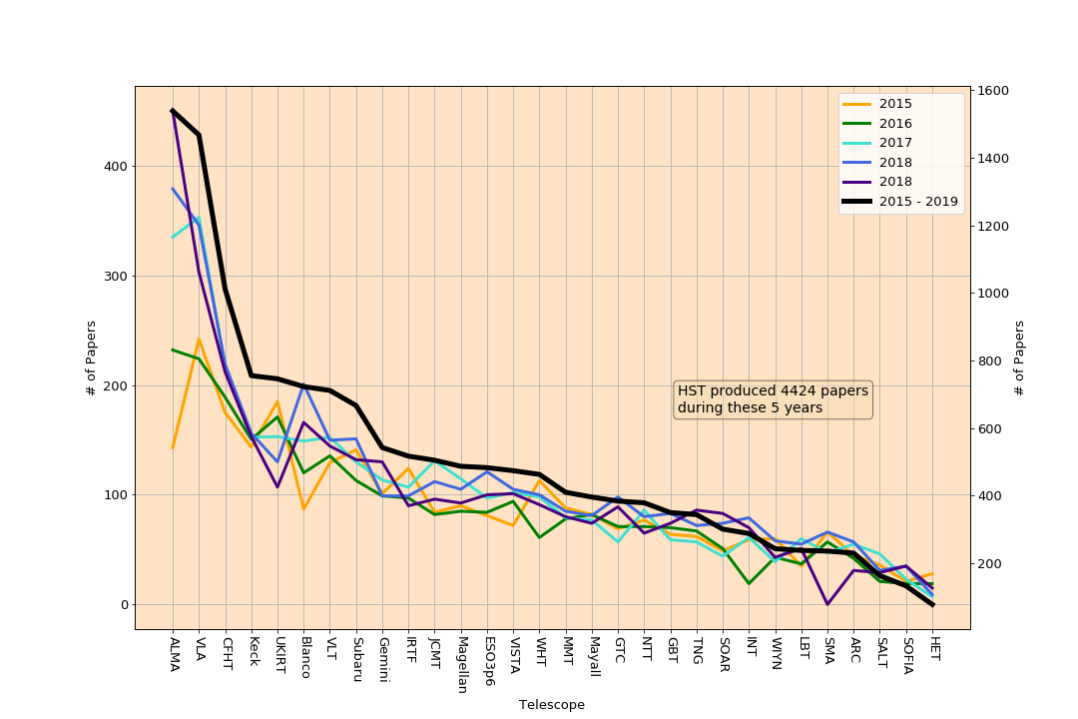

Slide 5
Impact
The following two slides show telescope impact per paper
Recall that impact of a paper is defined as the number of citations to the paper divided by the number of citations received by the median ApJ paper of the same year.
The next slide show Average Impact per Paper (AIPP) and Median Impact per Paper (MIPP) for the 5-year period
The second following slide is a box and whisker plot of impact per paper. The line is the AIPP while the line inside the box is the MIPP. The ends of the box represent the upper and lower quartile while end of the ‘whiskers’ represent the minimum and maximum impact for each telescope.

Slide 6
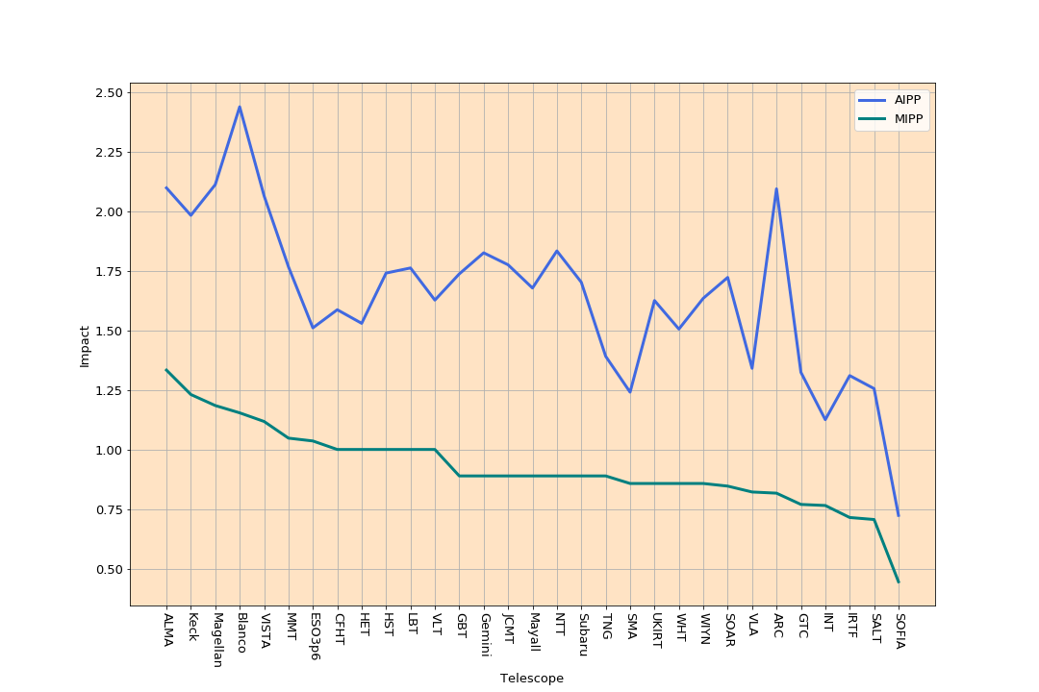

Slide 7
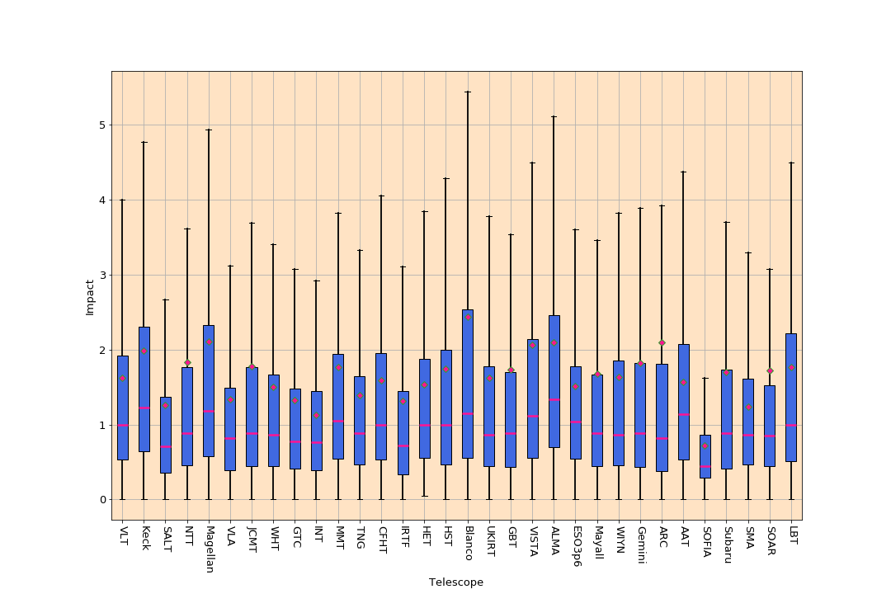

Slide 8
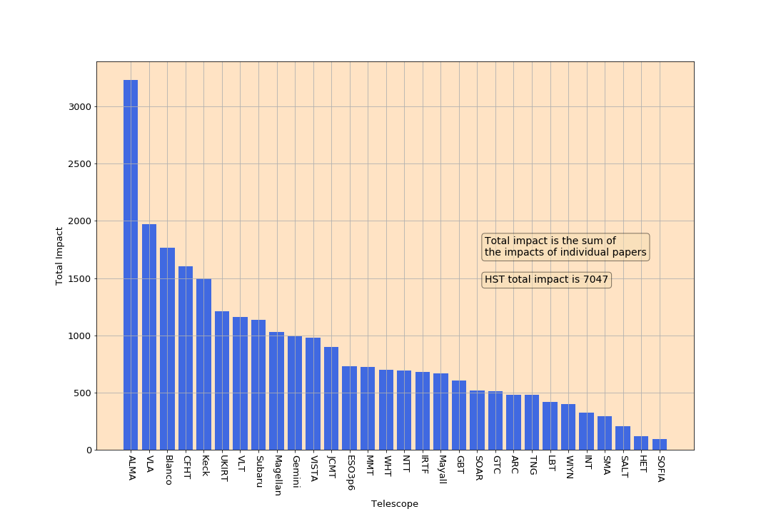
Total impact per telescope

Slide 9
High Impact Papers
Another performance metric is the number or fraction of high impact papers.
I define a paper as being high impact if it is in the 90th percentile of the complete distribution of papers
The following plot shows the percentage of a telescope’s papers that are high impact for each telescope

Slide 10
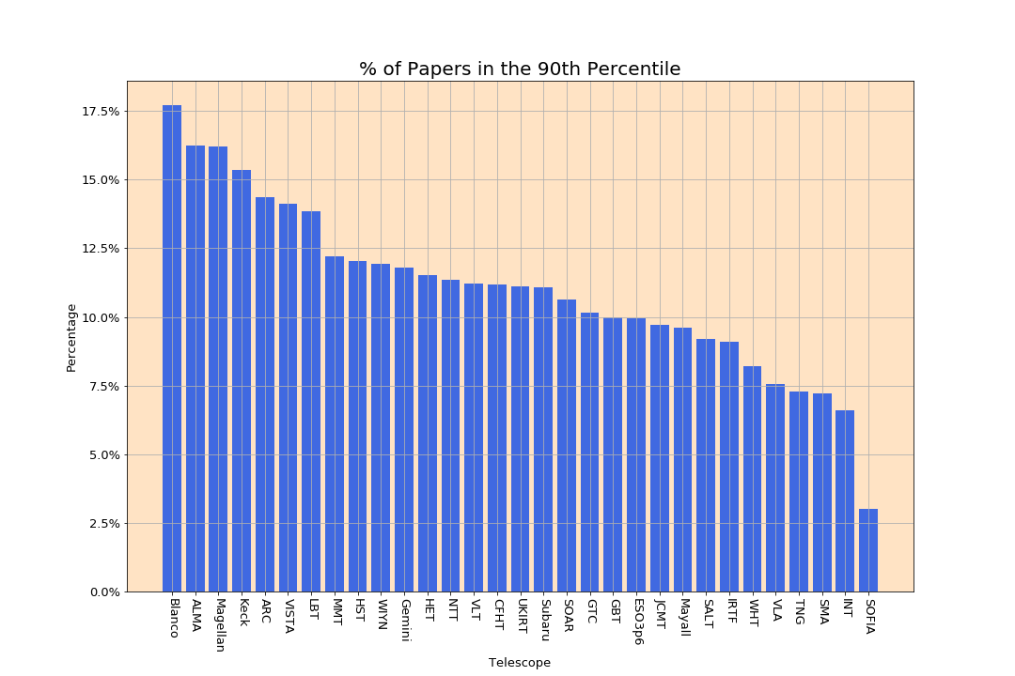

Slide 11
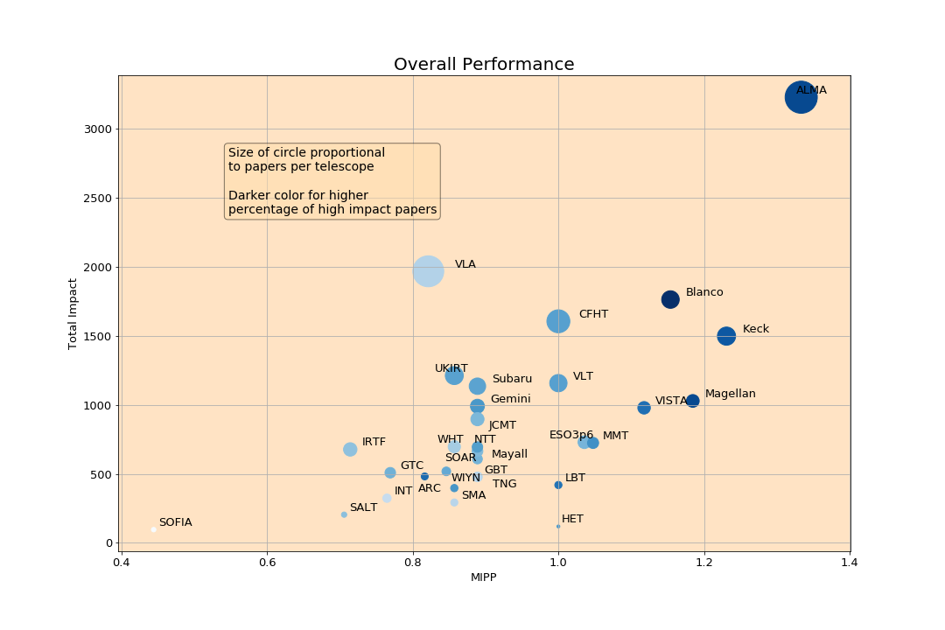
Overall Performance
This slide shows a summary of telescope performance. The two axes are MIPP and Total Impact, while the size of the points represent the total papers per telescope for 2015-2019. The color of the circles represents the fraction of papers in the top 10% of cited papers in the complete sample

Slide 12
Network Map
Telescopes are treated as “nodes” and a paper in common is considered an “edge” in the network
Map shown on following slide
A Yifan Hu clustering algorithm used to generate map.
Size of node proportional to log10(# of papers per telescope)
Color of node is the AIPP (darker reflects higher AIPP)
Connecting line thickness proportional to # of common papers
Network analysis shows that HST, VLT and Keck are most central to the network and that SOPHIA, ESO3p6 and LBT are least central.

Slide 13
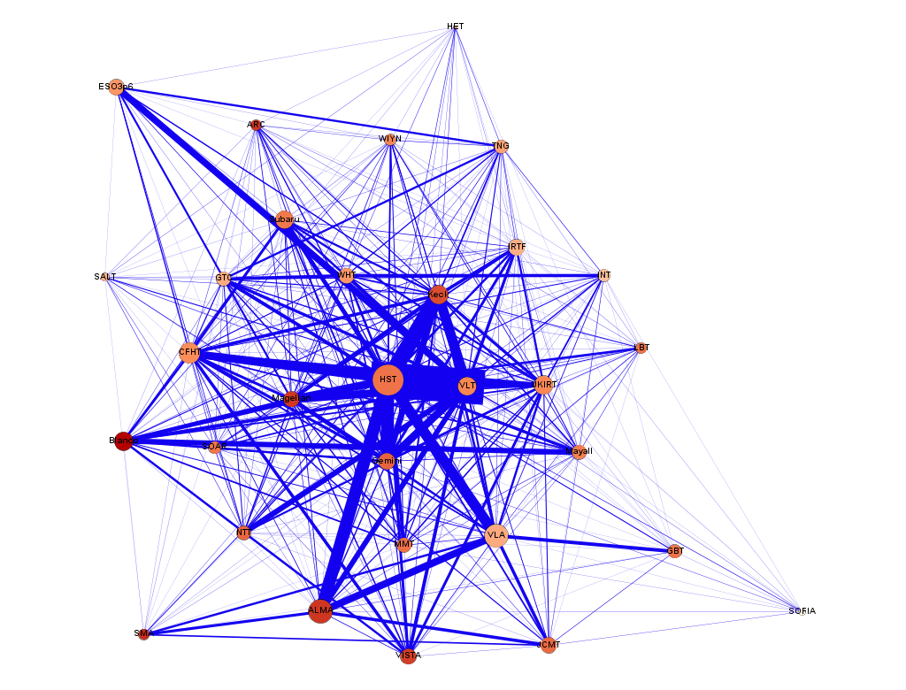

Slide 14
# of Authors
The next slide displays the # of paper and the ln(AIPP) vs the # of authors
The decline in single author papers continues – there are almost as many papers with 17 authors as single author papers. (For 2013-2017 almost as many papers with 15 authors as single author papers)
The distribution of AIPP is close to log-normal. The ln(AIPP) is shown with the standard error of this variable. The mean impact of a paper increases with the number of authors.

Slide 15
Productivity & Impact vs # of Authors

